Slide 1
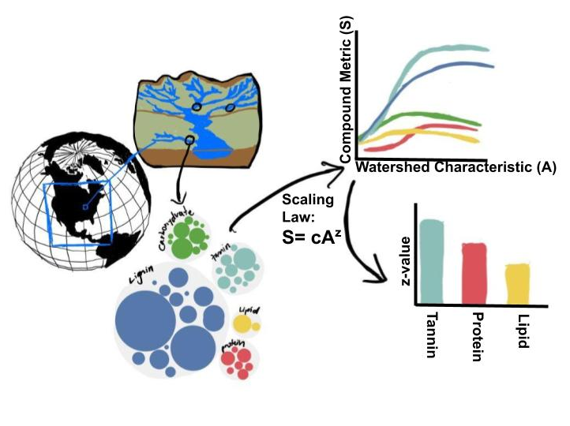
Discussion items – March-9th
Finalizing the plots and discussion for our manuscript
Table-1 significant features
WHONDRS
StreamStats
HydroSheds
EPAWaters-Catchment
EPAWaters-Watersheds
Associated Scaling law figures
Associated bar plots
C-value and Z-value plots
Associated PCA figures and loadings
Notes:
Significance of explanatory variables → Effect of random seed on the loading matrix importance.

Slide 2
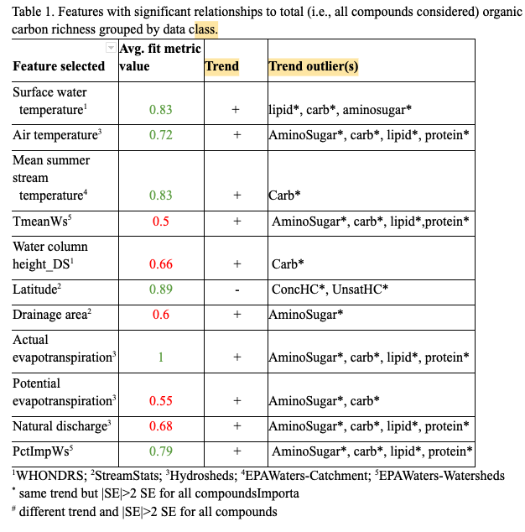
Important features
Some high-to-low important features
Actual ET (Hydrosheds)
Latitude (StreamStats)
Surface water temperature (WHONDRS)
Mean summer stream temperature (EPAW-catchment)
PctImpWs (EPAW-Watersheds)
Air temperature (HydroSheds)

Slide 3
Relevant WHONDRS figures → Local extrinsic variables
Relevant features
Surface water temperature
Water column height_DS

Slide 4
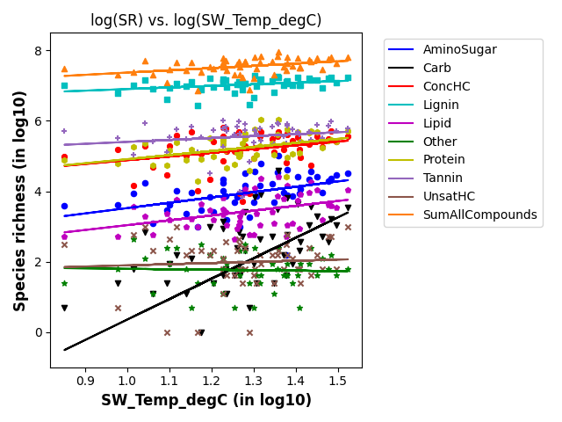
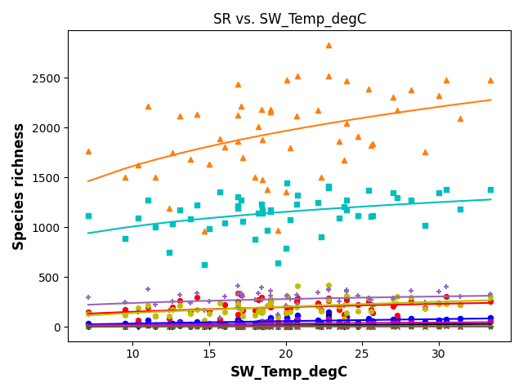
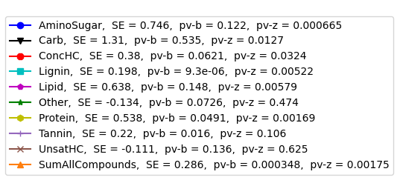
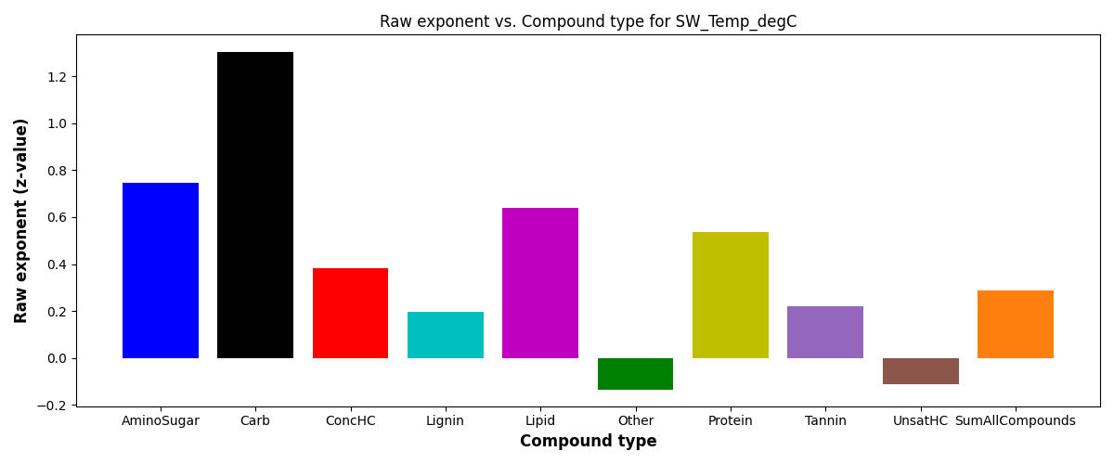
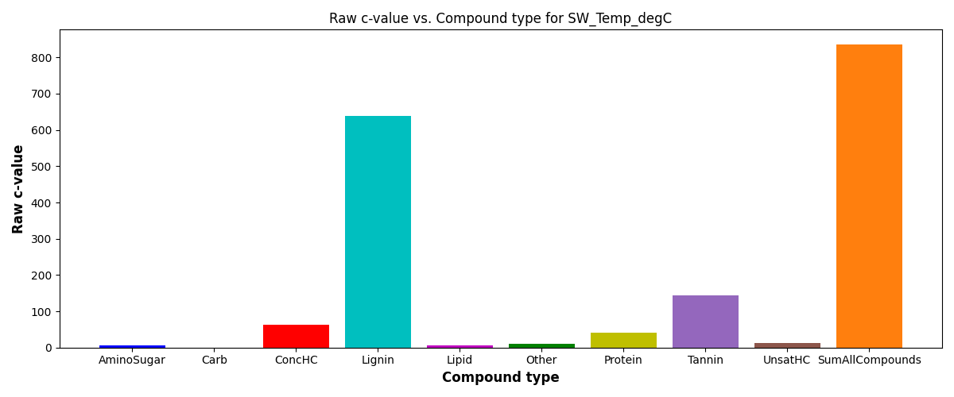
SR vs Surface water temperature
S = c*(ftr)^{z}
SE = scaling exponent or z-value

Slide 5
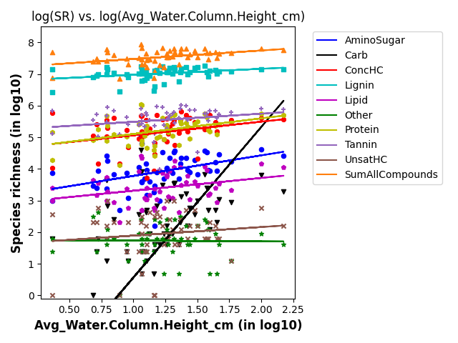
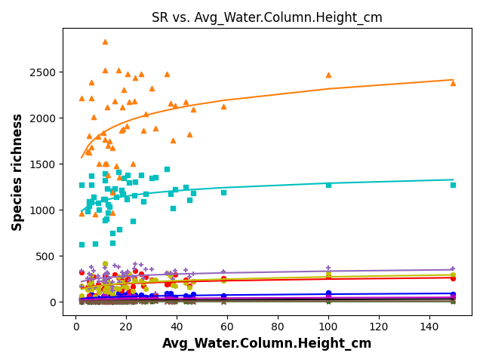
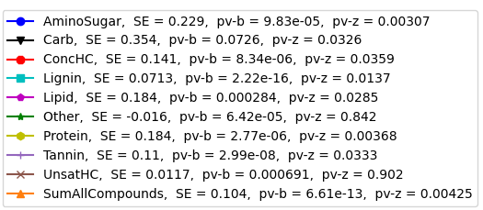
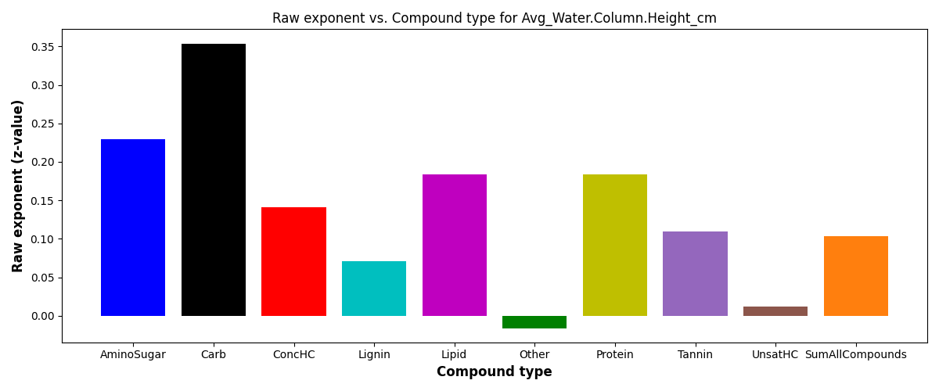
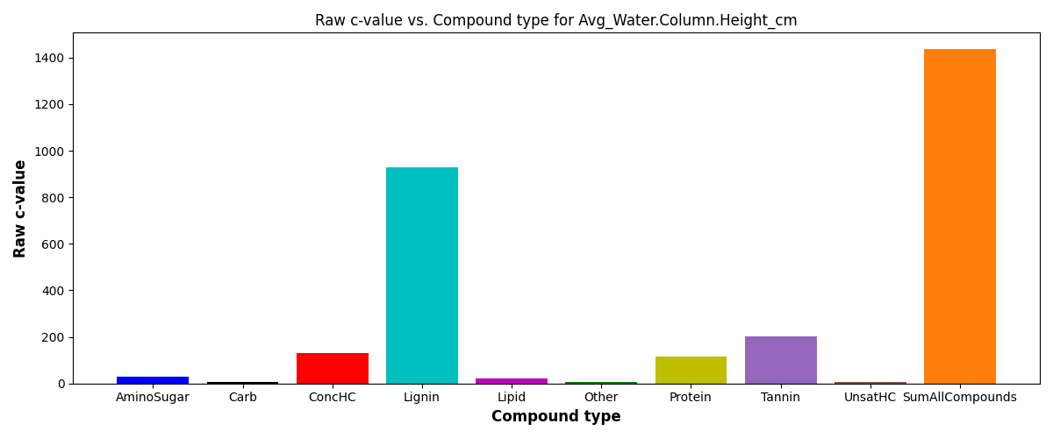
SR vs Water column height_DS
S = c*(ftr)^{z}
SE = scaling exponent or z-value

Slide 6
Relevant StreamStats figures → Local extrinsic variables
Relevant features
Latitude
Drainage area

Slide 7
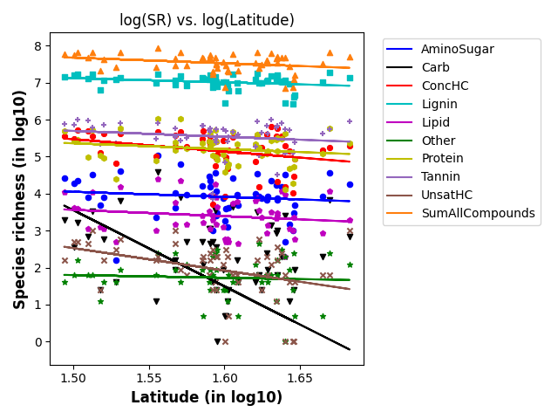
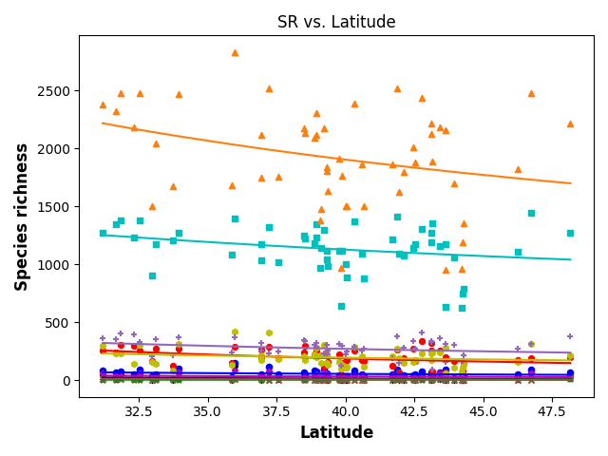
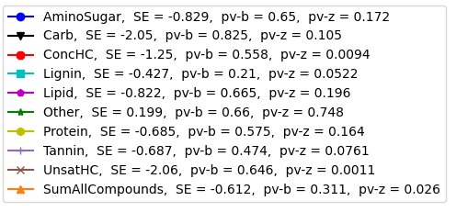
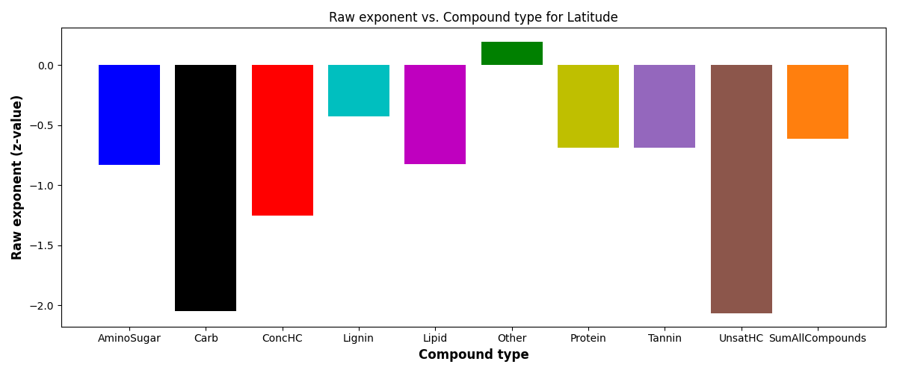
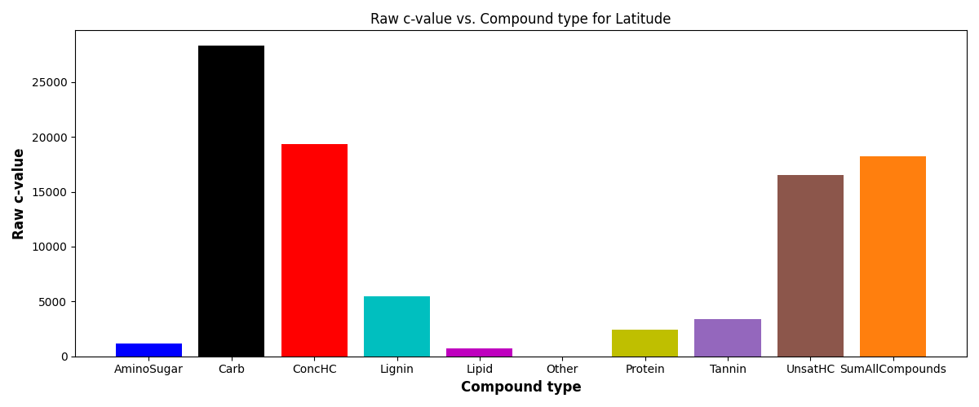
SR vs Latitude
S = c*(ftr)^{z}
SE = scaling exponent or z-value

Slide 8
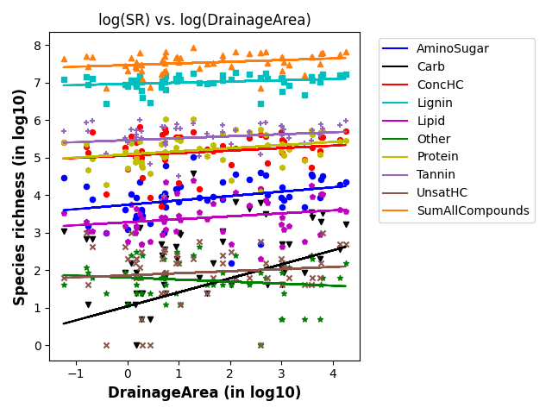
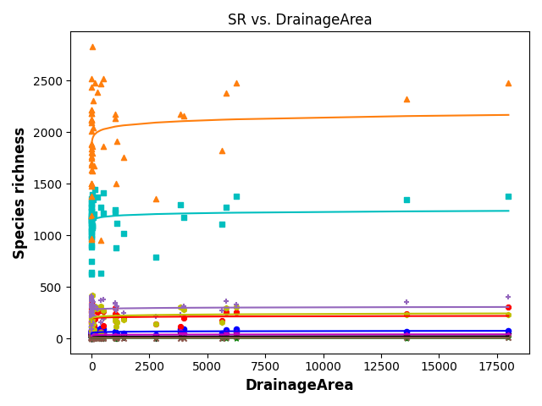
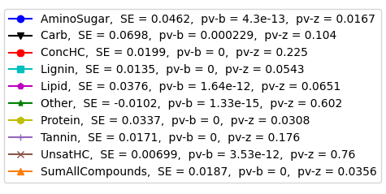
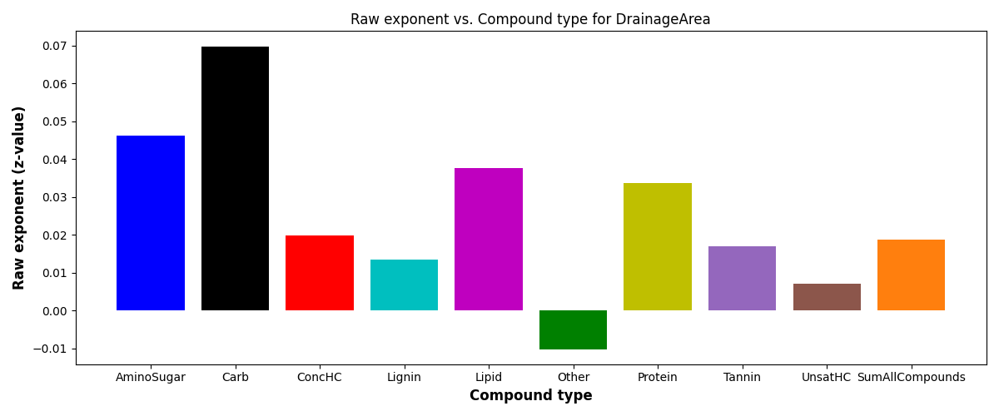
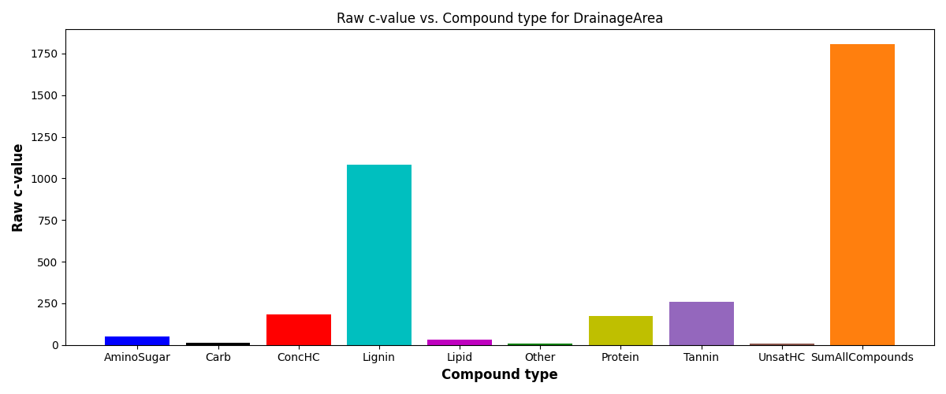
SR vs Drainage area
S = c*(ftr)^{z}
SE = scaling exponent or z-value

Slide 9
Relevant HydroSheds figures → Non-local extrinsic variables
Relevant features
Air temperature
Actual ET
Potential ET
Natural discharge

Slide 10
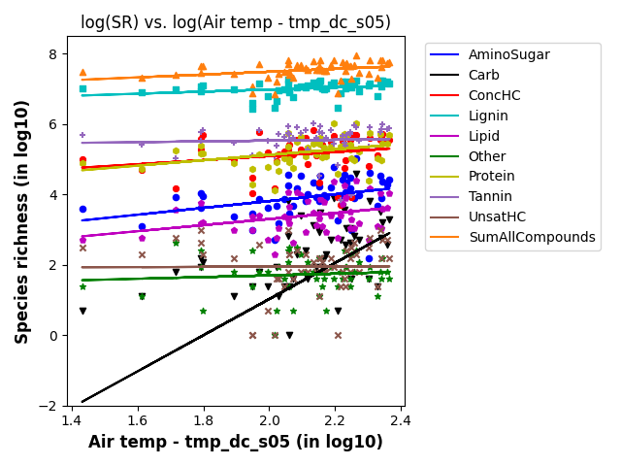
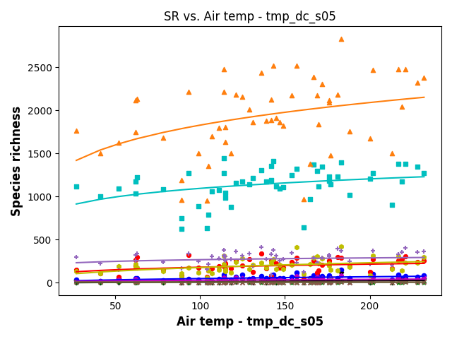
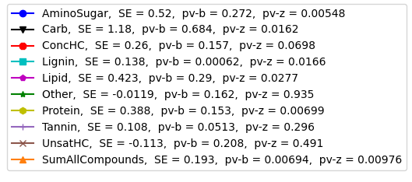
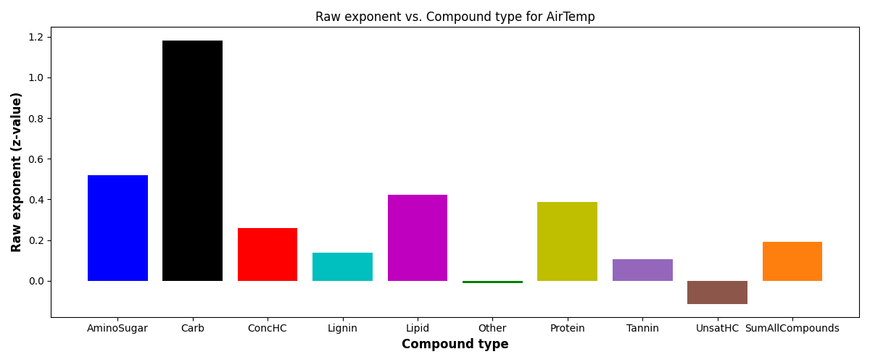
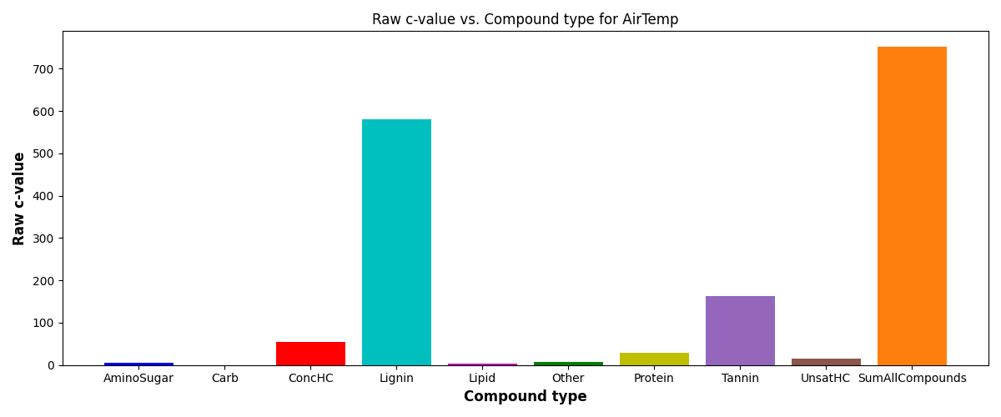
SR vs Air temperature
S = c*(ftr)^{z}
SE = scaling exponent or z-value

Slide 11
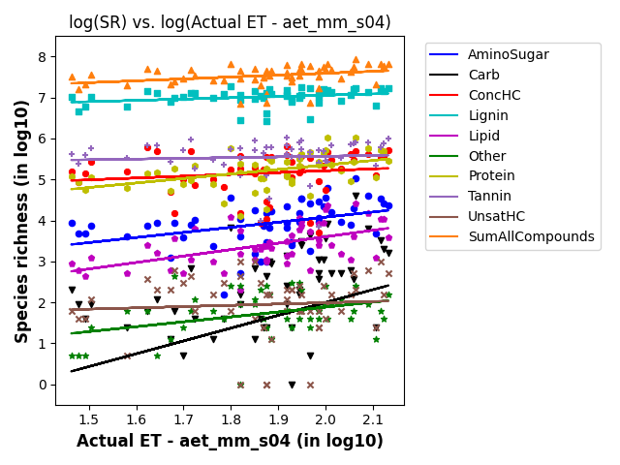
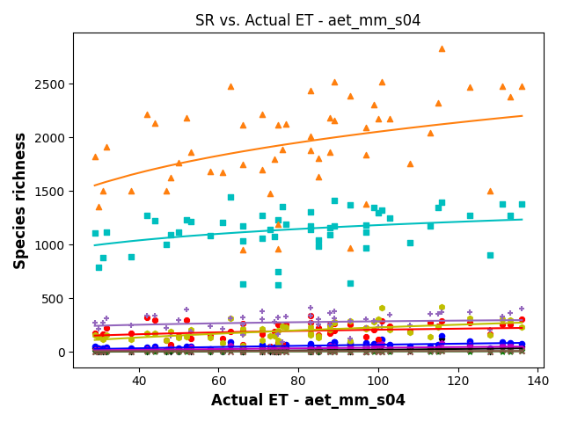
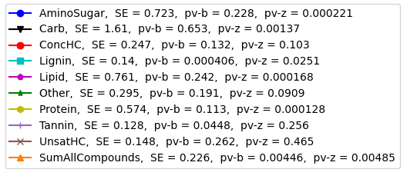
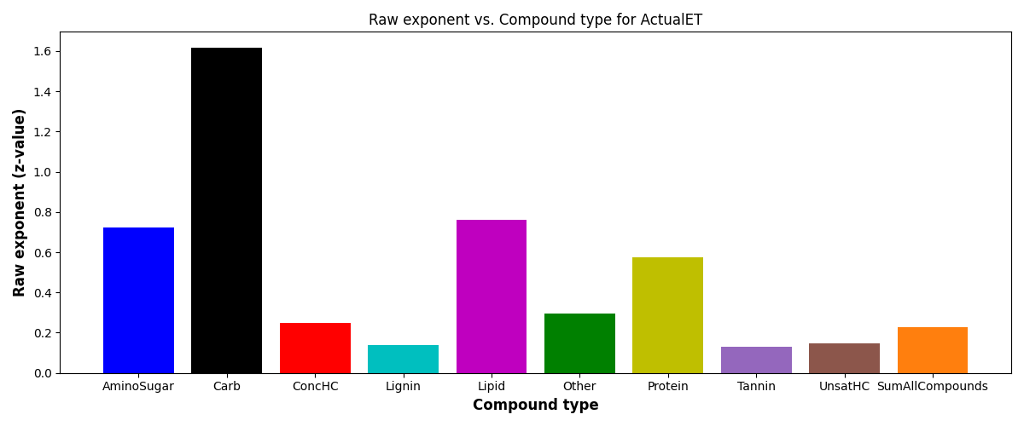
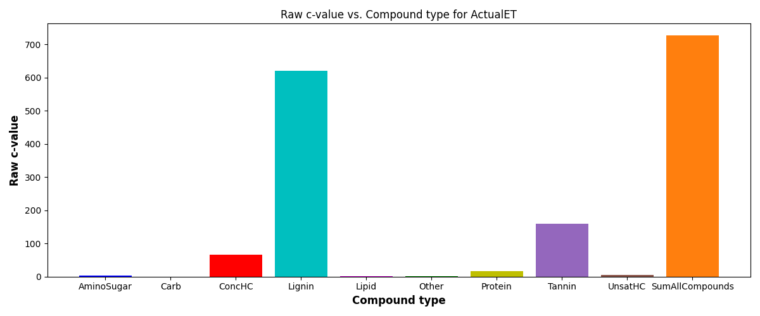
SR vs Actual ET
S = c*(ftr)^{z}
SE = scaling exponent or z-value

Slide 12
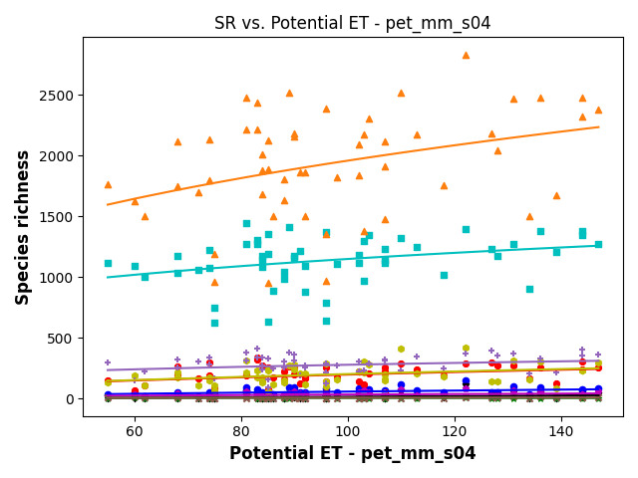
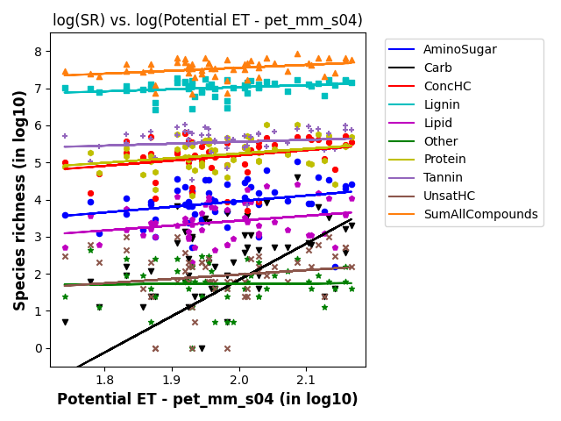
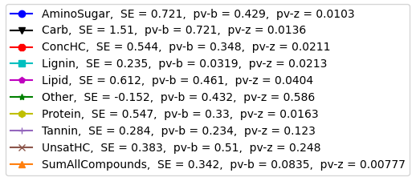
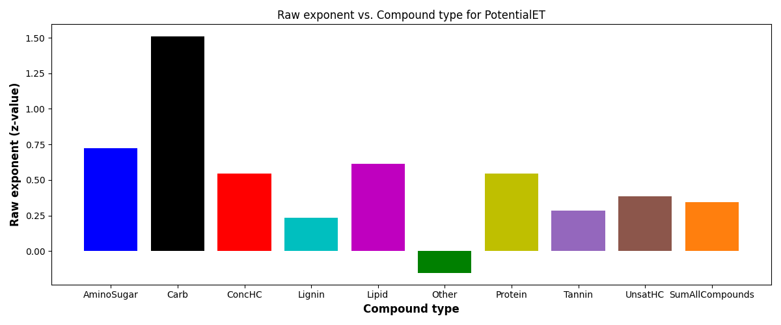
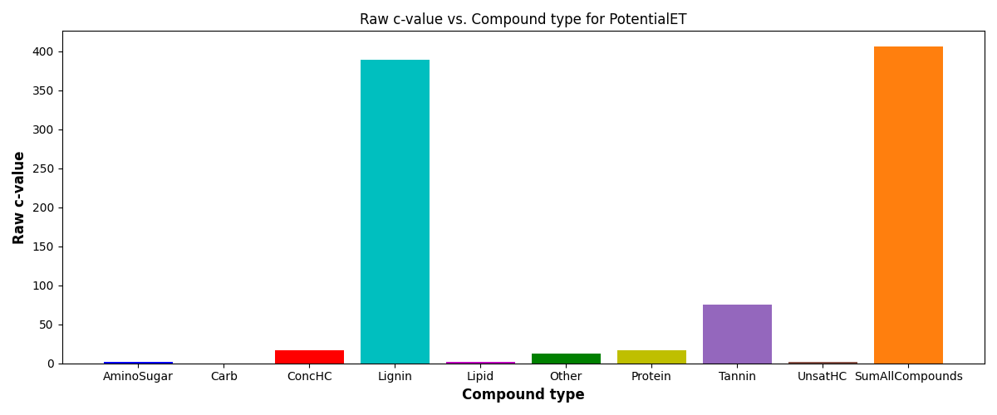
SR vs Potential ET
S = c*(ftr)^{z}
SE = scaling exponent or z-value

Slide 13
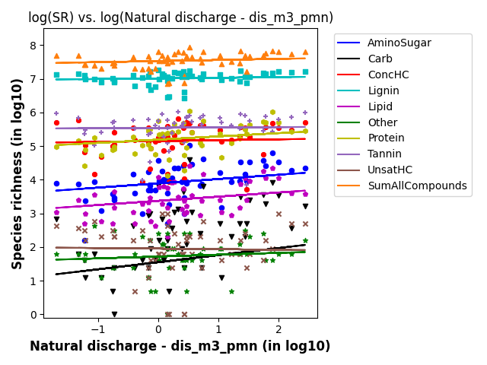
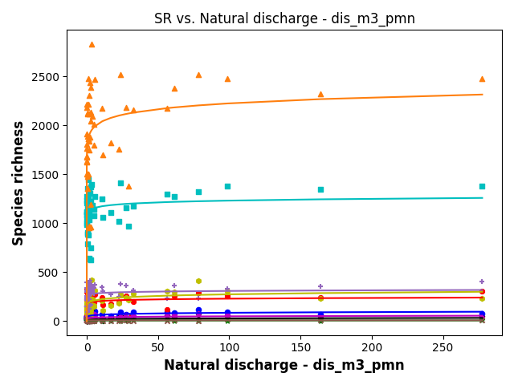
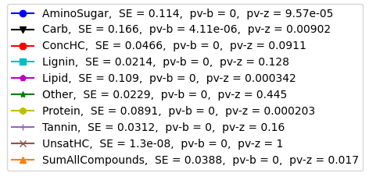
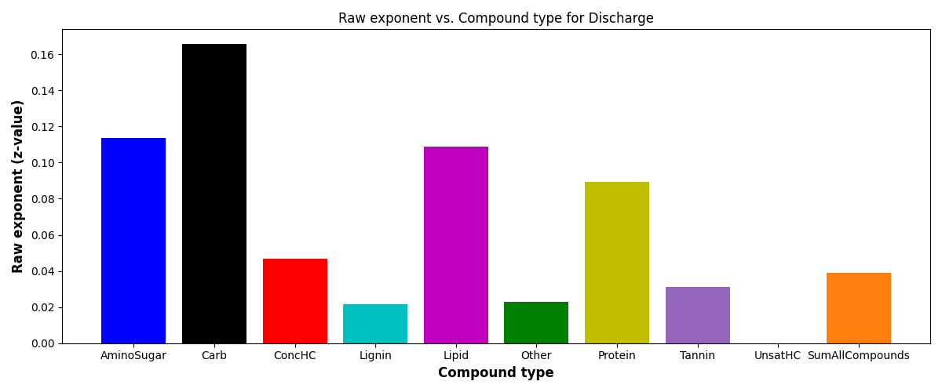

SR vs Natural discharge
S = c*(ftr)^{z}
SE = scaling exponent or z-value

Slide 14
Relevant EPAW-Catchment figures → Non-local extrinsic variables
Relevant features
Mean summer stream temperature

Slide 15
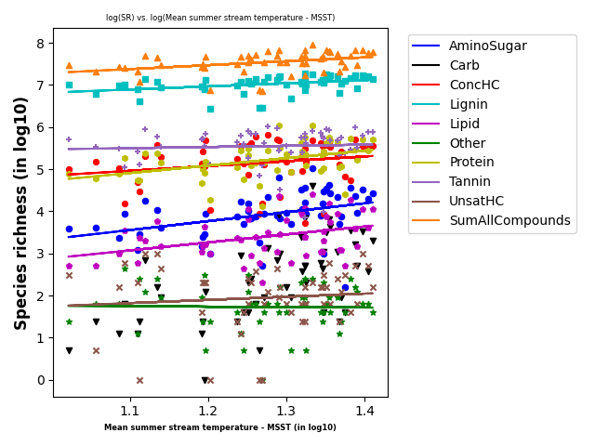
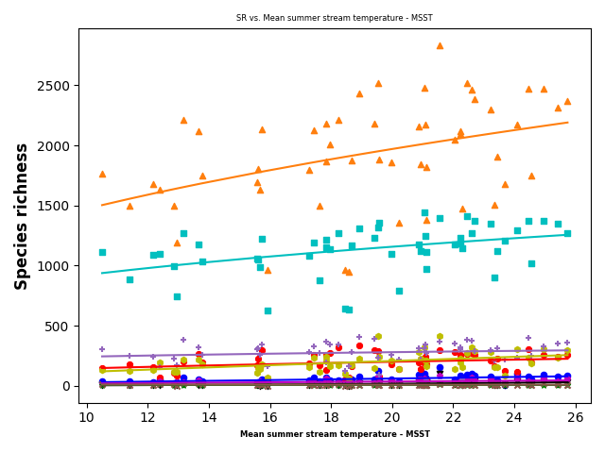
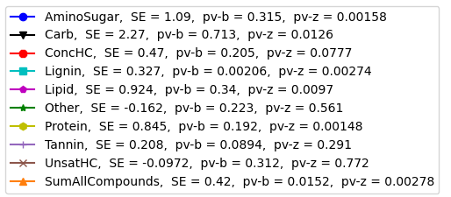
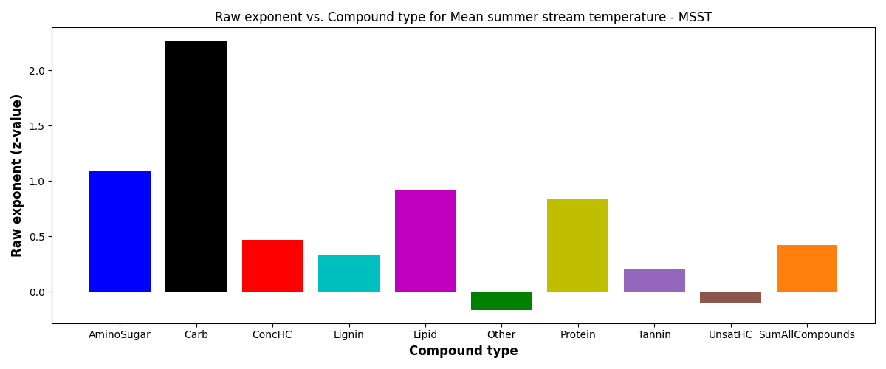
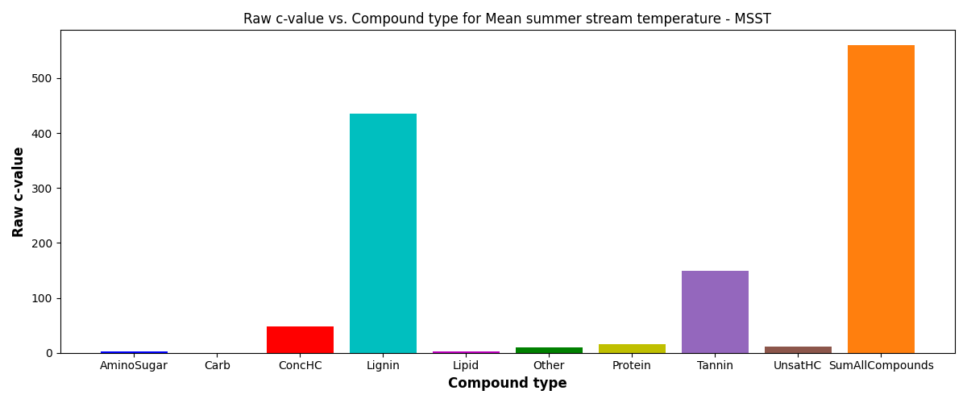
SR vs Mean summer stream temperature
S = c*(ftr)^{z}
SE = scaling exponent or z-value

Slide 16
Relevant EPAW-Watershed figures → Non-local extrinsic variables
Relevant features
TmeanWs
PctImpWs

Slide 17
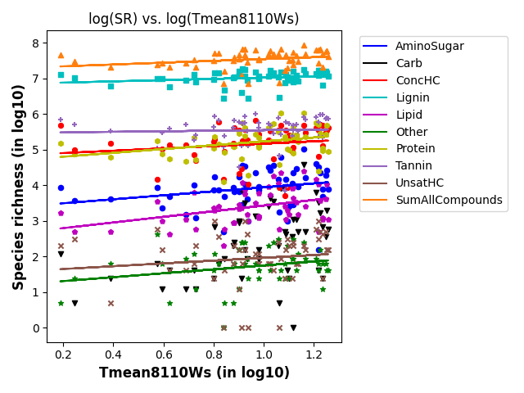
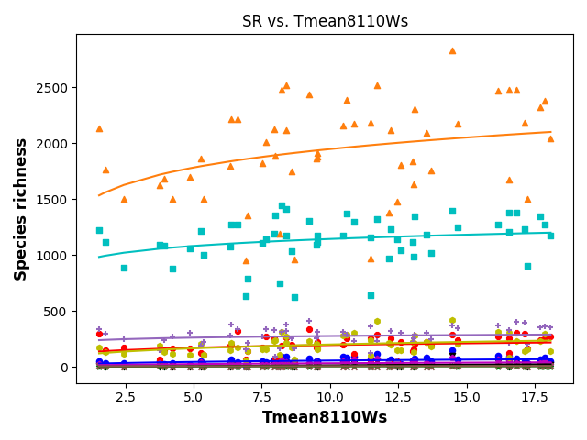
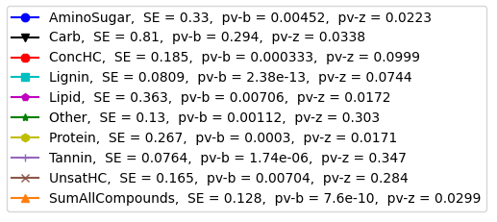
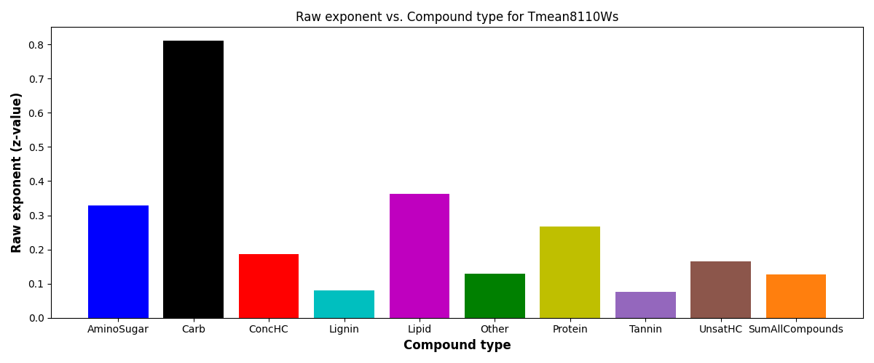

SR vs TmeanWs
S = c*(ftr)^{z}
SE = scaling exponent or z-value

Slide 18





SR vs PctImpWs
S = c*(ftr)^{z}
SE = scaling exponent or z-value

Slide 19

PCA analysis and biplots (variation across data samples w.r.t to 11 features)

