Slide 1
Discussion items – Jan-10th
PCA analysis
Variation across data features
Variation across data samples
Scaling laws with p-values for
Inundation Extent (from hydrosheds)
Min Basin Elevation (from streamstats)
Mean Imperviousness (from epa waters-catchment)
Open water land cover (from epa waters-catchment)
Developed Catchment Area (LU) (from epa waters-catchment)
PctImpWs (from epa waters-watersheds)
PctFrstLossWs (from epa waters-watersheds)
PctNonAgIntrodManagVegWs (from epa waters-watersheds)
TmeanWs (from epa waters-watersheds)
NPDESDensWs (from epa waters-watersheds)
SuperfundDensWs (from epa waters-watersheds)

Slide 2
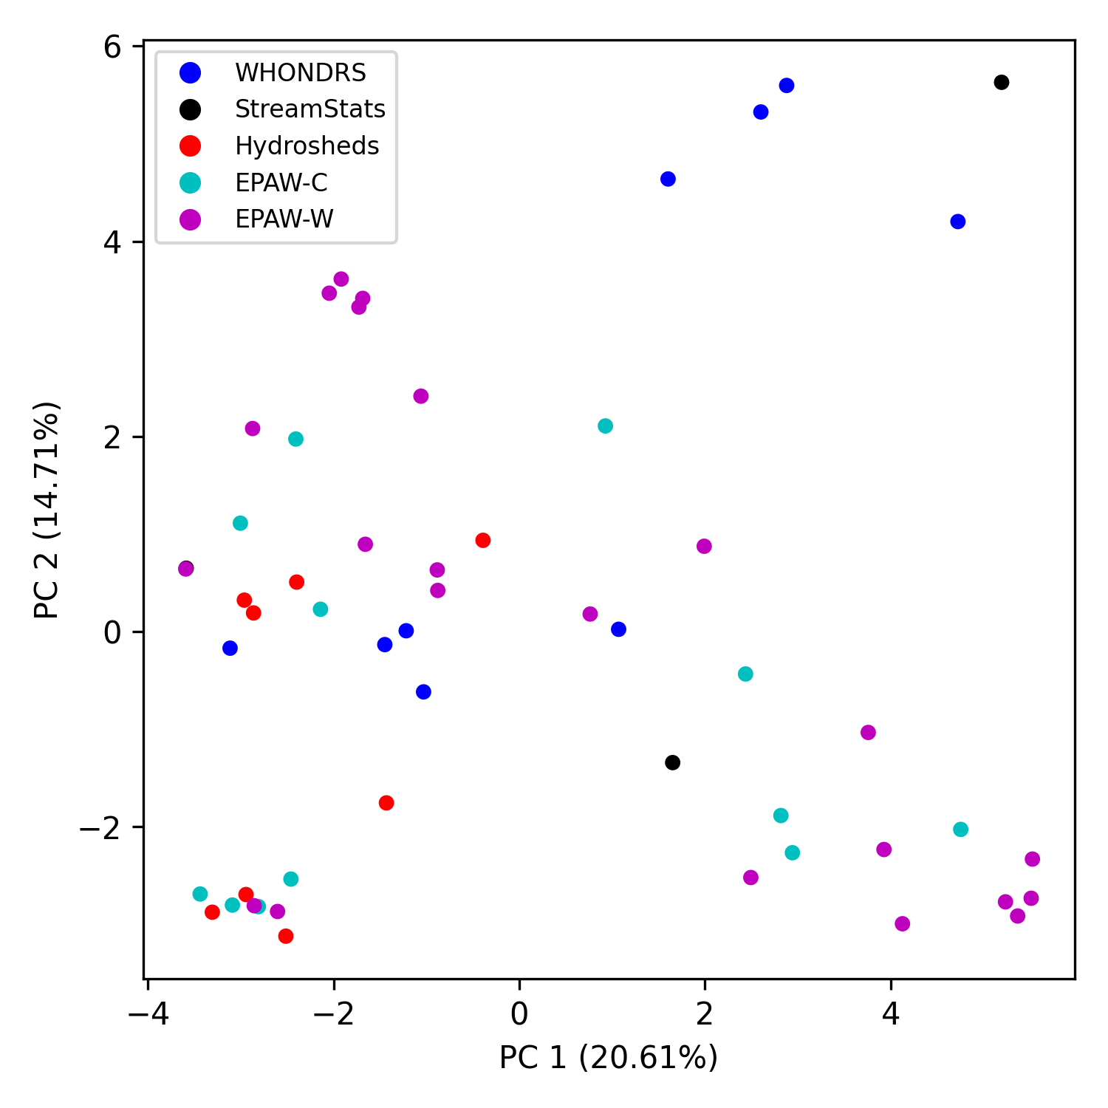
PCA analysis (variation across data features)

Slide 3
PCA analysis (biplots)
Notes:
https://towardsdatascience.com/what-are-pca-loadings-and-biplots-9a7897f2e559
https://www.frontiersin.org/files/Articles/1003159/frwa-04-1003159-HTML/image_m/frwa-04-1003159-g005.jpg
https://www.jcchouinard.com/pca-with-python/
https://stackoverflow.com/questions/39216897/plot-pca-loadings-and-loading-in-biplot-in-sklearn-like-rs-autoplot

Slide 4
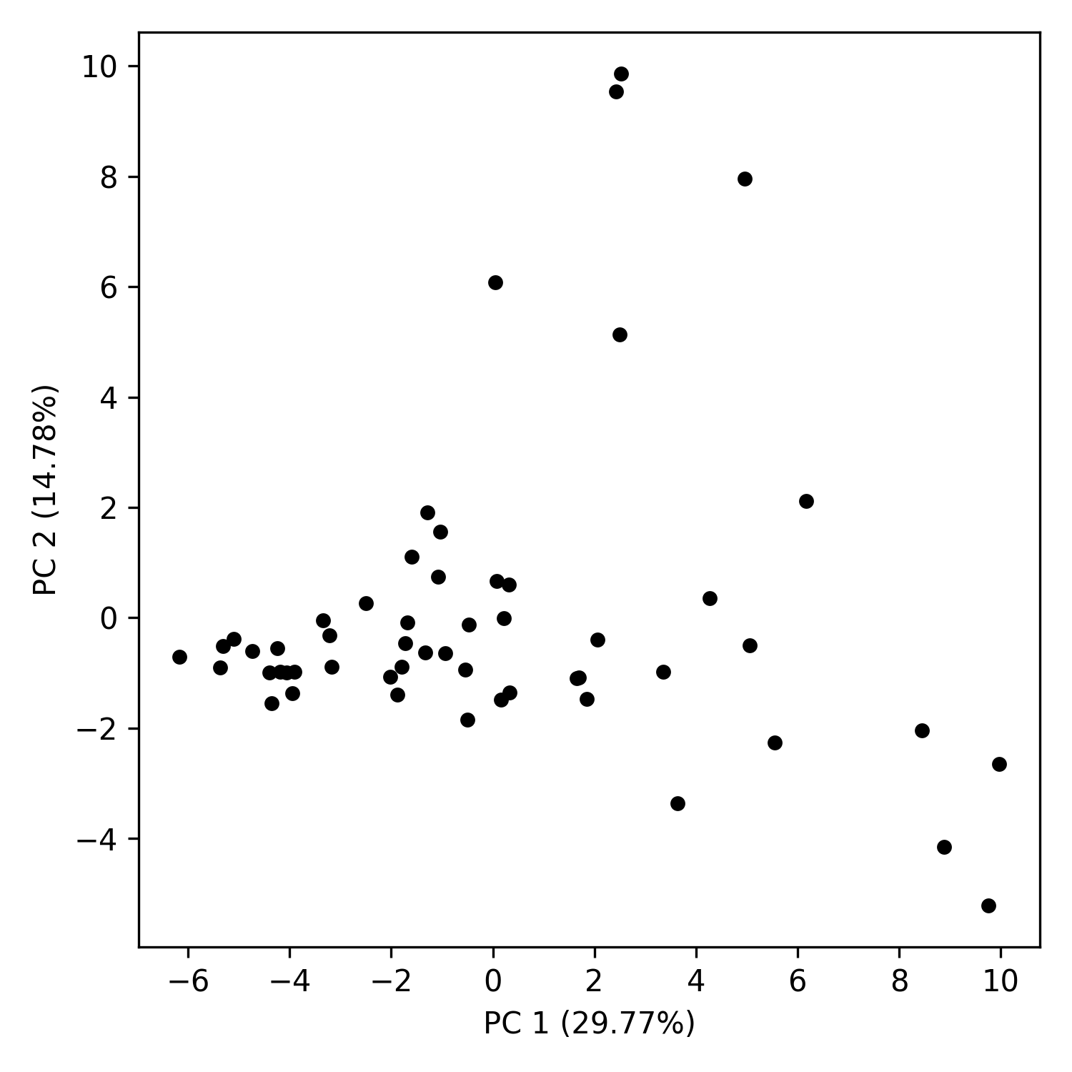
PCA analysis (variation across data samples)

Slide 5
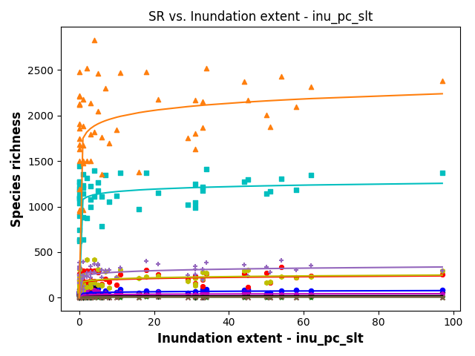
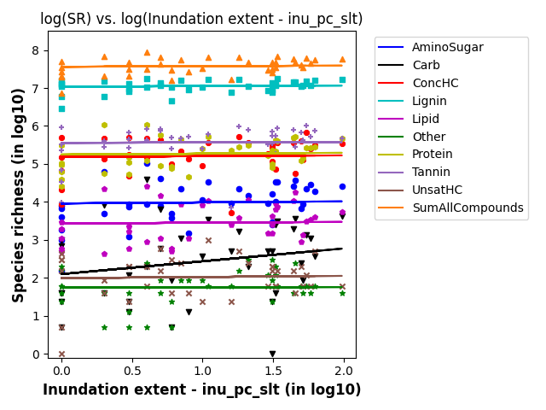
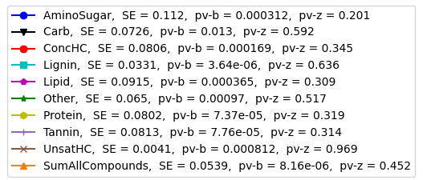
SR vs Indundation Extent

Slide 6
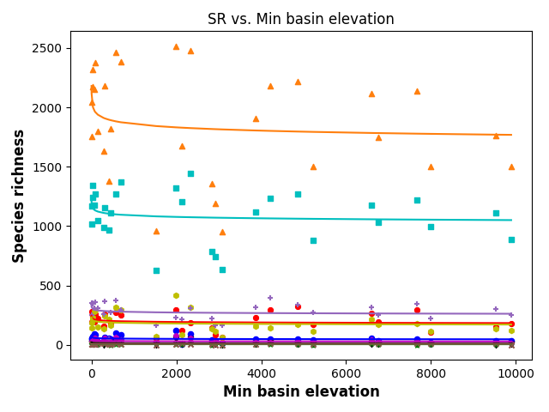
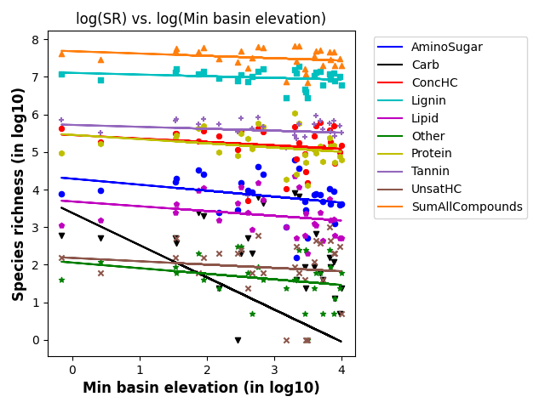
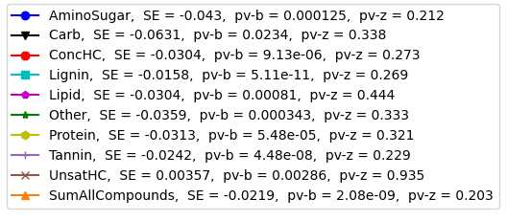
SR vs Min basin elevation

