Slide 1
Discussion items – Feb-7th
Scaling laws with p-values for (done)
Inundation Extent (from hydrosheds) – done
Min Basin Elevation (from streamstats) – done
Mean Imperviousness (from epa waters-catchment) -- done
Open water land cover (from epa waters-catchment) -- done
Developed Catchment Area (LU) (from epa waters-catchment) – done
PctImpWs (from epa waters-watersheds) – done
PctFrstLossWs (from epa waters-watersheds) –done
PctNonAgIntrodManagVegWs (from epa waters-watersheds) –done
TmeanWs (from epa waters-watersheds) – done
NPDESDensWs (from epa waters-watersheds) – done
SuperfundDensWs (from epa waters-watersheds) – done
S = cA^{z} (working on this)
Z-value of bar plot
C-value of bar plot
What can we put in supplementary figures? (working on this)
Notes:
Significance of explanatory variables → Effect of random seed on the loading matrix importance.

Slide 2
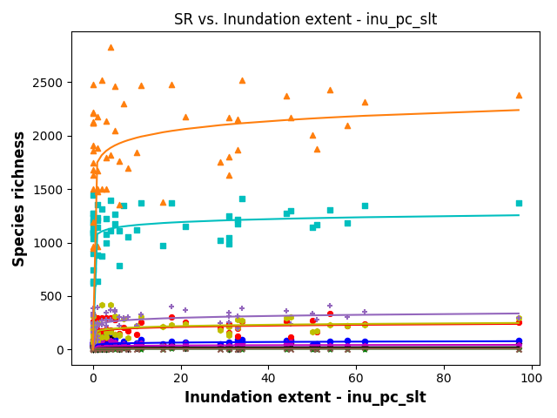
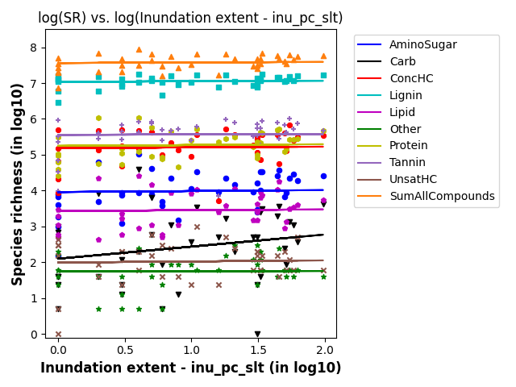
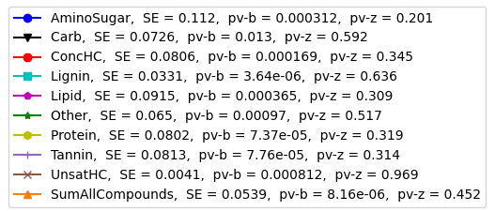
SR vs Indundation Extent (from hydrosheds)
S = b*(ftr)^{z}
SE = scaling exponent

Slide 3
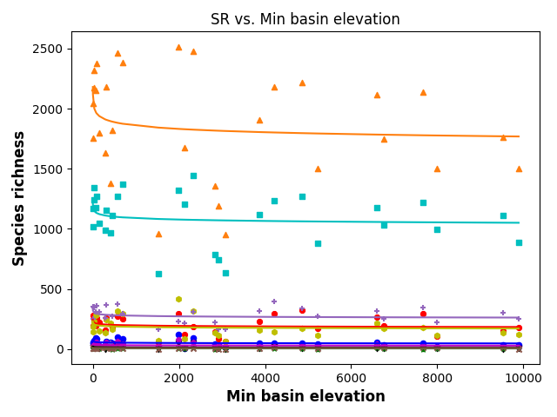
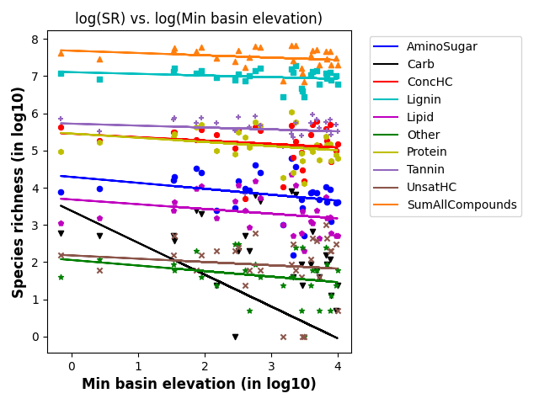
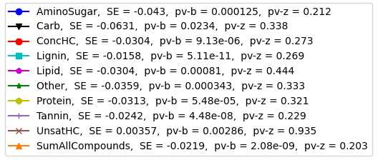
SR vs Min basin elevation (from streamstats)
S = b*(ftr)^{z}
SE = scaling exponent

Slide 4
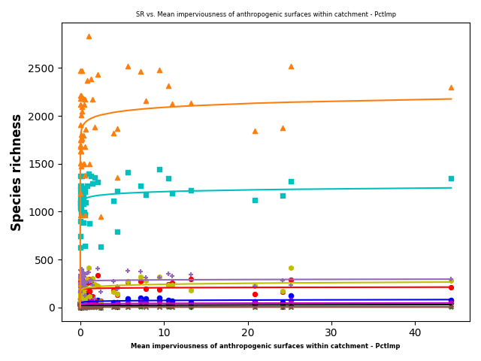
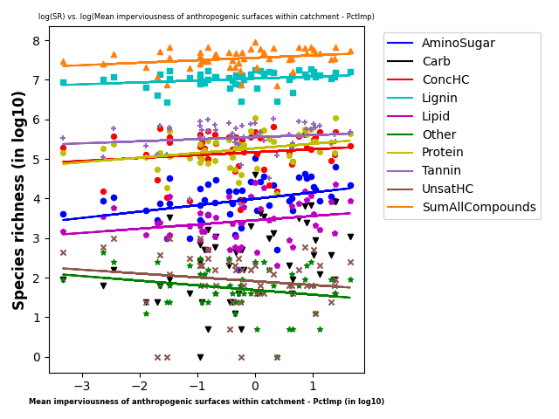
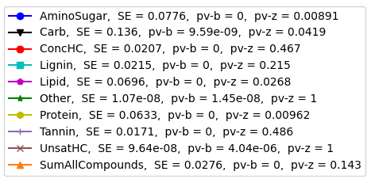
SR vs Mean Imperviousness (from epa waters-catchment)
S = b*(ftr)^{z}
SE = scaling exponent

Slide 5
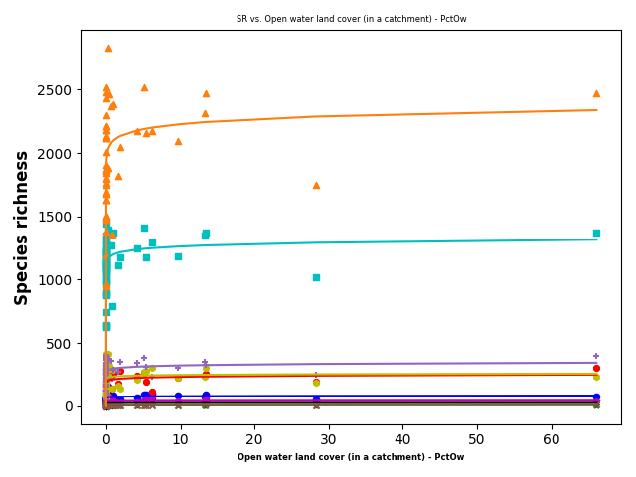
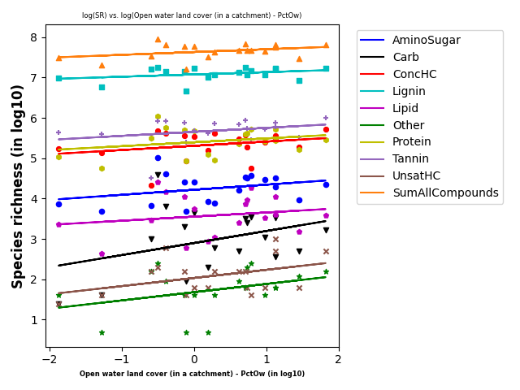
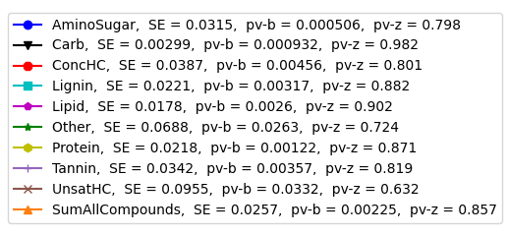
SR vs Open water land cover (from epa waters-catchment)
S = b*(ftr)^{z}
SE = scaling exponent

Slide 6
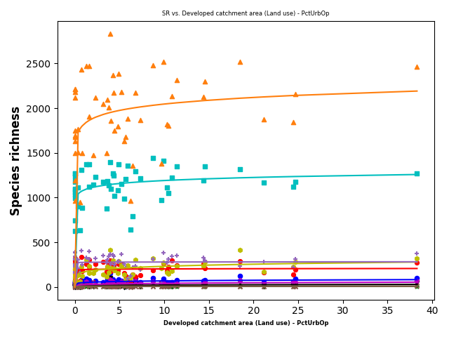
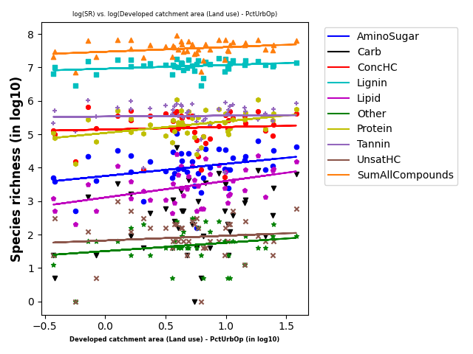
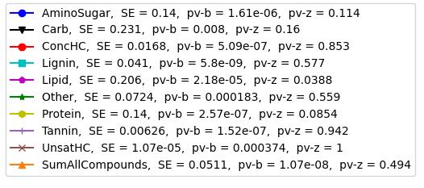
SR vs Developed Catchment Area (LU) (from epa waters-catchment)
S = b*(ftr)^{z}
SE = scaling exponent

Slide 7
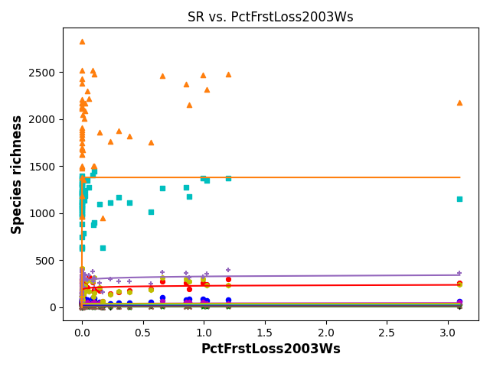
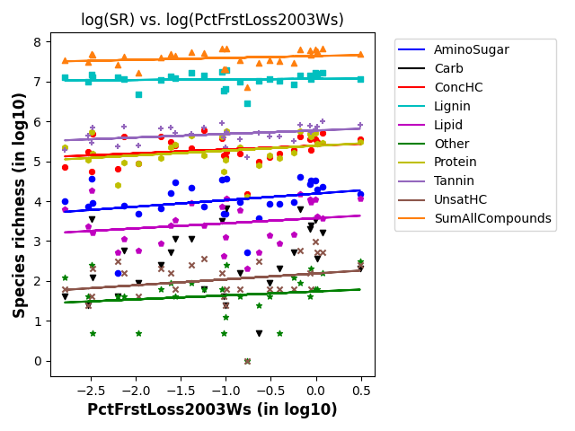
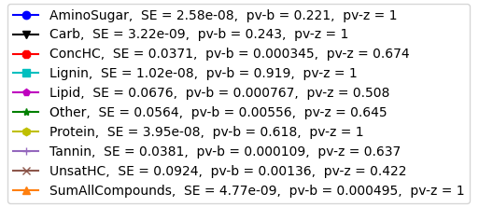
SR vs PctFrstLossWs2003 (from epa waters-watersheds)
S = b*(ftr)^{z}
SE = scaling exponent

Slide 8
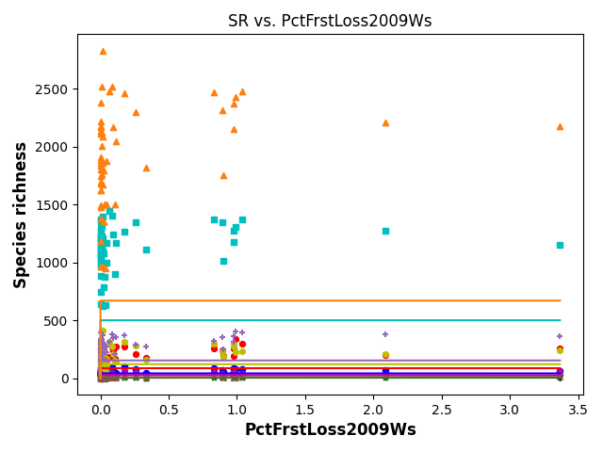
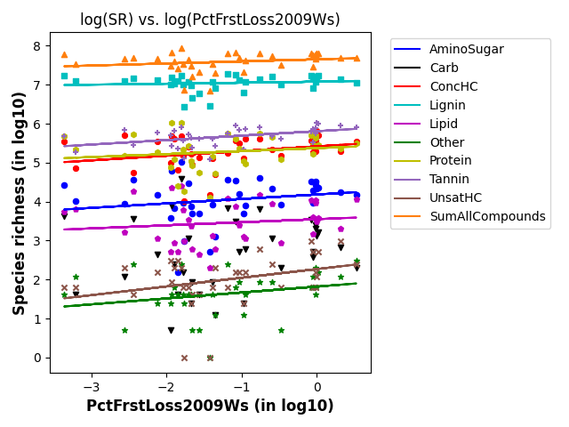
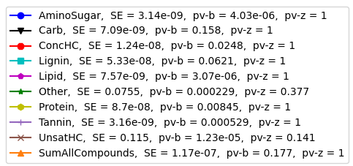
SR vs PctFrstLossWs2009 (from epa waters-watersheds)
S = b*(ftr)^{z}
SE = scaling exponent

Slide 9
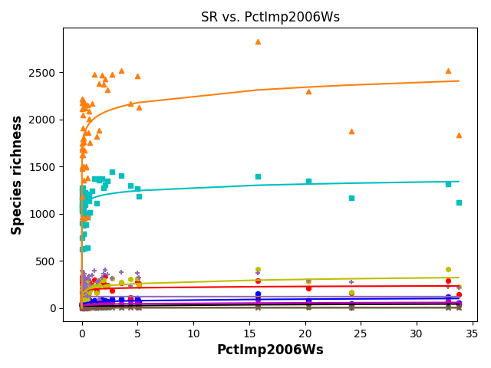
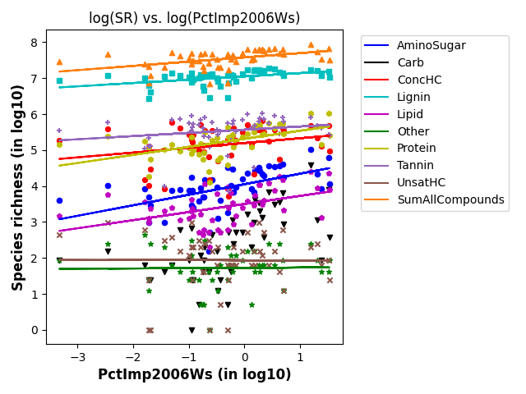
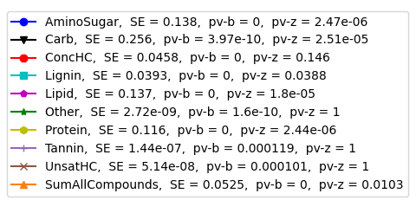
SR vs PctImpWs2006 (from epa waters-watersheds)
S = b*(ftr)^{z}
SE = scaling exponent

Slide 10
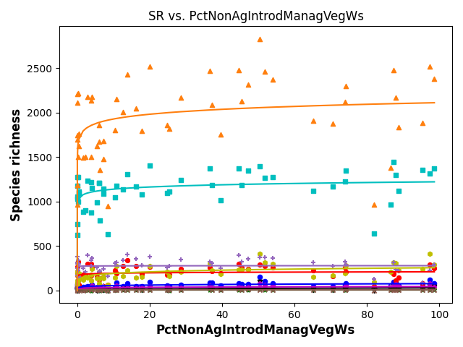
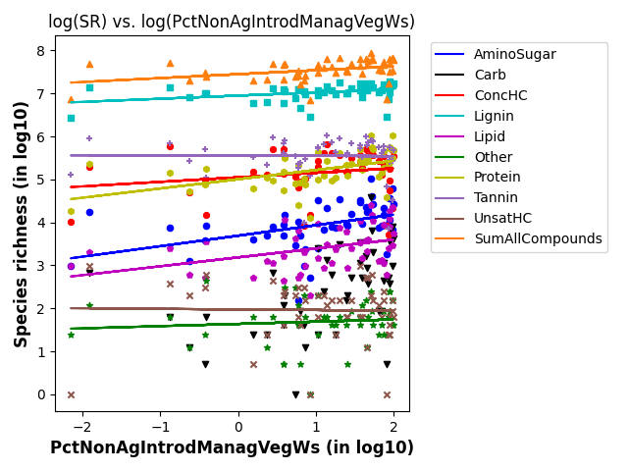
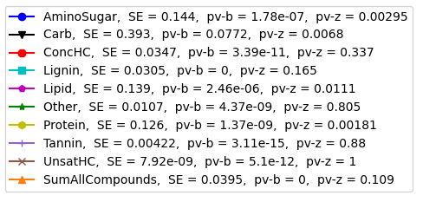
SR vs PctNonAgIntrodManagVegWs (from epa waters-watersheds)
S = b*(ftr)^{z}
SE = scaling exponent

Slide 11
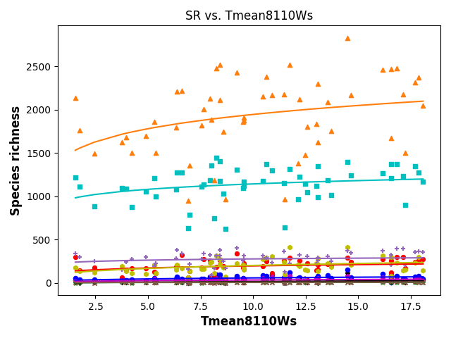
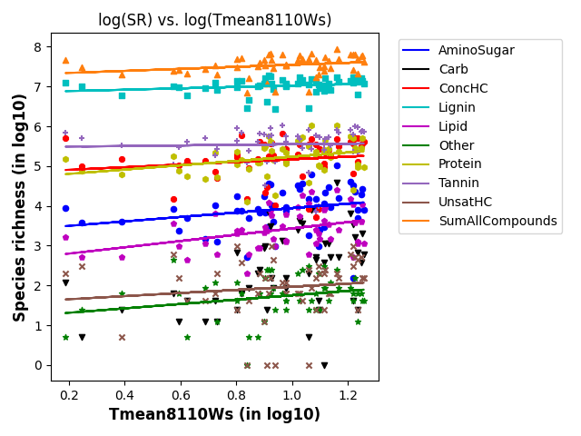
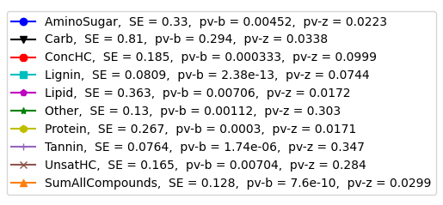
SR vs TmeanWs (from epa waters-watersheds)
S = b*(ftr)^{z}
SE = scaling exponent

Slide 12
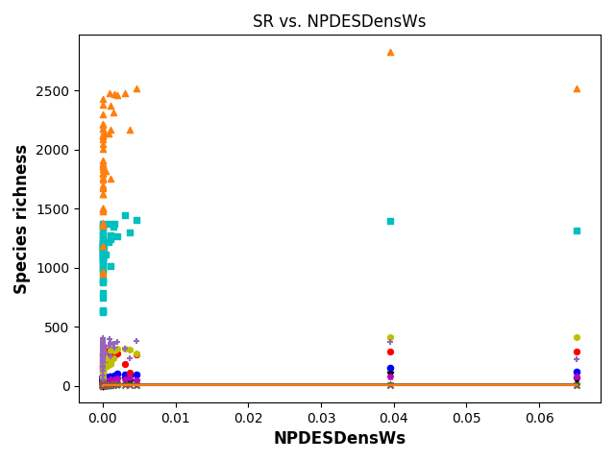
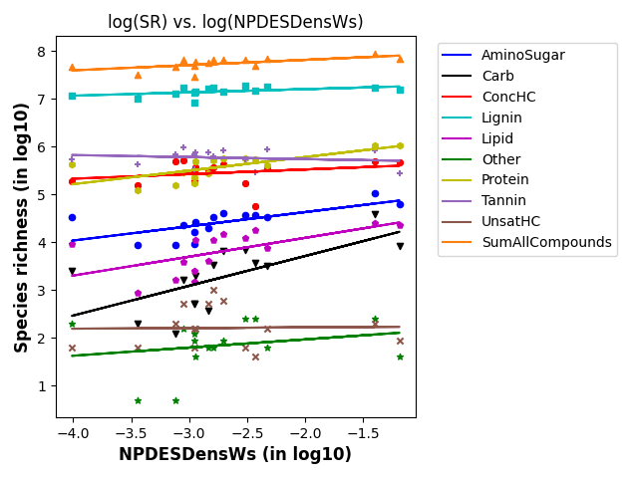
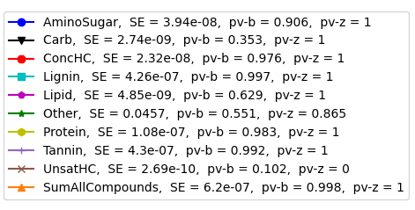
SR vs NPDESDensWs (from epa waters-watersheds)
S = b*(ftr)^{z}
SE = scaling exponent

Slide 13
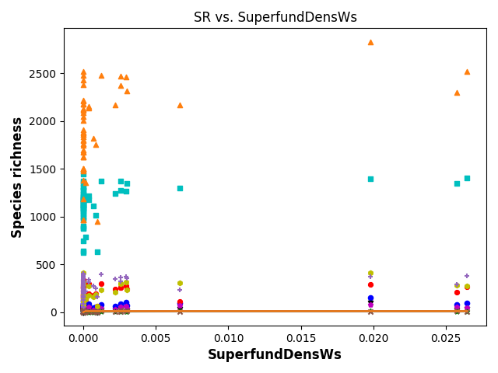
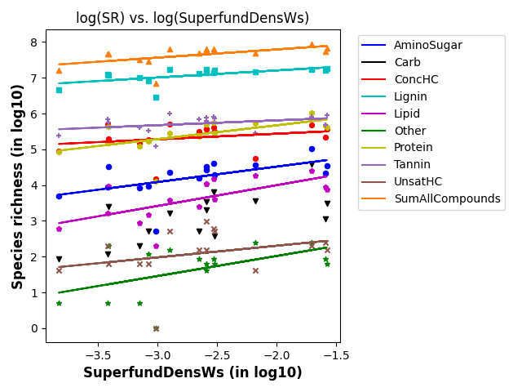
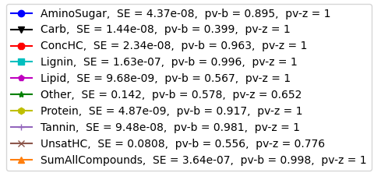
SR vs SuperfundDensWs (from epa waters-watersheds)
S = b*(ftr)^{z}
SE = scaling exponent

