Slide 1
Discussion items – Sep-27th
Scaling laws for WHONDRS data
Scaling laws for StreamStats data
Scaling laws for HYDROSHEDS data
Scaling laws for EPA-Waters-Catchment data
Scaling laws for EPA-Waters-Watershed data
Scaling laws are in the form → Species richness = b*(DataFeature)^{z}

Slide 2
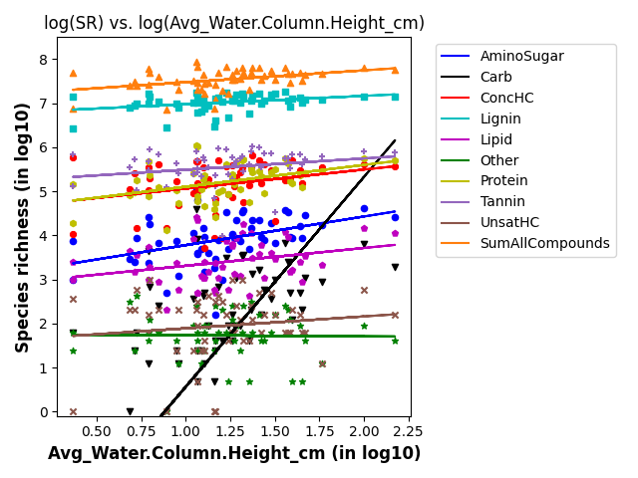
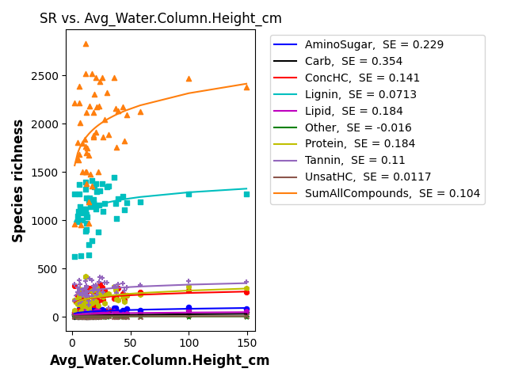
SR vs avg water column height

Slide 3
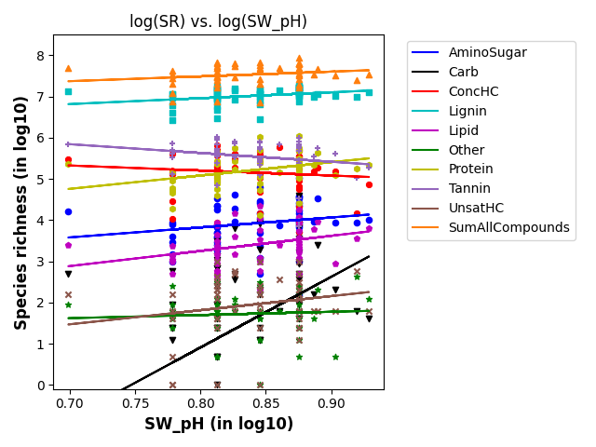
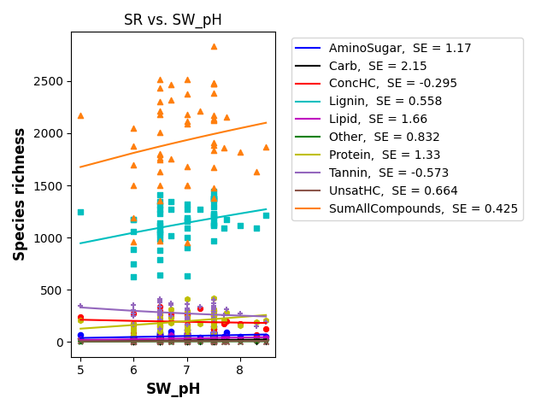
SR vs SW_pH

Slide 4
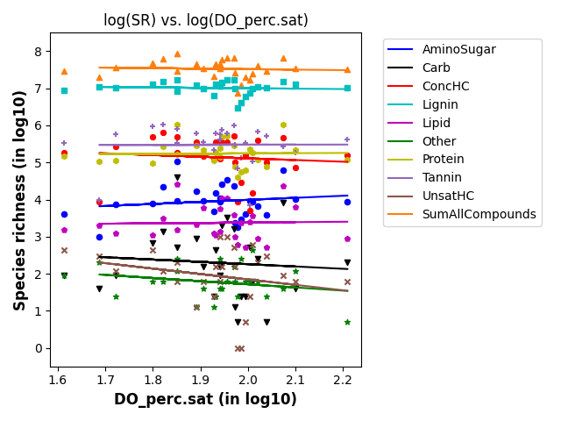
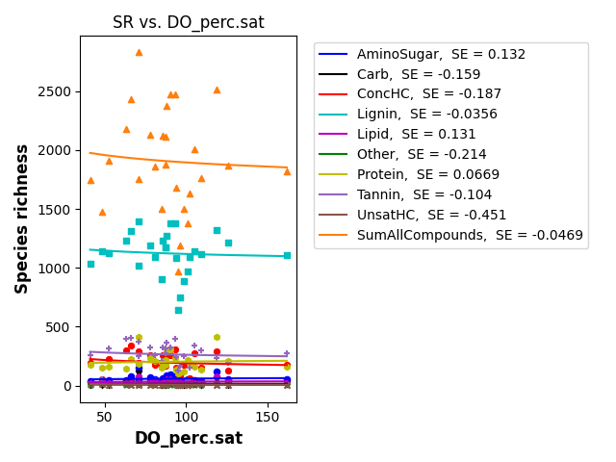
SR vs DO_per.sat

Slide 5
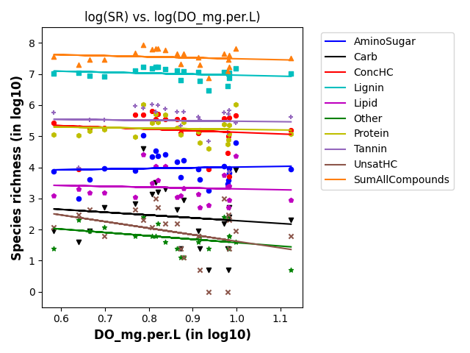
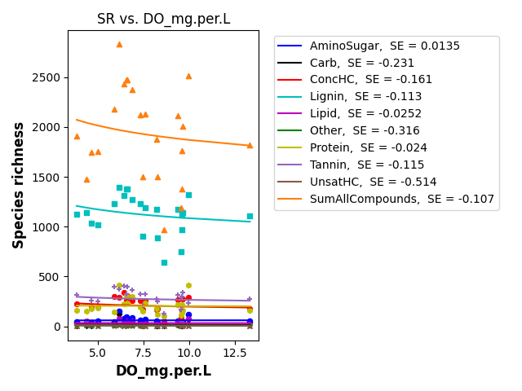
SR vs DO_mg.per.L

Slide 6
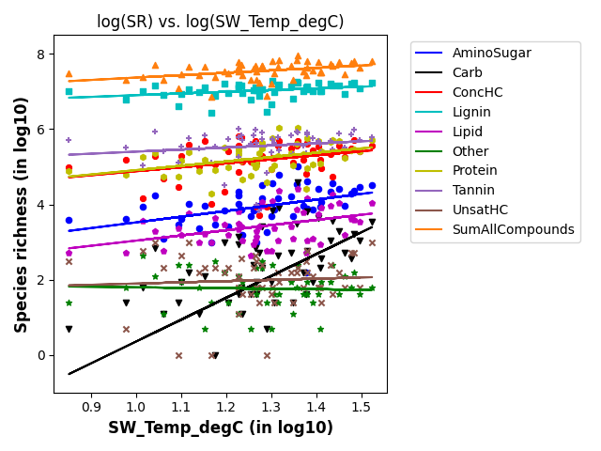
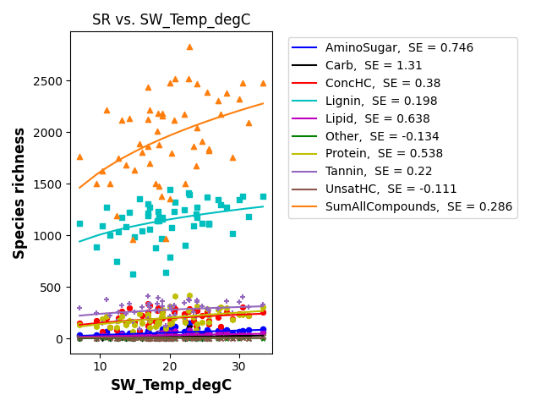
SR vs SW_Temp

