Slide 1
Discussion items – Oct-4th
Scaling laws for WHONDRS data
Scaling laws for StreamStats data
Scaling laws for HYDROSHEDS data
Scaling laws for EPA-Waters-Catchment data
Scaling laws for EPA-Waters-Watershed data
Scaling laws are in the form → Species richness = b*(DataFeature)^{z}

Slide 2
Scaling laws: SR vs WHONDRS
Scaling laws are in the form → Species richness = b*(DataFeature)^{z}
Data features include
SW_Temp_degC -- Water temperature at 50% depth at downstream sampling location
DO_mg.per.L -- Dissolved oxygen at 50% depth at downstream sampling location
DO_perc.sat -- Dissolved oxygen at 50% depth at downstream sampling location
SW_pH -- pH value from colorimetric pH strip
Avg water column height
DS_Water.Column.Height_cm -- Height of water column at downstream sampling location
MS_Water.Column.Height_cm -- Height of water column at midstream sampling location
US_Water.Column.Height_cm -- Height of water column at upstream sampling location

Slide 3
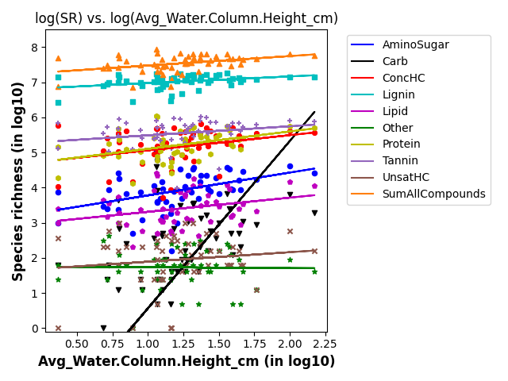
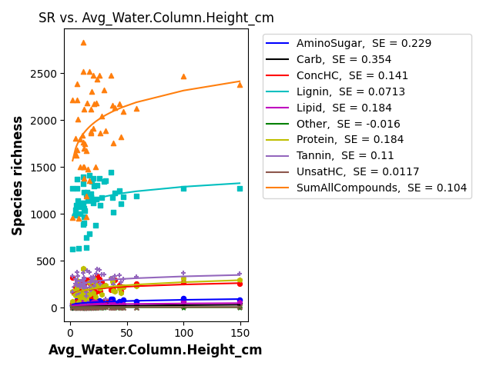
SR vs avg water column height

Slide 4
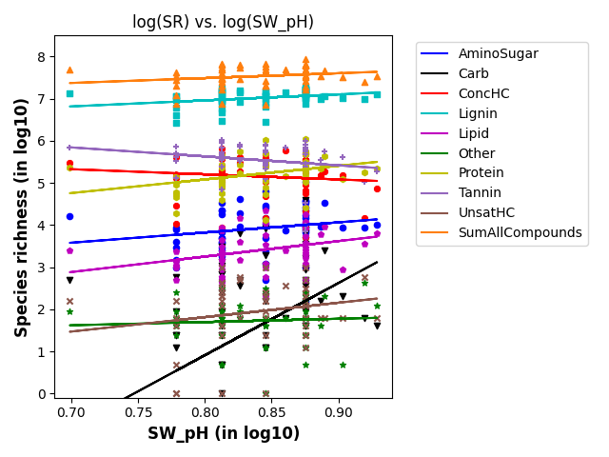
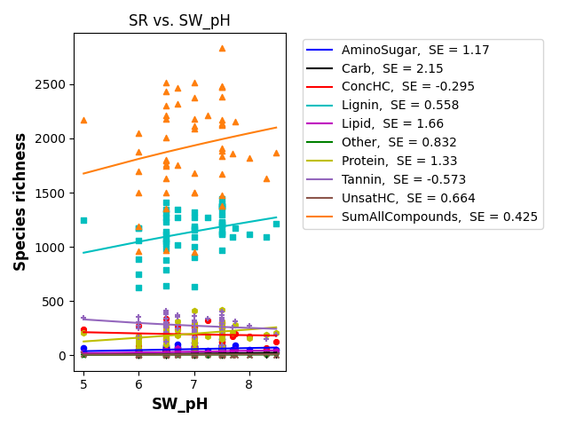
SR vs SW_pH

Slide 5
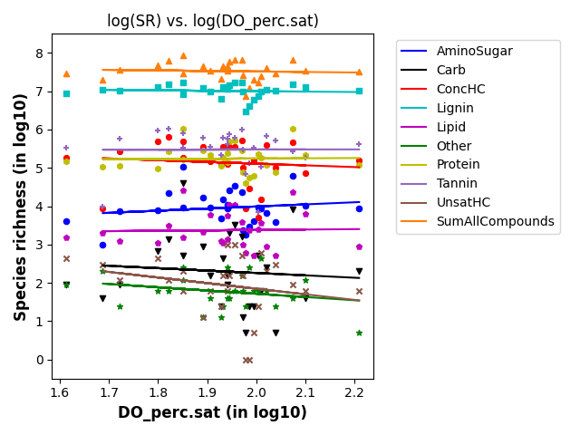
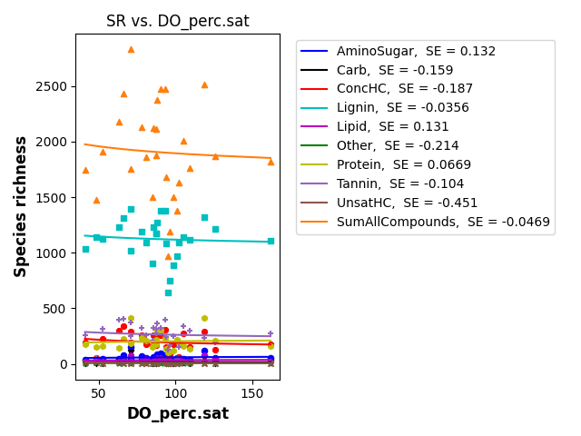
SR vs DO_per.sat

Slide 6
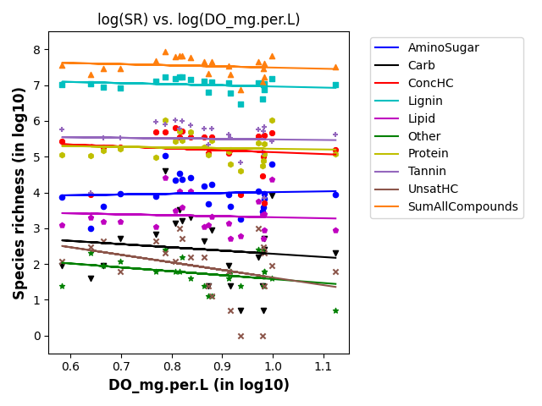
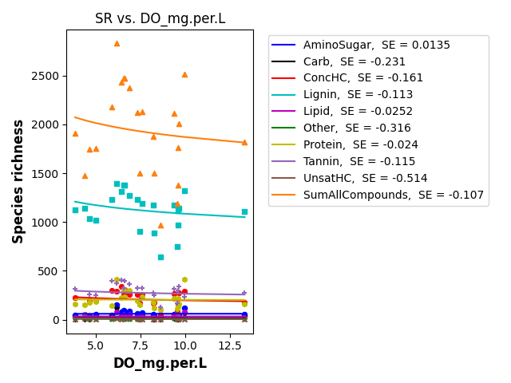
SR vs DO_mg.per.L

Slide 7
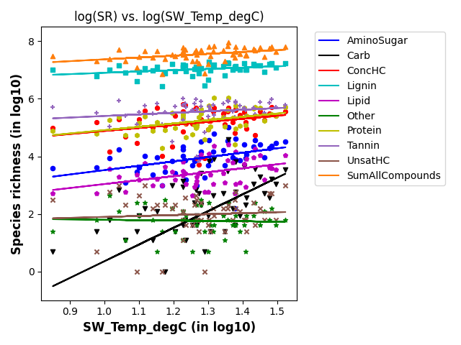
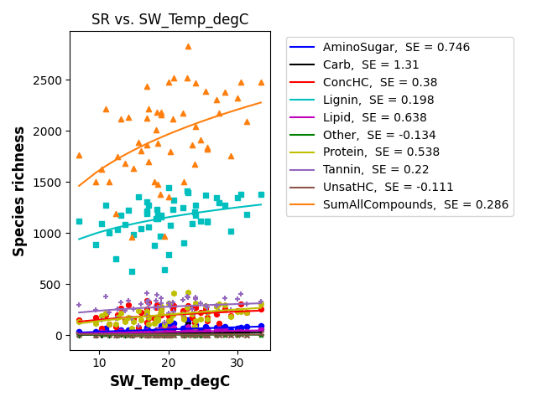
SR vs SW_Temp

Slide 8
Scaling laws: SR vs StreamStats
Scaling laws are in the form → Species richness = b*(DataFeature)^{z}
Data features include
Latitude – Radiation is an important
Drainage area
Precipitation
Forest cover

Slide 9
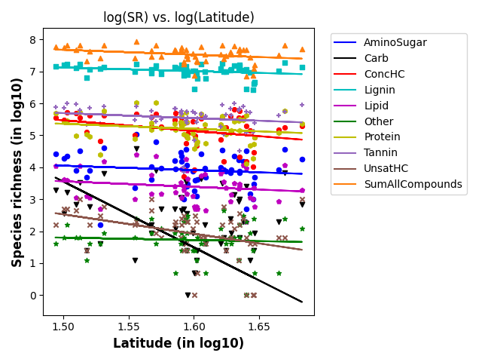
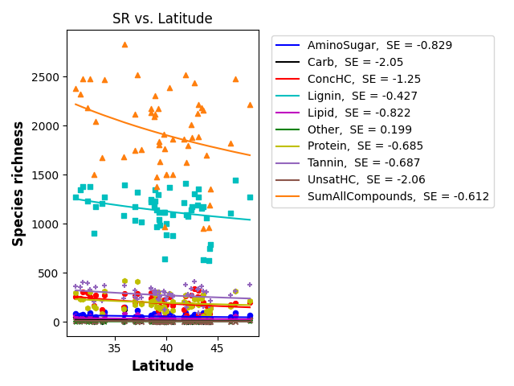
SR vs latitude

Slide 10
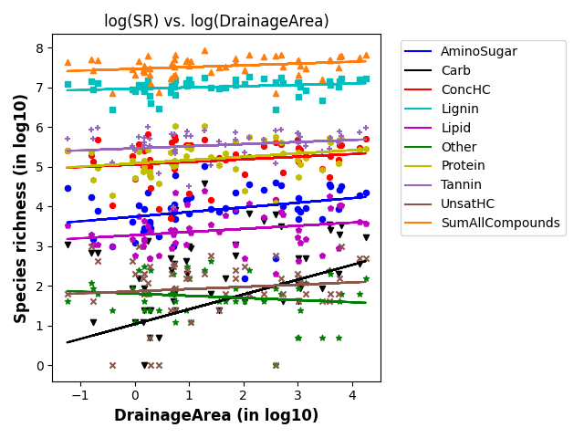
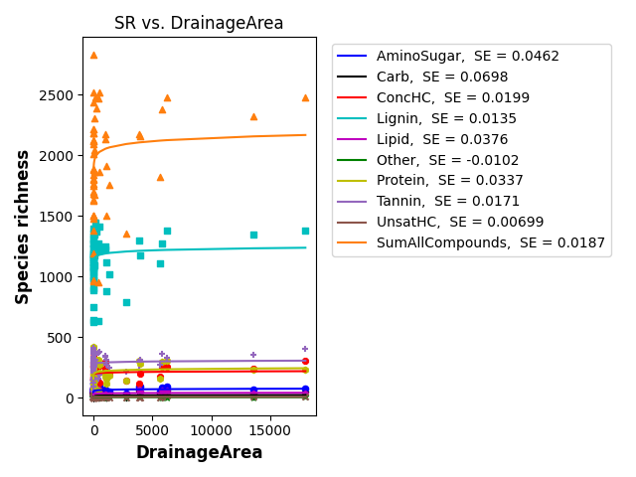
SR vs drainage area

Slide 11
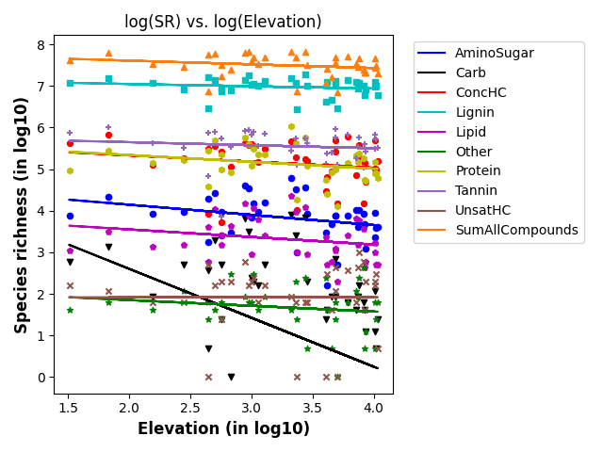
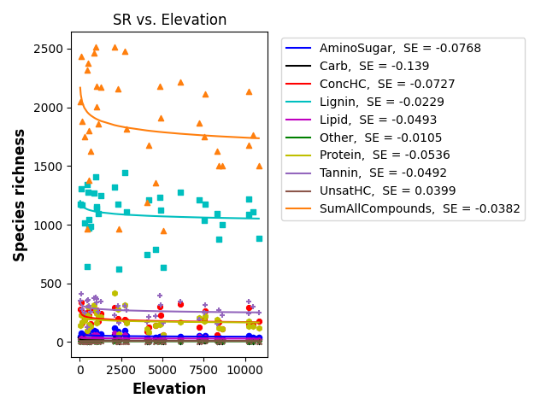
SR vs elevation

Slide 12
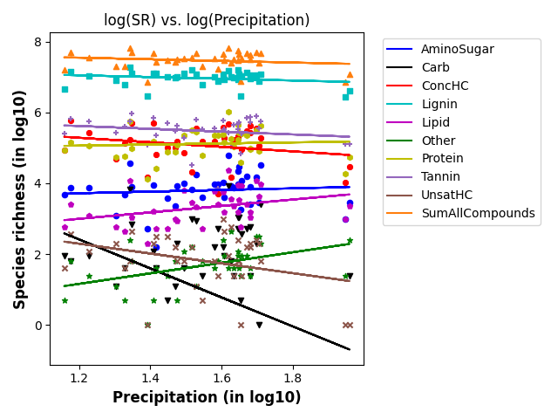
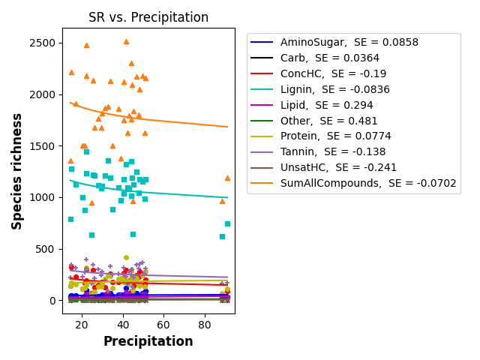
SR vs precipitation

Slide 13
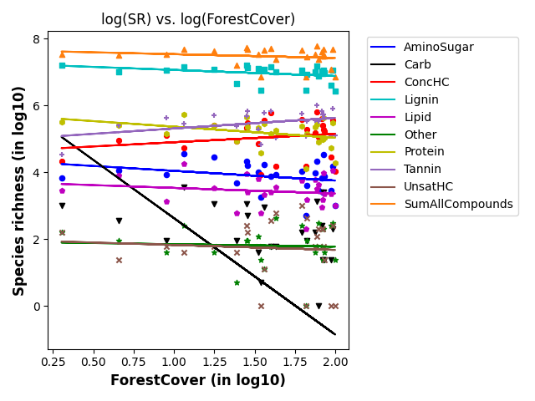
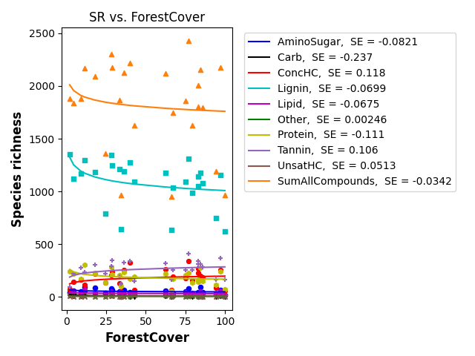
SR vs forest cover

Slide 14
Scaling laws: SR vs HYDROSHEDS
Scaling laws are in the form → Species richness = b*(DataFeature)^{z}
Data features include
Actual ET – can be related to pH and DO
Potential ET – can be related to pH and DO
Air temperature – can be related to pH and DO
Natural discharge -- can be related to pH and DO

Slide 15
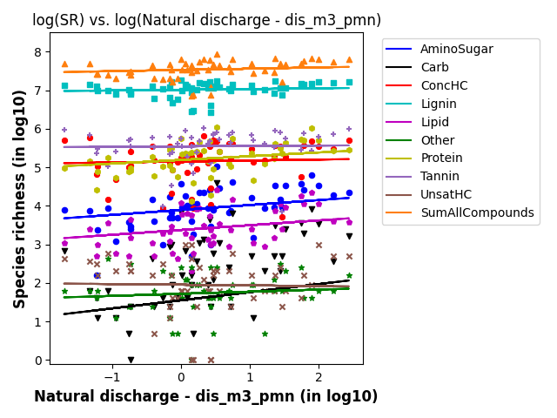
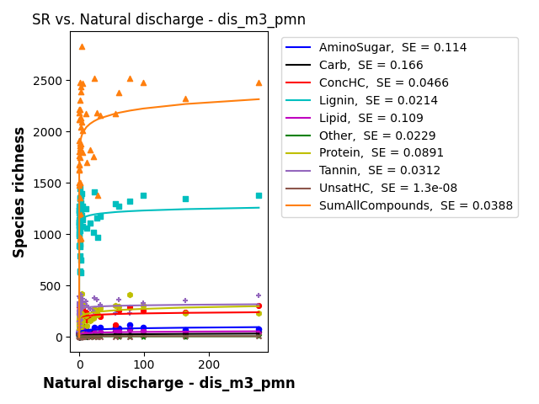
SR vs discharge

Slide 16
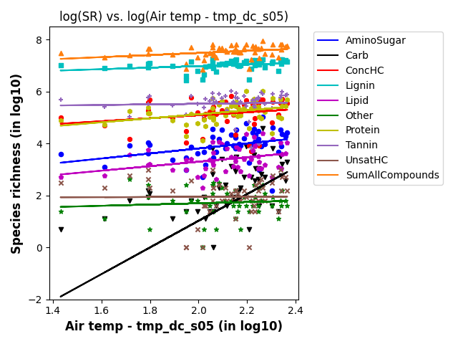
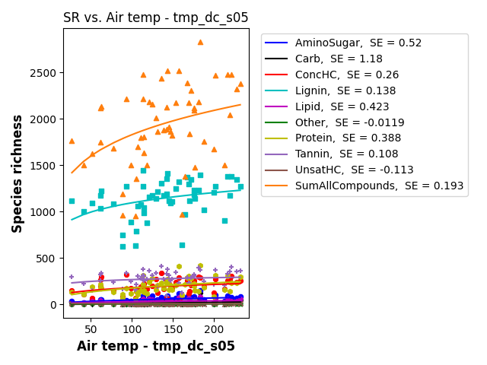
SR vs air temperature

Slide 17
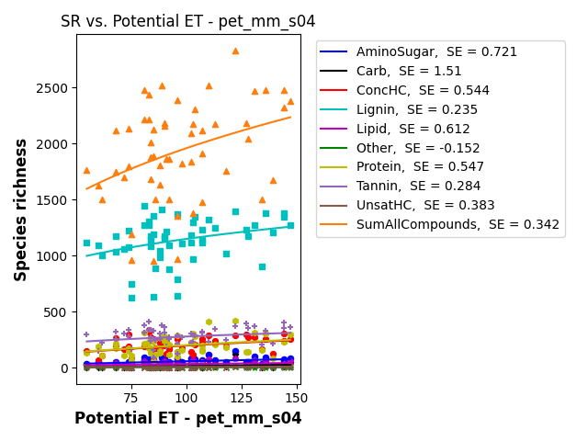
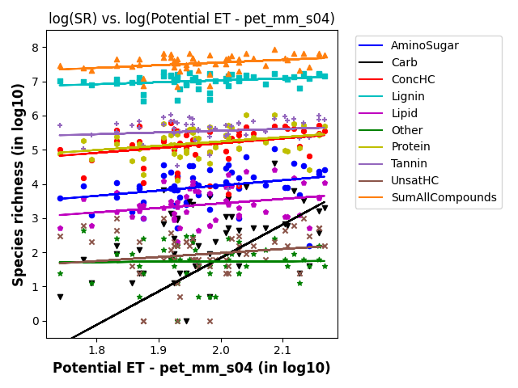
SR vs potential ET

Slide 18
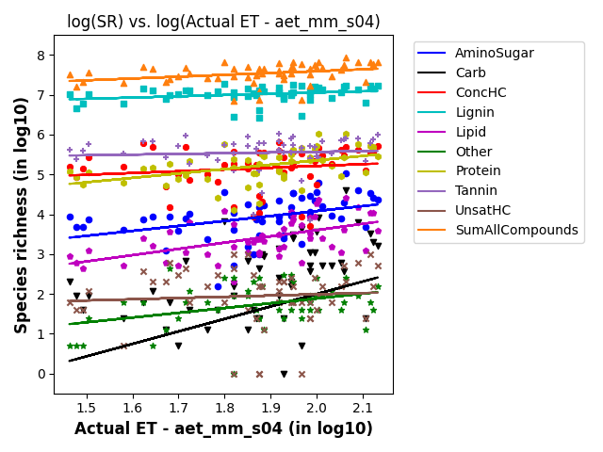
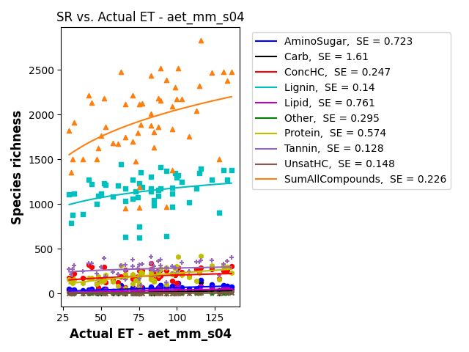
SR vs actual ET

Slide 19
Scaling laws: SR vs EPAWaters-Catchment
Scaling laws are in the form → Species richness = b*(DataFeature)^{z}
Data features include
Stream temperature (summer, annual) – Local avg
PctNonAgIntrodManagVegCat
% Nonagriculture nonnative introduced or managed vegetation landcover type reclassed from LANDFIRE Existing Vegetation Type (EVT), within catchment
Precipitation gradient

Slide 20
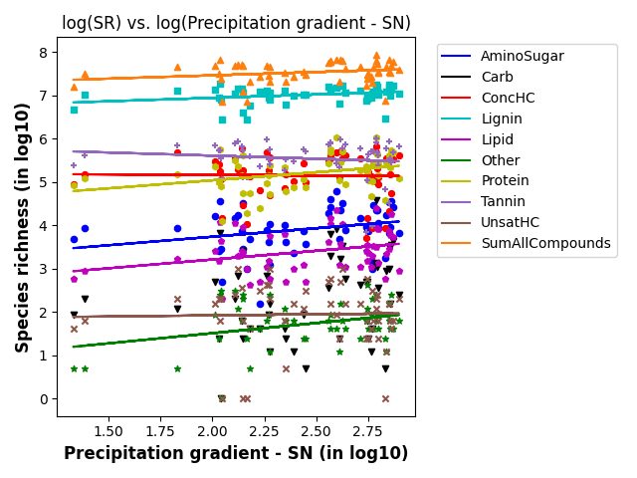
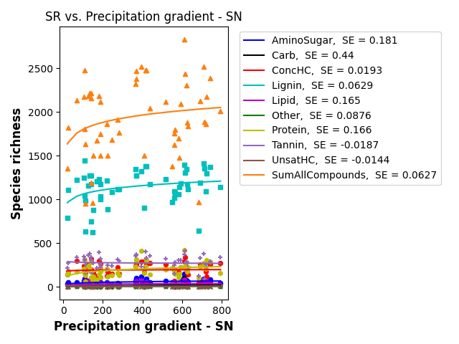
SR vs precipitation gradient

Slide 21
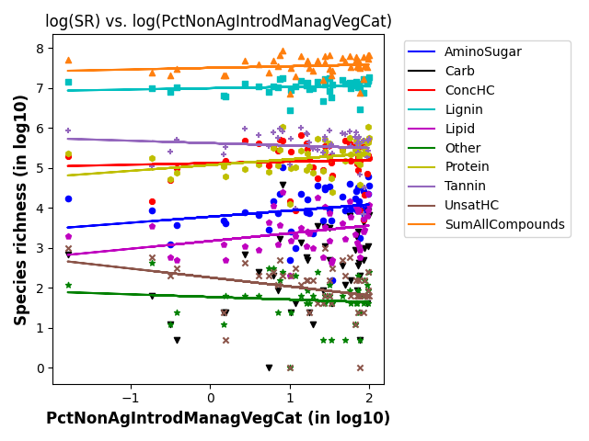
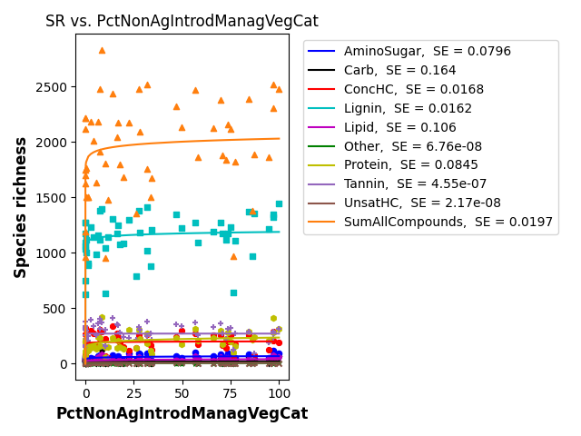
SR vs PctNonAgIntrodManagVegCat

Slide 22
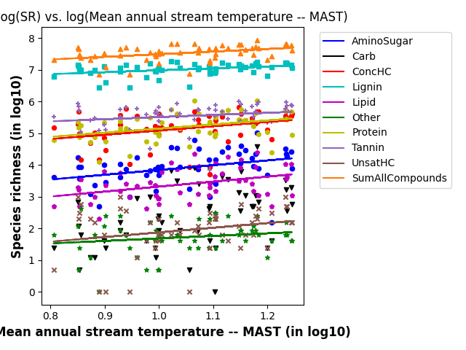
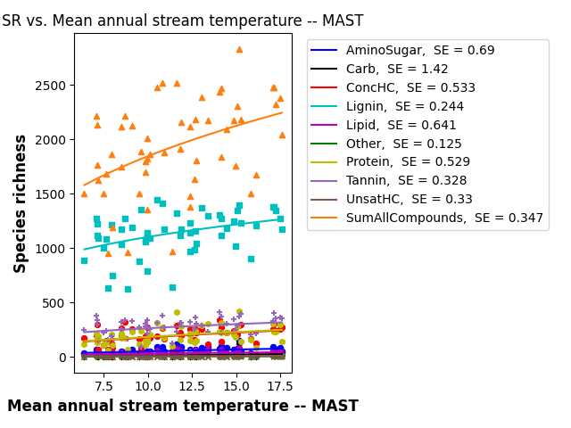
SR vs Mean annual stream temperature

Slide 23
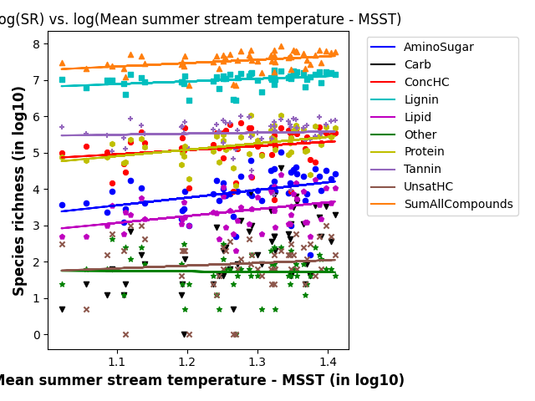
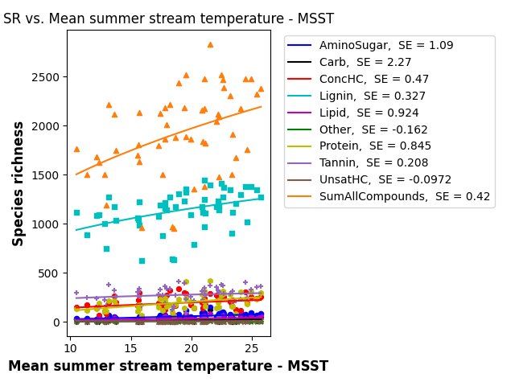
SR vs Mean summer stream temperature

Slide 24
Scaling laws: SR vs EPAWaters-Watersheds
Scaling laws are in the form → Species richness = b*(DataFeature)^{z}
Data features include
PcTUrbLo, PctUrbMd, and PctUrbHi
% of watershed area classified as developed, low/med/high-intensity land use

Slide 25
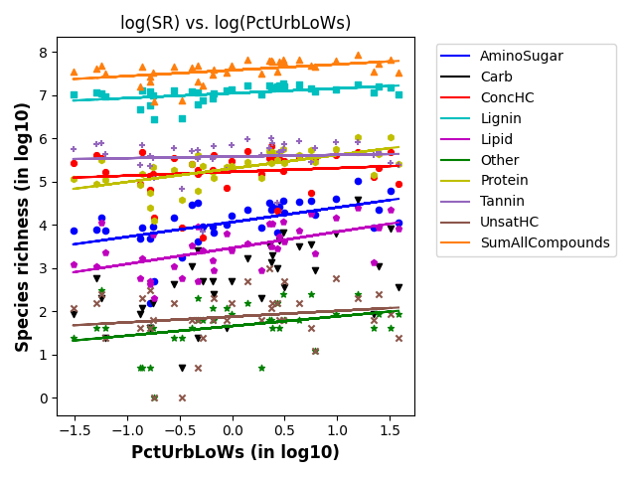
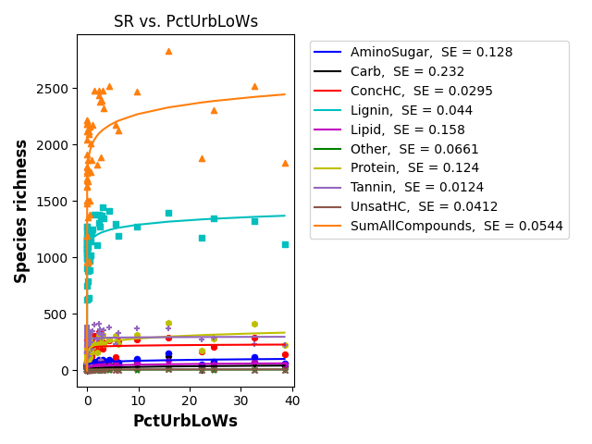
SR vs PctUrbLoWs

Slide 26
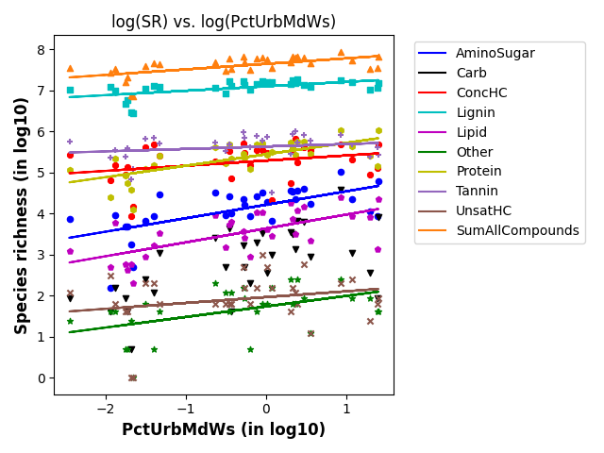
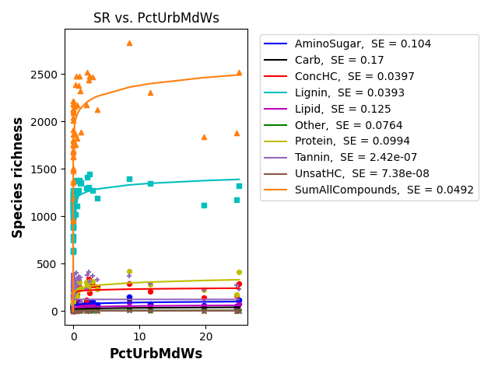
SR vs PctUrbMdWs

Slide 27
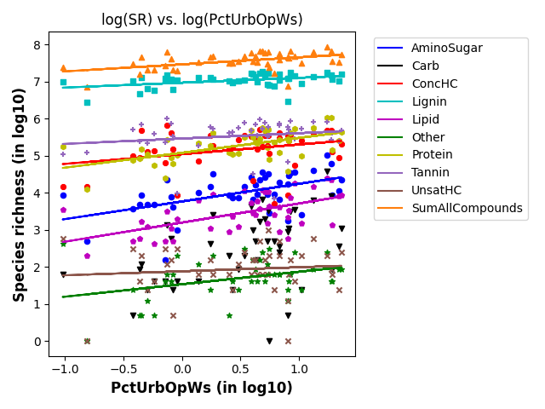
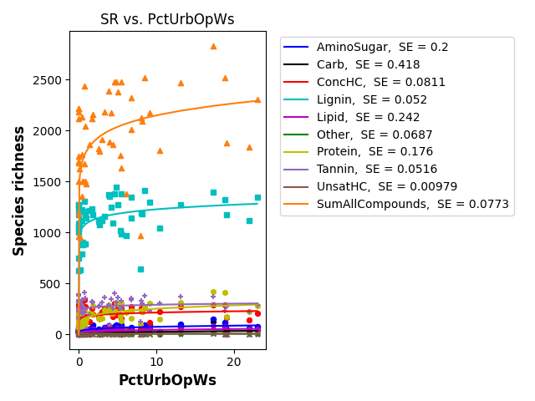
SR vs PctUrbOpWs

