Slide 1
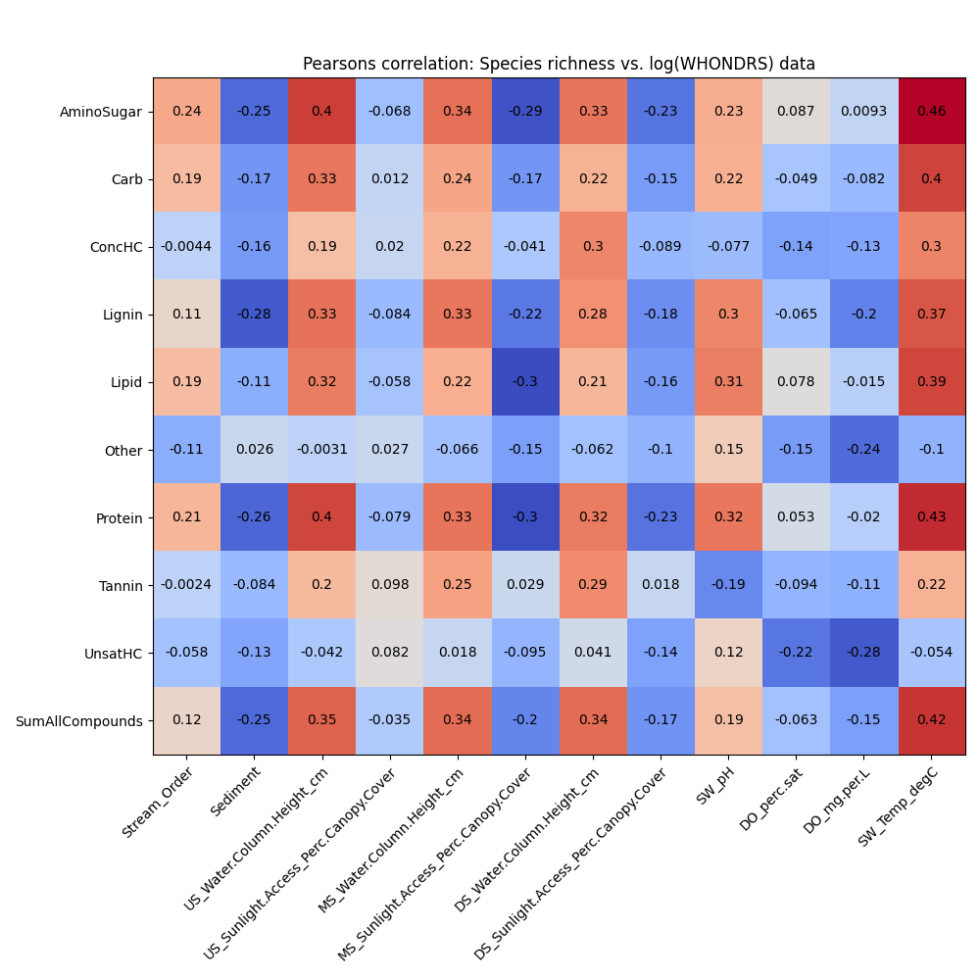
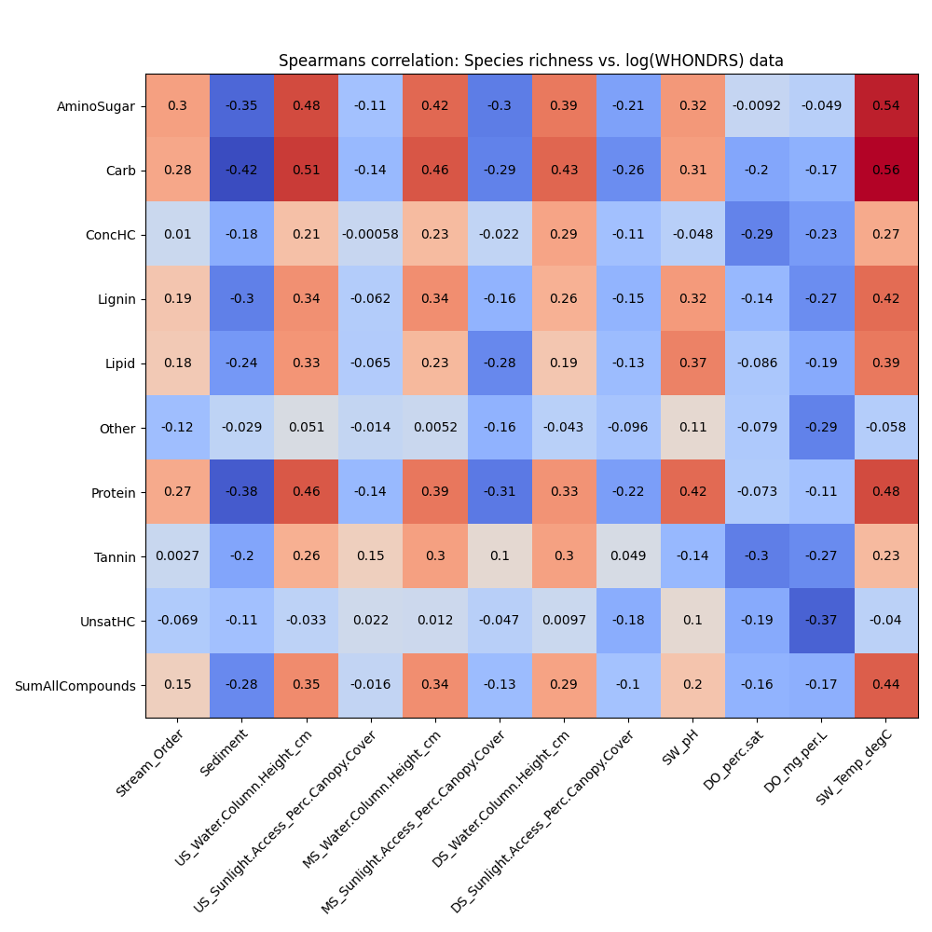
Pearsons and Spearsman correlation plots (WHONDRS)

Slide 2
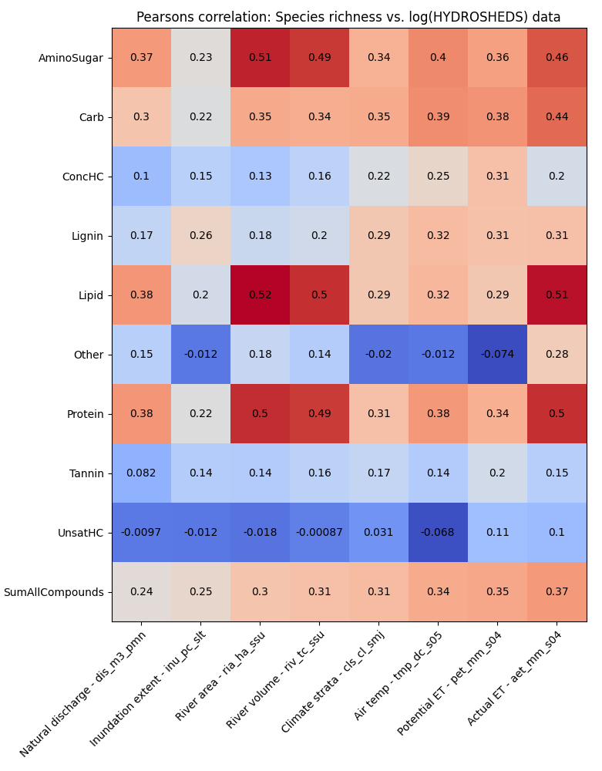
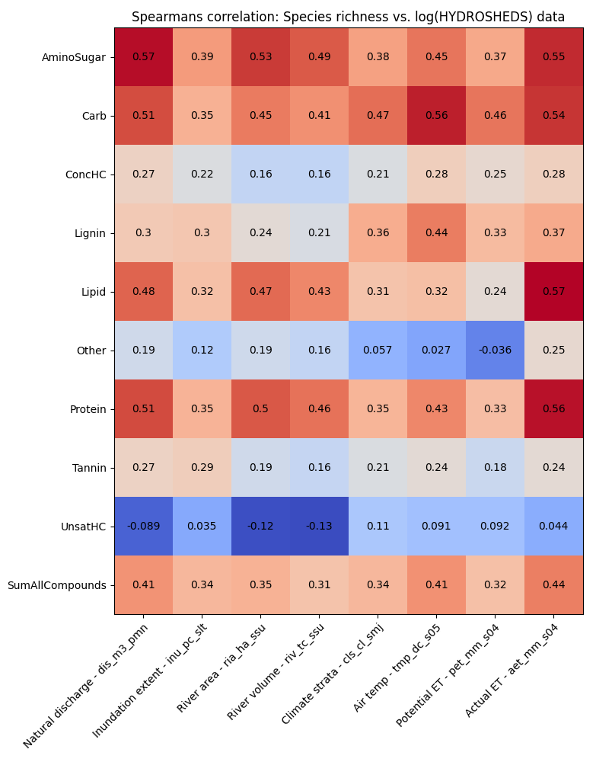
Pearsons and Spearsman correlation plots (HydroSheds)

Slide 3
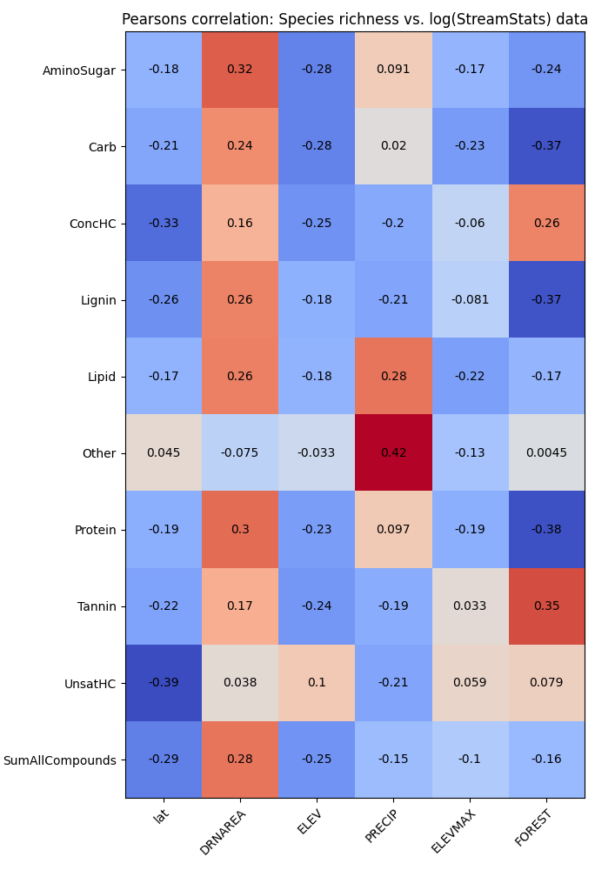
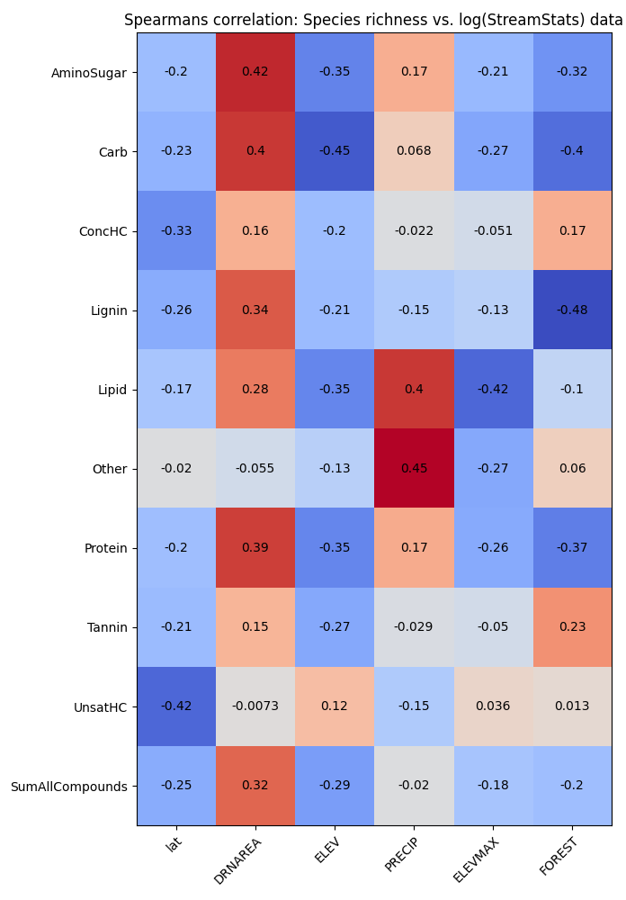
Pearsons and Spearsman correlation plots (StreamStats)
Notes:
0. Shannon diversity is proxy for species richness
Change the color for the heatmap
Blue (positive) and red (negative) colors
Explore biogeochemical transformation metric (how many compounds have changed) is correlating better than species richness

Slide 4
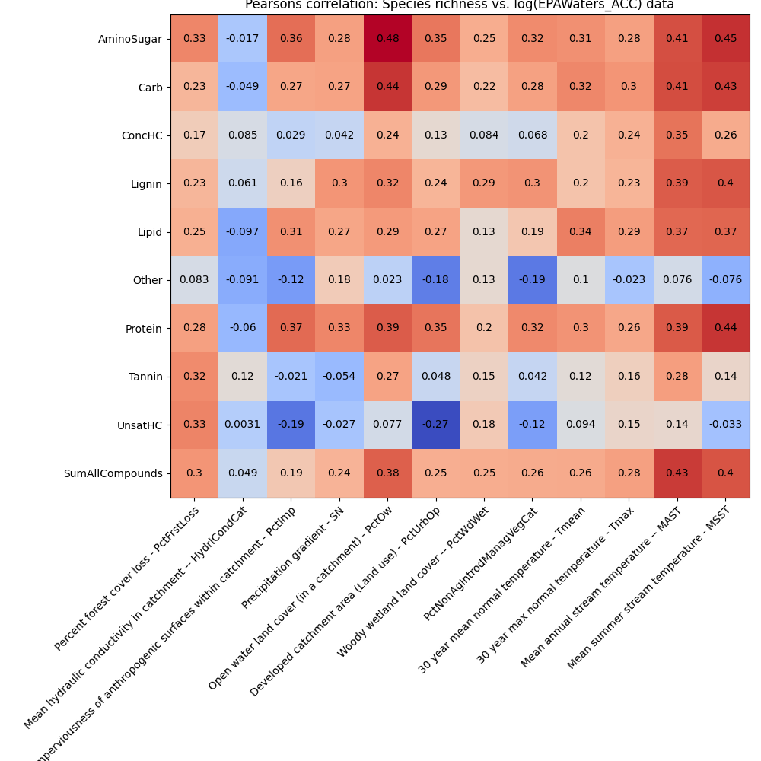
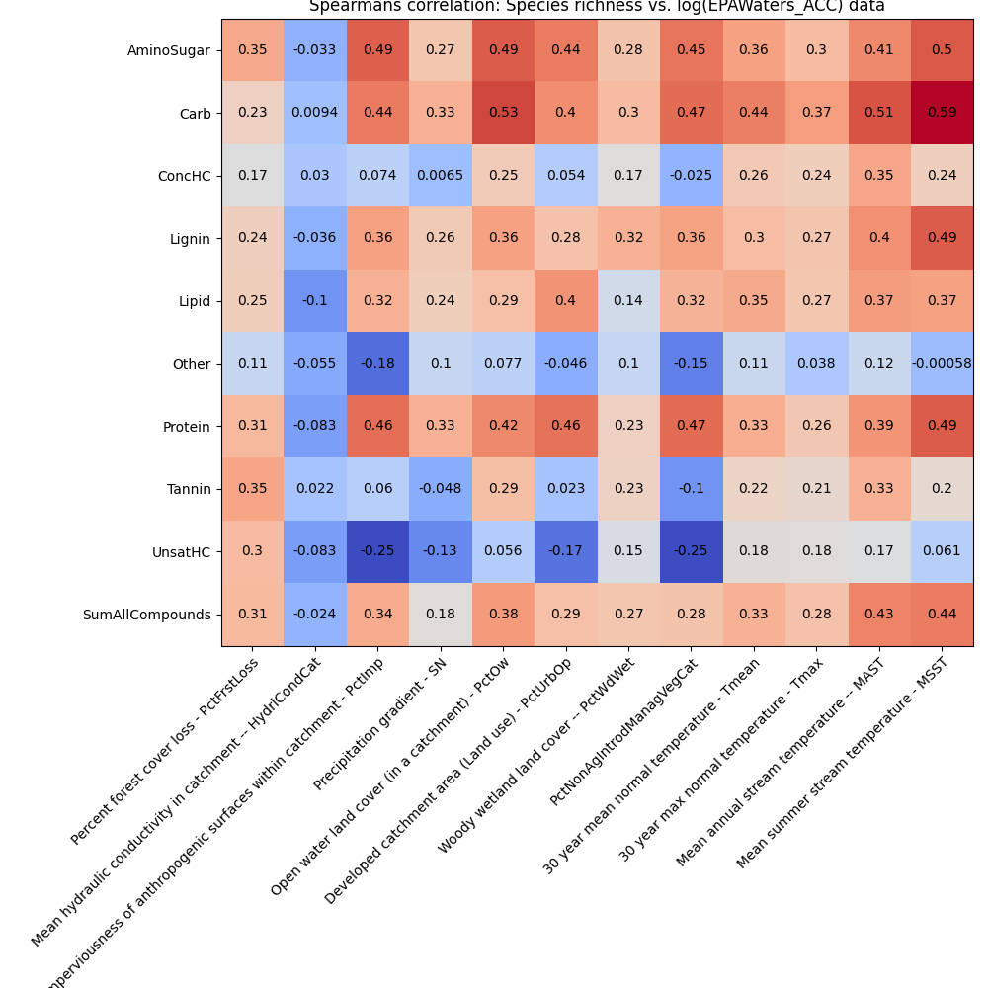
Pearsons and Spearsman correlation plots (EPAWaters-Catchment)

Slide 5
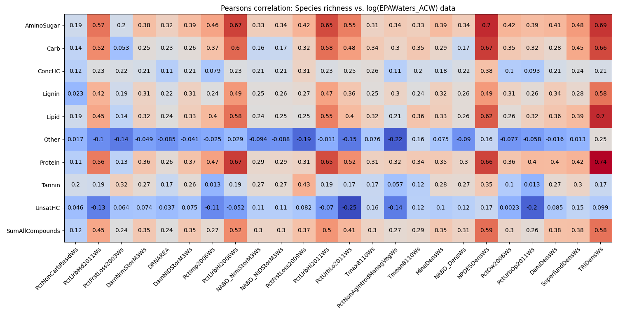
Pearsons correlation plots (EPAWaters-Watershed)

Slide 6
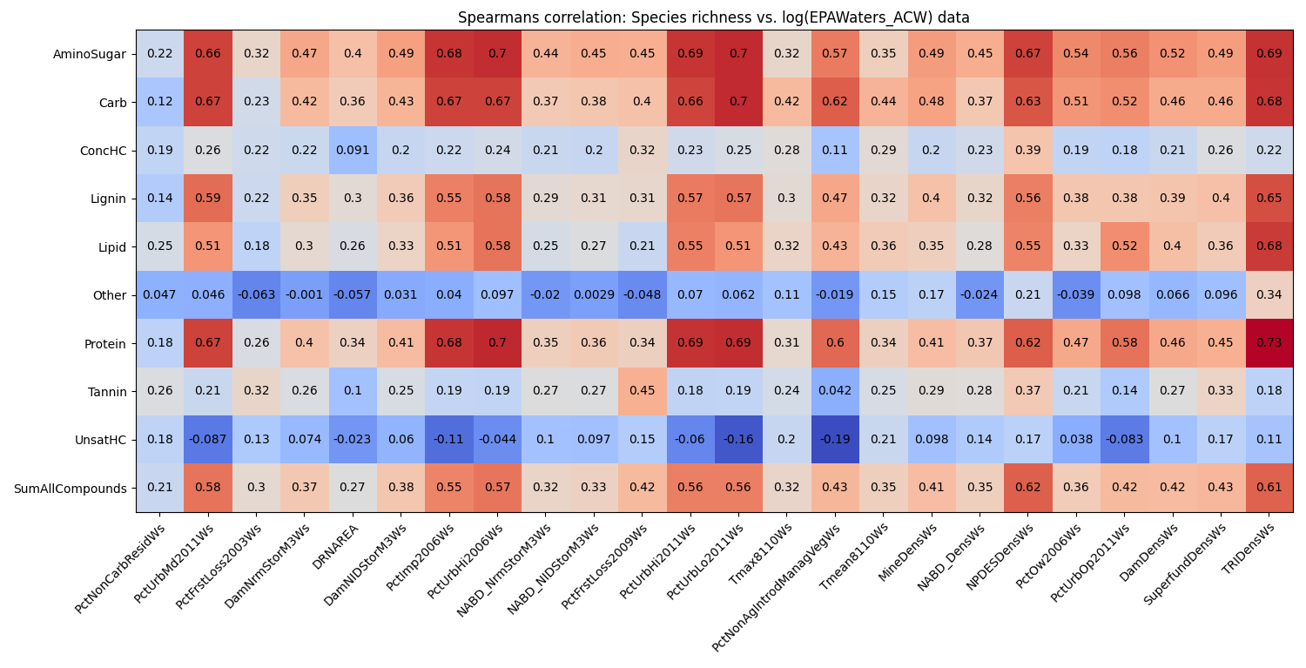
Spearsman correlation plots (EPAWaters-Watershed)

