Slide 1
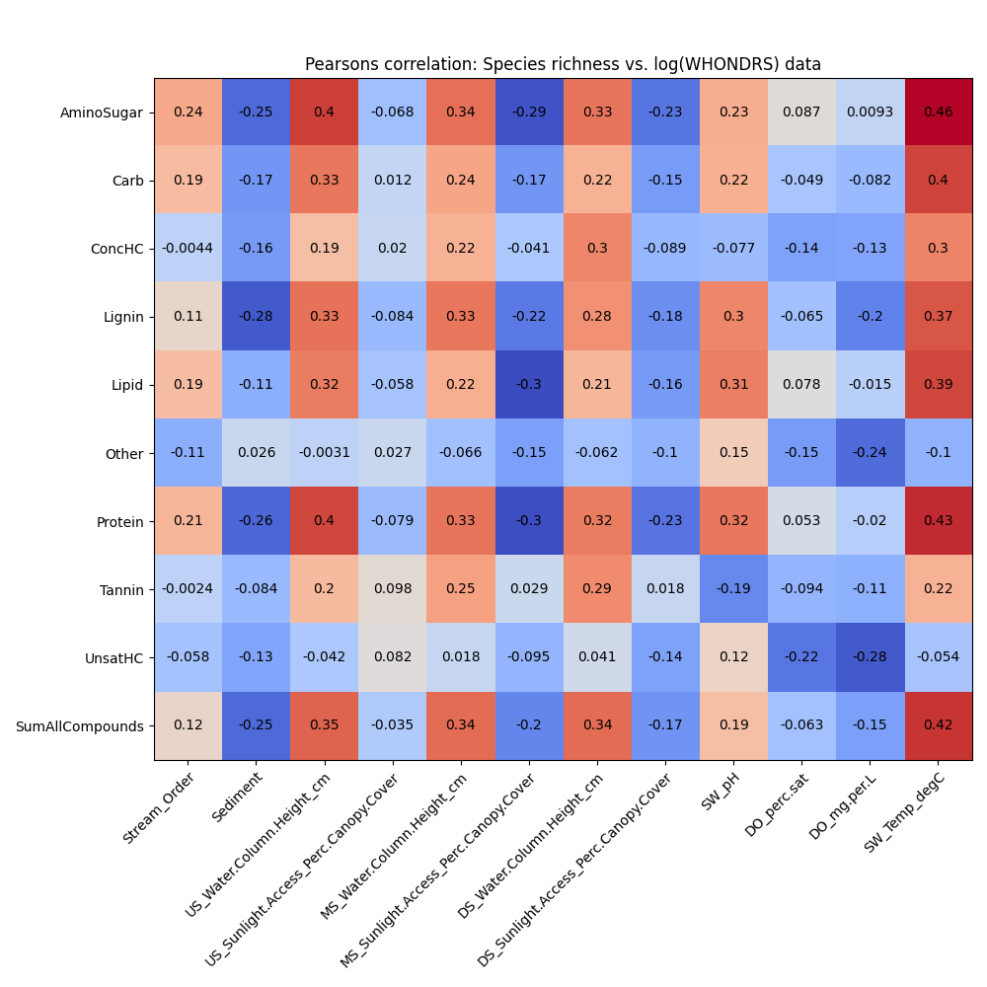
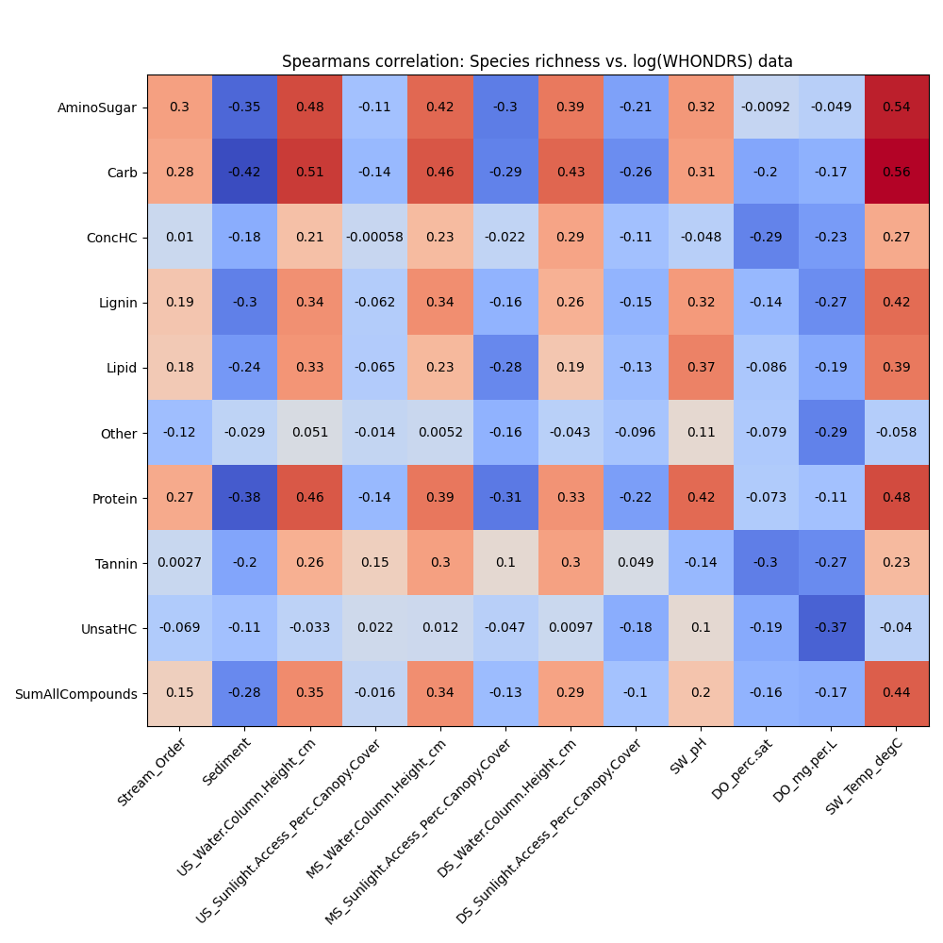
Pearsons and Spearsman correlation plots (WHONDRS)

Slide 2
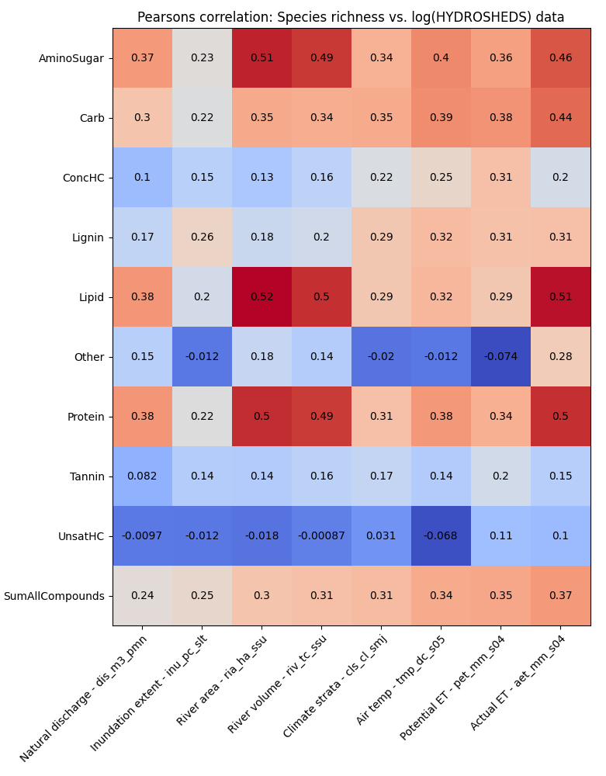
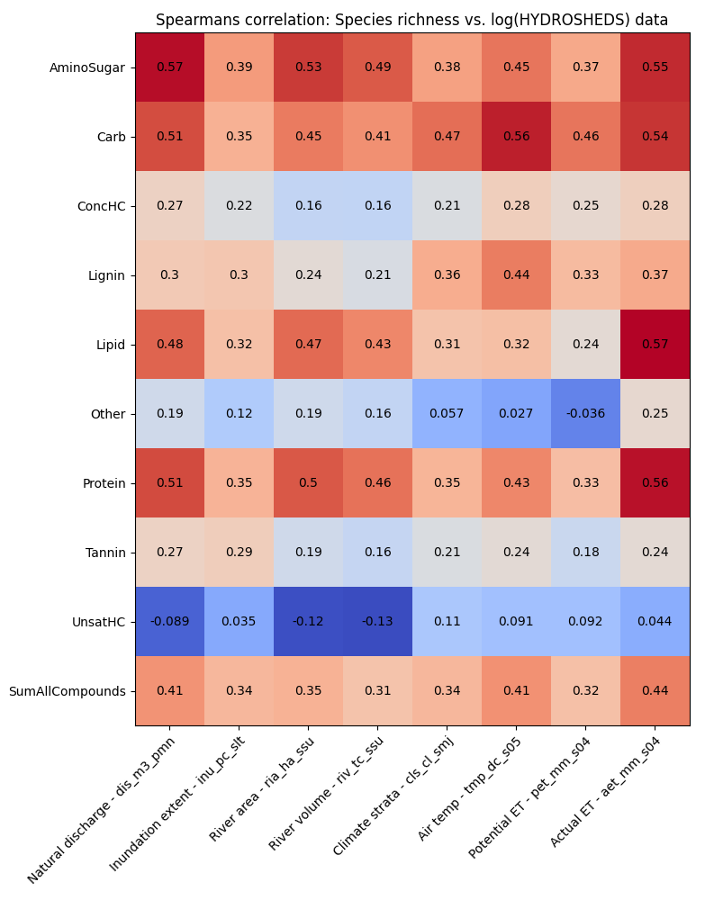
Pearsons and Spearsman correlation plots (HydroSheds)

Slide 3
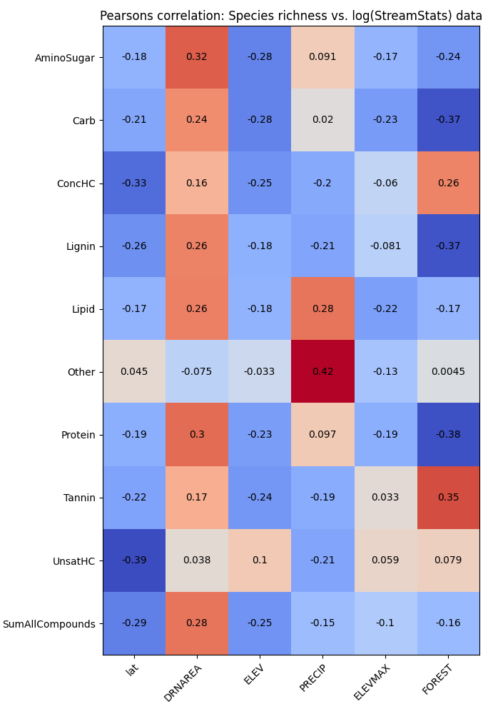
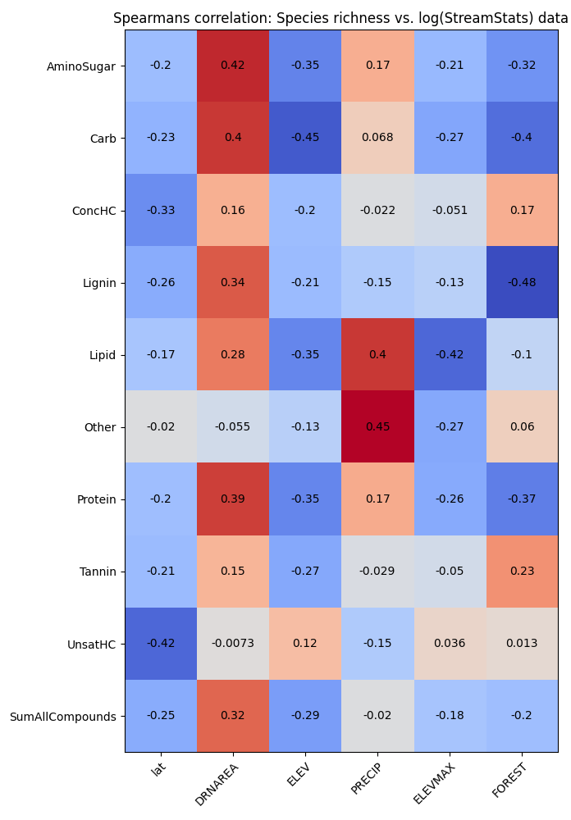
Pearsons and Spearsman correlation plots (StreamStats)
Notes:
0. Shannon diversity is proxy for species richness
Change the color for the heatmap
Blue (positive) and red (negative) colors
Explore biogeochemical transformation metric (how many compounds have changed) is correlating better than species richness

Slide 4
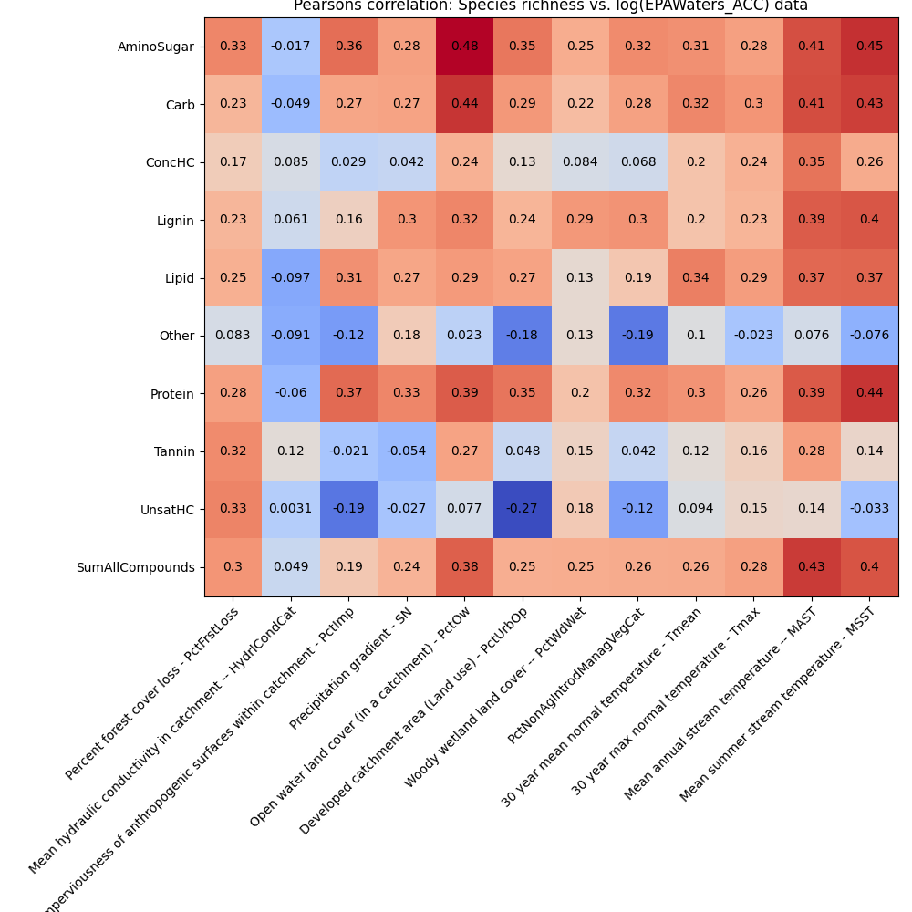
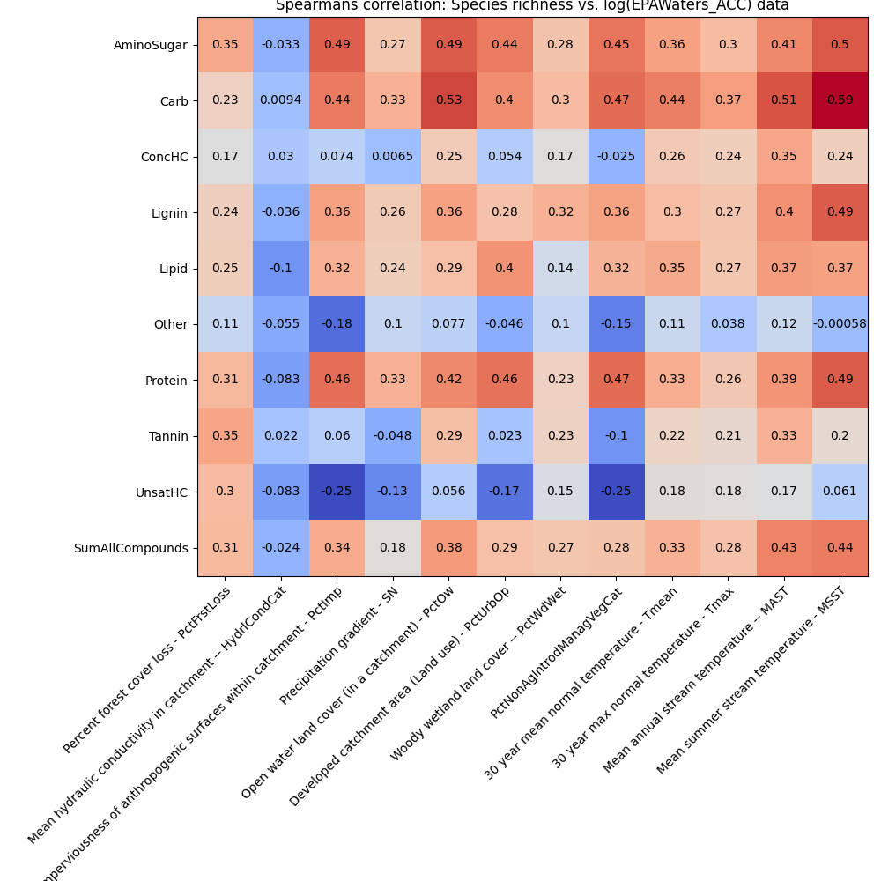
Pearsons and Spearsman correlation plots (EPAWaters-Catchment)

Slide 5
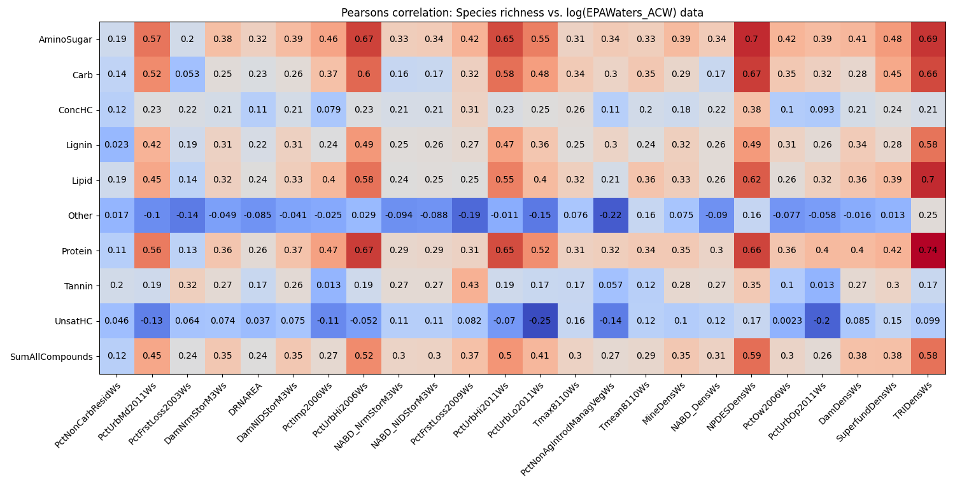
Pearsons correlation plots (EPAWaters-Watershed)

Slide 6
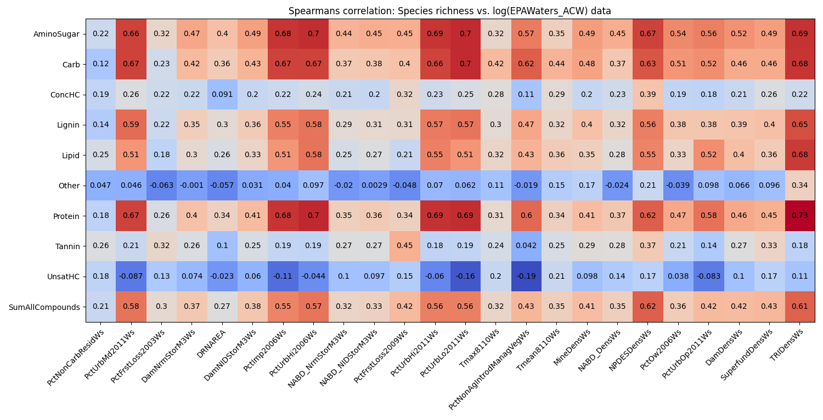
Spearsman correlation plots (EPAWaters-Watershed)
Notes:
Proportional to total sum --> and re-run the analysis
Which compounds among the 9 drive the linear and non-linear correlation (within aminosugar class that are group together)
Compute p-value threshold and reduce the figure (check in python)
Model building – RDA model approach
PCA plots, which PCA components are important in explaining and see the features in the PCA components
Slope with color and correlation indicated by star
Provide a dataframe to James
Look for beta regression (logit-regression or Gaussian regression or Poisson data) between Species richness and Extrinsic factors
If proportion data, revisit the analysis.

Slide 7
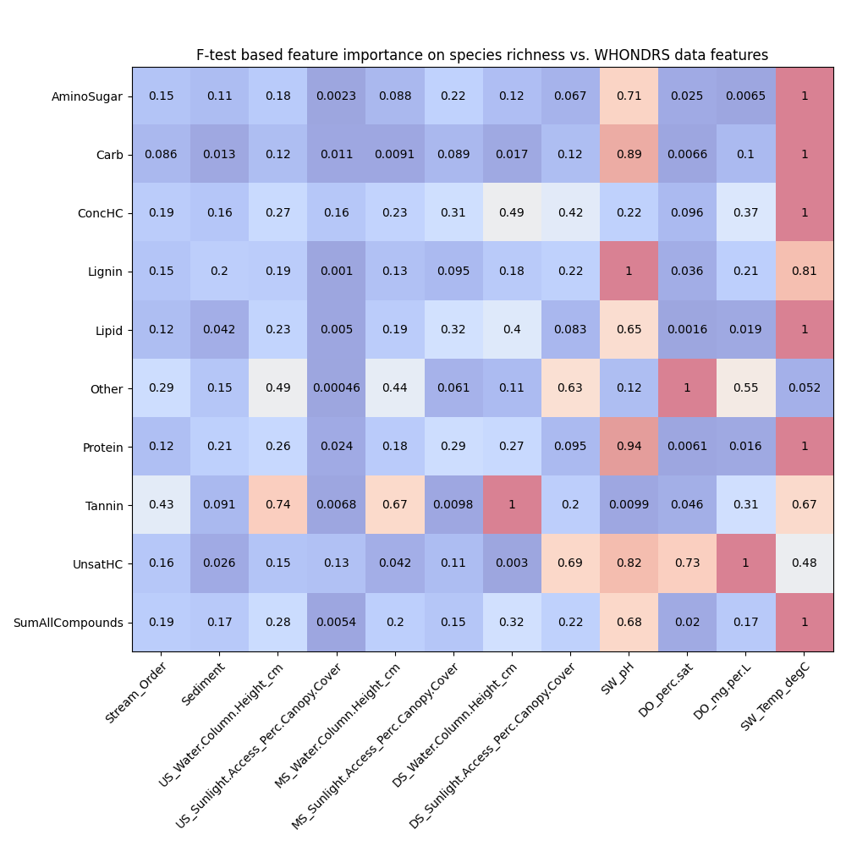
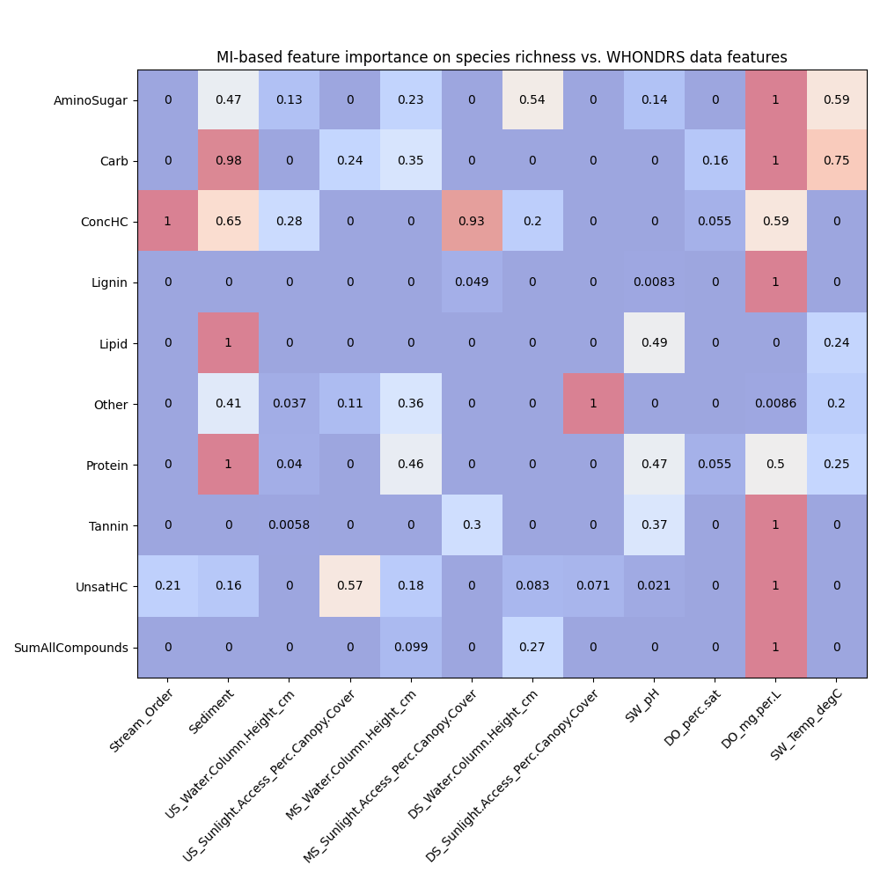
Feature importances using F-test and MI (WHONDRS)

Slide 8
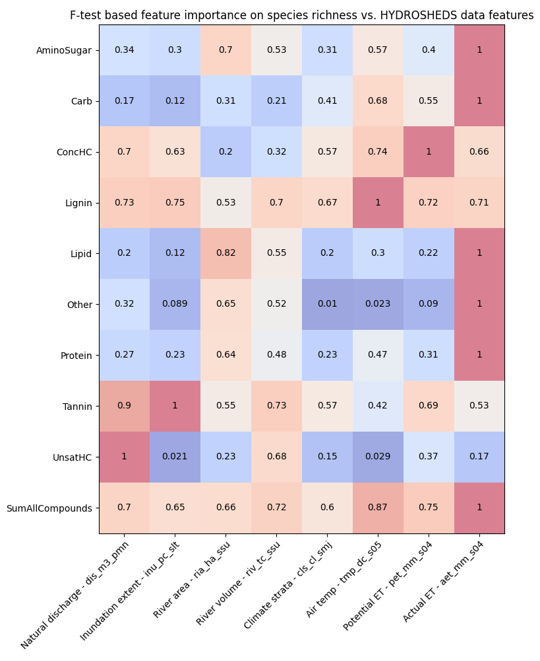
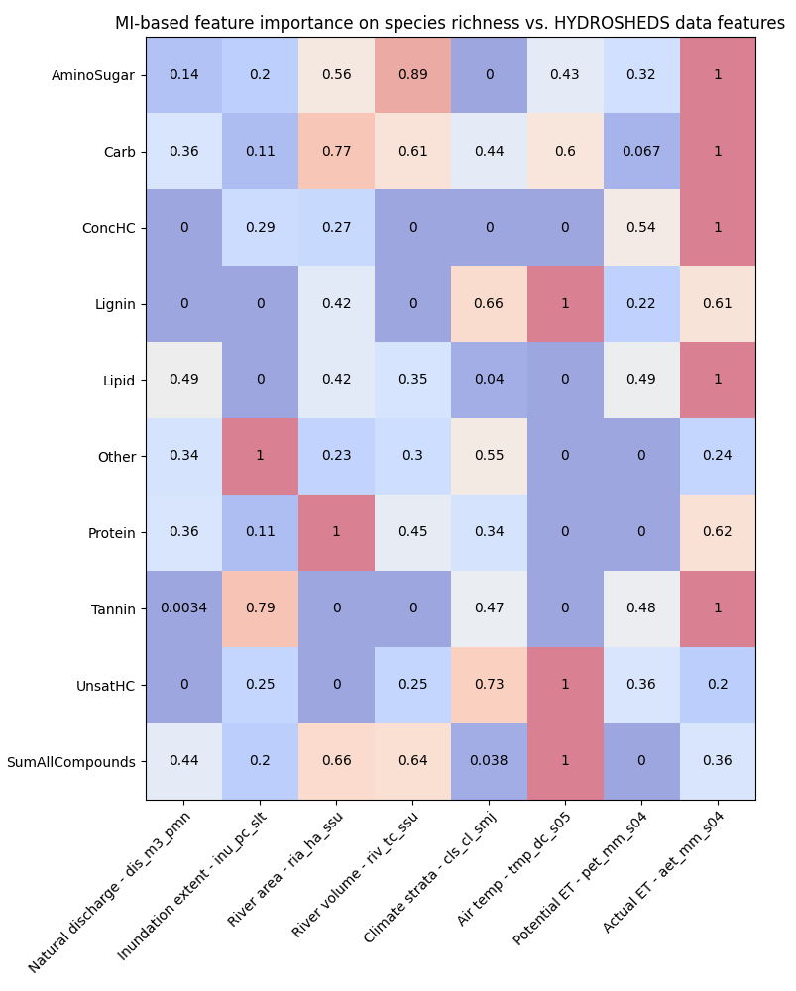
Feature importances using F-test and MI (HydroSheds)

Slide 9
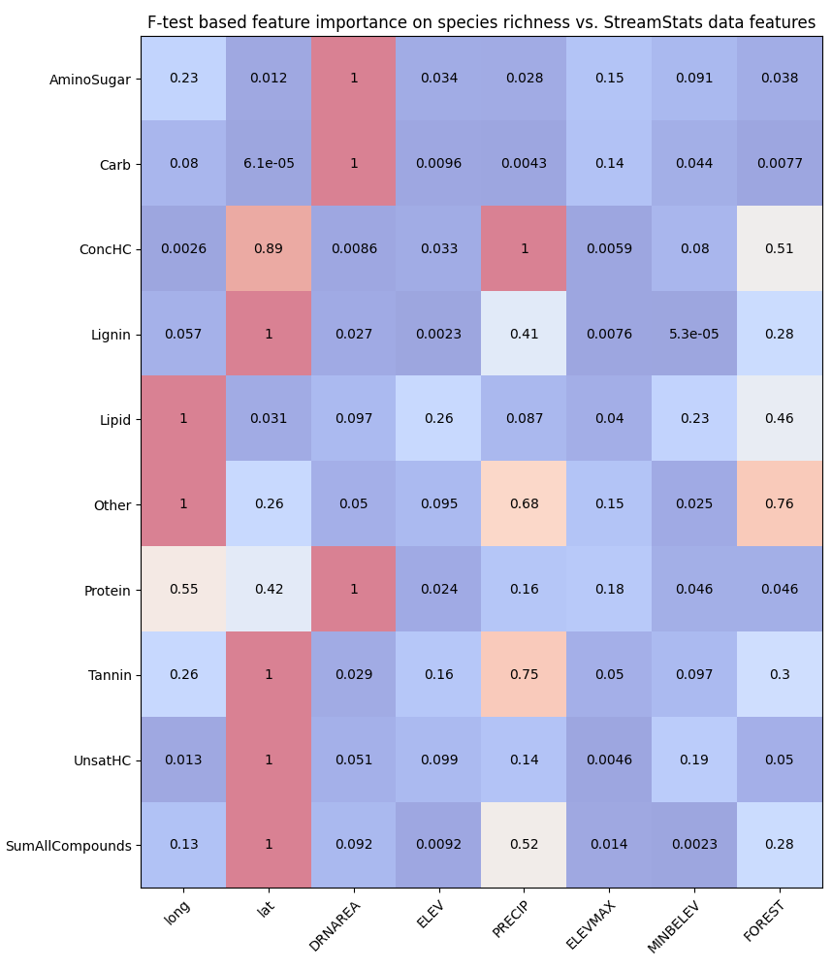
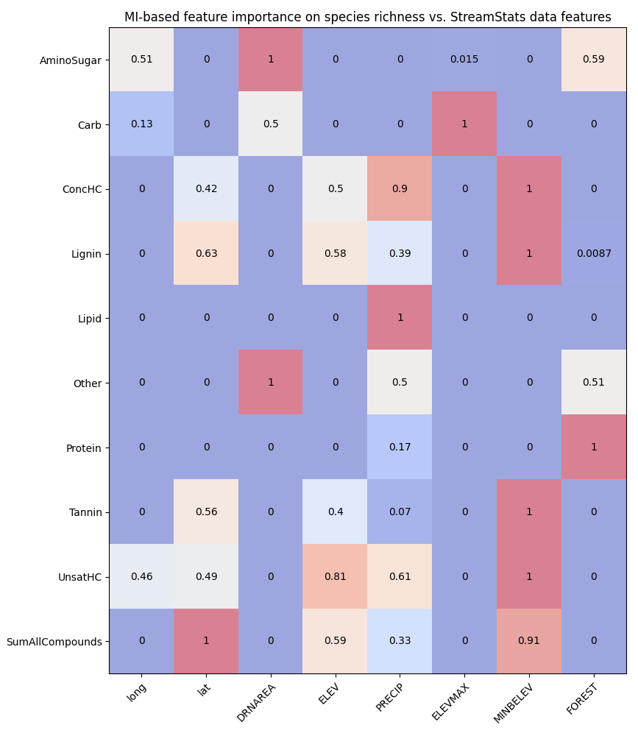
Feature importances using F-test and MI (StreamStats)

Slide 10
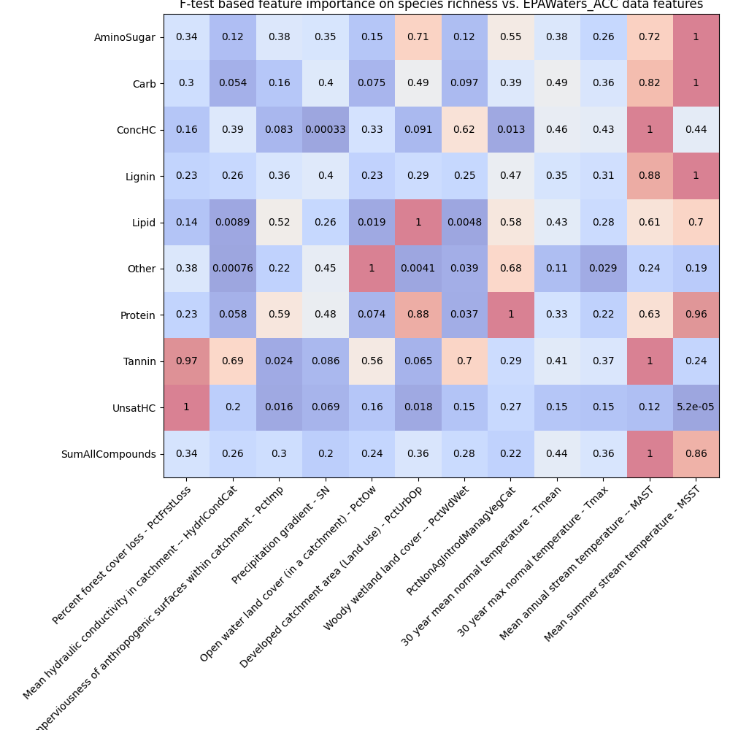
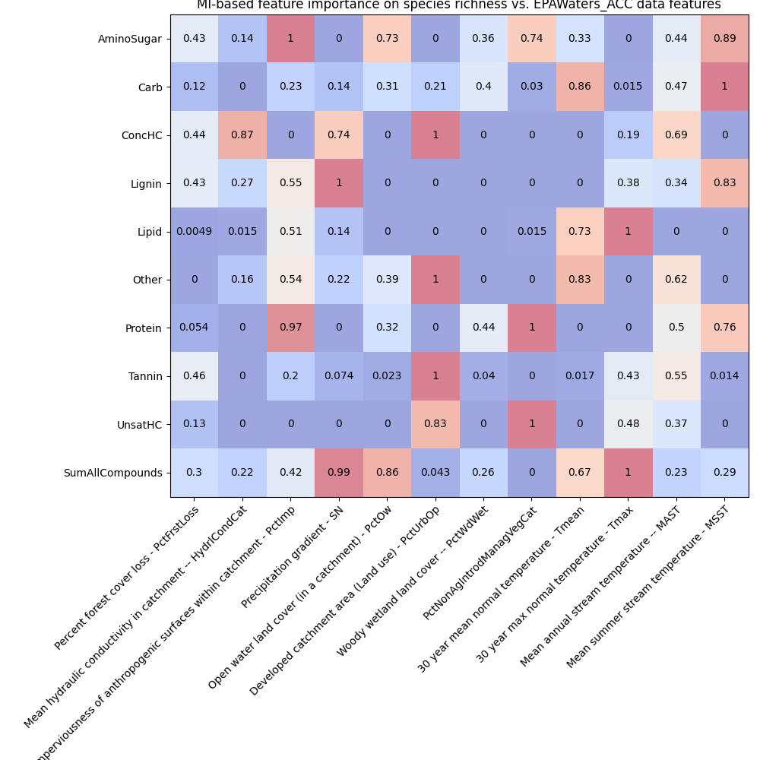
Feature importances using F-test and MI (EPAWaters-Catchment)

Slide 11
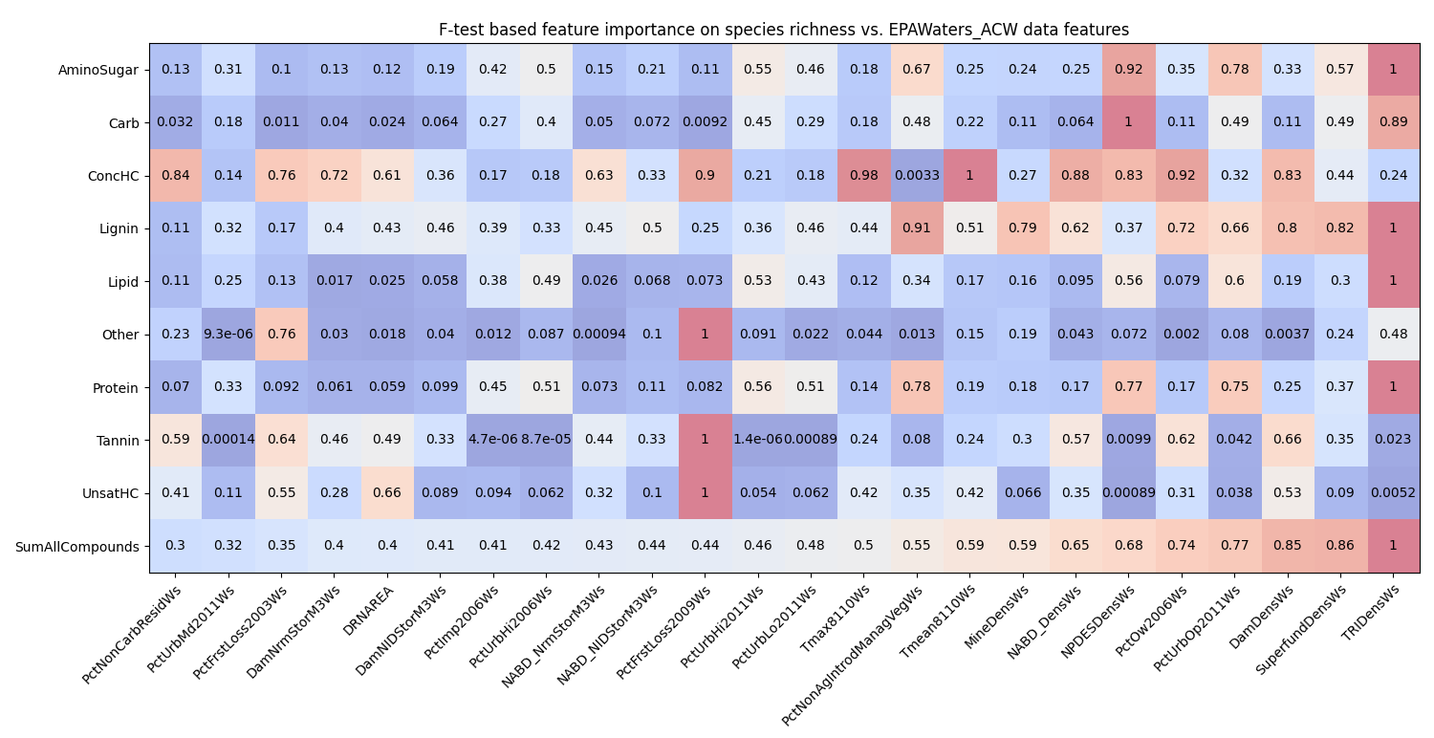
Feature importances using F-test (EPAWaters-Watershed)

Slide 12
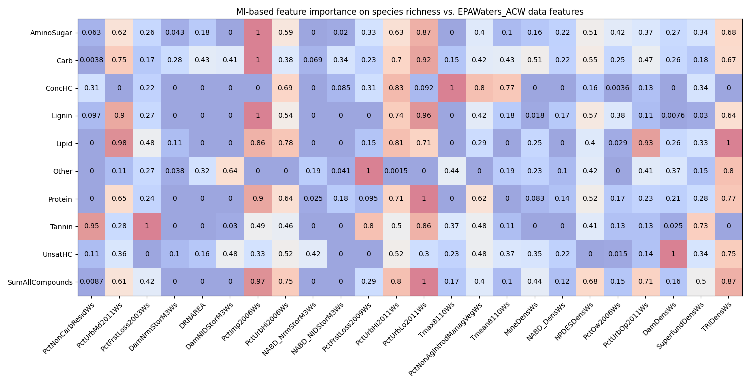
Feature importances using MI (EPAWaters-Watershed)

