Slide 1
Discussion items – Sep-13th
Feature importance across
WHONDRS
HYDROSHEDS
STREAMSTATS
EPA-Waters-Catchment
EPA-Waters-Watershed
Assumptions
Next steps

Slide 2
Feature importance among WHONDRS variables
Metric/Descriptor of intrinsic variables
Species richness
This is estimated from the sample site data
Metrics/Descriptors of extrinsic variables
WHONDRS metadata for these sites
Surface water temperature
Dissolved oxygen
pH
Stream order
Feature importances → X: (all_samples, n_features); Y: (all_samples,)
Pearson correlation
Spearsman correlation
F-test
Mutual information (MI)
Random Forest (RF) with n_trees = 100
SHAPley values (based on RF model)

Slide 3
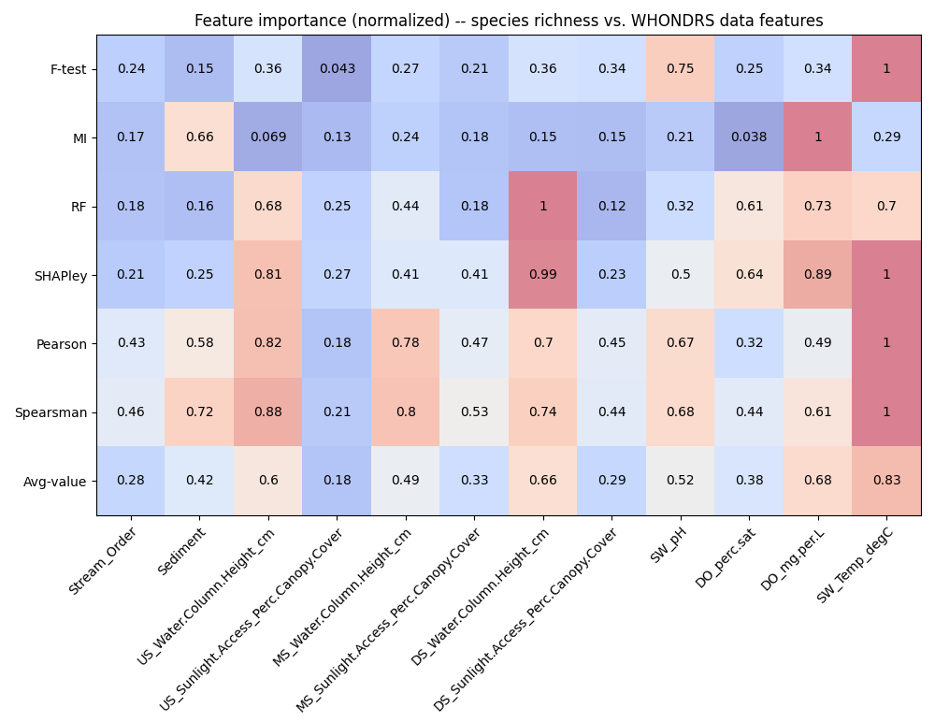
Feature importances among WHONDRS variables
Behavior threshold for feature importance = 0.5
Min requirement = One feature shows a value > 0.5 among the feature importance methods
SW_Temp_degC -- Water temperature at 50% depth at downstream sampling location
DO_mg.per.L -- Dissolved oxygen at 50% depth at downstream sampling location
DO_perc.sat -- Dissolved oxygen at 50% depth at downstream sampling location
SW_pH -- pH value from colorimetric pH strip
DS_Water.Column.Height_cm -- Height of water column at downstream sampling location
MS_Water.Column.Height_cm -- Height of water column at midstream sampling location
US_Water.Column.Height_cm -- Height of water column at upstream sampling location
Sediment -- Dominant sediment type. From provided controlled vocabulary
Notes:
Citations for these statistical tests
Explain each of them and about what we discussed today
PCA analysis across WHONDRS, HydroSheds, StreamStats, and EPAwaters – On the extrinsic variables (grouping of variables – Local variables and non-local (landscape) variables)
Landscape variables – HydroSheds, StreamStats, and EPAWatersheds
What a scaling plot would look like?
Avg the water column height
Convert the binary map
Four variables separately and combination of four variables
Particular local variances (WHONDRS) and non-local variables (watershed characteristics)
Roughly the Van Krevleven diagram?
Local vs non-local variables slide explaining the difference -- Story line described in Creed paper
Feature importance across compounds

Slide 4
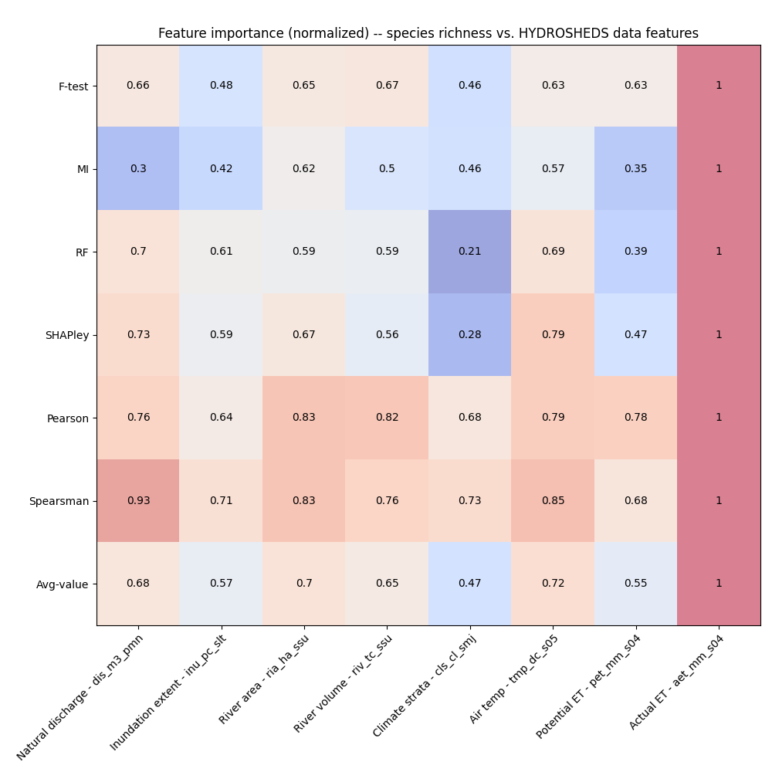
Feature importances among HYDROSHEDS variables
Behavior threshold for feature importance = 0.5
Min requirement = One feature shows a value > 0.5 among the feature importance methods
Actual ET – can be related to pH and DO
Potential ET – can be related to pH and DO
Air temperature – can be related to pH and DO
Climate strata
River volume – can be related to pH and DO
River area – can be related to pH and DO
Inundation extent
Natural discharge
Notes:
Citations for these statistical tests
Explain each of them and about what we discussed today
PCA analysis across WHONDRS, HydroSheds, StreamStats, and EPAwaters – On the extrinsic variables (grouping of variables – Local variables and landscape variables)
Landscape variables – HydroSheds, StreamStats, and EPAWatersheds
What a scaling plot would look like?
Remove the reiver area and river volume
ET is surprise
Aridity – ET and precip (a combination) an important driver for organic chemistry (look at index in drought.gov from Utah)

Slide 5
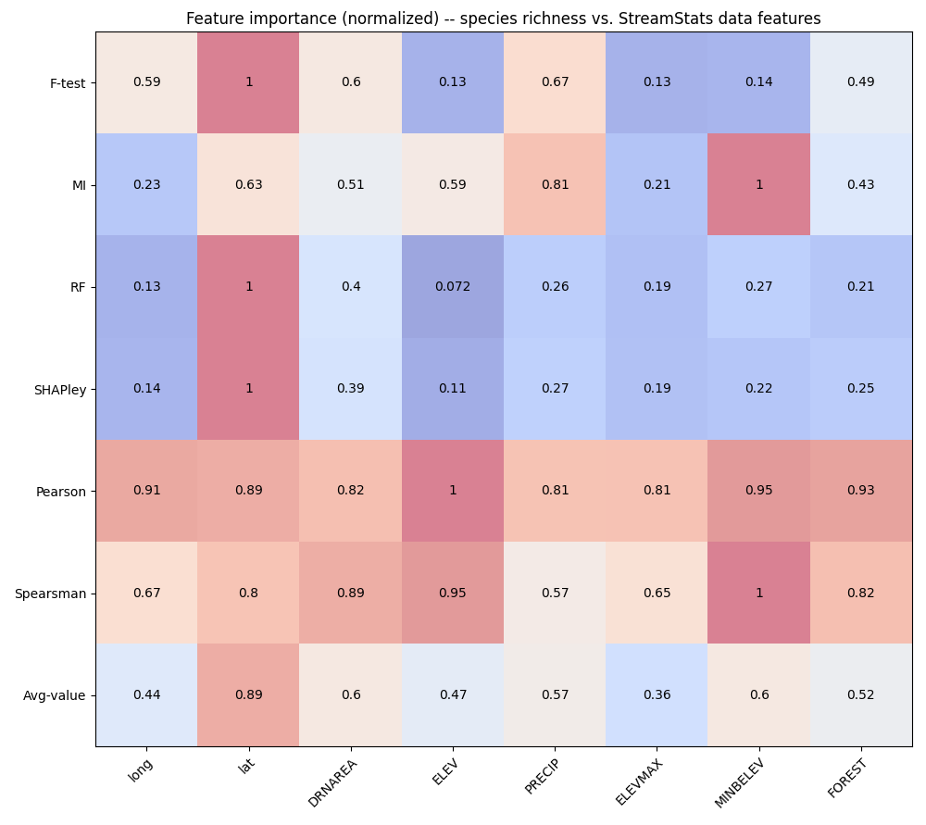
Feature importances among StreamStats variables
Behavior threshold for feature importance = 0.5
Min requirement = One feature shows a value > 0.5 among the feature importance methods
Latitude – Radiation is an important
Longitude
Drainage area
Minbelev (Min basement elevation)
Precipitation
Forest cover
Notes:
Citations for these statistical tests
Explain each of them and about what we discussed today
PCA analysis across WHONDRS, HydroSheds, StreamStats, and EPAwaters – On the extrinsic variables (grouping of variables – Local variables and landscape variables)
Landscape variables – HydroSheds, StreamStats, and EPAWatersheds
What a scaling plot would look like?
Remove elevmax and elevmin

Slide 6
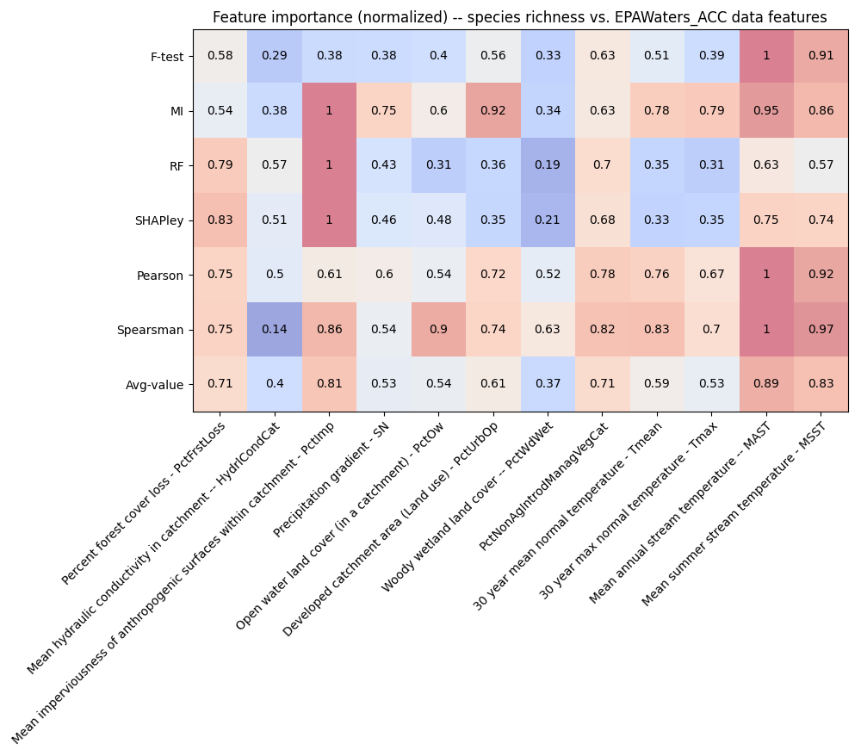
Feature importances among EPAWaters-Catchment variables
Behavior threshold for feature importance = 0.5
Min requirement = One feature shows a value > 0.5 among the feature importance methods
Stream temperature (summer, annual) – Local avg
PctNonAgIntrodManagVegCat
% Nonagriculture nonnative introduced or managed vegetation landcover type reclassed from LANDFIRE Existing Vegetation Type (EVT), within catchment
Land use and land cover – Local avg
Forest cover loss
Precipitation gradient
Notes:
Citations for these statistical tests
Explain each of them and about what we discussed today
PCA analysis across WHONDRS, HydroSheds, StreamStats, and EPAwaters – On the extrinsic variables (grouping of variables – Local variables and landscape variables)
Landscape variables – HydroSheds, StreamStats, and EPAWatersheds
What a scaling plot would look like?
EPA-Waters-Catchment -- The local land cover characteristics

Slide 7
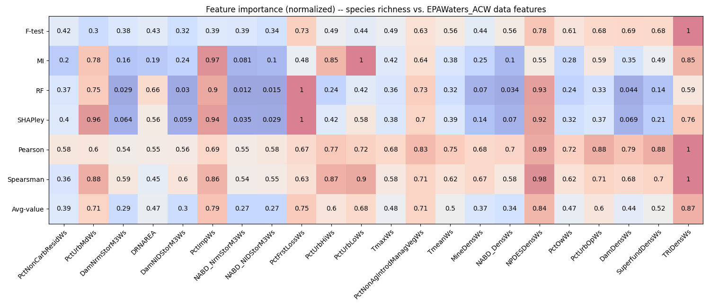
Feature importances among EPAWaters-Watershed variables
Behavior threshold for feature importance = 0.5
Min requirement = One feature shows a value > 0.5 among the feature importance methods
TriDensWs
Density of TRI (Toxic Release Inventory) sites within watershed (sites/square km)
NPDESDensCat
Density of permitted NPDES (National Pollutant Discharge Elimination System) sites within catchment (sites/square km)
PctNonAgIntrodManagVegWs
% Nonagriculture nonnative introduced or managed vegetation landcover type reclassed from LANDFIRE Existing Vegetation Type (EVT), within watershed
PcTUrbLo, PctUrbMd, and PctUrbHi
% of watershed area classified as developed, low/med/high-intensity land use
Percent of Forest loss
Mean imperviousness of anthropogenic surfaces within watershed
Drainage area
Notes:
Citations for these statistical tests
Explain each of them and about what we discussed today
PCA analysis across WHONDRS, HydroSheds, StreamStats, and EPAwaters – On the extrinsic variables (grouping of variables – Local variables and landscape variables)
Landscape variables – HydroSheds, StreamStats, and EPAWatersheds
What a scaling plot would look like?
Removing forest increases the alpha-diversity

Slide 8
Assumptions (1/2)
Feature importance is needed before developing scaling relationships as the number of features are large
Sample size is small
F-test
Univariate feature selection works by selecting the best features based on univariate statistical tests.
Univariate linear regression tests returning F-statistic and p-values
Mutual information
Measures the dependency between the variables. It is equal to zero if and only if two random variables are independent, and higher values mean higher dependency.

Slide 9
Assumptions (2/2)
Pearson correlation coefficient
Measures the linear relationship between two datasets
Spearsman correlation coefficient
Nonparametric measure of the monotonicity of the relationship between two datasets
SHAPley
A method based on cooperative game theory and used to increase transparency and interpretability of ML models

Slide 10
Next steps
Scaling laws for local and non-local variables
Individual features
Combination of features
PCA analysis on all the important extrinsic descriptors
Effective visualization of the feature importance across all extrinsic descriptors

