Slide 1
Discussion items – Jan-24th
PCA analysis (done)
Variation across data features
Variation across data samples
Scaling laws with p-values for (working on it)
Inundation Extent (from hydrosheds) -- done
Min Basin Elevation (from streamstats) -- done
Mean Imperviousness (from epa waters-catchment)
Open water land cover (from epa waters-catchment)
Developed Catchment Area (LU) (from epa waters-catchment)
PctImpWs (from epa waters-watersheds)
PctFrstLossWs (from epa waters-watersheds)
PctNonAgIntrodManagVegWs (from epa waters-watersheds)
TmeanWs (from epa waters-watersheds)
NPDESDensWs (from epa waters-watersheds)
SuperfundDensWs (from epa waters-watersheds)
S = cA^{z}
Z-value of bar plot
C-value of bar plot
What can we put in supplementary figures?
Notes:
Significance of explanatory variables → Effect of random seed on the loading matrix importance.

Slide 2
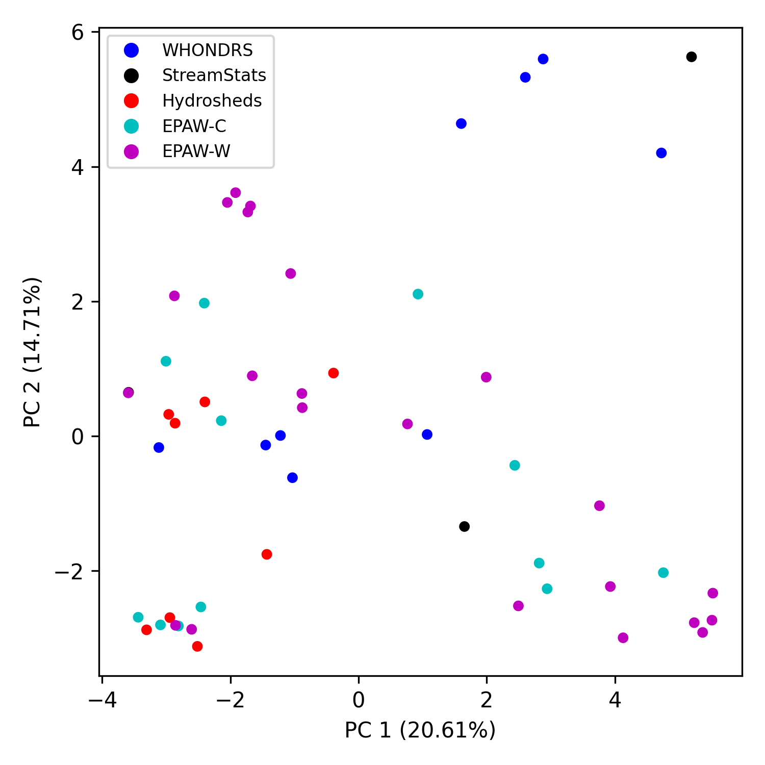
PCA analysis (variation across data features)

Slide 3
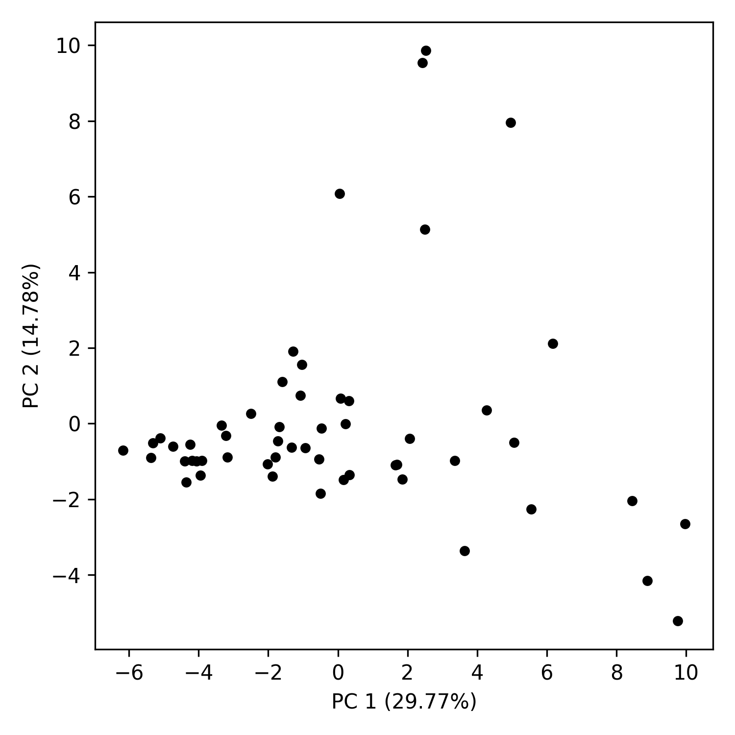
PCA analysis (variation across data samples)

Slide 4
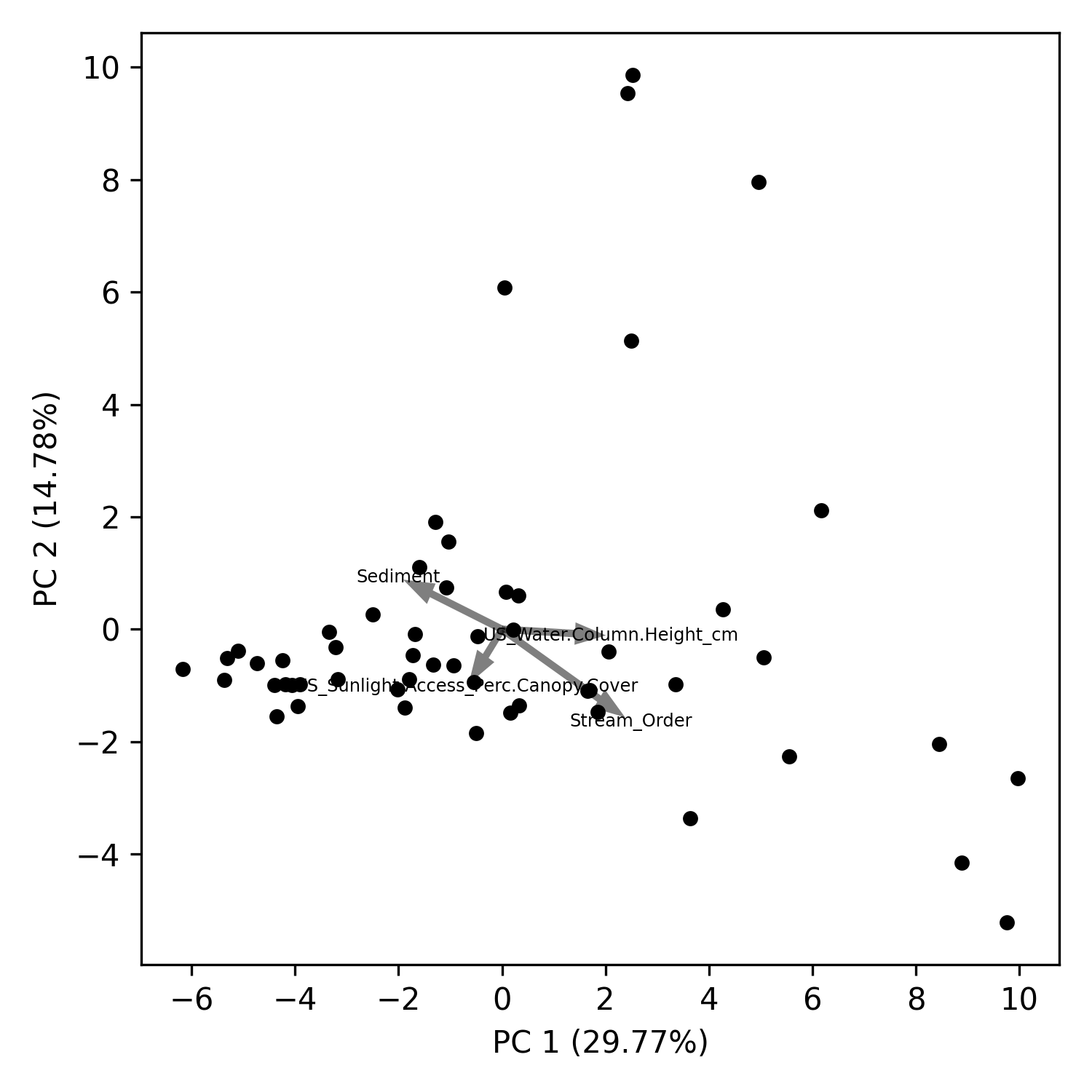
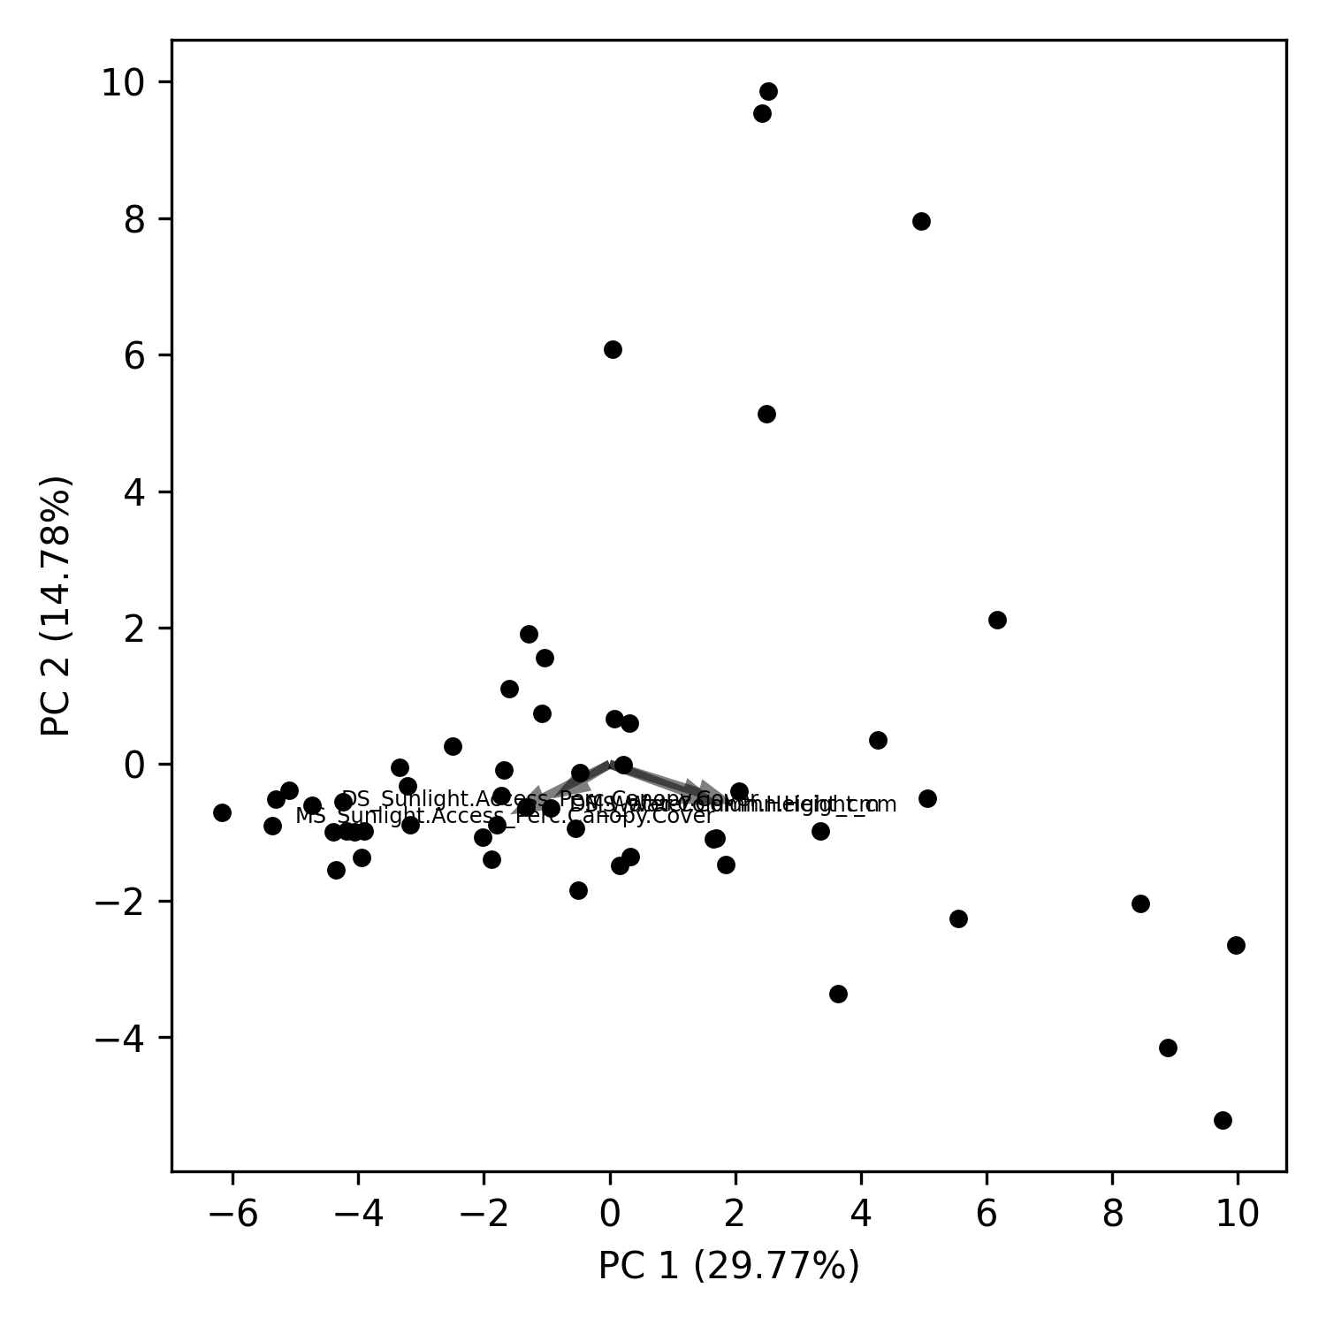
PCA analysis (biplots) -- WHONDRS
Notes:
https://towardsdatascience.com/what-are-pca-loadings-and-biplots-9a7897f2e559
https://www.frontiersin.org/files/Articles/1003159/frwa-04-1003159-HTML/image_m/frwa-04-1003159-g005.jpg
https://www.jcchouinard.com/pca-with-python/
https://stackoverflow.com/questions/39216897/plot-pca-loadings-and-loading-in-biplot-in-sklearn-like-rs-autoplot
Significance of explanatory variables → Effect of random seed on the loading matrix importance.

Slide 5
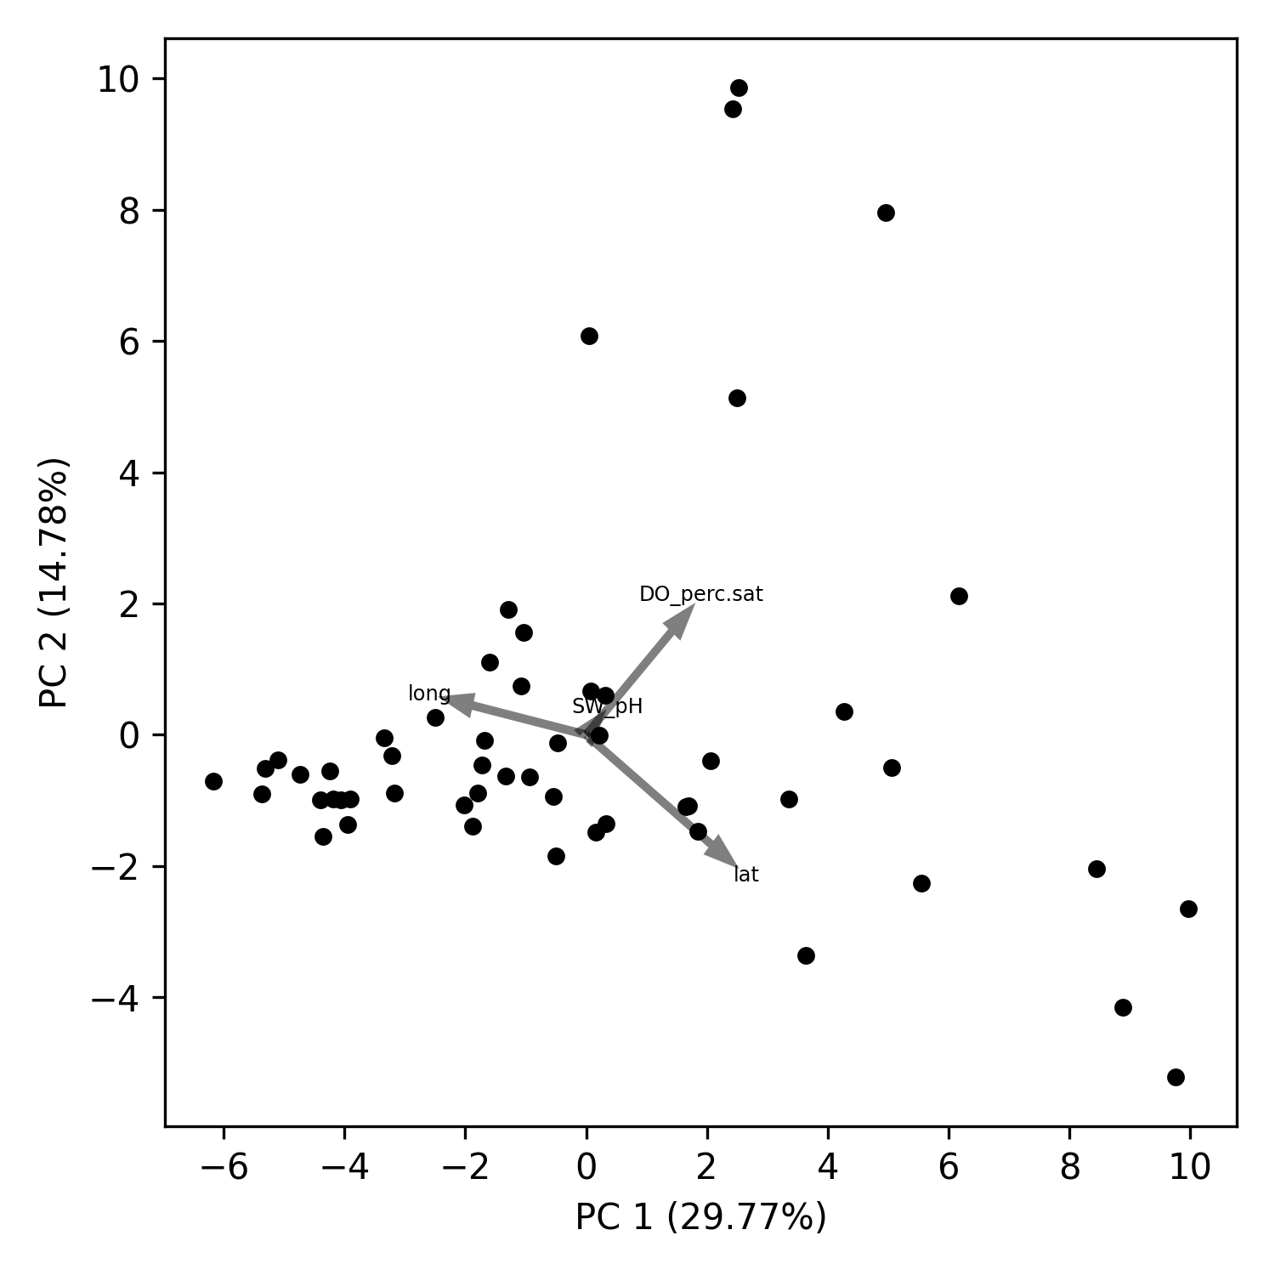
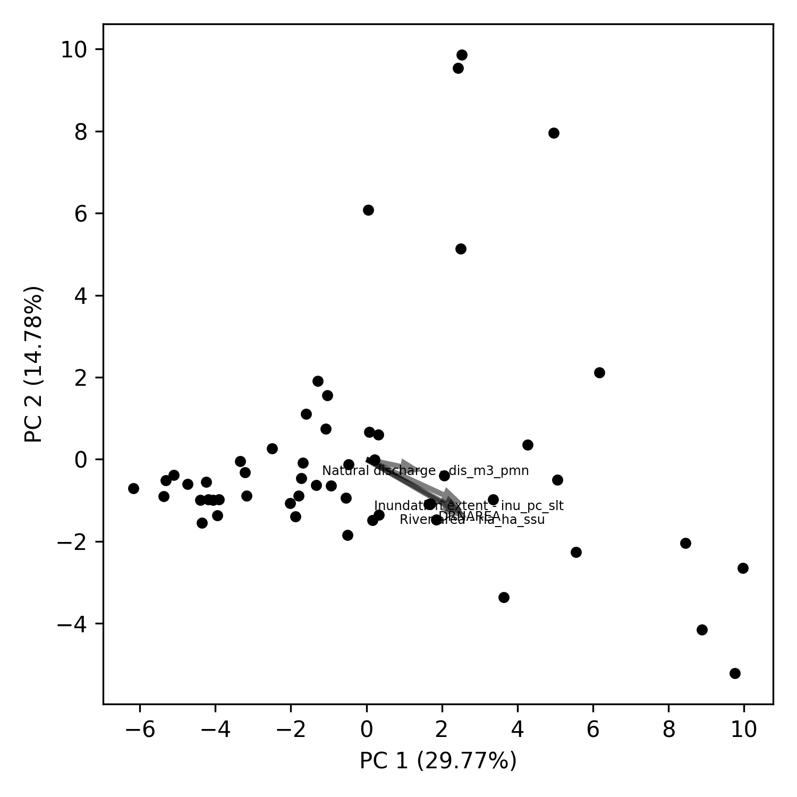
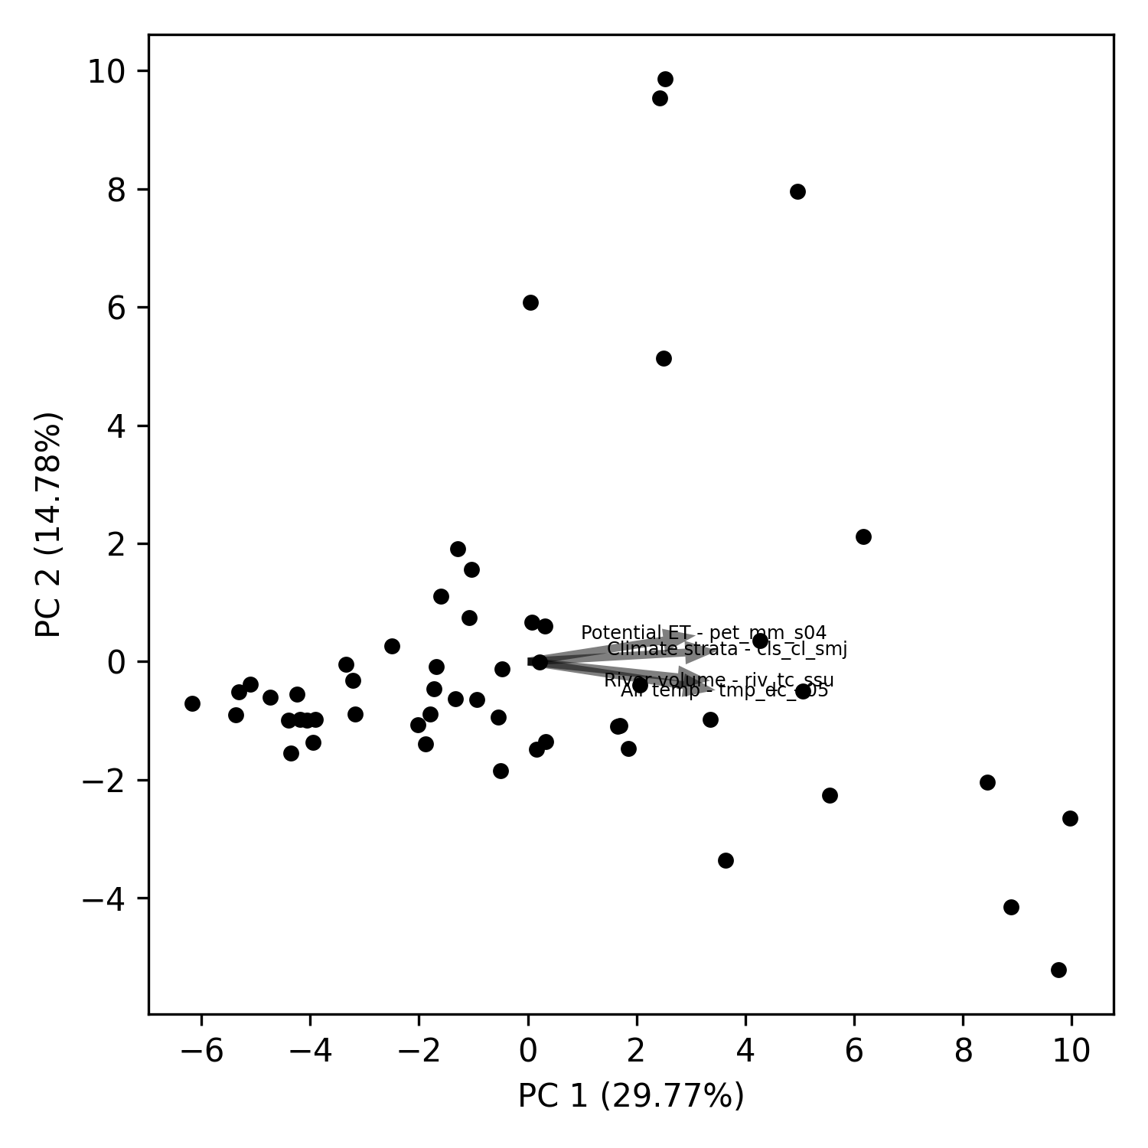
PCA analysis (biplots) – WHONDRS/StreamStats/Hydrosheds
Notes:
https://towardsdatascience.com/what-are-pca-loadings-and-biplots-9a7897f2e559
https://www.frontiersin.org/files/Articles/1003159/frwa-04-1003159-HTML/image_m/frwa-04-1003159-g005.jpg
https://www.jcchouinard.com/pca-with-python/
https://stackoverflow.com/questions/39216897/plot-pca-loadings-and-loading-in-biplot-in-sklearn-like-rs-autoplot

Slide 6
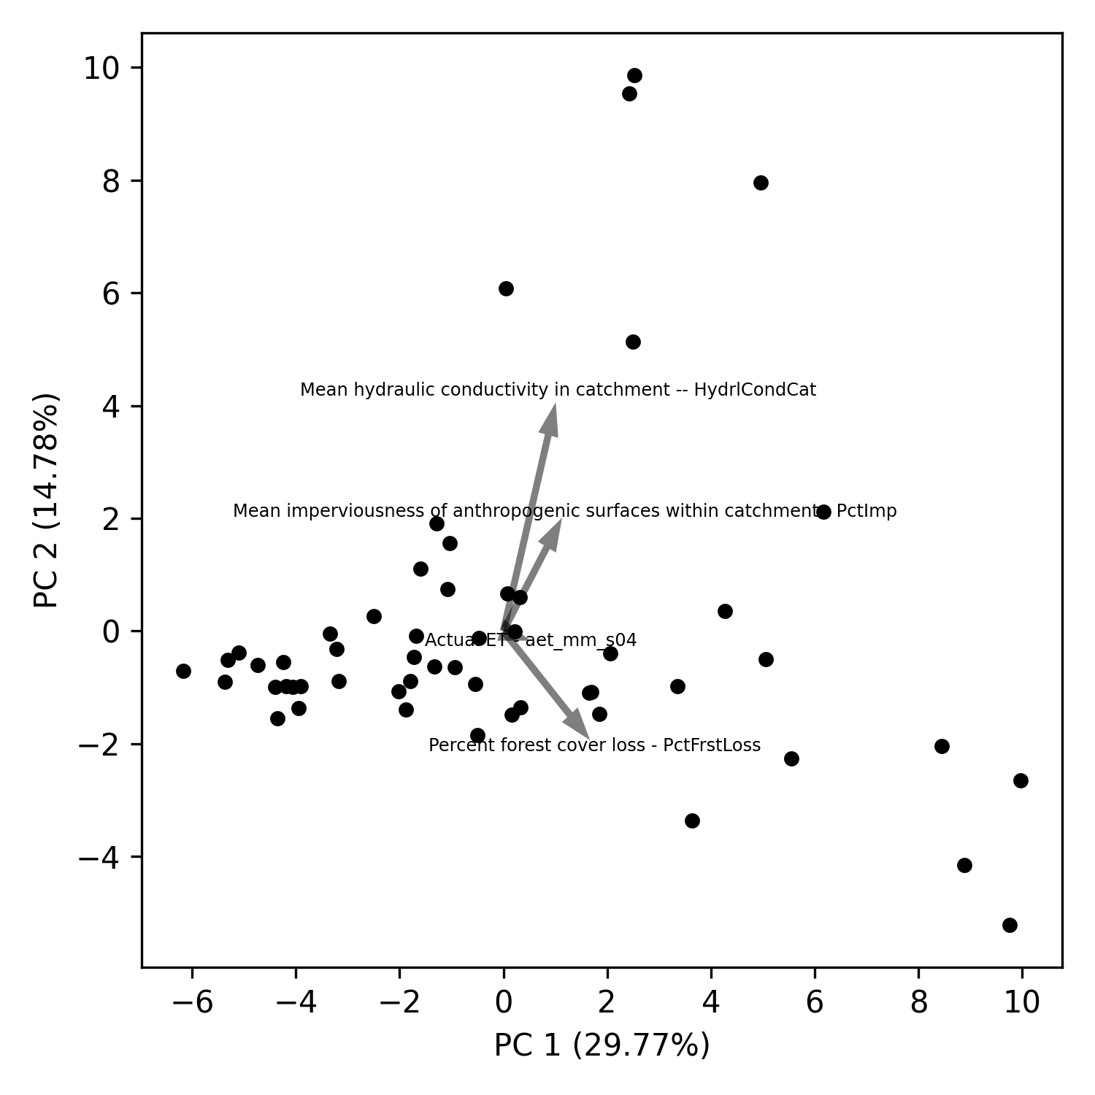
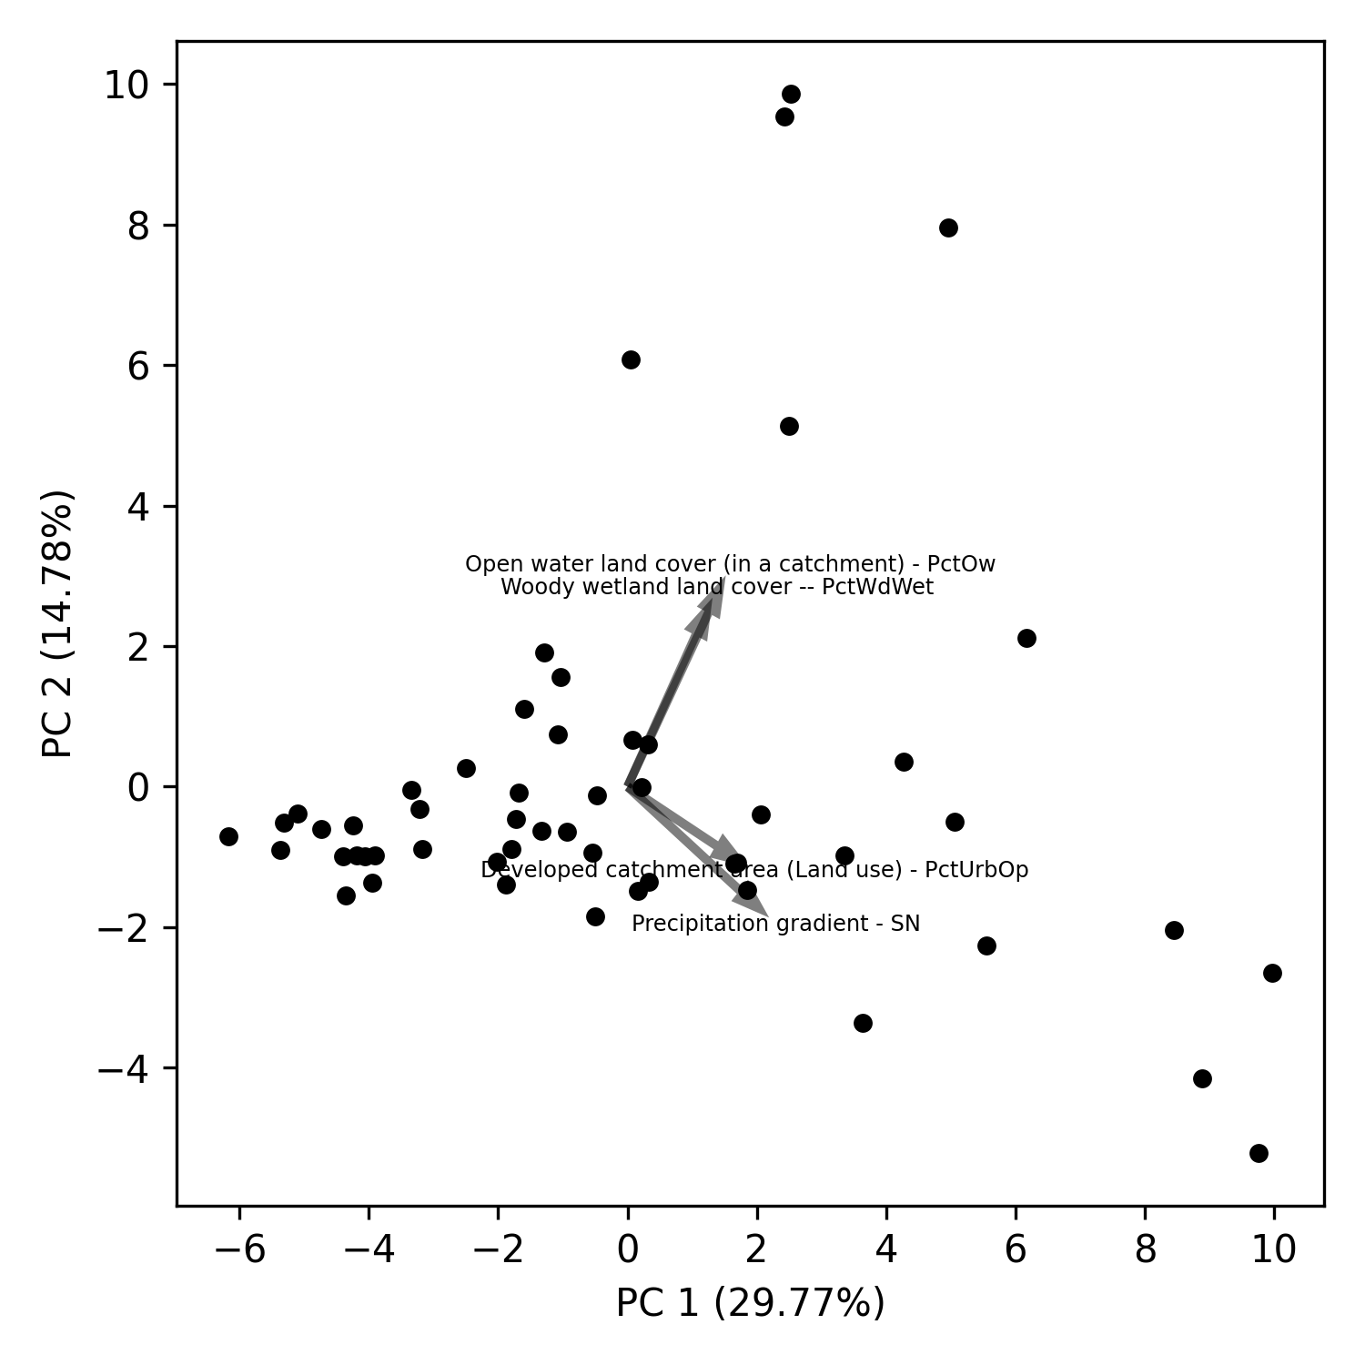
PCA analysis (biplots) – EPA-waters
Notes:
https://towardsdatascience.com/what-are-pca-loadings-and-biplots-9a7897f2e559
https://www.frontiersin.org/files/Articles/1003159/frwa-04-1003159-HTML/image_m/frwa-04-1003159-g005.jpg
https://www.jcchouinard.com/pca-with-python/
https://stackoverflow.com/questions/39216897/plot-pca-loadings-and-loading-in-biplot-in-sklearn-like-rs-autoplot

Slide 7
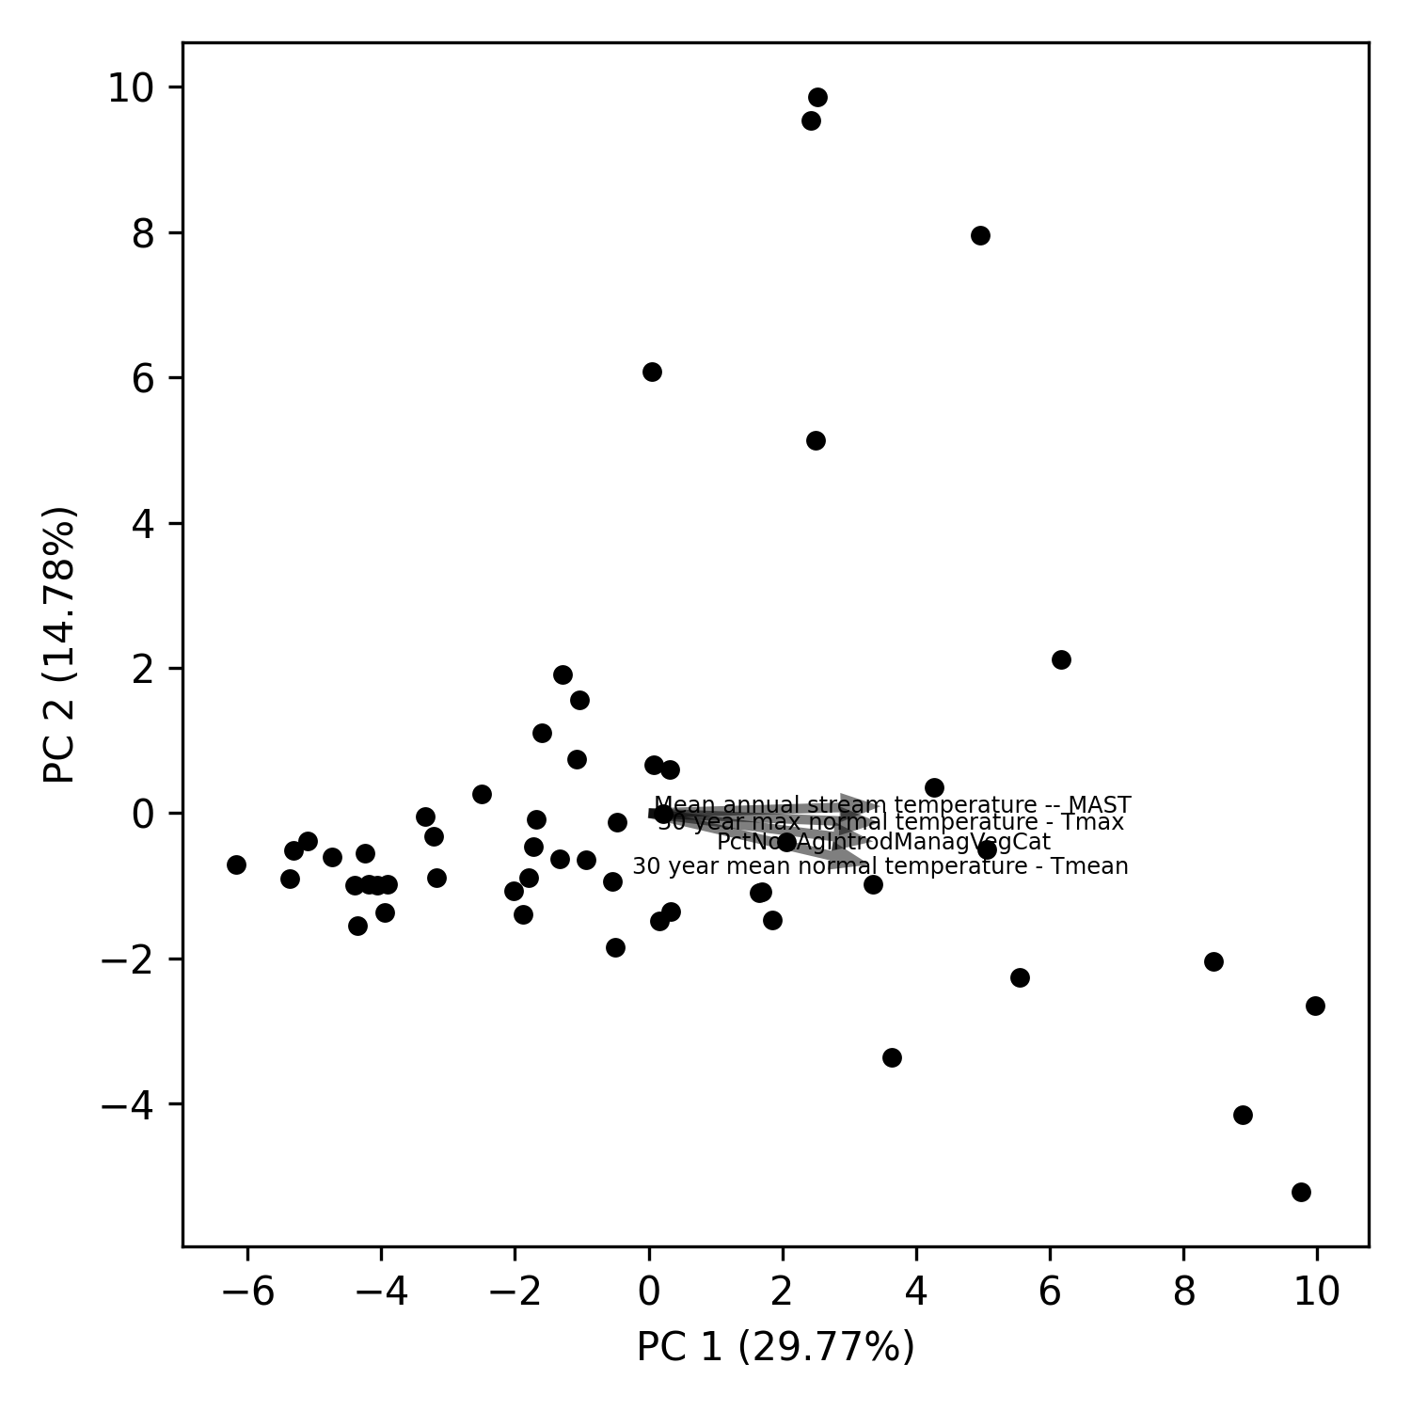
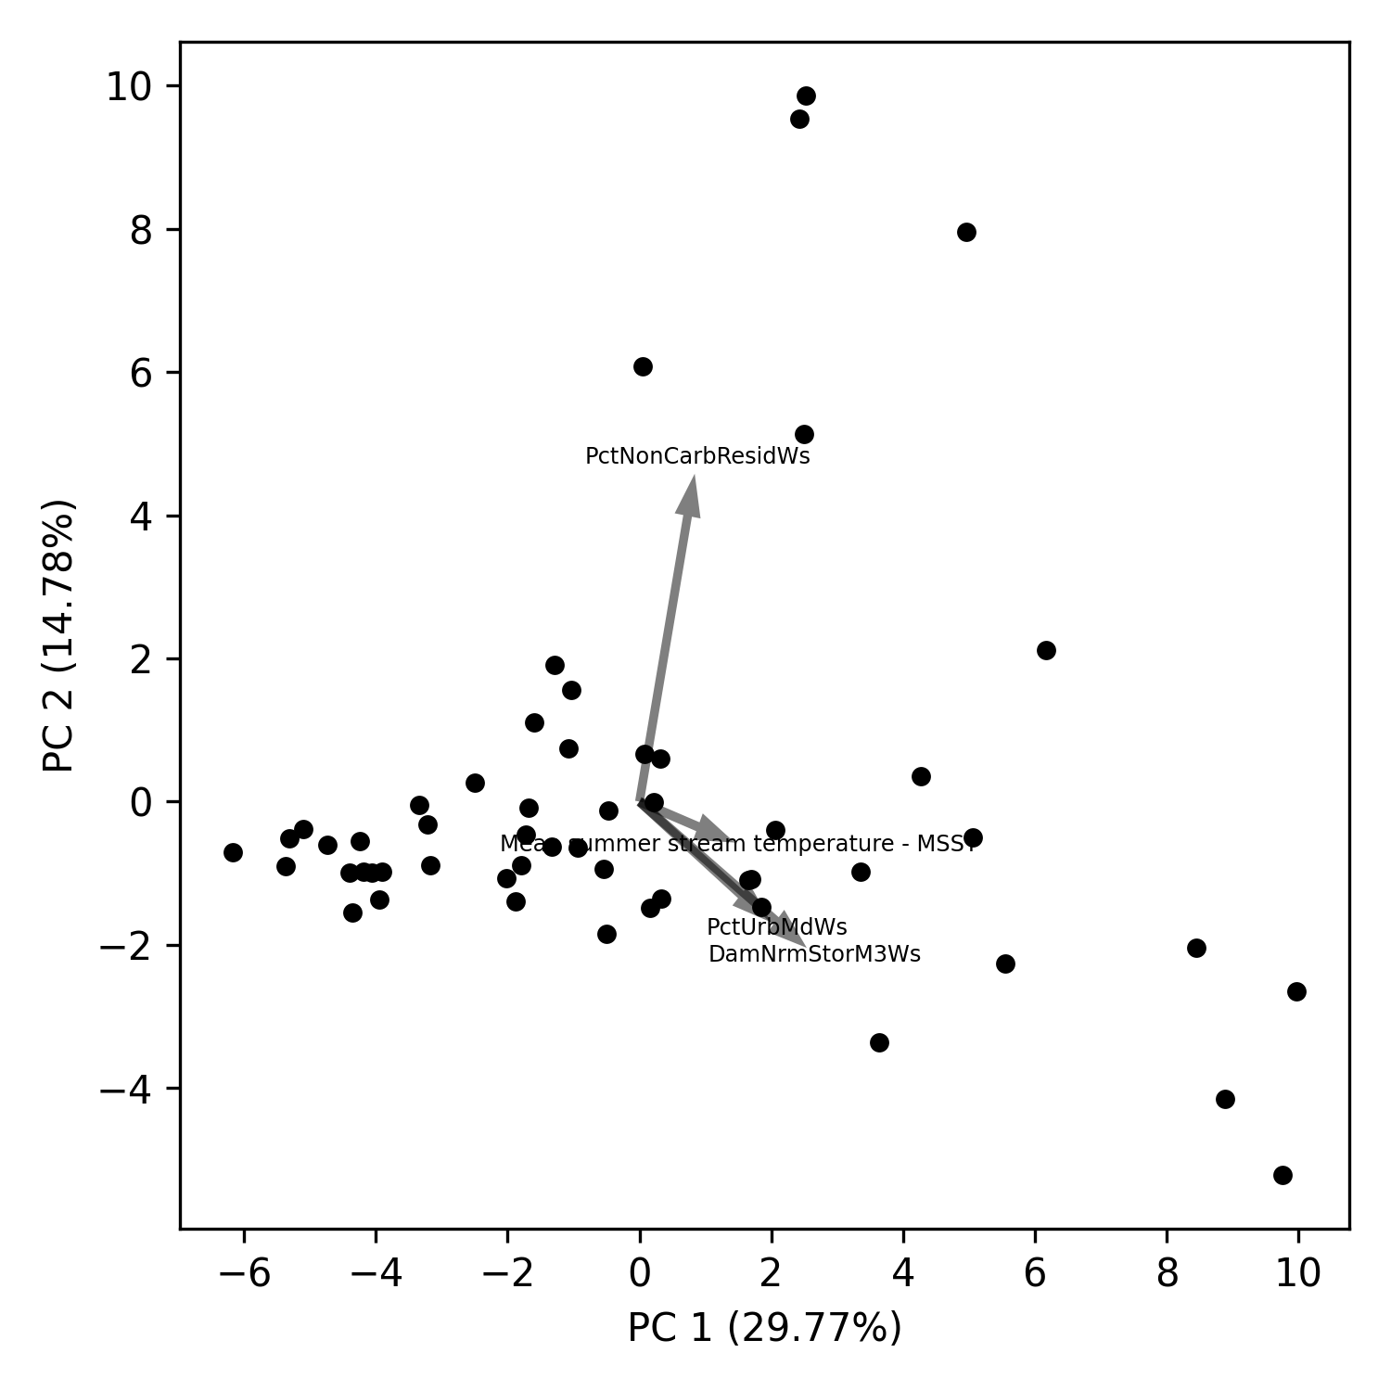
PCA analysis (biplots) – EPA-waters
Notes:
https://towardsdatascience.com/what-are-pca-loadings-and-biplots-9a7897f2e559
https://www.frontiersin.org/files/Articles/1003159/frwa-04-1003159-HTML/image_m/frwa-04-1003159-g005.jpg
https://www.jcchouinard.com/pca-with-python/
https://stackoverflow.com/questions/39216897/plot-pca-loadings-and-loading-in-biplot-in-sklearn-like-rs-autoplot

Slide 8
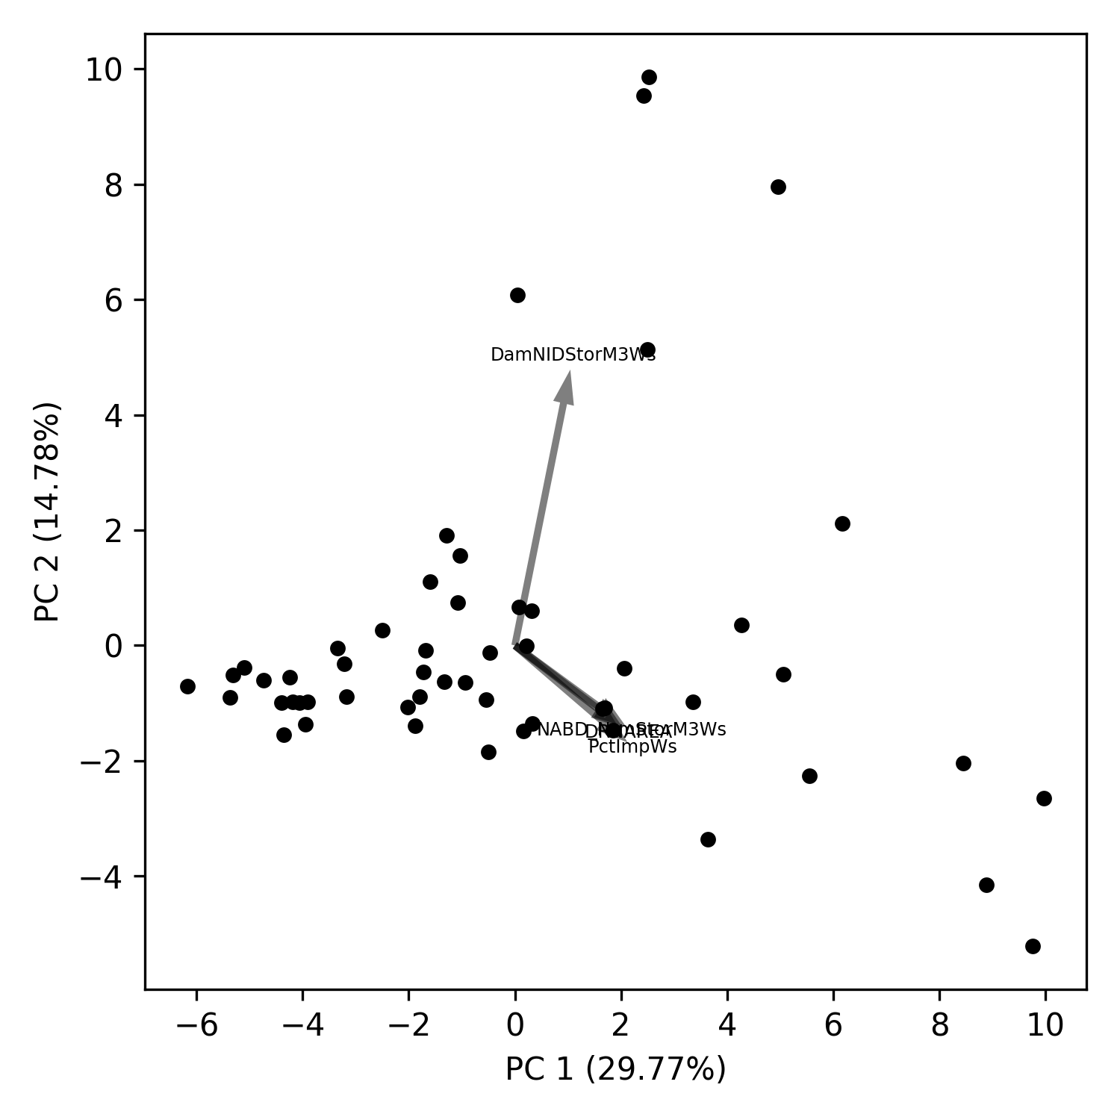
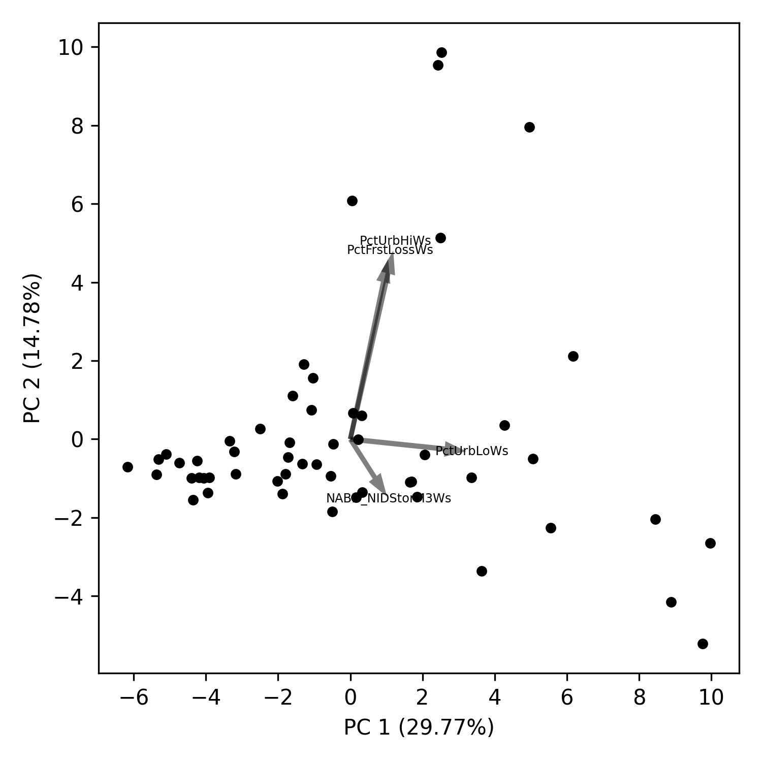
PCA analysis (biplots) – EPA-waters
Notes:
https://towardsdatascience.com/what-are-pca-loadings-and-biplots-9a7897f2e559
https://www.frontiersin.org/files/Articles/1003159/frwa-04-1003159-HTML/image_m/frwa-04-1003159-g005.jpg
https://www.jcchouinard.com/pca-with-python/
https://stackoverflow.com/questions/39216897/plot-pca-loadings-and-loading-in-biplot-in-sklearn-like-rs-autoplot

Slide 9
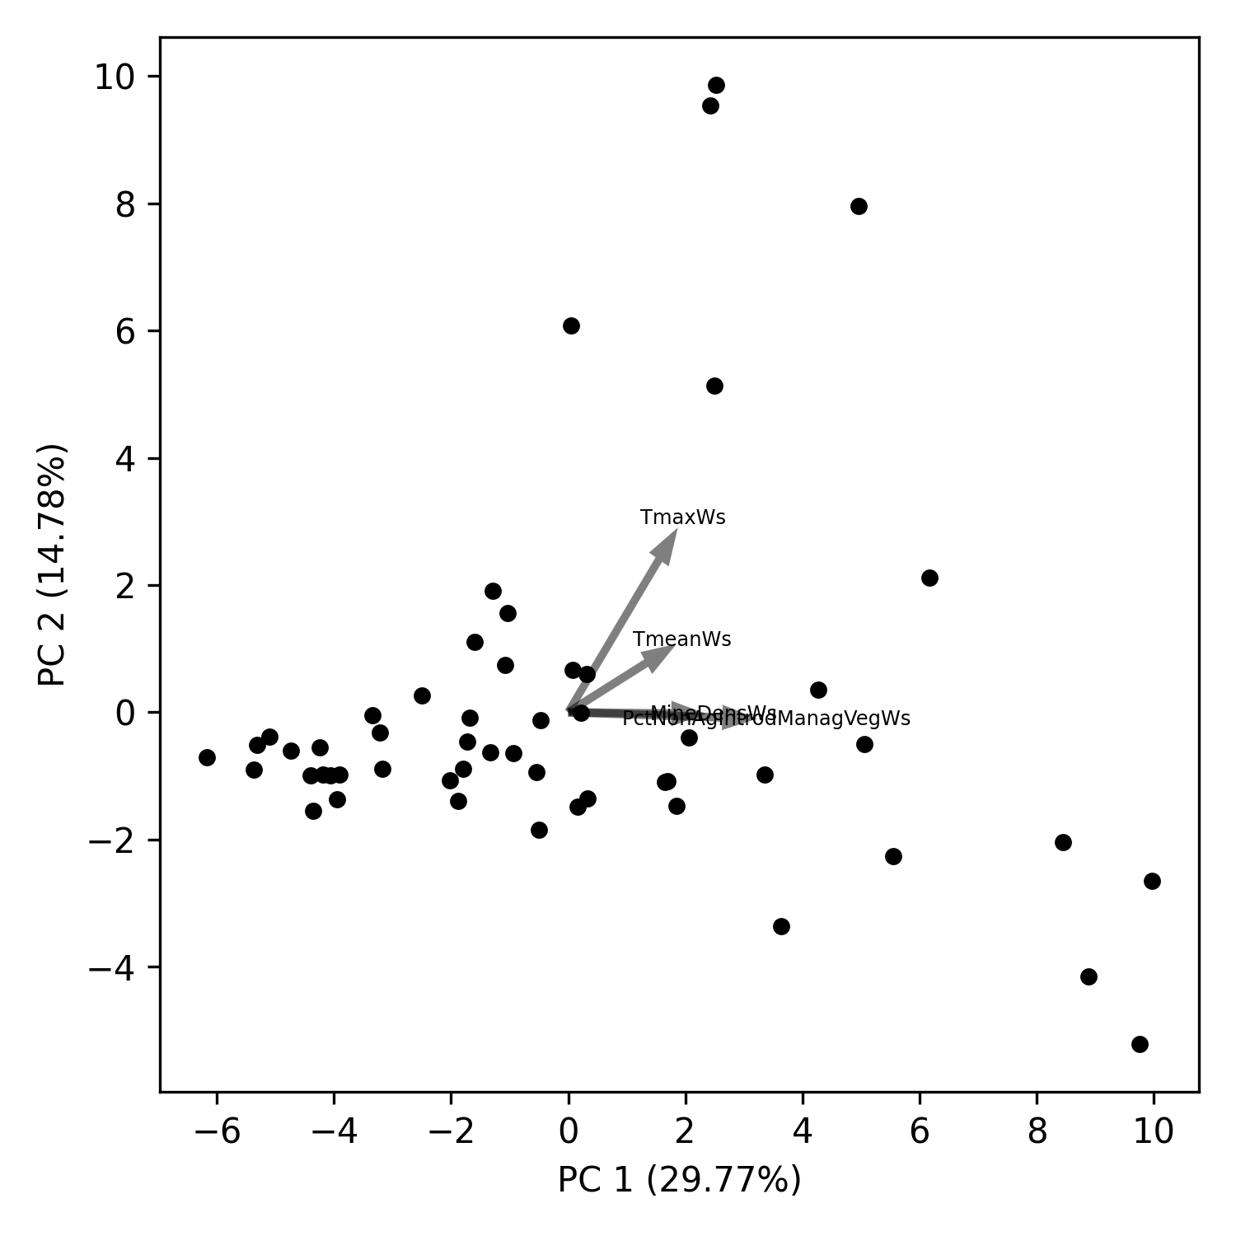
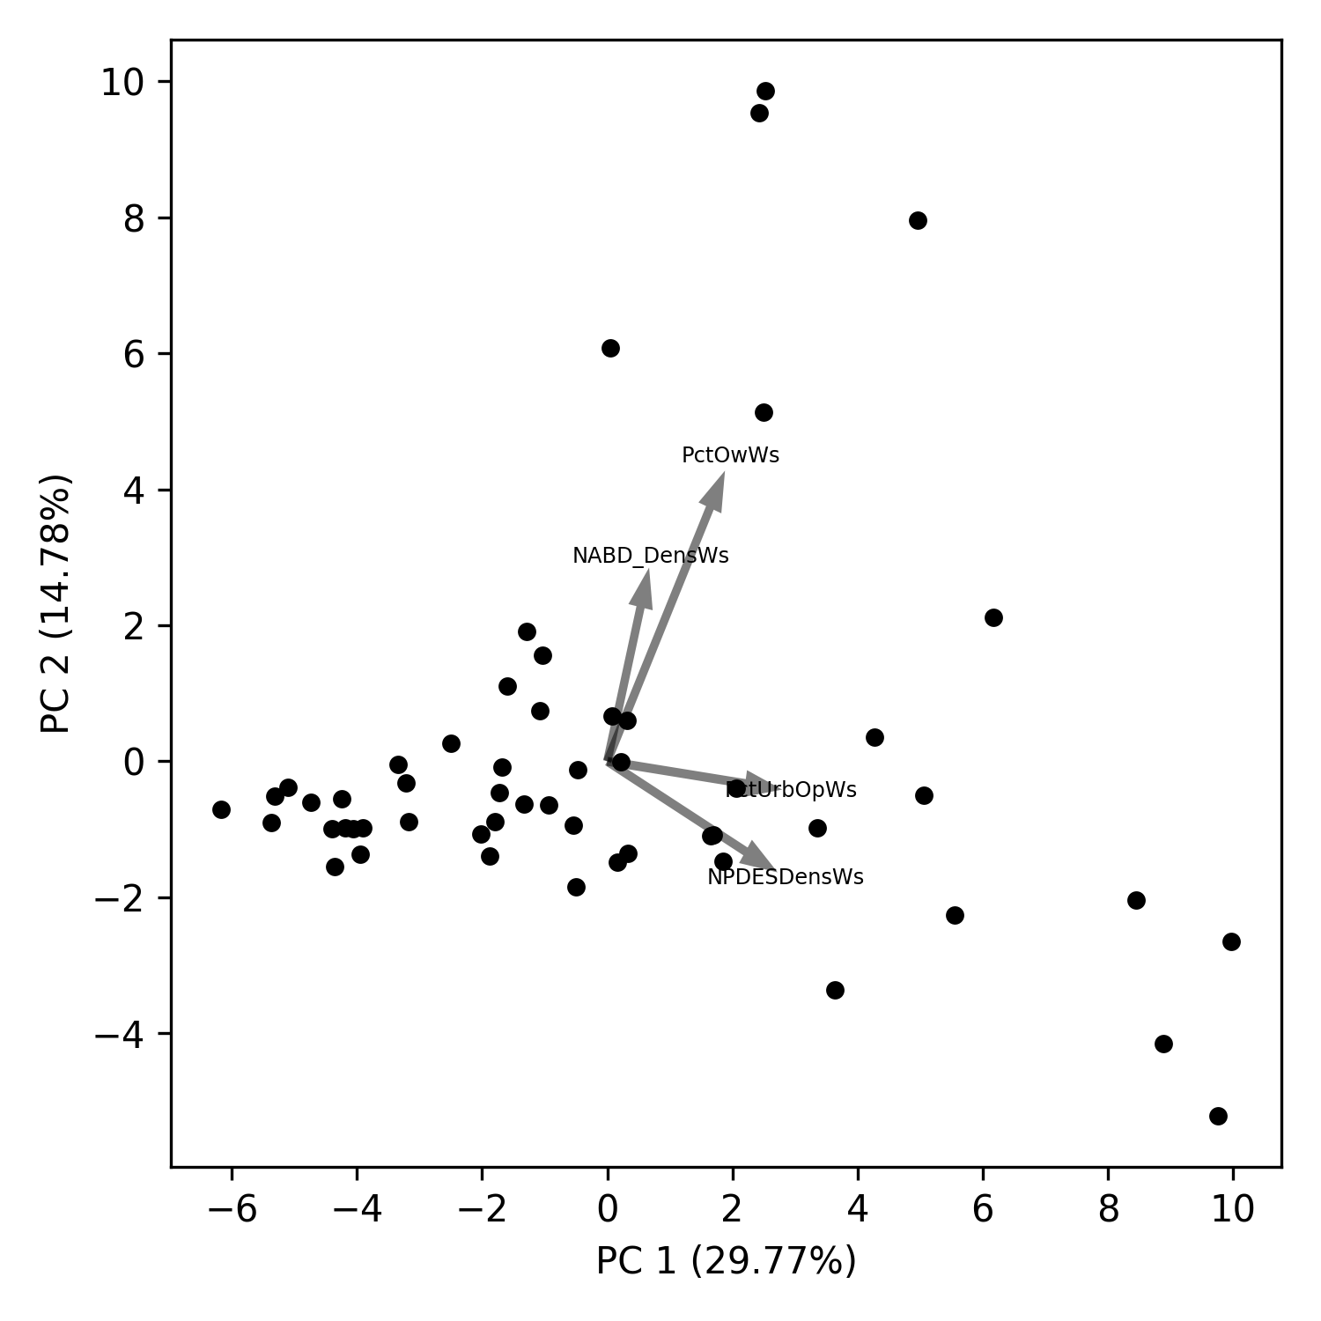
PCA analysis (biplots) – EPA-waters
Notes:
https://towardsdatascience.com/what-are-pca-loadings-and-biplots-9a7897f2e559
https://www.frontiersin.org/files/Articles/1003159/frwa-04-1003159-HTML/image_m/frwa-04-1003159-g005.jpg
https://www.jcchouinard.com/pca-with-python/
https://stackoverflow.com/questions/39216897/plot-pca-loadings-and-loading-in-biplot-in-sklearn-like-rs-autoplot

Slide 10
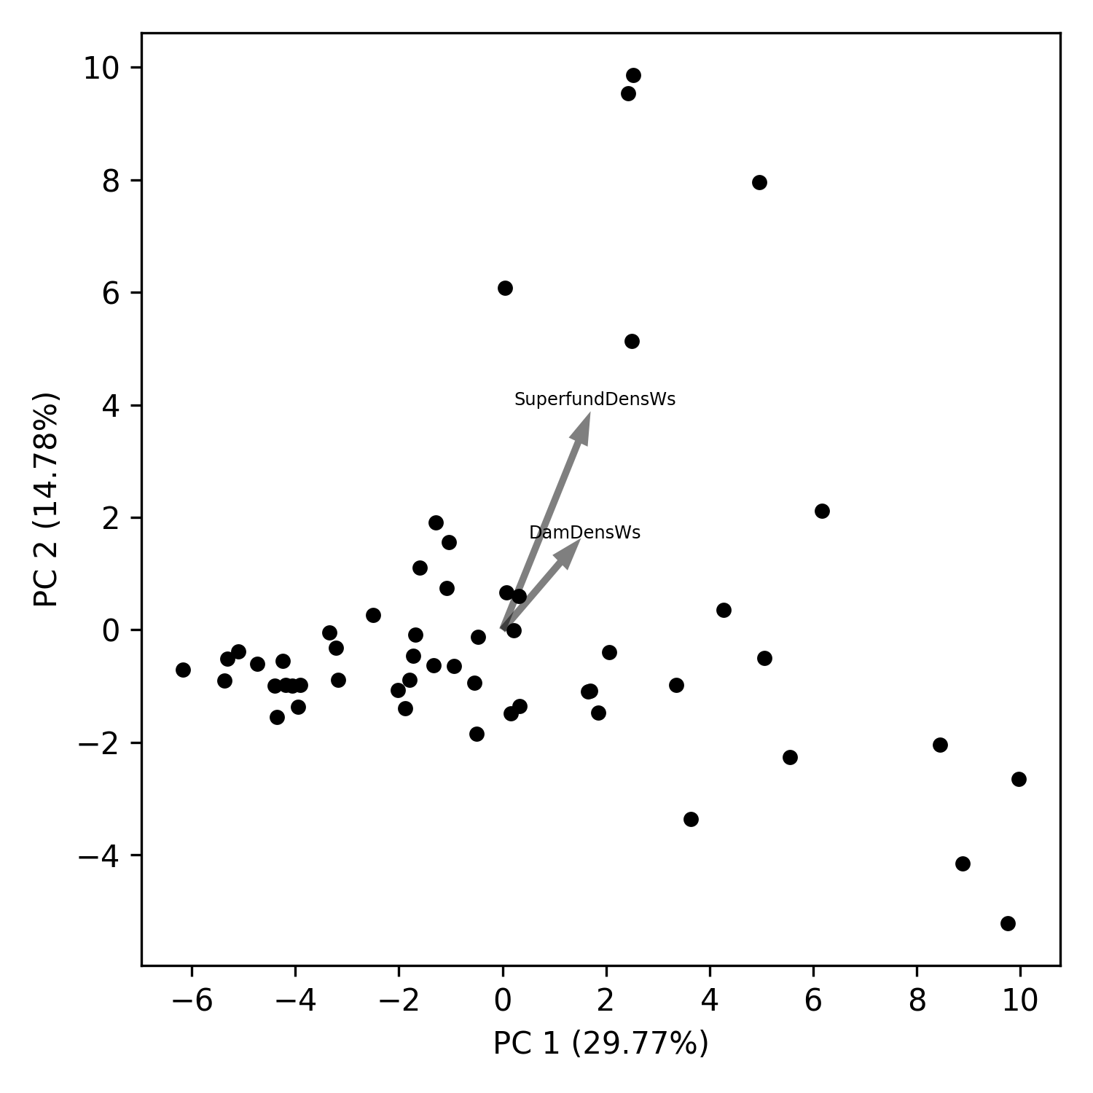
PCA analysis (biplots) – EPA-waters
Notes:
https://towardsdatascience.com/what-are-pca-loadings-and-biplots-9a7897f2e559
https://www.frontiersin.org/files/Articles/1003159/frwa-04-1003159-HTML/image_m/frwa-04-1003159-g005.jpg
https://www.jcchouinard.com/pca-with-python/
https://stackoverflow.com/questions/39216897/plot-pca-loadings-and-loading-in-biplot-in-sklearn-like-rs-autoplot

Slide 11
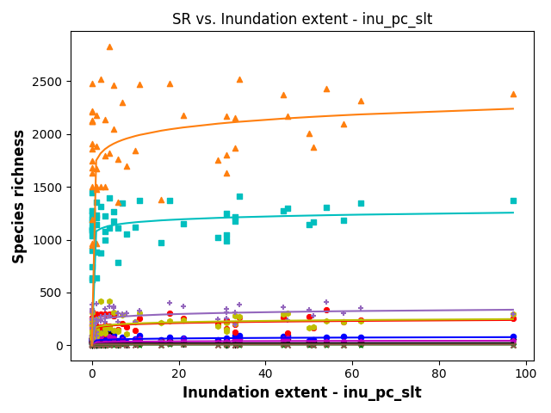
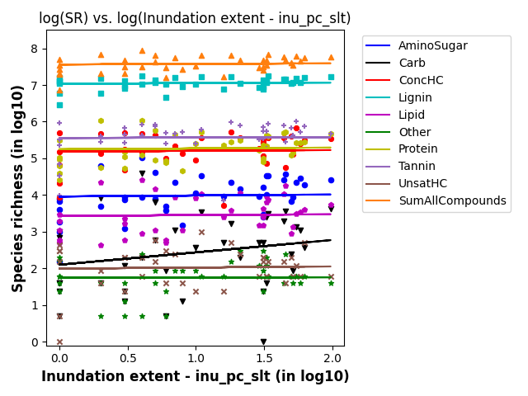
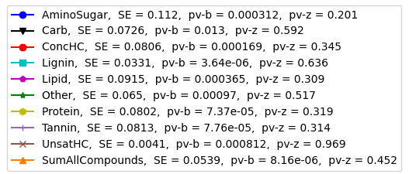
SR vs Indundation Extent

Slide 12
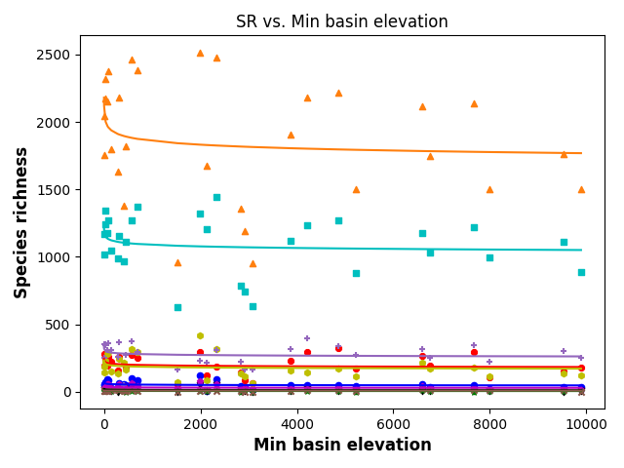
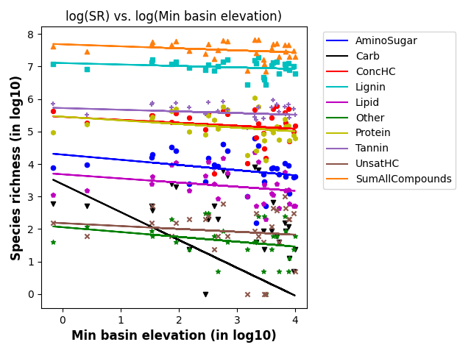
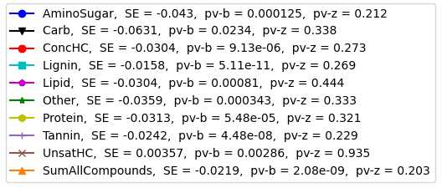
SR vs Min basin elevation

