Slide 1
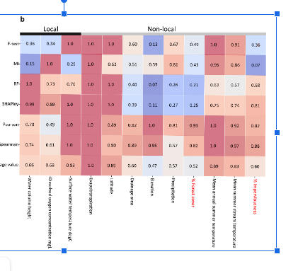
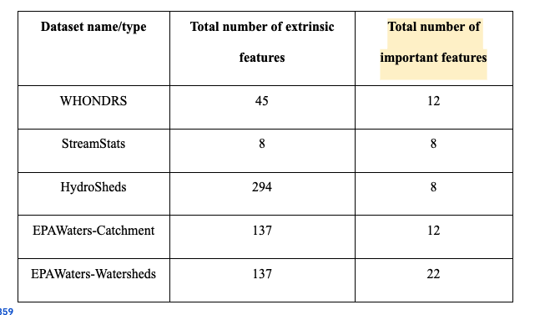
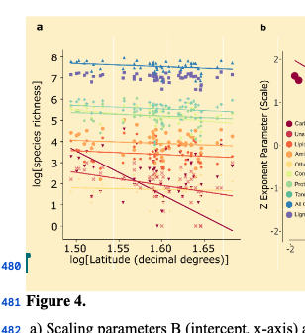
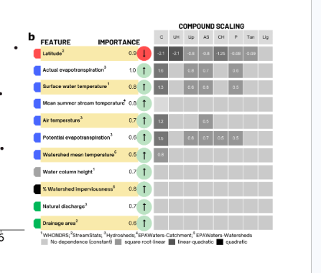


3. Entire reduced feature set importance
2. Reduced set of features
Spearsman and Pearson correlation
Dataset name | Reduced feature | Avg feature importance value
1. Total features and all the compounds
4. Features greater than 0.5 and selecting important ones across all the datasets

Slide 2
