Slide 1
Eating (Dining) Philosopher
Prepared By :-
Mayur Vaja 250160450061
Viraj Maru 250160450052
Nikunj Mevada 250160450062

Slide 2
1. Introduction:-
→ Eating Philosopher Problem is a synchronization problem in Operating System.
→ It explains how multiple processes share limited resources.
→ This problem helps to understand coordination between processes.
→ It was introduced by Edsger Dijkstra.

Slide 3
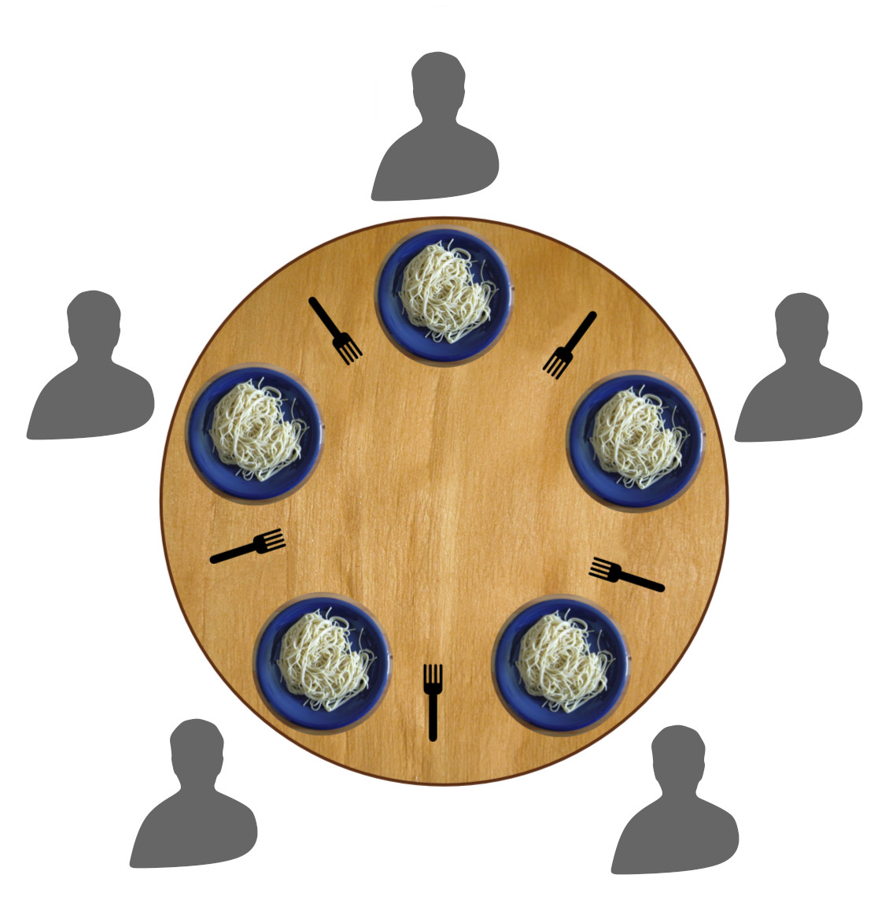
Dining Philosophers Diagram:-

Slide 4
2. Definition of the Problem:-
→ In this problem, philosophers need forks to eat food.
→ But the number of forks is limited.
→ Because of this, conflicts can occur between philosophers.
→ So we need proper rules to manage resources.

Slide 5
3. Basic Concept:-
→ There are 5 philosophers sitting around a table.
→ There are 5 forks placed between them.
→ Each philosopher needs two forks to eat.
→ If both forks are not available, the philosopher cannot eat.

Slide 6
4. States of Philosopher
→ Each philosopher has three main states.
→ Thinking state: philosopher is not using any resource.
→ Hungry state: philosopher is waiting for forks.
→ Eating state: philosopher is using both forks.

Slide 7
5. Key Components
→ Philosopher represents a process or thread.
→ Fork represents a shared resource.
→ Resources are limited and shared among philosophers.
→ Proper synchronization is required to avoid problems.

Slide 8
6. Working of the System
→ First, philosopher is in thinking state.
→ Then he becomes hungry and tries to pick forks.
→ If both forks are available, he starts eating.
→ After eating, he releases both forks and goes back to thinking.
Thinking → Hungry → Pick Forks → Eating → Release Forks → Thinking.

Slide 9
7. Deadlock Problem:-
→ Deadlock occurs when all philosophers pick one fork at the same time.
→ Then each philosopher waits for the second fork.
→ No philosopher gets both forks.
→ So no one can eat and the system gets stuck.

Slide 10
8. Starvation Problem:-
→ Starvation happens when a philosopher never gets a chance to eat.
→ Other philosophers keep taking forks again and again.
→ One philosopher keeps waiting for a long time.
→ So he remains hungry forever.

Slide 11
9. Solution Techniques:-
→ Semaphore is used to control access to forks.
→ Order of picking forks can be changed (odd/even method).
→ Number of philosophers allowed can be limited.
→ Monitor can also be used for safe resource handling.

Slide 12
10. Program Implementation:-
→ In the program, philosophers try to take forks.
→ If forks are available, they eat.
→ After eating, they release forks.
→ This process repeats continuously to simulate real behavior.

Slide 13
→ Program:-
#include <stdio.h>
#define N 5
int fork[N] = {1,1,1,1,1}; // 1 = available, 0 = not available
void philosopher(int i)
{ printf("\nPhilosopher %d is THINKING\n", i); printf("Philosopher %d is HUNGRY\n", i); // check if both forks are available if(fork[i] == 1 && fork[(i+1)%N] == 1)
{ fork[i] = 0; // take left fork fork[(i+1)%N] = 0; // take right fork
printf("Philosopher %d takes forks\n", i); printf("Philosopher %d is EATING\n", i);

Slide 14
fork[i] = 1; // release left fork fork[(i+1)%N] = 1; // release right fork
printf("Philosopher %d releases forks\n", i); } else
{ printf("Philosopher %d is WAITING (fork not available)\n", i); } }
int main()
{ int i; for(i = 0; i < N; i++) { philosopher(i); } return 0; }

Slide 15
11. Real-Life Example:-
→ Imagine 5 friends sitting with 5 spoons.
→ Each person needs 2 spoons to eat food.
→ If everyone takes one spoon, no one can eat.
→ This situation is similar to deadlock.

Slide 16
12. Conclusion:-
→ This problem helps to understand synchronization in Operating System.
→ It explains deadlock and starvation clearly.
→ It shows the importance of proper resource management.
→ It is one of the most important concepts in OS.

Slide 17
Thank You

