Slide 1
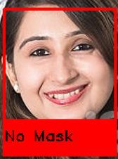
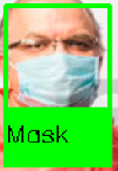

Mask Recognition
(using Python, OpenCV, SVM)
Made By: Vyom Verma CO20368

Slide 2

INTRODUCTION
COVID-19 has called for strict measures to be followed in order to prevent the spread of disease.
Face masks are one of the personal protective equipment. People wear face masks once they step out of their homes.
To monitor that people are following this basic safety principle, a strategy should be developed. A face mask detector system can be implemented to check this.
Face mask detection means to identify whether a person is wearing a mask or not.

Slide 3

INTRODUCTION
The first step to recognize the presence of a mask on the face is to detect the face, which makes the strategy divided into two parts: to detect faces and to detect masks on those faces.
Face detection is one of the applications of object detection and can be used in many areas like security, biometrics, law enforcement and more.

Slide 4

FEATURES
It works on live video from the default webcam.
Works on a already saved video file or an image on the disk.
Draws a rectangle of different color for different case which makes it easier to identify individual wearing mask.

Slide 5
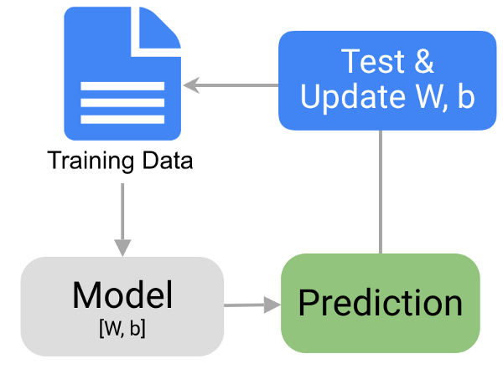
PROCESS
Loading datasets(with mask and without mask)
Training the SVM model
Testing the SVM
Making predictions after
detecting face

Slide 6
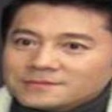
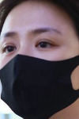
LOADING DATASET
Dataset contains images of people with and without mask.
1250 pictures exist for both the categories.
All the images are already cropped out.
Images are loaded for both categories in different arrays and exported in numpy format(.npy).

Slide 7
TRAINING
“Support Vector Machine” (SVM) is a supervised machine learning algorithm that can be used for both classification or regression challenges. However, it is mostly used in classification problems.
Our problem is of classification type because there are 2 categories to choose from (mask and no mask).
Dataset is loaded from .npy file and passed to the SVM and trained.
After training, accuracy is calculated.

Slide 8
PREDICTION
Each frame from the video is processed using OpenCV and default face recognizer is used which is available at opencv website.
The classifier for the face recognition is loaded and applied to each frame to return the location of faces on the frame.
Faces are then passed to the model to predict if it has a mask or not.
If yes, then a green box showing “Mask” appears on the face and if no, a red box showing “No Mask” appears. The box is drawn on the frame using opencv.

Slide 9


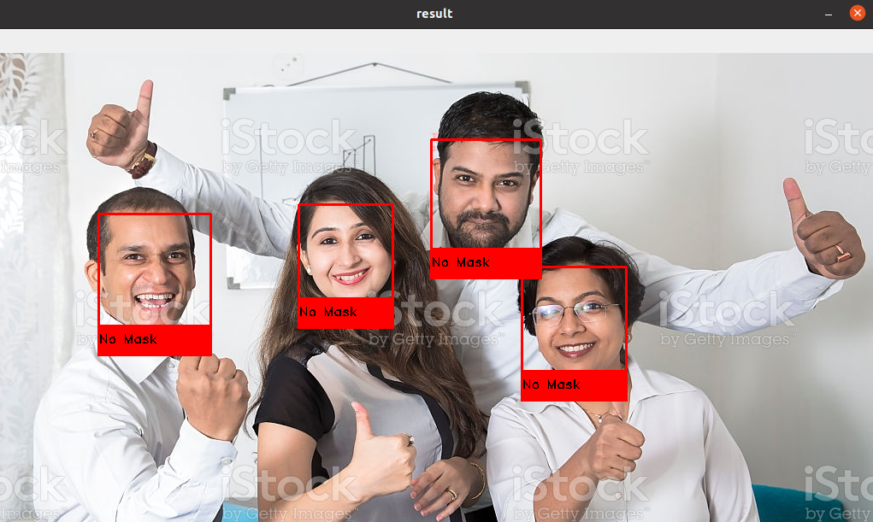
NO MASK

Slide 10
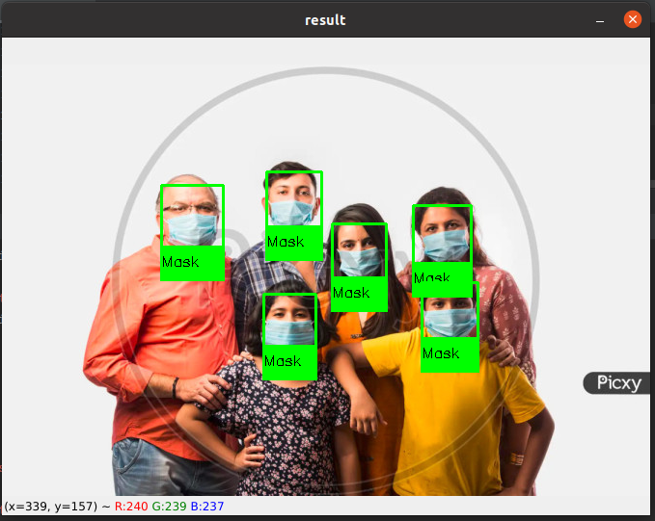
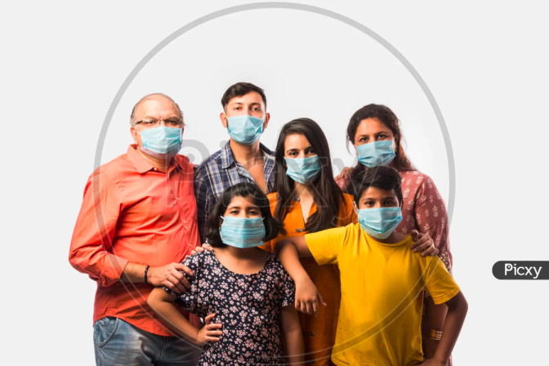
MASK

Slide 11

Future Improvements
Face recognition method can be improved as face detection method sometimes fails on faces with masks.
This project can be extended to identify people even with face mask on.
Further identification of type of face mask person is wearing.

Slide 12
REFERENCES
https://www.py4e.com/html3/01-intro
https://www.python.org/downloads/windows
https://code.visualstudio.com/docs/?dv=win
https://pypi.org/project/printy/
https://docs.python.org/release/3.8.3/glossary.html
https://opencv.org/
https://numpy.org/doc/stable

Slide 13
THANK YOU

