Slide 1
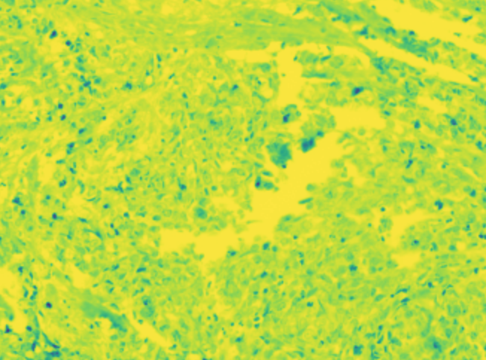
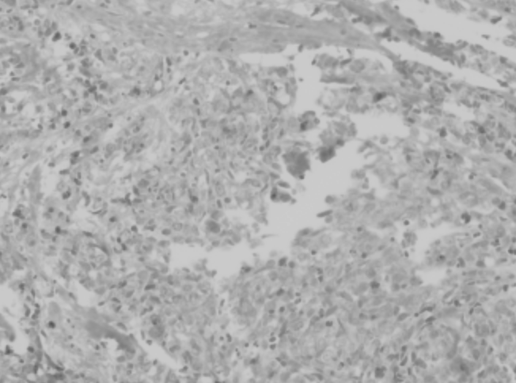
CD3
(3,1004,1334)
(1,1004,1334)
CD3
FOXP3
FOXP3
CD8
(3,1004,1334)
(1,1004,1334)
(3,1004,1334)
CD8
(3,1004,1334)
(1,1004,1334)
(3,1004,1334)
(1,1004,1334)

