Slide 1
GMALL: Stewart Platform
MTE 380: Design Review 1
Gavin Grimm, Marvin Bullinger
Learn Group 2

Slide 2
Agenda
1
Design Goals
2
Constraint and Criteria
3
Decision Analysis
4
Preliminary Conceptual Design
5
Project Timeline

Slide 3

Design Goals
What Do We Hope to Achieve?
“Our goals for this project are to design a Stewart Platform that can balance balls of varying weight (ping pong ball, golf ball, ball bearing), for at least 15 seconds, while also being able to guide said balls along a set trajectory of a circle. The platform will need to maintain the balance of the balls after the introduction of physical disturbances.”

Slide 4
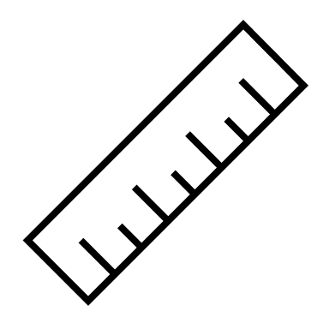
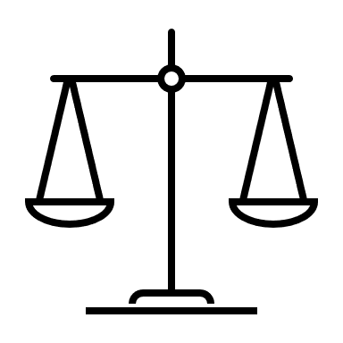





Constraints
Must-Haves for this Project
Dimensions
Platform must fall within $30±5 by 30±5 cm$
BALANCE
Platform must be able to balance balls, even under physical distrurbance for at least 10 seconds
Stewart Platfrom Constraints
Trajectory
Platform must be able to move balls along a fixed path.
BUDGET
The total cost of components must be under $150 CAD
Mechanical Strength
The platform must be able to operate under varying weights (ping pong to ball bearing)

Slide 5
Design Criteria​​​
Design criteria are a list of additional "nice-to-have " features our team had compiled.
Unlike design constraints, they are not essential the functioning of the stewart platform but serve to optimize the system and help it function more effectively
List of Design Criteria
Bouncing the Ball
Cost Optimization
Ease of construction
Reaction Speed/Controls
Range of motion
Design criteria, alongside the design constraints, are used as guidelines for Stewart platform designs

Slide 6
Design Criteria​​ - Decision Matrix​
Each design criteria are given a score by a team member.
This is to allow us to prioritize on which design criterion to implement first.
Each criterion is given a score from 1 (lowest) to 5 (highest)
Criteria | Aidan’s Weight | Leo’s Weight | Luke’s Weight | Marvin’s Weight | Gavin’s Weight | Avg. Weight
Bounce Ball | 2 | 2 | 5 | 4 | 1 | 2.8
Optimize Cost/ | 4 | 4 | 2 | 4 | 3 | 3.4
Ease of assembly/disassembly | 4 | 5 | 3 | 2 | 5 | 3.8
Reaction speed/control | 4 | 3 | 4 | 5 | 2 | 3.6
Range of motion | 4 | 2 | 1 | 3 | 4 | 2.8

Slide 7
Decision Analysis
Morphological Box
Parameters | Configurations
Number of Motors | 2 | 3 | 4 | 6
Motor Type | Stepper | Servo | - | -
Material | PLA | ABS | Aluminium | Aluminium / ABS
Size of the platform [cm] | 25 by 25 | 27.5 by 27.5 | 30 by 30 | 35 by 35
Joint type (for connection to platform) | Ball | Hinge | Ball (Magnet) | Universal
Microcontrollers | RPi | Arduino + RPi | - | -
Ball detection | Camera (CV) Above | Proximity Sensor (3) | Camera (CV) Below | -
Notes:
Determined design criteria, moved on to important features of design
Added several options for each feature
Finally, moving down the table, selected desired feature for each design (show first line)
To explore different designs, chose features for two more designs (show other two lines)
Compared designs using decision matrix (next slide)
After ironing out the design constraints and criteria we moved on to identifying the more important features of the design. For this, we used a morphological feature box. This was to help ideate conceptual designs that we could compare and eventually sketch. To create a design, we went down the list feature by feature, drawing a line between chosen components (show first line). We did this two more times (show other two lines), and then moved on to our decision matrix.

Slide 8
Decision Analysis
Multi-Criteria Decision Analysis
Criteria | Weight | Scores (0 - 5)
 |  | Design 1 | Design 2 | Design 3
Ability to Bounce Ball | 2.8 | 4 | 0 | 2
Optimize Cost | 3.4 | 4 | 5 | 1
Ease of Assembly / Disassembly | 3.8 | 4 | 5 | 1
Reaction Speed & Control | 3.6 | 5 | 3 | 2
Range of Motion | 2.8 | 4 | 3 | 2
Weighted Total: | - | 70.2 | 55.2 | 25.6
Notes:
Used averaged weights given previously in design criteria
As group, rated each design on criteria through unanimous decision
Have clear “winner” for which design to go with
Can remind everyone which one by going back a slide and reading out design
With this design in mind, we went to creating a sketch of this design (hand over to Marvin)
Using the weighted averages from before, we compared each selected design using the shown matrix. Our scores were decided through unanimous decision after discussing the strengths and weaknesses of each design. From here, it’s clear to see the favored design, and Marvin will present our sketch for this design.

Slide 9
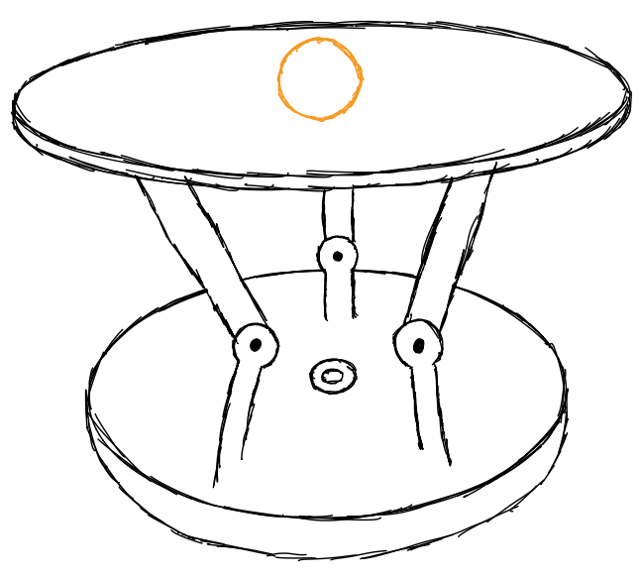
Preliminary Conceptional Design
System sketch – Design 1

Slide 10
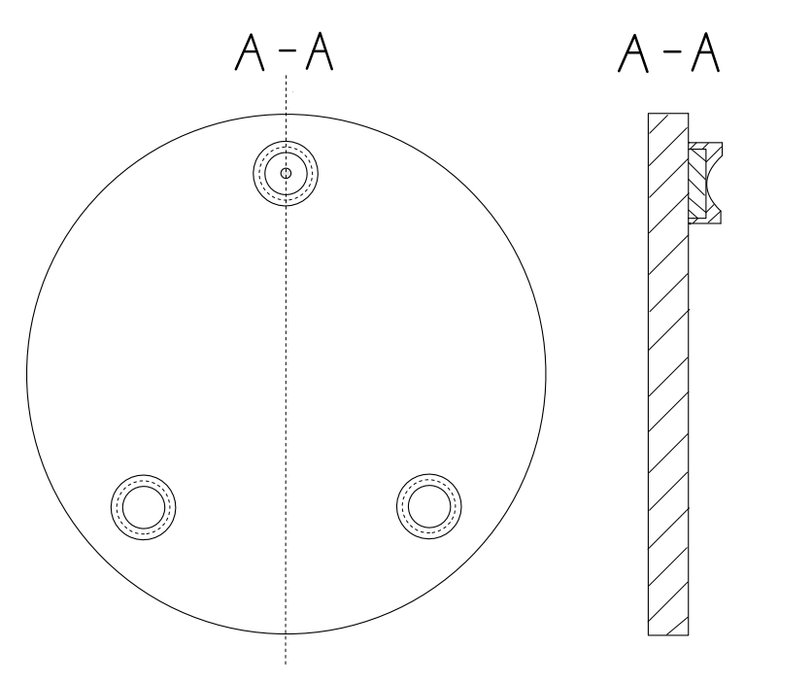
Preliminary Conceptional Design
Balancing Table – Design 1

Slide 11
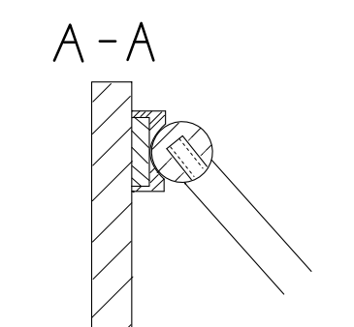
Preliminary Conceptional Design
Magnet Joint – Design 1
Notes:
sectional view

Slide 12
Project Timeline
Gantt Chart

