Slide 1
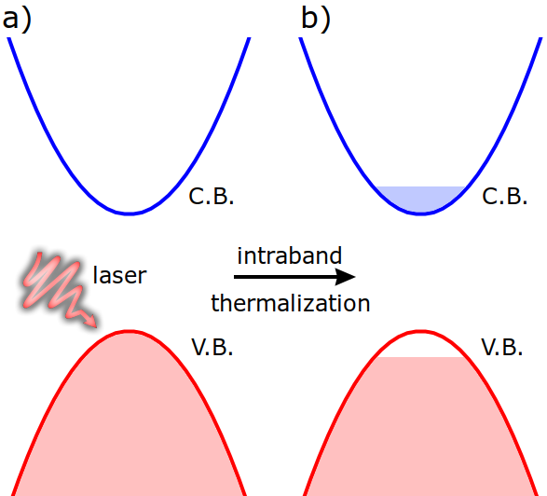
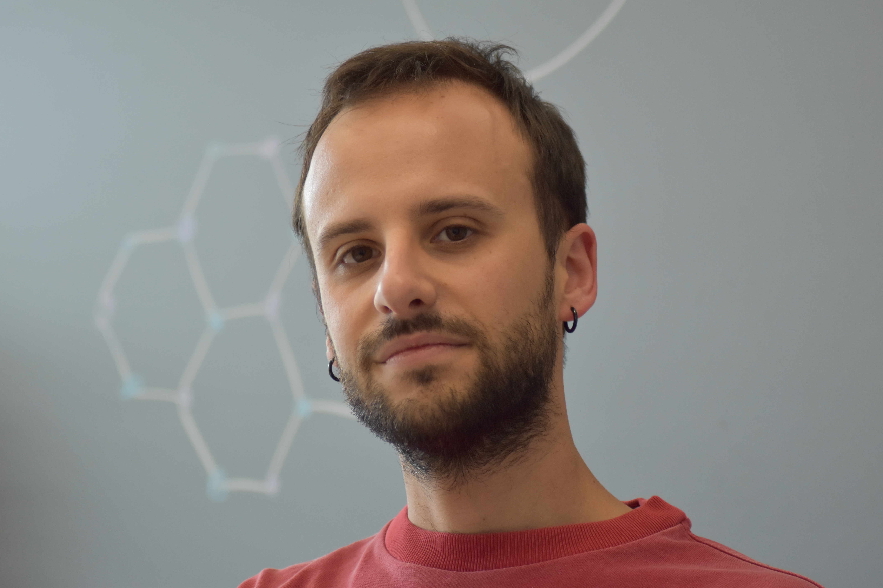




Constrained Density Functional Perturbation Theory – Hands on
Giovanni Marini and Matteo Calandra
Giovanni Marini and Matteo Calandra, Phys. Rev. B 104, 144103 (2021)

Slide 2
How to efficiently simulate phonon and structural dynamics at very long times ?
Constrained Density functional perturbation theory for photexcited insulators
Giovanni Marini and Matteo Calandra, Phys. Rev. B 104, 144103 (2021)
Complete cDFPT framework : two different chemical potentials and electron-hole plasma distribution, no supercells.
We build on top of Refs.:
S. De Gironcoli, Phys. Rev. B 51, 6773(R) (1995)
Tangney & Fahy, PRL 82, 4340 (1999), PRB Phys. Rev. B 65, 054302 (2002)
Complete structural optimization (forces/cell optimization).
Vibrational properties (phonon dispersion)
Electron-phonon interaction (including photocarriers-photocarriers screening)
Coupling with SSCHA, Machine-learning based MD, ab initio BOMD, CPMD
A. Corradini, G. Marini and M.C., npj Computational Materials 11, 151 (2025)
How does all this framework works ?

Slide 3
Structural Optimization – Example: Ground state Silicon
Input file PW_Si_GS/vc-relax.in
&control
calculation = 'vc-relax'
tprnfor=.true.
tstress=.true.
pseudo_dir='../Pseudo/',
/
&system
ibrav=2, celldm(1) =10.20,
nat=2, ntyp=1,
ecutwfc=30.0
occupations="fixed",
/
&electrons
/
&ions
/
&cell
/
ATOMIC_SPECIES
Si 28.086 Si.pz-vbc.UPF
ATOMIC_POSITIONS {alat}
Si 0.00 0.00 0.00
Si 0.25 0.25 0.25
K_POINTS automatic
4 4 4 1 1 1
Fixed occupation as the ground state is insulating.
Perdew Zunger xc (LDA)

Slide 4
Structural Optimization – Example: Ground state Silicon
Output PW_Si_GS/vc-relax.out
bravais-lattice index = 2
lattice parameter (alat) = 10.2000 a.u.
unit-cell volume = 265.3020 (a.u.)^3
number of atoms/cell = 2
number of atomic types = 1
number of electrons = 8.00
number of Kohn-Sham states= 4
….
This is the number of valence states.
As the sistem is insulating/semiconducting, no conduction states are needed.
[Si]=[Ne] 3s² 3p² has 4 electrons in valence, two atoms per cell=8 electrons,
4 bands (two electrons per band).

Slide 5
Structural Optimization – Example: Photoexcited Silicon
Input file PW_Si_Excited/vc-relax_twochem.in
&control
calculation = 'vc-relax'
tprnfor=.true.
tstress=.true.
twochem=.true.
pseudo_dir='../Pseudo/',
/
&system
ibrav=2, celldm(1) =10.20,
nat=2, ntyp=1,
ecutwfc=30.0
nbnd=8
nbnd_cond=4
nelec_cond=0.1
occupations="smearing"
degauss_cond=0.01
degauss=0.01
smearing='gaussian'
/
&electrons
/
&ions
/
&cell
/
ATOMIC_SPECIES
Si 28.086 Si.pz-vbc.UPF
ATOMIC_POSITIONS {alat}
Si 0.00 0.00 0.00
Si 0.25 0.25 0.25
K_POINTS automatic
4 4 4 1 1 1
Changes are concentrated in these two blocks

Slide 6
Structural Optimization – Example: Photoexcited Silicon
Input file PW_Si_Excited/vc-relax_twochem.in
&control
calculation = 'vc-relax'
tprnfor=.true.
tstress=.true.
twochem=.true.
pseudo_dir='../Pseudo/',
/
&system
ibrav=2, celldm(1) =10.20,
nat=2, ntyp=1,
ecutwfc=30.0
nbnd=8
nbnd_cond=4
nelec_cond=0.1
occupations="smearing"
degauss_cond=0.01
degauss=0.01
smearing='gaussian'
/
&electrons
/
&ions
/
&cell
/
ATOMIC_SPECIES
Si 28.086 Si.pz-vbc.UPF
ATOMIC_POSITIONS {alat}
Si 0.00 0.00 0.00
Si 0.25 0.25 0.25
K_POINTS automatic
4 4 4 1 1 1
Flag activating the two chemical potentials option in pw.x

Slide 7
Structural Optimization – Example: Photoexcited Silicon
Input file PW_Si_Excited/vc-relax_twochem.in
&control
calculation = 'vc-relax'
tprnfor=.true.
tstress=.true.
twochem=.true.
pseudo_dir='../Pseudo/',
/
&system
ibrav=2, celldm(1) =10.20,
nat=2, ntyp=1,
ecutwfc=30.0
nbnd=8
nbnd_cond=4
nelec_cond=0.1
occupations="smearing"
degauss_cond=0.01
degauss=0.01
smearing='gaussian'
/
&electrons
/
&ions
/
&cell
/
ATOMIC_SPECIES
Si 28.086 Si.pz-vbc.UPF
ATOMIC_POSITIONS {alat}
Si 0.00 0.00 0.00
Si 0.25 0.25 0.25
K_POINTS automatic
4 4 4 1 1 1
We need to include more bands as we want to populate the conduction band

Slide 8
Structural Optimization – Example: Photoexcited Silicon
Input file PW_Si_Excited/vc-relax_twochem.in
&control
calculation = 'vc-relax'
tprnfor=.true.
tstress=.true.
twochem=.true.
pseudo_dir='../Pseudo/',
/
&system
ibrav=2, celldm(1) =10.20,
nat=2, ntyp=1,
ecutwfc=30.0
nbnd=8
nbnd_cond=4
nelec_cond=0.1
occupations="smearing"
degauss_cond=0.01
degauss=0.01
smearing='gaussian'
/
&electrons
/
&ions
/
&cell
/
ATOMIC_SPECIES
Si 28.086 Si.pz-vbc.UPF
ATOMIC_POSITIONS {alat}
Si 0.00 0.00 0.00
Si 0.25 0.25 0.25
K_POINTS automatic
4 4 4 1 1 1
We need to tell pw.x how many of these bands belong to the conduction, this means
The last four bands (5,6,7,8) belongs to the conduction.

Slide 9
Structural Optimization – Example: Photoexcited Silicon
Input file PW_Si_Excited/vc-relax_twochem.in
&control
calculation = 'vc-relax'
tprnfor=.true.
tstress=.true.
twochem=.true.
pseudo_dir='../Pseudo/',
/
&system
ibrav=2, celldm(1) =10.20,
nat=2, ntyp=1,
ecutwfc=30.0
nbnd=8
nbnd_cond=4
nelec_cond=0.1
occupations="smearing"
degauss_cond=0.01
degauss=0.01
smearing='gaussian'
/
&electrons
/
&ions
/
&cell
/
ATOMIC_SPECIES
Si 28.086 Si.pz-vbc.UPF
ATOMIC_POSITIONS {alat}
Si 0.00 0.00 0.00
Si 0.25 0.25 0.25
K_POINTS automatic
4 4 4 1 1 1
As we transfered electrons in the conduction band, leaving holes in the valence,
The system is metallic and we need to treat the system as a metal.
In principle we can use different values for the electrons broadening (degauss_cond)
And for the holes broadening (degauss)
In the present case they are identical.

Slide 10
Structural Optimization – Example: Photoexcited Silicon
Input file PW_Si_Excited/vc-relax_twochem.in
&control
calculation = 'vc-relax'
tprnfor=.true.
tstress=.true.
twochem=.true.
pseudo_dir='../Pseudo/',
/
&system
ibrav=2, celldm(1) =10.20,
nat=2, ntyp=1,
ecutwfc=30.0
nbnd=8
nbnd_cond=4
nelec_cond=0.1
occupations="smearing"
degauss_cond=0.01
degauss=0.01
smearing='gaussian'
/
&electrons
/
&ions
/
&cell
/
ATOMIC_SPECIES
Si 28.086 Si.pz-vbc.UPF
ATOMIC_POSITIONS {alat}
Si 0.00 0.00 0.00
Si 0.25 0.25 0.25
K_POINTS automatic
4 4 4 1 1 1
Number of electron per cell in the conduction band.
For charge conservation, the same number of holes will be put in the valence band.

Slide 11
Structural Optimization – Example: Photoexcited Silicon
Output file PW_Si_Excited/vc-relax_twochem.out
bravais-lattice index = 2
lattice parameter (alat) = 10.2000 a.u.
unit-cell volume = 265.3020 (a.u.)^3
number of atoms/cell = 2
number of atomic types = 1
number of electrons = 8.00
number of Kohn-Sham states= 8
Increased number of KS states including conduction states

Slide 12
Structural Optimization – Example: Photoexcited Silicon
Output file PW_Si_Excited/vc-relax_twochem.out
bravais-lattice index = 2
lattice parameter (alat) = 10.2000 a.u.
unit-cell volume = 265.3020 (a.u.)^3
number of atoms/cell = 2
number of atomic types = 1
number of electrons = 8.00
number of Kohn-Sham states= 8
Increased number of KS states including conduction states
---------------------------------2CHEM----------------------------------
You are performing a constrained density-functional perturbation theory
employing two chemical potentials, one for electrons and one for holes.
Please refer to:
Giovanni Marini, Matteo Calandra
Lattice dynamics of photoexcited insulators
constrained density-functional perturbation theory
Phys. Rev. B 104, 144103 (2021)
doi:10.1103/PhysRevB.104.144103
The conduction manifold is constituted by 4 bands
0.1000 electrons are placed in the conduction manifold
---------------------------------2CHEM----------------------------------
Number of conduction band states and
Number of photoexcited electrons

Slide 13
Structural Optimization – Example: Photoexcited Silicon
Output file PW_Si_Excited/vc-relax_twochem.out
First iteration
Computing stress (Cartesian axis) and pressure
total stress (Ry/bohr**3) (kbar) P= -4.26
-0.00002894 0.00000000 0.00000000 -4.26 0.00 0.00
-0.00000000 -0.00002894 0.00000000 -0.00 -4.26 0.00
0.00000000 0.00000000 -0.00002894 0.00 0.00 -4.26
Note the appearance of a non-zero stress at the
first iteration due to the presence of photoexcited
carriers.

Slide 14
Structural Optimization – Example: Photoexcited Silicon
Output file PW_Si_Excited/vc-relax_twochem.out
First iteration
Computing stress (Cartesian axis) and pressure
total stress (Ry/bohr**3) (kbar) P= -4.26
-0.00002894 0.00000000 0.00000000 -4.26 0.00 0.00
-0.00000000 -0.00002894 0.00000000 -0.00 -4.26 0.00
0.00000000 0.00000000 -0.00002894 0.00 0.00 -4.26
Final iteration
Computing stress (Cartesian axis) and pressure
total stress (Ry/bohr**3) (kbar) P= -0.38
-0.00000259 0.00000000 -0.00000000 -0.38 0.00 -0.00
0.00000000 -0.00000259 -0.00000000 0.00 -0.38 -0.00
-0.00000000 -0.00000000 -0.00000259 -0.00 -0.00 -0.38
Structural minimization accomplished.
Converged structure
CELL_PARAMETERS (alat= 10.20000000)
-0.499316644 0.000000000 0.499316644
0.000000000 0.499316644 0.499316644
-0.499316644 0.499316644 -0.000000000
ATOMIC_POSITIONS (alat)
Si -0.0000000000 -0.0000000000 0.0000000000
Si 0.2496583221 0.2496583221 0.2496583221
End final coordinates
Initial (Ground state) a= 2.6988 Å
Converged (Exc. State) a= 2.695114 Å
Si contracts when photoexcited.

Slide 15
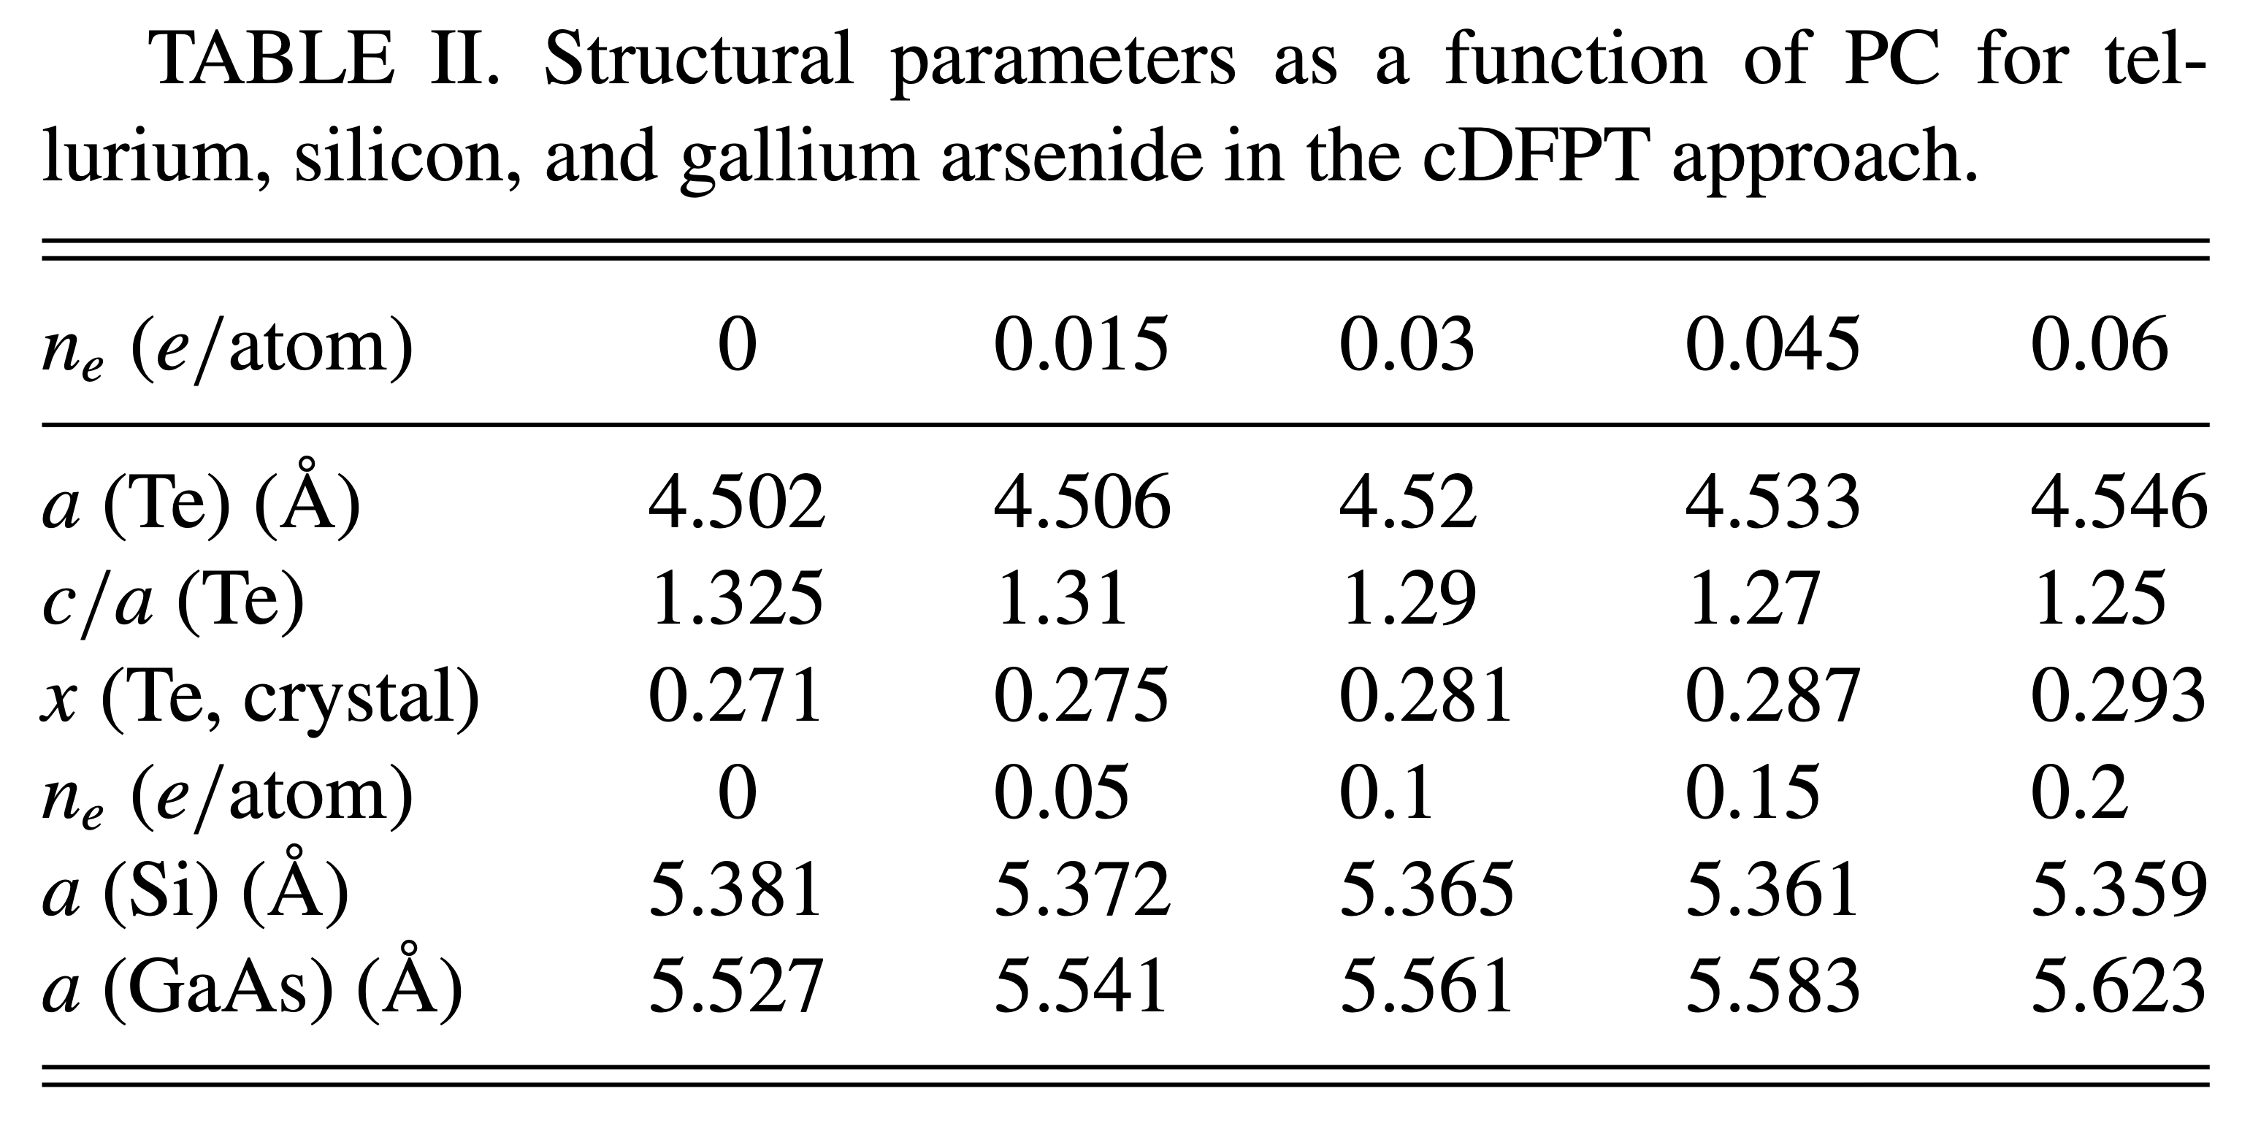
Structural Optimization – Homework
Try to reproduce the following results in
Giovanni Marini and Matteo Calandra, Phys. Rev. B 104, 144103 (2021)

Slide 16
Electronic structure, ground state v.s. photoexcited silicon
PW_Si_Bands_Excited/
The electronic structure is obtained iusing the same procedure as usual
But using the new flags we studied before.
mpirun -n 24 pw.x -npool 4 -in scf_twochem.in > scf_twochem.out
mpirun -n 24 pw.x -npool 4 -in nscf_twochem.in > nscf_twochem.out
mpirun -n 24 bands.x -npool 4 -in bands.in > bands.out
...
the Fermi energy is 5.8489 ev
the conduction Fermi energy is 7.0813 ev
! total energy = -15.84463702 Ry
...
Valence and conduction band fermi levels.

Slide 17
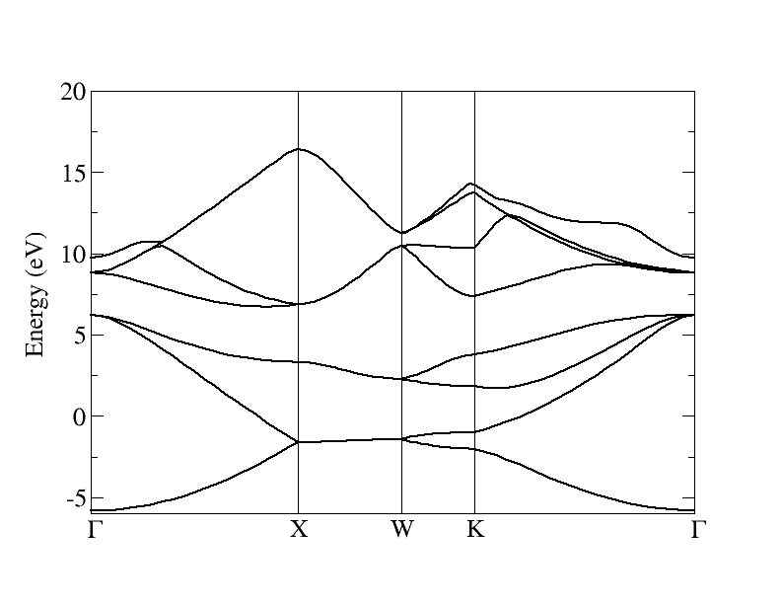
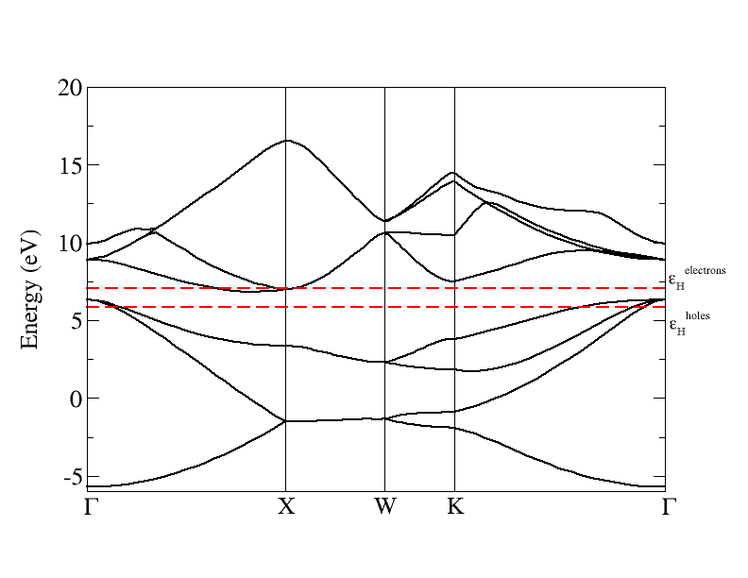
Electronic structure, ground state v.s. photoexcited silicon
Ground state
Photexcited state
Note the very small holes and electrons Fermi surfaces in the photoexcited state!
Generally very large electron and phonon momenta grids are needed to converge photoexcited calculations!

Slide 18
cDFPT – phonon calculation
PH_Si_Excited/
Once the flags in the pw.x scf calculation has been set for the twochem option nothing is needed in the phonon calculation.
mpirun -n 24 pw.x -npool 4 -in scf_twochem.in > scf_twochem.out
mpirun -n 24 ph.x -npool 4 -in ph_twochem.in > ph_twochem.out
The phonon input is the same as for the ground state (remember to converge k and q points) and all options
valid for the ground state in ph.x are still valid for the excited state.
si
&inputph
amass(1)= 28.086,
fildyn='dynq1',
fildvscf='dvscf',
outdir='./',
alpha_mix(1)=0.2
tr2_ph=1.0d-16,
trans=.true.,
/
0.0 0.0 0.0

Slide 19
cDFPT – phonon calculation
Ph.x output
Pert. # 1: Fermi energy shift valence (Ry) = 0.0000E+00 -2.4489E-39
Pert. # 2: Fermi energy shift valence (Ry) = -2.0961E-18 2.5102E-39
Pert. # 3: Fermi energy shift valence (Ry) = -2.8912E-18 -4.8979E-40
Pert. # 1: Fermi energy shift conduction (Ry) = 1.8070E-20 0.0000E+00
Pert. # 2: Fermi energy shift conduction (Ry) = -5.4210E-20 5.7397E-42
Pert. # 3: Fermi energy shift conduction (Ry) = -3.6140E-20 -1.5306E-41
At q=0 the Fermi shift occurs both for
Valence and conduction states.
WARNING : in espresso 7.5 a bug was introduced for systems with non-zero fermi shifts.
The bug has been corrected in version 7.5NC
The version 7.4 is also correct

Slide 20
cDFPT – phonon calculation
Excited state
Excited state
Diagonalizing the dynamical matrix
q = ( 0.000000000 0.000000000 0.000000000 )
**************************************************************************
freq ( 1) = -0.303738 [THz] = -10.131598 [cm-1]
freq ( 2) = -0.303738 [THz] = -10.131598 [cm-1]
freq ( 3) = -0.303738 [THz] = -10.131598 [cm-1]
freq ( 4) = 15.285581 [THz] = 509.872114 [cm-1]
freq ( 5) = 15.285581 [THz] = 509.872114 [cm-1]
freq ( 6) = 15.285581 [THz] = 509.872114 [cm-1]
**************************************************************************
Diagonalizing the dynamical matrix
q = ( 0.000000000 0.000000000 0.000000000 )
*********************************************************************
freq ( 1) = -0.436693 [THz] = -14.566520 [cm-1]
freq ( 2) = -0.436693 [THz] = -14.566520 [cm-1]
freq ( 3) = -0.436693 [THz] = -14.566520 [cm-1]
freq ( 4) = 12.556812 [THz] = 418.850152 [cm-1]
freq ( 5) = 12.556812 [THz] = 418.850152 [cm-1]
freq ( 6) = 12.556812 [THz] = 418.850152 [cm-1]
*********************************************************************
Note the strong softening of the optical modes due to photoexcitation

Slide 21
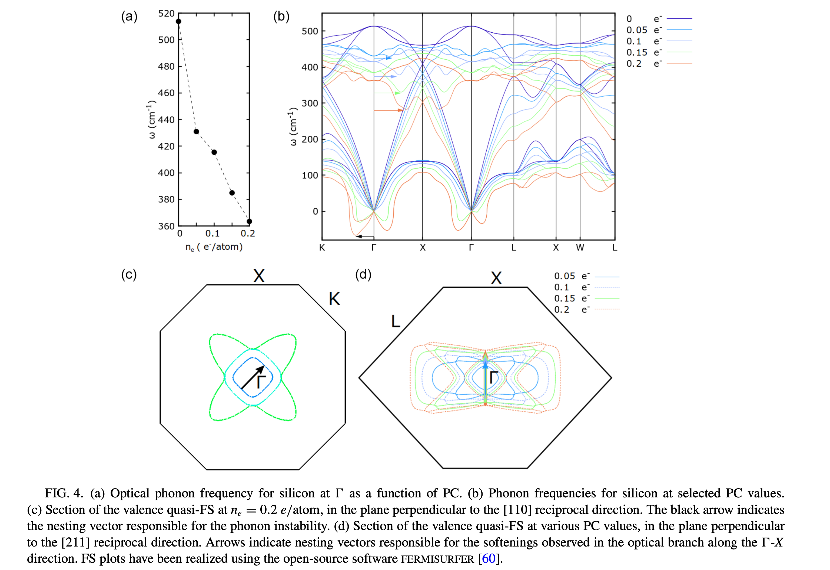
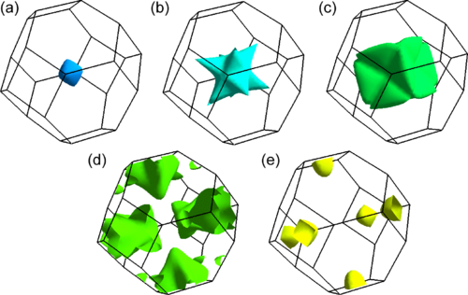
cDFPT – phonon calculation Si
(a)–(c) The three sheets of the valence quasi-FS for silicon
at a PC value of 0.2 𝑒/atom (d) and (e) The two sheets of the
conduction quasi-FS at a PC value of 0.2 𝑒/atom FS
Giovanni Marini and Matteo Calandra, Phys. Rev. B 104, 144103 (2021)

Slide 22
cDFPT – Conclusions
Remember to cite
Giovanni Marini and Matteo Calandra, Phys. Rev. B 104, 144103 (2021)
And quantum espresso
When you use cDFPT be careful in what follows:
The code is intended to work for systems that are gapped after photoexcitation. If the gap closes
after photexcitation (usually the gap is reduced by photoexcitation) it could work, depends on what
happens exactly.
Be careful with convergence. Photoexcitation creates small Fermi surfaces and calculations
requires very dense electron and phonon momentum grids.
Forces can be used to develop machine learning potential in the presence of photoexcitation
see for example:
A. Corradini, G. Marini and M.C., npj Computational Materials 11, 151 (2025)

