Slide 1
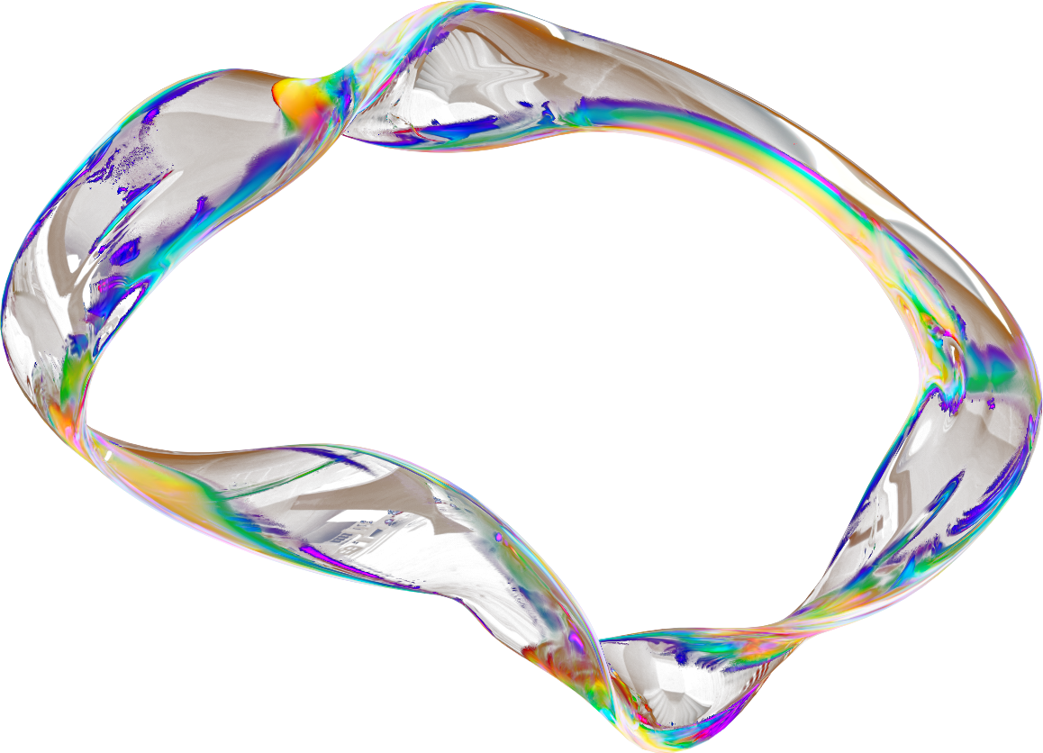

COMP 262
SENTIMENT ANALYSIS
For Amazon Fashion Reviews
Jaturaput Jongsubcharoen 301391425
Juan David Baarrero 301352353
Maria Paula Nova 301374220
Daniela Diaz 301281747
Anmol Sagar Shrestha 301364068

Slide 2
PROJECT OBJECTIVE
Phase 1 focuses on exploration, labeling, preprocessing, lexicon selection, and evaluation
  Build complete reproducible pipeline
  Ratings to proxy ground-truth labels
  Implement VADER & TextBlob
  Evaluate with weighted metrics & confusion matrices

Slide 3


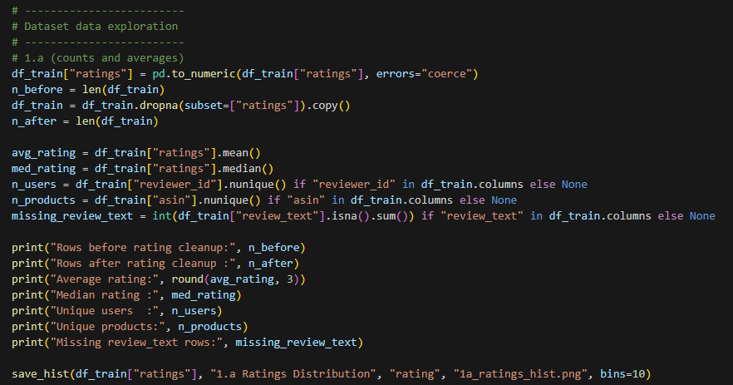

3,176 REVIEWS
We load train and test CSVs and compute statistics programmatically to ensure reproducibility. We also optionally apply index files to match the required subset.
Avg rating: 4.011
Median: 5
406 users
31 products
DATASET
OVERVIEW

Slide 4
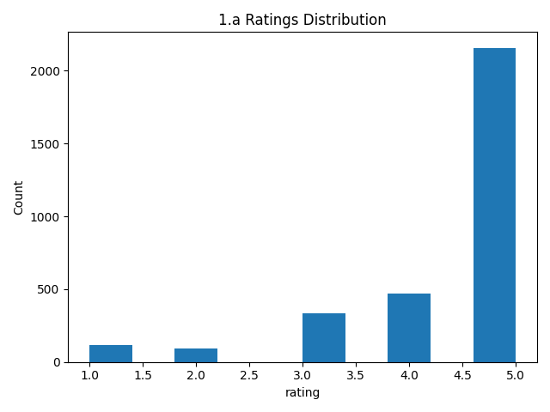
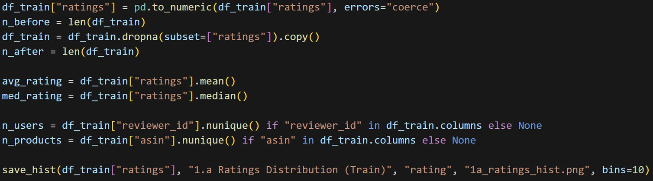
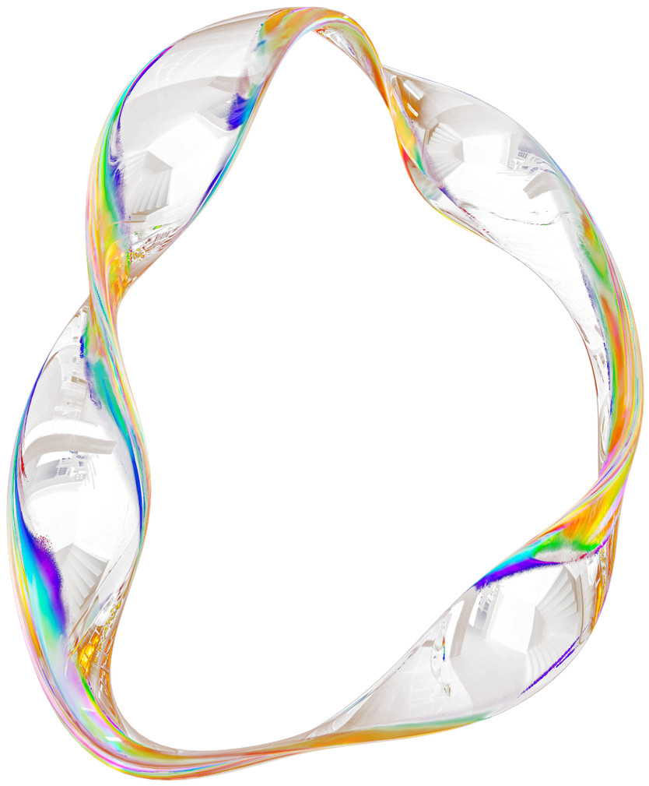
RATINGS DISTRIBUTION
5-star reviews dominate → strong class imbalance
This imbalance influences evaluation, which is why we use weighted metrics, not just accuracy.

Slide 5
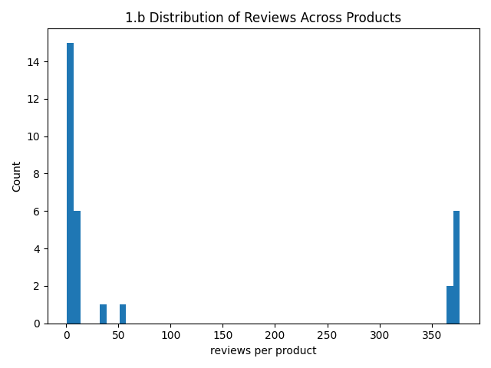
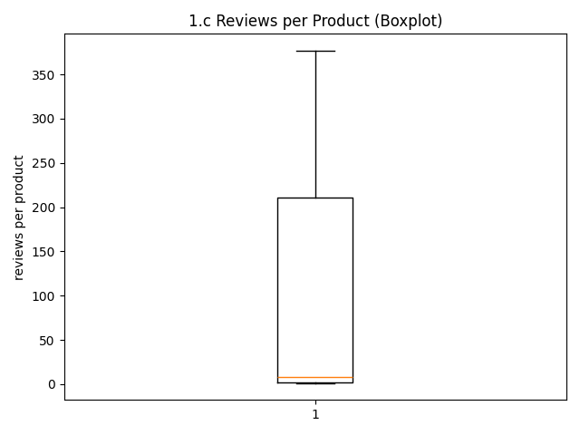
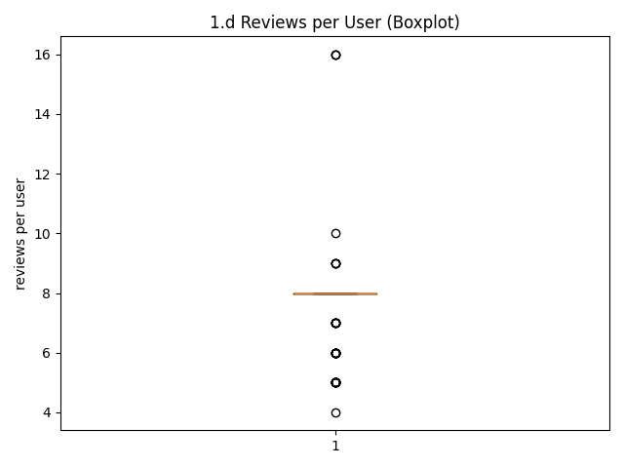

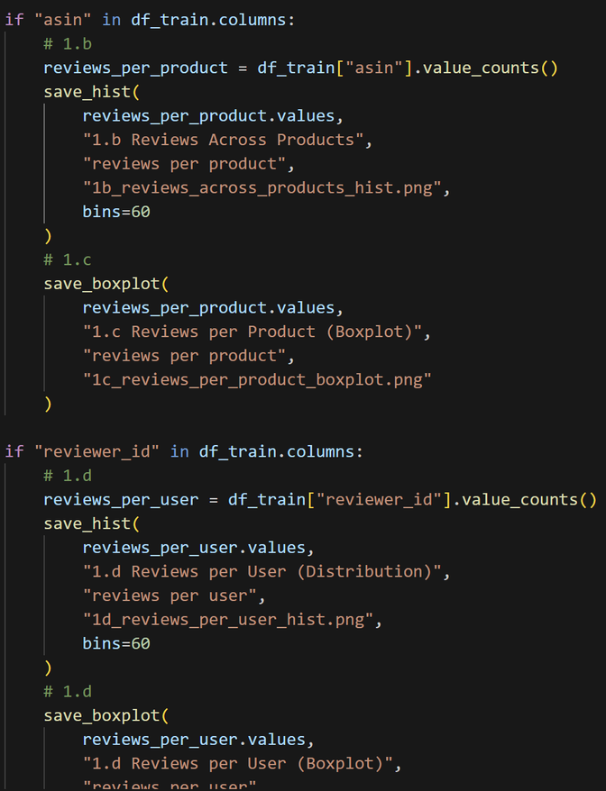
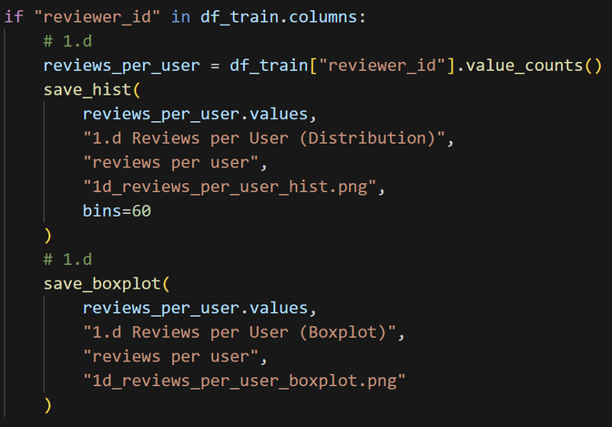
PRODUCT & USER SPARSITY
Median reviews per product = 8
Mean reviews per product = 102.45
Mean reviews per user = 8
Mean reviews per user = 7.82
The dataset has a long-tail distribution and sparse interactions across both products and users.

Slide 6
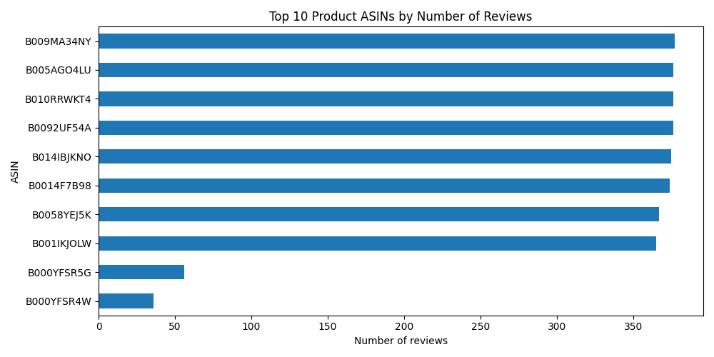
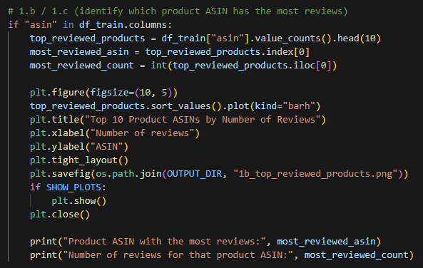
PRODUCT & USER SPARSITY
Top reviewed products are not equally distributed.
Some ASINs have very high review counts.
Others in the top 10 have much lower counts.
A small number of products dominate review activity.

Slide 7
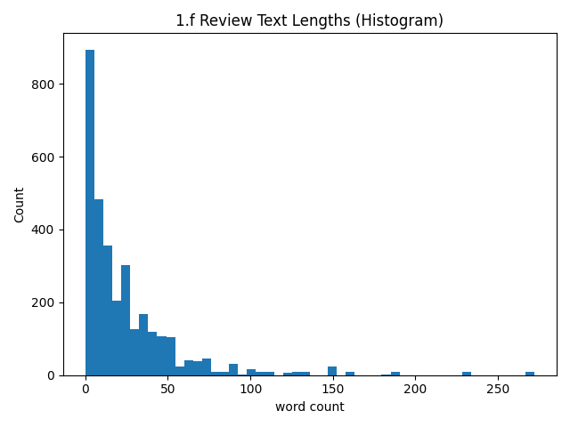
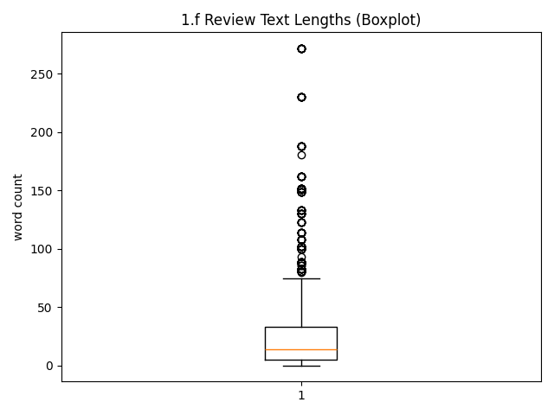
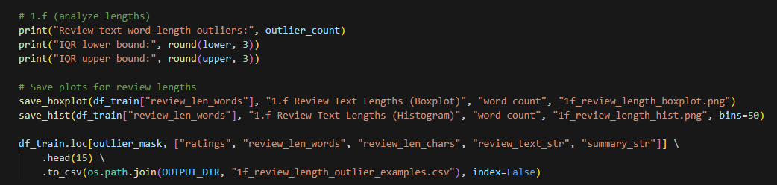
REVIEW LENGTH & OUTLIERS
Avg = 24.71 words
Median = 14 words
Max = 272 words
163 outliers (IQR rule)
Outliers are retained because lexicon models don’t depend on fixed-length vectors, so text length doesn’t break feature representation

Slide 8
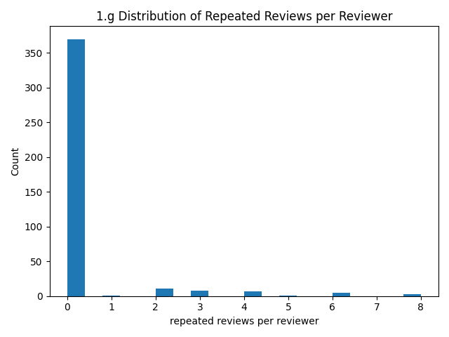
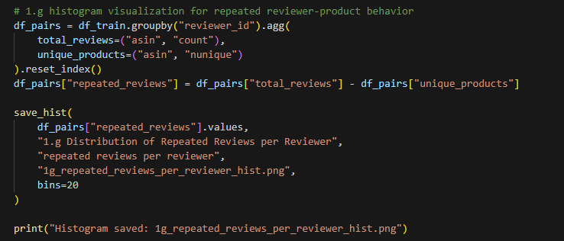
PRODUCT & USER SPARSITY
Most reviewers have 0 repeated reviews for the same product.
A small group of reviewers has many repeated reviews.
Duplicate reviewer–product reviews are not evenly distributed.
Repeated review activity is driven by a small subset of users.

Slide 9
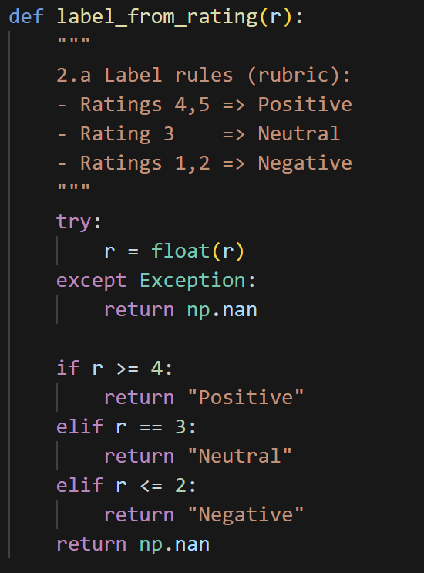
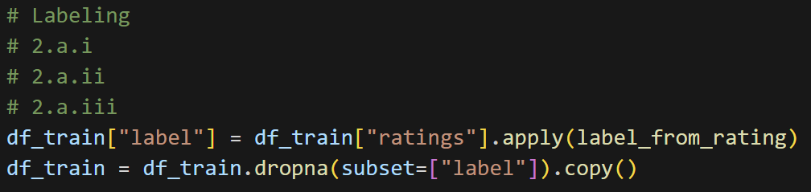
LABELING STRATEGY
4–5 → Positive
3 → Neutral
1–2 → Negative
This converts ratings into proxy ground-truth sentiment labels to enable supervised evaluation.

Slide 10
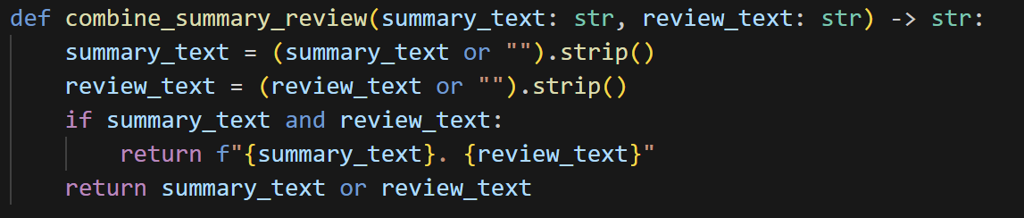
COLUMN SELECTION & TEXT COMBINATION
summary + review_text → full_text
Improves lexical coverage
Combining both fields reduces sparse-text misclassification and captures more sentiment-bearing words.

Slide 11
CLEANING & QUALITY CHECKS
REMOVE INVALID RATINGS
COUNT EMPTY TEXTS
NO MAJOR STRUCTURAL CLEANING
LEXICON MODELS REQUIRE ACTUAL TEXT CONTENT, SO WE REMOVE INVALID RATINGS AND ENSURE TEXT FIELDS ARE USABLE WITHOUT DOING HEAVY IMPUTATION.

Slide 12
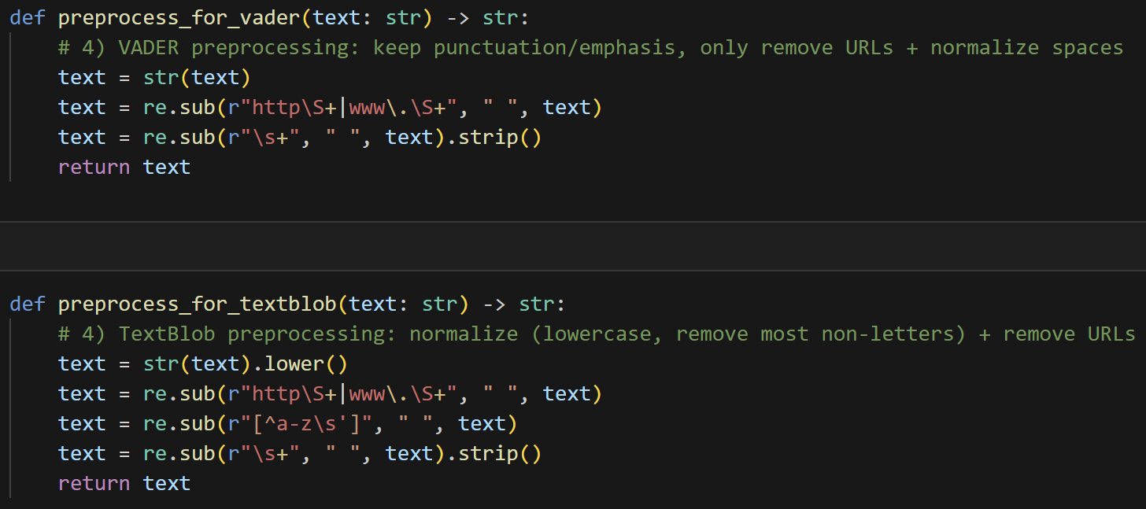
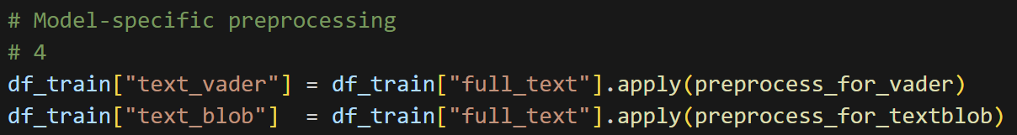
MODEL-SPECIFIC NORMALIZATION
VADER: REMOVE URLS + NORMALIZE WHITESPACE
TEXTBLOB: LOWERCASE + REMOVE URLS + REMOVE NON-ALPHABETIC CHARACTERS

Slide 13
LEXICON STUDY & SELECTION
Analyzed: VADER, TextBlob, SentiWordNet
SentiWordNet excluded due to POS + WSD complexity
Selected VADER & TextBlob

Slide 14
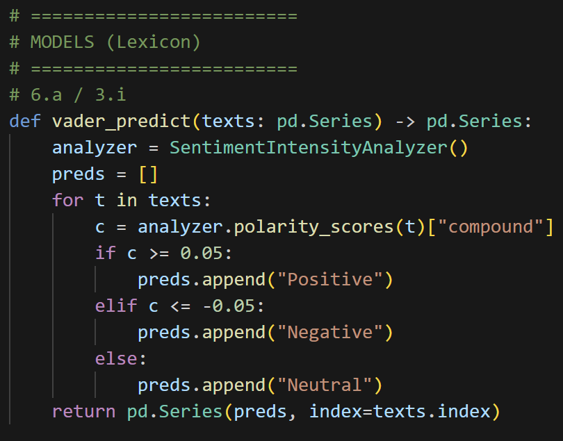
VADER MODEL
Uses SentimentIntensityAnalyzer
VADER is rule-based and includes heuristics for negations, punctuation emphasis, and intensity modifiers.
Compound score [-1,1]
Thresholds ±0.05

Slide 15
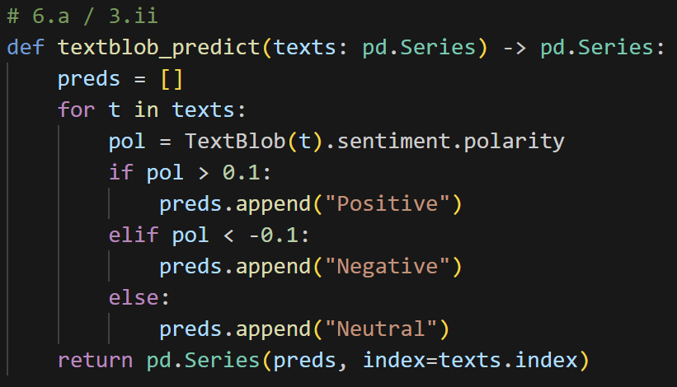
POLARITY SCORE [-1,1]
THRESHOLDS ±0.1
TEXTBLOB MODEL

Slide 16
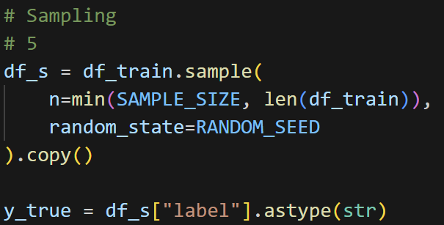
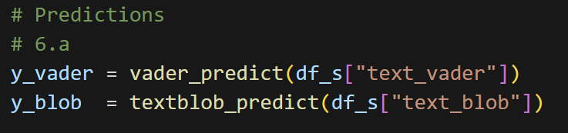
SAMPLING & EVALUATION SETUP
Sample size = 1000
Random seed = 42
Metrics: Accuracy, Weighted Precision/Recall/F1, Confusion Matrix

Slide 17
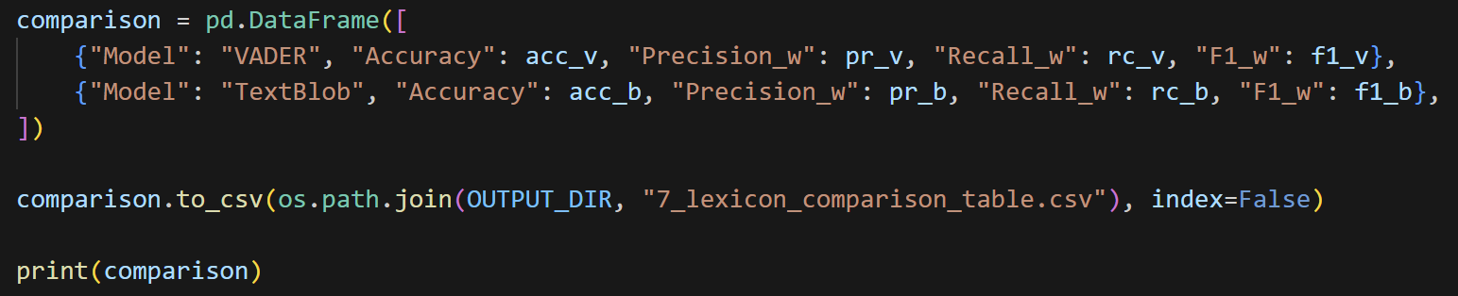
RESULTS TABLE
MODEL
Accuracy
Precision (weighted)
Recall (weighted)
F1 (weighted)
VADER | 0.831 | 0.806164 | 0.831 | 0.817365
TextBlob | 0.783 | 0.780078 | 0.783 | 0.778511

Slide 18
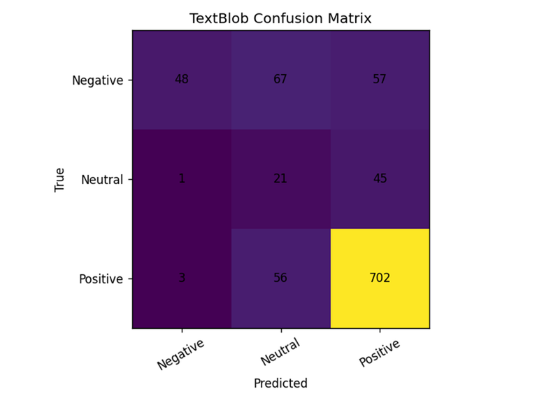
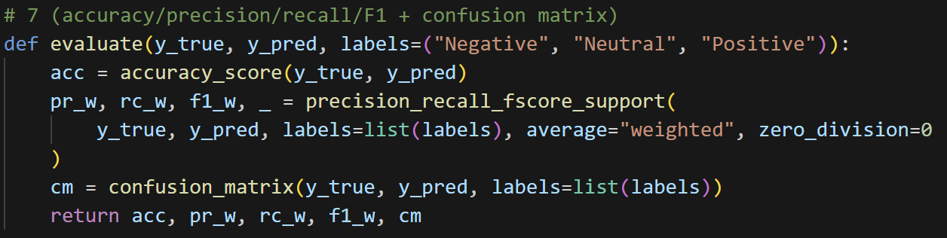
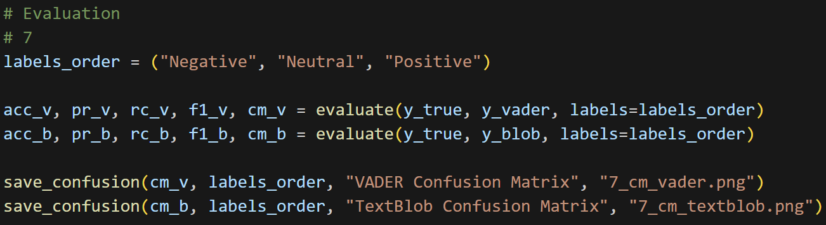
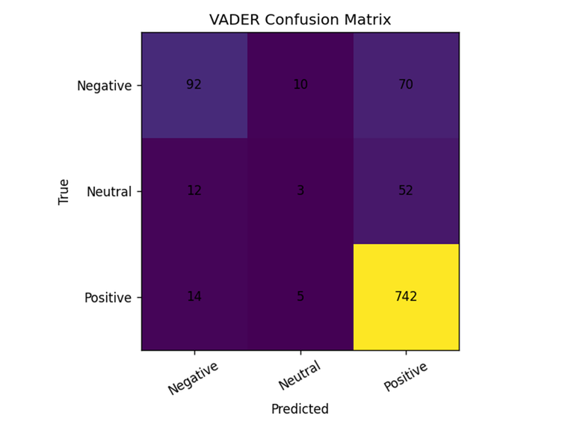
Both models perform best on the Positive class. Neutral is the hardest to classify.
CONFUSION MATRICES

Slide 19
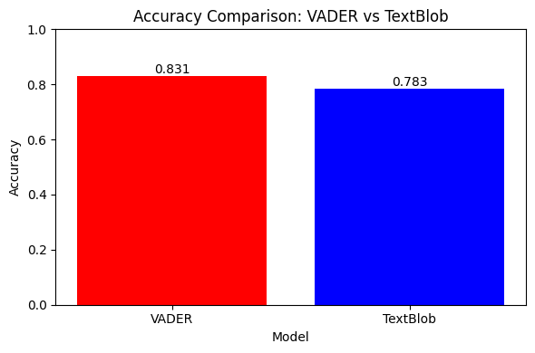
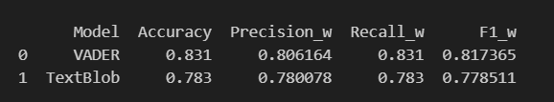
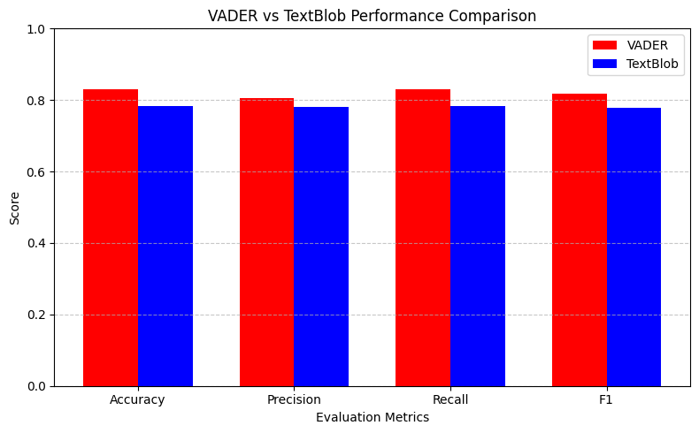
Both models perform best on the Positive class. Neutral is the hardest to classify.
VADER vs TextBlob

Slide 20
DISCUSSION
  VADER stronger overall
  TextBlob more conservative
  Common failures:
  Sarcasm
  Subtle sentiment
  Domain-specific terms
CONCLUSION
  Complete lexicon-based pipeline built
  VADER best baseline
  Strong foundation for Phase 2

Slide 21
THANK YOU
for your time and attention

