Slide 1

Bass Fishing Data Analysis and Prediction Model
SUMMARY
I have pulled data from the biggest fishing tournament of the year for Major League Fishing – REDCREST
After uploading the data to a database, I will prepare it for a machine learning model.
The goal for the model is prediction. Specifically, can the model predict the size of a fish if given controllable attributes.
The controllable attributes being used are:
Bait, Area, Cover, Depth, Time of Day
Can we create a model that helps us catch bigger fish?
Let’s see!

Slide 2

An Introduction to Professional Bass Fishing
Major League Fishing (MLF) is a professional bass fishing organization. With a few specific differences to traditional fishing tournament formats.
The tournaments are over several days and have time periods each day. After the first 4 days cuts are made and only the top 20 anglers advance. Another set of cuts are made on the 5th day and the to 10 advance to the final day.
All fish score over a specified minimum weight (2lbs)
In an effort to sustain healthy fish populations fish are weight in the boat logged and immediately released back into the water.
A few years ago, MLF started making the fish catch data public and accessible through their website. Allowing someone with an interest to perform analysis

Slide 3
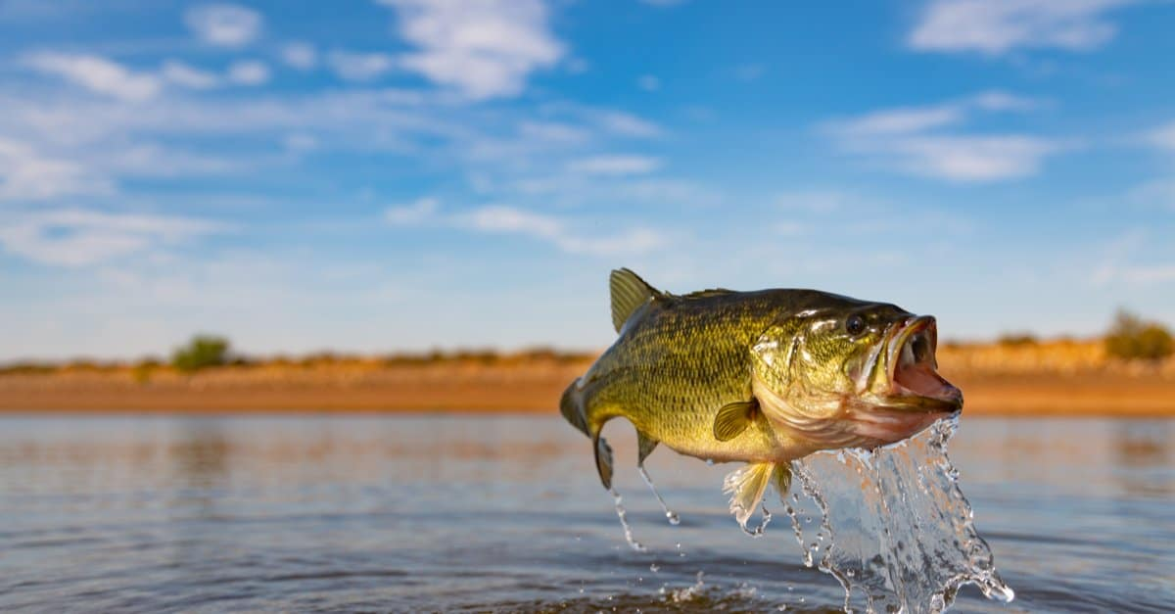
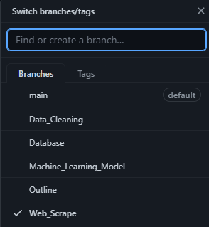
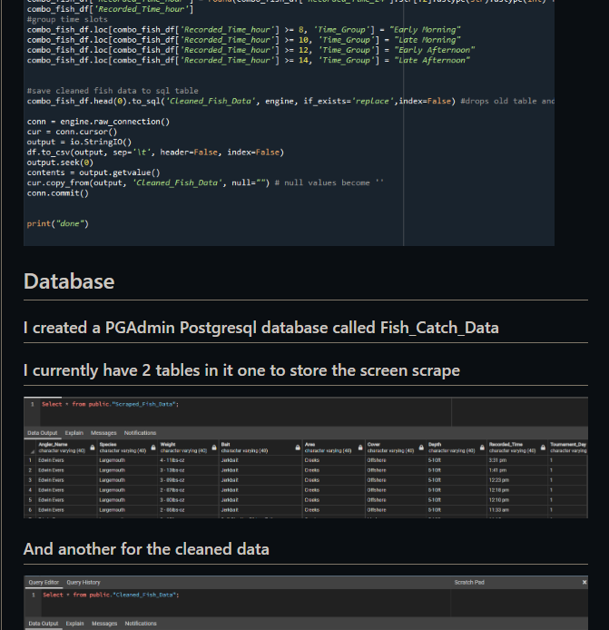
GitHub
There is a GitHub setup with a full ReadMe file.
There are several branches for each individual block of the project.

Slide 4
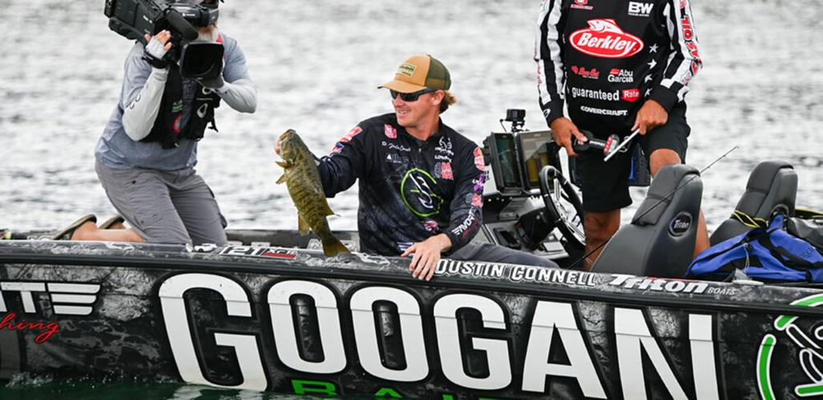
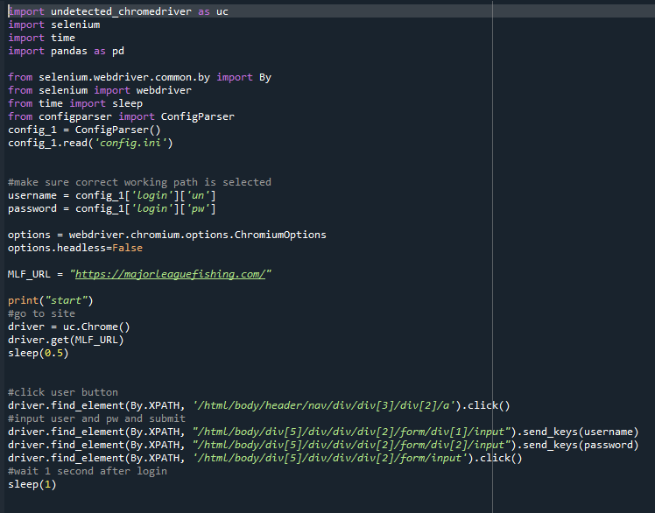
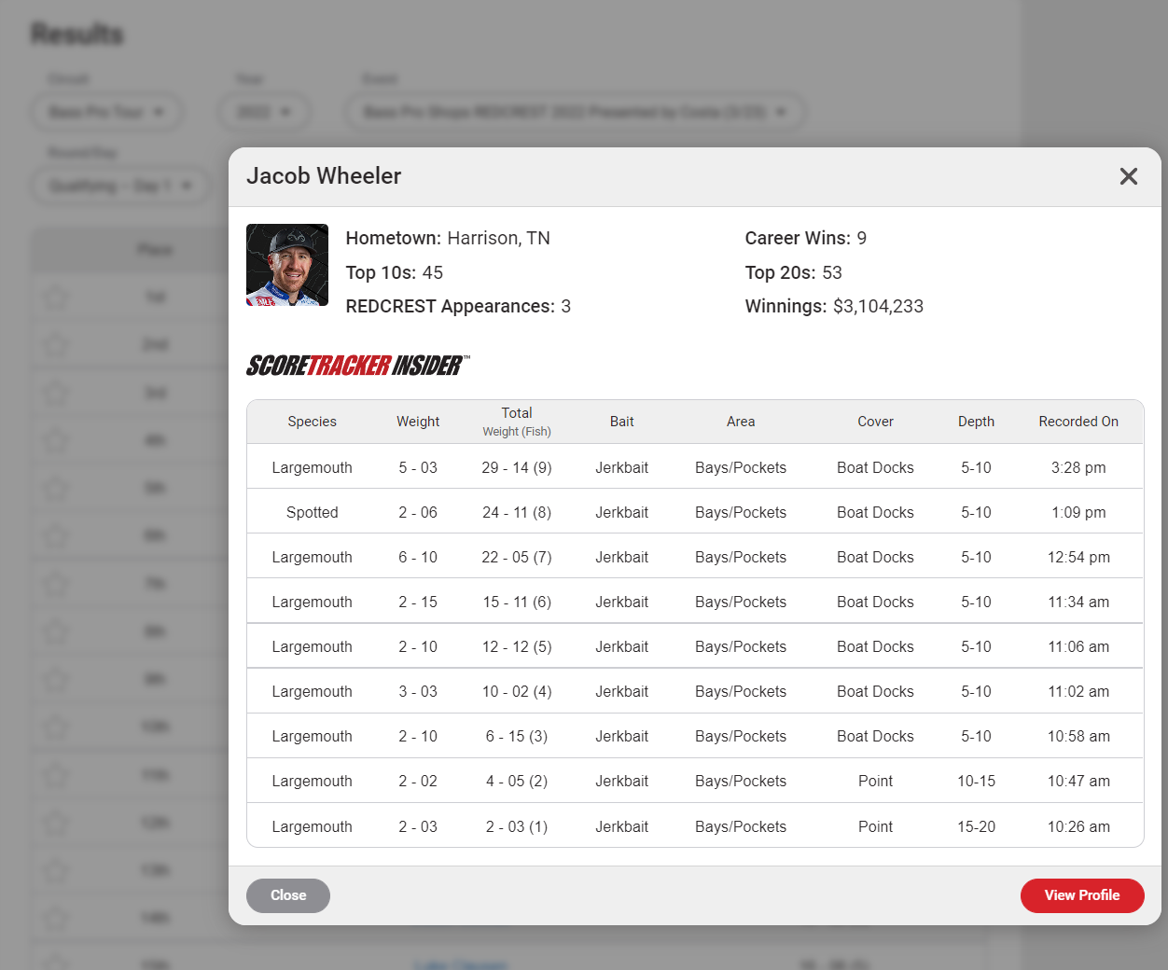
Web Scrape
The first step was to retrieve the data. Using Selenium for Python I was able to write a script that will scrape the data from the MLF website and store it into a database.

Slide 5

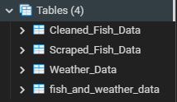
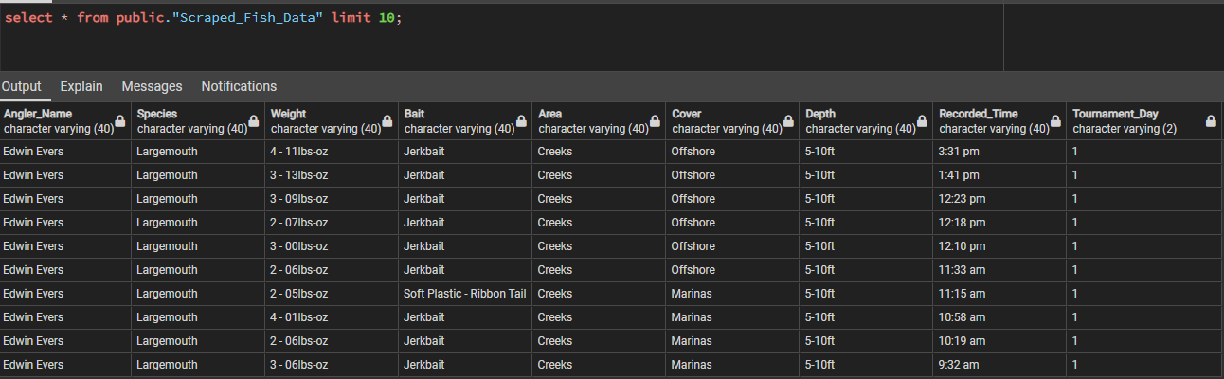
Database
pgAdmin 4 is used for a PostgreSQL database and the iterations of data are stored there.

Slide 6
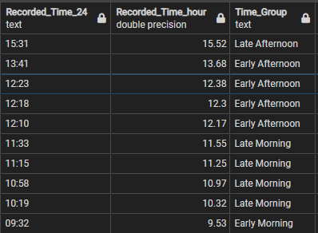
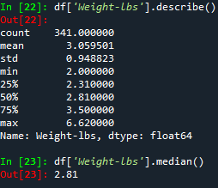
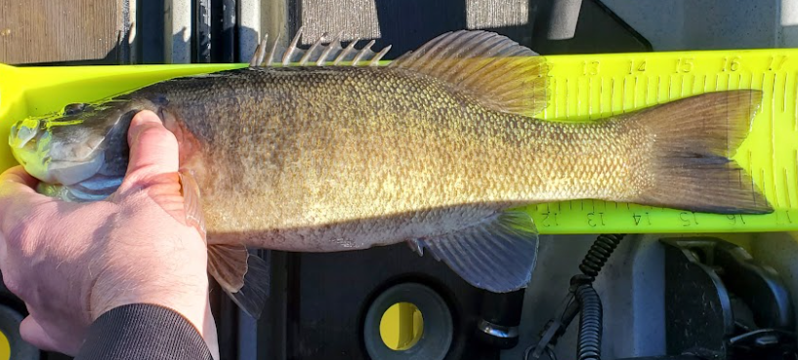
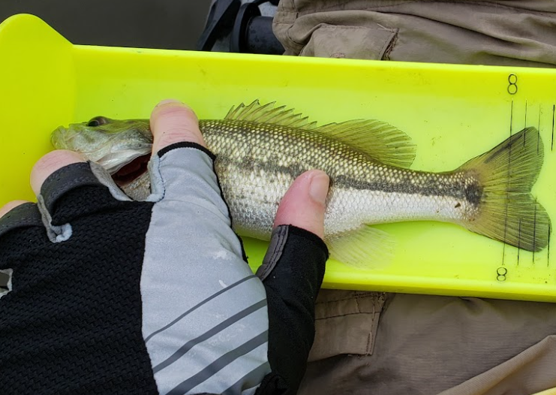
Data Exploration and Cleaning
As expected, the data is very noisy with not much separating the data.
See Interactive Dashboard for examples
A few columns were transformed into formats better suited for analysis such as changing weight from a ‘lbs-oz’ string format to a simple decimal format.
A few features were bucketed such as time of day to limit the amount of variables for the model.
After testing with the model, it was decided a binary choice on target would make for a good model.
3lbs was close to a median and mean weight for the data and colloquially would be a large fish.
3lbs was chosen as the separator for the target. “>= 3lbs” is a Big Fish and “<3lbs” is a Small Fish.

Slide 7

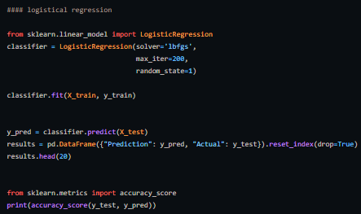

Machine Learning Model
After pairing down the subclasses and separating the target to a binary Big Fish or Small Fish. The machine learning model chosen was a Logistic Regression Model.
After optimizing the model, the results revealed a 0.605 accuracy score

Slide 8
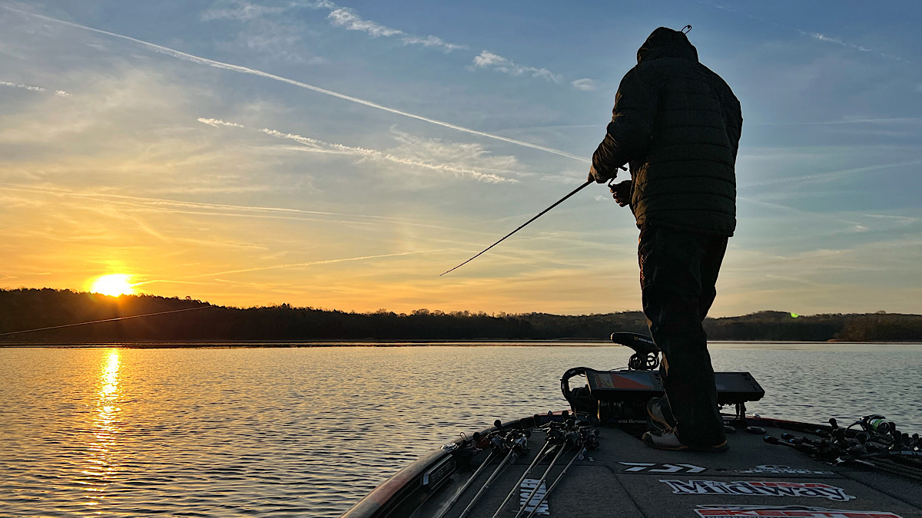
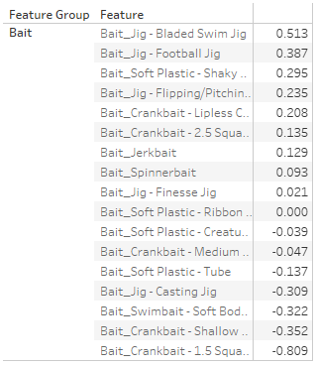
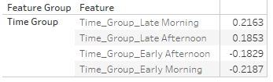
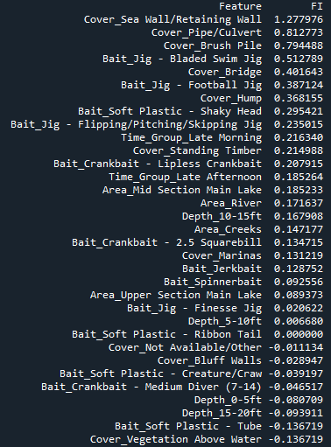
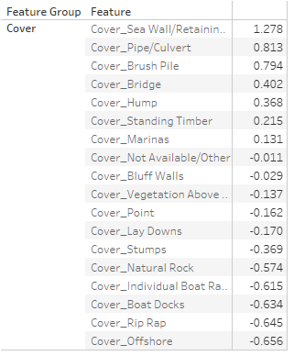
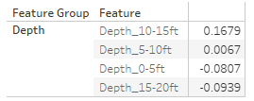
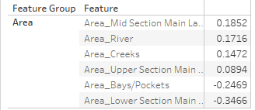
Feature Importance
Feature Importance allows us to assign a score that represents how useful a given attribute is a predicting an outcome
(Higher scores mean bigger fish)

Slide 9
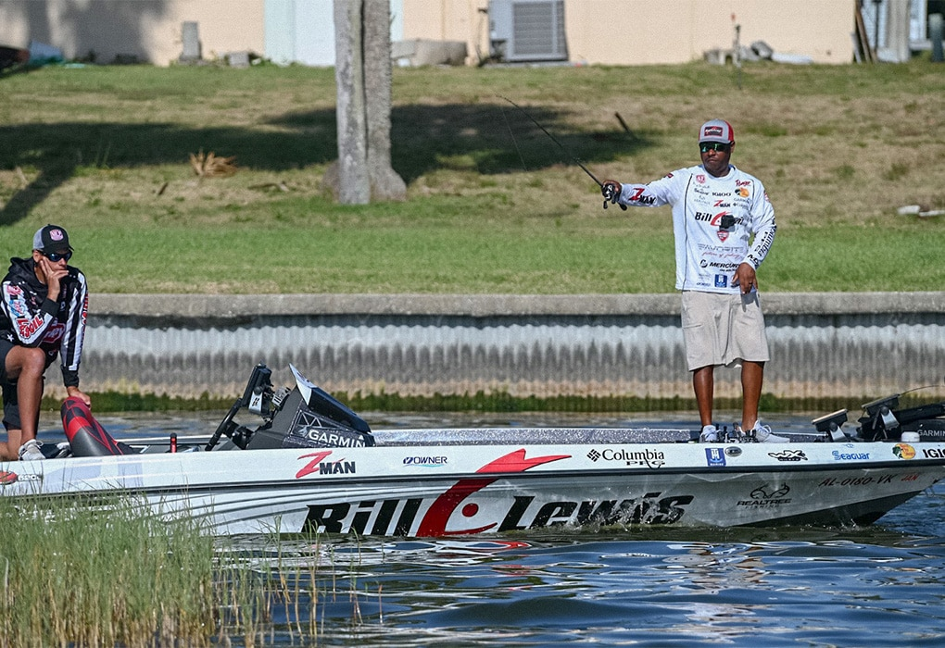
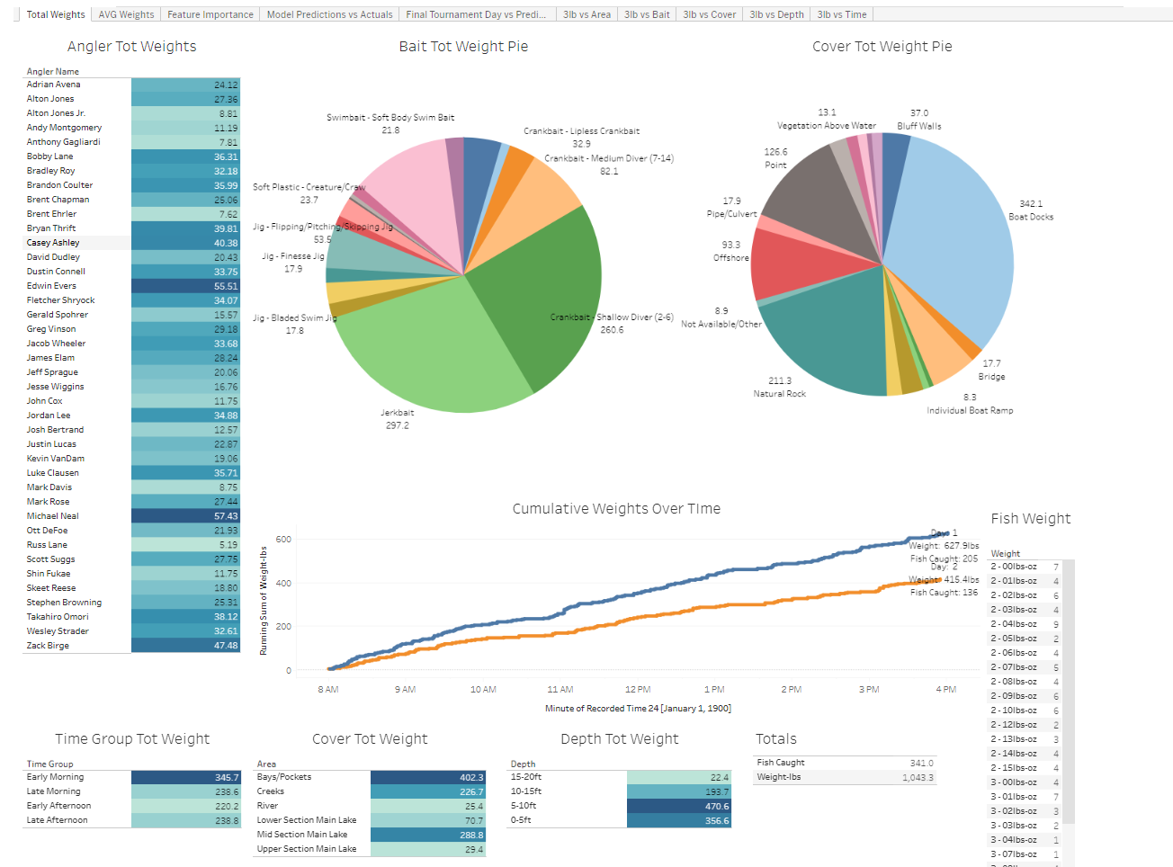
Dashboard
Interactive Dashboard on Tableau Public that breakdown the data.
Link to Workbook

Slide 10

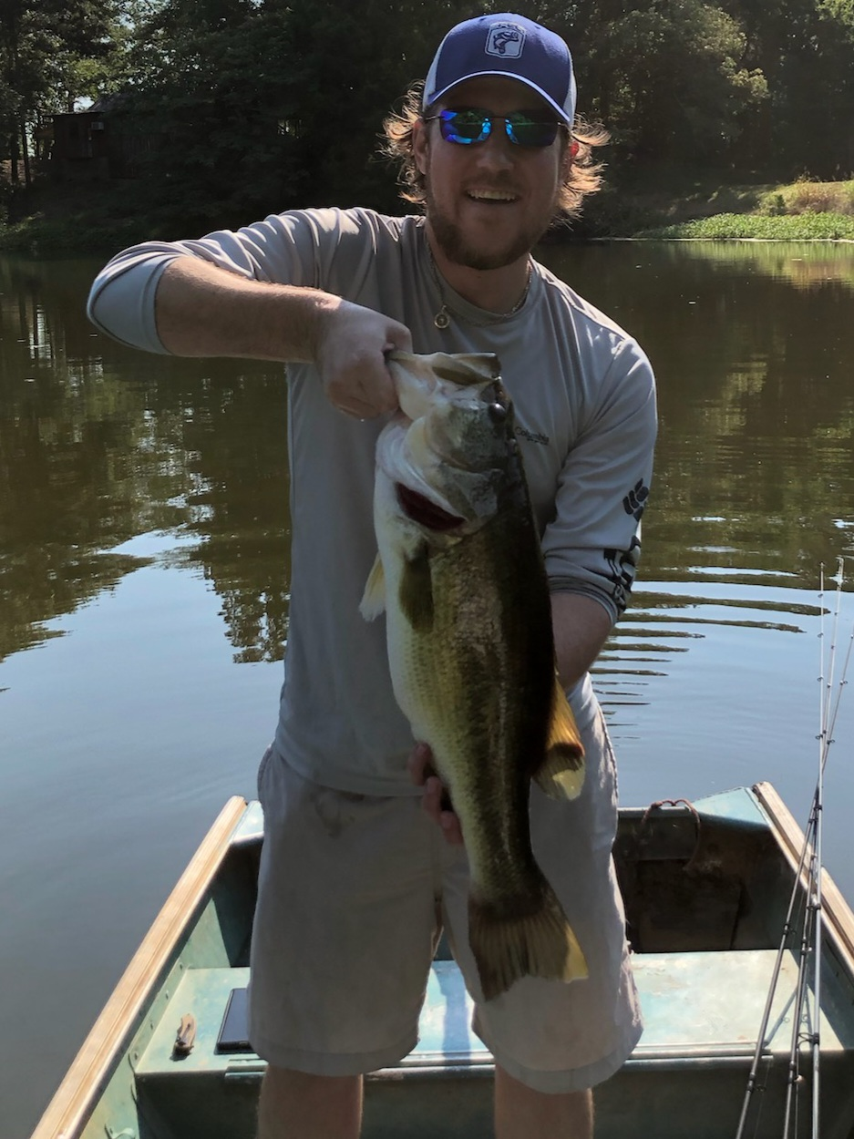
Let’s go Fishing!

