Slide 1

Bass Fishing Data Analysis and Prediction Model
SUMMARY
I have pulled data from the biggest fishing tournament of the year for Major League Fishing – REDCREST
After uploading the data to a database, I will prepare it for a machine learning model.
The goal for the model is prediction. Specifically, can the model predict the size of a fish if given controllable attributes.
The controllable attributes being used are:
Bait, Area, Cover, Depth, Time of Day
Can we create a model that helps us catch bigger fish?
Let’s see!

Slide 2
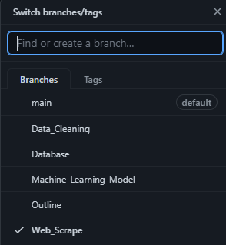
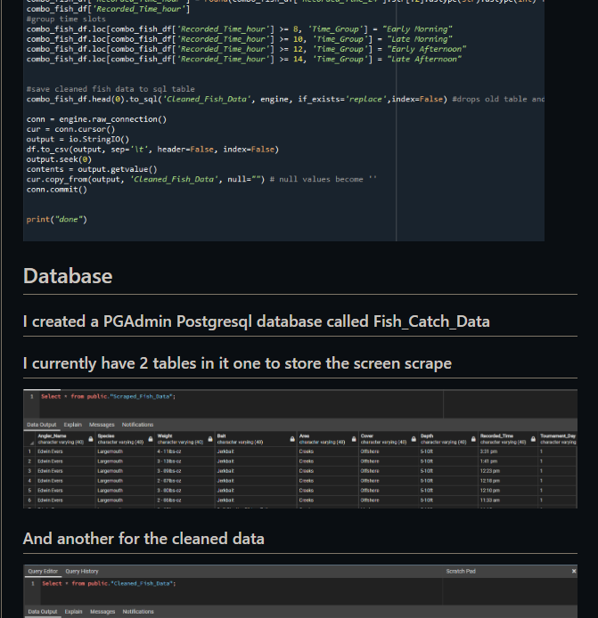
GitHub
There is a GitHub setup with a full ReadMe file.
There are several branches for each individual block of the project.

Slide 3

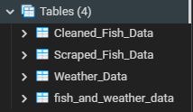
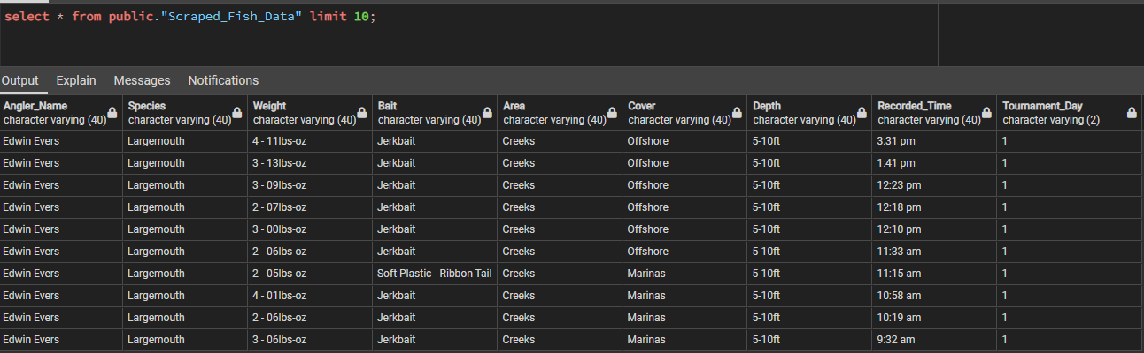
Database
pgAdmin 4 is used for a PostgreSQL database and the iterations of data are stored there.

Slide 4
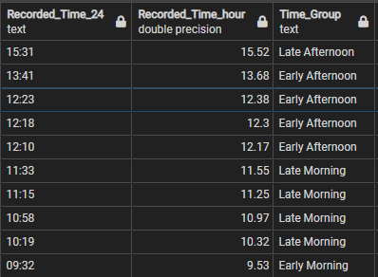
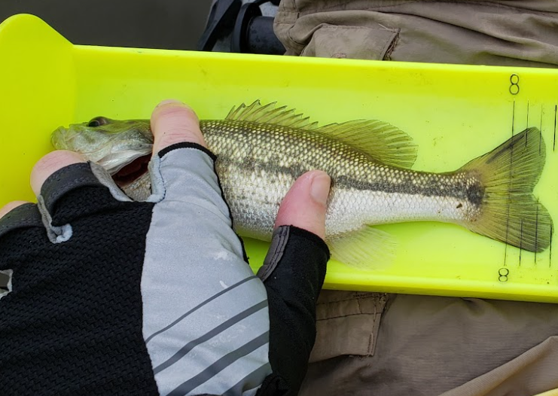
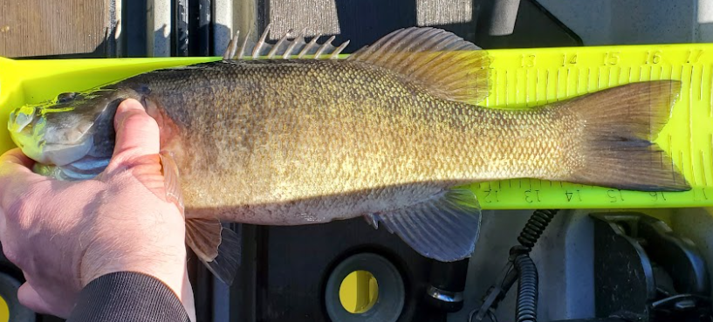
Data Exploration and Cleaning
As expected, the data is very noisy with not much separating the data.
See Interactive Dashboard for examples
A few columns were transformed into formats better suited for analysis such as changing weight from a ‘lbs-oz’ string format to a simple decimal format.
A few features were bucketed such as time of day to limit the amount of variables for the model.
After testing with the model it was decided a binary choice on target would make it easier for the model.
3lbs was close to a median weight for the data and colloquially is a large fish.
3lbs was chosen as the separator for the target. “>= 3lbs” is a Big_Fish and “<3lbs” is a Small_Fish.

Slide 5
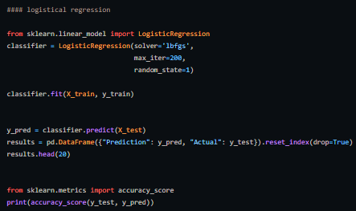
Machine Learning Model
After pairing down the subclasses and separating the target to a binary Big_Fish or Small_Fish. The machine learning model chosen was a Logistic Regression Model.

Slide 6
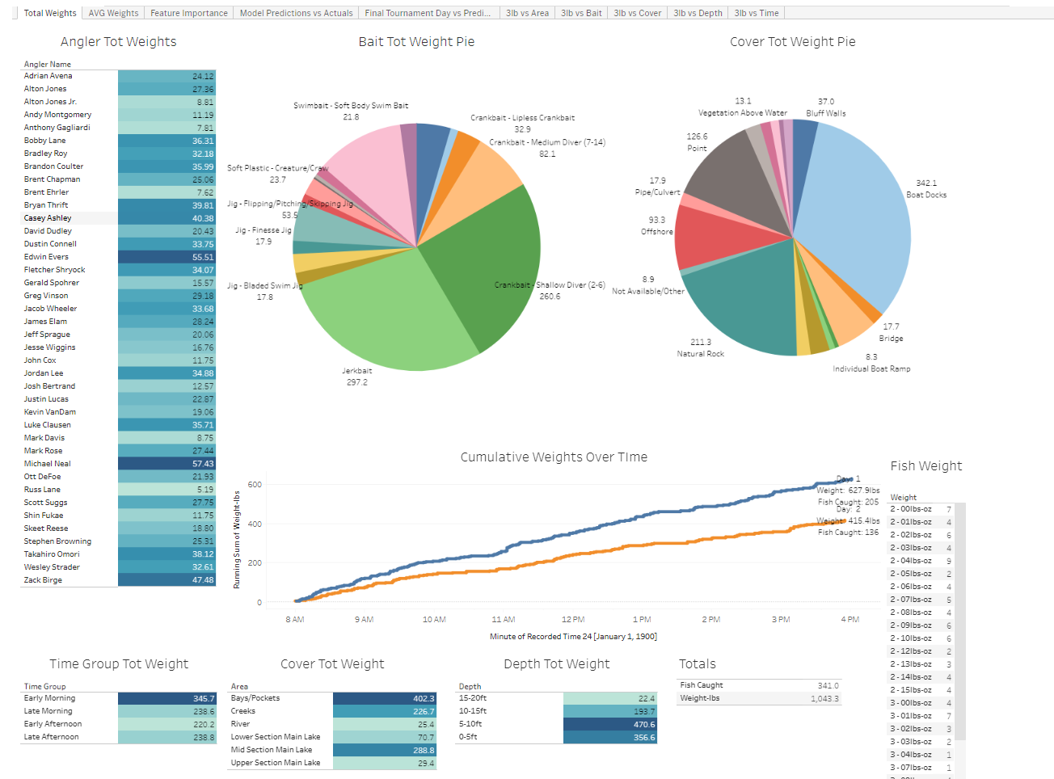
Dashboard
Interactive Dashboard on Tableau Public that breakdown the data.
Link to Workbook

Slide 7
Results

Slide 8
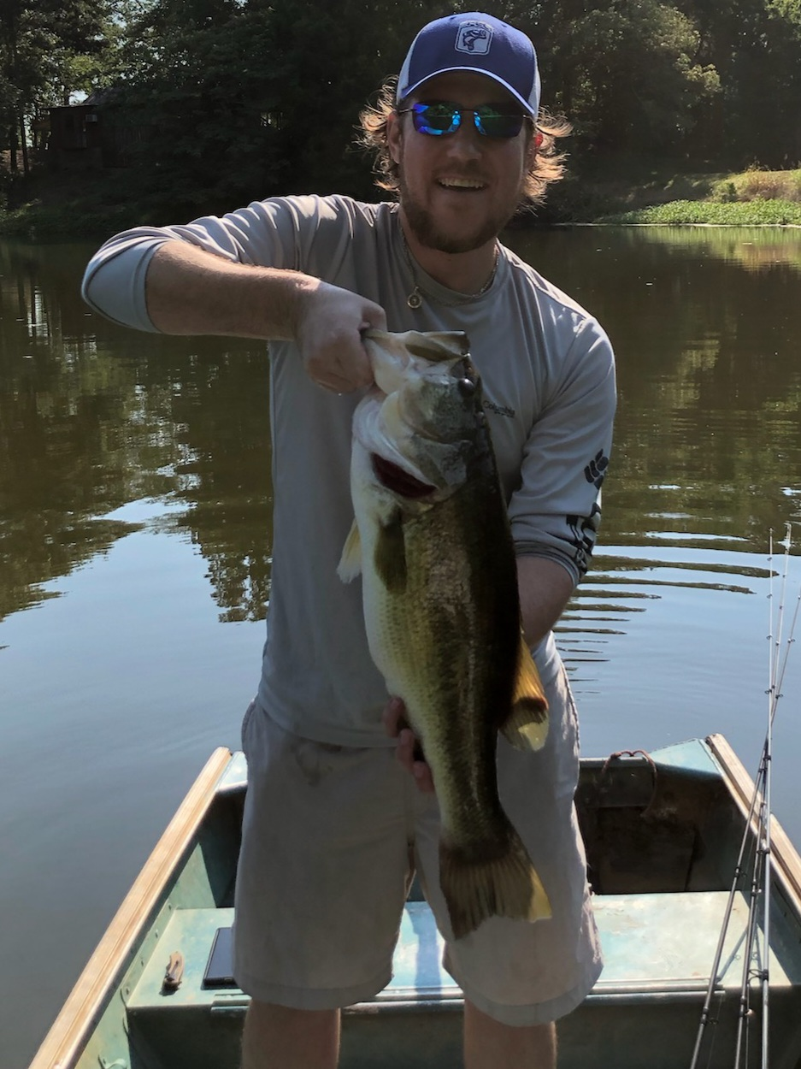
Lets go Fishin

