Slide 1

DESIGNING D-FLIP FLOP USING VARIOUS CIRCUITS
BTP CODE : B24VRK01
A.KIRANMAI:S20210020251
T.RAJASEKHAR:S20210020325
Mentor: Dr. Ramesh Kumar

Slide 2
Objectives:
Introduction of novel design approach for ternary D-flipflop
Utilization of ternary buffer and two STIs with dual power supplies
Proposal of two hybrid architectures for ternary D-flipflop designs
Combination of ternary buffer, STIs, and successor-predecessor circuits
Analysis of CNTFET and GNRFET outputs.

Slide 3
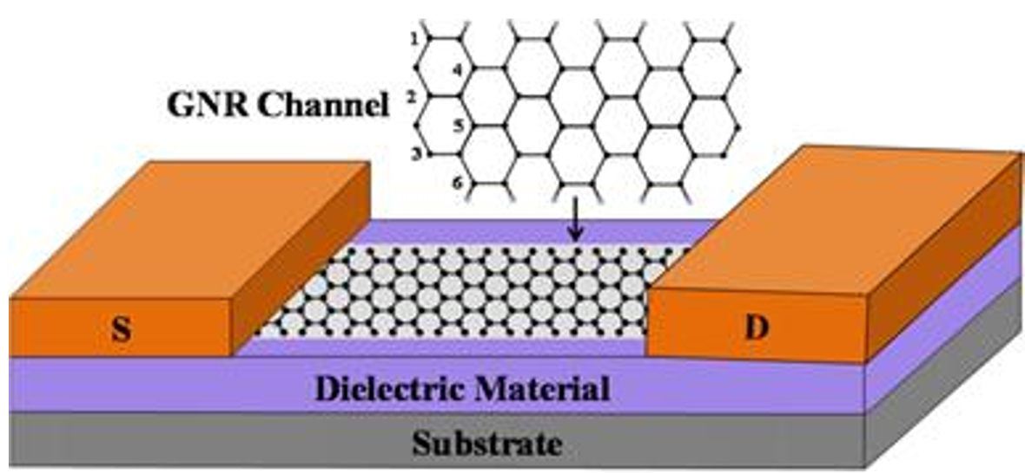
Introduction of GNRFET
A GNRFET is fabricated by simply making connections between a channel of graphene nanoribbons and the metal contacts of source and the drain.
GNRFETs have garnered significant interest due to their potential for high carrier mobility, excellent electrical properties, and nanoscale
dimensions.
These transistors offer advantages such as
high on-off current ratios, high carrier
velocities, and potential compatibility
with existing silicon-based electronics.
GNRFET [5]

Slide 4
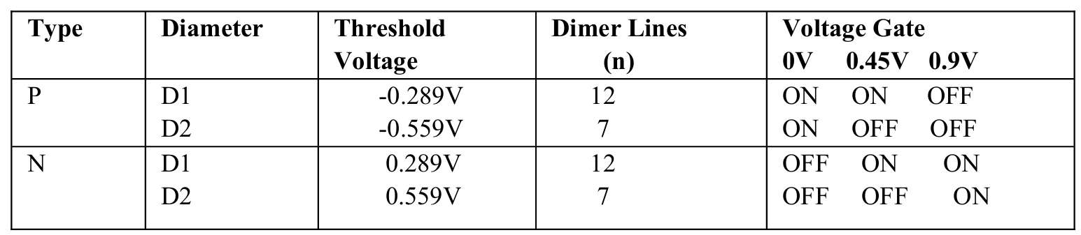
The width (W) of GNR is calculated as
𝑊=(𝑁+1)(√3/2) 𝑎
Where, ‘N’ represents no of dimer lines which is proportional to width of GNR, a
is the lattice constant i.e., 0.142 nm.
Vth inversely proportional to width of GNR. No. of dimer lines is inversely proportional to energy band gap.
Parameters of GNRFET is nRib,n,L,Tox,sp,dop,p.
n=19
n=10

Slide 5
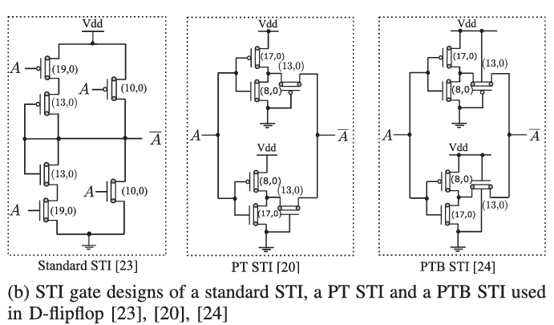
Circuits:
Designing D-Flip flop using Buffer and STI circuits:
STI[2] PT STI[3] PTB STI[1]
Existing Designs of Standard Ternary Inverter(STI)

Slide 6
Modified STI Circuit Buffer Circuit
Here Ap and An are outputs of PTI and NTI
Vdd
Vdd
Ap
(10,0)
A
(10,0)
Output
Output
Ap
A
(10,0)
Ap
(19,0)
An
(10,0)
(19,0)
Gnd
Vin | Buffer | STI
0 | 0 | 2
1 | 1 | 1
2 | 2 | 0
An
(19,0)
Gnd
An
(19,0)
Vdd/2
Vdd/2

Slide 7
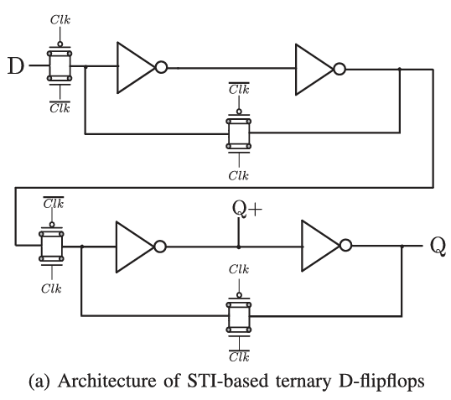
Existing D-Flip Flop Design: Modified D-flip flop Design:
CLK
Ternary Buffer
D
CLK
CLK
CLK
CLK
Q+
STI
STI
Q
CLK
CLK
STI BASED D-FLIPFLOP[1]
CLK

Slide 8
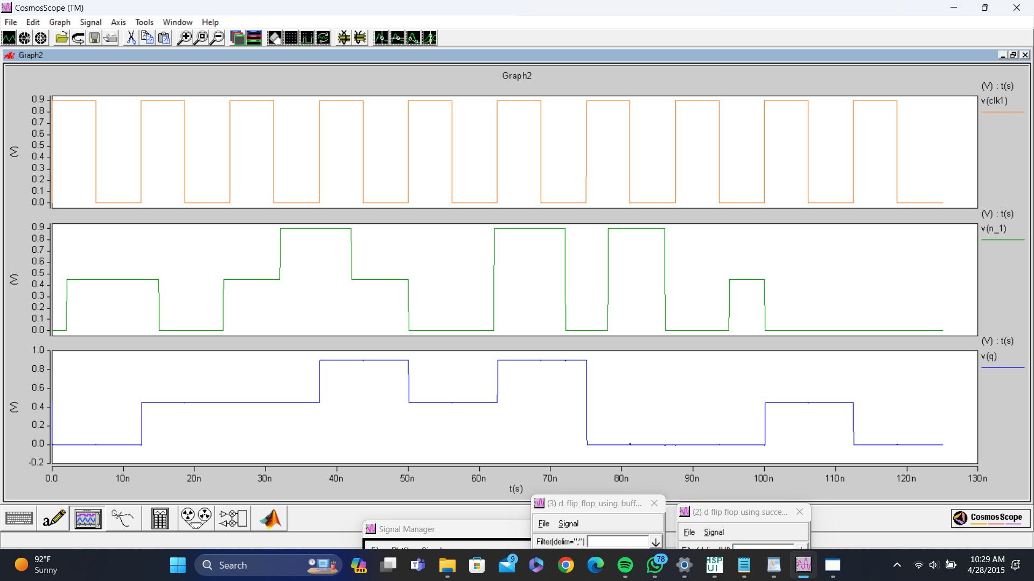
Output Waveforms:
CNTFET OUTPUT WAVEFORM

Slide 9
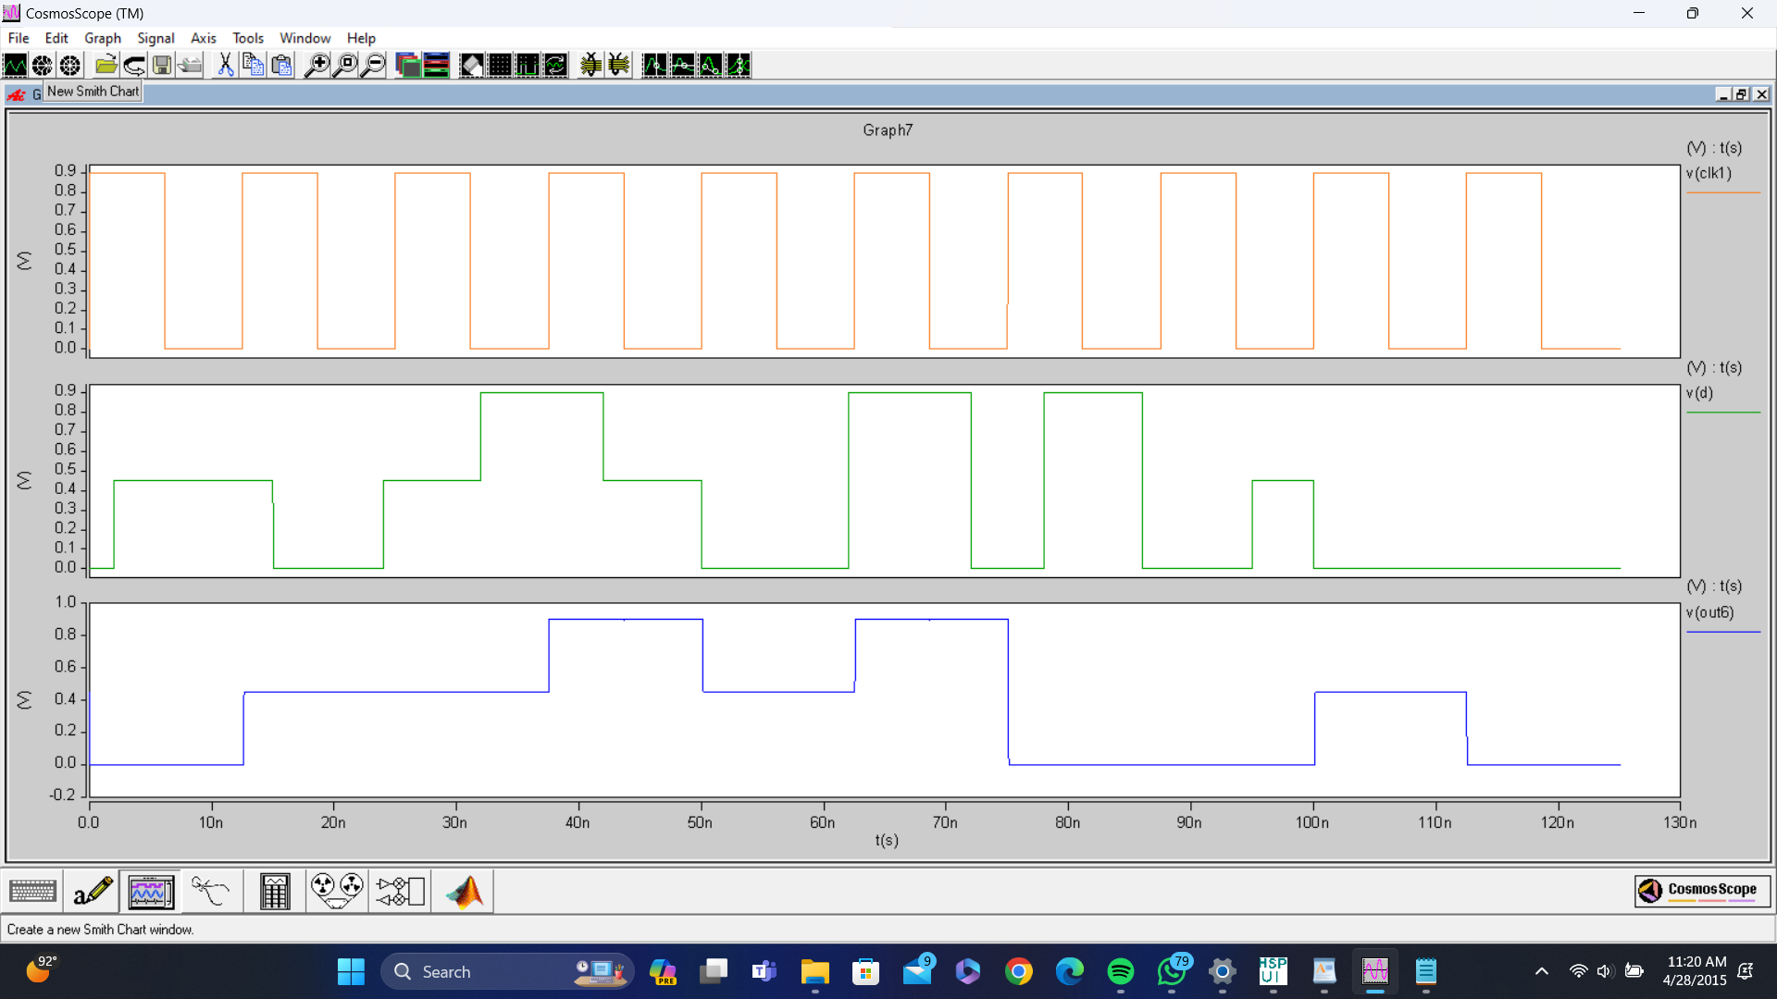
Output Waveforms:
GNRFET OUTPUT WAVEFORM

Slide 10
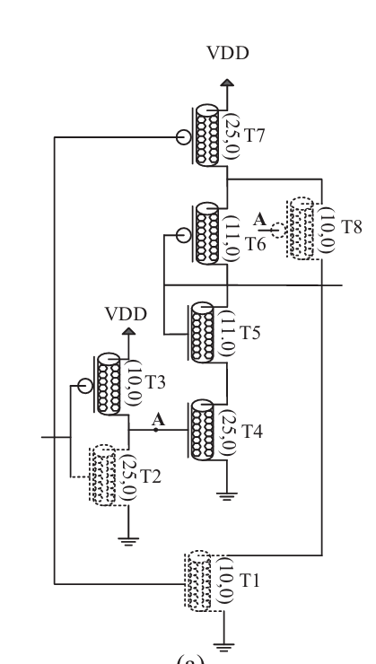
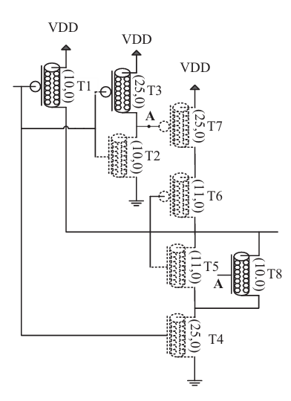
Designing D-Flip flop using Successor and Predecessor circuits:
Existing Designs of Successor and Predecessor circuits
Successor Circuit[1]
Predecessor Circuit[1]

Slide 11
Modified Successor Circuit Predecessor Circuit
NTI
Vdd
Vdd
A
(10,0)
1
(19,0)
A
A
(10,0)
Vdd
Output
Vdd
(19,0)
A
(19,0)
A
(19,0)
(19,0)
(19,0)
A
(19,0)
(10,0)
A
Gnd
(19,0)
output
A
(10,0)
Gnd
A
A
(10,0)
1
(19,0)
Vin | Successor | Predecessor
0 | 1 | 2
1 | 2 | 0
2 | 0 | 1
Gnd
Gnd
PTI

Slide 12
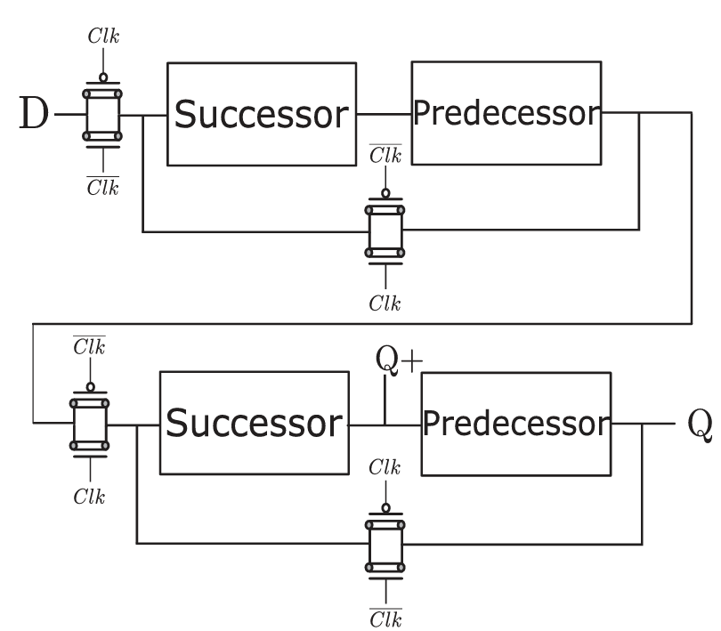
Existing D-Flip Flop Design: Modified D-flip flop Design:
CLK
D
Successor
Predecessor
CLK
CLK
CLK
CLK
Q+
Successor
Predecessor
Q
CLK
CLK
D-flip flop using successor and predecessor circuits[1]
CLK

Slide 13
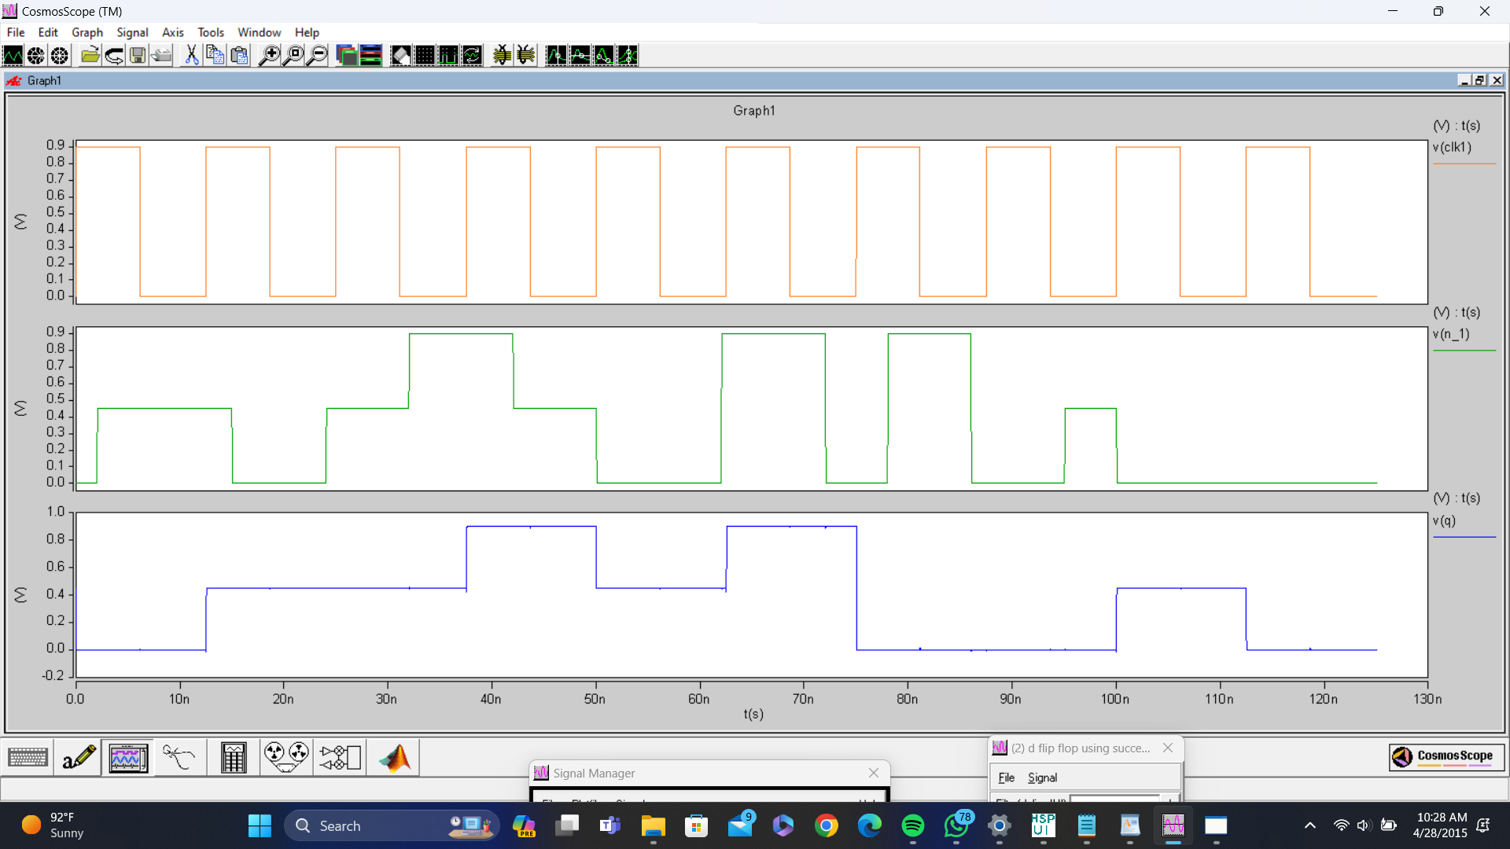
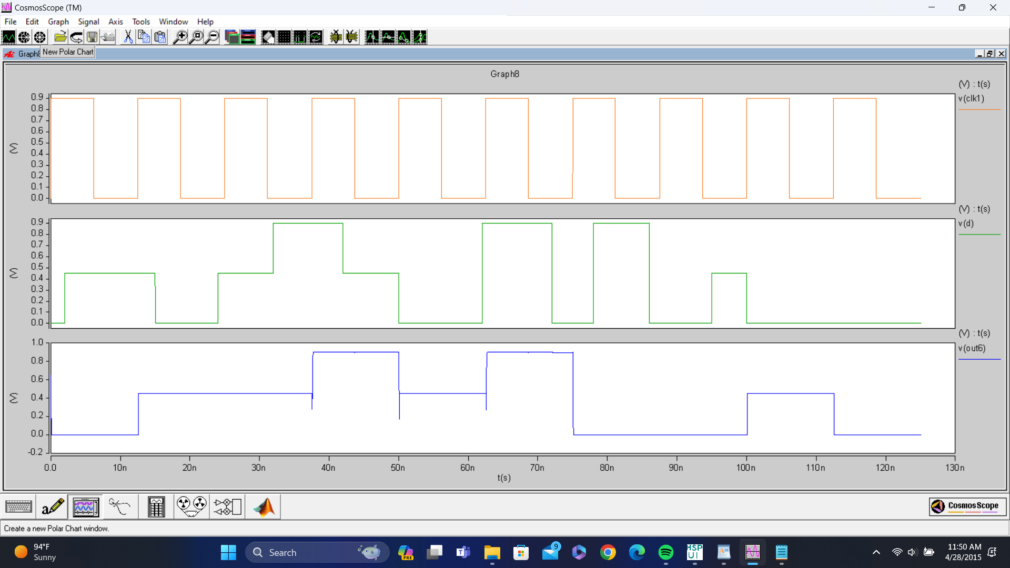
Output Waveforms:
CNTFET OUTPUT WAVEFORM
GNRFET OUTPUT WAVEFORM

Slide 14
D-FLIP FLOP USING BUFFER AND SUCCESSOR PREDECESSOR CIRCUITS [HYBRID CIRCUIT]:
CLK
Ternary Buffer
D
CLK
CLK
We designed hybrid circuits by combining buffer , successor and predecessor circuits to analyse the quantities Power consumption and delay of circuit.
CLK
CLK
Q+
Successor
Predecessor
Q
CLK
CLK
CLK

Slide 15
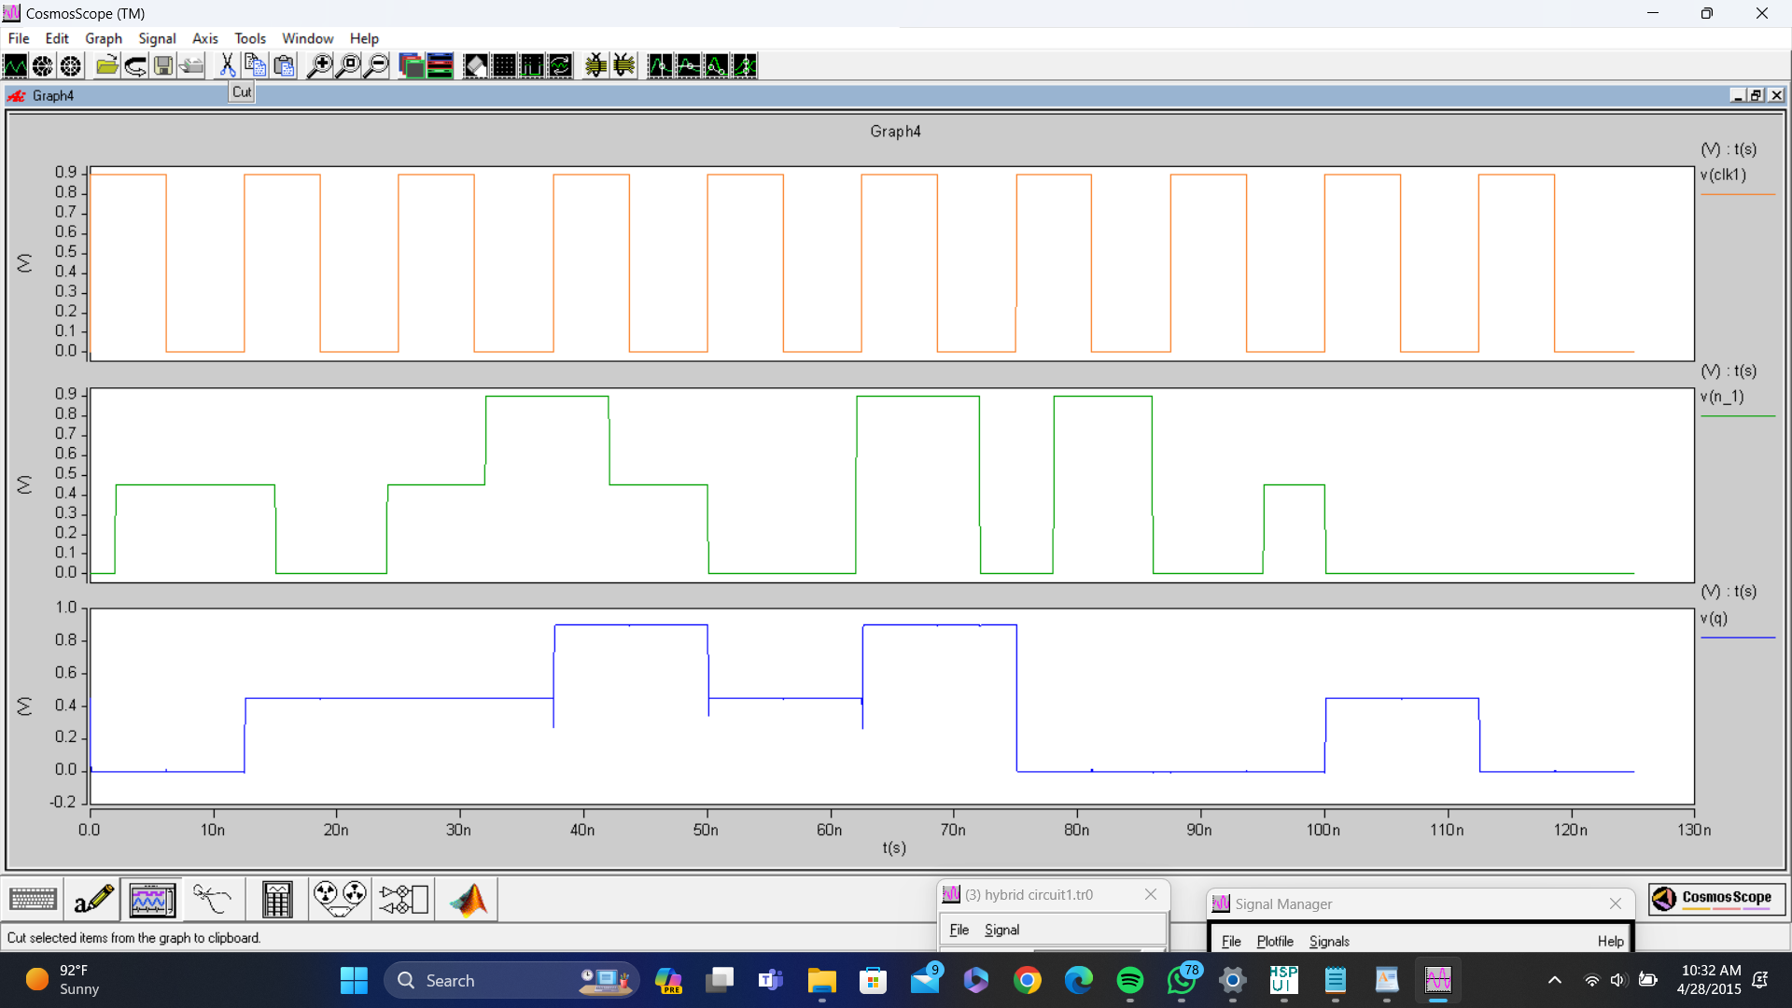
Output Waveforms:
CNTFET OUTPUT WAVEFORM
GNRFET OUTPUT WAVEFORM

Slide 16
D-FLIP FLOP USING SUCCESSOR PREDECESSOR AND STI CIRCUITS [HYBRID CIRCUIT]
CLK
D
Successor
Predecessor
CLK
CLK
We designed hybrid circuits by combining successor ,predecessor circuits and STI circuits to analyse the quantities Power consumption and delay of circuit.
CLK
CLK
Q+
STI
STI
Q
CLK
CLK
CLK

Slide 17
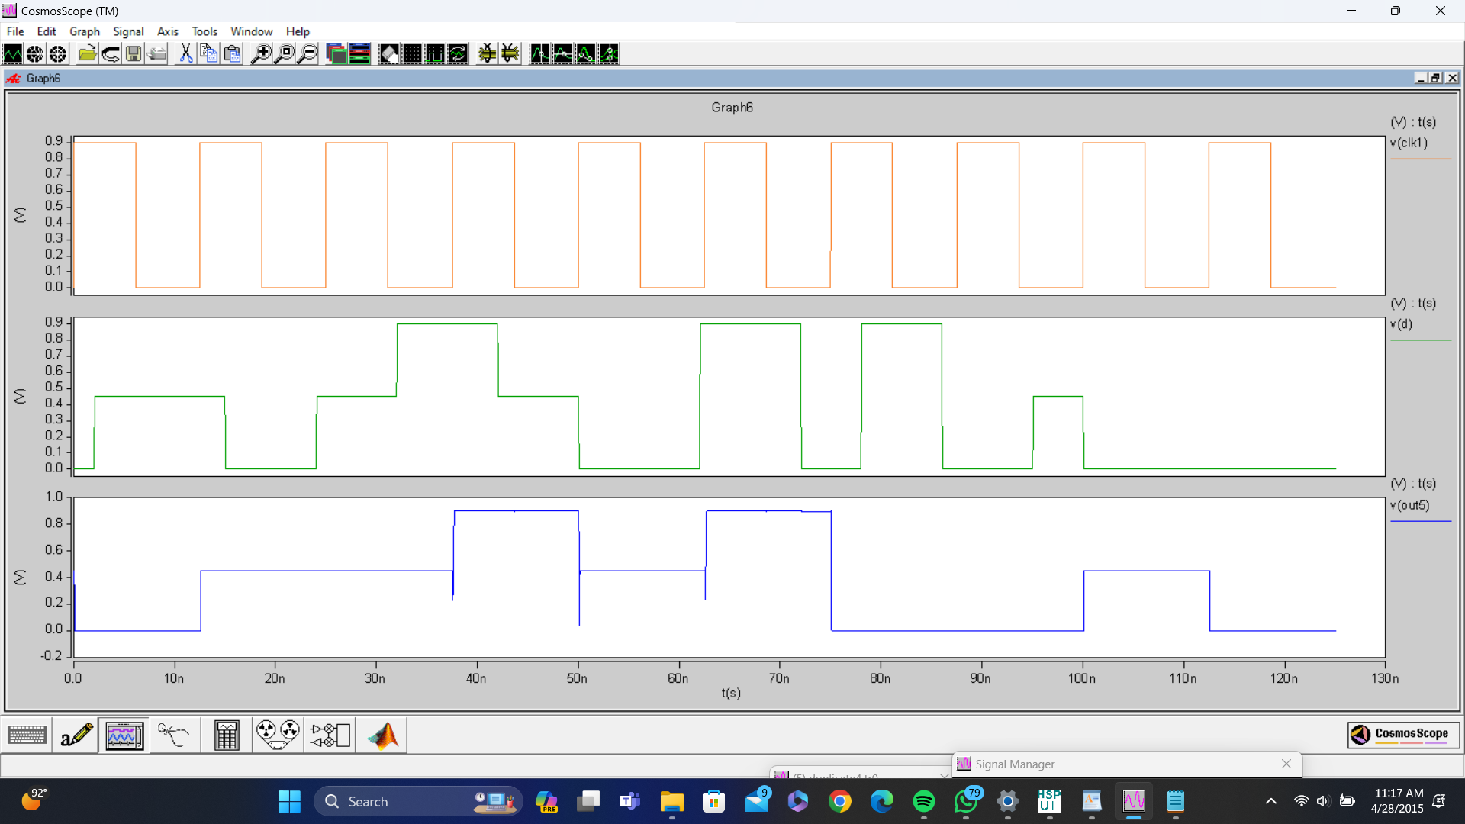
Output Waveforms:
CNTFET OUTPUT WAVEFORM
GNRFET OUTPUT WAVEFORM

Slide 18
CNTFET VS GNRFET
Comparison of Power(W)
Circuit | CNTFET | GNRFET
D-FLIP FLOP USING BUFFER AND STI CIRCUITS | 1.0712e-06 | 1.6326e-06
D-FLIP FLOP USING SUCCESSOR PREDECESSOR CIRCUITS | 6.5782e-08 | 3.3997e-06
D-FLIP FLOP USING BUFFER AND SUCCESSOR PREDECESSOR CIRCUITS | 1.0683e-06 | 3.4255e-06
D-FLIP FLOP USING SUCCESSOR PREDECESSOR AND STI CIRCUITS | 1.0894e-06 | 3.4255e-06

Slide 19
CNTFET VS GNRFET
Comparison of Propagation Delay(sec)
Circuit | CNTFET | GNRFET
D-FLIP FLOP USING BUFFER AND STI CIRCUITS | 3.5257e-08 | 3.5307e-08
D-FLIP FLOP USING SUCCESSOR PREDECESSOR CIRCUITS | 3.5433e-08 | 3.6961e-08
D-FLIP FLOP USING BUFFER AND SUCCESSOR PREDECESSOR CIRCUITS | 3.5277e-08 | 3.5325e-08
D-FLIP FLOP USING SUCCESSOR PREDECESSOR AND STI CIRCUITS | 3.5258e-08 | 3.5314e-08

Slide 20
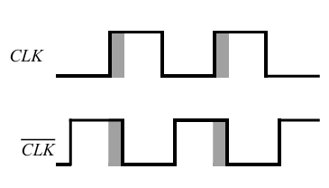
Conclusion:
The simulated results obtained for the CNTFET and GNRFET structures for D-Flip Flop suggests that CNTFET structures can be possible low power alternative in sub nanometer regime.
CNTFET threshold voltage can be controlled by diameter which depends on the chirality vector. In GNRFET threshold voltage can be controlled by width which depends on number of dimer lines.
The design process utilizes different techniques in terms of transistor arrangement, two power supplies (Vdd, Vdd/2), transistor count reduction to reach the final target.
CLK and CLK both low for a short period of time (the overlap period), both sampling pass transistors conduct and there is a direct path from the D input to the Q output.
Clock overlapping[4]

Slide 21

TIMELINE:
1
Literature Review and implemented some basic ternary inverters circuits and basic building blocks needed to improvise D-Flipflops.
2
Building D-flipflops using buffer-STI and successor-predecessor circuits (CNTFET and GNRFET)
3
New idea of design for D flipflop that avoids zero-zero overlapping and 1-1 overlapping.
4
Trying to design single phase clock in designing D-flip flop and try to design TSPC.

Slide 22

References:
[1] K.RahbariandS.A.Hosseini,“NovelternaryD-flip-flap-flopandcounter based on successor and predecessor in nanotechnology,” AEU- Int. J. Electron. Commun., vol. 109, pp. 107–120, Sep. 2019.
[2] T. Sharma and L. Kumre, “Design of unbalanced ternary counters using shifting literals based D-Flip-Flops in carbon nanotube technology,” Com put. Elect. Eng., vol. 93, 2021, Art. no. 107249.
[3] S. Gadgil and C. Vudadha, “Design of CNFET-based low-power ternary sequentiallogiccircuits,”inProc.IEEE21stInt.Conf.Nanotechnol.,2021, pp. 169–172.
[4]Chen YY, Sangai A, Gholipour M, Chen D. Graphene nano-ribbon field-effect transistors as future low power devices. Proc Int Symp Low Power Electron Des. 2013;151–6.
[5]Venkataiah C.¹, Mallikarjuna Rao Y.², “Performance analysis of Ternary Adder and Ternary Multiplier without using Encoders and Decoders” April 2021 IEEE Access 9(April):1.

Slide 23

THANK YOU

