Slide 1
3D Face Reconstruction and Facial Expression Transfer
Summary of Techniques and Models

Slide 2
Understanding 3D Face Reconstruction
Key Concepts:
Landmark Detection (eyes, nose, mouth)
3D Model Fitting (template model adjustment)
Texture Mapping (applying colors & details)
Pose & Expression Estimation

Slide 3
Importance of Accurate 3D Face Models
Why It Matters:
Captures detailed facial movements
Ensures realistic expression transfers
Adjusts for head angles, lighting, etc.

Slide 4
Comparison of 3D Face Reconstruction Models
Model | Strengths | Limitations | Use Cases
FaceMesh | Fast, low power | Lacks detail | Live filters
3DDFA | Accurate, versatile | Slower | Facial recognition
Deep3DFace | High detail | High processing power | VR, Games

Slide 5
Facial Expression Transfer
Process:
Capture expression from source face
Apply to target face while keeping identity
Align facial features, adjust textures

Slide 6
FaceMesh Approach
Steps:
Triangular division using Delaunay Triangulation
Affine transformation for warping
Blending for expression transfer
Challenges: Pose misalignment, 2D distortions

Slide 7
3DDFA Approach
Steps:
3D Fitting with Morphable Model (3DMM)
Expression and texture transfer
Advantages: Better pose and lighting handling, fewer distortions

Slide 8
Deep3DFace Approach
Steps:
Detailed 3D mesh reconstruction
Warping for expression transfer
Texture mapping for realism
Best For: Capturing small details like wrinkles, fine movements

Slide 9
Metrics for Evaluating Expression Transfer
Metrics:
RMSE: 2D Landmarks accuracy
MAE: 3D Landmarks precision
SSIM: Visual similarity (brightness, contrast, texture)

Slide 10


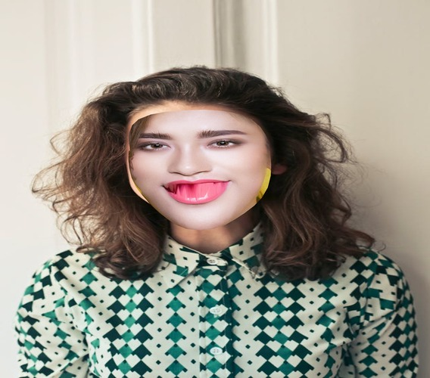
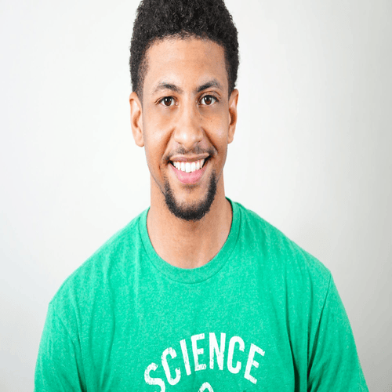

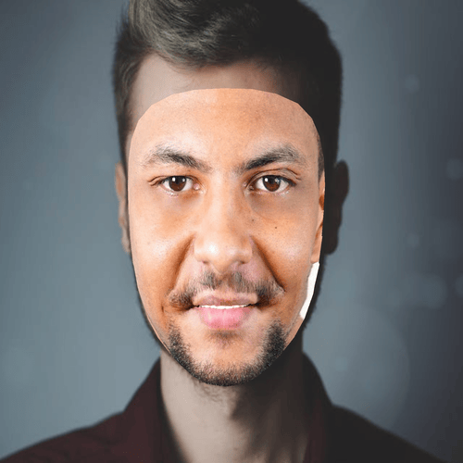
Experiments & Results
Test Case 1: RMSE: 168.7, MAE: 110.8, SSIM: 0.67
Test Case 2: RMSE: 187.7, MAE: 116.8, SSIM: 0.54

Slide 11
Challenges and Improvements
Challenges:
Complexity of advanced models (Deep3DFace)
Computational demands (GPU, Linux compatibility)
Improvements: Use 3DDFA for better accuracy or Deep3DFace for realism

Slide 12
Conclusion
Summary:
FaceMesh: Best for speed, not detail
3DDFA: Balanced, good for most tasks
Deep3DFace: High-quality results for specialized tasks
Future Work: Incorporating more advanced models for improved accuracy

