Slide 1
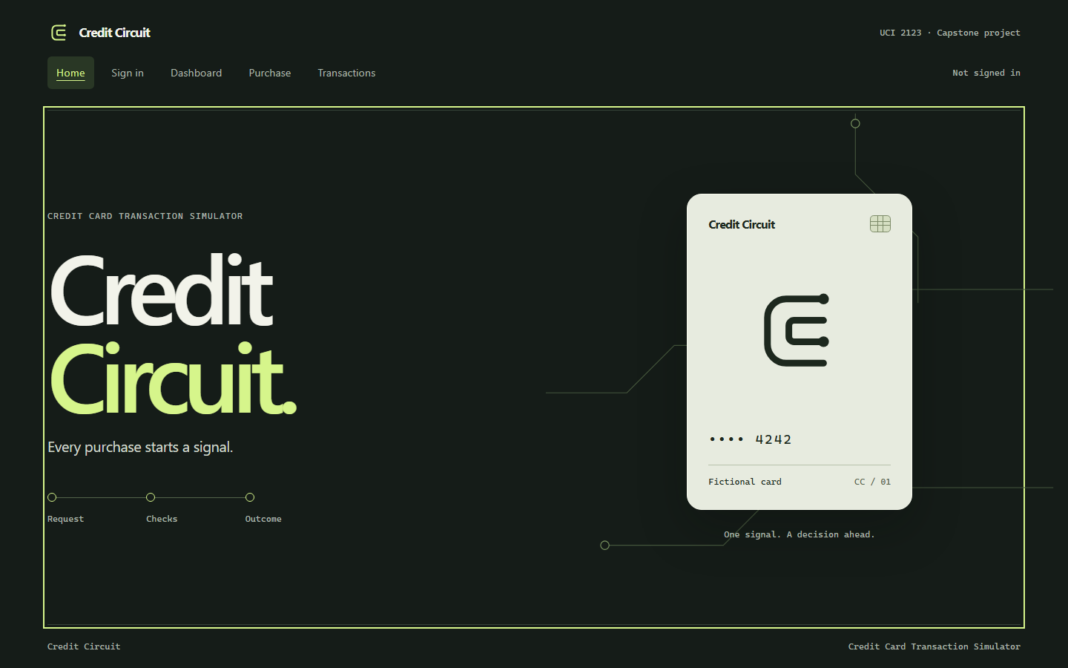
Credit Circuit
Fictional purchases
with clear outcomes
UCI 2123 capstone
October 13, 2026
Local React, Spring Boot, MySQL
Notes:
0:00–0:30. I built a local credit card transaction simulator for UCI 2123. All cards, identities, merchants, and balances are fictional. The home screen retains the Request, Checks, Outcome teaser. Source: outputs/01_Project_Proposal/03_Submission_Proposal.md and home-desktop.png. The instructor waived AWS and related deployment/DevOps work.

Slide 2
The problem
An uncertain response needs a safe retry.
A customer must reach only their own account.
A balance change must agree with its history.
A decline needs a clear financial explanation.
Approved local scope: application and quality evidence.
AWS and related deployment work are waived.
Notes:
0:30–1:15. A purchase can exceed available credit or reach the wrong account if the API checks only roles. A network failure can leave a customer unsure whether a purchase saved. I built explicit decisions, safe retries, ownership checks, and consistent balance/history writes. This is a classroom simulator, with no bank/payment network connection. AWS infrastructure, deployment pipelines, and cloud monitoring are waived. Jira and branch protection are outside this pass. Source: current proposal and authentication/financial ADRs.

Slide 3
Application architecture
React page
and fetch
Spring Security
signed JWT
Controller
@Valid
Service
rules / locks
JPA repository
queries
MySQL
four tables
Boundary validation checks format.
Services enforce ownership and money rules.
One API, one database, one JWT authentication path.
Notes:
1:15–2:15. Trace a page through fetch, Spring Security, controller, service, repository, and MySQL. The bearer token comes only from React memory. Controllers validate shape; services check stored role/ownership and financial rules. JPA repositories query and lock rows. I used the class banking app as a learning reference without copying its supplied solution. Source: outputs/02_Architecture/01_System_Architecture.md. This diagram is editable native slide content.

Slide 4
Four tables
Table | Purpose
app_users | Identity, BCrypt hash, role
credit_accounts | Limit, outstanding balance, ACTIVE/FROZEN
demo_cards | Profile, masked display, expiry
card_transactions | Purchase/refund outcomes and request IDs
Available credit = limit − outstanding balance
A refund links to its original purchase once.
Notes:
2:15–3:00. app_users stores BCrypt and USER/ADMIN. A customer owns one credit account and one fictional card. An administrator has no account. card_transactions stores purchases and linked full refunds. No full number/security code/token column exists. BigDecimal/DECIMAL handle money and available credit is calculated. Foreign keys and unique constraints protect relationships; no cascade deletes financial history. Source: ERD and sql/01_schema.sql.

Slide 5
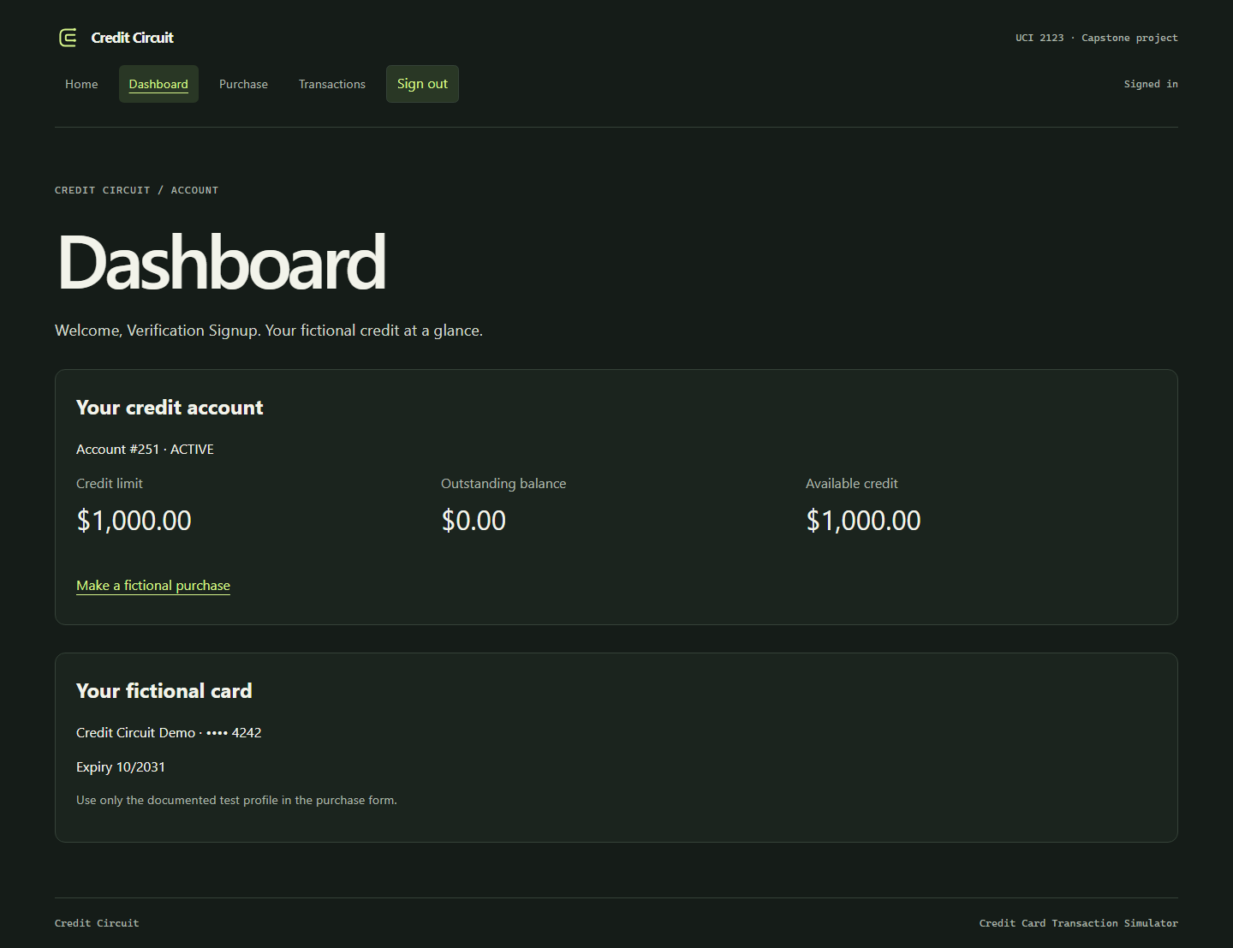
Live customer and admin demo
Register and sign in
Purchase $50
Save a $2,000 decline
Refund the original $50
Freeze and reactivate
Every value in the demonstration is fictional.
Notes:
3:00–6:00. Open the running app. Use private credentials, never show passwords or tokens. Register/sign in as customer and show the masked card and $1,000 available. Purchase $50 using the displayed expiry and fictional profile. Show $950 available. Purchase $2,000 and show a saved insufficient-credit decline with no balance change. Open history and confirm the full $50 refund. Show original/refund and restored credit. Sign out, sign in as ADMIN, find/freeze the customer account, and show activity. Customer spending declines while frozen. Reactivate for the next demo. The local guide has the full sequence. Screenshot is verified fixture data, not an active credential. Source: browser-results.json and dashboard-desktop.png.

Slide 6
Retries and consistent balances
Protection | Job
Stable request UUID | An identical retry returns the saved transaction
Account write lock | Competing balance changes wait their turn
Database transaction | Balance and history commit or roll back together
201: new financial outcome
200: identical saved retry
DECLINED: saved decision with no balance increase
Notes:
6:00–7:00. Explain three separate protections. The UUID identifies one submission; account/request uniqueness backs it. A pessimistic account lock serializes competing changes. @Transactional commits balance and history together or rolls both back. READ_COMMITTED lets a waiting retry see a prior commit. An identical retry returns 200 with the original transaction and current account summary. New approval/decline/refund returns 201. Full refunds use the original amount and one unique original_purchase_id. Browser tests lose responses after real saves; MySQL tests verify concurrency/rollback. Source: TransactionService, financial ADR, Java/browser results.

Slide 7
Authentication and access
BCrypt password checks and signed JWT verification
USER/ADMIN routes plus account ownership
Access stays in React memory for 15 minutes
Local CORS and authentication rate limiting
Sign-out discards browser access.
A copied token remains valid until expiration.
Notes:
7:00–7:45. BCrypt checks passwords. Spring Security/Nimbus validate HS256 signatures, expiration, issuer, audience, positive numeric subject, role, and time claims. The random signing key stays outside Git. Registration cannot choose ADMIN. Services still check stored roles and ownership. React holds access in memory and expires/discards it on sign-out/reload/401. A copied token remains valid until expiry; no refresh/revocation infrastructure exists. Explicit bearer headers, no accepted authentication cookies, and credentials=omit justify the API CSRF scope. CORS and a small per-IP auth limit apply. This transport was explicitly reviewed in SonarQube. Sources: authentication ADR, SecurityConfiguration, and https://docs.spring.io/spring-security/reference/6.5/servlet/exploits/csrf.html .

Slide 8
Verification evidence
Check | Measured result
JUnit and MySQL | 36 passed, including 10 MySQL tests
JaCoCo Java lines | 95.74%, with a 70% minimum gate
Postman | 49 requests, 72 assertions passed
Chromium workflows | 11 groups passed
SonarQube | Actual Java/React analysis and saved report
Reports distinguish real behavior from injected failure cases.
Notes:
7:45–8:30. Reports are from October 8 on the real local application/MySQL. The 36 Java tests include ten MySQL integration tests. JaCoCo line coverage is 95.74%, branch 77.33%, with an enforced 70% line gate; no production class exclusions. Postman executes 47 exported items plus two rate-limit subrequests, 49 HTTP requests and 72 assertions. Eleven browser groups cover real customer/admin workflows and explicitly injected failure/empty/expiration cases. Automated accessibility is Chromium only. SonarQube is the actual local Community Build, not another linter. Its saved report records the processed gate, findings and justified CSRF/table reviews. Source: outputs/03_Verification/ .

Slide 9
Lessons and remaining work
Retries need stable identity.
Locks and transactions solve different problems.
Quality claims need actual evidence.
Planned 3D card after required application work
Two peer reviews and recorded changes
Rehearsal October 12
Presentation and submission October 13
Notes:
8:30–9:15. A request ID, lock, and transaction solve different problems. Boundary validation and service rules have different jobs. Quality claims need actual tool results and honest limits. I still need two peer reviews and to give/incorporate feedback, private demo access, and personal rehearsal. The 3D card remains planned after the required app works. Rehearse October 12; present/submit October 13. Do not claim reviews/submission have occurred. Source: self-assessment and blank peer-review worksheet.

