Slide 1
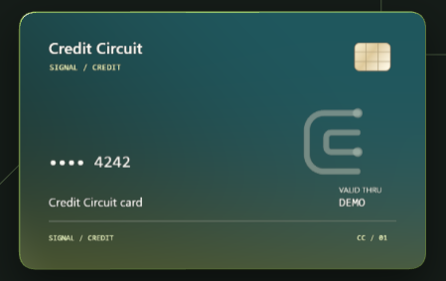
Marvens Jean / UCI 2123
Credit
Circuit.
Every purchase starts a signal.
Credit card transaction simulator
01
Notes:
**Cue:** Name → project → purchase, balance, refund.
### Script
I'm Marvens Jean, and this is Credit Circuit, my UCI 2123 capstone. It's a credit card transaction simulator built with React, Spring Boot, and MySQL. I'll walk through a purchase, what happens to the account balance, and how a refund brings it back.
Sources: Application artwork: outputs/03_Verification/card-model-front.png, October 10, 2026.

Slide 2
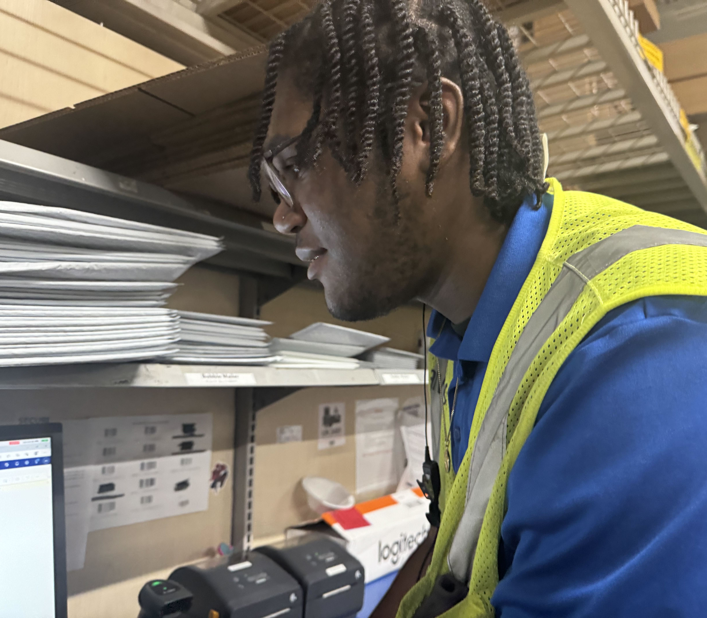
ABOUT ME
My background
is in retail.
Development interested me because
I wanted to understand how
everyday processes work.
My interest in finance led me to
explore credit card transactions.
02
Notes:
**Cue:** Retail background → curiosity about everyday processes → finance.
### Script
Most of my background is in retail. What drew me to development was wanting to understand the systems behind everyday things we usually take for granted. Finance interests me, so exploring what happens behind a credit card purchase felt like a good place to start.
Sources: Personal background and interests supplied by Marvens Jean. Photo supplied by the presenter: IMG_0020.jpg.

Slide 3
PROBLEM AND SOLUTION
Trying again shouldn’t cost you twice
A dropped connection shouldn’t turn a $50 purchase into a $100 problem.
A $50 purchase
You try again
Still $50
You submit the purchase
The same purchase, retried
Credit Circuit recognizes the retry
Credit Circuit
See what happened to every purchase,
with clear decisions and refunds you can trace.
03
Notes:
**Cue:** $50 → connection drops → retry → one outcome and a matching balance.
### Script
That brings me to the problem I wanted to solve.
Take a $50 purchase: the page hangs, and you never get a confirmation. You try again. Now you're wondering whether you've been charged twice.
That's the problem I built around. A customer needs a clear answer, and their balance needs to match what actually happened.
Credit Circuit recognizes repeated requests, records approvals and declines, and links a full refund to its original purchase. Customers can follow their history, and administrators can control account status. Everything uses fictional cards and balances.
Sources: Illustrative $50 retry scenario. Implementation: backend/src/main/java/com/marvens/capstone/service/TransactionService.java.

Slide 4
ARCHITECTURE
The stack
React
API call
Controller
Service
JPA
MySQL
Form and
feedback
Purchase
request
Validate
input
Decide the
outcome
Load and
save
Store the
records
One backend. Four tables.
Each part has a clear job, so I can follow a purchase through the app.
04
Notes:
**Cue:** React = screens → Spring Boot = decisions → MySQL = saved records.
### Script
Here's the path a purchase takes through the application.
I used three main technologies. React builds the screens the customer interacts with. Spring Boot runs behind those screens and handles the rules for purchases and refunds. MySQL keeps the account information and transaction history.
When someone submits a purchase, the screen sends the information, the backend checks it, and the database saves the outcome. The result comes back to the customer as a receipt and an updated balance.
Each part has a clear job, which helps me follow a purchase through the application.
Sources: outputs/02_Architecture/01_System_Architecture.md.

Slide 5
INSIDE THE BACKEND
The purchase service
01
Check the customer and lock their account
TransactionService
02
Check the assigned card
The service connects each history
record to the checked account
and assigned card.
03
Look for the same request ID
04
Check expiry, account status, and credit
transaction.setAccount(
customerAccount);
transaction.setCard(
assignedCard);
05
Approve or decline
06
Save the outcome and balance together
05
Notes:
**Cue:** Right account and card → allowed purchase? → correct balance and history.
### Script
The purchase decisions happen in the service. This is the part of the backend that decides whether a purchase can go through.
It checks that the customer is using their own account and assigned card. It also checks whether the card has expired, whether the account is frozen, and whether enough credit is available.
For an approved purchase, the outstanding balance goes up by that amount. A decline leaves that balance unchanged. Both outcomes are recorded so the customer can see what happened.
The two lines shown here connect that purchase record to the account and card it belongs to.
Sources: backend/src/main/java/com/marvens/capstone/service/TransactionService.java.

Slide 6
DATABASE
The relationships
1 customer / 1 account
1 account / 1 card
User
Credit account
Fictional card
Customer identity
Limit, balance, status
Assigned to the account
account_id
card_id
Many transactions
Transaction
Each refund links back
to its original purchase.
Purchase or refund history
06
Notes:
**Cue:** Customer → account → card → purchase → linked refund.
### Script
Every purchase needs a record I can trace back to the right account.
The database has four connected groups of records: users, accounts, fictional cards, and transactions. A customer has an account, the account has a card, and purchases are connected to both.
A refund stays linked to the purchase it reverses. The original purchase remains in history, alongside the refund and the balance after each outcome.
That gives me a clear trail of where a balance change came from.
Sources: outputs/02_Architecture/02_Entity_Relationship_Diagram.md.

Slide 7
API
The request and result
One submitted form
One returned response
Amount and merchant
Assigned card details
Request ID
Transaction outcome
Current account balance
201
New outcome, including a decline
200
Identical retry
07
Notes:
**Cue:** Customer submits details → sees outcome, reason, and updated credit.
### Script
After that decision, the customer needs a clear answer.
The purchase form sends the card details, merchant, and amount to the backend. The result tells the screen whether the purchase was approved or declined and provides the current account balance.
The customer sees a receipt, a reason if the purchase was declined, and updated available credit. They can see the outcome without having to work it out themselves.
Sources: outputs/02_Architecture/03_API_Design.md and TransactionController.java.

Slide 8
FAILURE PATHS
When something goes wrong
Declined purchase
Save the reason. Leave the balance unchanged.
Same request again
Return the existing transaction.
Same ID, changed details
Reject the conflicting request.
Concurrent spending or failed write
Lock the account. Commit or roll back together.
08
Notes:
**Cue:** Retry = same purchase → simultaneous purchases wait → balance and history stay together.
### Script
That answer needs to stay reliable when something goes wrong.
If the same purchase is retried, the app returns the original result. The retry doesn't add another purchase to the balance.
If two purchases arrive together, the app handles changes to that account one at a time so both can't spend the same remaining credit.
The balance change and purchase history are also saved together. If saving fails, neither change sticks. I did that to prevent a changed balance with no purchase recorded to explain it.
Sources: TransactionService.java and the recorded transaction integration tests.

Slide 9
VERIFICATION
Security and testing
95.56%
BCrypt passwords
Signed JWTs in React memory
Role and ownership checks
Java line coverage
Postman
47 Java tests
56 requests / 83 assertions passed
Including 13 real MySQL integration tests
SonarQube quality gate passed
Recorded runs: October 9, 2026
09
Notes:
**Cue:** Protected access → own account only → successful and failed purchases tested.
### Script
I tested those situations and checked who can access each account.
Spring Security protects account access. BCrypt protects stored passwords, and signed JWTs let the server verify who is signed in. Customers can only use their own accounts; administrators have separate controls.
The tests cover approvals, declines, retries, purchases arriving together, and failed saves. The recorded Java run passed 47 tests, exercising over 95 percent of the code's lines. The October 9 Postman API checks and SonarQube code quality review also passed.
Sources: outputs/03_Verification/01_Completion_Checklist.md and 02_Quality_Report.md. Recorded Java, Postman, and SonarQube evidence: October 9, 2026. Later frontend checks: October 10.

Slide 10
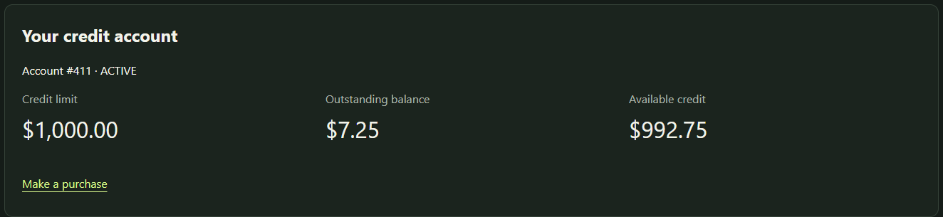
RECORDED DEMO
A purchase in Credit Circuit
Credit at a glance
01
Dashboard and flippable card
02
$50 approved purchase
03
Decline above available credit
04
History and full refund
05
Admin account freeze
Fictional cards and balances
10
Notes:
**Cue:** Recorded application → five actions → play video.
### Script
Here's a recording of that workflow running locally. I'll walk through the dashboard, an approved purchase, a decline, a full refund, and an administrator freezing the account.
Demo narration:
**Cue:** Follow the visible action. Leave room to read each result.
The sections below follow the video in order. The finished recording is 2:57 and silent. I will follow the visible action rather than treat these sections as fixed speaking intervals.
### Dashboard and card
I'll start on the customer's dashboard. This account shows its outstanding balance and available credit. The assigned fictional card is masked, and I can flip it to see the back.
### Approved purchase
I'm submitting a $50 purchase. The assigned card details were filled in before recording.
The receipt confirms the approval. The outstanding balance increases by $50, and the available credit decreases by the same amount.
### Declined purchase
This purchase is above the remaining available credit. It is declined with a reason, and the balance stays at the amount shown after the first purchase.
### History and full refund
Both outcomes are in the transaction history. I can refund the approved $50 purchase in full.
The original purchase stays in history, and a separate refund points back to it. The confirmation shows that my available credit has returned to where it started.
### Admin freeze
I've switched to a separately signed-in administrator. Here is the same customer account.
I can freeze it, and the status changes to Frozen. The service declines new purchases on a frozen account, while eligible refunds remain available.
Sources: Application screenshot: outputs/03_Verification/card-wallet-masked.png, October 10, 2026. Fictional balances only.

Slide 11
LESSONS LEARNED
What this project taught me
Consistency starts with the design
The balance and history commit together.
Every refund points to its original purchase.
Failure paths deserve their own tests
Retries, concurrent spending, and failed writes
need evidence from the database tests.
Thank you
11
Notes:
**Cue:** Checks behind a purchase → clear history → what happens when things go wrong.
### Script
Building that workflow showed me how much happens behind the Buy button. Checking the account, making a decision, and keeping the balance and history consistent all contribute to the receipt the customer sees.
Linking refunds to their original purchases made that history easier to follow. Testing what happens when someone retries, two purchases arrive together, or a save fails also helped me check that the account stays consistent.
Credit Circuit brings that together in a complete purchase and refund workflow. Thank you. I'm happy to take questions.
Sources: Presenter reflections based on the project simplification and testing work.

