Slide 1
REPRODUCIBILITY STUDY · ICLR 2021
An Image is Worth
16×16 Words
Transformers for Image Recognition at Scale
A Reproducibility Study · ViT-Base/16 on CIFAR-10
Dosovitskiy et al., ICLR 2021 · arXiv:2010.11929

Slide 2
PARADIGM SHIFT
Introduction
Vision Transformer (ViT): Core Idea
Adapts the standard Transformer — originally built for NLP — directly to images
Minimal modifications: keep the architecture, change only the input
Image → sequence of patches:
split image into fixed-size patches, linearly embed each one
Patches are treated as "tokens," analogous to words in NLP
Trained end-to-end on image classification with supervised learning
ViT Reproducibility · CIFAR-10
2 / 12

Slide 3
MOTIVATION
The big idea: images as sequences
The Claim
From image → sequence of patches
A pure Transformer — with no convolutions — can classify images competitively if given enough data. Chop the image into fixed patches, treat each patch as a "word," and let self-attention do the rest.
→
…
Why it Mattered
Unified architecture across vision and language
Fewer hand-crafted inductive biases than CNNs
Scales gracefully with data and compute
CLS token (teal) + patch tokens → Transformer
ViT Reproducibility · CIFAR-10
1 / 12

Slide 4
PARADIGM SHIFT
Vision Transformer vs. Convolutional Nets
CNN
ViT
Convolutional Neural Network
Vision Transformer
Locality
Each filter sees a small neighborhood only.
Translation equivariance
Built into the weight-sharing of convolutions.
Hierarchy
Features coarsen with depth via pooling.
Data-efficient
Strong priors → learns from smaller datasets.
Global attention
Every patch can attend to every other patch.
Minimal inductive bias
Position is only known through a learned embedding.
Flat, uniform structure
Same block repeated L times — no pooling hierarchy.
Data-hungry
Needs ~14M+ images to match CNN priors.
ViT Reproducibility · CIFAR-10
2 / 12

Slide 5
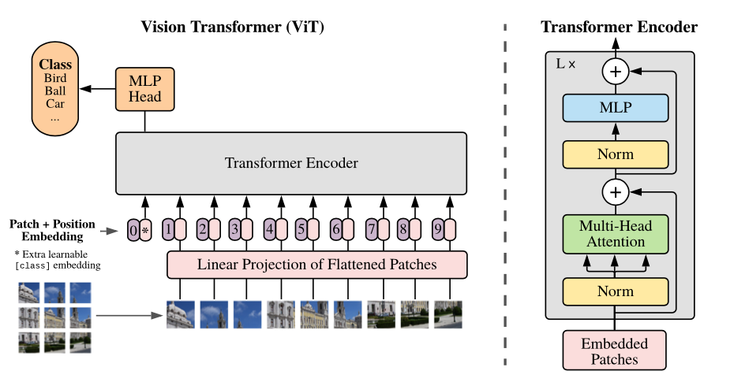
Vision Transformer
MOTIVATION
From image to sequence
Input image x ∈ ℝ^(H×W×C) is split into N patches of size P×P
Each patch is flattened and linearly projected to a D-dim embedding (the "patch embedding")
Result: a sequence of N tokens, where N = HW/P²
Class token
A learnable [class] token is prepended to the sequence (BERT-style)
Its final output serves as the image representation
Classification head: MLP with one hidden layer during pre-training; single linear layer during fine-tuning
ViT Reproducibility · CIFAR-10
1 / 12

Slide 6
Vision Transformer
MOTIVATION
Position embeddings
Standard learnable 1D position embeddings added to patch embeddings
2D-aware variants tested but gave no significant gains
Transformer encoder
Alternating Multi-Head Self-Attention (MSA) and MLP blocks
LayerNorm before each block, residual connections after
ViT Reproducibility · CIFAR-10
1 / 12

Slide 7
Inspecting ViT:
What Does It Learn?
Patch embedding filters
First layer linearly projects flattened patches into a lower-dim space
Top principal components resemble plausible basis functions for representing patch structure
Position embeddings learn 2D structure (even though they're 1D)
Closer patches → more similar embeddings
Row-column structure emerges naturally; same-row/same-column patches share similar embeddings
Attention distance ≈ receptive field in CNNs
Measures how far across the image each attention head looks
Low layers: mixed behavior — some heads attend globally, others stay highly local
Attention distance grows with depth — deeper layers integrate information more globally
Model attends to semantically relevant regions for classification
ViT Reproducibility · CIFAR-10
1 / 12

Slide 8
ARCHITECTURE
How the Vision Transformer works
Image
(B, 3, 224, 224)
Anatomy of the Encoder Block
Patch Embedding
Conv2d P=16, s=16
LayerNorm
Multi-Head Self-Attention
[CLS] + Patches
(B, 197, 768)
+ Residual
LayerNorm
+ Pos. Embedding
learnable 1D
MLP (GELU, ratio = 4)
Transformer × 12
LN → MSA → LN → MLP
+ Residual
CLS token — a learnable vector prepended to the sequence; its output is used for classification.
Patch size 16 — 224×224 image ÷ 16 = 14×14 grid = 196 patches + 1 CLS = 197 tokens.
Embedding dim 768 — each token is a 768-dim vector throughout the network (ViT-Base).
CLS → Linear
Linear(768, 10)
Class Logits
(B, 10)
ViT Reproducibility · CIFAR-10
3 / 12

Slide 9
COMPONENT 1 OF 3
Patch embedding: turning pixels into tokens
The trick
Shape transformation
A Conv2d layer with kernel = stride = 16 does two things at once: it slices the image into non-overlapping 16×16 patches and projects each one into a 768-dimensional vector. No overlapping receptive fields — each pixel belongs to exactly one token.
Input image
(B, 3, 224, 224)
raw RGB pixels
Conv2d(3→768, k=16, s=16)
(B, 768, 14, 14)
one vector per patch
By the numbers (224×224 input)
Flatten + transpose
14 × 14
patch grid
(B, 196, 768)
sequence of tokens
196
patch tokens
+ 1
[CLS] token
Prepend [CLS]
(B, 197, 768)
197
total sequence length
ready for transformer
ViT Reproducibility · CIFAR-10
4 / 12

Slide 10
COMPONENT 2 OF 3
Multi-head self-attention
Attention(Q, K, V) = softmax( Q Kᵀ / √dₖ ) · V
Multi-head: 12 parallel attentions
h1
h2
h3
h4
What the equation does
h5
h6
h7
h8
Each token projects into three roles: Query, Key, Value.
The dot product Q·Kᵀ measures how much each token wants to listen to every other token.
Softmax turns those scores into a distribution that sums to 1.
Each token's output is a weighted blend of all Values — a global, content-aware mix.
h9
h10
h11
h12
768 ÷ 12 heads = 64 dims/head
Each head looks at a different subspace — some learn local structure, some learn long-range relationships. Their outputs are concatenated and projected back to 768.
ViT Reproducibility · CIFAR-10
5 / 12

Slide 11
COMPONENT 3 OF 3
MLP, residuals, and the CLS token
ƒ
+
★
MLP with ratio 4
Residual connections
[CLS] token
Applied independently to every token after attention.
Two linear layers with GELU activation in between:
768 → 3072 → 768
Expanding to 4× gives the network the width it needs to mix features learned by attention.
Every sub-layer is wrapped in an additive shortcut:
x = x + SubLayer( LayerNorm(x) )
Critical for training 12 stacked blocks — gradients flow through the skip path without vanishing.
A learnable vector prepended to the sequence before the transformer sees it.
Through 12 layers of attention it aggregates information from every patch.
Only its final state is sent to the classification head.
ViT Reproducibility · CIFAR-10
6 / 12

Slide 12
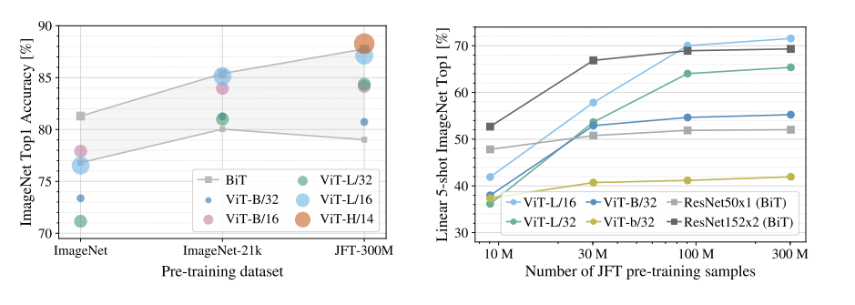
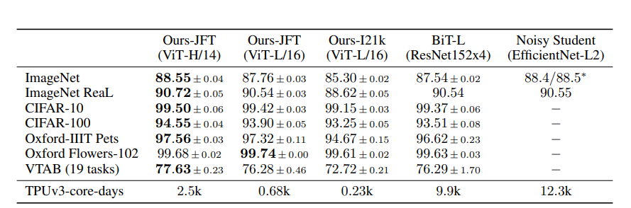
Paper Claims & Results
Pretraining Data Requirement
ViT Reproducibility · CIFAR-10
1 / 12

Slide 13
OUR REPRODUCTION
Experimental setup
Model & data
Data pipeline
Backbone
ViT-Base/16 (pretrained on ImageNet-21k)
transforms.Compose([
Resize((224, 224)),
RandomHorizontalFlip(p=0.5),
ColorJitter(0.2, 0.2, 0.2, 0.1),
Normalize(
mean=[0.485, 0.456, 0.406],
std =[0.229, 0.224, 0.225]
)
])
Dataset
CIFAR-10 — 60 000 × 32×32 images, 10 classes
Input resolution
Upsampled to 224 × 224
Patch size
16 × 16 → 14×14 = 196 tokens
Sequence length
197 (196 patches + 1 [CLS])
Embedding dim
768
Heads / Layers
12 / 12
Note: mean / std values are ImageNet statistics — a telltale sign of fine-tuning a pretrained backbone.
Parameters
≈ 86 M
Classifier head
Linear(768, 10)
ViT Reproducibility · CIFAR-10
7 / 12

Slide 14
FINE-TUNING RECIPE
Training configuration
⚙
Optimizer
▼
Learning rate
⎙
Loss
AdamW
Warmup → cosine decay
peak LR = 0.001
Cross-entropy (10 classes)
label smoothing disabled
⎘
Batch size
↻
Schedule
◉
Evaluation
64 per GPU
mixed precision (fp16)
≈ 10 000 steps
~1 hour on a single 8 GB GPU
Test Top-1 accuracy
on CIFAR-10 test set (10 000 imgs)
ViT Reproducibility · CIFAR-10
8 / 12

Slide 15
RESULTS
How close to the paper?
OUR REPRODUCTION
Side-by-side comparison
98.68%
ViT-Base/16 fine-tuned at 224×224
ORIGINAL PAPER
ViT-Base/16 fine-tuned at 384×384
The gap. A likely contributor: we upsampled to 224×224 (196 patches) while the paper used 384×384 (576 patches) — fewer spatial tokens, less granular information per image.
ViT Reproducibility · CIFAR-10
9 / 12

Slide 16
ANALYSIS
Structural Limitations
Known structural limitations
1
No spatial inductive bias
Locality and translation equivariance must be learned from data — ViT needs roughly 14M+ pretraining images to match CNN priors on the same benchmarks.
2
Fixed training resolution
Positional embeddings are tied to the training grid. Changing resolution at inference requires interpolation, which degrades performance.
3
Uniform patch size
No multi-scale hierarchy like CNN feature pyramids. This limits performance on dense prediction tasks such as detection and segmentation.
ViT Reproducibility · CIFAR-10
10 / 12

Slide 17
Thank You

