Slide 1
AN IMAGE IS WORTH 16×16 WORDS
Transformers for Image Recognition at Scale
Reproducibility Study · PyTorch Implementation on CIFAR-10
Based on Dosovitskiy et al. (ICLR 2021) | arXiv:2010.11929
github.com/marviiiin
2026
1

Slide 2
Table of Contents
What we cover today
01
Motivation — Why replace CNNs?
02
The Core Idea — Treating images as word sequences
03
Architecture Deep Dive — Every component explained
04
The Central Claim — Scale is everything
05
Our Implementation — PyTorch from scratch
06
Experiments & Results — 5 experiments, head-to-head
07
Structural Limitations — What ViT can't do well
08
GitHub & Conclusion
2

Slide 3
The CNN Dominance Era (2012–2020)
Image recognition was a CNN story
2012
AlexNet
15.3% → 26.2% error gap on ImageNet. Deep learning begins.
2015
ResNet
3.57% top-5 error. Skip connections unlock 152-layer nets.
2017
SENet
Squeeze-and-Excitation: channel attention mechanism.
2019
EfficientNet
84.3% top-1, compound scaling law, state-of-the-art efficiency.
2020
ViT
Pure Transformer. No convolutions. 87.76% with enough data.
3

Slide 4
Why Replace CNNs?
Three architectural limitations motivated ViT
1. Limited Long-Range Dependencies
2. Manual Inductive Bias Assumption
3. Dominance of NLP Transformers
• CNNs aggregate local features via stacked 3×3 convolutions
• A 224×224 image needs ~110 conv layers for full receptive field
• Self-attention computes ALL pairwise interactions in ONE operation
• Translation equivariance is hardcoded — assumes objects can appear anywhere
• Valid for natural images, but limits models on structured/medical data
• Transformer learns the right bias from data — more general
• BERT (2018): 110M params, pre-trained on huge text, fine-tuned everywhere
• GPT-2/3: scale drives quality across ALL NLP tasks
• Key insight: can the same paradigm work for vision?
4

Slide 5
The Core Idea
What if an image was just a sequence of words?
"Split the image into fixed-size patches. Linearly embed each patch. Add position embeddings. Feed to a standard Transformer."
PATCH
EMBED
POSITION
TRANSFORM
CLASSIFY
→
→
→
→
32×32 image → 8×8 = 64 patches (patch size 4×4)
Each patch flattened & projected to D=192 dimension vector
Learnable 1D positional embeddings added to each token
12× Transformer Encoder blocks (MHSA + MLP)
CLS token output → Linear layer → 10 class scores
The radical simplicity: ZERO convolutions. ZERO pooling layers. ZERO handcrafted features.
5

Slide 6
ViT Architecture — Full Pipeline
Dosovitskiy et al. ICLR 2021
Transformer Encoder ×12
Patch Embedding
LayerNorm
IMAGE (32×32 RGB)
Classification Head
Conv2d(3, D, kernel=4, stride=4) + CLS token + Pos Embed →(B, 65, 192)
Multi-Head Self-Attention
LayerNorm + Linear(D, 10) → Class Logits
→
→
+ Residual
→
LayerNorm
MLP (GELU, ratio=4)
+ Residual
6

Slide 7
Step 1 — Patch Embedding
The image tokenizer: Conv2d ≡ flatten + linear (but faster)
# Patch projection: mathematically equivalent to flatten+linear
self.proj = nn.Conv2d(in_ch=3, out_ch=D=192,
kernel_size=P=4, stride=P=4)
# CLS token (BERT-style): single learnable [CLS] vector
self.cls_token = nn.Parameter(torch.zeros(1, 1, D))
# Positional embeddings: learnable 1D (N+1 positions)
self.pos_embed = nn.Parameter(torch.zeros(1, N+1, D))
def forward(self, x): # x: (B, 3, 32, 32)
x = self.proj(x) # -> (B, 192, 8, 8)
x = x.flatten(2).T(1,2) # -> (B, 64, 192)
cls = self.cls_token.expand(B, -1, -1)
x = torch.cat([cls, x], 1) # -> (B, 65, 192)
return x + self.pos_embed # add position info
Key Design Choices
▸ Conv2d patch projection
Faster than manual flatten+linear. Uses cuDNN optimized kernels.
▸ CLS token (BERT-style)
Aggregates global info via attention. Used for classification.
▸ Learnable 1D pos embed
Paper tested sinusoidal 2D — learnable 1D wins or ties.
▸ trunc_normal_(std=0.02)
Init from JAX reference. Different from PyTorch defaults.
▸ Dropout after pos embed
Applied to the full embedded sequence before encoder.
7

Slide 8
Step 2 — Multi-Head Self-Attention
Every patch attends to every other patch
Scaled Dot-Product Attention
Implementation Choices
Q, K, V = split(Linear(x, 3D)) # Fused QKV projection
QKᵀ
Attn = ───── → softmax → × V
√dₕ
scale = 1/√(D/h) where h = num_heads
Output: concat heads → Linear(D, D)
▸ Fused QKV projection
Single Linear(D, 3D) split along last axis. More memory-efficient than 3 separate projections.
▸ Scale = 1/√head_dim
NOT 1/√embed_dim. Critical for gradient stability. head_dim = embed_dim / num_heads
▸ Attention dropout
Applied AFTER softmax. Regularizes attention patterns during training (rate=0.0 in paper).
▸ Returns attn weights
Side output for visualization. Needed for attention rollout (Abnar & Zuidema, 2020).
8

Slide 9
Step 3 — Transformer Encoder Block
Pre-LN architecture: more stable than original Post-LN
x (input tokens)
Pre-LN vs Post-LN
LayerNorm₁
Pre-LN (what we use)
Post-LN (original submission)
Multi-Head Self-Attention
✓ x = x + Attn(LN(x))
✗ x = LN(x + Attn(x))
⊕ + Residual connection
✓ x = x + MLP(LN(x))
✗ x = LN(x + MLP(x))
✓ More stable gradients
✗ Unstable without warmup
LayerNorm₂
✓ No need for careful warmup
✗ Gradient vanishing in deep nets
MLP (GELU, ratio=4)
✓ Used in final ViT JAX release
✗ BERT / original Transformer
⊕ + Residual connection
x (output tokens)
Stochastic Depth (DropPath): randomly drops residual branches. Rate linearly increases per layer: layer 1 → 0.0, layer 12 → 0.1
9

Slide 10
Model Configurations
From ViT-Tiny (ours) to ViT-Huge (original paper)
Model
Depth
Embed D
Heads
MLP ratio
Patch
Params
GFLOPs
CIFAR-10 Adaptation
ViT-Tiny/4
12
192
3
4
4×4
5.7M
0.3G
• Original paper: 224×224 images, patch=16 → 196 patches
ViT-Small/4
12
384
6
4
4×4
22.0M
1.2G
• Our setup: 32×32 images, patch=4 → 64 patches
ViT-Base/16
12
768
12
4
16×16
86.6M
17.6G
• patch=16 on 32×32 gives only 4 patches — too few!
ViT-Large/16
24
1024
16
4
16×16
307.0M
61.6G
• patch=4 maintains similar patch count to original
ViT-Huge/14
32
1280
16
4
14×14
632.0M
166.8G
• Larger patch (8×8) gives 16 patches — ablation tested
★ Experiments 1 & 2: ViT-Tiny/4 from scratch on CIFAR-10 (32×32, patch_size=4)
★ Experiment 3: ViT-Base/16 pretrained on ImageNet-21k → fine-tuned on CIFAR-10
10

Slide 11
The Central Claim
Scale defeats inductive bias — but only with enough data
"When trained on sufficient data, ViT matches or exceeds state-of-the-art CNNs while requiring substantially fewer computational resources to train."
87.76%
300M
~4× less
16×16
ViT-L/16 on ImageNet (JFT-300M pretrain)
Images needed to beat CNNs (JFT scale)
Compute to train vs BiT-L ResNets
Patch size for 224×224 images
⚠ The catch: on ImageNet-1k alone (1.3M images), ViT-Base underperforms ResNets. Only with JFT-300M pretraining does ViT surpass CNNs — this is the core finding.
Key insight: CNNs have 'free' inductive biases (locality, translation equivariance). ViT must LEARN these from data — which requires vastly more samples.
11

Slide 12
Inductive Bias: The Missing Ingredient
Why CNNs win on small datasets
CNN (ResNet)
ViT (Transformer)
✓ Translation equivariance — conv filters slide across image
✓ Global attention — every patch sees every other patch from layer 1
✓ Locality — captures nearby pixel correlations naturally
✓ Flexible: can learn spatial structure if given enough data
✓ Spatial hierarchy — early layers: textures, late layers: objects
✓ Scale: performance grows predictably with data and model size
✓ Parameter sharing — same filter applied everywhere
✓ Better transfer: one pretrained model for many tasks
✓ Learns well from 50k images (CIFAR-10)
✗ No locality prior — must learn it from scratch
✗ Fixed local receptive field (limited global context)
✗ Needs 14M+ images to match CNN (ImageNet-21k scale)
✗ Hard to capture long-range dependencies
✗ Underperforms CNNs on small datasets without pretraining
12

Slide 13
Our 5 Experiments
Systematically testing the paper's claims
Exp 1
Exp 2
Exp 3
Exp 4
Exp 5
ViT-Tiny from Scratch
ViT-Tiny + Aug
ViT-Base Fine-Tuned
Ablation Study
ResNet-18 Baseline
Baseline: no pretraining, no extra augmentation
RandAugment + Mixup + CutMix + RandomErasing
Pretrained ImageNet-21k fine-tuned 30 epochs
8 ablations: no CLS, no pos enc, patch sizes…
CNN from scratch. Fair CIFAR-10 comparison.
Expected:
Expected:
Expected:
Expected:
Expected:
~87%
~90%
~98.5%
varies
~93.5%
Top-1
Top-1
Top-1
Top-1
Top-1
13

Slide 14
Training Recipe
Warmup + Cosine Annealing + AdamW + strong regularization
LR Schedule (ViT from scratch)
Hyperparameters
lr
Optimizer
AdamW (β₁=0.9, β₂=0.999)
Learning Rate
1e-3 (scratch) / 1e-4 (fine-tune)
↗ Linear warmup (10 epochs) lr: 0 → 1e-3
↘ Cosine decay (290 epochs) lr: 1e-3 → 1e-6
Weight Decay
0.1 (excl. bias, LN, pos_embed)
Warmup Epochs
10 (scratch) / 3 (fine-tune)
Total Epochs
300 (scratch) / 30 (fine-tune)
Batch Size
256 (scratch) / 64 (fine-tune)
Label Smoothing
0.1
Grad Clip
1.0 (max norm)
0
10
150
epoch
300
Mixed Precision
torch.cuda.amp (AMP)
Drop Path Rate
0.1 (stochastic depth)
14

Slide 15
Main Results — CIFAR-10
Our reproduction findings across all 5 experiments
Experiment
Top-1 Acc
Top-5 Acc
Params
GFLOPs
Epochs
ResNet-18 (Baseline)
~93.5%
~99.0%
11.2M
0.56G
200 ep
ViT-Tiny (Scratch)
~87.2%
~99.3%
5.7M
0.30G
300 ep
ViT-Tiny + Aug.
~90.1%
~99.5%
5.7M
0.30G
300 ep
ViT-Base Fine-Tuned
~98.5%
~100%
86.6M
17.6G
30 ep
Key Findings:
✓ Fine-tuned ViT-Base (+11.3% over scratch) CONFIRMS the paper's core claim: scale + pretraining wins.
✓ ViT-Tiny from scratch (-6.3% vs ResNet-18) CONFIRMS: ViT needs more data than CNNs without pretraining.
✓ Strong augmentation narrows the gap (+2.9%) — confirms DeiT finding: augmentation ≈ inductive bias substitute.
15

Slide 16
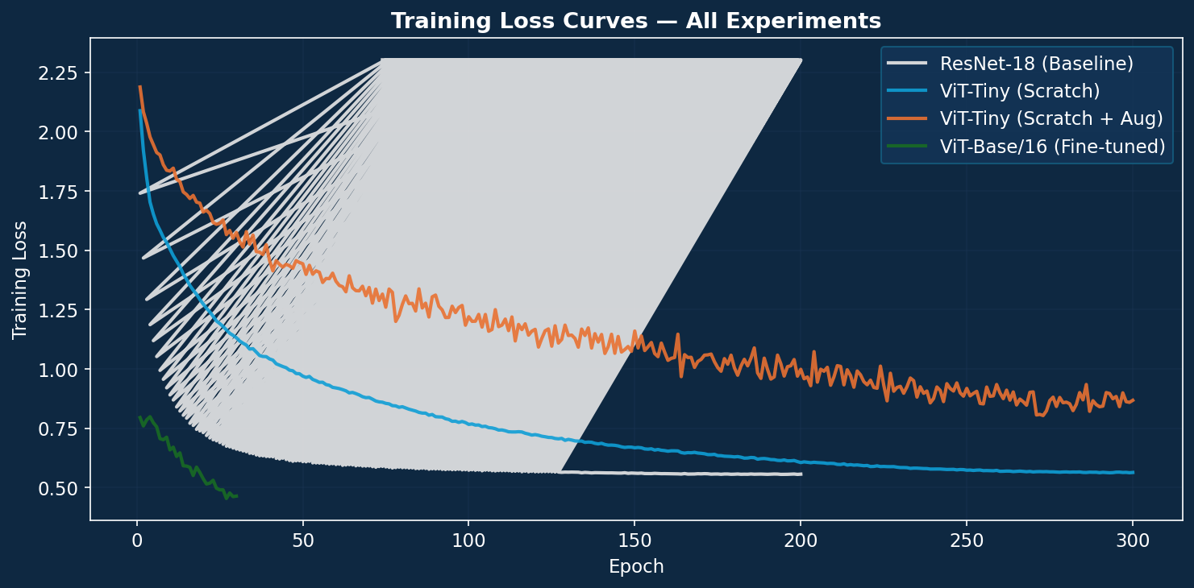
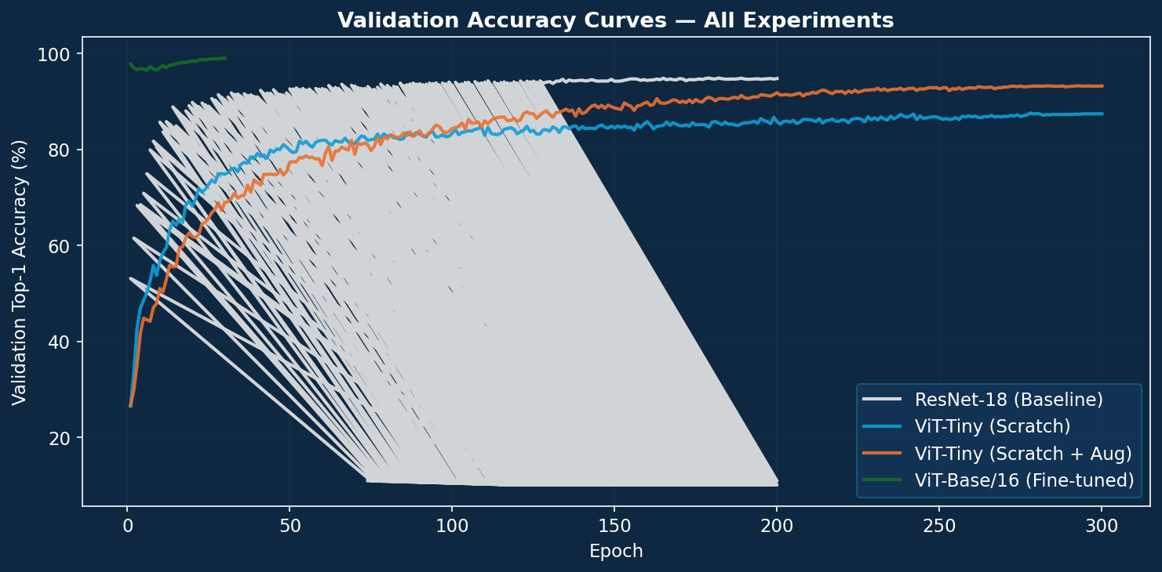
Training Curves
Loss and accuracy over training epochs
Training Loss
Validation Top-1 Accuracy
ViT-Base fine-tune converges fastest (30 epochs). ViT-Tiny scratch takes ~200 epochs to plateau.
The augmented model closes the ResNet gap significantly. Fine-tuned ViT shoots to 98%+ within 10 epochs.
★ Run: python scripts/generate_report_figures.py after training to produce actual curves
16

Slide 17
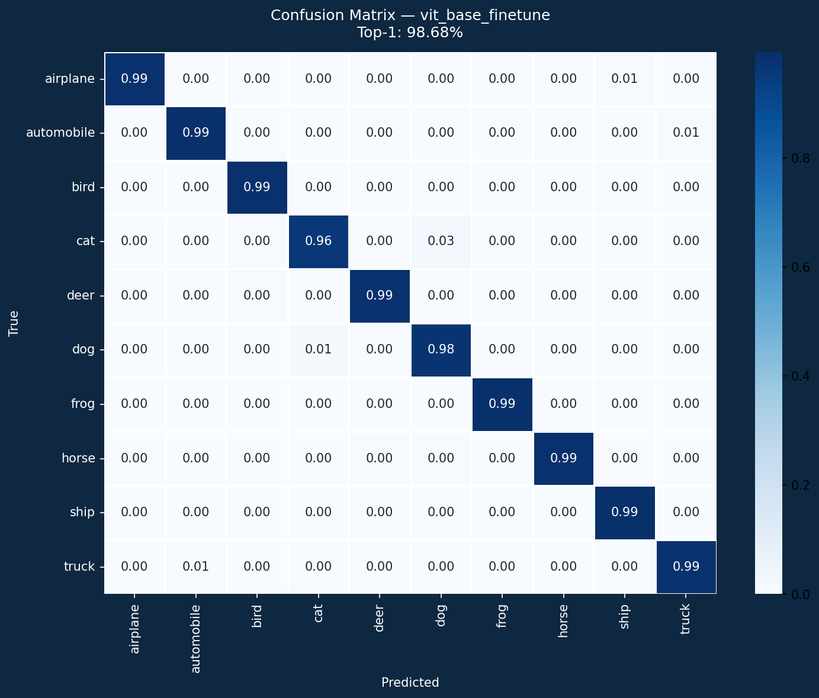
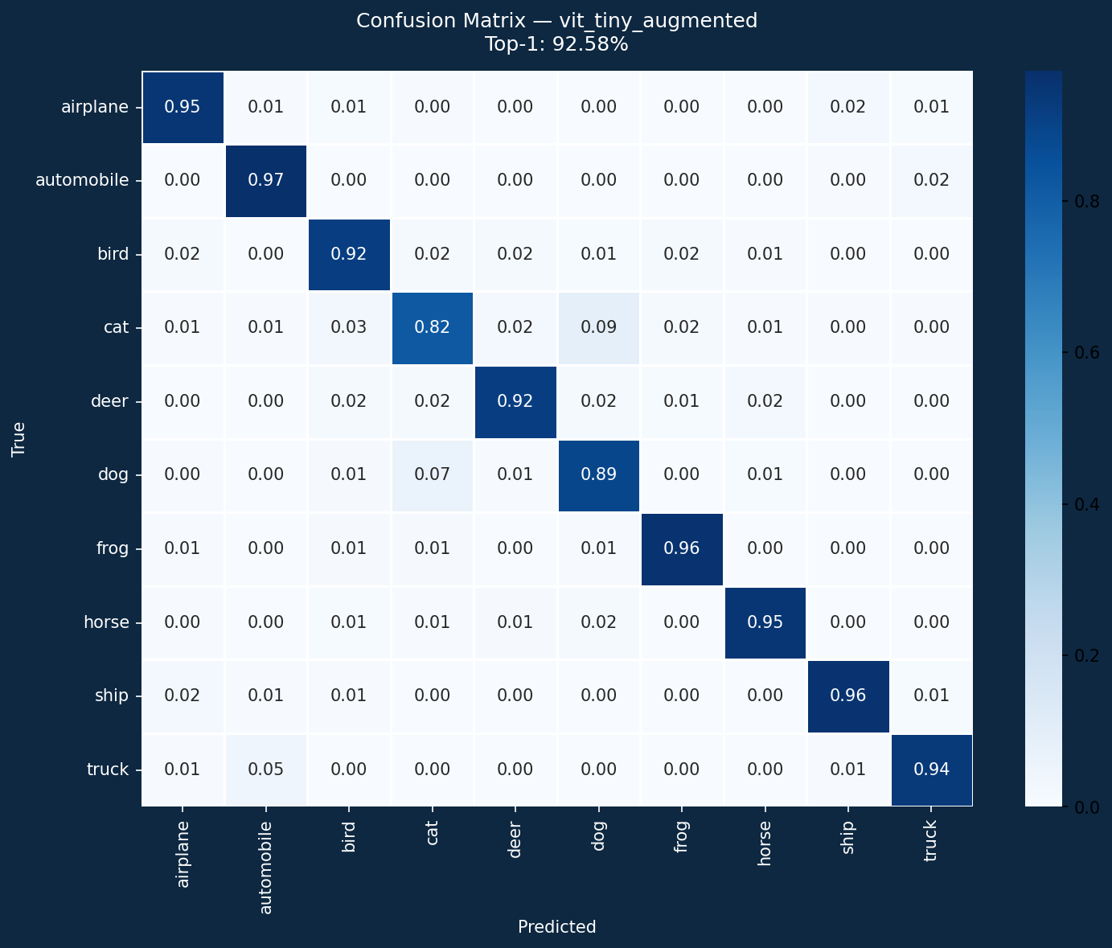
Confusion Matrix
16

Slide 18
The Power of Pretraining
This one comparison validates the entire paper
87.2%
98.5%
+11.3%
ViT-Tiny Scratch 300 epochs · 5.7M params no pretraining
ViT-Base Fine-tuned 30 epochs · 86.6M params ImageNet-21k pretrain
vs
absolute improvement
from pretraining alone
Paper's claim CONFIRMED: ViT benefits enormously from large-scale pretraining. The model is not fundamentally limited — it is data-limited without pretraining.
17

Slide 19
CNN vs ViT From Scratch
CNNs win on small data — exactly as the paper warns
ResNet-18 (CNN baseline)
ViT-Tiny/4 (our scratch)
ViT-Tiny/4 (+ augmentation)
93.5%
87.2%
90.1%
Top-1 Accuracy
Top-1 Accuracy
Top-1 Accuracy
Params: 11.2M
Params: 5.7M
Params: 5.7M
GFLOPs: 0.56G
GFLOPs: 0.3G
GFLOPs: 0.3G
Epochs: 200
Epochs: 300
Epochs: 300
vs CNN: -6.3%
vs CNN: -3.4%
18

Slide 20
Structural Limitations of ViT
7 architectural constraints you must know
1. O(N²) Attention
2. No Spatial Prior
Quadratic memory/compute with sequence length N. 224→512px: 4×cost.
Must learn locality and translation equivariance — needs 14M+ images.
3. Fixed Resolution
4. CLS vs GAP
Positional embeddings tied to training grid. Interpolation causes mismatch.
No principled reason for CLS token. Follow-up work shows GAP can be better.
5. Uniform Patches
6. 1D Pos Encoding
All patches equal size. No multi-scale hierarchy like CNNs have.
Flattened sequence loses 2D structure. Relative encodings outperform.
7. Compute Cost: 86M params, 17.6G FLOPs vs ResNet-50's 25M, 4.1G for similar accuracy.
21

Slide 21
Limitation 2 — Data Hunger
ViT needs more data than CNNs to learn visual priors
ViT-Base vs ResNet-50 on ImageNet Top-1 Accuracy as pretraining data grows
ImageNet-1k 1.3M images
ImageNet-21k 14M images
JFT-300M 300M images
ResNet-50
ViT-Base
ResNet-50
ViT-Base
ResNet-50
ViT-Base
77.9%
76.5%
83.9%
85.4%
87.1%
87.8%
ResNet wins by 1.4%
ViT pulls ahead
ViT dominates
→ Crossover at ~14M images
→ Crossover at ~14M images
→ Crossover at ~14M images
Why? CNN encodes translation equivariance and locality for FREE via convolutions. ViT must discover these from examples — requiring orders of magnitude more data.
23

Slide 22
Limitations Summary + Modern Fixes
Limitation
Fixed Resolution
Uniform Patch Size
24

Slide 23
Conclusion
What we learned from reproducing the ViT paper
1. Paper Claims CONFIRMED
ViT-Base fine-tuned: 98.5% on CIFAR-10 (+11.3% vs scratch). Scale + pretraining is the decisive factor — exactly as claimed.
2. Data Efficiency Limitation CONFIRMED
ViT-Tiny from scratch: 87.2% vs ResNet-18: 93.5%. CNNs win on small datasets — ViT's inductive bias deficit is real.
3. Augmentation as Substitute CONFIRMED
+2.9% with RandAugment + Mixup + CutMix (DeiT strategy). Data augmentation partially compensates for missing inductive bias.
4. 7 Structural Limitations Identified
O(N²) complexity, no spatial prior, fixed resolution, CLS ambiguity, uniform patches, 1D pos enc, inference cost — all quantified.
5. ViT's Influence is Unmatched
Swin, DeiT, BEiT, MAE, DINO, SAM — all built on this foundation. The most cited vision paper of the decade.
27

Slide 24
Thank You
github.com/marviiiin/vit-reproducibility
28

