Slide 1
IDEAS INNOVATION ZONE
Presented by
Victor Mwenda
Event:
Africa Tech Challenge
(Live Demo : http://biasharamanager.com/atc/register.html)

Slide 2
INTRODUCTION
Link investors and innovators.
Post projects
Project impressions

Slide 3
FUNCTIONALITIES
Post and view projects.
Elicit and view project impressions.
Comment on projects, elicit comment impressions.
Contact innovators and investors.
View your project performance.

Slide 4
DEMO
The Demo contains the above showed functionalities
Post and view projects.
Elicit and view project impressions.
Comment on projects, elicit comment impressions.
Contact innovators and investors.
View your project performance.

Slide 5
Get Started

Slide 6
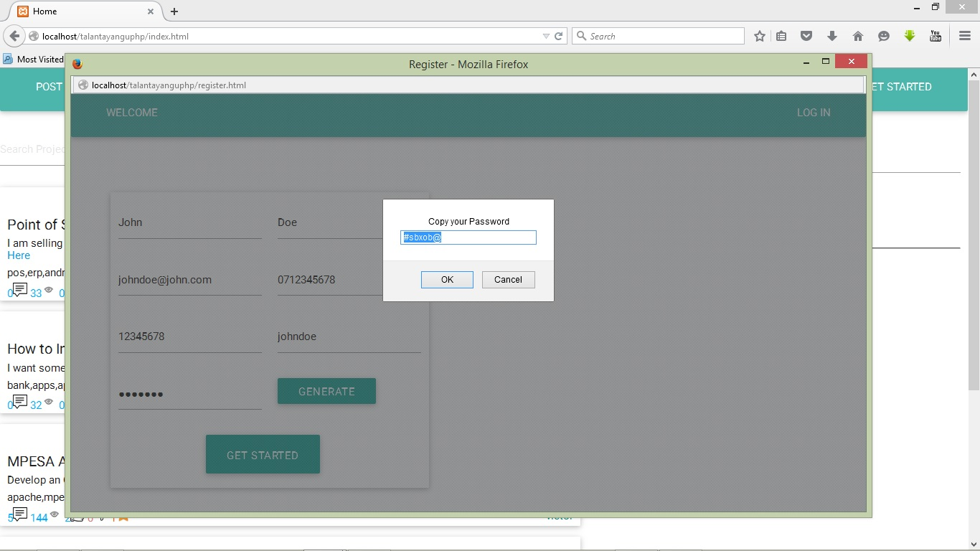

Slide 7
Post and View Posted Projects/Ideas

Slide 8
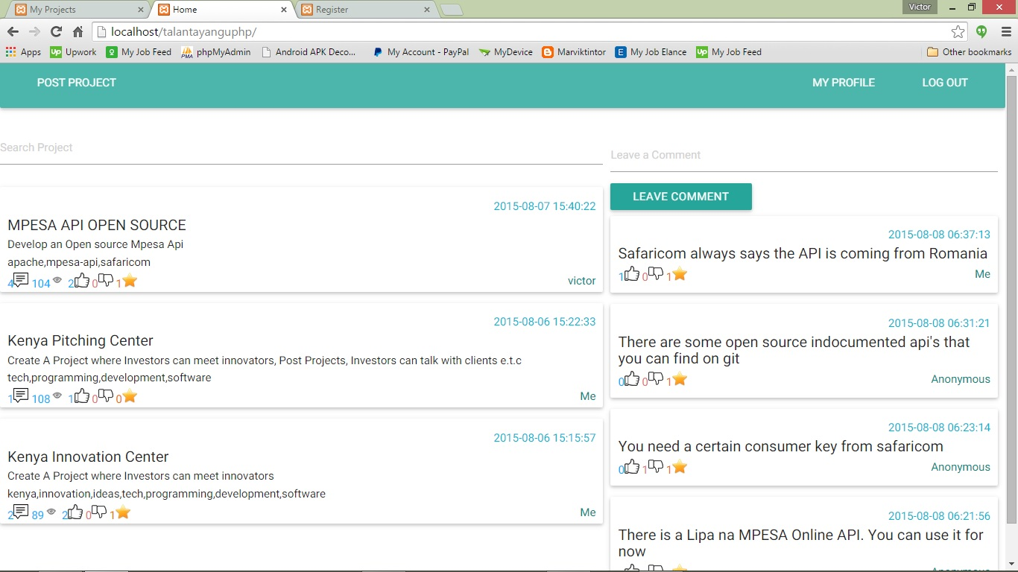

Slide 9
Search for Ideas/Projects

Slide 10
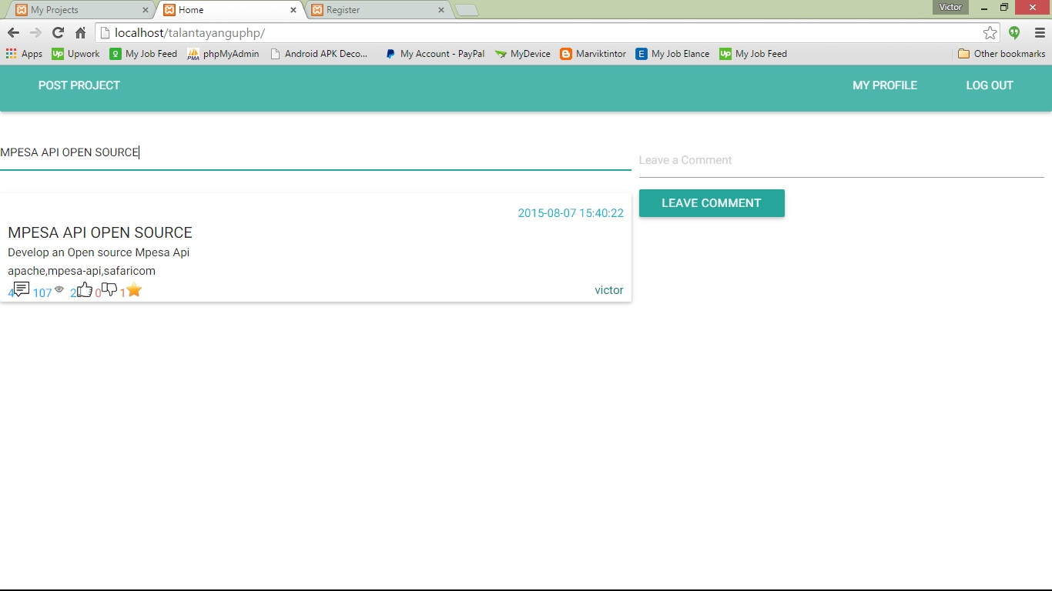

Slide 11
View an Idea Poster Profile!

Slide 12
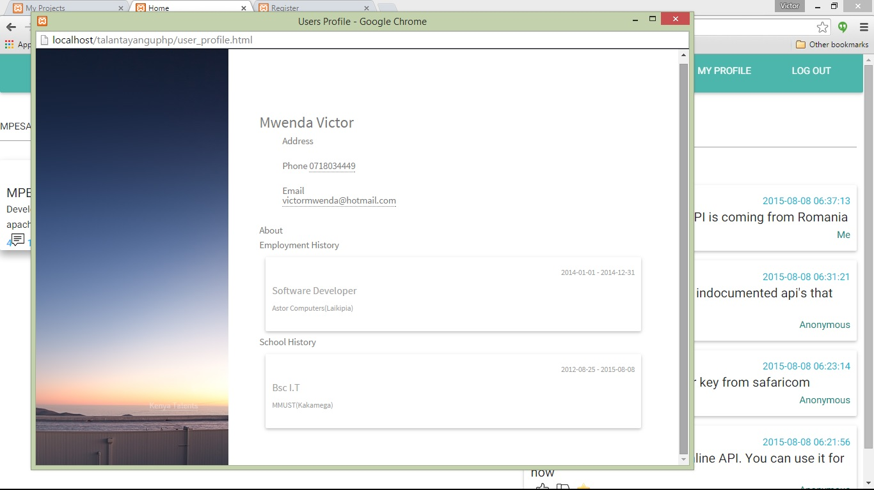

Slide 13
Enrich your profile

Slide 14
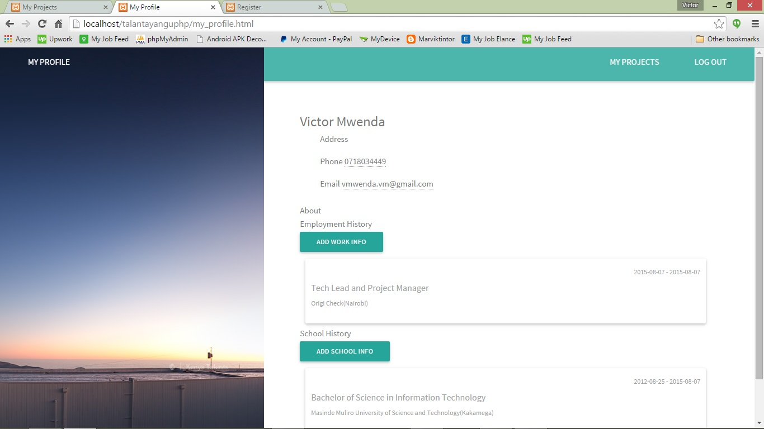

Slide 15
Your Ideas at the Market Place

Slide 16
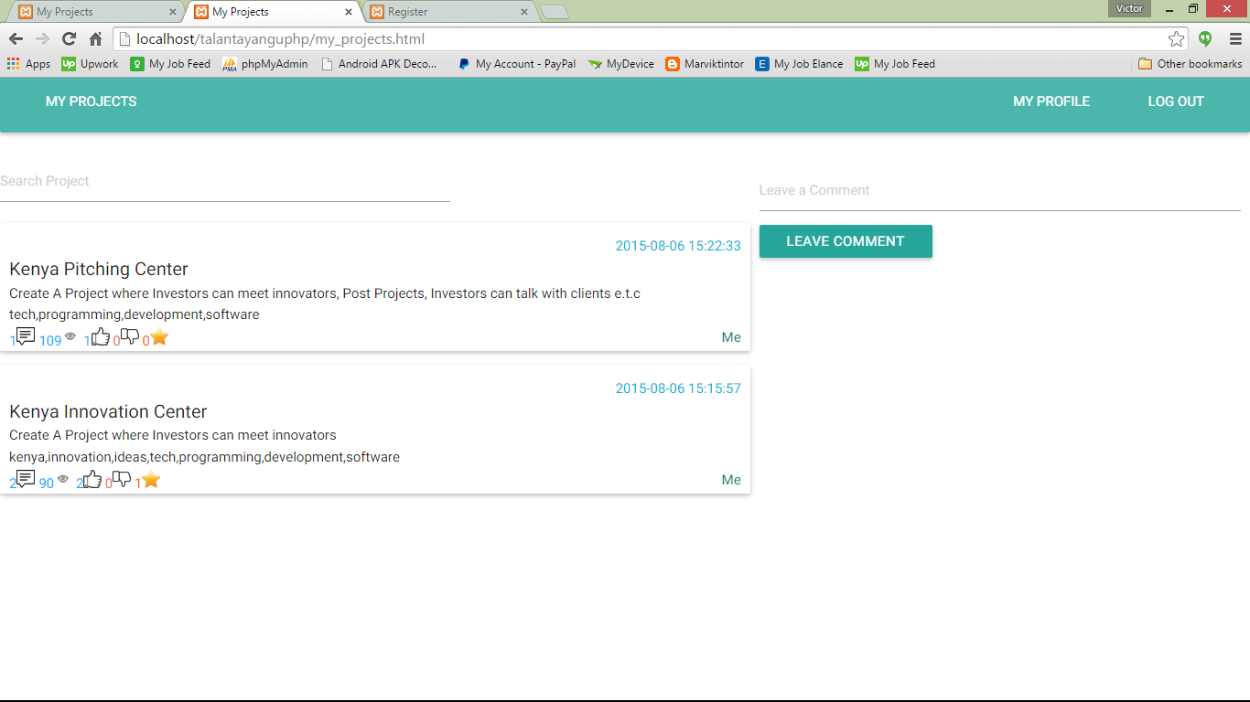

Slide 17
Idea Impressions

Slide 18
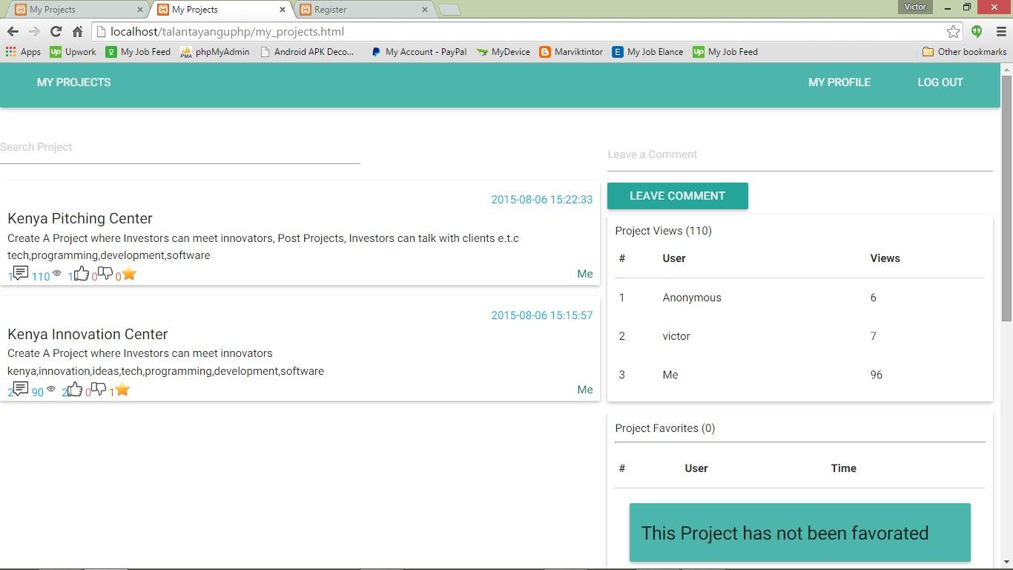

Slide 19
View Impressions on 1. Who saw your Idea 2. Who Liked 3. Who starred or (“favorated”) 4. Who commented

Slide 20
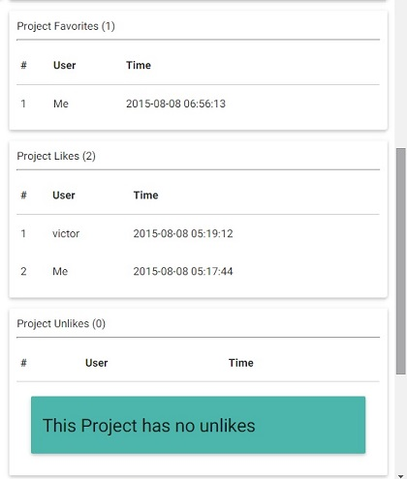
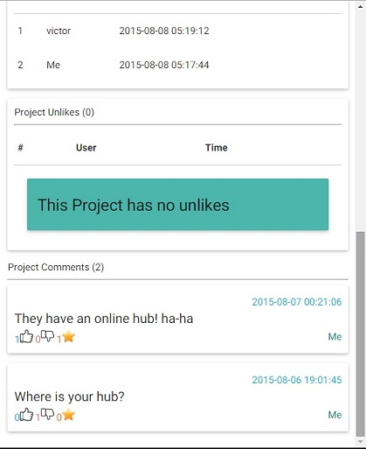

Slide 21
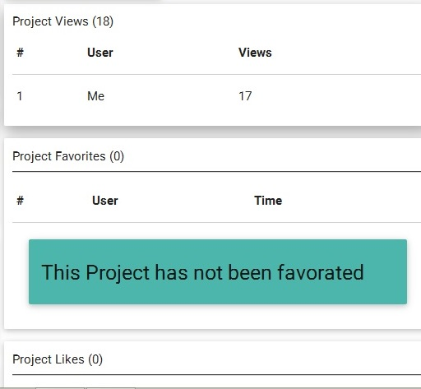
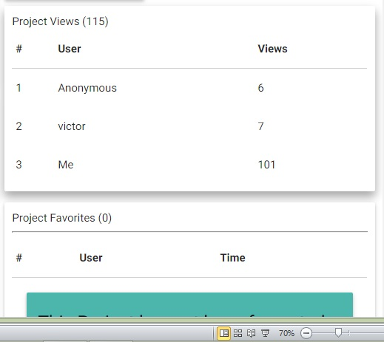

Slide 22
THANK YOU
QUESTIONS?

