Slide 1


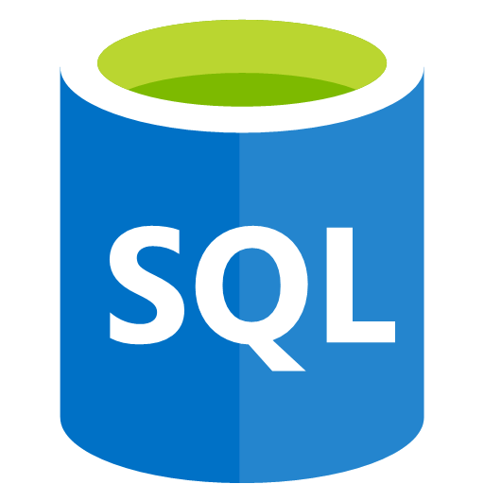



Edge Architecture
OPC Data
ONNX Models
Predictions
OPC PLC 1
SQL Server
Invoke prediction
via direct method
Azure Functions
Logic Apps
Automation Scripts
Az PowerShell
Az CLI
OPC PLC 2
OPC Publisher
Stream Analytics
Python Scorer
IoT Hub
OPC PLC 3
Machine Side
IoT Edge runtime
Azure Cloud
Async ML training
process
Cloud or On-Prem

Slide 2
OPC Data
[
{
"NodeId": "http://microsoft.com/Opc/OpcPlc/#s=RandomSignedInt32",
"ApplicationUri": "urn:OpcPlc:opcserver3",
"DisplayName": "RandomSignedInt32",
"Value": {
"Value": 1479348239,
"SourceTimestamp": "2021-08-02T13:12:26.8447859Z"
}
},
{
"NodeId": "http://microsoft.com/Opc/OpcPlc/#s=DipData",
"ApplicationUri": "urn:OpcPlc:opcserver3",
"DisplayName": "DipData",
"Value": {
"Value": -84.4327925502015,
"SourceTimestamp": "2021-08-02T13:12:26.939643Z"
}
},
{
"NodeId": "http://microsoft.com/Opc/OpcPlc/#s=SpikeData",
"ApplicationUri": "urn:OpcPlc:opcserver3",
"DisplayName": "SpikeData",
"Value": {
"Value": -84.4327925502015,
"SourceTimestamp": "2021-08-02T13:12:26.9396206Z"
}
}
]
Simulating three machines
The same three tags per machine

Slide 3
Streaming job
-- Forward telemetry input as-is
Select
*
INTO
telemetryoutput
FROM
opcpublisherinput
-- Store latest value for each OPC tag in OPC Data table
SELECT
Value.SourceTimestamp,
NodeId,
ApplicationUri,
(LAG(Value) OVER (PARTITION BY ApplicationUri LIMIT DURATION(minute, 3) WHEN DisplayName = 'DipData')).Value As DipData,
(LAG(Value) OVER (PARTITION BY ApplicationUri LIMIT DURATION(minute, 3) WHEN DisplayName = 'SpikeData')).Value As SpikeData,
(LAG(Value) OVER (PARTITION BY ApplicationUri LIMIT DURATION(minute, 3) WHEN DisplayName = 'RandomSignedInt32')).Value As RandomSignedInt32
INTO
opcnodesdboutput
FROM
opcpublisherinput
-- Store prediction values in Predictions table
SELECT
*
INTO
predictionsdboutput
FROM
predictionsinput

Slide 4
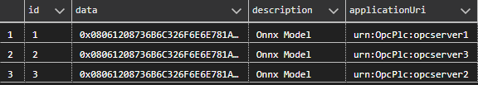
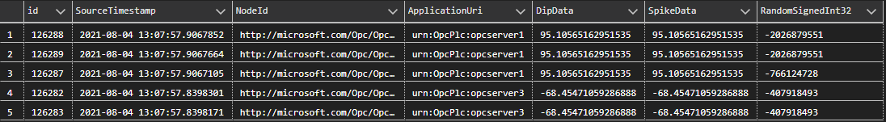
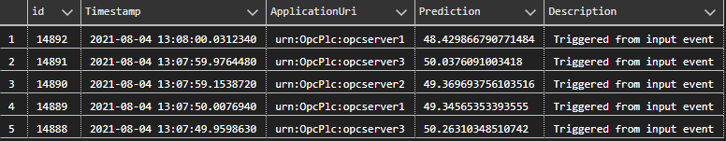
Database Schema
Models Table
OPC Data Table
Predictions Table

Slide 5
Python Scorer module
One input to receive events from streaming job’s telemetry output
Returns predict score based on ApplicationUri data property
One output to send prediction scores back to streaming job’s prediction input
Handles direct method to return prediction from on latest data values based on ApplicationUri data property
Dependencies:
setuptools
pyodbc
pandas
onnxmltools
Onnxruntime
NOTE: OPC data table complexity can be leveraged in scorer module’s business logic by retrieving the latest non-null values for each tag for the triggered machine, and then create the array to invoke the prediction.
query = f'SELECT TOP 1 DipData, SpikeData, RandomSignedInt32 FROM {features_table} WHERE ApplicationUri=\'{applicationUri}\' ORDER BY SourceTimestamp DESC'
x_train = pandas.DataFrame(sql_query, columns=['DipData', 'SpikeData', 'RandomSignedInt32'])
sess = onnxruntime.InferenceSession(onnx_model)
y_pred = np.full(shape=(len(x_train)), fill_value=np.nan)
for i in range(len(x_train)):
inputs = {}
for j in range(len(x_train.columns)):
inputs[x_train.columns[j]] = np.full(shape=(1,1), fill_value=x_train.iloc[i,j])
sess_pred = sess.run(None, inputs)
y_pred[i] = sess_pred[0][0][0]
prediction = y_pred.tolist()

Slide 6
Database automation options
In the case where SQL Server is part of the edge deployment, the following options can be considered to automate configuration at scale:
DACPAC files
Docker image using MSSQL as base image + initialization script files
Initialization procedure from Python edge module

