Slide 1
Spring Boot 入门
规则是通往自由世界的大路！
Marvin@Dashi

Slide 2
Agenda
What? → Why? → How?
Spring Boot的特性
Spring Boot 的生态环境
开发工具支持

Slide 3
What is Spring Boot?
Spring Boot makes it easy to create stand-alone, production-grade Spring-based Applications that you can run. We take an opinionated view of the Spring platform and third-party libraries, so that you can get started with minimum fuss. Most Spring Boot applications need very little Spring configuration.

Slide 4
Spring Boot的特性
能够创建可独立运行的基于Spring的应用程序(无需部署WAR包，内嵌tomcat)
通过自定义的“starter”来简化配置
提供了可以用于生产环境的监控、健康检查和外部化配置
不需要代码生成器和XML配置
预定义的开箱即用的配置，同时提供了方便的可以满足需求的配置项
简单易用、新手友好
Notes:
1. Provide a radically faster and widely accessible getting-started experience for all Spring development.
2. Be opinionated out of the box but get out of the way quickly as requirements start to diverge from the defaults.
3. Provide a range of non-functional features that are common to large classes of projects (such as embedded servers, security, metrics, health checks, and externalized configuration).
4. Absolutely no code generation and no requirement for XML configuration.

Slide 5
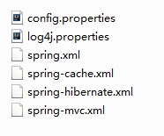

没有Spring Boot之前

Slide 6
Spring Boot 的生态环境
足够多的Starter可以使用
官方starter： https://start.spring.io/
spring-cloud-starter-eureka
第三方支持:
mybatis-spring-boot-starter
pagehelper-spring-boot-starter

Slide 7
Spring Boot 的生态环境
开发工具支持:
STS/Eclipse/Idea
在线代码生成工具
编译工具支持：
Maven
Gradle
Spring Boot Cli (Groovy)

Slide 8
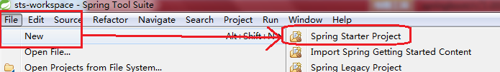
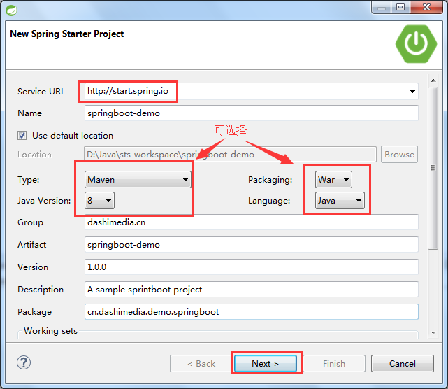
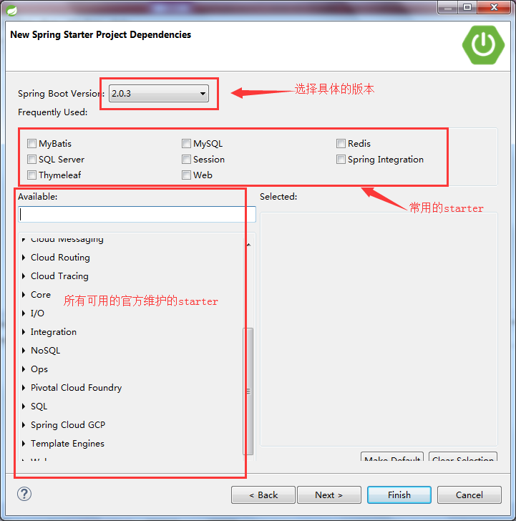
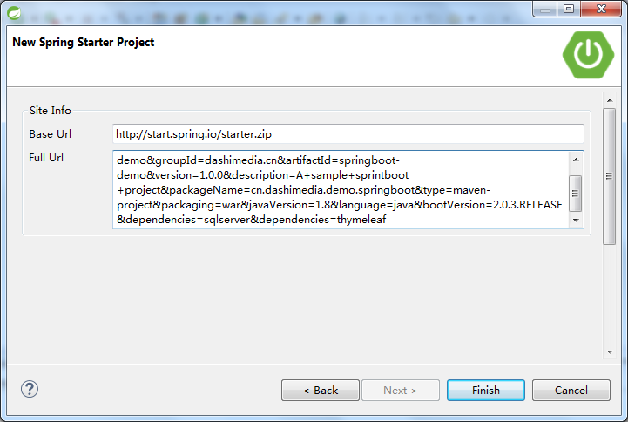
Getting Start
在线创建项目： https://start.spring.io/
STS创建项目：

Slide 9
重要的配置
@SpringBootApplication(2.0+)
@Configuration
@EnableAutoConfiguration
@ComponentScan

Slide 10
参考文档
https://docs.spring.io/spring-boot/docs/2.0.3.RELEASE/reference/htmlsingle/#boot-documentation

