Slide 1
CivicSign
How to sign up
Create your free account in minutes — UK e-signatures with audit trail included.
1920×1080 screenshots · United Kingdom · No credit card required

Slide 2
Sign-up journey
1
Visit civicsign.com
Free plan includes
5 documents per billing period
Unlimited signers
Tamper-evident audit trail
PDF & Word support
2
Click Start free
3
Enter name, work email & password
4
Create your free account
5
Verify your email (one-time code)
6
Land on your dashboard — ready to send

Slide 3
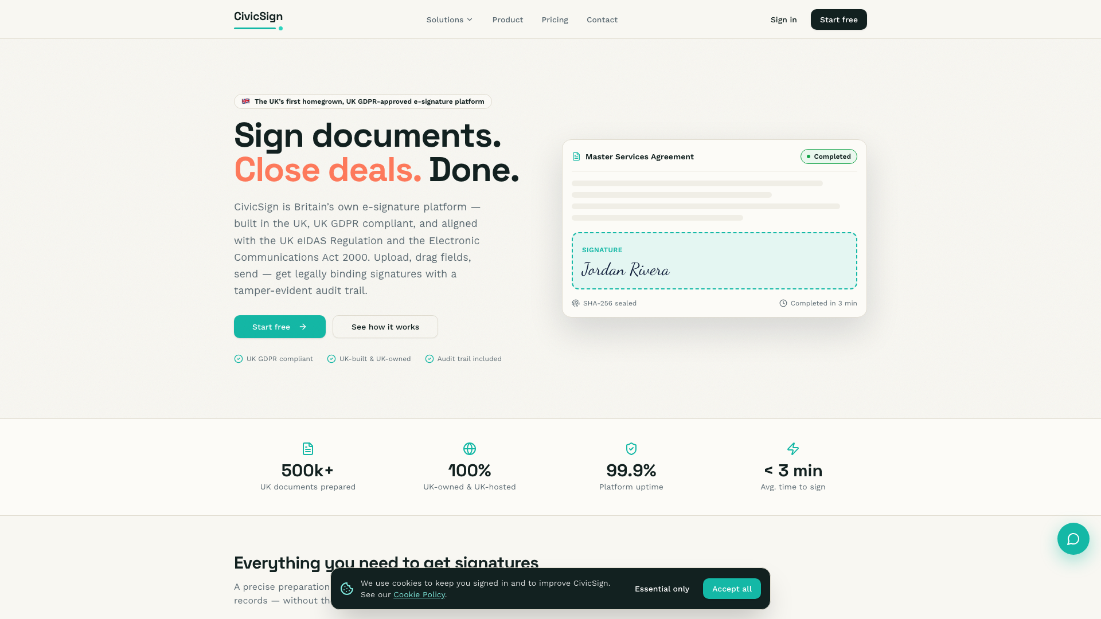
Step 1
Open the CivicSign website
Go to civicsign.com (or your team's CivicSign URL). The homepage shows pricing, features and how UK eIDAS signatures work.
Bookmark the site for your team
Works on desktop and mobile browsers

Slide 4
Step 2
Click Start free
Use Start free in the header or hero section. You'll land on the registration page — no payment details needed for the Free plan.
Already have an account? Use Sign in instead

Slide 5
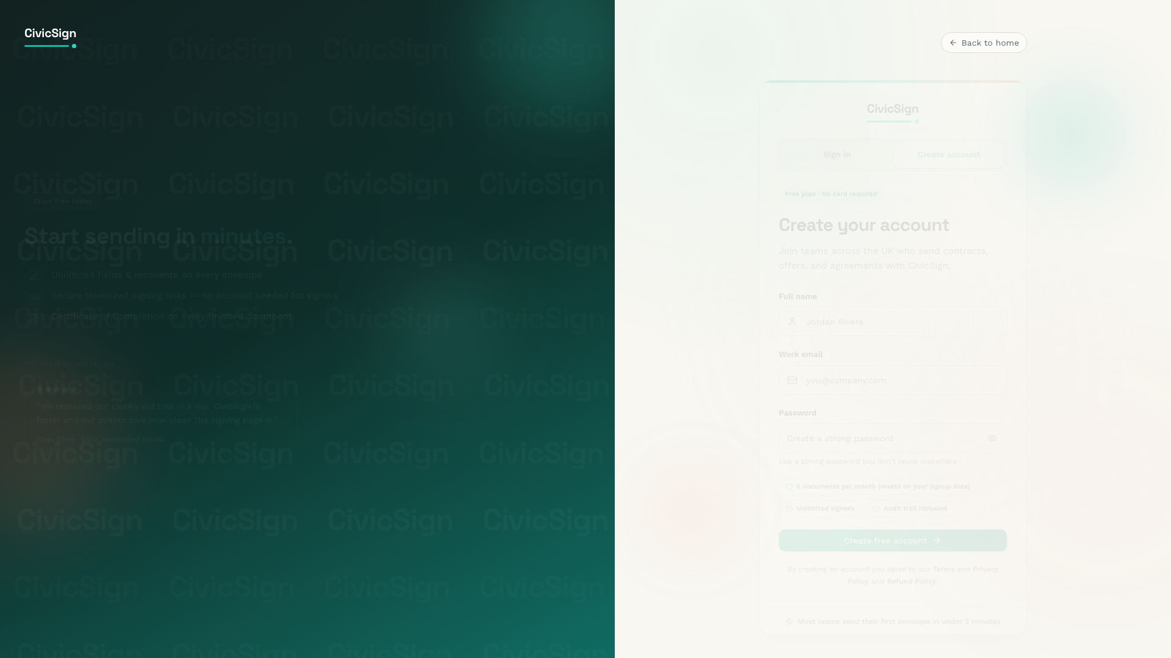
Step 3
Open the registration form
The Create your account screen asks for your full name, work email and a strong password. Review what's included on the Free plan before you continue.
Free plan · No card required
5 documents per billing period on Free

Slide 6
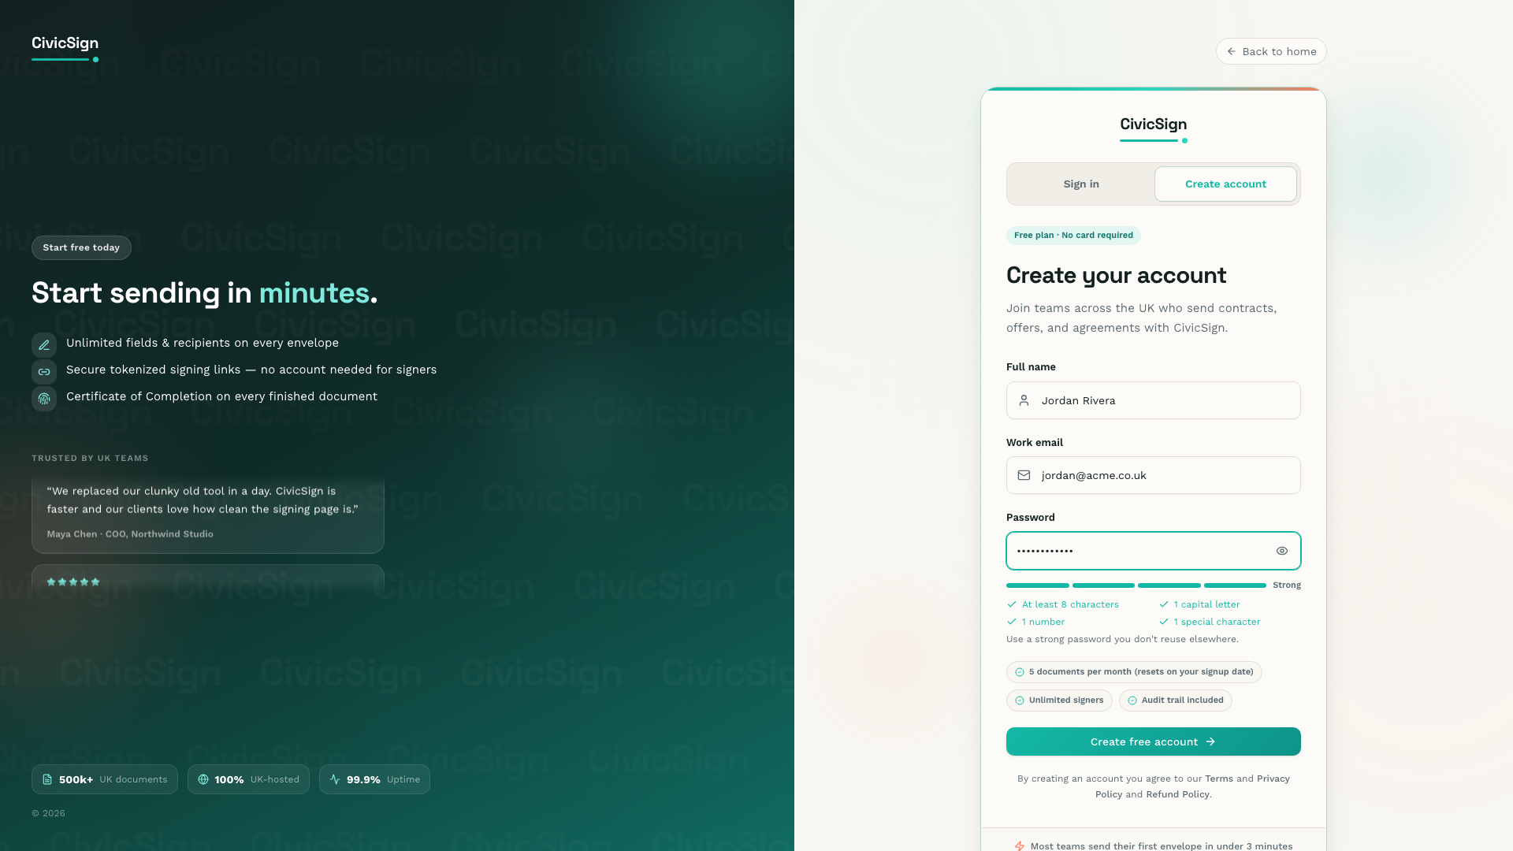
Step 4
Enter your details
Fill in your name and work email. Create a password with at least 8 characters, one capital letter, one number and one special character — the strength meter guides you.
Use a work email your team recognises
Don't reuse passwords from other sites

Slide 7
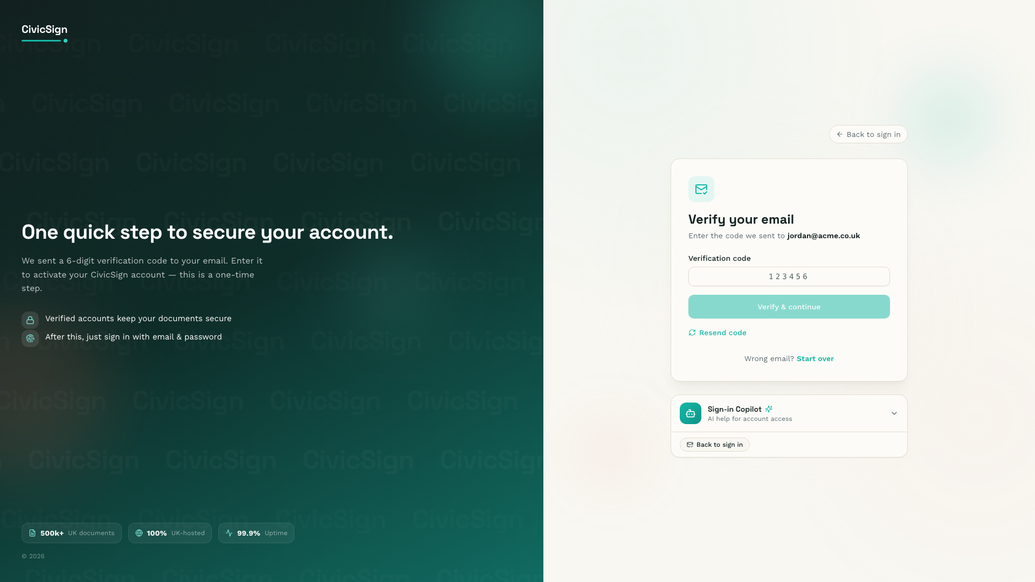
Step 5
Verify your email
CivicSign sends a one-time 6-digit code to your inbox. Enter it on the verification screen to activate your account. This step keeps your account secure.
Check spam if the code doesn't arrive
Use Resend code if needed

Slide 8
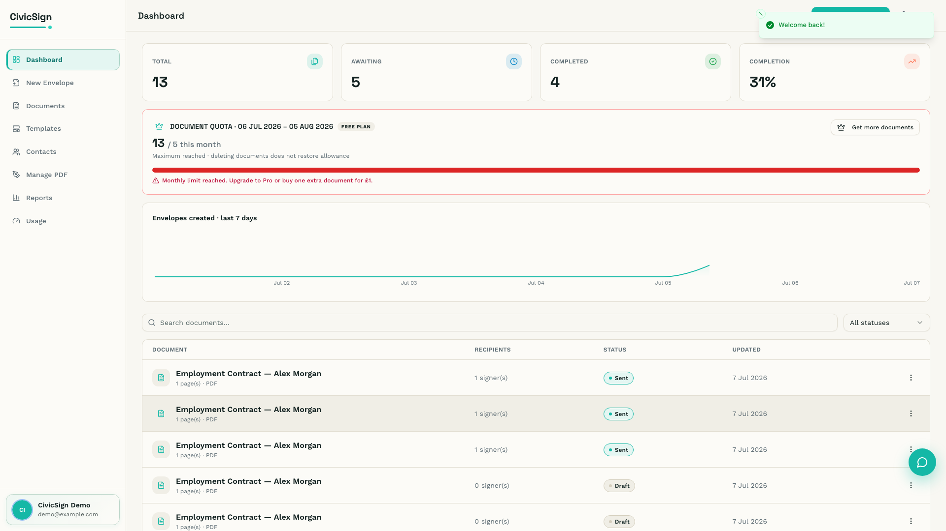
Step 6
Welcome to your dashboard
After verification you're taken to your dashboard. From here you can start a new envelope, track documents and see your monthly quota.
Click New Envelope to send your first document
Upgrade to Pro anytime from Settings

Slide 9
You're ready to send
Start free at civicsign.com — no credit card required.
Dashboard → New Envelope → Upload → Prepare → Send

