Slide 1
Algebraic Topology
and Optimal Transportation:
...How to build Spines from Singularity...
J.H.Martel

Slide 2
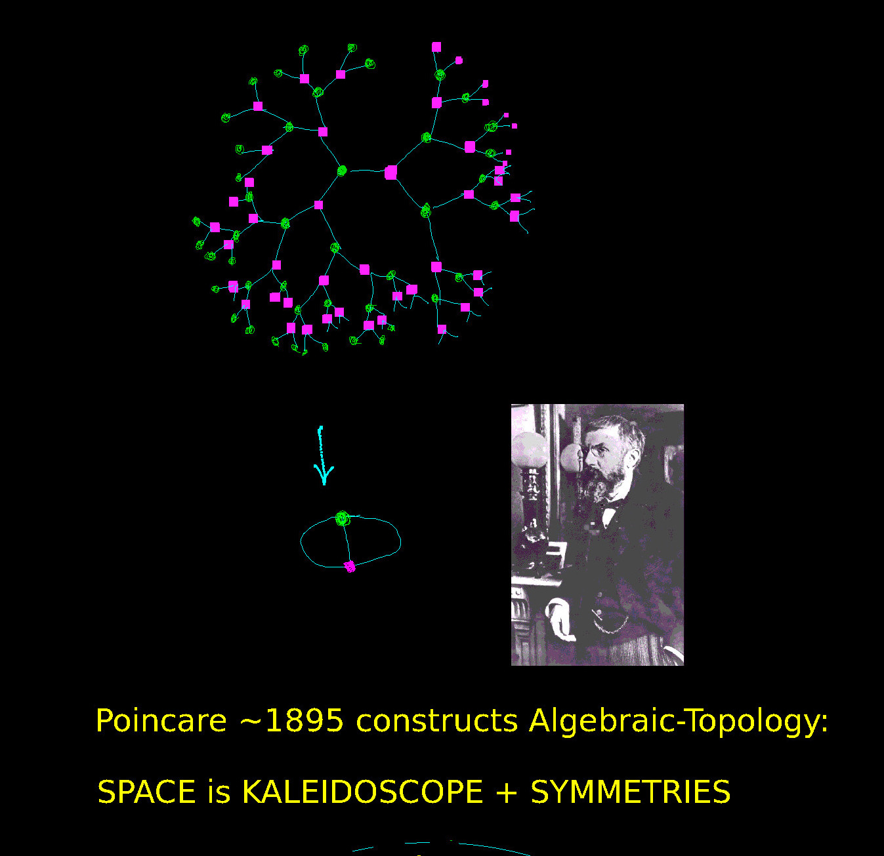
X EΓ-model
=Universal Cover of space M π (M) = Γ
group Γ = Space Symmetries
of universal cover X
Group-cohomology Topological
of Γ = Symmetries
of EΓ action
1
X / Γ quotient
with π = Γ
1
Fundamental group, Universal Covering Spaces, orbit quotients.

Slide 3
Our thesis introduces and develops a general technique
for explicitly constructing SMALL-dimensional EΓ classifying spaces.
Hypothesis: when Γ is infinite, discrete, Bieri-Eckmann duality group
with finite cohomological dimension cd(Γ)=ν < +∞ and dualizing module D.
Ex: Γ= Z, Z, Z, …. torsion-free abelian groups
= GL(Z^2), GL(Z^3), Sp(Z^4), Sp(Z^6), … arithmetic groups G(Z) of Q-reductive groups,
= MCG(Σ_g) … mapping class groups of closed surfaces,
= …, knotgroups,
= …., etc.
2
3

Slide 4
Our method presumes a user has initial explicit geometric EΓ model X
i.e. (X,d) is finite-dimensional Cartan-Hadamard space (NPC contractible)
where group action X x Γ → X isometric, proper discontinuous, free,
and quotient X/Γ finite volume.
……. all models not created equal…..
Ex: - MCG(Σ_g) acts isometrically on Teich(Σ_g) with Weil-Petersson geometry.
- G(Z) acts isometrically on spaces of quadratic (or hermitian) forms.
- GL(Z^2) acts isometrically on Voronoi’s cone, projectivizes to H
(Poincare disk)
2

Slide 5
If X is geometric EΓ model, then typically dim(X)>> …. >> cd(Γ).
Bieri-Eckmann formula: cd(Γ) = dim(X) – (q + 1), q=spherical-dimension(D).
--------------------------------------------------------------------------------------------------------------
Our thesis constructs Γ-invariant closed subsets Z of X, with dim(Z) ≈ cd(Γ),
for which the inclusion Z → X is homotopy-isomorphism, and
explicit Γ-equivariant continuous deformation retracts X onto Z, and
we describe technique for achieving Z with MAX codimension dim(Z) != cd(Γ).
Definition: such maximal-codimension retracts Z are called minimal spines/souls.
(homological duality)

Slide 6
Spines and Souls : Tradition in Geometric-Homology.:
Klein, Minkowski, Poincare, Steenrod, Thom, Lefschetz, Thurston, Gromov, Neeman, Mumford, Gromoll-Cheeger-Perelman, Soule, Ash, McConnell, ….
...how to construct NEW models of old spaces, and as explicit as possible?
“Textbook” constructions of EΓ are abstract/external/dislocated
- requires perfect knowledge of Γ, i.e. generators and relations.
- Milnor: EΓ=joins(Γ,Γ,Γ,...).
- Wall: inductive wedges of spherical-complexes and attaching maps.
- Postnikov towers, Cayley graphs, Rips complex, … .
We presume limited knowledge of Γ,
but require explicit geometric EΓ-model (X,d,vol_X).
Our thesis develops a new program for In Situ reduction-to-spine,
- ! construct spines as explicit subsets of initial model X !
- ready-made for implementation on WOLFRAM.
- Nonlinear extension of Soule-Ash’s Well Rounded Retract !

Slide 7
...illustrating our approach:

Slide 8
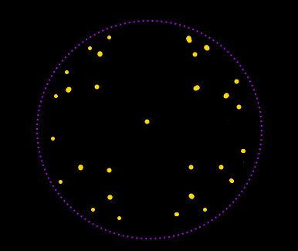
Initial EΓ model (X,d,volX).
Yellow dots = Γ orbit of pt. x
γ.x
x

Slide 9
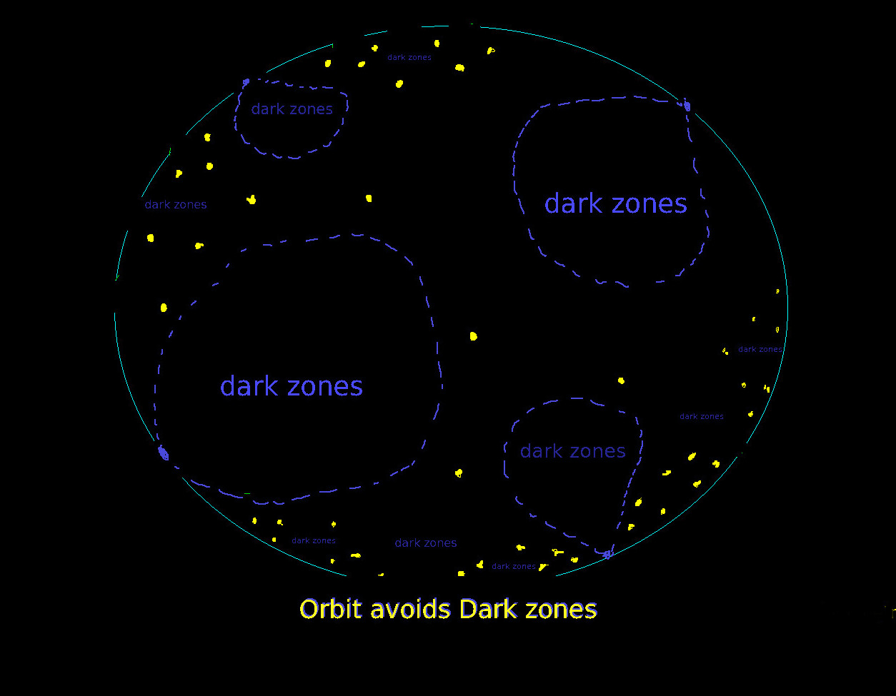
- Γ orbit avoid dark zones.
Dark zones
=
Γ-rational horoballs V[t]
Excision X[t] obtained by
scooping out / excising
the dark zones from X.

Slide 10
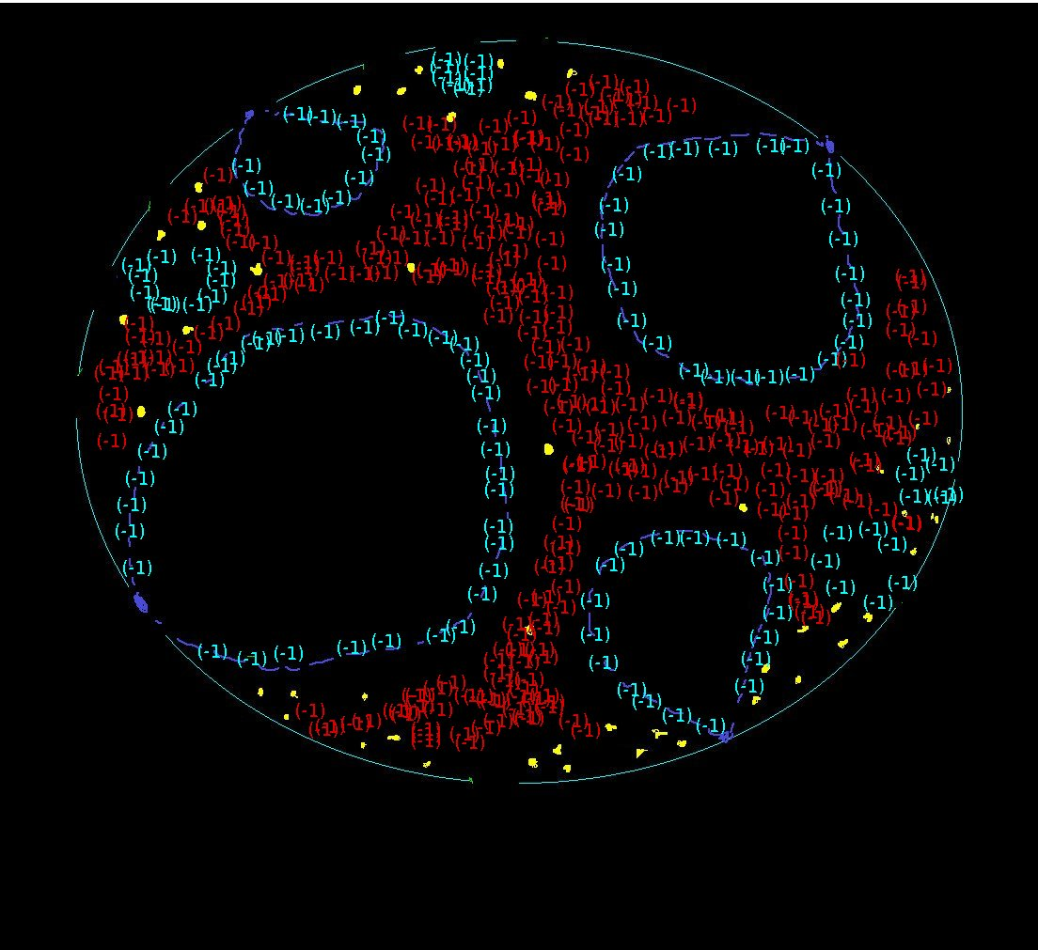
Excision model is
manifold-with-corners
X[t] x δ X[t] .
Next: define
source measures σ
and target measures τ
(-1) source measure on X[t]
-------------------------------
(-1) target measure
on δX[t]

Slide 11
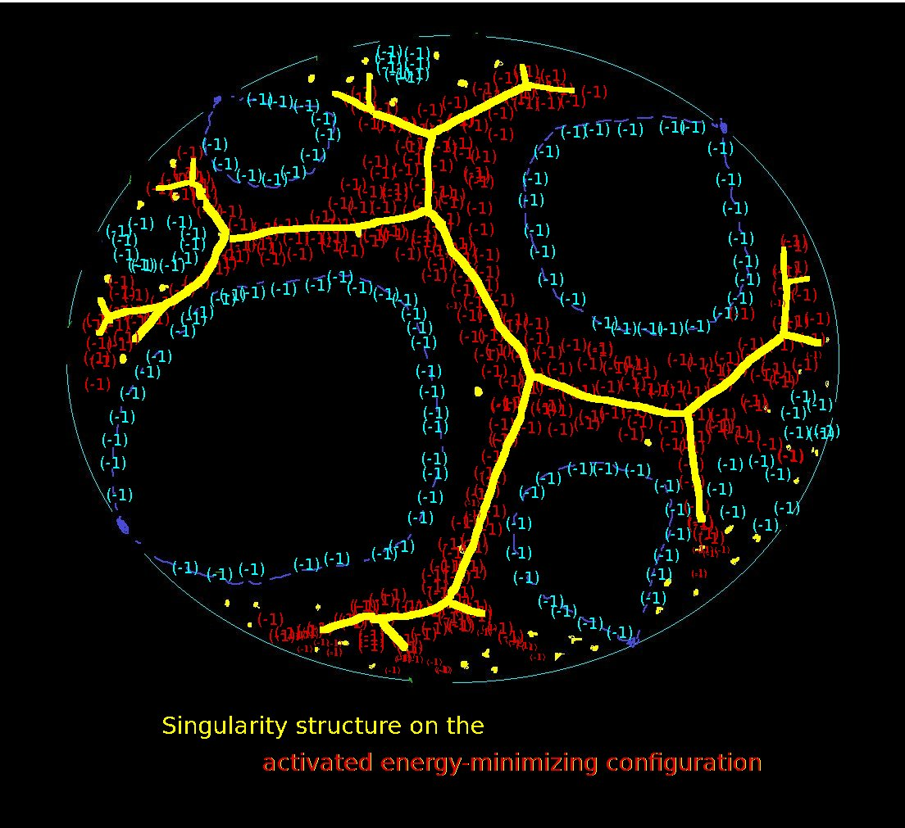
With measures σ, τ, we next
study the singularities of
c-optimal semicouplings
from source to target.
δX[t] X[t]
Z: 2 → 2
We propose:
Spines are readily displayed in the
locus-of-discontinuity (Singularities)
of optimal semicouplings.

Slide 12
...Spines are not hidden…

Slide 13
...Spines are not hidden…
Spines are readily displayed
in locus-of-discontinuity Z
of deformation retracts r : X[t] → δX[t]
------------------------------------------------------------------------------

Slide 14
...Spines are not hidden…
-----------------------------------------------------------------------------
Spines readily displayed in
Kantorovich’s Contravariant Singularity Functor Z(σ,τ, c*)
of c-optimal semicouplings π from (X[t], σ) to (δX[t], τ)
source target
… where c*: X[t] x δX[t] is our two-pointed repulsion cost (defined below).

Slide 15
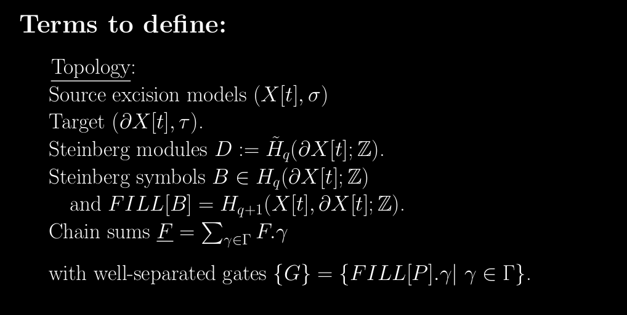
Singularity functor Z(σ,τ, c*)
of c-optimal semicouplings π
from source (X[t], σ) to target (δX[t], τ)

Slide 16
FILL[B].γ
FILL[B].γ

Slide 17
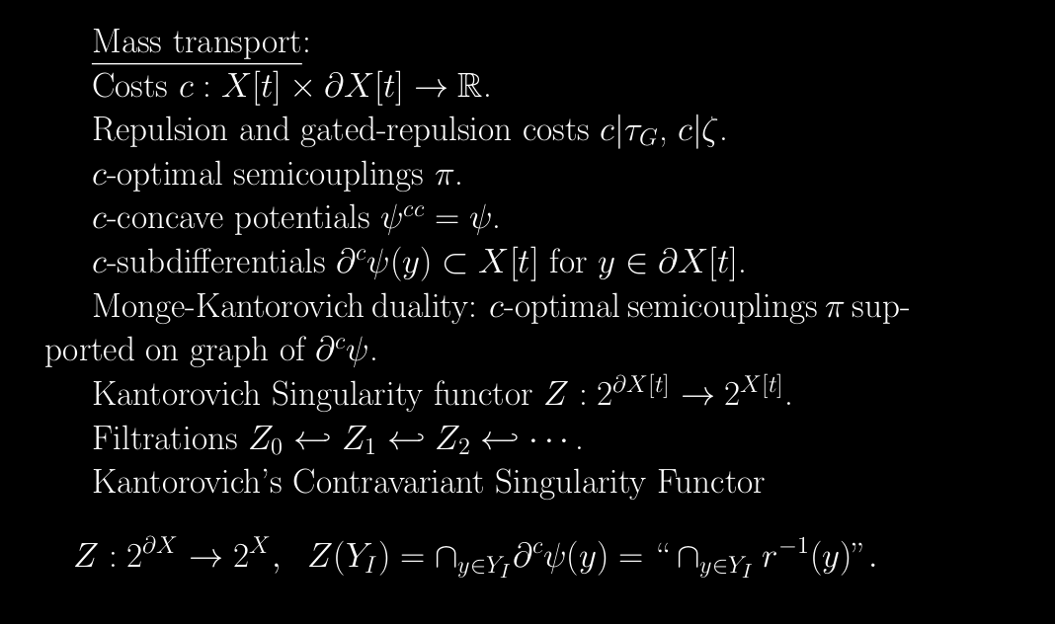
Two-pointed repulsion and visibility costs c* , v

Slide 18
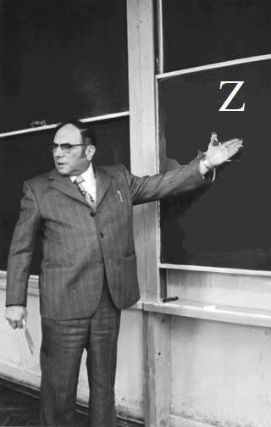
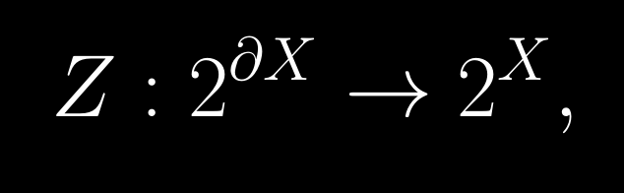
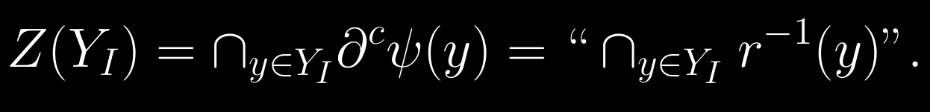
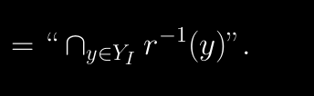
… but everything summarized in: Kantorovich’s Contravariant Singularity Functor

Slide 19

...Singularity is overburdened term.
Economic Definition:
Singularity arises wherever there is competition
for limited common resources.
Singularity is Why countries exist with borders.

Slide 20
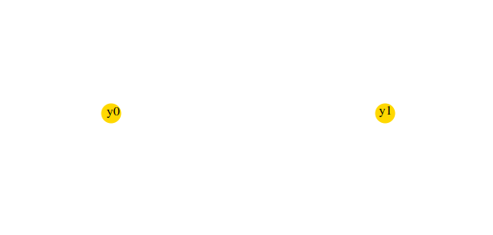
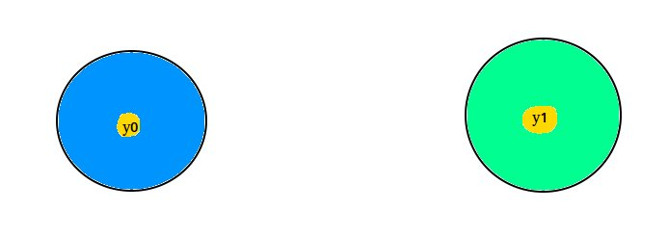
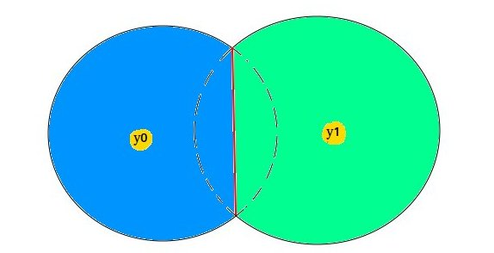
Singularity: wherever competition for limited resources:
c=d**2/2 quadratic cost
(+)→ ← (–) attraction
_______________________
- y0,y1 no competition
(no interact)
- Singularity=Empty
______________________
- y0,y1 compete/interact
- Singularity nonempty
and stable/persistent w.r.t. target mass

Slide 21
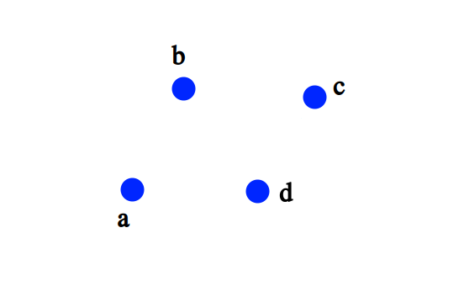
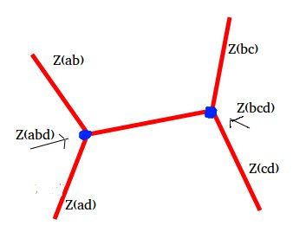
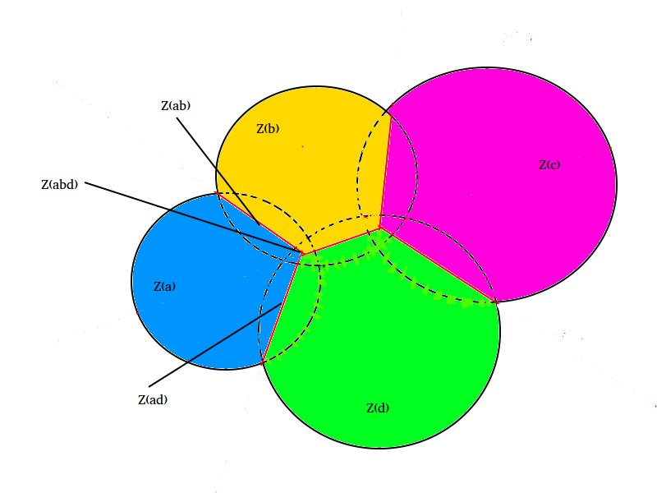
Source = 2-dim background field
Target = +a+b+c+d (4 point masses)
c=d**2/2 quadratic
cost
(+)→ ← (–) attraction

Slide 22
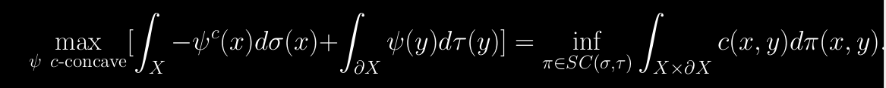
Kantorovich Functor is EXPLICIT.
cc
Key definitions: - c-concave potentials ψ = ψ.
- c-subdifferentials
Monge-Kantorovich Duality:
c-optimal semicouplings π supported on graph of c-subdifferential
of c-concave potentials potentials ψ = ψ
cc
c
– ψ (x) + ψ(y) =< c(x,y)

Slide 23
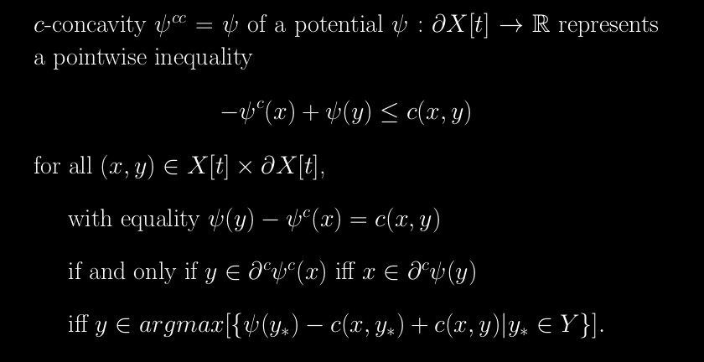
Kantorovich’s Contravariant Singularity Functor IS EXPLICIT.
-
Variational defn. of
c-subdifferential
Define Z({y}) :=

Slide 24
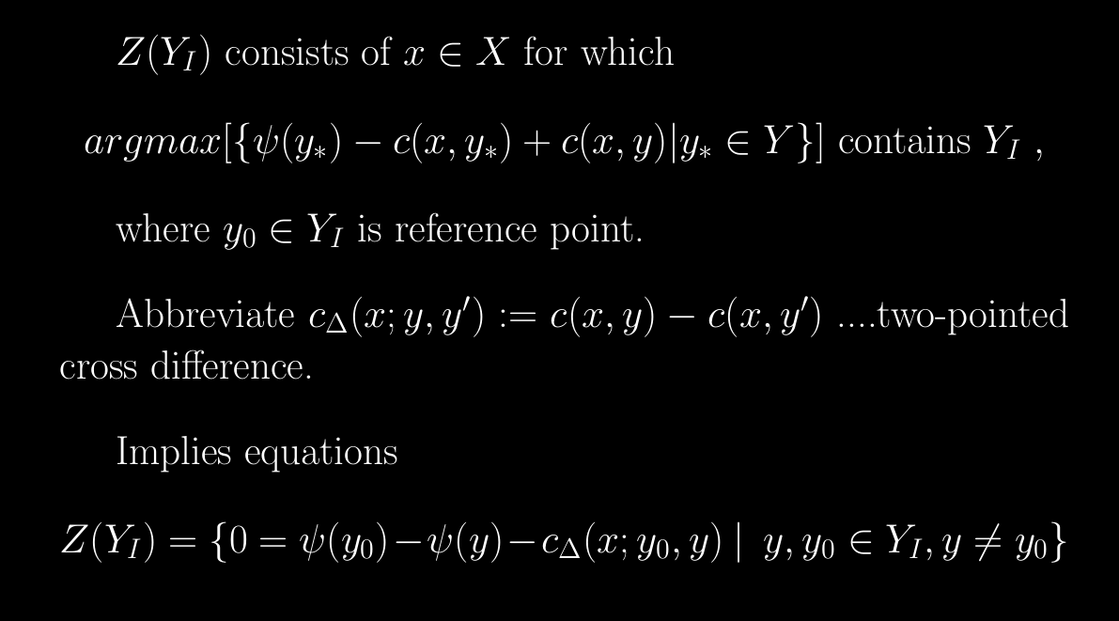
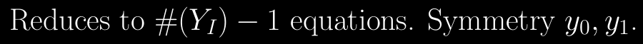
Kantorovich’s Contravariant Singularity Functor IS EXPLICIT.
Variational defn. of
c-subdifferential

Slide 25

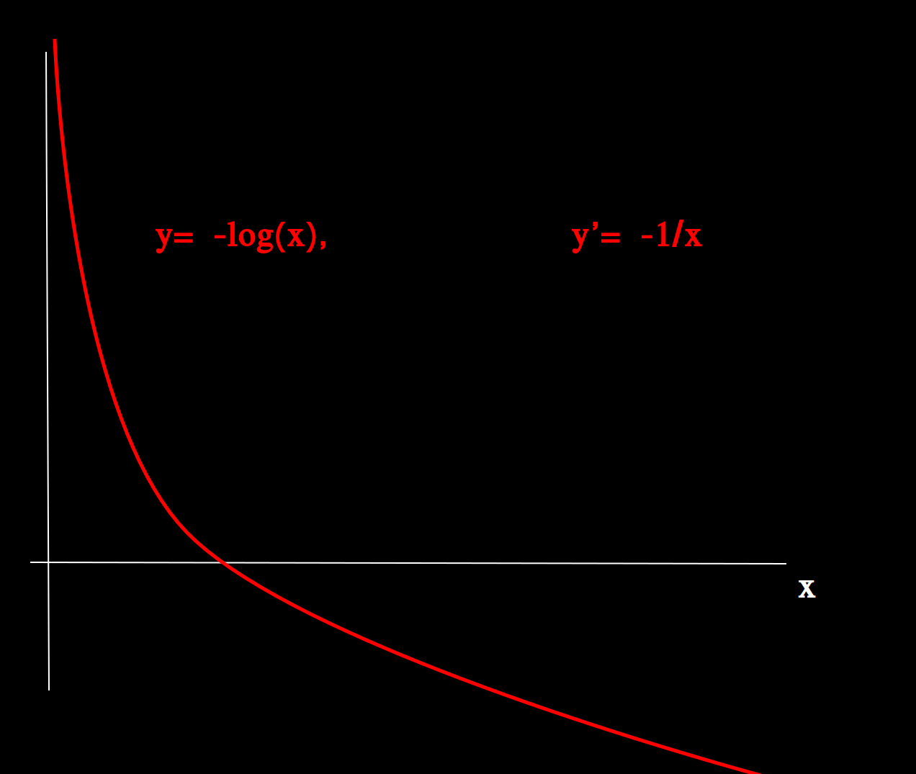
Applications to Algebraic Topology:
Contravariance says Z(Y_I)’s are local cells in X[t], parameterized contravariantly by subsets Y_I of Y=δX[t]
Theorem (Local Reduction)
We find local criterion (UHS conditions) which ensures Z(Y_I) ← Z(Y_J) is homotopy-
isomorphism, and construct explicit continuous deformation retracts wherever (UHS) satisfied.
Proof: - Variational definition of c-subdifferentials,
and gradient flow toward positive poles (not zeros!).
- Modelled on gradient flow to +∞ of f(x)= – log(x)
- flow accelerates into the + ∞ cusp !
then
y= – log(x)
y’ = –1/x

Slide 26
Applications to Algebraic Topology:
If we “skewer the cube diagonally” and filtrate according to dimension, we obtain
descending chain of closed subsets
X[t]← Z{1} ← Z{2} ← Z{3} ← …, ………………… where codim Z{k}=k-1
-Contravariance implies Z{1}, Z{2}, Z{3},… are homology-cycles in X, δ Z{k}=0 ..… consequence of adjunction formula
Theorem (Global Reduction):
We identify index J >= 0 such that local cells {Z(Y_I) | Y_I → Y} and their local
homotopy reductions assemble into global continuous reductions
X →X[t] → Z1 → Z2 → … → Z{J+1}
and such that Z{J+1} is a codimension-J closed subvariety of X,
with inclusion Z{J+1} → X a continuous homotopy-isomorphism.
Applications need index J be large as possible.
J defined by max. codimension of cell Z(Y_I) where (UHS) satisfied.
- Best results obtained with anti-quadratic repulsion (visibility) costs.

Slide 27
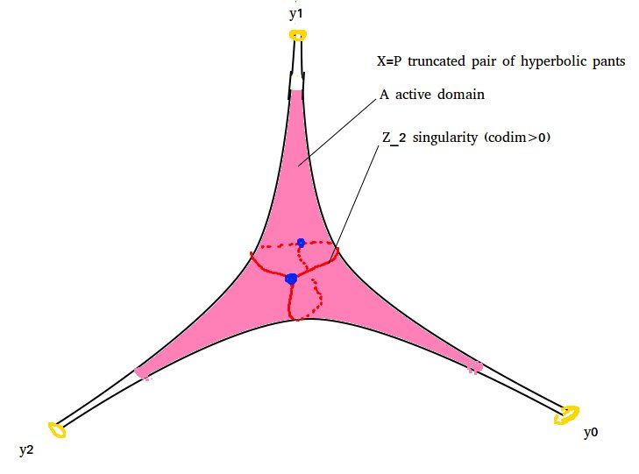
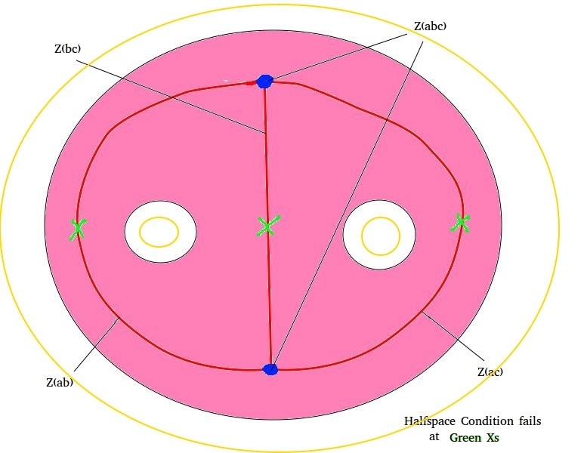
Θ-graph Singularity of excised pant P[t] →δP[t]

Slide 28
...back to Application of Kantorovich Singularity:
...Spines are not hidden…
Spines are readily displayed
in locus-of-discontinuity Z
of def. retracts r : X[t] → δX[t]
------------------------------------------------------------------------------
Spines readily displayed in
Kantorovich’s Contravariant Singularity Functor Z(σ,τ, c*)
of c*-optimal semicouplings π from (X[t], σ) to (δX[t], τ)
source target

Slide 29
Γ-rational Excision X[t] x δX[t]
Given initial geometric EΓ model (X,d, vol ) :
- require Γ-invariant boundary
... but the familiar Gromov visual boundary X(∞) is not useful
since Γ acts ergodically on X(∞) with respect to natural Lebesgue measure.
- implies Γ-invariant Radon measures on X(∞)
do NOT descend to Radon measures on X(∞) / Γ.
Step (0): Construct Γ-rational excision X[t] with proper-discontinuous boundary δX[t] .
Obtain: Source (X[t], σ) ------- >> Target ( δX[t], τ )
Excision: X[t]=X – U V[t] obtained by scooping-out/excising
a countable {t}-family of Γ-rational horoballs V[t] in X.
Γ-rationality implies X[t] and boundary δX[t] are Γ-invariant subsets
- inherit proper-discontinuous Γ-actions.

Slide 30
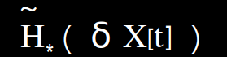

Excision: Bieri-Eckmann duality:
Κey Property: δX[t] has homotopy-type of countable wedge of q-spheres, and
D = is Bieri-Eckmann dualizing module (“Steinberg module”)
- Steinberg module D is infinite cyclic ZΓ-module generated by spheres at-infinity B (called “Steinberg symbol”)
X[t] contractible + LES relative homology + NPC ==>>
isomorphism with inverse
flat-filling
FILL[B] B FILL=δ^{-1}
~

Slide 31
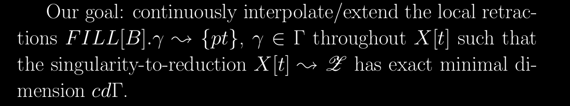
Homological duality:
-Steinberg symbols are relative cycles FILL[B] ε
-Bieri-Eckmann duality implies FILL[B] is dual cycle to minimal spines fundamental class.
- dim(FILL[B]) is max codimension of minimal spine (homological duality formula)
- Observe FILL[B] deformation retracts to {pt} …………. FILL[B]→{pt}.
Interpolation Problem solved
with Two Pointed-(Visibility)-Repulsion cost c=v,
and Kantorovich Functor Z=Z(σ, τ, v ) on
Γ-rational excision X[t], δ X[t]

Slide 32
...to illustrate the Interpolation Problem:

Slide 33
Initial geometric EΓ-model X

Slide 34
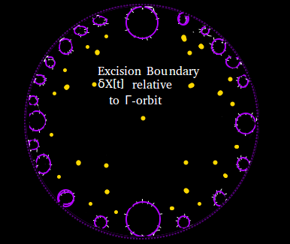

Slide 35
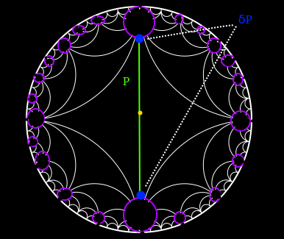
Steinberg symbol P is
relative 1-cycle; with boundary δP a boundary 0-sphere.

Slide 36
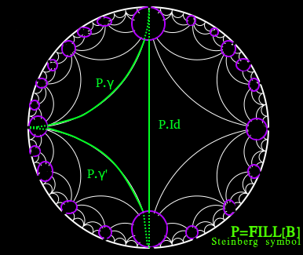
The subset {Id, γ, γ’} successfully Closes the Steinberg symbol.

Slide 37
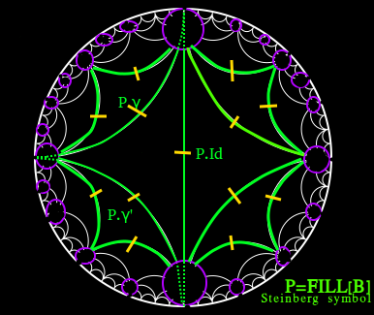
Homological duality ==>>
Minimal spine is dual to
Steinberg symbols P, P.γ, γ ε Γ.
¿¿ How to assemble/interpolate
the local reductions
{ P.γ→ {pt}, γ ε Γ }
to obtain a Spine
throughout X[t] ??
Answer:
Kantorovich Singularity functor Z(σ,τ,v)
of two-pointed visible repulsion cost
v: X[t] x δX[t] → R

Slide 40
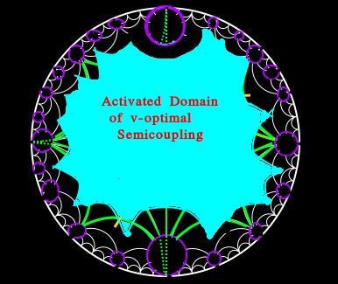

Slide 41
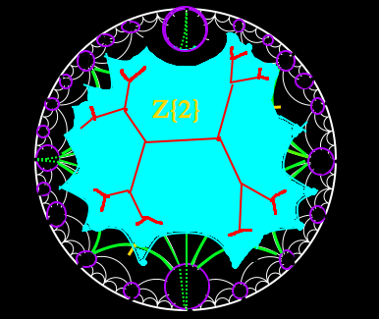

Slide 43
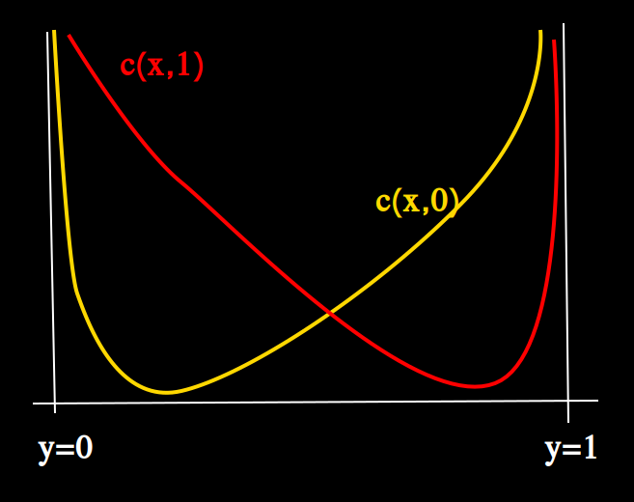
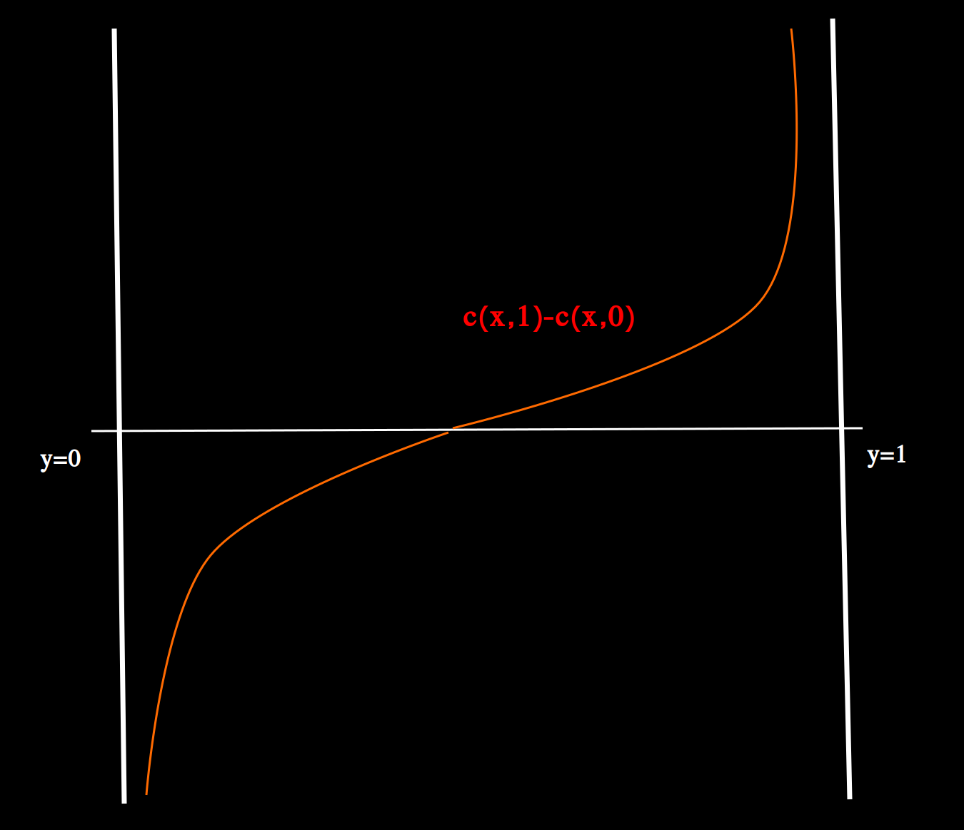
One-dimensional repulsion cost:
Unit interval I=[0,1] , boundary δI={0,1}
c(x,0) = |x| + 2|1-x|
c(x,1) = 2|x| + |1-x|
c(x,1) – c(x,0) = |1-x| – |x|
- cross-difference is critical-point free!
(critical points at poles x=0,1)
fibres connected.
-2
-2
-2
-2
-2
-2

Slide 44
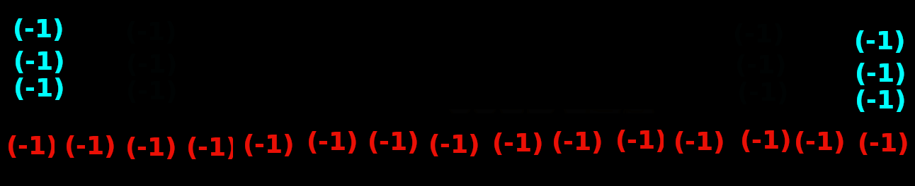
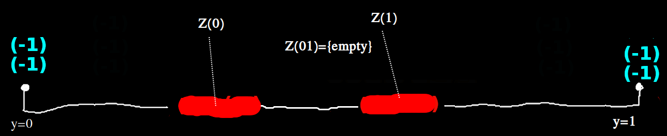
Consider closed unit interval X = [0,1] with boundary δX={0, 1}.
σ is uniform distribution of (-1) charges. mass(σ) =15(-)
τ is uniform distribution of (-1) charges. Mass(τ) = 4(-)
mass(σ) >>...>> mass(τ)
Ground state

Slide 45
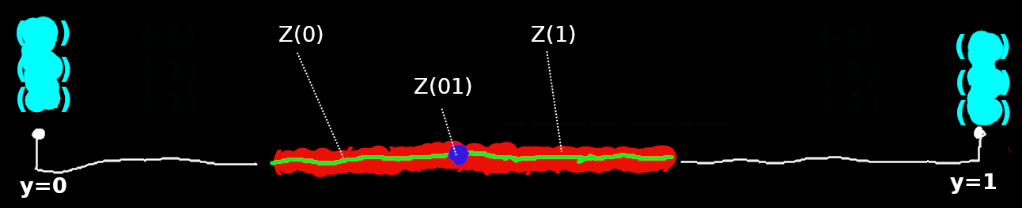
Consider closed unit interval X = [0,1] with boundary δX={0, 1}.
σ is uniform distribution of (-1) charges. mass(σ) =15(-)
τ is uniform distribution of (-1) charges. Mass(τ) = 6(-)
mass(σ) >>> mass(τ)
Ground state

Slide 46
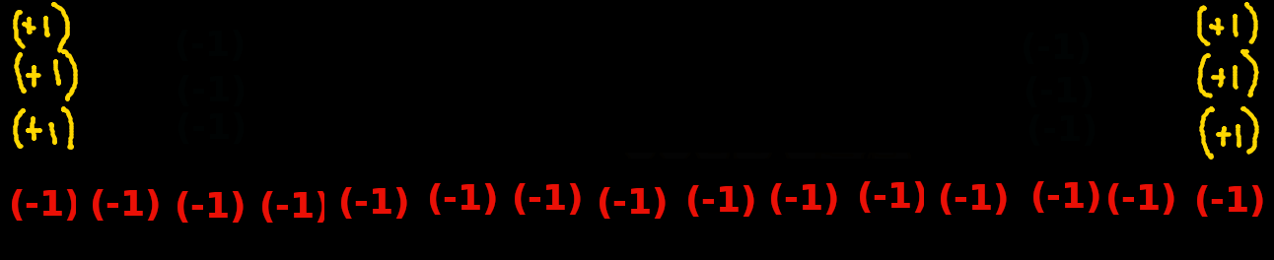
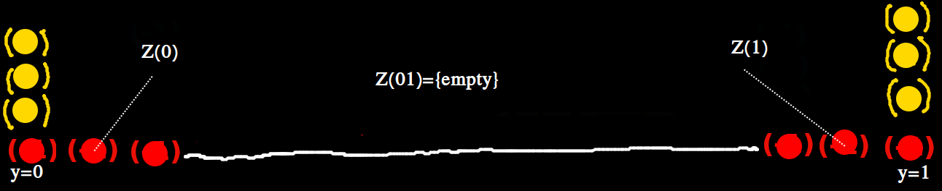
Consider closed unit interval X = [0,1] with boundary δX={0, 1}.
σ is uniform distribution of (-1) charges. mass(σ) =15(-)
τ is uniform distribution of (+1) charges. Mass(τ) = 6(+)
mass(σ) > mass(τ)
Ground state
Ground state

Slide 48
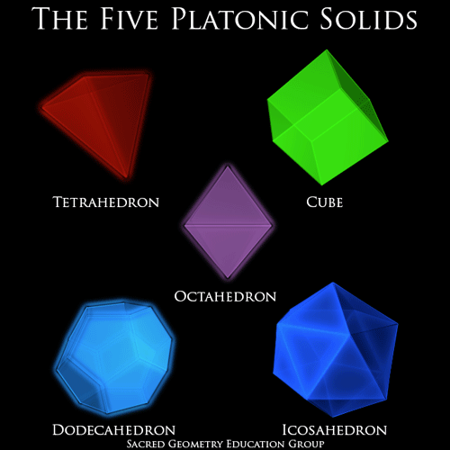
Closing Steinberg (CS):
In low dimensions (CS) is the problem of stitching a football from collection of panels {P}.
Ex: Regular platonic solids solve (CS) with panels P = triangle, square, pentagon.
P=Triangle
P=Triangle
P=Square
Polyhedra
At-infinity !
(CS) implies
F=conv(P,P’,…)
is relative cycle
F ε H_*( X[t], δ X[t])
P=Pentagon

Slide 49
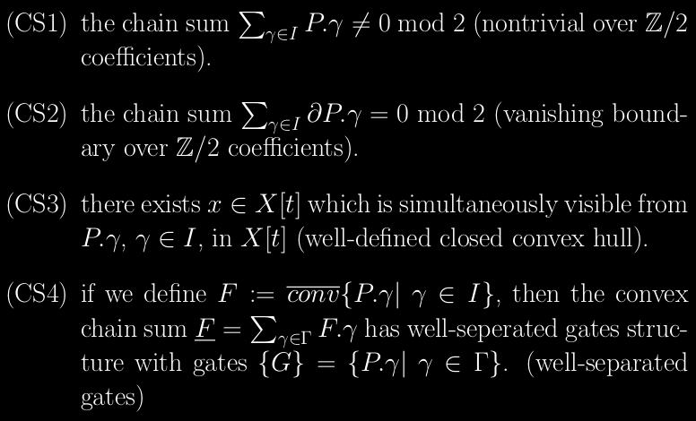
Closing Steinberg:
In our applications the panels {P} = { FILL[B].γ | γ ε Γ } are flat-filled Steinberg symbols.
- Seek finite subset I of Γ such that panel translates { P.γ | γ ε I } assemble to “closed football”
Formal definition:

Slide 50
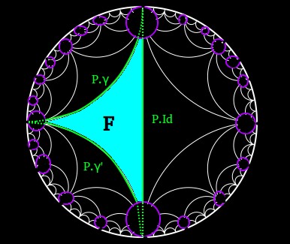
Closing Steinberg:
CS1, CS2 ==> constructing nonzero ξ ε H_0 ( Γ, Z_2 Γ x D ).
- equivalent to a syzsygy in projective homological resolution of D.
CS4 ==> the translates F. Γ define chain sum F = Σ F.γ
- Γ acts on chain summands of F like “shift operator” equivalent to right-action Γ x Γ → Γ

Slide 51
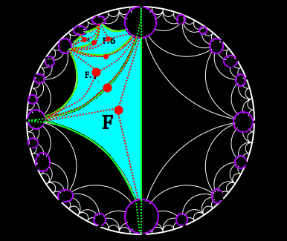

Slide 52
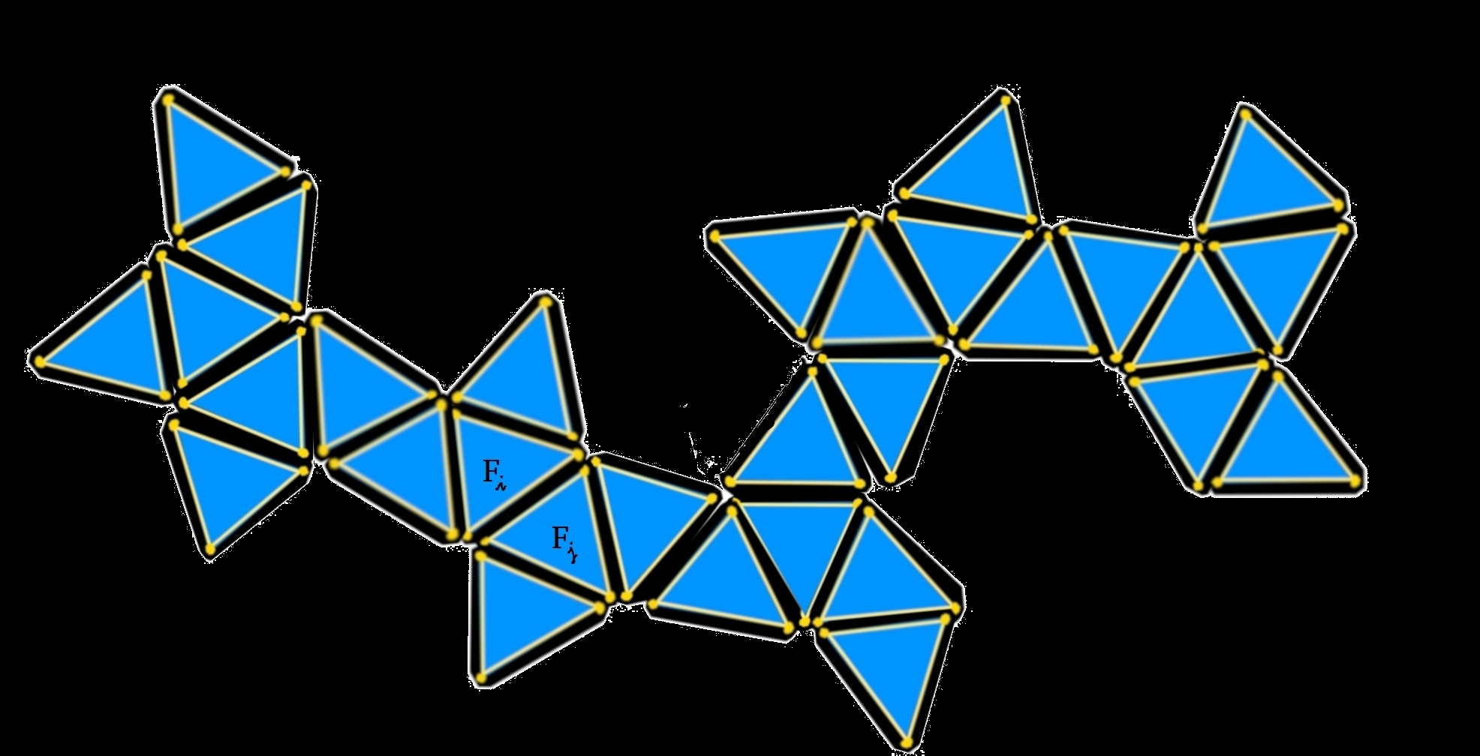
Chain sum F with well-separated gates:
CS replaces X[t] with a chain sum F, a type of partition of unity.
Well-separated gates == summands F,F’ have trivial intersection or F∩F’=P

Slide 53
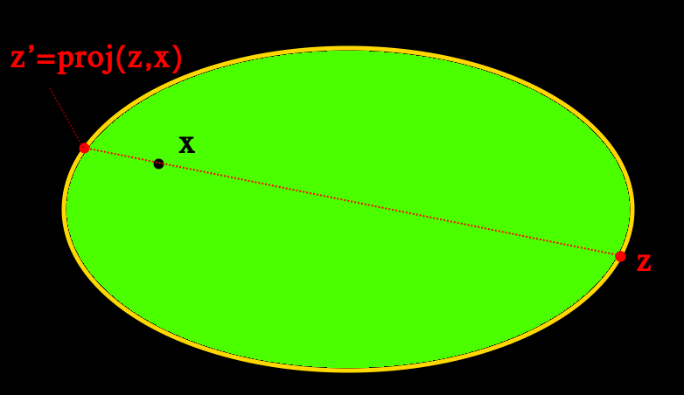
Two-pointed Repulsion cost c* :
c*(x,z) := ½. dist(x,z)^{-2} + dist(x, proj(z,x))^{-2}
- the 2-pointed repulsion cost c* leads to singularity functor Z(σ, τ, c* )
- Our proposal is finally that (UHS) conditions are satisfied up to index J=cd(D) ,
and Kantorovich singularity equivariantly homotopy-reduces the source X
to minimal spine Z .

Slide 54
Two-pointed Repulsion cost c* :
c*(x,z) := ½. dist(x,z)^{-2} + dist(x, proj(z,x))^{-2}
- c* extends to repulsion cost on chain sum F with well-separated gates {G}
- gates G geodesically convex implies c* is continuous interpolation
of the restricted 2-pointed repulsion costs c*|G
- Singularity structures Z(σ,τ, c*) are continuous interpolation of
restricted singularity structures Z(σ, τ, c*|G) , over gates {G} of F

Slide 55
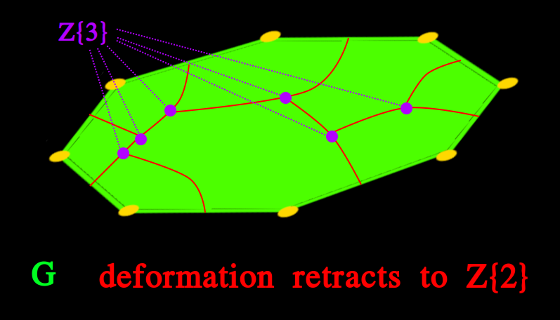
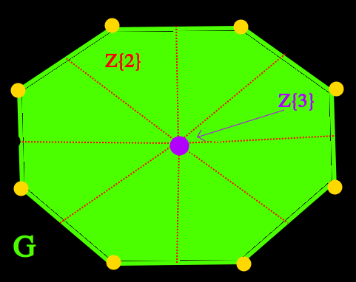
… Closing Steinberg (CS) and Interpolating Local Reductions:
- in our applications the gates {G} of the chain sum F will coincide with the Γ-orbit of Steinberg symbols P.γ = FILL[B].γ , γ ε Γ .
- the singularity structures of the two-pointed repulsion costs c and visibility cost produce homotopy-reductions of the gates G=P to points, G → {pt} .
- generic convex panels G deformation retract to Z{2},
and Z{3} is disconnected.
- gate G with large symmetry implies G reduces to Z{3}={pt}

Slide 56
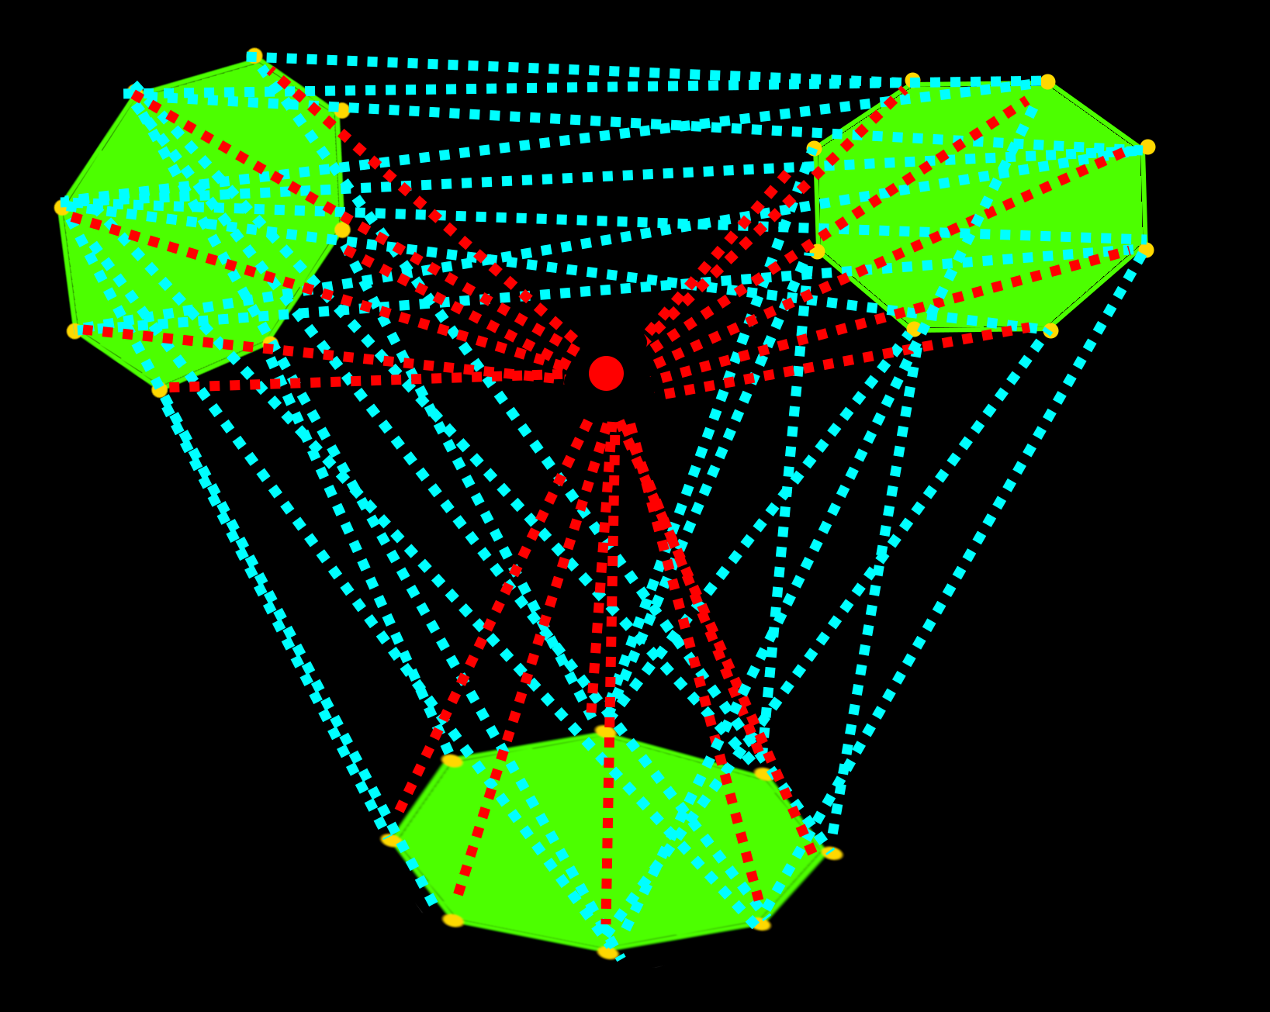
Successfully Closing Steinberg symbol replaces X with a convex chain sum
F = Σ F.γ
where F := conv[P, P.γ, P.γ’, ...]
- Hypotheses of (CS) implies:
the convex hull F is well-defined,
and
- translates F.γ, γ ε Γ , have well- separated gates {G} coincident
with Γ-orbit of Steinberg symbols G=FILL[B]
F

Slide 57
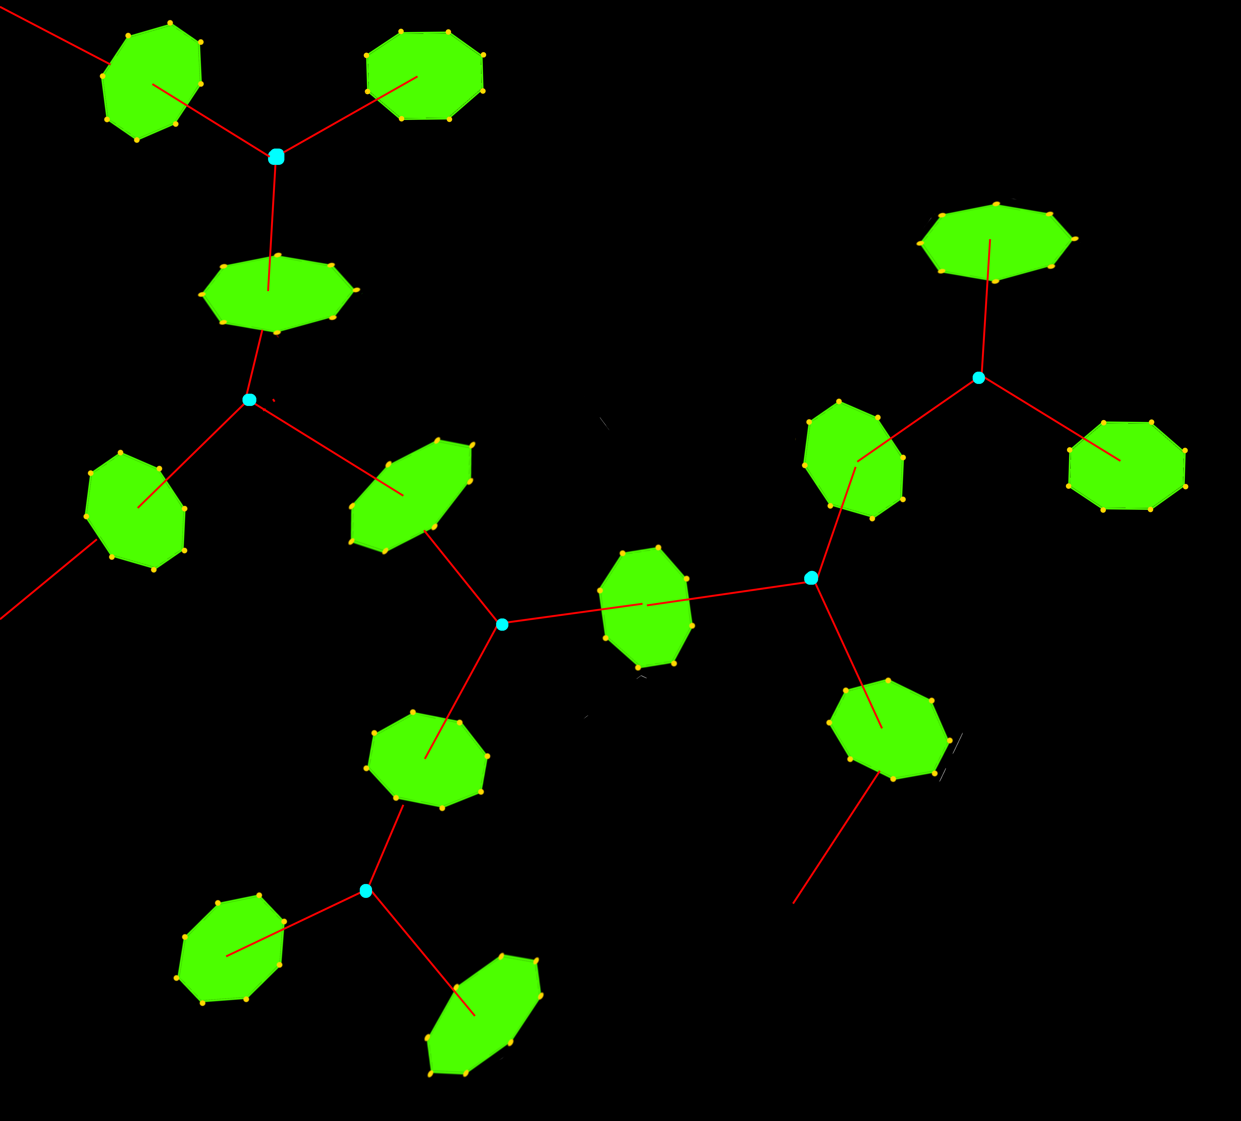
G
c*-optimal semicouplings from source X=F
to target Y=E[F]
G
G
G
G
G
We construct
explicit continuous homotopy-reductions
G
F→Singularity Z{2}

Slide 58
Given initial geometric EΓ model X,
- we construct excision X[t] with boundary δX[t]
- we Close Steinberg and replace X[t] with chain sum F
- we install two-pointed visibile repulsion cost v: X[t] x δX[t] → R
Then Kantorovich’s Singularity functor Z=Z(σ,τ,v) constructs explicit homotopy-reductions
X→ X[t] → Z{1} → Z{2} → … → Z{J+1}, where index J>1 depends on (UHS) conditions.
We conjecture (and prove in special cases) that costs c* , v satisfy sufficient (UHS) conditions
for applications.

Slide 59
The End.
Thank you.
┬

