Slide 1
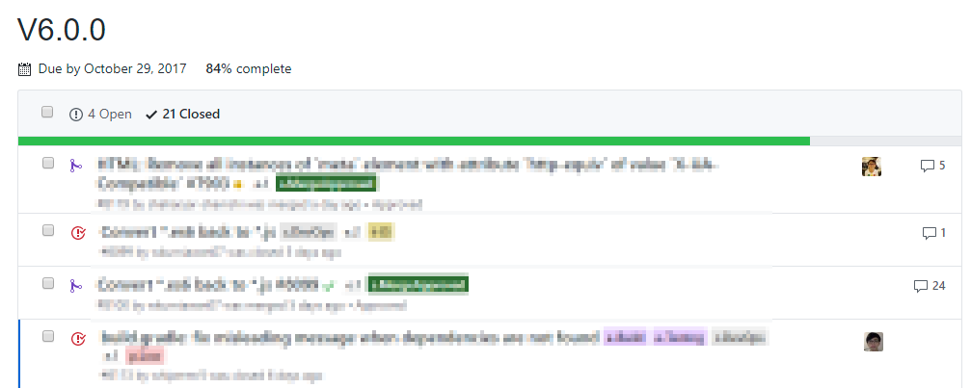
Issues and PRs assigned to the milestone
Issues assigned to team members

