Slide 1
When does an AI
commit to a wrong answer?
Blink of an Eye & Critical Windows
Marvin Li
HMMT
With Sitan Chen (ICML 2024)
With Aayush Karan and Sitan Chen (ICML 2025)
01
Notes:
Opening: An AI can generate a long solution, but a small part of it may decide the final answer. We will solve one short problem, then restart the AI at different points to see when the wrong answer becomes fixed. No machine-learning background is assumed. Sources: https://arxiv.org/abs/2403.01633 and https://proceedings.mlr.press/v267/li25at.html

Slide 2
A one-line mistake changes the answer
Arithmetic sequence: T₁ = T₃ − T₂ and T₄ = 8.
a = first term. d = common difference.
Correct calculation
The model’s calculation
a = (a + 2d) − (a + d)
a = d
8 = a + 3d = 4d
T₃ = T₂ + 2d
a = 2d
8 = a + 3d = 5d
a = 2
a = 16/5
Blink of an Eye (2025), Figure 5. Model response paraphrased.
02
Notes:
Give the audience about 15 seconds to solve the problem before walking through the two columns. With common difference d, consecutive terms differ by d. Thus a=d and the fourth term is 4d=8, so a=2. The Phi-3 response instead used T3=T2+2d, incorrectly counting two gaps between adjacent terms. Its answer was 16/5. This is an algebraic paraphrase of the response, not an exact quote. Source: https://proceedings.mlr.press/v267/li25at.html, Figure 5.

Slide 3
Restart the model from an unfinished solution
A language model repeatedly samples the next piece of text.
Keep this prefix
“Let the common difference be d.
The first term equals the third minus the second…”
Generate many new endings.
How often does the answer still equal 16/5?
Method: Blink of an Eye (2025), Sections 2 and 6
03
Notes:
A language model produces one token at a time. Tokens are pieces of words or symbols. It samples a next token conditional on the prompt and all earlier tokens. To test commitment, take one finished response, keep only a prefix, and independently sample many new continuations. Repeat at different prefix lengths. The prefix below is a shortened pedagogical paraphrase of the arithmetic response. It is not a new measured experiment. Source: https://proceedings.mlr.press/v267/li25at.html, Section 2.2.1 and Section 6.

Slide 4
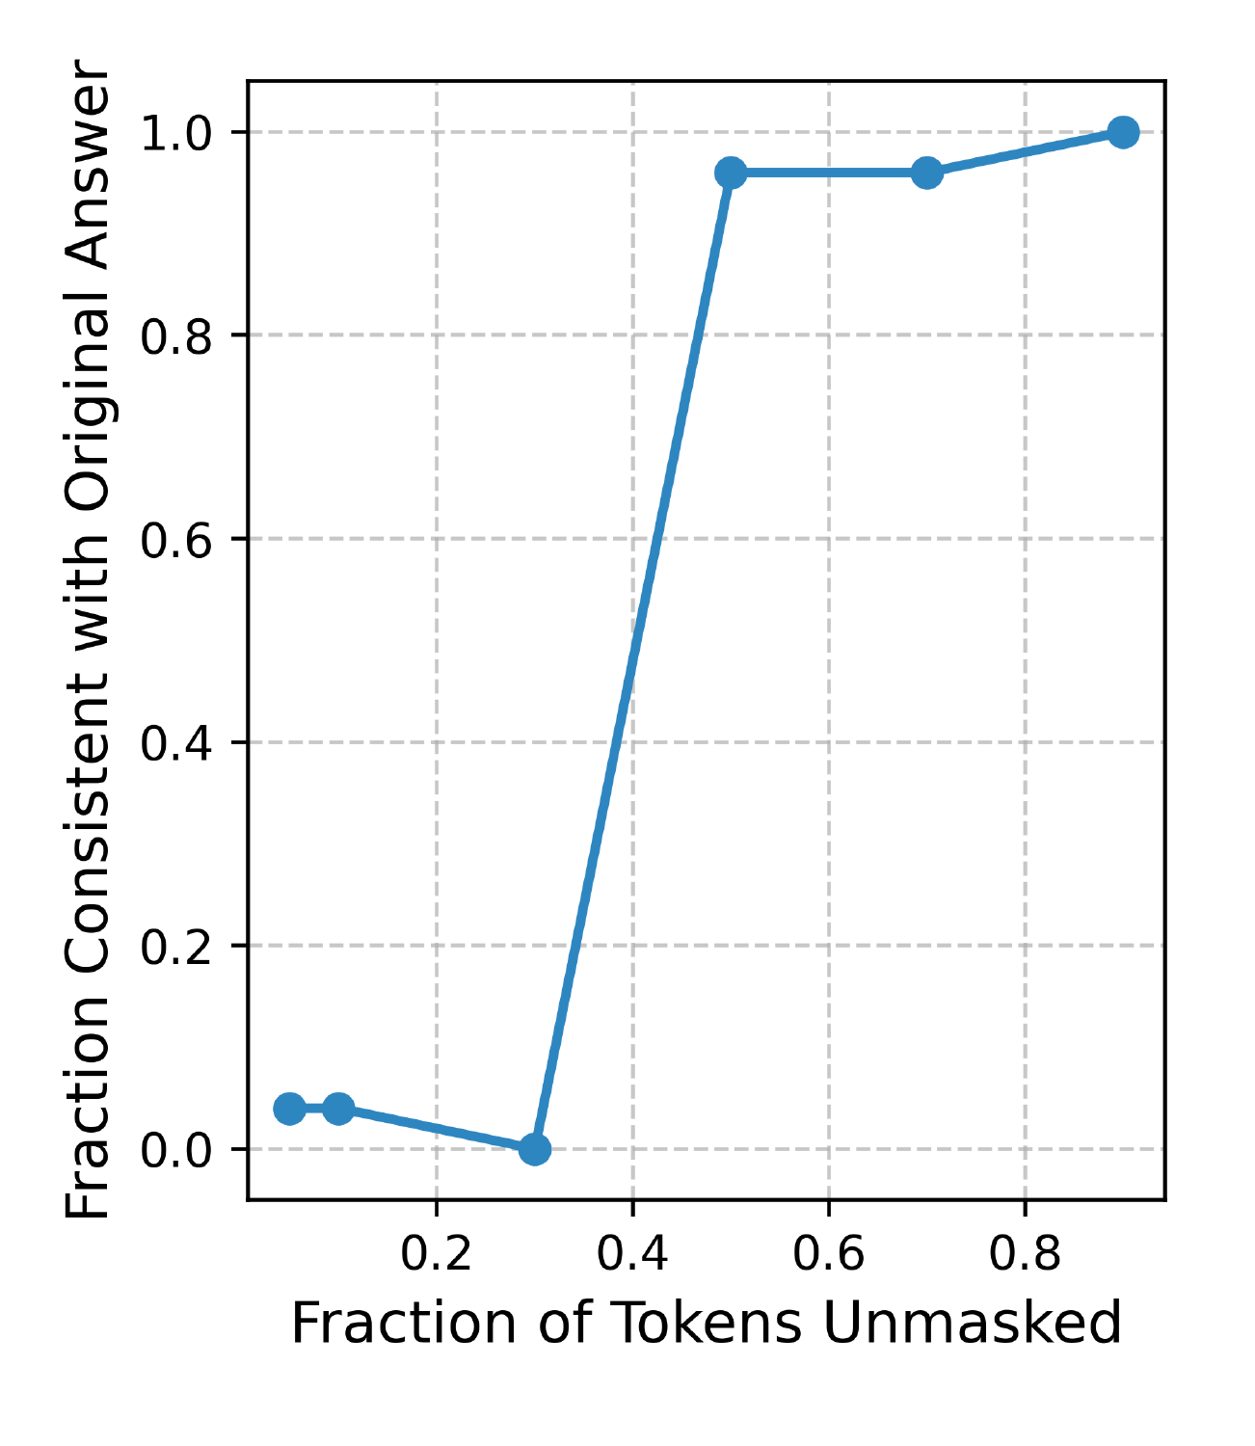
A short interval fixes the wrong answer
Keep about 30%
The answer can change.
Keep about 50%
Almost every continuation
returns the same wrong answer.
This transition is a critical window.
Observed result: Blink of an Eye (2025), Figure 5
04
Notes:
This is the original plot from Figure 5, enlarged without redrawing or inventing data. The horizontal axis is the fraction of the original response kept; larger means a later restart point. The vertical axis is the fraction of regenerated answers matching the original, incorrect answer 16/5. Between the displayed 0.3 and 0.5 prefix fractions, answer agreement rises sharply. The experiment localizes commitment to an interval, not necessarily a single token or the precise cause of the mistake. Source: https://proceedings.mlr.press/v267/li25at.html, Figure 5.

Slide 5
A few clues can change the odds sharply
Two possible modes: A and B. Start with odds A:B = 1:99.
Each new clue is 10× as likely under A as under B.
Probability of A (%)
Odds multiply
1:99 (1%)
10:99 (9%)
100:99 (50%)
1000:99 (91%)
Illustrative Bayes calculation, not model measurements
05
Notes:
This is a fully specified hypothetical Bayes calculation, not an experimental result or a theorem that every LLM has two modes. Suppose the prior odds of mode A versus mode B are 1:99. Each observed clue has conditional likelihood ten times larger under A than B. Bayes multiplies the odds by ten for each clue. After k clues, P(A|clues)=10^k/(99+10^k). The displayed values are rounded percentages. Independence is unnecessary if each conditional likelihood ratio, given preceding clues, is ten. This shows how incremental observations can produce a fast change in a hidden mode probability. It does not mean the model literally computes these odds. Related motivation: https://proceedings.mlr.press/v267/li25at.html, Example 4.3.

Slide 6
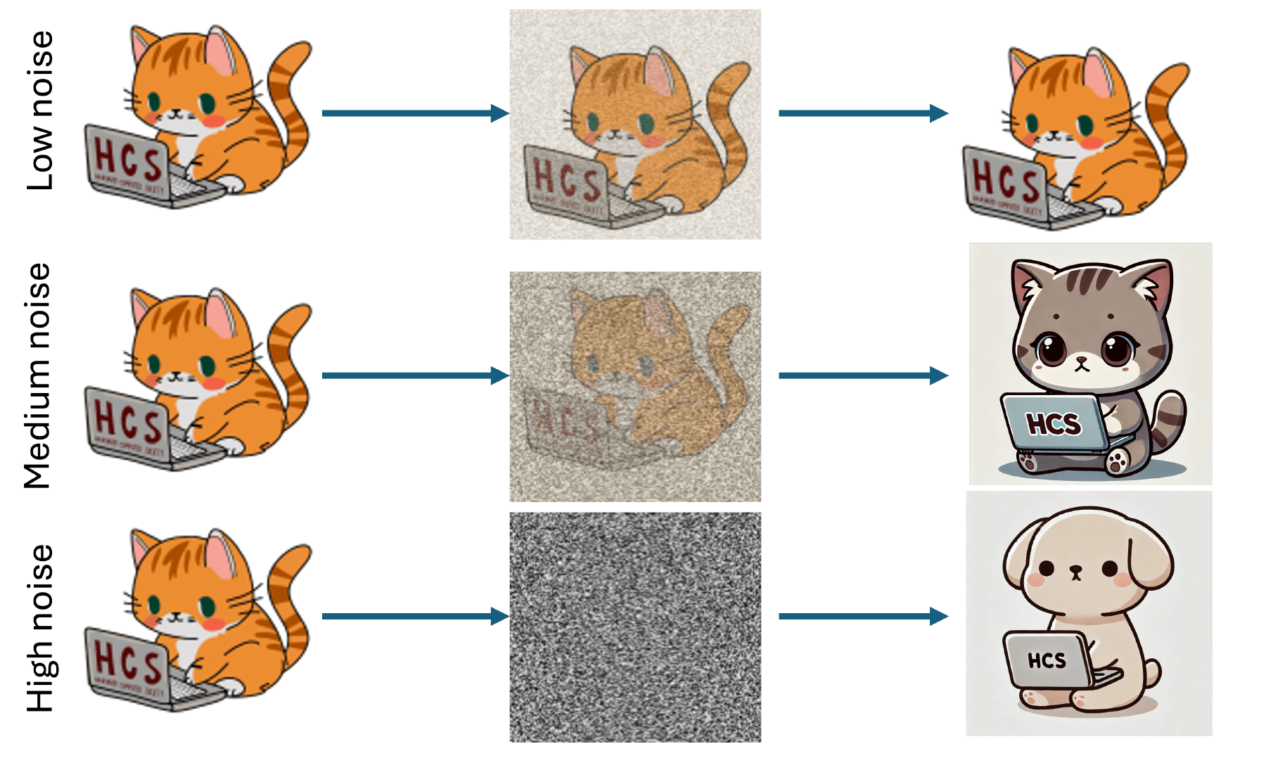
Images have an analogous restart experiment
A diffusion model builds an image by progressively removing noise.
Add a little noise
The details survive.
Add more noise
Color changes. It is still a cat.
Add heavy noise
Even “cat” can disappear.
Illustration: Blink of an Eye (2025), Figure 3
06
Notes:
Introduce diffusion before the figure: a diffusion model generates an image by progressively removing noise. For the forward-reverse experiment, begin with a generated image, add a chosen amount of noise, then denoise again. The figure is a cartoon, not experimental data. A feature can be any property defining a group of outputs. At intermediate noise, the specific color can change while the cat feature remains. Source: https://proceedings.mlr.press/v267/li25at.html, Figure 3.

Slide 7
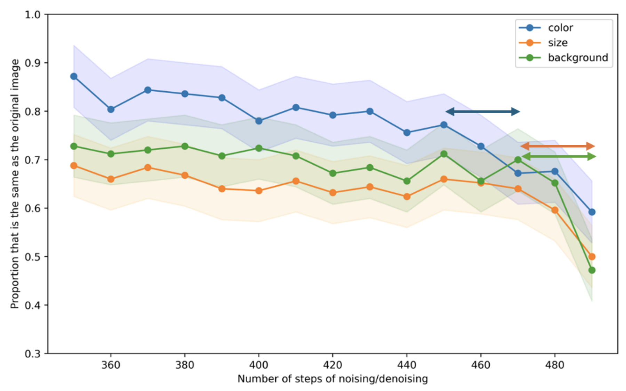
Critical Windows: feature timing in diffusion
Experiment
Color, size and background
lose agreement at
different noise levels.
Theory
For mixtures of bell-shaped
populations, separation
controls feature timing.
Theory assumes ideal diffusion and strongly log-concave components.
Li & Chen, Critical Windows, ICML 2024, Figure 4
07
Notes:
Li and Chen, ICML 2024. The figure is the paper’s Stable Diffusion 2.1 experiment on 250 car images. The x-axis increases with the amount of noise added before regeneration. CLIP assesses agreement in color, size and background. The arrows mark the reported windows. The theoretical part bounds feature-preserving ranges for mixtures of strongly log-concave distributions with an ideal reverse process, with explicit estimates for well-conditioned Gaussian mixtures. A Gaussian is a bell-shaped cloud of points. Strong log-concavity is a more general single-cloud condition. The estimates depend on within-group and between-group separation, and lead to a hierarchy interpretation under additional separation assumptions. Real-image experiments illustrate the phenomenon but do not establish those assumptions. Source: https://arxiv.org/abs/2403.01633, Sections 4-7, Figure 4.

Slide 8
Erasing detail while preserving the group
Orange cats are a group inside all cats.
Forget which kind of cat
The remaining information cannot distinguish orange from brown.
Keep enough information to distinguish cats from dogs
Regeneration can change the color while preserving the cat population.
Common principle behind both papers
08
Notes:
This states the intuition of the general theorem, not a claim that all distributions automatically have such a regime. Let A be a smaller population contained in B. If degraded A and B are close and degraded B and its complement remain distinguishable, regenerating with the full model from degraded A approximates B. For the cartoon, A is orange cats and B is all cats. Crucially, closeness is about the whole distribution of regenerated outputs, not just a single label. Source: https://proceedings.mlr.press/v267/li25at.html, Theorem 3.1; https://arxiv.org/abs/2403.01633, main theorem.

Slide 9
Blink of an Eye: why the principle is general
Similar observations give similar regenerated distributions.
If the observations still identify the group, regeneration
rarely leaves it.
The proof uses conditional probability and the triangle inequality.
Applies to text and diffusion under the paper’s sampling framework.
Li, Karan & Chen, Blink of an Eye, ICML 2025
09
Notes:
Li, Karan and Chen, ICML 2025. Start with the common experiment rather than introducing stochastic localization as jargon. The theory applies to Markov degradation and ideal posterior sampling, including Gaussian noising and right-to-left token masking. Proof sketch: applying the same reverse kernel to nearby observation distributions preserves closeness (data processing). Distinguishability keeps the average posterior leakage outside the target group small. Combine by the triangle inequality. Unlike the 2024 result, this does not require log-concavity and its error bound has no explicit ambient-dimension factor. Exact result, if requested: TV(q_t,p_B) ≤ epsilon(1+max(1,W)/sqrt(2)), where TV(p_A,t,p_B,t) ≤ epsilon, TV(p_B,t,p_complement,t) ≥ 1-epsilon^2, and W is outside/inside prior mass. TV is the largest event-probability difference. Sharp or nonempty windows require additional structure. Source: https://proceedings.mlr.press/v267/li25at.html, Theorem 3.1 and Section 3.2.

Slide 10
The arithmetic example is part of a broader pattern
MATH responses with a critical window (%)
A window can mark
a consequential
reasoning step.
Agreement with an answer
does not establish
that it is correct.
Measured criterion: >0.5 jump in original-answer agreement.
Blink of an Eye (2025), Section 6. All models are Instruct variants.
10
Notes:
Measured fractions of MATH benchmark generations with a critical window: Llama-3.1-8B-Instruct 42.2%, Qwen-2.5-7B-Instruct 16.6%, Phi-3-7B-Instruct 30.2%. A critical window in this experiment means a jump greater than 0.5 in original-answer agreement between consecutive truncation fractions. Models are the Instruct variants, as listed in the paper. Generations with windows were less accurate in the reported experiments. This is an association and not proof that windows cause errors. Consistency measures agreement with the original answer, whether correct or incorrect. Source: https://proceedings.mlr.press/v267/li25at.html, Section 6 and Table 1.

Slide 11
We can study when an answer becomes fixed
Critical Windows (2024)
Geometry explains feature timing in diffusion.
Blink of an Eye (2025)
The same probability principle applies to text and images.
Could restarting near a window help repair a wrong solution?
Papers: arxiv.org/abs/2403.01633 and arxiv.org/abs/2502.00921
11
Notes:
Return to the opening question. Resampling at different points gives an operational way to locate commitment to an output property. The 2024 paper establishes geometric diffusion results. The 2025 paper gives a general framework for images and language. Neither the theorem nor the empirical observations guarantee every transition is sharp, or that every critical window is an error. Pose the final question as an open direction, not a demonstrated repair method. Full papers: https://arxiv.org/abs/2403.01633 and https://proceedings.mlr.press/v267/li25at.html

