Slide 1
Survival of the Tetris
CS 4701
Rohit Biswas (rb625)
Tao Marvin Liu (tl474)

Slide 2
Introduction
Learned about Genetic Algorithms in class, saw its application on Tetris
Goal is to create a genetic algorithm that will identify the best move to make for each turn in a game of Tetris

Slide 3
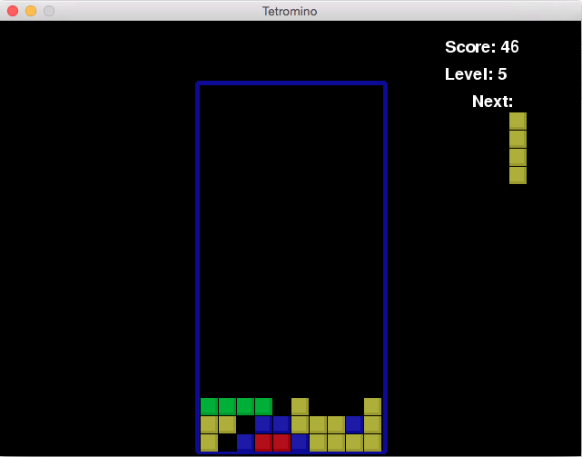
Framework - Game
Pygame
Started with open source Tetris Implementation
Removed all user input and timers since they are not needed
Implemented functions getAllMoves() and evaluateBoard()
AI runs evaluateBoard() on all the boards returned by getAllMoves() and chooses the best one

Slide 4
Framework - Trainer
Extension of game implementation described in last slide
Remove all GUI to improve performance
Used DEAP evolutionary algorithm framework to learn parameters

Slide 5
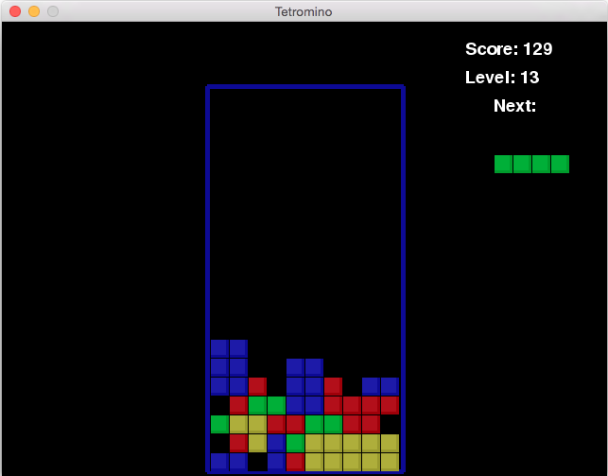
Heuristics
Total Height
Sum of height of each column
Lower height means we are further away from losing
Lines Completed
Objective we are trying to maximize
Holes
Empty space with piece above it in same column
Want to minimize these since they are hard to clear
Height Variance
Total difference in height between adjacent columns
Uneven heights make it harder to form a complete line
“I” Block needs to be placed
Initial Total Height = 7+7+5+4+6+6+5+4+5+5 = 54
Initial Holes = 4
Initial Height Variance = 0+2+1+2+0+1+1+1+0 = 8
Next Potential Boards Calculated with new values for Heuristics with “I” Block

Slide 6
Genetic Representation of Solution
Evaluate each move by linear combination of the 4 heuristics
Solution represented by vector w = <a, b, c, d>
Score = a × Total Height + b × Lines Completed + c × Holes + d × Height Variance
Looking for a vector w which performs the best

Slide 7
Evaluating Fitness
Play 10 games for each weight vector and sum up the total number of lines cleared
Playing multiple games reduces variance and effects of high bias
Limit number of tetrominoes per game to prevent training from taking an extremely long time

Slide 8
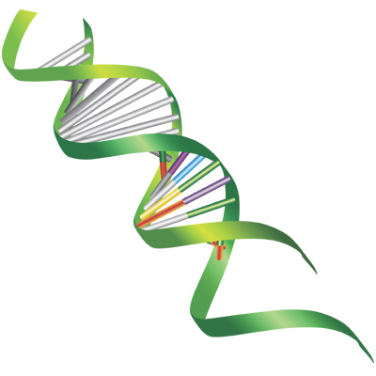
Genetic Algorithm
Randomly selected initial population of 100
For each generation:
Evaluate fitness of entire population
Tournament selection to find parents
One point crossover, gaussian mutation, and reproduction to create 100 children
Tournament selection on 200 (parent and children) vectors to pick 100 to survive to next generation
Run for 30 generations (not enough time or computing power for more)

Slide 9
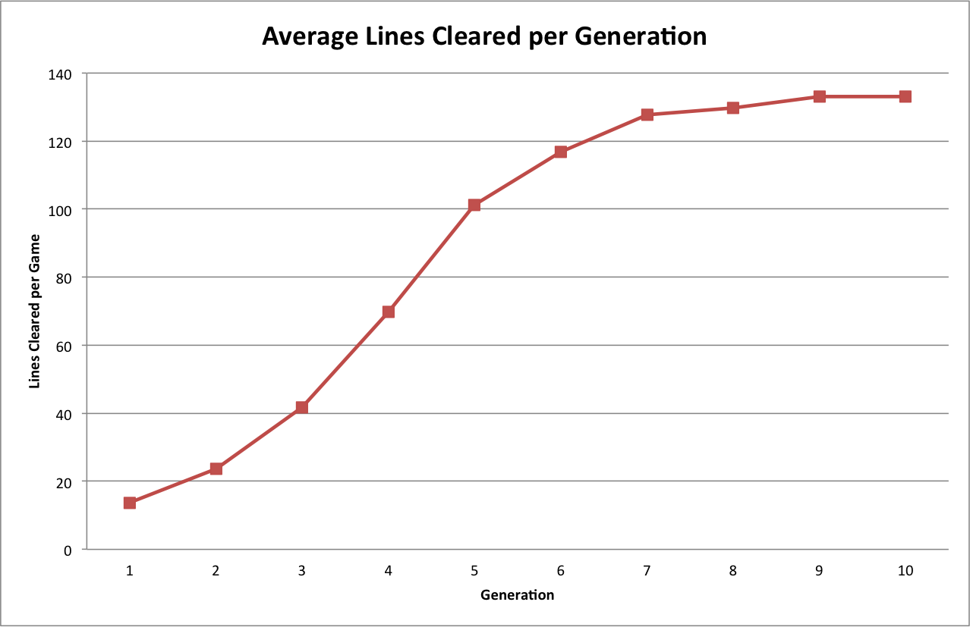
Initial Results
10 generations only (due to bad performance)
Average lines cleared reaches a maximum because we limited each game to 400 tetrominoes

Slide 10
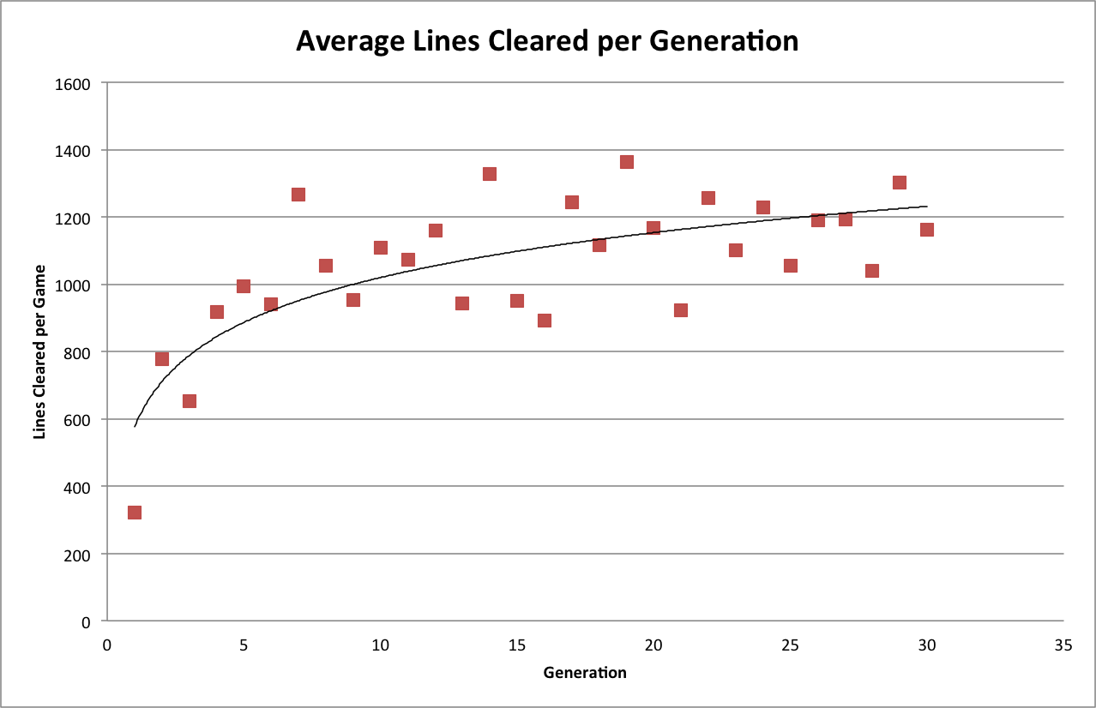
Final Results
Population size 100
30 generations
Increase limit to 5000 tetrominoes per game

Slide 11
Future Improvements
Increasing search space to deal with overhang
Looking ahead to the next move
Tuning genetic algorithm hyper-parameters
Improving performance via GPU processing or clusters

