Slide 1
Final Year Project (ITE4116M)
Oral Presentation
Project Title: Online Learning and Tutoring Platform (Tutor Cat)
Supervisor: Clarence Lau Group 1
Student:
Mak Chi Wang

Slide 2



Background
Online Learning and Tutoring Platforms
Name: Tutor Cat
Target: Tutor and student
Programming language: PHP , HTML5
Database : MySQL Database

Slide 3
Function List
Sign up & Login (Student / Tutor)
Chat Room (All users)
Payment and Point System (PayPal, Credit Card, Alipay, etc… and point payment. Buy course or note to get points)
Course System (Student: Search Tutor, Buy Course and View course record) (Tutor: Create Course )
Calendar System(Student and tutot view course date and detail)
Analyze System(Tutor view analyze report such as no of course and profit)
Notes System (Student: Buy Notes) (Tutor: Create Notes)
Rating System (Student: Rate Tutor)
UserSetting System (All users: Profile System)
Report System (All users: Report Student / Tutor)
Adminstration (Admin)

Slide 4
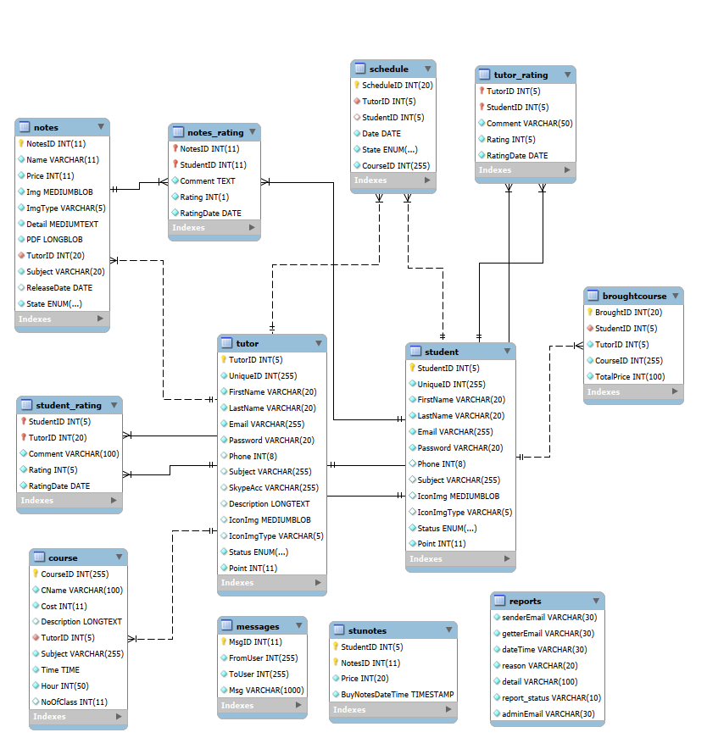
Entity Relationship Diagram

Slide 5
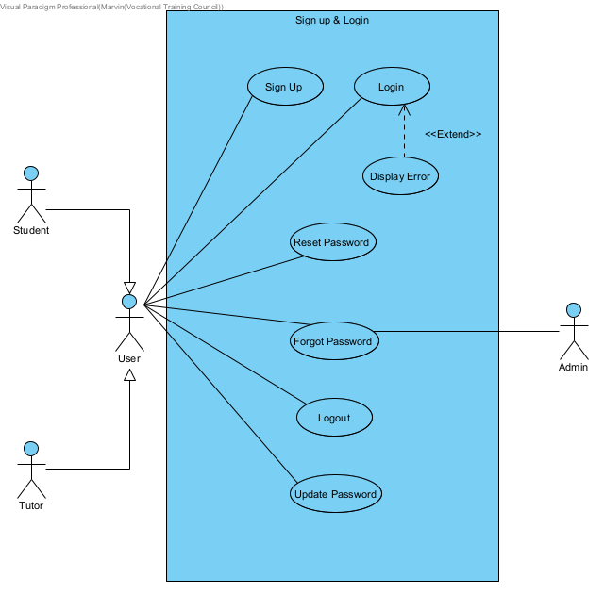
Use Case - Sign up & Login

Slide 6
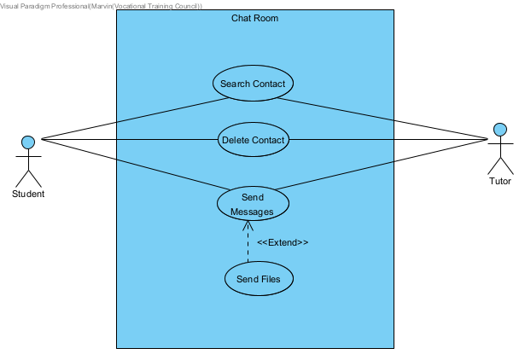
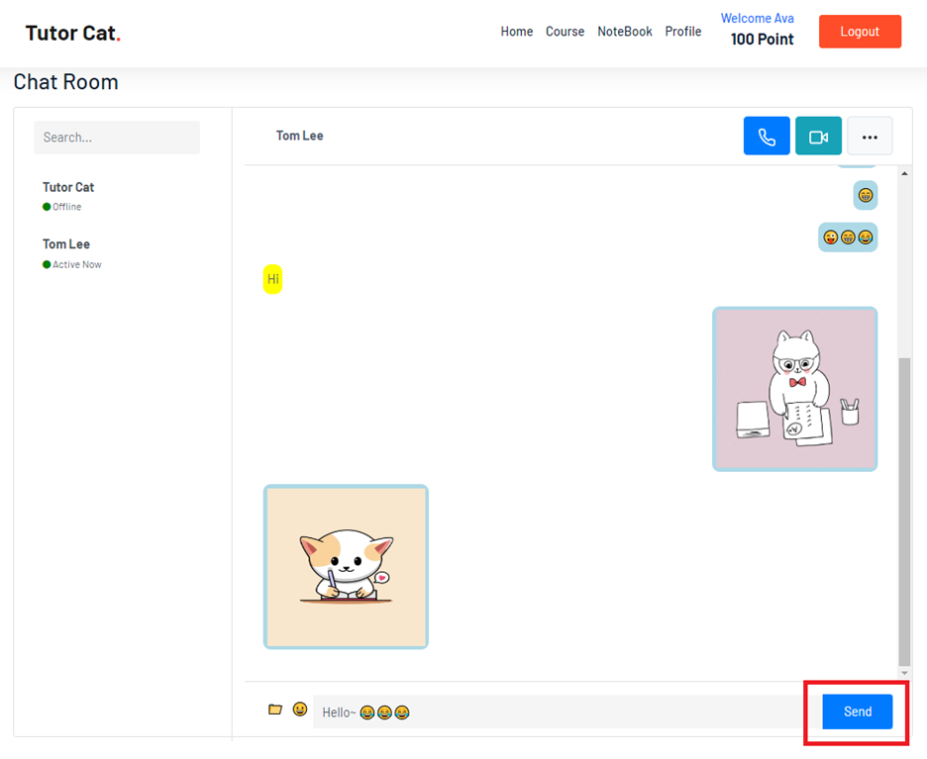
Use Case - Chat Room
Use Ajax for real-time chat room
Good for older or less capable web server or hosting environment that does not support WebSockets. (like older versions of Internet Explorer)
Use WebSockets for real-time chat room
Better fit for handle multiple bidirectional messages between the browser and the server with superior performance and capabilities.

Slide 7
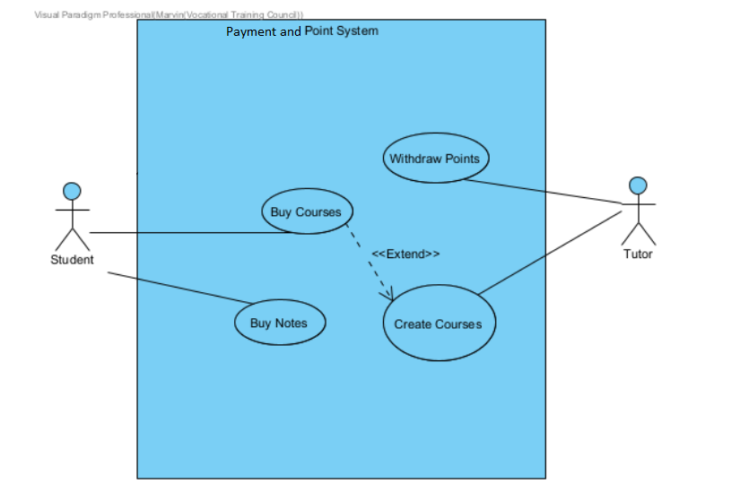
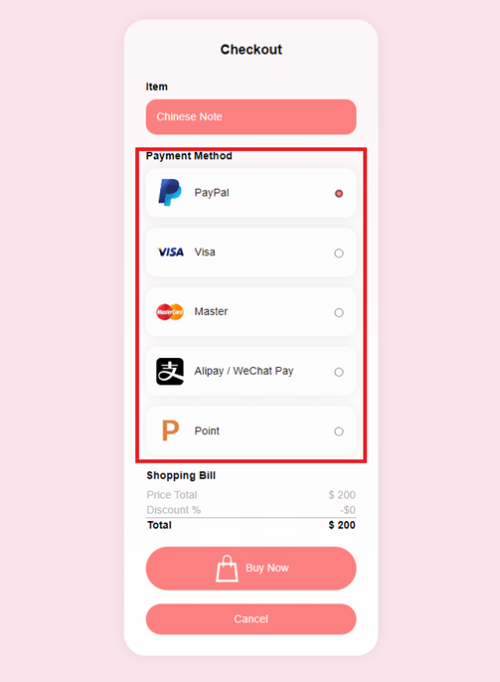
Use Case - Payment and Point System
PayPal sandbox
It is a testing environment provided by PayPal for simulated payment.
Stripe Payment Test Mode
Including credit card payment, Alipay, and WeChat Pay.

Slide 8
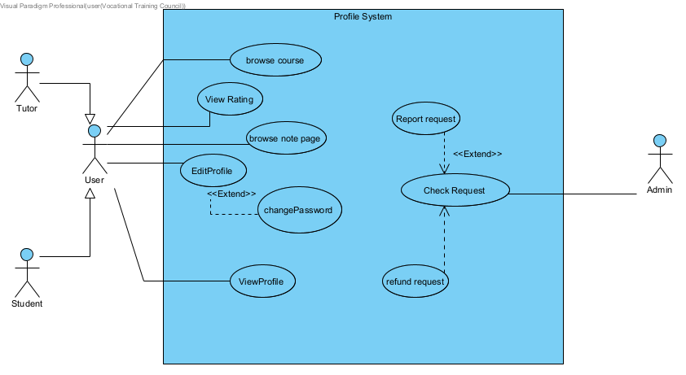
Use Case - Profile System

Slide 9
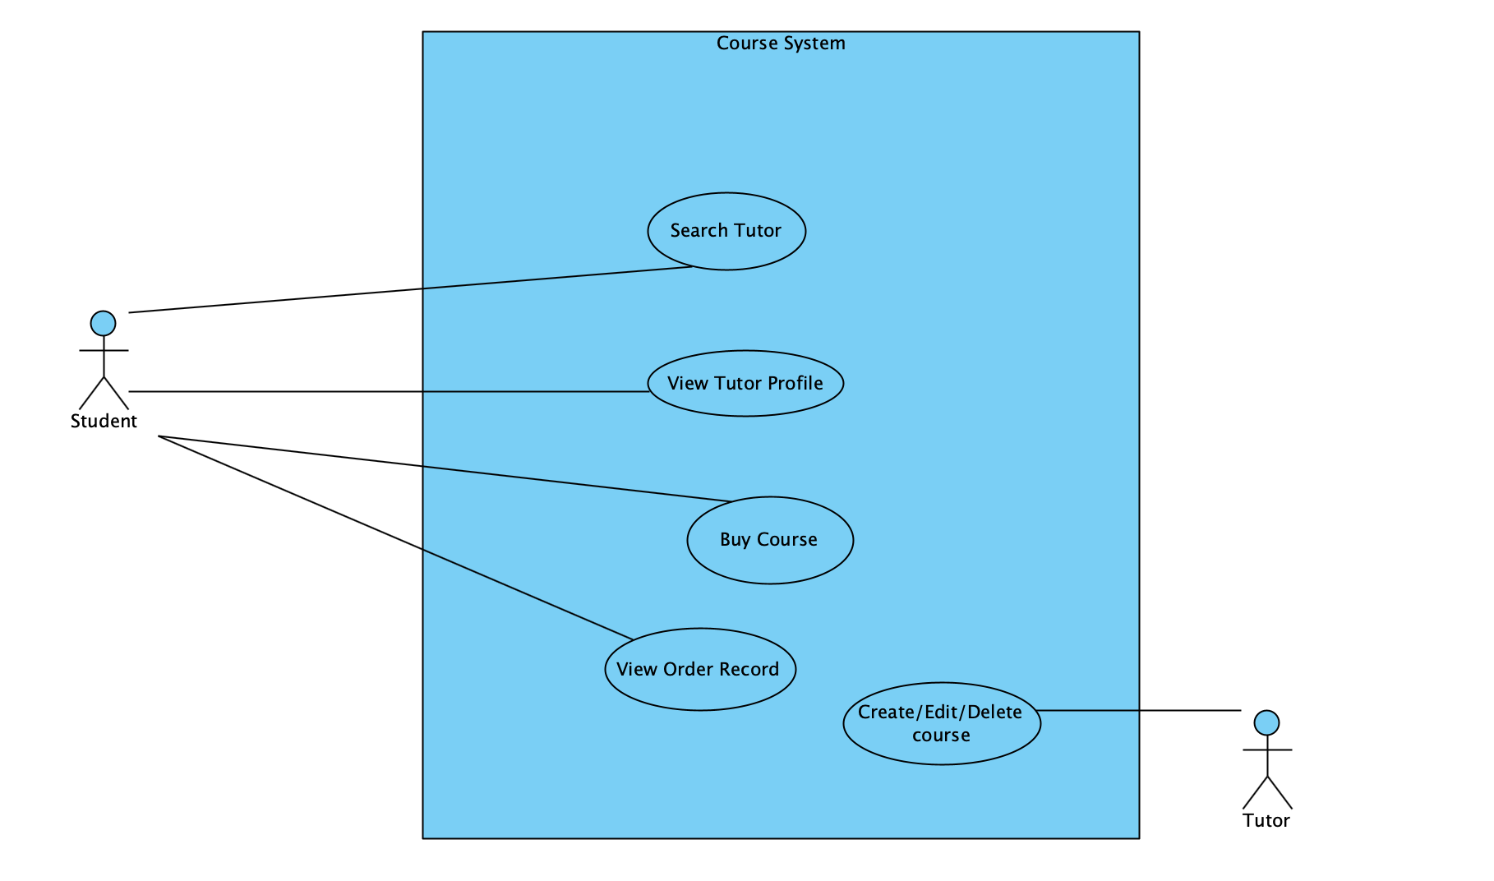
Use Case - Course System

Slide 10
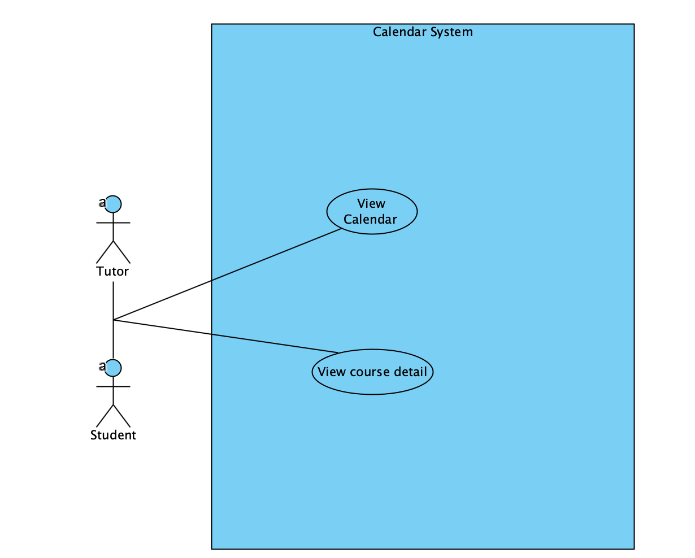
Use Case - Calendar System

Slide 11
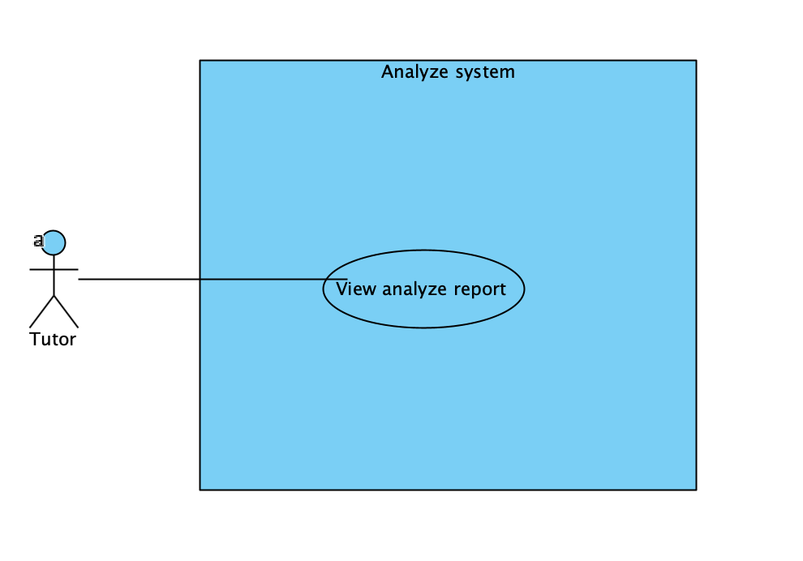
Use Case - Analyze System

Slide 12

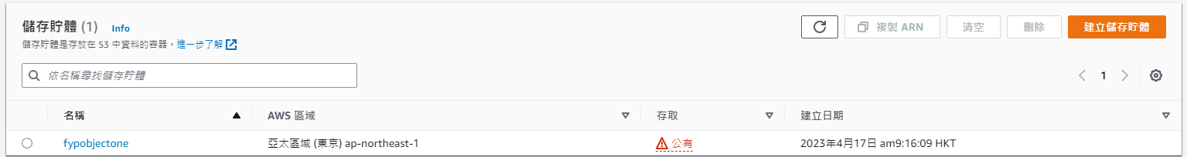
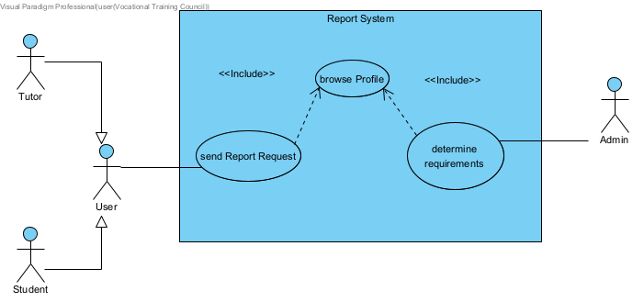
Use Case - Report System
Technology used on Report system(Provide video evidence)
Reasons for using this technology
Safety
reliability

Slide 13
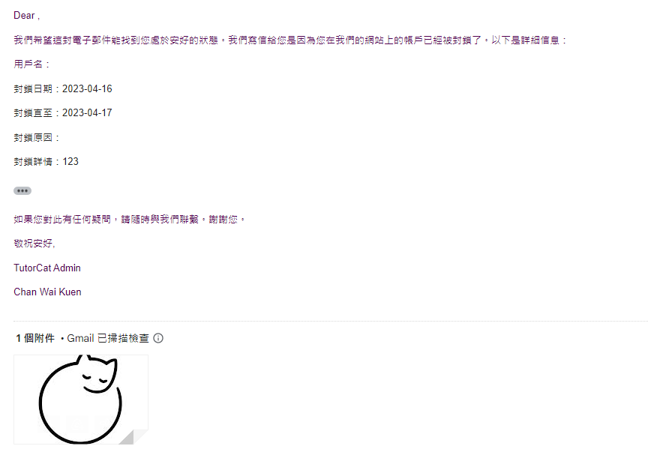

Report System- Suspended User function
Technology used
Let users know that their account or IP address has been Suspended

Slide 14
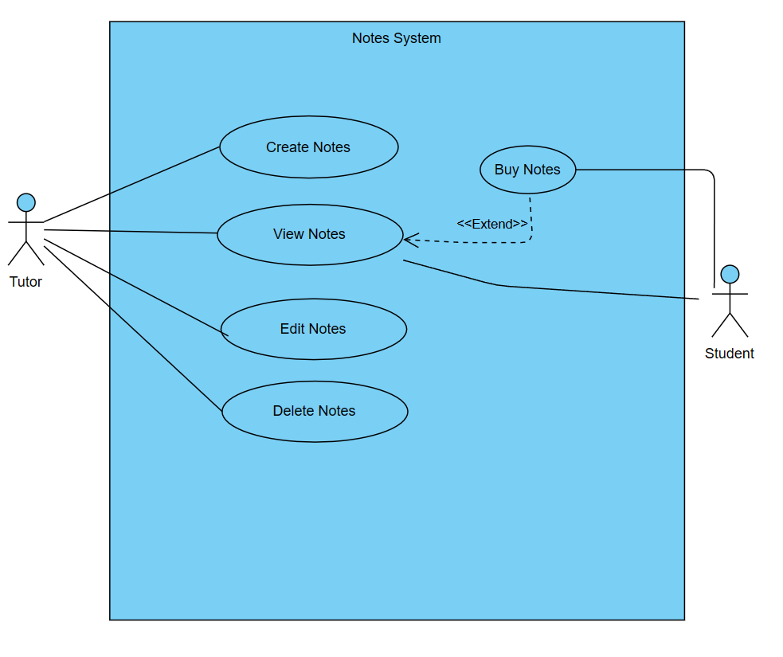
Use Case - Notes System
Tutor : Create, Edit ,Delete the notes
Student: Buy Notes
Common: View Notes
*Delete Notes is not delete record just set Notes to private .

Slide 15
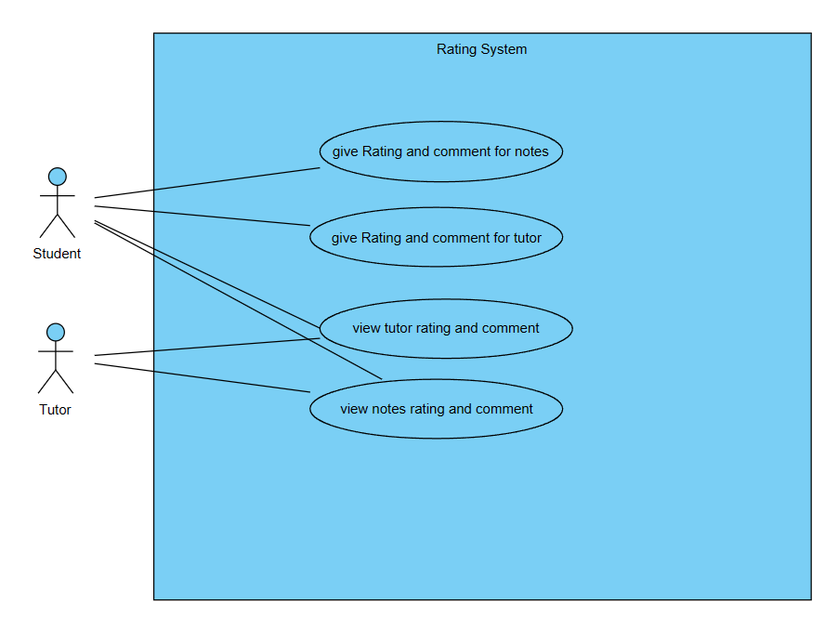
Use Case - Rating System
Student: give rating and comment to notes and tutor .
Common : view tutor and notes rating.

Slide 16
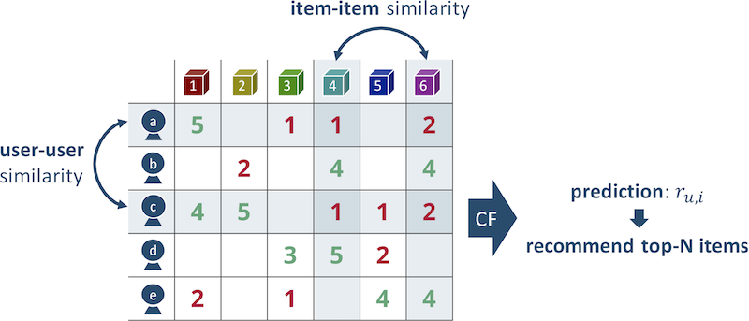

Recommender System
We are builded a Recommender System for the Notes System to predict which notes the student would like to see.we use item-base similarity to make prediction.
I will explain more in demo.

Slide 17
Recommender System
Why I use item base collaborative filtering.
Item-based collaborative filtering can often recommend items that users may not have discovered otherwise, leading to increased engagement and customer satisfaction.
So, In terms of business,We can sell more products(notes) to students.

Slide 18
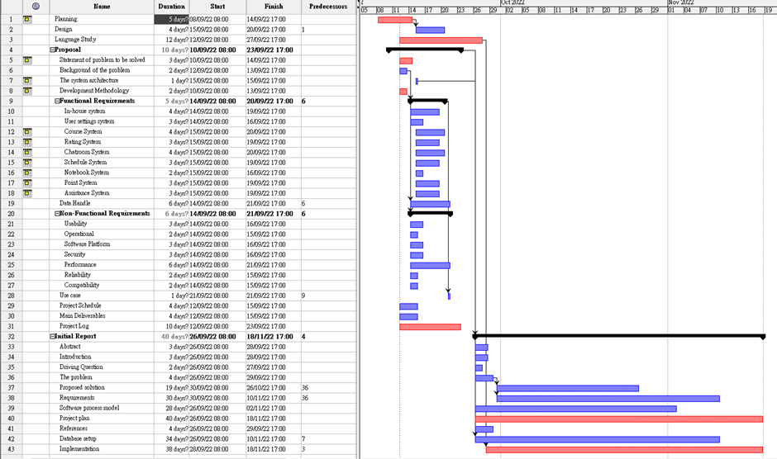
Project schedule

Slide 19

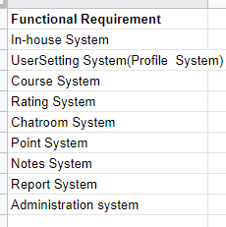
Project schedule

Slide 20
Summary of project Function
Recommendation System
In-house System(login system)
Notes System
Chatroom System
UserSetting System(Profile System)
Rating System
Report System
Course System and Calendar System
Analyze System
Payment and Point System
Administration system
Notes:
Course system: student and teacher’s schedule
Report System: report rating comment.
Administration system: refund request and managing user account
Document verification system

