Slide 1



E-CHAT: A REAL-TIME SECURE WEB-BASED CHAT APPLICATION
CSD 334 – Mini Project
Presented by: Group 5
Under the guidance:
Dr. Ajesh F
Professor
Dr. Sanila S Associate Professor Computer Science and Engineering
Marvin M Varghese (TKI23CS064 & 6332)
Muhammad Sajid (TKI23CS077 & 6342)
Parthan S (TKI23CS090 & 6346)
Azeem N (TKI23CS038 & 6321)
06/04/2026
Final Review, CSD 334 - MINI PROJECT
1

Slide 2


Table of Contents
Problem Statement
Aims & Objectives
Literature Review
Proposed System Overview
Block Diagram
Methodology/ Procedure
Result and GUI
SDG Mapping
Roles and Responsibilities of Members
References
06/04/2026
Final Review, CSD 334 - MINI PROJECT

Slide 3
Problem Statement
Existing chat apps rely on centralized servers and lack true end-to-end encryption.
Many systems struggle with scalability and real-time multimedia performance.
Web and cross-device support is limited in current solutions.
This project builds a secure web-based chat application for real-time communication
It uses a TypeScript frontend, Python backend and PostgreSQL for scalability and privacy.
06/04/2026
Final Review, CSD 334 - MINI PROJECT

Slide 4
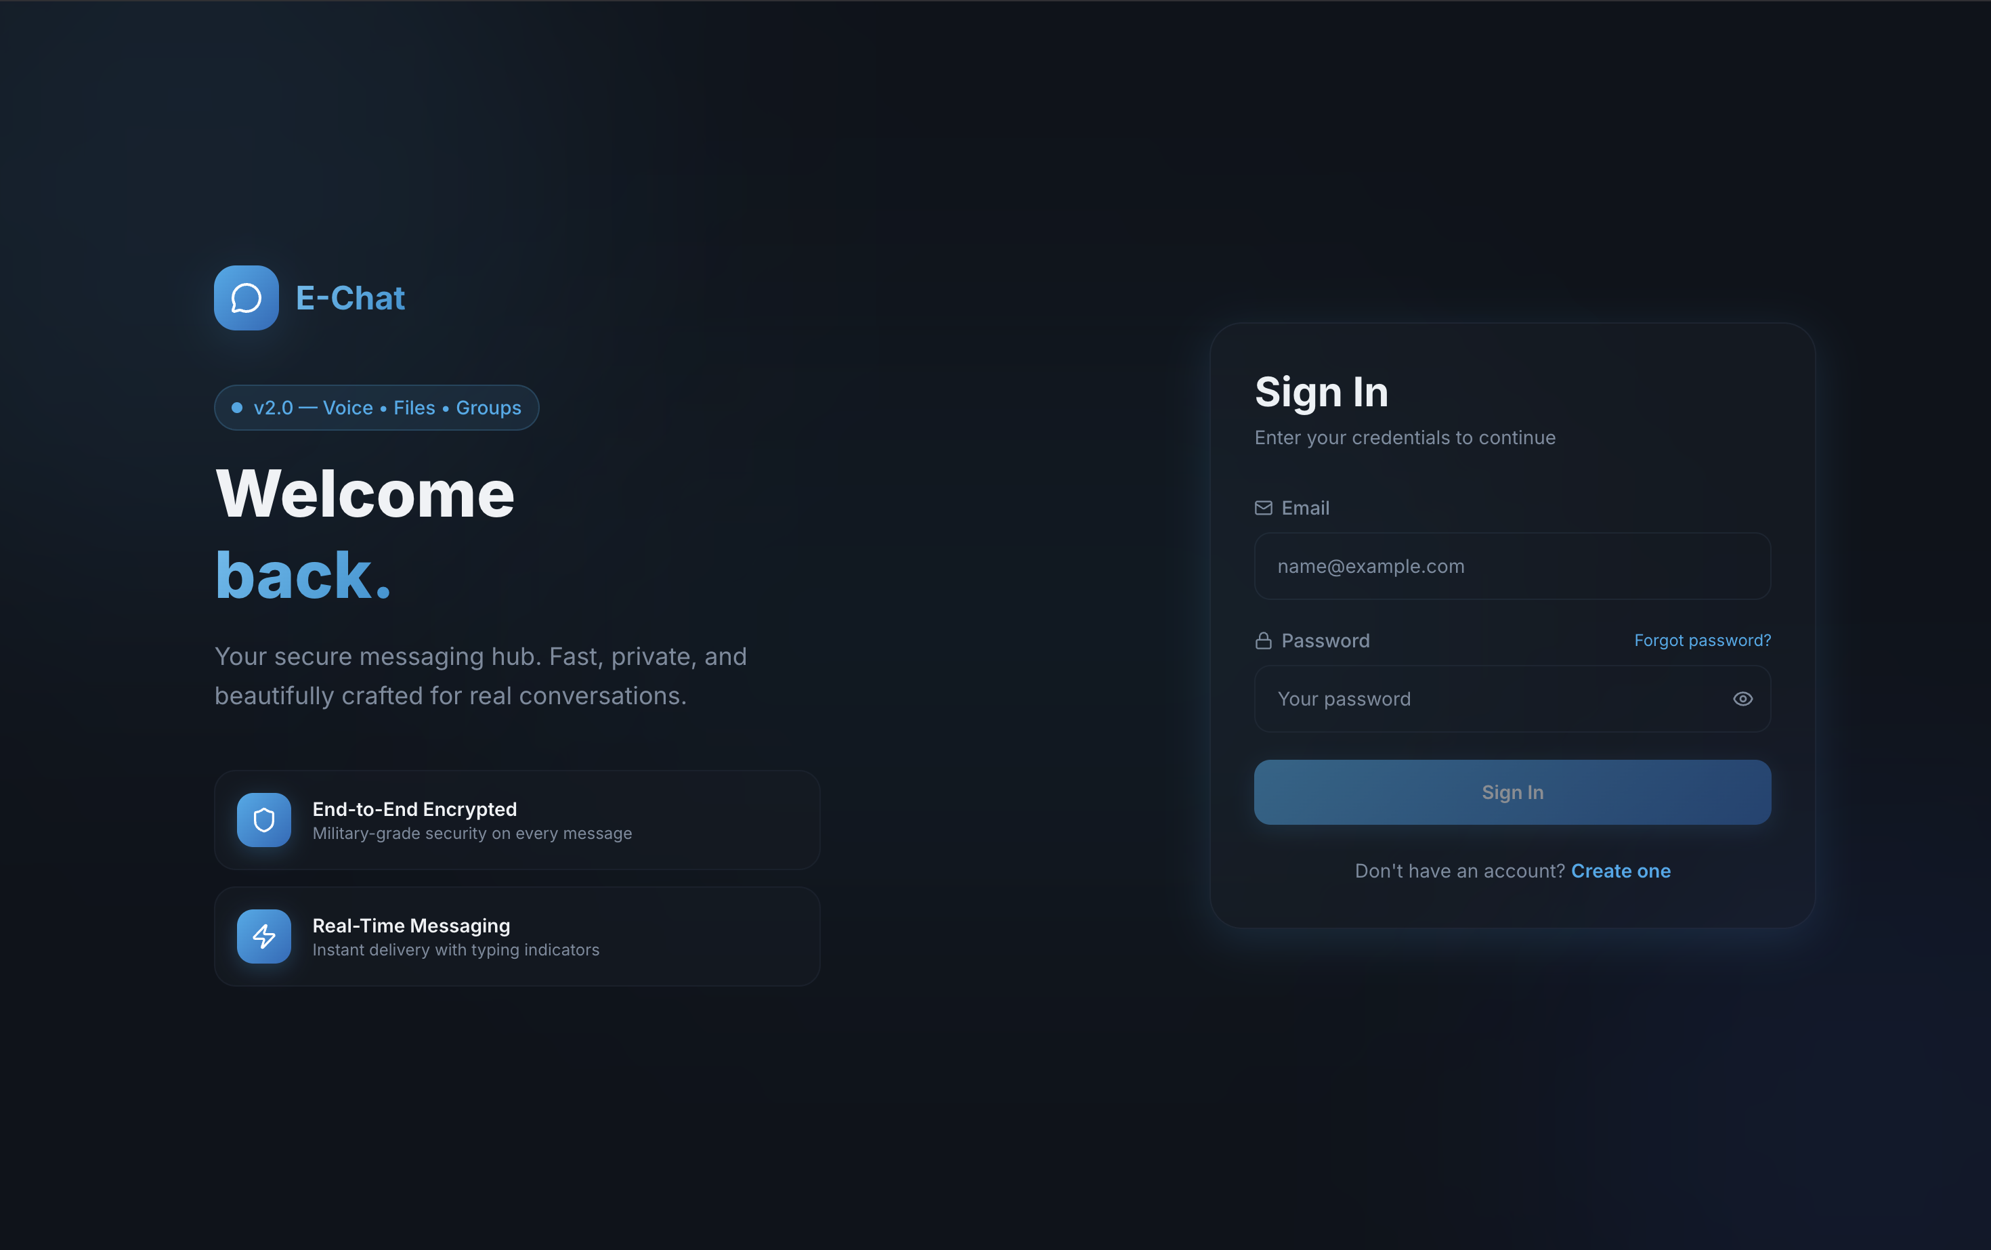

Aim
To develop a secure, real-time web chat application with modern UI and scalable cloud deployment.
Objectives
To implement real-time messaging using WebSocket
technology
To provide secure user authentication using JWT tokens
To design a responsive and intuitive user interface
To ensure data persistence using a PostgreSQL database
06/04/2026
Final Review, CSD 334 - MINI PROJECT
Notes:
GAIT ANALYSIS AND PULL TEST.

Slide 5
Literature Review
S. No | Title | Authors | Journal & Year of publication | Key Points
1 | Communicating and Displaying Real- Time Data with WebSocket | Pimentel V., Nickerson B.G | EEE Internet Computing (2012) vol. 16(4), pp. 45-53 | • WebSocket faster than HTTP polling for real-time data transfer with reduced latency
2 | The WebSocket Protocol | Fette I., Melnikov A. | RFC 6455, IETF (2011) | Standard protocol for bi-directional real- time communication over single TCP connection
3 | JSON Web Token (JWT) | Jones M., Bradley J., Sakimura N. | RFC 7519, IETF (2015) | Stateless authentication tokens for scalable web applications
4 | How Does Your Password Measure Up? The Effect of Strength Meters on Password Creation | Ur B., Kelley P.G., Komanduri S., et al. | USENIX Security Symposium (2015) pp. 65-80 | Real-time password feedback increases strong passwords by 26%
5 | Microservices Architecture: A Systematic Literature Review | Alshuqayran N., Ali N., Evans R. | . ACM Computing Surveys (2016) | Microservices enable independent deployment and scalability for web applications
06/04/2026
Final Review, CSD 334 - MINI PROJECT

Slide 6
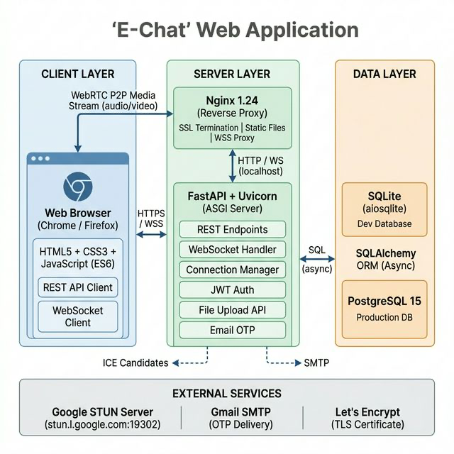
Block diagram
06/04/2026
Final Review, CSD 334 - MINI PROJECT

Slide 7
Methodology/Procedure
Development Approach: Agile-based iterative model with 5 sprints over 10 weeks; continuous build, test, and improvement.
System Architecture: 3-layer design – Presentation (Next.js), Communication (Socket.IO), Data (FastAPI + SQLAlchemy)
Real-Time Communication: Event-driven messaging using JWT authentication with HTTP fallback
Audio/Video Communication: WebRTC signaling using Offer–Answer–ICE Candidate exchange
Security: JWT-based authentication with bcrypt (sha256) password hashing.
Database Design: Relational model with User, Contact, Group, Message, OTP, and Call History entities
Communication Model: REST APIs for authentication and data handling; Socket.IO for real-time events.
Frontend Strategy: Optimistic UI rendering with server-side message confirmation.
Deployment: Docker-based containerization with GitHub for version control.
Testing: Functional testing and end-to-end user flow validation
06/04/2026
Final Review, CSD 334 - MINI PROJECT

Slide 8
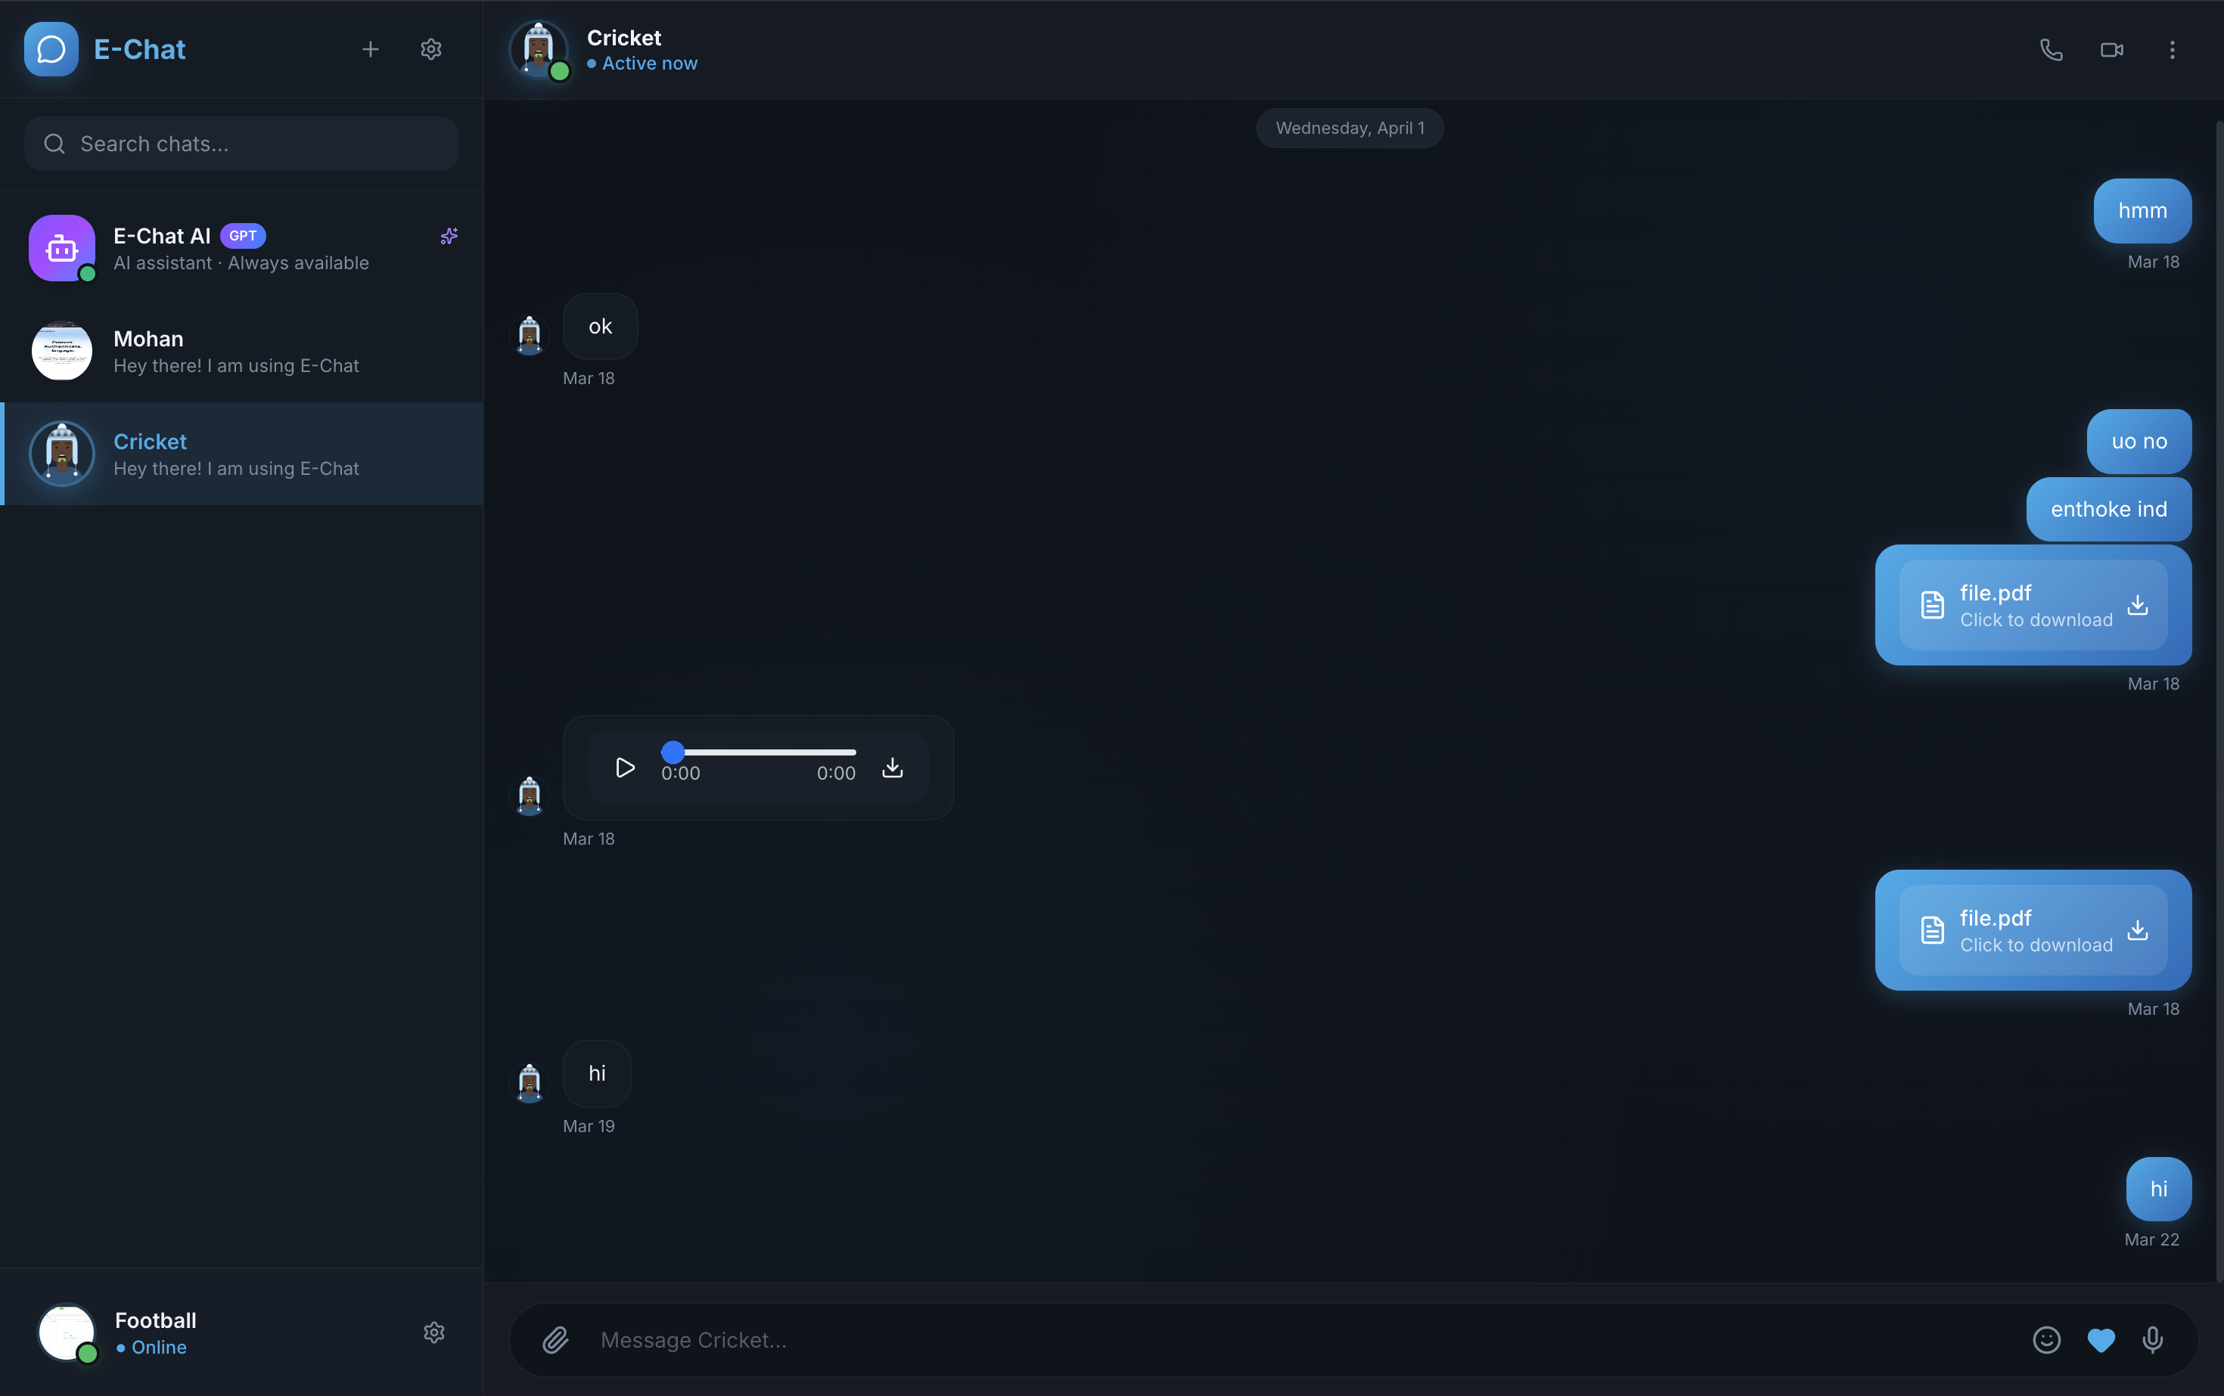
Result and GUI
06/04/2026
Final Review, CSD 334 - MINI PROJECT

Slide 9
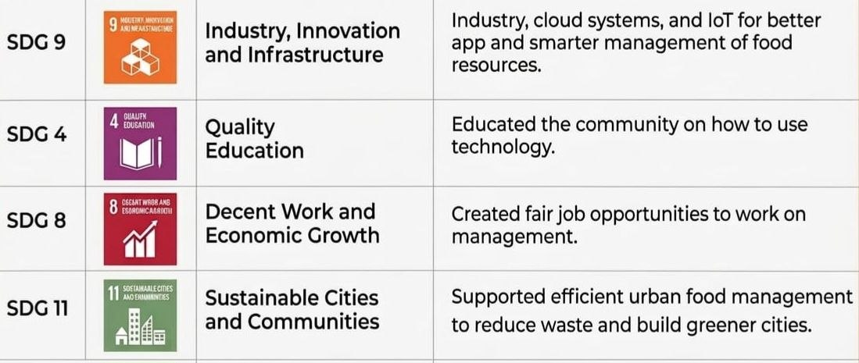
SDG Mapping
06/04/2026
Final Review, CSD 334 - MINI PROJECT

Slide 10
Roles and Responsibilities of Members
Member | Name | Role / Responsibility
Member 1 | Marvin M Varghese | Project Lead & Backend Developer - FastAPI
Member 2 | Muhammed Sajid | Frontend Developer & UI/UX Designer - Next.js, React, Tailwind CSS, password strength indicator, responsive design
Member 3 | Parthan S | Database Administrator & Backend Support - PostgreSQL, SQL Alchemy, database schema, data modeling, query optimization
Member 4 | Azeem N | DevOps Engineer & Testing Lead - Vercel/Railway deployment, CI/CD, testing, documentation, security
06/04/2026
Final Review, CSD 334 - MINI PROJECT

Slide 11
REFERENCE
[1] I. Fette and A. Melnikov, "The WebSocket Protocol," RFC 6455, Internet Engineering Task Force, Dec. 2011. [Online]. Available: https://tools.ietf.org/html/rfc6455
[2] M. Jones, J. Bradley, and N. Sakimura, "JSON Web Token (JWT)," RFC 7519, Internet Engineering Task Force, May 2015. [Online]. Available: https://tools.ietf.org/html/rfc7519
•[3] C. Richardson, Microservices Patterns: With Examples in Java. Shelter Island, NY: Manning Publications, 2018.
[4] B. Ur, P. G. Kelley, S. Komanduri, et al., "How Does Your Password Measure Up? The Effect of Strength Meters on Password Creation," in Proc. 24th USENIX Security Symposium, Washington, DC, USA, Aug. 2015, pp. 65-80
[5] "Next.js Documentation," Vercel Inc., 2024. [Online]. Available: https://nextjs.org/docs
[6] S. Ramirez, "FastAPI Framework," 2024. [Online]. Available: https://fastapi.tiangolo.com
[7] G. Rauch, "Socket.IO: Real-time Application Framework," Automattic Inc., 2024. [Online]. Available: https://socket.io/docs
[8] PostgreSQL Global Development Group, "PostgreSQL 15 Documentation," 2024. [Online]. Available: https://www.postgresql.org/docs/15
[9] "Vercel Platform Documentation," Vercel Inc., 2024. [Online]. Available: https://vercel.com/docs
[10] "Railway Platform Documentation," Railway Corp., 2024. [Online]. Available: https://docs.railway.app
06/04/2026
Final Review, CSD 334 - MINI PROJECT

Slide 12
Thank you
06/04/2026
Final Review, CSD 334 - MINI PROJECT

