Slide 1
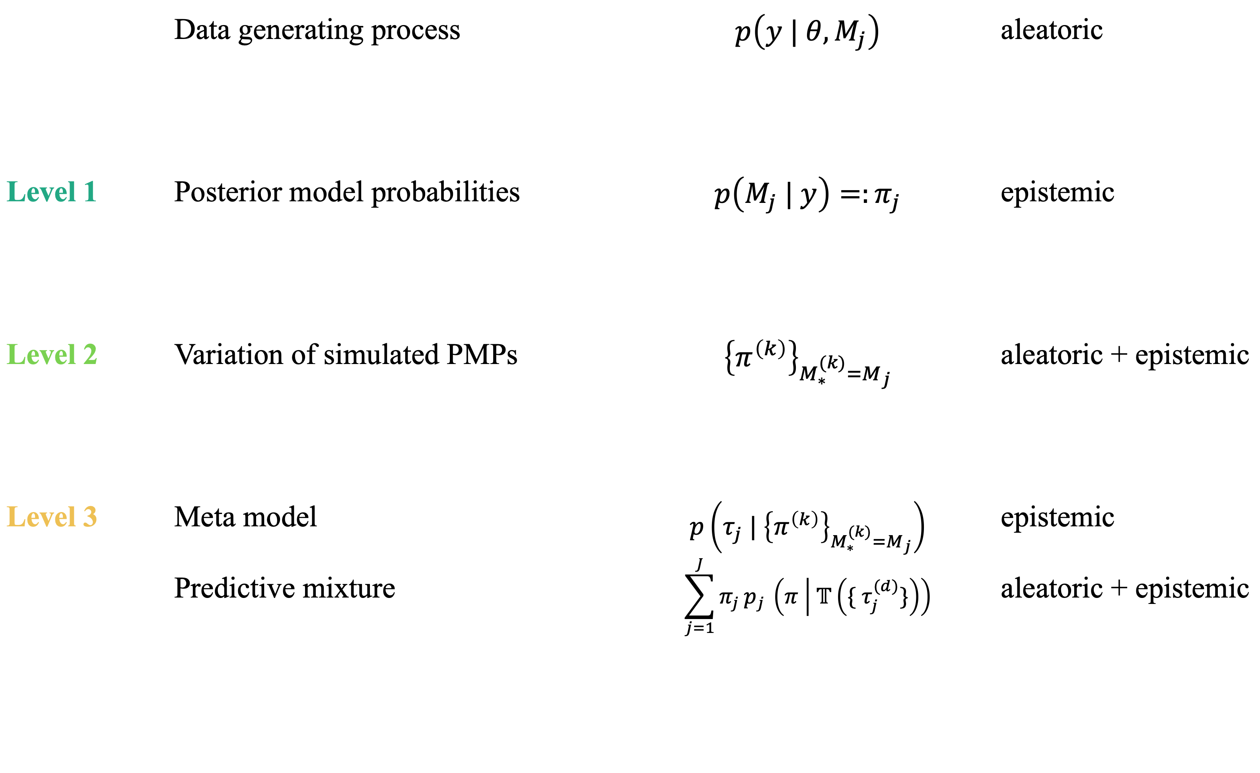
 | Data generating process | $$p\left(y | θ, M_{j}\right)$$ | aleatoric
Level 1 | Posterior model probabilities | $$p\left(M_{j} | y\right)=:π_{j}$$ | epistemic
Level 2 | Variation of simulated PMPs | $${\left\{π^{\left(k\right)}\right\}}_{M_{∗}^{(k)}=M_{j}}$$ | aleatoric + epistemic
Level 3 | Meta model Predictive mixture | $$p\left(τ_{j} | {\left\{π^{\left(k\right)}\right\}}_{M_{∗}^{(k)}=M_{j}}\right)$$ $$\sum_{j=1}^{J}{π_{j }p_{j }\left(π | 𝕋\left(\{ τ_{j}^{(d)}\}\right)\right)}$$ | epistemic aleatoric + epistemic
s
s
o

