Slide 1
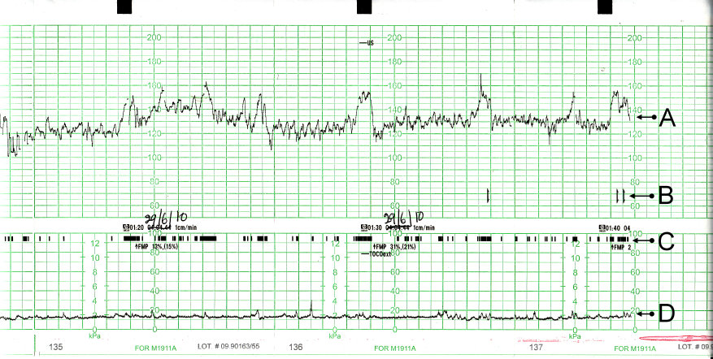
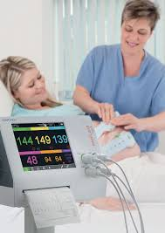
Introduction: Cardiotography
Cardiotocography (CTG) is a standard technique used to monitor the fetal heartbeat and uterine contractions during pregnancy and labour
Problem: CTG-analysis remains partly subjective and has to be done ad hoc
Aim: Objectify the analysis of CTG-data through ML-techniques
Dataset: Data from 2126 CTGs
Freely available from the UCI archive. Has been used quite extensively for learning purposes within the ML field and is used in several publications.
Task: Classification of CTG into Normal, Suspect and Pathologic (N,S,P)

Slide 2

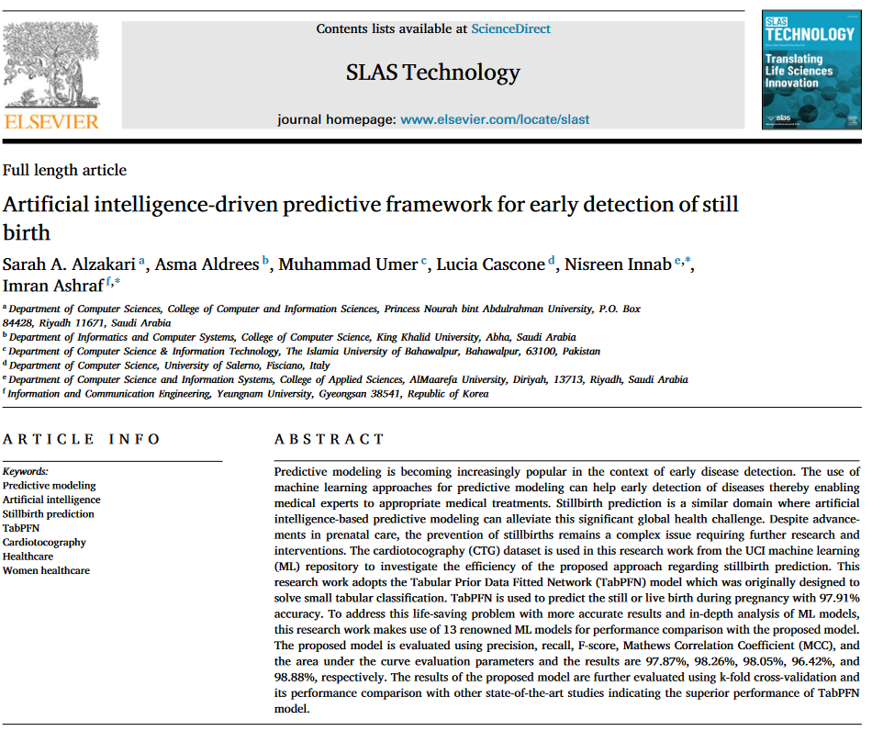
Literature Review: LR and SVM are fitting baseline models.
Findings hint towards promising ML models that can be used as baseline model for this analysis (e.g. Logistic Regression; Support Vector Machine)
The TabPFN model outperformed all other approaches, achieving an accuracy of 97.91% and high scores across all evaluation metrics. Its computational efficiency allows for rapid predictions, making it suitable for real-time applications.

Slide 3
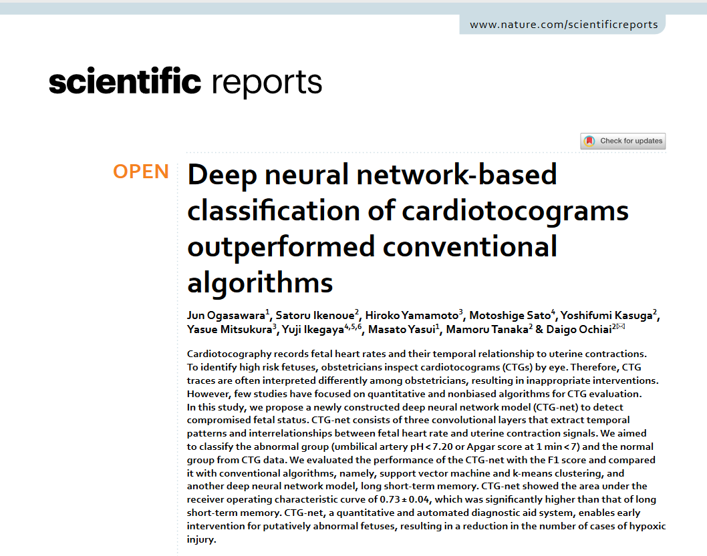
Literature Review: LR and SVM are fitting baseline models.
Findings hint towards promising ML models that can be used as baseline model for this analysis (e.g. Logistic Regression; Support Vector Machine)
Neural networks appear to have the potential to outperform conventional models in classification performance when applied to CTG data.

Slide 4
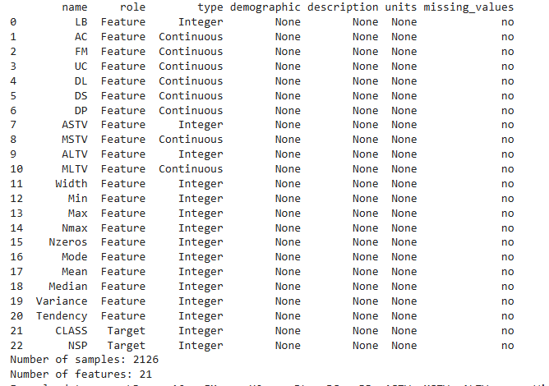
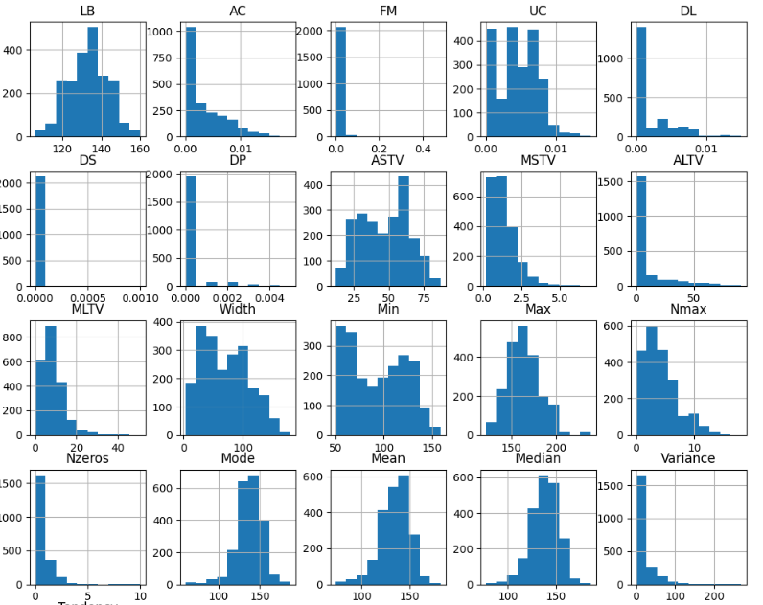
Dataset characteristics: Clean dataset but high class imbalances
Clean dataset without any missing values → No preprocessing required
Main characteristics
2126 observations (1655 normal, 295 suspect, and 176 pathological entries)
21 features

Slide 5
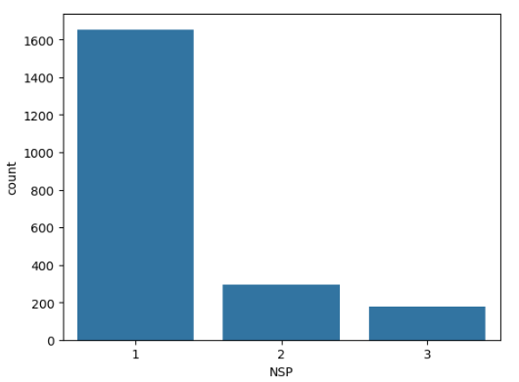
Class imbalances have major threats
Threats
Bias toward the majority class
Misleading evaluation
Poor generalization
Tried Solutions
Undersampling / Oversampling
SMOTE

Slide 6
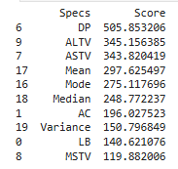
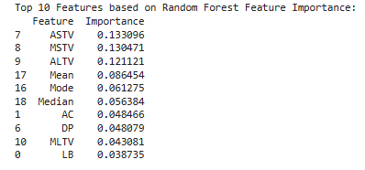
Feature selection identified ten main features.
SelectKBest
Random Forest Feature Importance

Slide 7
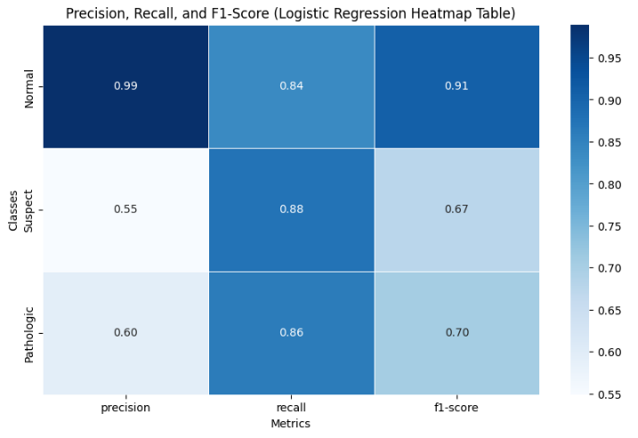
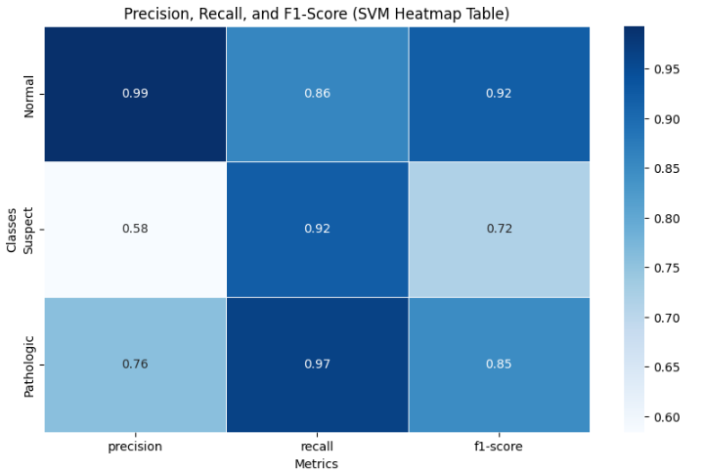
Baseline model(s)
Aim: Simple and effective baseline models with high interpretability.
Logistic Regression
Benchmark linear model
Accuracy: 0.85
Support Vector Machine (SVM)
Complements Logistic Regression (nonlinearity)
Accuracy: 0.88

Slide 8
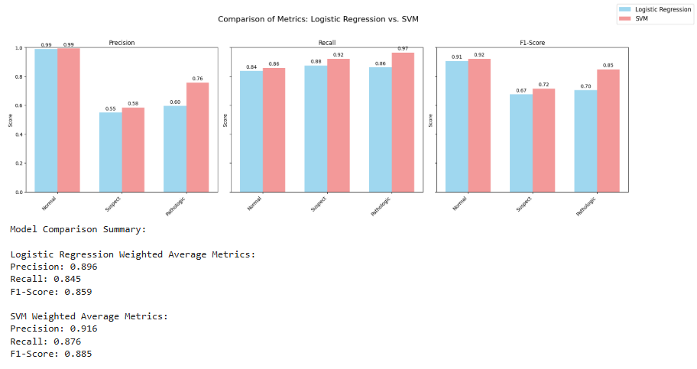
Baseline model(s)

Slide 9
Model Definition
The comparison between the baseline models shows that we need a model that accounts for non-linearity.
Studies suggest that neural networks are promising for the analysis of CTG data (Alzakari et al., 2024; Amin et al., 2019; Ogasawara et al., 2021).
Goal: Hyperparameter Optimization
We conducted a random search (Bergstra & Bengio, 2012) to determine optimal values for the hyperparameters.
Notes:
9

Slide 10
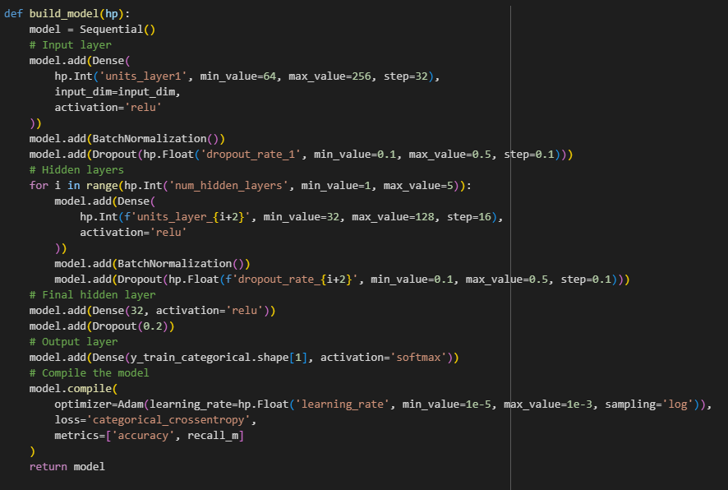
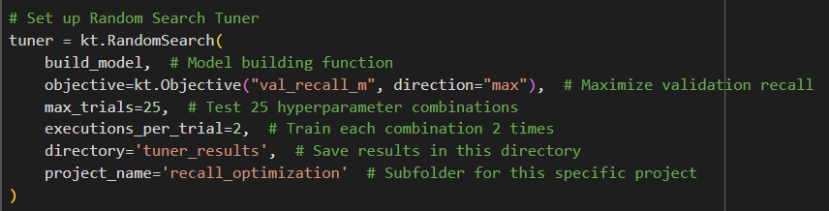
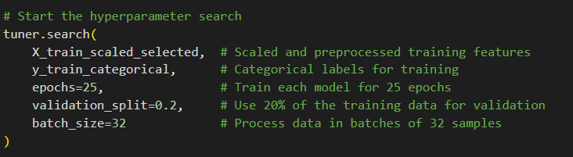
Random Search
Hyperparameters varied in the Random Search:
layer1: Number of neurons in the first layer (input layer). Range: 64 to 256 (in steps of 32).
dropout_rate_1: Dropout rate for the first layer. Range: 0.1 to 0.5 (in steps of 0.1).
num_hidden_layers Number of hidden layers Range: 1 to 5.
layer_{i+2}: Number of neurons in each hidden layer. Range: 32 to 128 (in steps of 16).
dropout_rate_{i+2} Dropout rate for each hidden layer (each layer has its own hyperparameter). Range: 0.1 to 0.5 (in steps of 0.1).
learning_rate Learning rate for the Adam optimizer. Range: 1e-5 to 1e-3 (logarithmic sampling)
Notes:
10

Slide 11
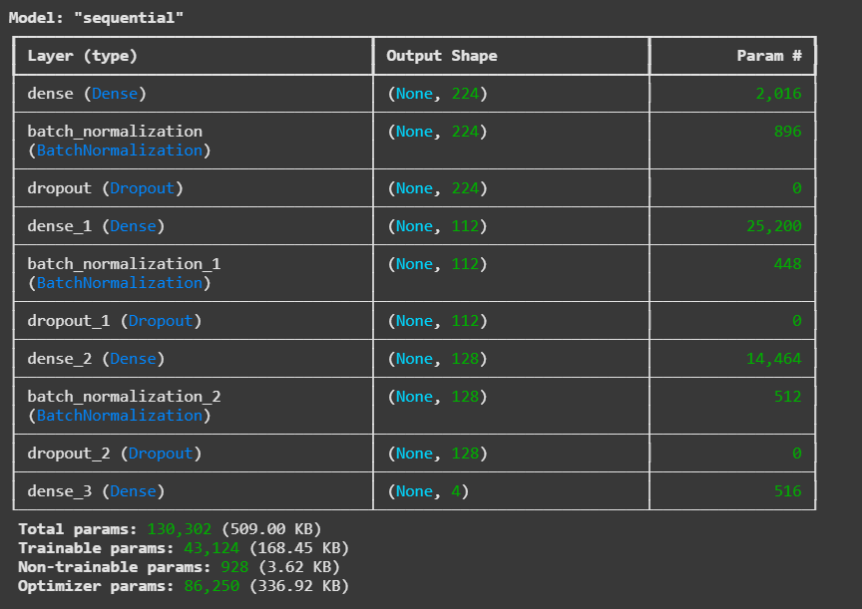
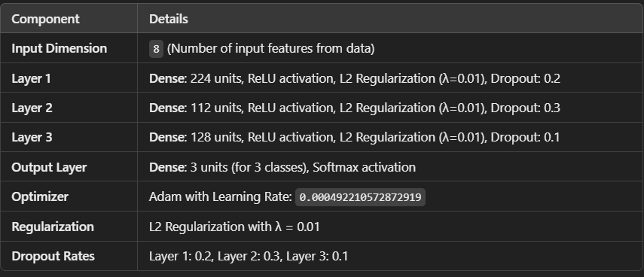
Model Architecture
Notes:
11

Slide 12
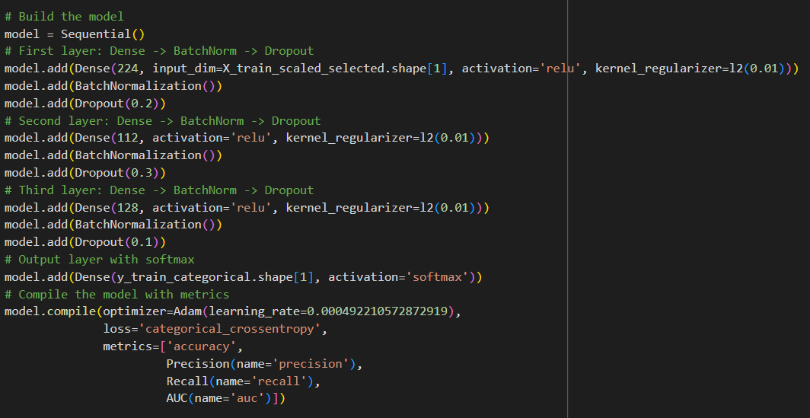
Model Code

Slide 13
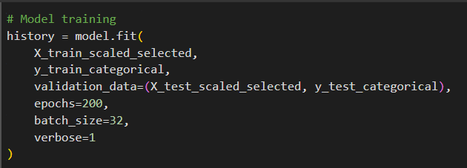
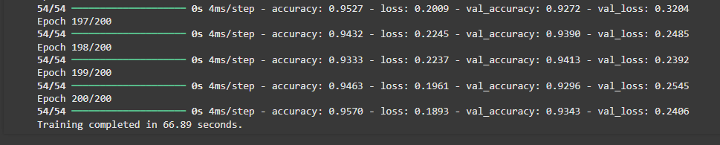
Model Training
Notes:
13

Slide 14
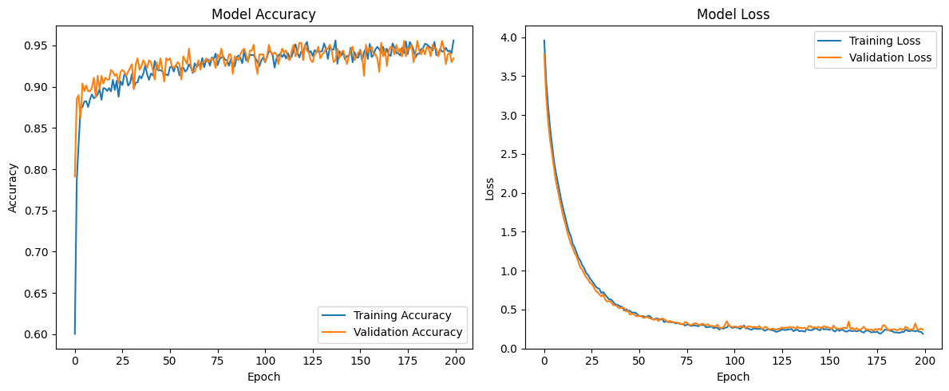
Overfitting?
Notes:
14

Slide 15
Model Evaluation
Primary Metrics
Recall: Ensure no pathological cases are missed (focus on sensitivity).
F1-Score: Balances Precision and Recall for each class.
Secondary Metrics
Precision: Evaluate the proportion of correct positive predictions to avoid excessive false alarms.
Confusion Matrix: Analyze detailed classification errors.
Accuracy: Provides an overall performance snapshot but is less reliable for imbalanced datasets.
Notes:
15

Slide 16
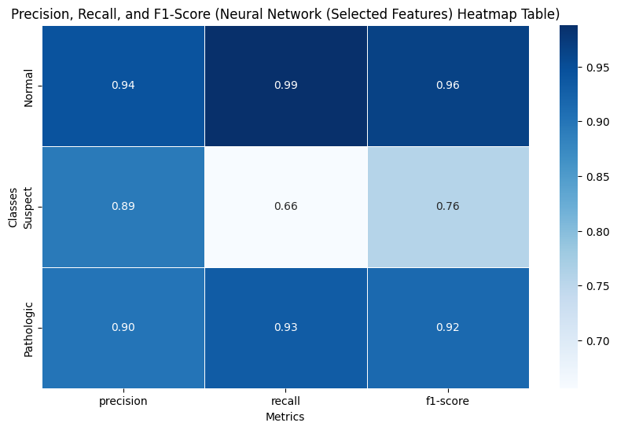
Results
Notes:
16

Slide 17
Results
Notes:
17

Slide 18
Results
Notes:
18

Slide 19
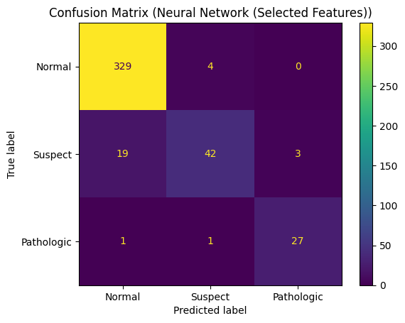
Results
Notes:
19

Slide 20
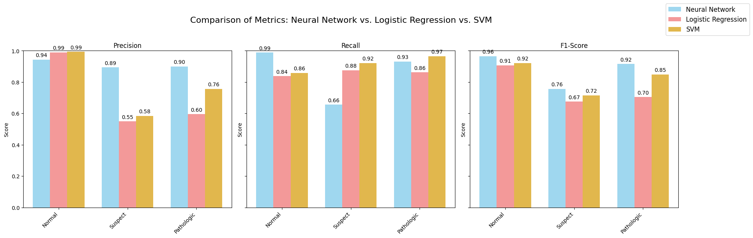
Comparison with Baseline Models
Notes:
20

Slide 21
Challenges and Errors / Discussion
Why do the baseline models perform (much) better for suspect?
Class Imbalance
The minority class "Suspect" is underrepresented, which might challenges the neural network?
Small Dataset
With only 2126 data points, neural networks require more data to generalize well?
Model Architecture
The current neural network architecture may not be sufficiently complex or well-tuned to capture patterns in the "Suspect" and "Pathologic" classes?

Slide 22
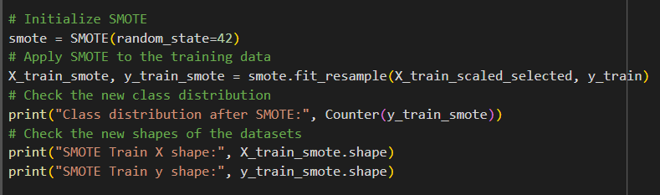
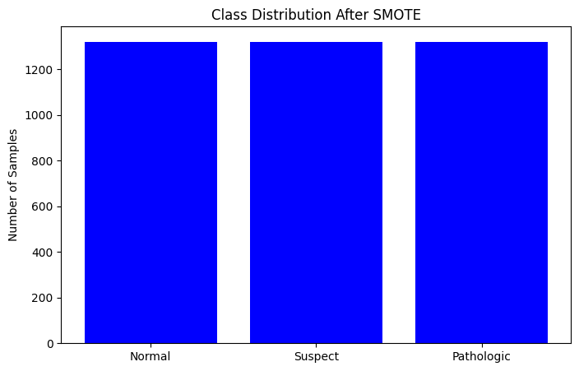
Class Imbalances – Oversampling with SMOTE

Slide 23
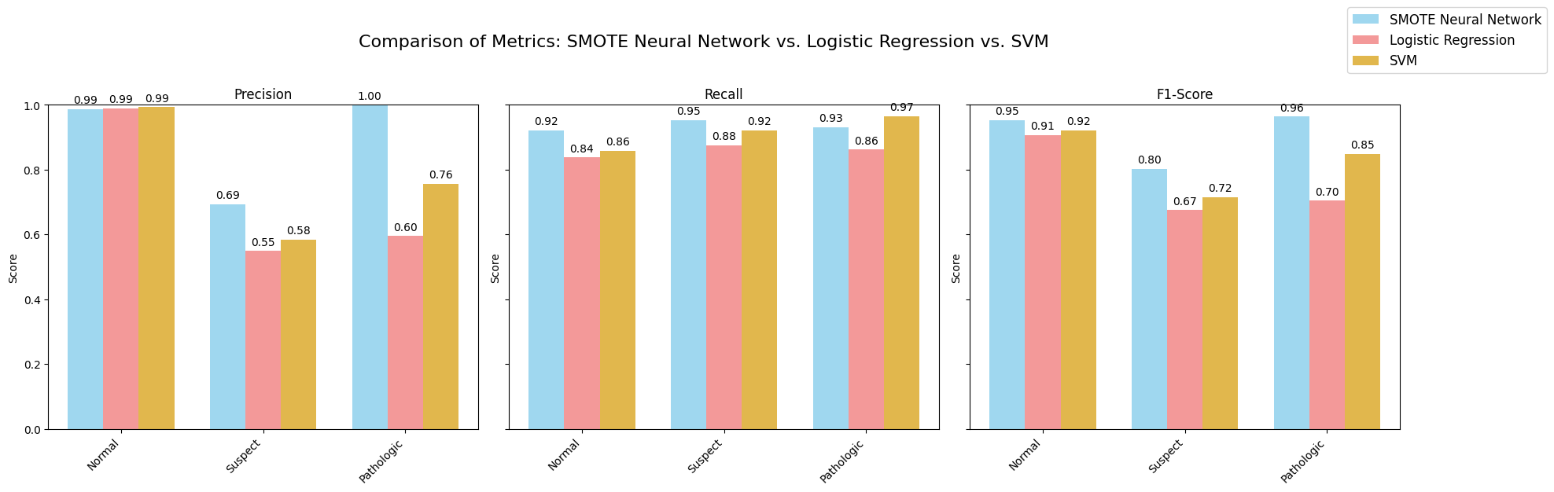
Results with SMOTE

Slide 24
Limitations

Slide 25
Q & A

