Slide 1
Artificial Neural Network
Jony Sugianto
jony@evolvemachinelearners.com
0812-13086659
github.com/jonysugianto

Slide 2
Neural Network Application
https://www.youtube.com/watch?v=hPKJBXkyTKM

Slide 3
Neural Network Application
https://www.youtube.com/watch?v=-96BEoXJMs0

Slide 4
Biological Neuron
https://www.youtube.com/watch?v=NsBaPtemAjs

Slide 5
Dopamin and the brain
https://www.youtube.com/watch?v=lIJW9XLDE-I

Slide 6
From Biology to Computer Model
https://www.youtube.com/watch?v=gcK_5x2KsLA

Slide 7
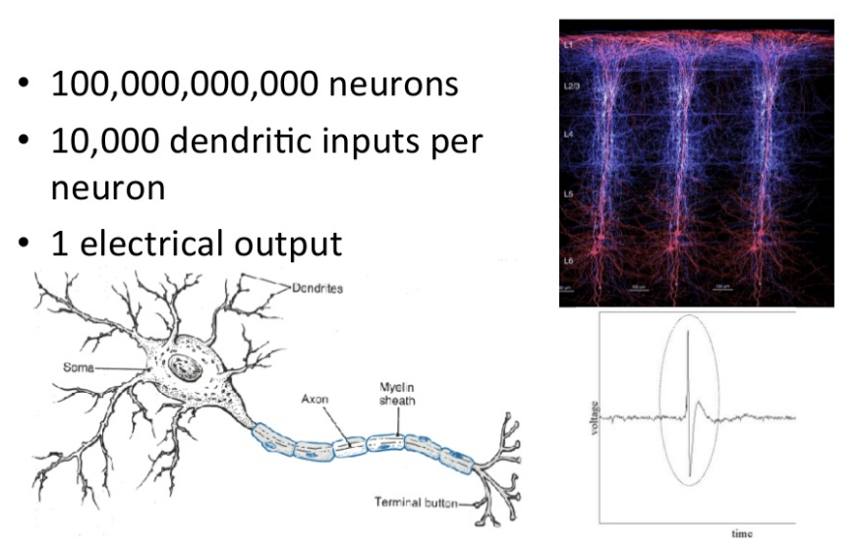
How does your brain work?

Slide 8
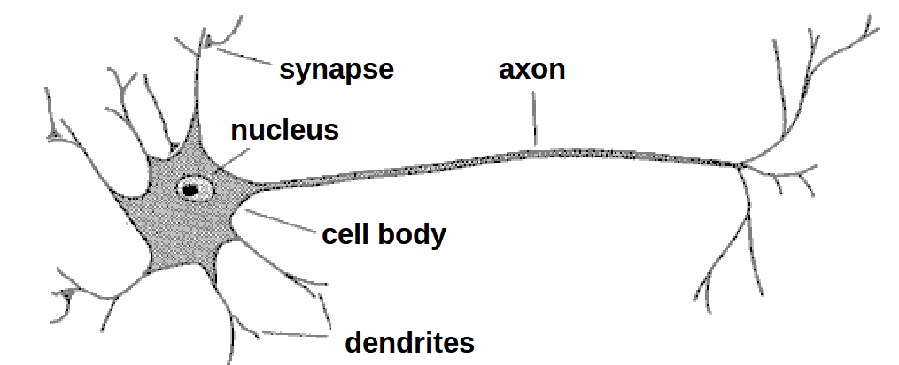
Biological neuron
A neuron has
  A branching input (dendrites)
  A branching output (the axon)
The information circulates from the dendrites to the axon via the cell body
Axon connects to dendrites via synapses
  Synapses vary in strength
  Synapses may be excitatory or inhibitory

Slide 9
Properties of the brain
It can learn, reorganize itself from experience
It adapts to the environment
It is robust and fault tolerant

Slide 10
Biological Neural Nets
Pigeons as art experts (Watanabe et al. 1995)
  Experiment:
    Pigeon in Skinner box
    Present paintings of two different artists (e.g. Chagall / Van Gogh)
    Reward for pecking when presented a particular artist (e.g. Van Gogh)

Slide 11
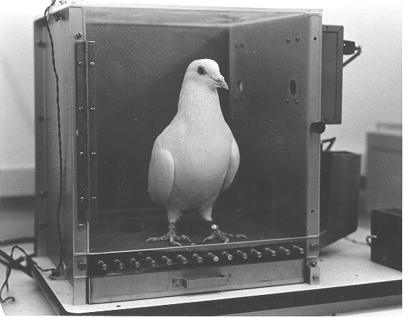
Pigeons as art experts

Slide 12
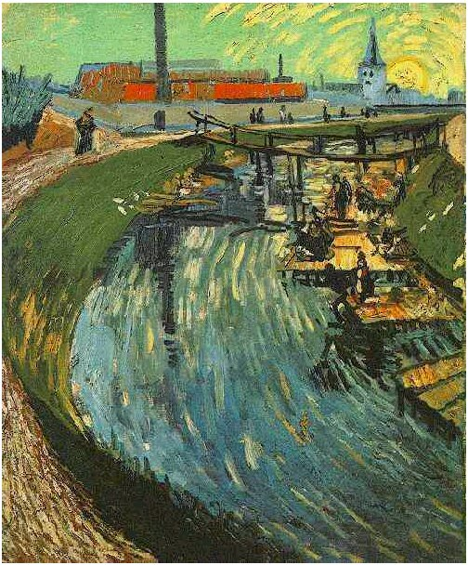
Pigeons as art experts
Notes:
Canal with Women Washing, 1888

Slide 13
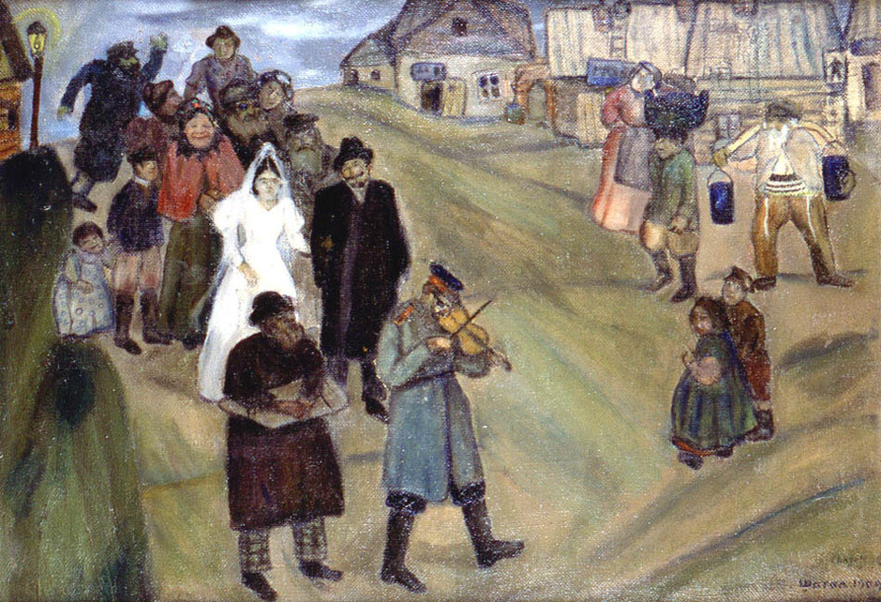
Pigeons as art experts

Slide 14
Pigeons as art experts
Pigeons were able to discriminate between Van Gogh and Chagall with 95% accuracy (when presented with pictures they had been trained on)
Discrimination still 85% successful for previously unseen paintings of the artists
Pigeons do not simply memorise the pictures They can extract and recognise patterns (the ‘style’) They generalise from the already seen to make predictions
this is what neural networks (biological and artificial) are good at (unlike conventional computer)

Slide 15
What are Neural Networks?
Models of the brain and nervous system
Highly parallel
  Process information much more like the brain than a serial computer
Learning
  Very simple principles
  Very complex behaviours
Applications
  As powerful problem solvers
  As biological models

Slide 16
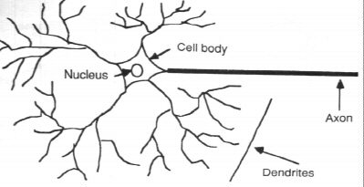
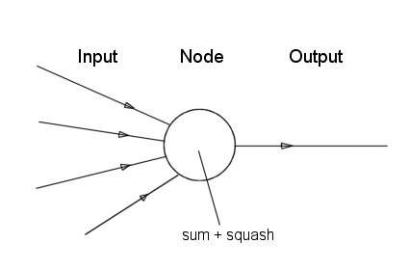
Bilogical Neurone vs. Artificial Neuron

Slide 17
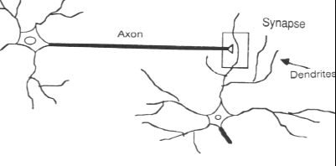
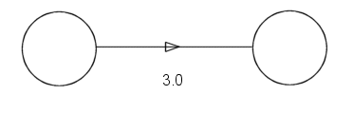
Synapse vs. weight

Slide 18
What is an artificial neuron ?
Definition : Non linear, parameterized function with restricted output range
y
w0
x1
x2
x3

Slide 19
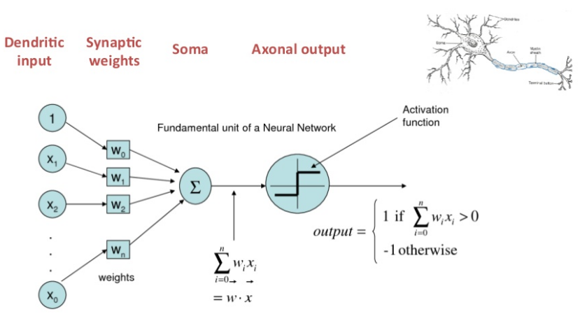
One Simple Abstraction

Slide 20
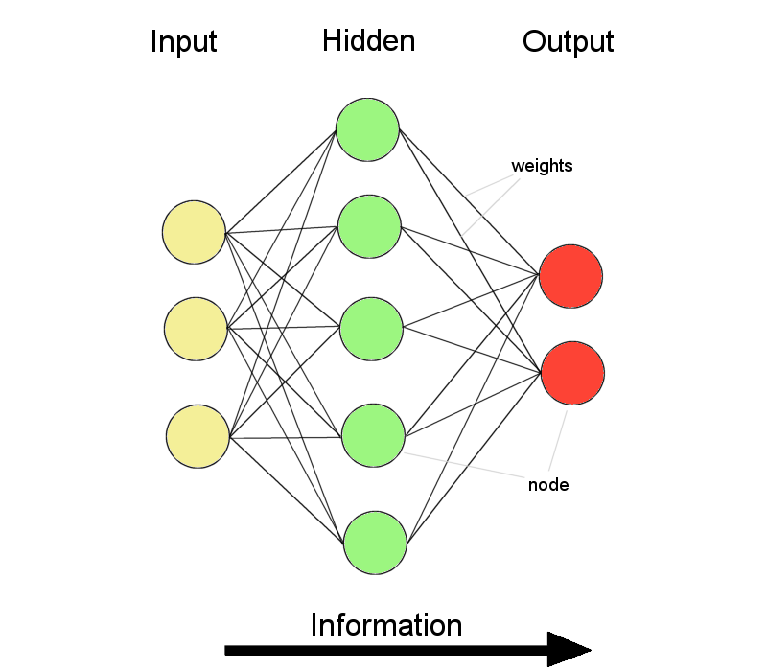
ANNs – The basics
ANNs incorporate the two fundamental components of biological neural nets:
Neurones (nodes)
Synapses (weights)

Slide 21
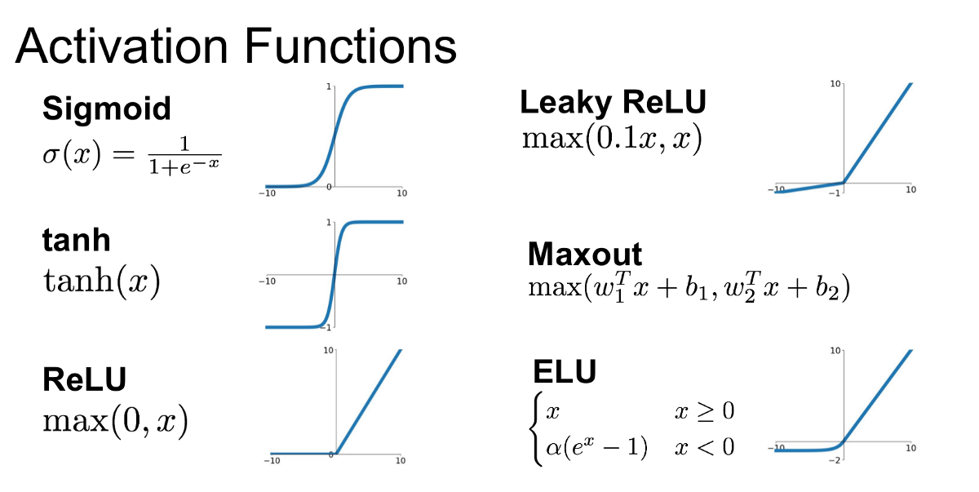

Slide 22
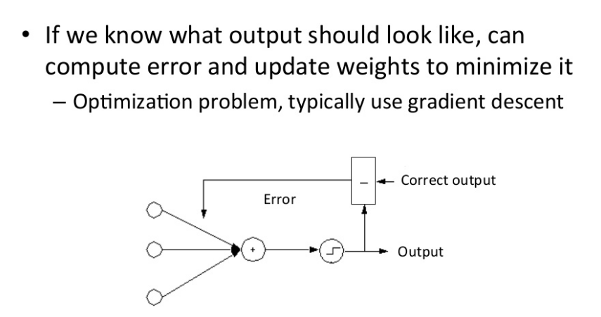
How to learn the weights?

Slide 23
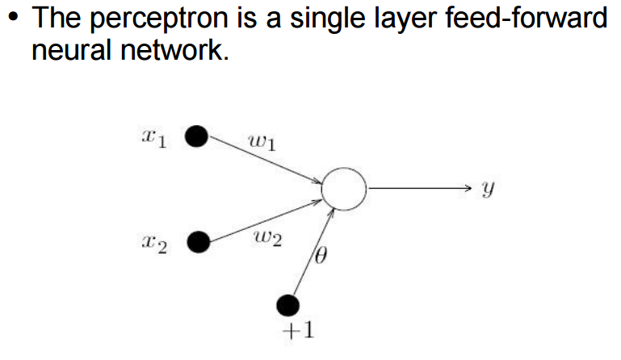
Simple Perceptron

Slide 24
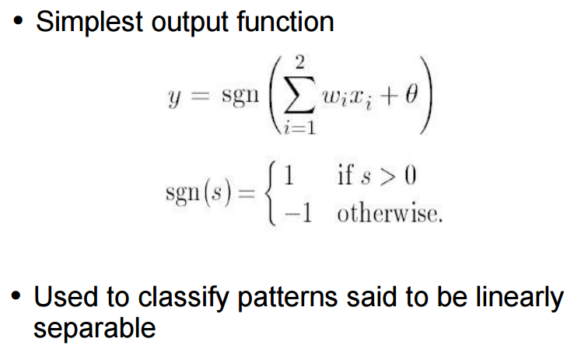
Simple Perceptron

Slide 25
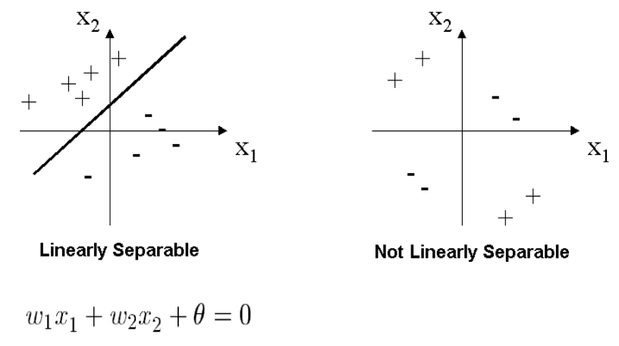
Linearly separable

Slide 26
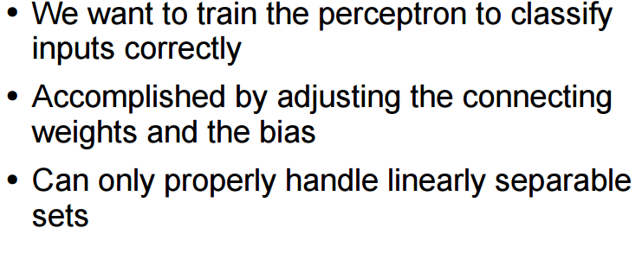
Perceptron Learning Algorithm

Slide 27
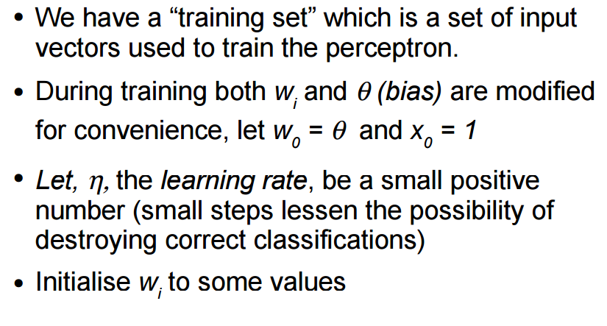
Perceptron Learning Algorithm

Slide 28
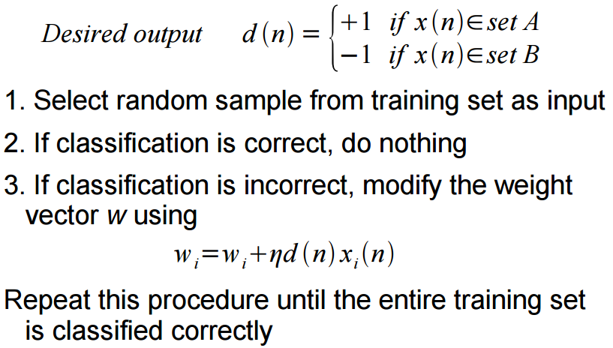
Perceptron Learning Algorithm

Slide 29
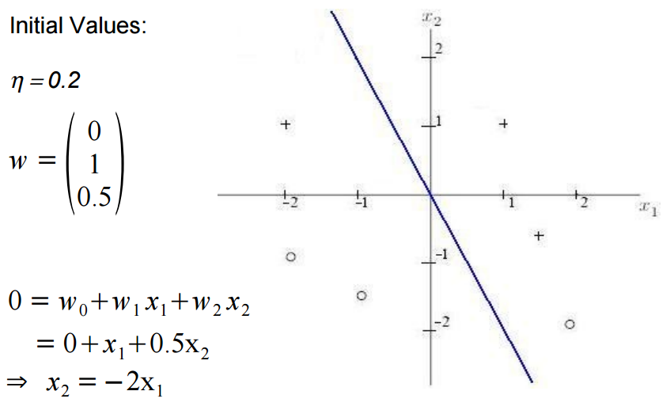
Learning Example

Slide 30
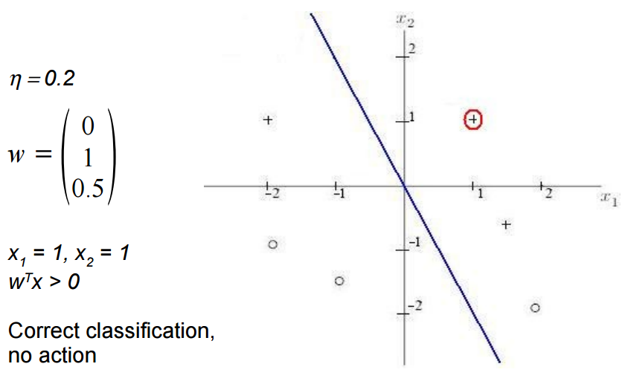
Learning Example

Slide 31
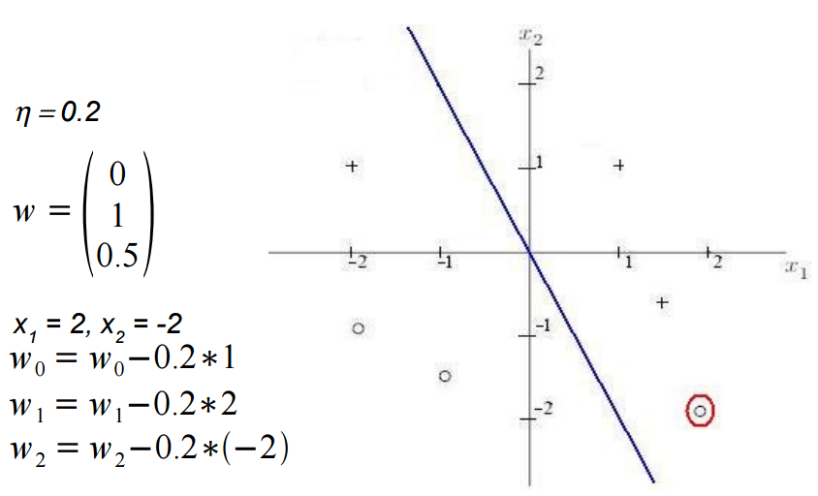
Learning Example

Slide 32
Learning Example

Slide 33
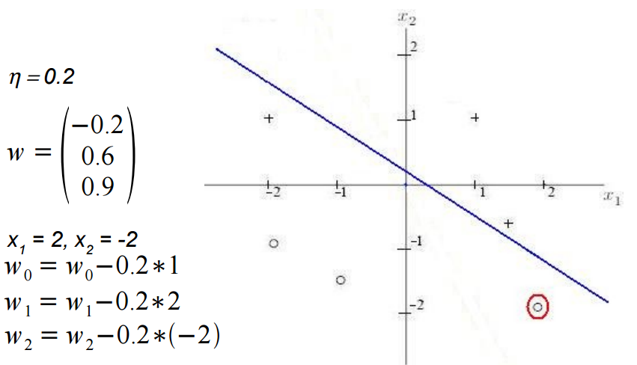
Learning Example

Slide 34
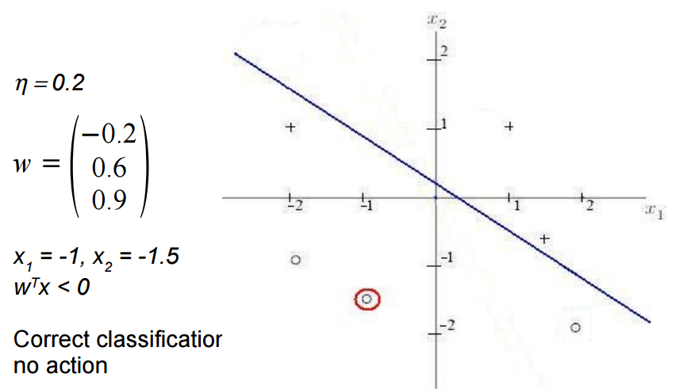
Learning Example

Slide 35
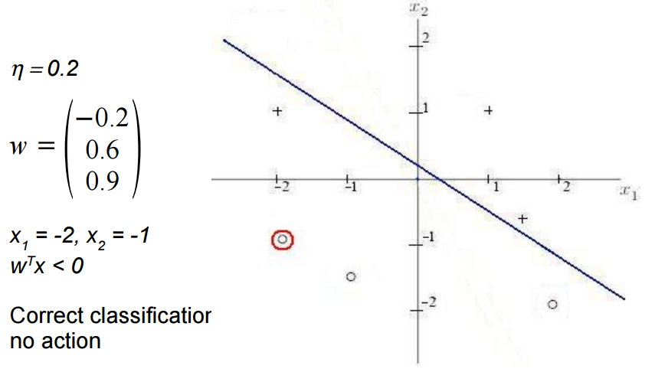
Learning Example

Slide 36
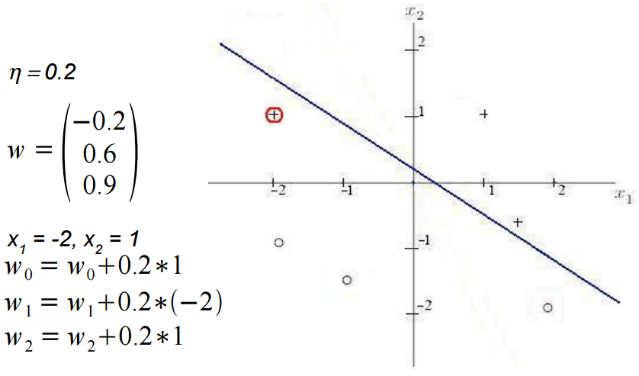
Learning Example

Slide 37
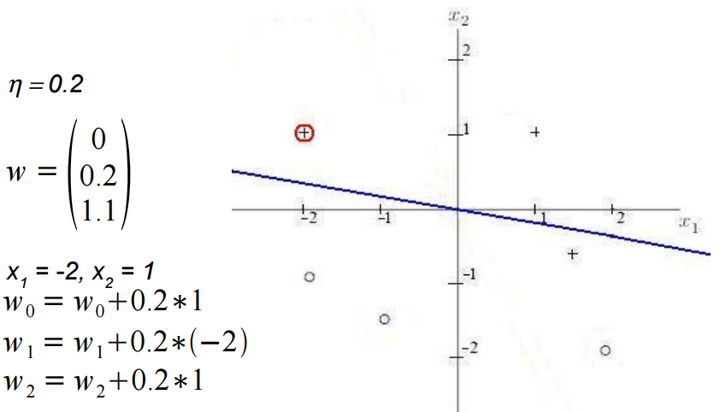
Learning Example

Slide 38
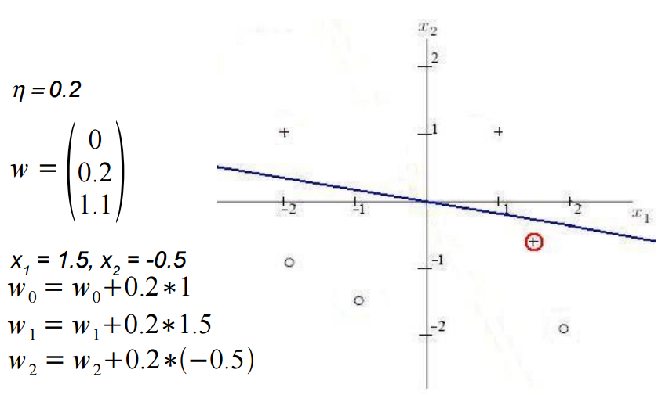
Learning Example

Slide 39
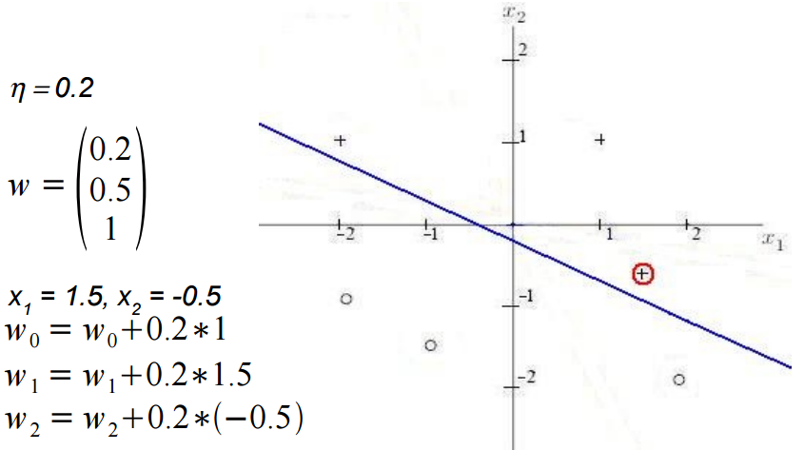
Learning Example

Slide 40
Implementation Single Node Neuron
w=[0,0]
b=[0]
def create_perceptron():
w[0] = random.random()
w[1] = random.random()
b[0] = random.random()

Slide 41
Implementation Single Node Neuron
def activate(x):
sum= (w[0] * x[0]) + (w[1] * x[1]) + b[0]
if sum > 0 :
return 1
else:
return -1

Slide 42
Implementation Single Node Neuron
def compute_error(target,predicted):
error = target - predicted
return error

Slide 43
Implementation Single Node Neuron
def learn(error, learning_rate, x):
w[0] = w[0] + learning_rate*error*x[0]
w[1] = w[1] + learning_rate*error*x[1]
b[0] = b[0] + learning_rate*error*1

Slide 44
Implementation Single Node Neuron
def one_step_learn(x_sample, y_sample, learning_rate):
predicted = activate(x_sample)
error = compute_error(y_sample, predicted)
#print error
learn(error, learning_rate, x_sample)

Slide 45
Implementation Single Node Neuron
def train(x_dataset, y_dataset, learning_rate, n_iteration):
for i in range (n_iteration):
rn = random.randint(0, len(x_dataset)-1)
x_sample = x_dataset[rn]
y_sample = y_dataset[rn]
one_step_learn(x_sample, y_sample, learning_rate)
# if i %100:
# print ('w old', w)
# print ('b old', b)

Slide 46
Implementation Single Node Neuron
if __name__ == "__main__":
x_dataset = [[0,0],
[0,1],
[1,0],
[1,1]]
y_dataset = [-1,1,1,1]
#y_dataset = [-1,-1,-1,1]
print('activation before learning')
for x in x_dataset:
print(activate(x))
learning_rate = 0.01
create_perceptron()
train(x_dataset, y_dataset, learning_rate, 500)
print('activation after learning')
for x in x_dataset:
print(activate(x))

Slide 47
Perceptron with numpy
Input Data
X = np.array([
[-2, 4],
[4, 1],
[1, 6],
[2, 4],
[6, 2]
])
Include Bias into Input Data
X = np.array([
[-2, 4, 1],
[4, 1, 1],
[1, 6, 1],
[2, 4, 1],
[6, 2, 1]
])

Slide 48
Perceptron with numpy
import numpy as np
from matplotlib import pyplot as plt
Input Data
X = np.array([
[-2, 4],
[4, 1],
[1, 6],
[2, 4],
[6, 2]
])
Include Bias into Input Data
X = np.array([
[-2, 4, 1],
[4, 1, 1],
[1, 6, 1],
[2, 4, 1],
[6, 2, 1]
])
Output Data
y = np.array([-1,-1,1,1,1])

Slide 49
Perceptron with numpy
def plot(X):
for d, sample in enumerate(X):
# Plot the negative samples
if d < 2:
plt.scatter(sample[0], sample[1], s=120, marker='_', linewidths=2)
# Plot the positive samples
else:
plt.scatter(sample[0], sample[1], s=120, marker='+', linewidths=2)
# Print a possible hyperplane, that is seperating the two classes.
plt.plot([-2,6],[6,0.5])
plt.show()

Slide 50
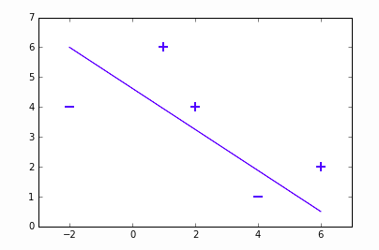
Perceptron with numpy
def plot(X):
for d, sample in enumerate(X):
# Plot the negative samples
if d < 2:
plt.scatter(sample[0], sample[1], s=120, marker='_', linewidths=2)
# Plot the positive samples
else:
plt.scatter(sample[0], sample[1], s=120, marker='+', linewidths=2)
# Print a possible hyperplane, that is seperating the two classes.
plt.plot([-2,6],[6,0.5])
plt.show()

Slide 51
Perceptron with numpy
def perceptron_sgd(X, Y):
w = np.zeros(len(X[0]))
eta = 1
epochs = 10
for epoch in range(epochs):
for i, x in enumerate(X):
if (np.dot(X[i], w)*Y[i]) <= 0:
w = w + eta*X[i]*Y[i]
return w

Slide 52
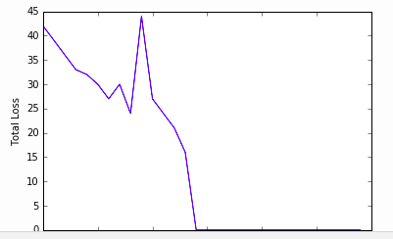
Perceptron with numpy
def perceptron_sgd_plot(X, Y):
w = np.zeros(len(X[0]))
eta = 1
n = 30
errors = []
for t in range(n):
total_error = 0
for i, x in enumerate(X):
if (np.dot(X[i], w) * Y[i]) <= 0:
total_error += (np.dot(X[i], w) * Y[i])
w = w + eta * X[i] * Y[i]
errors.append(total_error * -1)
plt.plot(errors)
plt.xlabel('Epoch')
plt.ylabel('Total Loss')
return w

