Slide 1
< Development of KBS solution to address real life problems />
G-8: < TANURON, Kenneth Luyao />
< VILLANEA, Marvin Tapere />
< ZAYAS, Sylwyn Franz Suan />

Slide 2
outline
Time, Schedules, and resources
Representing temporal and resource constraints
Hierarchical planning
High-level actions
Planning and acting in NONDETERMINISTIC DOMAINS
Sensorless planning
Multiagent planning
Solving scheduling problems
Searching for primitive solutions
Searching for abstract solutions
Contingent planning
Online replanning
Planning with multiple simultaneous actions
Planning with multiple agents: Cooperation and coordination

Slide 3
Time, Schedules, and resources
Representing temporal and resource constraints
A typical job-shop scheduling problem, consists of a set of jobs, each of which consists a collection of actions with ordering constraints among them. Each action has a duration and a set of resource constraints required by the action. Each constraint specifies a type of resource (e.g., bolts, wrenches, or pilots), the number of that resource required, and whether that resource is consumable (e.g., the bolts are no longer available for use) or reusable (e.g., a pilot is occupied during a flight but is available again when the flight is over). Resources can also be produced by actions with negative consumption, including manufacturing, growing, and resupply actions. A solution to a job-shop scheduling problem must specify the start times for each action and must satisfy all the temporal ordering constraints and resource constraints. As with search and planning problems, solutions can be evaluated according to a cost function; this can be quite complicated, with nonlinear resource costs, time-dependent delay costs, and so on. For simplicity, we assume that the cost function is just the total duration of the plan, which is called the makespan.

Slide 4
Time, Schedules, and resources
Representing temporal and resource constraints
The representation of resources as numerical quantities, such as Inspectors (2), rather than as named entities, such as Inspector (I1) and Inspector (I2), is an example of a very general technique called aggregation. The central idea of aggregation is to group individual objects into quantities when the objects are all indistinguishable with respect to the purpose at hand. In our assembly problem, it does not matter which inspector inspects the car, so there is no need to make the distinction.

Slide 5
Time, Schedules, and resources
Solving scheduling problems
We can apply the critical path method (CPM) to this graph to determine the possible start and end times of each action. A path through a graph representing a partial-order plan is a linearly ordered sequence of actions beginning with Start and ending with Finish.
The critical path is that path whose total duration is longest; the path is “critical” because it determines the duration of the entire plan—shortening other paths doesn’t shorten the plan as a whole, but delaying the start of any action on the critical path slows down the whole plan. Actions that are off the critical path have a window of time in which they can be executed. The window is specified in terms of an earliest possible start time, ES, and a latest SLACK possible start time, LS. The quantity LS – ES is known as the slack of an action.

Slide 6

Time, Schedules, and resources
Solving scheduling problems
One simple but popular heuristic is the minimum slack algorithm: on each iteration, schedule for the earliest possible start whichever unscheduled action has all its predecessors scheduled and has the least slack; then update the ES and LS times for each affected action and repeat.

Slide 7
Hierarchical planning
We concentrate on the aspect of hierarchical decomposition, an idea that pervades almost all attempts to manage complexity. The key benefit of hierarchical structure is that, at each level of the hierarchy, a computational task, military mission, or administrative function is reduced to a small number of activities at the next lower level, so the computational cost of finding the correct way to arrange those activities for the current problem is small. Nonhierarchical methods, on the other hand, reduce a task to a large number of individual actions; for large-scale problems, this is completely impractical.

Slide 8
Hierarchical planning
High-level actions
The basic formalism we adopt to understand hierarchical decomposition comes from the area of hierarchical task networks or HTN planning. As in classical planning, we assume full observability and determinism and the availability of a set of actions, now called primitive actions, with standard precondition–effect schemas. The key additional concept is the high-level action or HLA example given earlier. Each HLA has one or more possible refinements, into a sequence1 of actions, each of which may be an HLA or a primitive action (which has no refinements by definition). The same figure shows a recursive refinement for navigation in the vacuum world: to get to a destination, take a step, and then go to the destination.

Slide 9
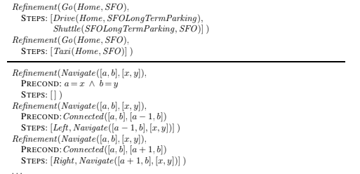
Hierarchical planning
High-level actions

Slide 10
Hierarchical planning
High-level actions
An HLA refinement that contains only primitive actions is called an implementation of the HLA. For example, in the vacuum world, the sequences [Right, Right, Down] and [Down, Right, Right] both implement the HLA Navigate ([1, 3], [3, 2]). An implementation of a high-level plan (a sequence of HLAs) is the concatenation of implementations of each HLA in the sequence.

Slide 11
Hierarchical planning
Searching for primitive solutions
The approach leads to a simple algorithm: repeatedly choose an HLA in the current plan and replace it with one of its refinements, until the plan achieves the goal. It is straightforward to design a graph-search version of the algorithm as well as depth-first and iterative deepening versions. In essence, this form of hierarchical search explores the space of sequences that conform to the knowledge contained in the HLA library about how things are to be done. A great deal of knowledge can be encoded, not just in the action sequences specified in each refinement but also in the preconditions for the refinements. For some domains, HTN planners have been able to generate huge plans with very little search.

Slide 12
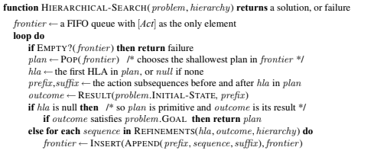
Hierarchical planning
Searching for primitive solutions

Slide 13
Hierarchical planning
Searching for abstract solutions The hierarchical search algorithm in the preceding section refines HLAs all the way to primitive action sequences to determine if a plan is workable. This contradicts common sense: one should be able to determine that the two-HLA high-level plan [Drive(Home, SFOLongTermParking), Shuttle(SFOLongTermParking, SFO)]

Slide 14
Hierarchical planning
Searching for abstract solutions
gets one to the airport without having to determine a precise route, choice of parking spot, and so on. The solution seems obvious: write precondition–effect descriptions of the HLAs, just as we write down what the primitive actions do. From the descriptions, it ought to be easy to prove that the high-level plan achieves the goal. This is the holy grail, so to speak, of hierarchical planning because if we derive a high-level plan that provably achieves the goal, working in a small search space of high-level actions, then we can commit to that plan and work on the problem of refining each step of the plan. This gives us the exponential reduction we seek. For this to work, it has to be the case that every high-level plan that “claims” to achieve the goal (by virtue of the descriptions of its steps) does in fact achieve the goal in the sense defined earlier: it must have at least one implementation that does achieve the goal. This property has been called the downward refinement property for HLA descriptions.

Slide 15
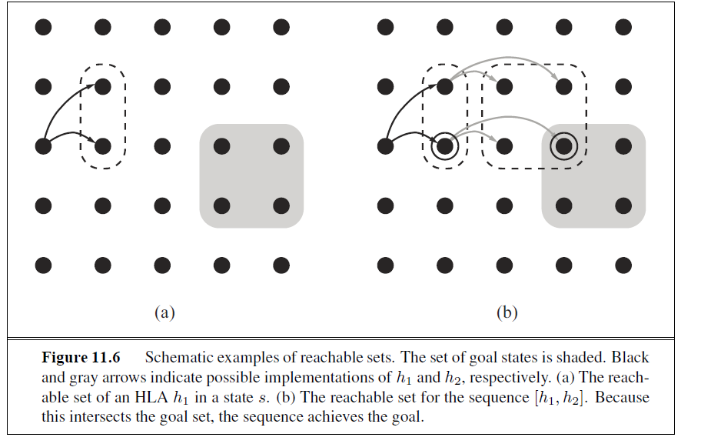

Slide 16
Hierarchical planning
Searching for abstract solutions
One safe answer (at least for problems where all preconditions and goals are positive) is to include only the positive effects that are achieved by every implementation of the HLA and the negative effects of any implementation. Then the downward refinement property would be satisfied.

Slide 17
Hierarchical planning
Searching for abstract solutions
The programming languages community has coined the term demonic nondeterminism for the case where an adversary makes the choices, contrasting this with angelic nondeterminism, where the agent itself makes the choices. We borrow this term to define angelic semantics for HLA descriptions. The basic concept required for understanding an given a state s, the reachable set for an HLA: written as REACH(s, h), is the set of states reachable by any of the HLA’s implementations. The key idea is that the agent can choose which element of the reachable set it ends up in when it executes the HLA; thus, an HLA with multiple refinements is more “powerful” than the same HLA with fewer refinements. We can also define the reachable set of a sequences of HLAs. For example, the reachable set of a sequence [h1, h2] is the union of all the reachable sets obtained by applying h2 in each state in the reachable set of h1:gelic semantics is the reachable set of an HLA:

Slide 18
Hierarchical planning
Searching for abstract solutions
Given these definitions, a high-level plan—a sequence of HLAs—achieves the goal if its
reachable set intersects the set of goal states. (Compare this to the much stronger condition
for demonic semantics, where every member of the reachable set has to be a goal state.)
Conversely, if the reachable set doesn’t intersect the goal, then the plan definitely doesn’t
work. Figure 11.6 illustrates these ideas.

Slide 19
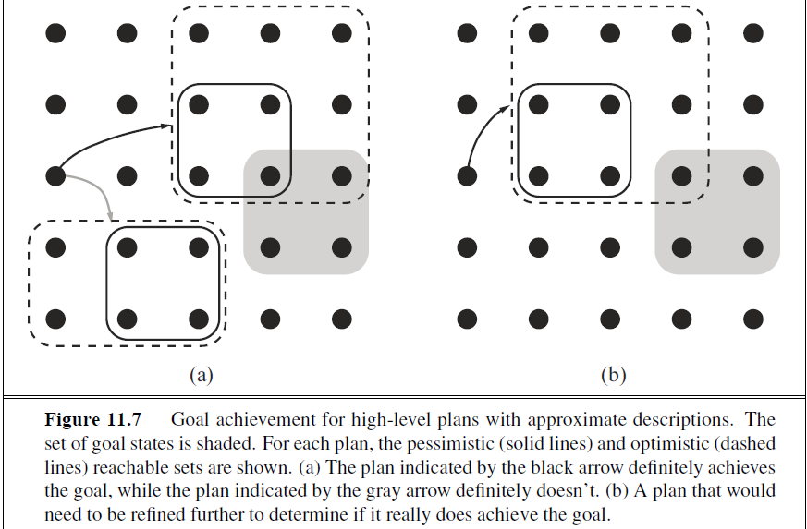

Slide 20
PLANNING AND ACTING IN NONDETERMINISTIC DOMAINS
Sensorless planning
Contingent planning
Online replanning

Slide 21
PLANNING AND ACTING IN NONDETERMINISTIC DOMAINS
Sensor less planning The sensor less planning algorithm must ensure that the plan achieves the goal in all possible circumstances, regardless of the true initial state and the actual actions outcomes.

Slide 22
PLANNING AND ACTING IN NONDETERMINISTIC DOMAINS
Contingent planning We saw in Chapter 4 that contingent planning—the generation of plans with conditional branching based on percepts—is appropriate for environments with partial observability, nondeterminism, or both. For the partially observable painting problem with the percept axioms given earlier, one possible contingent solution is as follows:

Slide 23
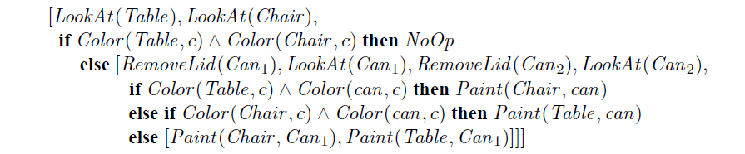

Slide 24
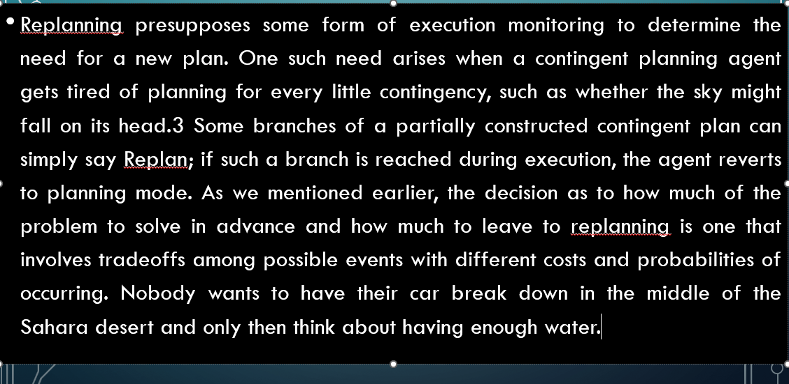
PLANNING AND ACTING IN NONDETERMINISTIC DOMAINS
Online replanning

Slide 25
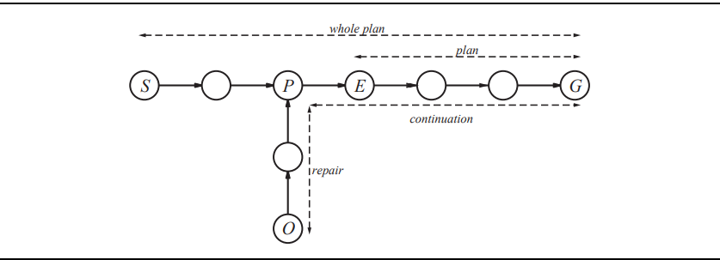
Online replanning

Slide 26
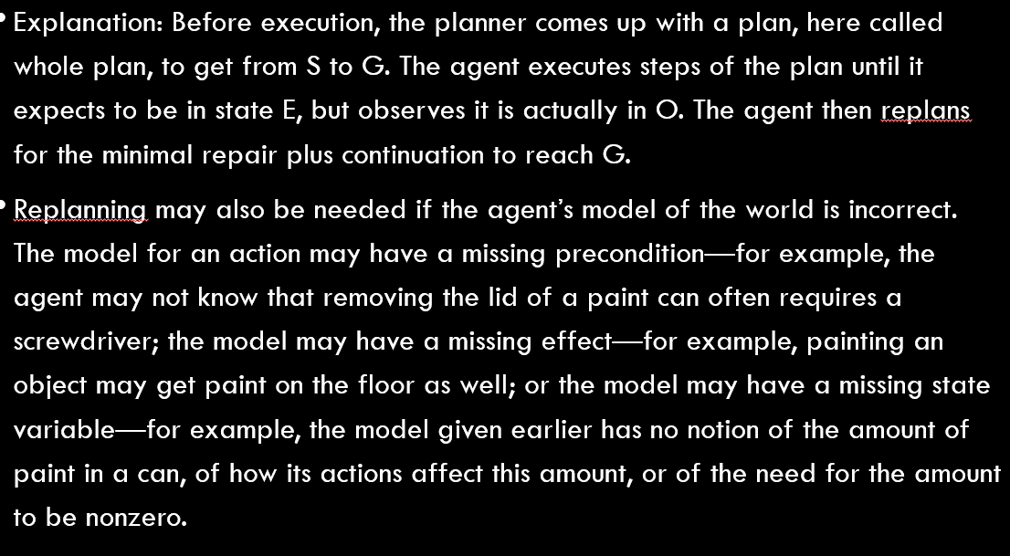

Slide 27
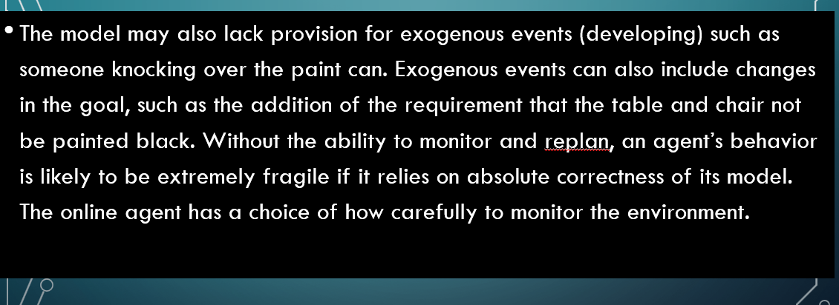

Slide 31
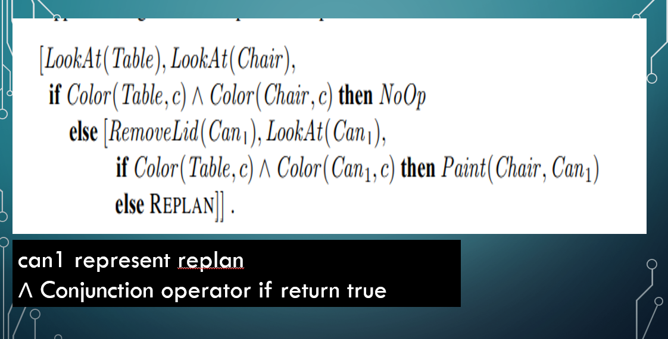

Slide 32
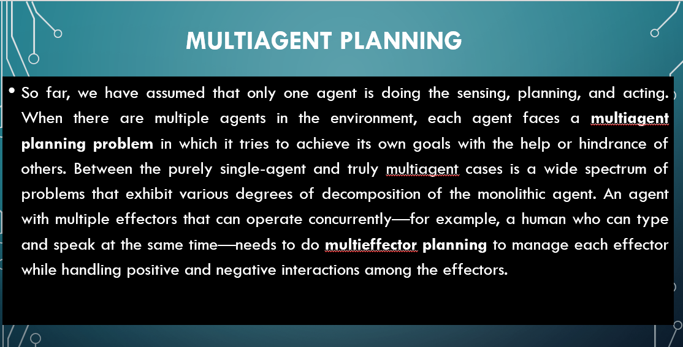

Slide 33
