Slide 1
AI Inspector: AI –Powered Visual Inspection System
Midpoint Evaluation
Group 4 : Marvin Wellington | Fallou Samb | Tunji Oluwataki | Abel Sanchez
Notes:
Introduce the team and project title.

Slide 2
Project Overview
The Problem
Our Solution
Manual quality inspections can be time-consuming and inconsistent.
Damaged products may go undetected, leading to quality control issues.
Mobile App – Captures an image of a package.
Amazon SageMaker – Classifies the package as Good or Damaged.
Amazon SNS – Sends a notification when a damaged package is detected.
Amazon DynamoDB – Stores inspection results.
API Gateway – Allows the app to retrieve previous inspection records.
Notes:
Problem: manual inspection is slow and inconsistent. Solution: photo in mobile app, cloud ML model classifies, results stored and shown.

Slide 3
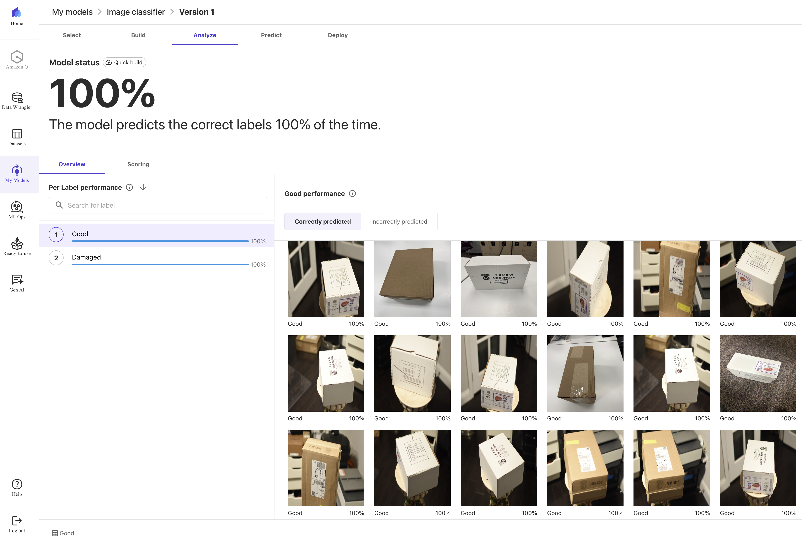
Model Training Results
Image classifier: Good vs. Damaged
Collect Images – Captured 800 images.
Upload Dataset – Imported images into SageMaker Canvas.
Label Dataset – 400 Good and 400 Damaged.
Train Model – Used Quick Build to train the model.
Evaluate Model – Reviewed accuracy and predictions.
Deploy Model – Created an endpoint for image classification.
Notes:
Quick build in SageMaker Canvas. Tell the story: many rounds of capturing new images to improve accuracy. The 100% is on a small dataset, so call it a baseline.

Slide 4
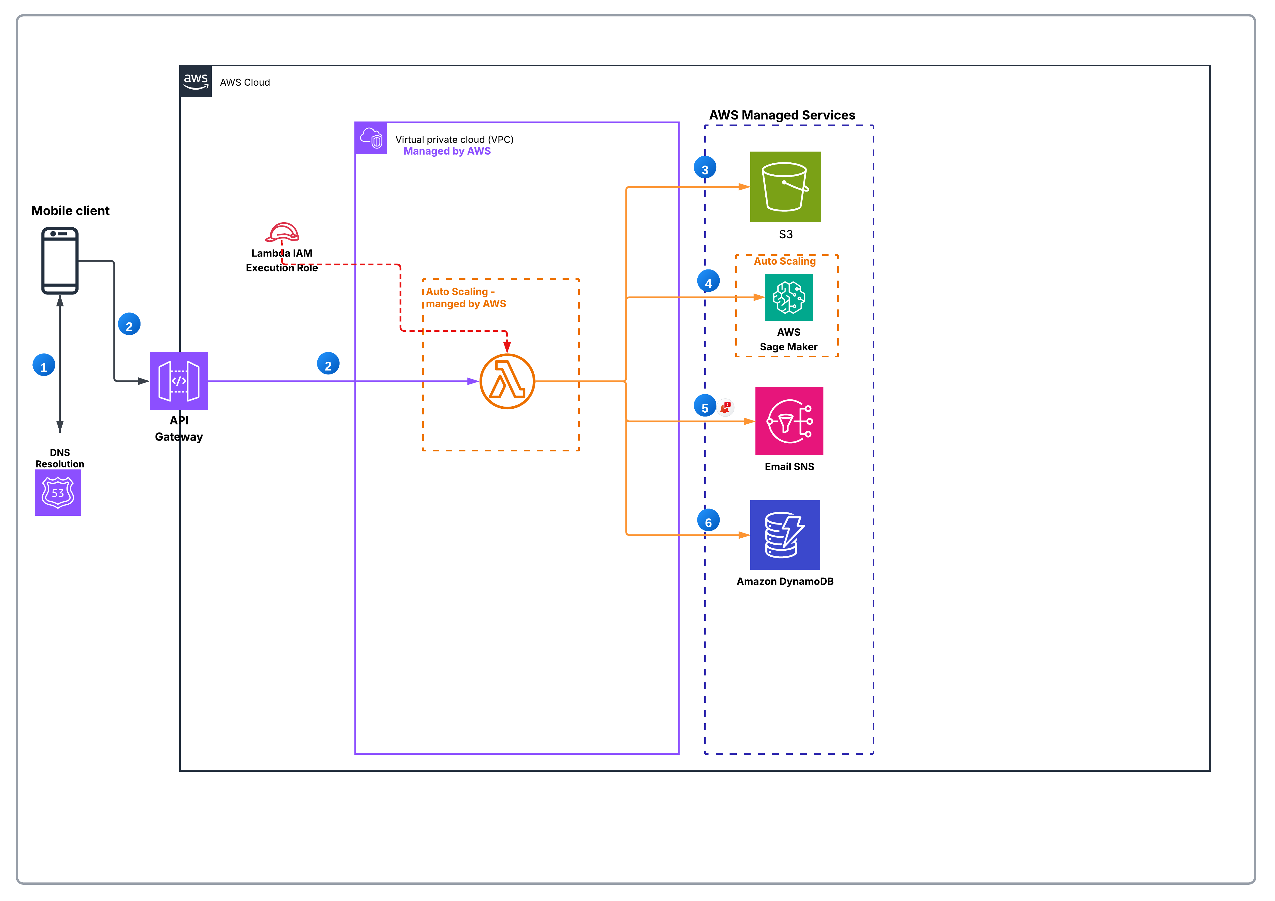
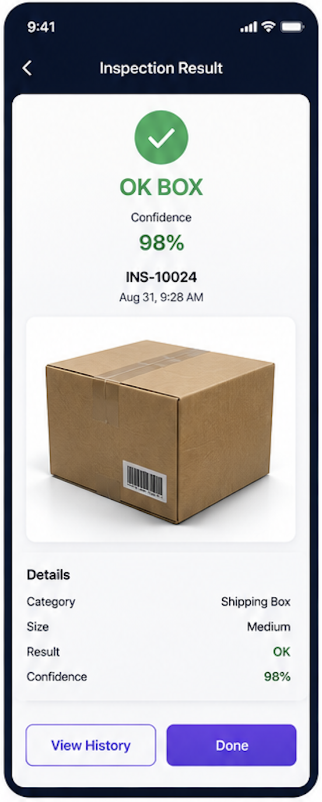
Current Architecture – Image Classification Pipeline
Built so far
Mobile App – Sends an image through API Gateway to Lambda.
Amazon S3 – Stores the captured image.
Amazon SageMaker – Classifies the image as Good or Damaged.
Amazon SNS – Sends a notification if a damaged box is detected.
Amazon DynamoDB – Stores the inspection results:
  Inspection ID
  Image Key
  Confidence Score
  Classification Result
  Timestamp
Mobile App – Displays the classification result.
HTTPS POST Link: https://vdtbxy07nl.execute-api.us-east-1.amazonaws.com/inspect
Notes:
Steps 1-5 are built. Dashboard, DynamoDB Stream to WebSocket push, and SNS email alert are the remaining parts of the diagram.

Slide 5
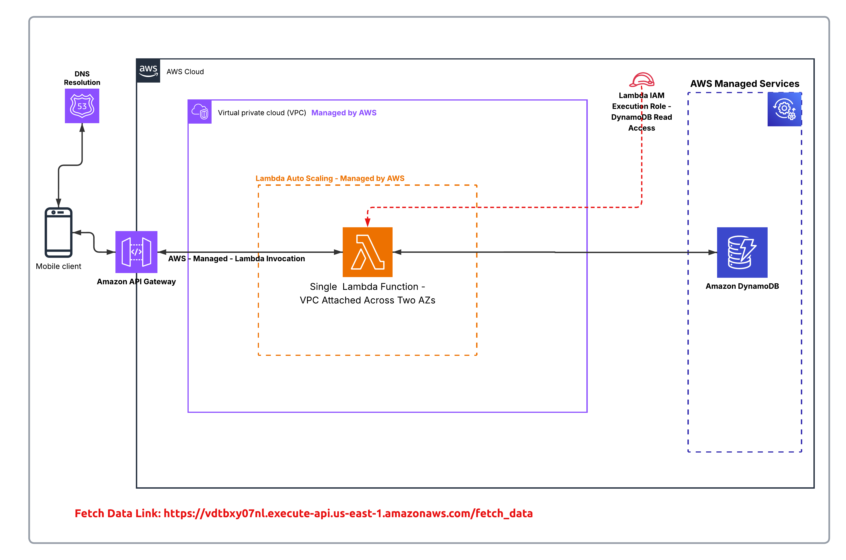
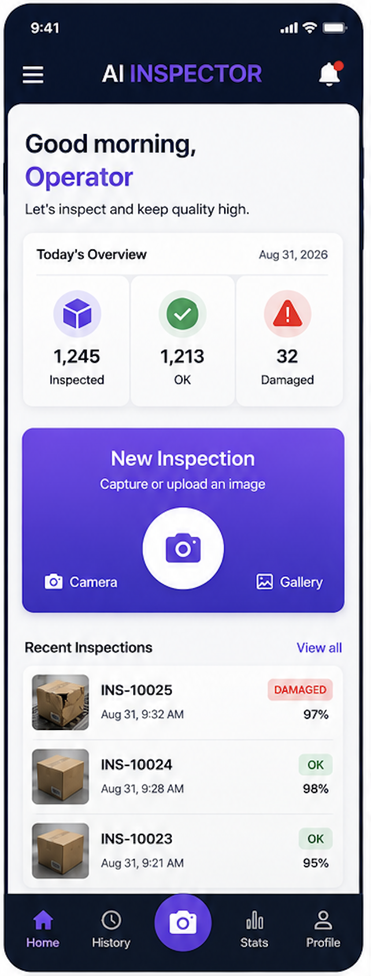
Current Architecture – Request Data Pipeline
Built so far
Mobile App – Sends a request to API Gateway.
API Gateway – Invokes the Lambda function.
AWS Lambda – Retrieves previous inspection records from DynamoDB.
Mobile App – Displays inspection history and images.
IAM Role – Grants Lambda only the permissions it needs.
Notes:
The app calls the fetch_data route to pull previous results and images back into the app.

Slide 6
Midpoint Evaluation
Live Demo
Notes:
Introduce the team and project title.

Slide 7
Progress Summary
✓
Mobile app
Challenge: model training
Captures box images and sends them to the cloud
Accuracy needed many extra photos
Re-captured images over and over, then retrained
Lesson: plan data collection early
✓
Backend to classify Image
DNS, API Gateway, Lambda, S3, SageMaker, DynamoDB
✓
Backend to request data for app
Past inspections loaded in app
Automation / DevOps: Terraform was used to automate infrastructure
GitHub repo: https://github.com/marvinwel/AI_Inspection_CSE_4333_5333
Notes:
Walk through what is done, then the main challenge: training data collection.

Slide 8
Remaining Work, Risks & Plan
Remaining Features
Scope & Risks
Dashboard – Develop a dashboard to monitor inspection results.
VPC – Configure a VPC with public and private subnets.
EC2 & ALB – Deploy the dashboard on EC2 behind an Application Load Balancer.
Real-Time Updates – Use DynamoDB Streams and API Gateway WebSocket to display live inspection results.
Infrastructure Costs – Additional AWS costs from EC2, ALB, and NAT Gateway.
Model Accuracy – Limited training data may affect performance on new images.
Plan: [10/31] Dashboard > [11/04] Real-Time > [11/07] EC2 + ALB > [11/13] final testing and demo
Notes:
Dashboard and real-time updates are the main remaining features. Independent model testing was removed from scope. Fill in dates.

