Slide 1
Evolutionary Prompt Optimization
Domain-Specific Phrase Identification with AUM
CSE 5320 • Team Project 1
Prompt → AI Output → Evaluation → Error Analysis → Revised Prompt
1

Slide 2
Problem & Optimization Objective
Problem
Challenge
Objective
Natural-language domain descriptions contain many possible phrases, but only a subset are useful for AUM domain modeling. A vague prompt can miss important phrases or return too many extras.
Balance recall and precision while keeping the prompt generic enough to work across different domains.
Optimize a generic prompt that enables an LLM to accurately identify domain-specific phrases using the Agile Unified Methodology (AUM), maximizing Precision, Recall, and F1.
2

Slide 3
P0 — Initial Prompt
Library domain • 3 independent runs • Ruleset B
You are an Agile Unified Methodology specialist. We need
you to extract the Domain phrases given from the document
provided. This is an identification step.
The domain phrases are:
- Noun / noun phrases
- X of Y Expressions
- Transitive verbs (do not include the object)
- Adjectives, enumeration
- Numeric, Quantity (includes singular numbers)
- Possession Expressions: <has/have/possess> X, Y, Z, etc.
- Consist of / Part of Expressions: <consist of/part of>
- X is a Y generalization / specialization
Output format:
<phrase type>:
- <phrase>
Rules:
- Do not prioritize your own linguistic interpretation
over these rules
- Extract only phrases explicitly present in the document
- Do not infer, paraphrase, generalize, or add phrases
- Preserve the phrase's original wording
- Treat singular/plural and grammatical variants as one
- Assign each phrase to exactly one category; no duplicates
- Nouns can overlap with other categories
- Adjectives should not overlap with possession;
possession takes priority
- Return only the requested output format, no explanations
Precision
Recall
F1
81.5%
88.1%
84.6%
runs 82.6 / 84.3 / 87.0
Error analysis
Modifiers and verbs filed as adjectives (unique, other, current, reserved); French and beginner missed.
P1: same content, restructured
Numbered into 13 general rules → 85.2% (1 run). Per-category rules came next (P3).
4

Slide 4
Evaluation Criteria
Expert solutions + precision, recall and F1, scored by script
Expert solutions
Matching: Ruleset B
Protocol
Library: 55 phrases
NTSS: 85 underlined phrases
Car rental: 64 (Brainstorming List)
Evaluation references only; never given to the model
Both sides normalized: lowercase, singular, base verb
An expert phrase counts if it appears inside an output phrase of the same category
Containment approved by the professor
3 fresh chats per version per domain
Prompt attached as a file
Mean of runs; the script decides, not LLM self-scores (+9 pts high)
Side note: final prompt (P12) F1 under the other rulesets
Ruleset | Library | Car rental | NTSS
A: exact match | 74.3% | 48.0% | 62.6%
B: containment by category (reported) | 90.6% | 55.6% | 78.9%
C: containment, categories ignored | 88.4% | 55.2% | 78.2%
D: containment for rules 6, 7, 9 only | 83.1% | 48.0% | 65.6%
6

Slide 5
Evolutionary Prompt Optimization
P0 → Pn: the major change in each kept version
P0
v00
P1
v01
P3
v03
P6
v05
P8
v5.2
P10
v5.4
P12
v5.6
Unstructured baseline
Role + 9 AUM phrase types
Per-category rules + analysis step
Priority rules, full example, file delivery
Relevance + proper-name filters
Value lists, passive "by", action nouns
Verb → next-word step (final)
84.6
LIB
85.2
LIB
91.3
LIB
93.6
LIB
72.9
NTSS
77.6
NTSS
90.6 · 78.9 · 55.6
LIB · NTSS · CAR
Tuned on library
Tuned on NTSS & car rental
Final prompt (Pn)
Also tried: P2 excluded (quoted library answers) • P4 invalid (paste stripped placeholders) • P5, P7, P9, P11 intermediate • P13 rejected (car rental 55.6 → 50.3)
7

Slide 6
Evolutionary Optimization Experiments (1/2)
Prompt → AI → Output → Evaluation → Error analysis → AI + team suggestions → Revised prompt
P1 → P3
HYPOTHESIS
Per-category definitions and a visible analysis step will stop words landing in the wrong category.
MODIFICATION
Rules per category, <analysis>/<answer> split, adjective value test, hotel example
RESULT
Library 85.2 → 91.3 (+6.1)
P3 → P6
HYPOTHESIS
Priority rules and a full worked example, delivered as a file, will make runs consistent.
MODIFICATION
Verb-over-adjective priority, literal verb forms, full example answer; attached as .md
RESULT
Library 91.3 → 93.6; run spread 6.7 → 0.5 pts
P6 → P8
HYPOTHESIS
Extra phrases on NTSS and car rental are background text and proper names.
MODIFICATION
Relevance filter + proper-name rule
RESULT
NTSS 69.2 → 72.9; Toyota, Corolla gone
8

Slide 7
Evolutionary Optimization Experiments (2/2)
Each change targets errors found in the previous version's runs
P9 → P10
HYPOTHESIS
NTSS loses on split value lists, passive verbs without "by", and action nouns.
MODIFICATION
Value lists as one line; passive verbs keep "by"; action nouns
RESULT
NTSS 75.0 → 77.6; attended by / reviewed by found
P11 → P12
HYPOTHESIS
Writing each verb's next word will make the model keep prepositions.
MODIFICATION
"verb → next word → phrase" analysis step; numbers go to Numeric
RESULT
Car rental 49.4 → 55.6 (+6.2)
P12 → P13
HYPOTHESIS
Listing every "of" will raise X of Y.
MODIFICATION
Enumerate every "of" in the analysis
RESULT
X of Y up, but car rental 55.6 → 50.3: rejected
9

Slide 8
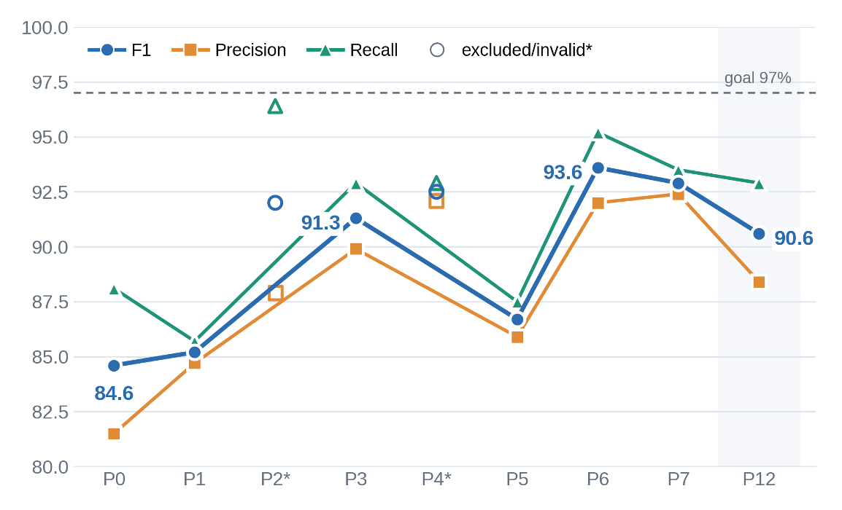
Optimization Results: Library
Precision, recall and F1 across prompt versions (Ruleset B, mean of runs)
P1 → P3: +6.1
Per-category rules and the analysis step
P5 → P6: +6.9
File delivery and a full example; run spread 0.5 pts
P6 → P12: −3.0
NTSS and car rental rules cost library: "two" dropped, action nouns
* 1 run. P2 (excluded, leakage) and P4 (invalid run) omitted. P8–P11 were tuned on NTSS and car rental and not run on library.
10

Slide 9
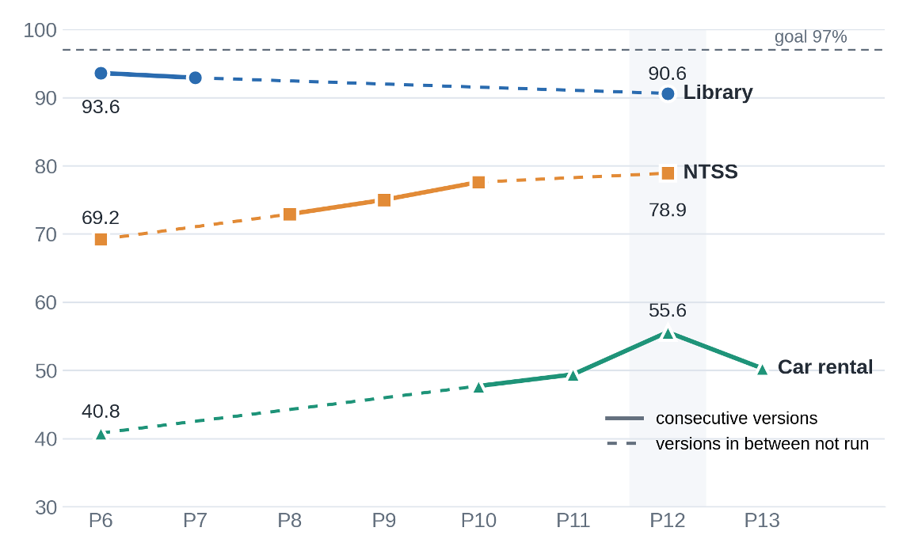
Optimization Results: All Three Domains
F1 from P6 onward (Ruleset B, mean of runs)
NTSS
change P6 → P12
+9.7
Car rental
+14.8
Library
−3.0
Lines skip versions that were not run on that domain. Car rental P6 = 1 run; all other points 3–4 runs.
11

Slide 10
AI and Human in the Loop
Which suggestions improved response quality (✔) and which did not (✘)
Suggested by AI (Claude), reviewed by team
Suggested / decided by team
✔ Per-category rules + analysis step (P3) +6.1 LIB
✔ Relevance + proper-name filters (P8) +3.7 NTSS
✔ Value lists, passive "by" (P10) +2.6 NTSS
✔ Verb → next-word step (P12) +6.2 CAR
✘ "Transitive verbs only" rule (P10): ignored by the model
✘ List every "of" (P13) −5.3 CAR
✔ Baseline and the 9 AUM phrase types (P0, P1)
✔ Caught leakage in P2; rebuilt with hotel examples
✔ Attach prompts as files, never paste (fixed P4/P5)
✔ 3 fresh chats per version; the script score decides
✔ Containment matching approved by the professor; chose Ruleset B
✘ LLM-run strict scoring prompt: reviewed, not adopted
12

Slide 11
Comparison: Baseline vs. Optimized
Library, 3 runs each, Ruleset B
P0: Baseline
P12: Final
81.5%
Precision
88.1%
Recall
84.6%
F1
88.4%
Precision
92.9%
Recall
90.6%
F1
Typical output errors
Typical output errors
Modifiers filed as adjectives: unique, other, current, subject
reserved / renewed misfiled or missed
Adjectives F1 0.38
Adjectives: only real values (French, beginner, valid, daily)
Verbs F1 0.97; X of Y F1 0.97
Still missed: book bar code; "two" in the X is a Y sentence
Peak library F1 was 93.6% at P6. P12 trades 3 points on library for +9.7 on NTSS and +14.8 on car rental.
13

Slide 12
Final Optimized Prompt (P12 = v5.6)
Structure of the prompt • complete text in Appendix (slides 18–21) and domain_phrase_prompt_v5.6.md
Role
Constraints
Methodology
AUM specialist; follow the rules exactly, not your own linguistic judgment
Only phrases in the text • no paraphrase • skip background • no proper names except the system
One rule block per AUM phrase type (9 types), each with inclusion and exclusion tests
Reasoning steps
Output format
Example
<analysis> first: adjective table (word | class | attribute | alternative value), then verb → next word → phrase
Fixed category headers inside <answer>, one phrase per line
One hotel-domain example that exercises every rule; no test-domain wording
14

Slide 13
Lessons Learned
Findings from this project
1
The expert keys disagree, which caps any single prompt
Library and NTSS mark everything that fits a rule; car rental keeps only what reaches the model. 3 car rental answers are not in the document.
2
Improving one domain moved another
NTSS and car rental rules cost library 3 points. P13 raised X of Y but cut car rental 5.3, so we kept the best version, not the newest.
3
Making a rule an analysis step beat stating it
"Transitive verbs only" was ignored. "Write each verb's next word" fixed prepositions: car rental +6.2.
4
How the prompt is delivered matters as much as its content
Pasting stripped placeholders (P4 invalid, P5 −4.6). Attaching as a file cut run spread from 6.7 to 0.5 points.
5
Scoring choices change conclusions
A mislabeled key category capped a perfect answer at 98.2%. LLM self-scores ran ~9 points high. Exact vs. containment: 74.3% vs. 90.6%.
16

Slide 14
Result Generalization
Final prompt (P12) tested unchanged on all three inputs • 3 fresh runs each • Ruleset B
Library
Car Rental
National Trade Show Service
90.6%
F1
55.6%
F1
78.9%
F1
Precision 88.4%
Recall 92.9%
Runs 88.5 / 90.9 / 92.3
Precision 46.9%
Recall 68.2%
Runs 55.1 / 54.6 / 57.0
Precision 70.0%
Recall 90.6%
Runs 78.0 / 76.7 / 82.1
The 97% goal was not reached on any domain. Car rental's key is curated, and 3 of its 64 answers do not appear in the document.
15

Slide 15
C0 — Initial Classification Prompt
Library domain • 3 independent runs •
Your task is to classify the domain-specific phrases
provided below into an object-oriented domain model structure.
Use the attached "Domain Description" and
"Classification Rules" files when performing the classification.
<domain_specific_phrases>
CLASSIFICATION TARGETS
- Classes: <class>
- Attributes: <class>.<attribute>
- Relationships:
* Association: as(<label>, <classA>, <classB>)
* Generalization: isa(<child>, <parent>)
* Aggregation: ag(<whole>, <part>)
- Association Classes: <name>(<classA>, <classB>)
STRICT OUTPUT FORMAT
CLASSES:
ATTRIBUTES:
RELATIONSHIPS:
ASSOCIATION CLASSES:
Do not include explanations, reasoning, notes,
or additional commentary.
Precision
Recall
F1
35.82%
51.85%
41.87%
runs 35.9 / 40.58 / 49.87
Error analysis
Baseline produced many false positives. The model added extra classes and associations and often chose structures that did not match the expert classification.
C1: Add knowledge grounding
Restrict the model to the Domain Description, Classification Rules, and provided domain-specific phrases. Goal: reduce unsupported classifications.
4

Slide 16
C1 — Knowledge Grounding
Library domain • isolate the effect of grounding
KNOWLEDGE GROUNDING
Perform the classification using ONLY:
1. Domain Description
2. Classification Rules
3. DOMAIN-SPECIFIC PHRASES
Treat these as the complete source of knowledge.
Do not use external knowledge, general software engineering
assumptions, or inferred concepts not supported by the sources.
Classification targets and strict output format remain unchanged.
C2 Validation Checklist
• Supported class
• Correct attribute owner
• Correct relationship type
• Correct endpoints
• Supported association class
• No unsupported concepts
Next: C2 Validation
Cross-check each proposed model element before final output.
4

Slide 17
C2 — Validation Pass
Final classification prompt modification
VALIDATION PASS
Before producing the final answer, internally cross-verify every
proposed model element against:
1. Domain Description
2. Classification Rules
3. DOMAIN-SPECIFIC PHRASES
Verify:
- each class is supported
- each attribute has a supported owner
- relationship type and endpoints are supported
- association classes and endpoints are supported
- no unsupported concepts are introduced
Remove redundant or unsupported classifications.
Why C1?
C0 allowed the model to consult the materials, but did not explicitly forbid unsupported assumptions.
Prompt change
Explicitly ground every classification in the supplied sources.
Next: C2 Validation
Cross-check each proposed model element before final output.
4

Slide 18
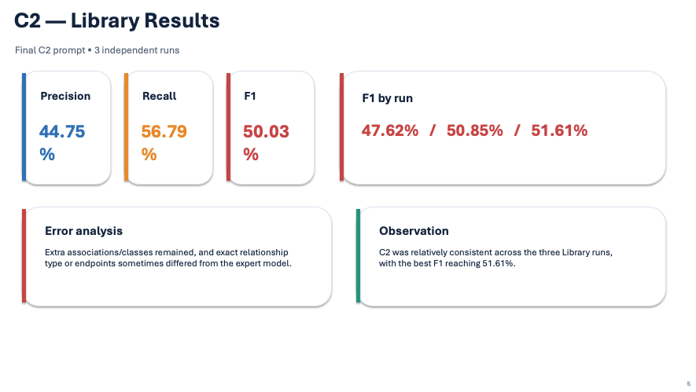

Slide 19
Classification Result Generalization
Final classification prompt (C2) tested on all three domains • 3 runs each
Library
Car Rental
National Trade Show Service
50.03 %
F1
52.72%
F1
50.98%
F1
Precision 44.75%
Recall 56.79%
Runs 47.62 / 50.85 / 51.61
Precision 54.31%
Recall 51.23%
Runs 53.85 / 50.47 / 53.85
Precision 44.55%
Recall 59.75%
Runs 50.85 / 53.23 / 48.85
C2 produced similar mean F1 across all three domains (50.03%–52.72%). The main remaining errors involved exact relationship types/endpoints, inheritance,
aggregation, and extra unsupported classifications.
15

Slide 20
Classification Findings
What the prompt evolution showed
• Grounding constrained the model to project materials.
• Validation forced a second check before final output.
• The final C2 prompt transferred consistently across all three domains.
• Class vs. attribute decisions.
• Exact association endpoints and relationship type.
• Inheritance and aggregation direction/structure.
• Avoiding extra unsupported model elements.
What improved
What remained difficult
Next phase: combine the final identification workflow with C2 classification and evaluate the end-to-end process.
4

Slide 21
CoT — Identification + Classification
One prompt, two steps • the model classifies the phrases it identified itself
STEP 1 - IDENTIFICATION
Final identification prompt P12 (v5.6), unchanged:
rules, <analysis> step, <answer> phrase list
STEP 2 - CLASSIFICATION
C2 prompt: knowledge grounding + validation pass
Phrase input = the model's own STEP 1 <answer>
Course classification rules included as text
OUTPUT
STEP 1 <analysis> and <answer>,
then STEP 2 <classification>
Expert solutions are used only to score the output.
Why CoT?
Step 3i: chain identification and classification so one prompt goes from the description to the domain model.
What changed from C2
C2 was given the expert phrase list. In CoT, STEP 2 gets only what STEP 1 found.
Setup
GPT-5.6 Sol, temporary chat, 3 fresh runs per domain, scored by script.
21

Slide 22
CoT Results: Identification (STEP 1)
Mean of 3 runs per domain • containment matching (Ruleset B style, no verb lemmatizing)
Library
Car Rental
National Trade Show Service
90.76%
F1
56.22%
F1
77.12%
F1
Precision 85.73%
Recall 96.43%
Runs 90.00 / 90.76 / 91.53
Precision 46.18%
Recall 71.88%
Runs 55.09 / 57.14 / 56.44
Precision 68.53%
Recall 88.17%
Runs 77.36 / 77.93 / 76.06
Close to v5.6 run alone (90.6% / 55.6% / 78.9%): adding the classification step did not change identification.
Exact-match F1: 77.86% / 51.74% / 65.52% (v5.6 writes possession, part-of and X-is-a-Y entries as full clauses).
22

Slide 23
CoT Results: Classification (STEP 2)
Mean of 3 runs per domain • classification F1 against the expert solution
Library
Car Rental
National Trade Show Service
40.91%
F1
30.91%
F1
42.59%
F1
Precision 36.35%
Recall 46.92%
Runs 50.85 / 40.62 / 31.25
Precision 27.25%
Recall 35.80%
Runs 31.01 / 33.61 / 28.12
Precision 33.68%
Recall 58.64%
Runs 36.47 / 42.76 / 48.53
C2 given the expert phrase list: 50.03% / 52.72% / 50.98%. In CoT, STEP 2 classifies the model's own STEP 1 phrases,
so extra or missing phrases from identification carry into the domain model.
23

Slide 24
CoT Findings
What chaining identification and classification showed
• Identification held steady inside the chained prompt.
• STEP 2 used only the model's own phrases; no expert list in the loop.
• Core structure was found in every domain: main classes, isa, aggregation (e.g. committee of reviewers).
• Classification F1 fell 8–22 points vs. C2 with the expert list.
• Extra STEP 1 phrases became extra classes and associations.
• Large run-to-run spread (Library 31.25–50.85%).
• Expert labels not in the text (status, body style, bill for) never appear.
What worked
What remained difficult
CoT automates the full path from description to domain model, but classification accuracy is limited by identification precision.
24

Slide 25
Conclusion & Future Work
1. Goal met?
2. Improvement
3. Next
Not at 97%
Best library: 93.6% (P6)
Final prompt: 90.6% library, 78.9% NTSS, 55.6% car rental
Library 84.6 → 90.6 (peak 93.6)
NTSS 69.2 → 78.9
Car rental 40.8 → 55.6
Every score: 3 fresh runs, scored by script, no test wording in the prompt
Ask which answer-key convention applies across domains
Adjudicate the 3 car rental answers missing from the text
Use a lemmatizer in the scorer
Restore the two library losses
Fixed model via API at temperature 0
17

Slide 26
Appendix: Final Prompt P12 (v5.6), part 1 of 4
Complete text as given to the model, attached as a .md file
You are an Agile Unified Methodology specialist performing the
phrase-identification step of domain modeling. Extract domain
phrases from the provided document. Follow these rules exactly
rather than your own linguistic judgment.
GENERAL RULES
1. Extract only phrases that appear in the document, using its
wording. Do not paraphrase, infer, or add phrases.
2. List singular/plural variants of the same phrase on one line,
separated by " / " (e.g., "room / rooms"). Only list variants
that actually appear in the text.
3. Put each phrase in exactly one category. Exceptions: a noun
phrase may also appear under X of Y, and X of Y phrases are
extracted from every sentence, including sentences already
used for Possession, Consist of, or Generalization.
4. Keep modifier + noun phrases whole (e.g., "room key",
"late fee"). Do not move the modifier into Adjectives. The
one exception is several modifiers sharing one noun (see
Adjectives).
5. Extract only phrases that would become part of the domain
model: a class, an attribute, an attribute value, or a
relationship between them. Skip background and motivation
(why the business wants the system, market conditions, costs
and savings), and skip generic words that name nothing
specific in the domain (information, system, thing, purpose,
time, day) unless the document treats that word as something
the system records.
6. Do not extract proper names of particular instances: company,
product, brand, venue, city, street or person names. Extract
the general term the document uses instead ("conference
venue", not the venue's name). The one exception is the name
of the organization or system the document is describing,
which is a class in the model and is extracted.
CATEGORIES
Nouns / noun phrases
- Things, people, roles, attributes, and records in the domain.
- Include nouns that name an activity or event in the domain
("inspection", "cancellation", "refund"). A noun form counts
even when the same action also appears as a verb elsewhere in
the text: "cancellation" goes under Nouns and "cancelled"
under Transitive verbs.
- List a word as its own noun only if it appears on its own in
the text. Do not split a compound noun phrase into its words.
X of Y Expressions
- Only phrases that literally contain the word "of". A phrase
built on any other preposition (for, before, with, to, in,
on) is never an X of Y phrase, however closely it describes
one.
- The phrase is exactly "<noun> of <noun phrase>": it starts at
the noun immediately before "of" and ends at the end of the
noun phrase immediately after it. Drop leading adjectives and
trailing prepositional phrases ("weekly review of bookings by
staff" -> "review of bookings").
- Never join two phrases with "and" ("colour and size" is not an
X of Y phrase). If a sentence has two "of" phrases, list them
separately.
- Work through the document one "of" at a time and list only
what you find. Do not rephrase a sentence so that it contains
"of".
Transitive verbs
- Verbs acting on an object, copied exactly as they appear in
the text. Do not convert them to base form. Omit the object
and auxiliaries (is/are/can be). List each verb once.
- Only transitive verbs. Exclude verbs that take no object
("stay", "arrive", "wait") and verbs that only introduce
another verb ("try to", "begin to"); for those, list the verb
they introduce instead. Exclude phrases that merely look like
verbs but work as prepositions ("according to", "owing to").
- Passive participles ("can be cancelled", "is assigned") are
verbs, not adjectives.
- A passive verb followed by "by" and the one doing the action
keeps "by": list "approved by", not "approved".
- A verb's "-ing" form used as an action is a verb, including
inside "when ...", "before ...", or "after ..." clauses ("when
assigning a room" gives "assigning"). List it as written.
- A word used as a verb anywhere in the text goes under
18

Slide 27
Appendix: Final Prompt P12 (v5.6), part 2 of 4
Complete text as given to the model, attached as a .md file
Transitive verbs only, never under Adjectives.
- Keep any preposition that belongs to the verb ("applied for",
"signed off by", "handed over to"). The preposition is part of
the verb, so listing the verb without it is wrong.
- Exclude words used as nouns ("the checkout").
- Exclude the linking words of the last three categories, even
though they are verbs. They belong to those categories only:
Possession: has, have, possesses, owns
Consist of / Part of: consists of, is made up of, is part
of, involves, includes, including, comprises, contains
Generalization: is a, is a kind of, is a type of, types of,
kinds of, is known as, can be regarded as
- Exclude only the linking word itself, not the other verbs in
the same sentence. A sentence such as "Closing a ward involves
discharging the patients and archiving their charts"
contributes "discharging" and "archiving" to this category;
only "involves" is withheld.
Adjectives, enumeration
- Include a word only if it would be a VALUE of an attribute in
the domain model: example values (often after "e.g.", "such
as", or in parentheses), status values, or frequencies.
- Status values count only if the word is not used as a verb
anywhere in the document.
- Exclude determiners, quantifiers, adverbs, and nouns used as
modifiers inside a noun phrase.
- When the document lists the values of one attribute together
(joined by commas, "and", or "or"), copy the whole list as one
line exactly as written ("single, double, or deluxe"). Do not
also list each value on its own line. A value that appears on
its own in the text gets its own line. If the listed values
are numbers ("one or two"), they are quantities: list them
under Numeric, Quantity instead of here.
- Several modifiers listed together before one noun are the
values of one attribute of that noun ("laundry, minibar, and
parking bills"). Copy the modifiers without the noun as one line
("laundry, minibar, and parking"), even though one noun
modifier on its own is excluded. This holds even when other
words come before the modifiers: "the hotel laundry, minibar, and
parking bills" still gives "laundry, minibar, and parking".
- Keep a negation with its value: "is not ready" gives "not
ready". List the bare value too only if it also appears
without "not".
- Ways of doing something given as alternatives ("online or at
the front desk") are the values of a method attribute: copy
them as one line. One adverb on its own is still excluded.
Numeric, Quantity
- A quantity answers "how many" or "how much" about something
in the domain. Test every candidate against that question
before listing it.
- Include numbers and quantity expressions, kept whole ("at
most 3 nights"), single numbers, vague quantities ("several",
"a number of", "one or more"), and distributive quantifiers
("each", "every", "all").
- Exclude dates, years, months, times, street addresses, postal
codes, phone numbers, and reference numbers. A year such as
"1994" and a date such as "March 3-5, 1994" answer "when", not
"how many", so neither is a quantity.
- Keep a quantity expression whole rather than splitting it:
list "one or more", never "one" and "more" separately.
Possession Expressions
- Full clause: "<subject> has/have/possesses <X>, <Y>, ...".
Consist of / Part of Expressions
- Full clause built on one of these linking words: consists of,
is made up of, is part of, involves, includes, including,
comprises, contains.
X is a Y generalization / specialization
- Check every sentence for generalization or naming phrases,
such as "is a", "is a kind of", "is a type of", "types of",
"kinds of", or similar linking phrases.
- Write each as one phrase in the form
"<specific> ... <general>", using the document's own words,
including its linking phrase. Reorder if needed. Do not
replace words or drop words, except the introductory
"There" in "There is/are ..." sentences.
- If a sentence names several specific terms, keep them
19

Slide 28
Appendix: Final Prompt P12 (v5.6), part 3 of 4
Complete text as given to the model, attached as a .md file
together in one phrase. Do not split them into separate lines.
- Never output a linking phrase by itself.
PROCESS
First, inside <analysis> tags:
- For each Adjectives candidate, write:
word | class | attribute | one other value that attribute
could take in this domain
Drop the word if you cannot name a realistic alternative
value, or if the word is used as a verb in the text. Note
which kept values the text lists together; each such list
becomes one line in the answer.
- For each Verb candidate, confirm it is used as a verb, takes
an object, and is not one of the linking words listed above.
Then write it as: verb -> next word in the text -> phrase to
list. If the next word is a preposition or particle that
links the verb to its object, place, or the one doing the
action (to, from, into, by, for, through, with, of, up, out),
the phrase to list is the verb plus that word.
Then, inside <answer> tags, start the first category header on
a new line, and put every header and every phrase on its own
line, exactly like this:
<answer>
Nouns / noun phrases
- room / rooms
- guest / guests
X of Y Expressions
- review of bookings
</answer>
EXAMPLE (different domain)
Text: "The Grand Rivera Hotel, at 120 Bay Road, Miami, opened on
March 3, 2019. The chain wanted to cut staffing costs in a tight
labour market, so it built a booking system. Rooms are single,
double, or deluxe. A suite is a type of room. Each guest has a
name and an email address. Preparing a room involves cleaning
the bathroom and stocking the minibar. Each booking belongs to
one guest and can be cancelled online. A booking is confirmed by
the front desk. Guests check in online or at the front desk.
The front desk prints the hotel laundry, minibar, and parking
bills at checkout. Rooms have one or two beds. A room that is
not ready cannot be assigned. Welcome packs are handed to guests
when assigning a room. Staff perform a nightly inspection of
rooms and log each cancellation. A guest may stay at most 14 nights."
<analysis>
single | Room | roomType | double -> keep
double | Room | roomType | deluxe -> keep
deluxe | Room | roomType | single -> keep
single, double, deluxe are listed together -> one line
"single, double, or deluxe"
nightly | Inspection | frequency | weekly -> keep
laundry, minibar, parking | Bill | billType | room service ->
keep; modifiers listed together before "bills" -> one line
"laundry, minibar, and parking" (the word "hotel" before the
list is not part of it)
one or two | Room | bedCount | three -> numbers -> Numeric,
Quantity, not Adjectives
not ready | Room | readiness | ready -> keep with "not"
online or at the front desk | Check-in | method | kiosk ->
keep as one line
online (alone, in "cancelled online") | (adverb) -> drop
check in -> takes no object -> not a transitive verb
cancelled -> online (adverb, not a preposition) -> "cancelled";
passive participle -> Transitive verb
confirmed -> by -> "confirmed by" (passive verb keeps "by")
belongs -> to -> "belongs to"
handed -> to -> "handed to"
assigned -> (end of sentence) -> "assigned"
assigning -> a -> "assigning" ("-ing" form used as an action)
stay -> takes no object -> not a transitive verb
inspection, cancellation -> nouns naming activities -> Nouns
cleaning, stocking -> verbs inside a Consist of sentence; only
"involves" is withheld -> Transitive verbs
involves -> Consist of / Part of linking word -> not a verb
has -> Possession linking word -> not a verb
"of" occurrences: "type of room", "inspection of rooms" -> both
are X of Y. "at 120 Bay Road" and "belongs to one guest" use
20

Slide 29
Appendix: Final Prompt P12 (v5.6), part 4 of 4
Complete text as given to the model, attached as a .md file
other prepositions -> not X of Y.
Quantities: "each" and "at most 14 nights" answer how many.
"March 3, 2019" and "120 Bay Road" answer when and where ->
not quantities.
Excluded by rule 5: staffing costs, labour market (background)
Excluded by rule 6: Grand Rivera Hotel, 120 Bay Road, Miami
</analysis>
<answer>
Nouns / noun phrases
- booking system
- room / rooms
- suite
- guest
- name
- email address
- bathroom
- minibar
- booking
- front desk
- bills
- checkout
- beds
- welcome packs
- staff
- inspection
- cancellation
X of Y Expressions
- type of room
- inspection of rooms
Transitive verbs
- built
- belongs to
- cancelled
- confirmed by
- prints
- assigned
- handed to
- assigning
- perform
- log
- cleaning
- stocking
Adjectives, enumeration
- single, double, or deluxe
- laundry, minibar, and parking
- not ready
- online or at the front desk
- nightly
Numeric, Quantity
- each
- one
- one or two
- at most 14 nights
Possession Expressions
- Each guest has a name and an email address
- Rooms have one or two beds
Consist of / Part of Expressions
- Preparing a room involves cleaning the bathroom and stocking the minibar
X is a Y generalization / specialization
- A suite is a type of room
</answer>
21

