Slide 1
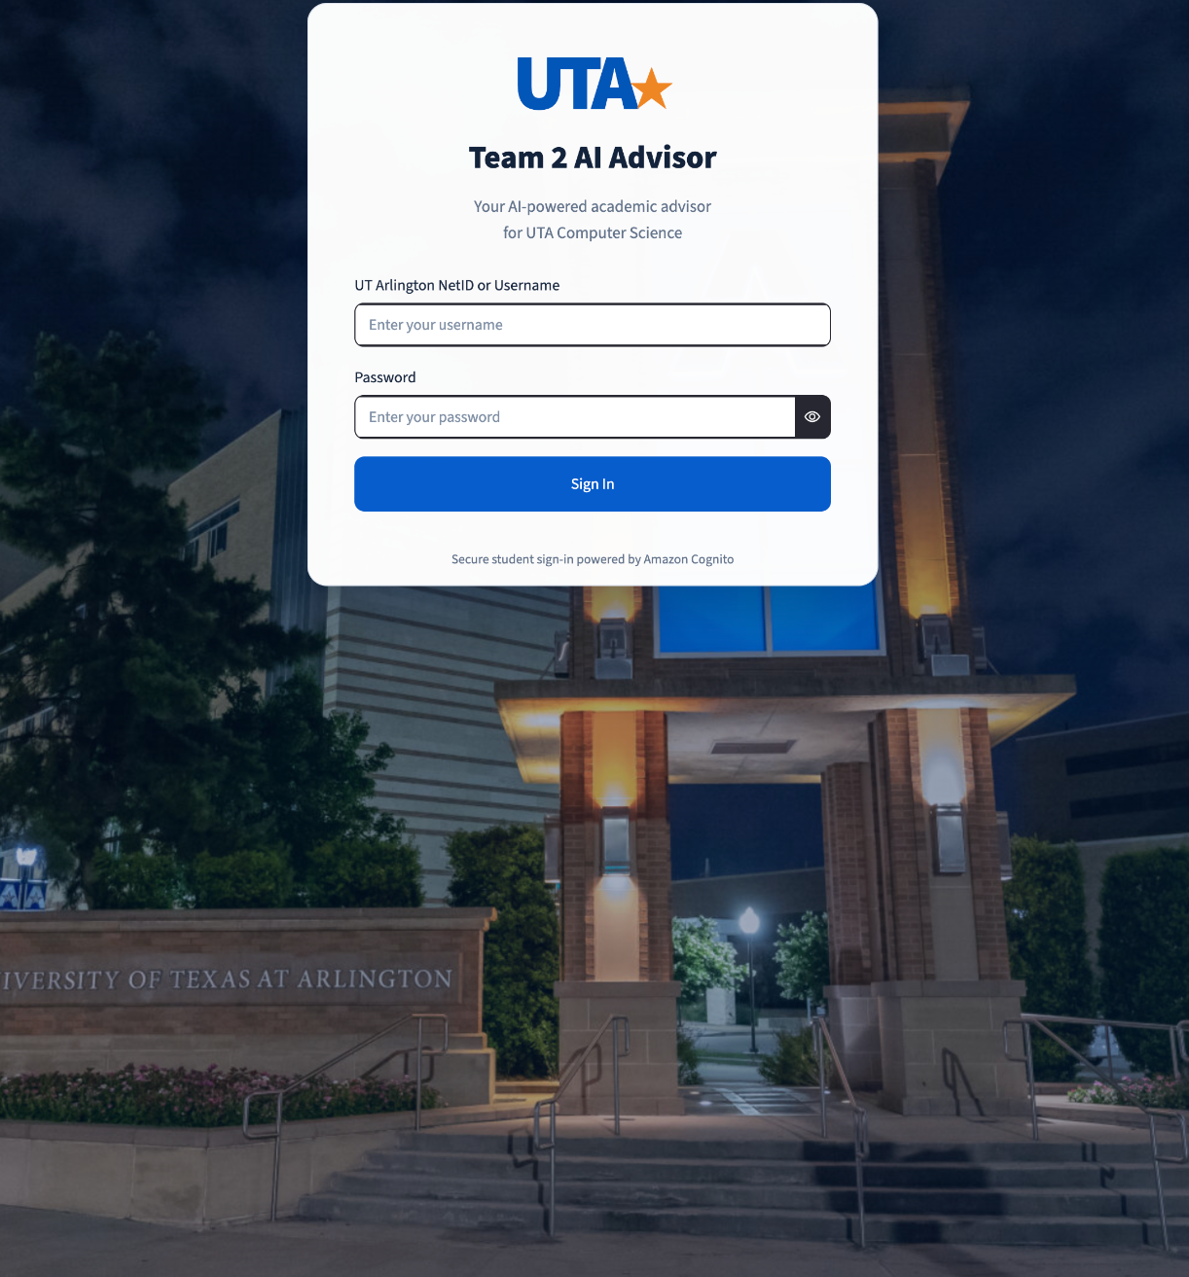
SOFTWARE ENGINEERING WITH GENERATIVE AI
UTA | TEAM 2
AI Academic
Advisor
An AI-powered student advising assistant built with LangChain, Amazon Bedrock, and AWS.
Team: Marvin Wellington • Joseph Fitchett • Ryan Patterson
Sarthak Wadhawan • Emily Ford

Slide 2
UTA • TEAM 2 AI ADVISOR
Overview of Presentation
From the academic advising challenge to our working AWS + LangChain solution
Project overview & requirements
Assumptions & constraints
01
02
Implemented features and student advising use cases
Project data, prerequisite rules, and boundaries
AWS architecture & RAG ingestion
LangChain routing & RAG retrieval
03
04
AWS services, deployment, and document indexing
Six intents, three paths, and router implementation
Structured advising workflows
Response generation & degree planning
05
06
Student records, eligibility, and degree requirements
Prompt instructions and Python advising tools
Testing & live demonstration
Lessons learned & future work
07
08
Fictional students, live demo, and app screenshots
Challenges, improvements, and future work
CSE 4392 / 5320 • TEAM ASSIGNMENT 2

Slide 3
UTA • TEAM 2 AI ADVISOR
Functional Requirements Implemented
How each functional requirement in the assignment is met by our implementation
# | Requirement | How the AI Advisor meets it | Status
1 | User interface | Streamlit web chat UI (prompt-based queries) with Cognito student sign-in | Implemented
2 | Multi-year degree plan | degree_plan route: Python planner builds a semester-by-semester plan from the transcript; summers optional | Implemented
3 | Exact & semantic queries | Exact: DynamoDB records + exact course lookup. Semantic: Titan embeddings + ChromaDB (RAG) | Implemented*
4 | Verify before recommending | Python checks AND / OR prerequisite groups and minimum grades against the transcript | Partial*
5 | Change plan / switch major | Plan follow-ups (e.g. “without summer semesters”) and the compare_plans route | Partial
6 | Conversation state | Chat history sent every turn; older turns summarized by the LLM (LangChain); router and course resolver use it | Implemented
7 | Structured + unstructured data | DynamoDB: students, transcripts, courses, programs. ChromaDB: catalogs and degree requirements | Implemented
8 | Multiple DBMS | DynamoDB (NoSQL) + ChromaDB (vector database); | Implemented
* Class schedule, add/drop queries and schedule-conflict checks (requirement 3 and 4d) are out of scope for this submission per the instructor.
CSE 4392 / 5320 • TEAM ASSIGNMENT 2

Slide 4
UTA • TEAM 2 AI ADVISOR
Assumptions and Constraints
Project assumptions
Operational constraints
• Academic data comes from structured course and program records.
• Students are fictional; records are for demonstration.
• Simplified course-based prerequisite rules.
• Results depend on available validated project data.
• Earlier planned prerequisites are assumed to be passed.
• Class schedules and add/drop questions are out of scope for this submission (instructor guidance).
• Prerequisite groups follow AND / OR logic.
• Minimum grades and completed courses affect eligibility.
• Course records must be validated for project rules.
• Missing or unvalidated rules limit advising conclusions.
• Required prerequisite order and concurrent options.
• Data stores: DynamoDB (NoSQL) and ChromaDB (vectors); no SQL DBMS in this prototype.
• Incomplete plans are reported and not saved.
Scope note: prototype advising support — not an official degree audit, registration, or UTA approval.
CSE 4392 / 5320 • TEAM ASSIGNMENT 2

Slide 5
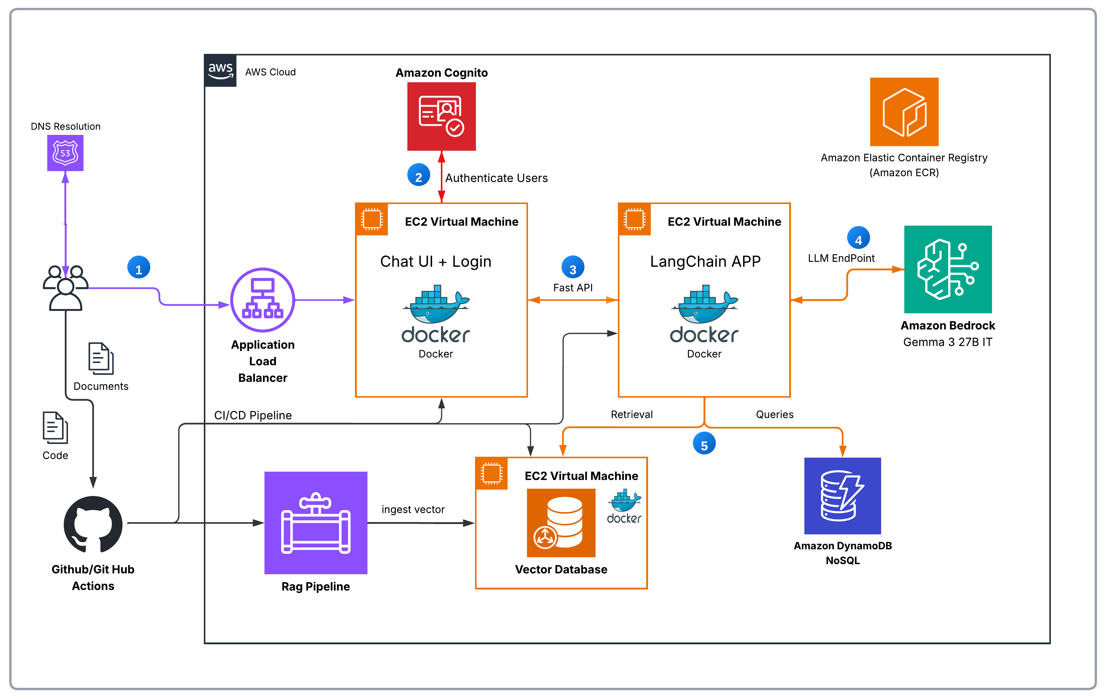
AWS SYSTEM ARCHITECTURE
Containerized application • Secure authentication • AI orchestration and data services
REQUEST FLOW Browser → ALB → Streamlit Chat UI → LangChain API → ChromaDB / DynamoDB / Bedrock

Slide 6
UTA • TEAM 2 AI ADVISOR
Models We Use: Gemma 3 27B IT and Titan Embeddings V2
Both models run on Amazon Bedrock: Gemma reads and writes text, Titan turns text into vectors for search
LLM • google.gemma-3-27b-it
EMBEDDINGS • amazon.titan-embed-text-v2:0
Google Gemma 3 27B IT
Amazon Titan Text Embeddings V2
128K
27 billion parameters, open-weight model from Google
Text and image input, text output; 140+ languages
Called through LangChain ChatBedrockConverse
8,192
Output vector: 1,024 dimensions (512 / 256 also available)
We request normalized vectors for similarity search
Called through LangChain BedrockEmbeddings and boto3
token context window
max input tokens (50,000 chars)
WHAT WE USE IT FOR
WHAT WE USE IT FOR
1 Router: classify each question into a route (temperature 0)
2 RAG answers from retrieved catalog text (temperature 0.2)
3 Explain Python advising results: eligibility, degree plans
4 Summarize older chat history (max 300 output tokens)
1 Ingestion: Lambda embeds each 1,000-character catalog chunk (≈ 210 tokens)
2 Query: embeds the student’s course question to search ChromaDB
3 Same model and dimensions on both sides, so vectors compare
What “-it” means: Instruction-Tuned. Google releases Gemma as PT (pre-trained: only continues text) and IT (further trained on instruction and chat examples to follow directions). Our prompts are instructions (“Return ONLY one route”, “Use ONLY RESULT”), so we use the IT version.
CSE 4392 / 5320 • TEAM ASSIGNMENT 2

Slide 7
UTA • TEAM 2 AI ADVISOR
RAG Pipeline: Document Ingestion & Indexing
Offline / update-time pipeline — prepares searchable knowledge before students ask questions
01
02
03
04
GitHub Repository
→
GitHub Actions
→
Amazon S3
→
AWS Lambda
Team pushes documents to GitHub (PDF, Word, .txt, md, csv, json)
Push triggers workflow to upload academic documents
Stores uploaded source files
S3 event triggers processing and text chunking
05
06
07
AWS Titan Embed v2 (8K)
→
ChromaDB
→
Microsoft Teams
Creates vector embeddings from text chunks
Stores vectors, source text, and metadata
Success notification sent to team chat
Indexed output
Text chunks • 1024-dimensional vectors • source metadata • Teams success alert
CSE 4392 / 5320 • TEAM ASSIGNMENT 2

Slide 8
UTA • TEAM 2 AI ADVISOR
AWS Lambda: LangChain RAG Document Ingestion
Actual code excerpts from our S3-triggered document ingestion Lambda
01
PARSE DOCUMENT
02
CHUNK TEXT
Custom Python extraction
LangChain • RecursiveCharacterTextSplitter
if extension == ".pdf":
reader = PdfReader(io.BytesIO(file_bytes))
return "\n".join(
page.extract_text() or ""
for page in reader.pages
)
CHUNK_SIZE = 1000
CHUNK_OVERLAP = 150
splitter = RecursiveCharacterTextSplitter(
chunk_size=CHUNK_SIZE,
chunk_overlap=CHUNK_OVERLAP,
separators=["\n\n", "\n", ". ", " ", ""]
)
chunks = splitter.split_text(text)
PDF, DOCX, TXT, MD, CSV, JSON
~250 tokens per 1,000 characters (estimate)
03
GENERATE EMBEDDINGS
04
INGEST INTO VECTOR DB
LangChain • BedrockEmbeddings
Custom Python • ChromaDB REST API
embeddings = BedrockEmbeddings(
model_id=EMBEDDING_MODEL_ID,
region_name=AWS_REGION,
client=bedrock,
model_kwargs={
"dimensions": 1024,
"normalize": True
}
)
vectors = embeddings.embed_documents(chunks)
chroma_request("upsert", {
"ids": [chunk_id],
"embeddings": [embedding],
"documents": [text],
"metadatas": [{
"source": source,
"chunk_index": chunk_index,
"document_hash": document_hash
}]
})
Amazon Titan Text Embeddings V2
ChromaDB stores vectors + text + metadata
DynamoDB prevents duplicate ingestion using document hashes, ETags, and processing locks.

Slide 9
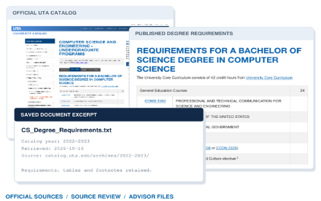

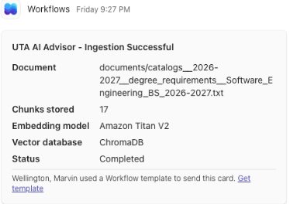
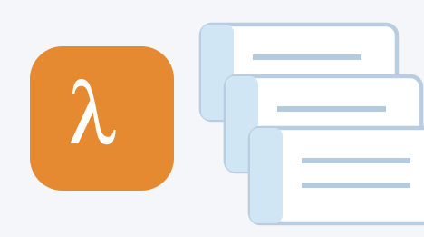


UTA • TEAM 2 AI ADVISOR
RAG Lifecycle: Sourcing, Ingestion & Confirmation
Official academic sources → searchable knowledge → ingestion confirmation
01
02
03
COLLECT & CHECK
TRANSFORM
CONFIRM
Document Retrieval & Sourcing
Document Parsing & Ingestion
Ingestion Confirmation
Documents
Academic source files
↓
Text chunks
AWS Lambda
↓
Embeddings
Collected official UTA catalogs, degree requirements,
Amazon Titan v2
prerequisites, policies and schedules. Checked
DynamoDB tracks document hashes and processing
↓
extracted content against published sources; preserved
status. After ingestion completes, a Teams
references and known limitations.
Vector store
notification reports the document, stored chunk
•
5 catalog years: 2022–2023 through 2026–2027
count, embedding model and vector database.
ChromaDB
•
CS, Computer Engineering and Software Engineering
•
127 files organized for advisor ingestion
Actual Teams ingestion notification
CSE 4392 / 5320 • TEAM ASSIGNMENT 2
Source review: Oct. 16, 2026 • Known limitations retained • Schedules are snapshots

Slide 10
UTA • TEAM 2 AI ADVISOR
LangChain Router: 6 Routes → 3 Processing Paths
The Bedrock LLM classifies the request; Python dispatches to the correct workflow.
Student question → FastAPI
→
LangChain Structure Prompt
with Student Question
→
LLM Selects route
One question → one route → one workflow
↓
↓
↓
PATH A | RAG
PATH B | STRUCTURED ADVISING
PATH C | FALLBACK
course_information
student_record
course_eligibility
degree_plan
compare_plans
unsupported
Titan Embeddings → ChromaDB
→ Retrieved catalog context
DynamoDB → Python advisor tools
→ Validation / planning
Safe response explaining
what the advisor cannot do
KEY POINT • Six route labels do not require six separate LLMs or AWS services.
CSE 4392 / 5320 • TEAM ASSIGNMENT 2

Slide 11
UTA • TEAM 2 AI ADVISOR
LangChain: LLM Intent Classification
Prompt template → Bedrock LLM → Output parser → Selected route
01 ROUTER PROMPT • ChatPromptTemplate
SIX POSSIBLE ROUTES
router_prompt = ChatPromptTemplate.from_messages([
("system", """You are the request router for
the UTA AI Advisor.
Classify the student's question into
exactly one route.
Conversation history: {history}
Available Routes.....
Return ONLY one exact route value.
Do not answer the student's question."""),
("human", "{question}")
])
course_information (vector search)
student_record (dynamoDB)
course_eligibility (dynamo + Python)
degree_plan (dynamo + Python)
compare_plans (dynamo + Python)
Unsupported (fallback response)
02 LANGCHAIN PIPELINE
03 INVOKE THE CHAIN
router_chain = (router_prompt | router_llm | StrOutputParser())
decision = router_chain.invoke({
"question": question,
"history": history_text
})
The LLM classifies intent only; Python dispatches the selected advising workflow.

Slide 12
UTA • TEAM 2 AI ADVISOR
Path A: RAG / Vector Search Retrieval
LangChain first routes the question; course-information requests enter the RAG pipeline
1
2
3
4
5
6
Question
LLM routing
Embed query
Vector search
Prompt assembly
LLM response
  →
→
→
→
→
“What is CSE 4308 about?”
Bedrock classifies question → course_information
Titan Embed v2 converts question to vector
ChromaDB provides relevant document chunks
LangChain combines question + context
Bedrock Gemma generates grounded answer
Routing decision: only course_information uses RAG; other routes use their own advising workflows.
CSE 4392 / 5320 • TEAM ASSIGNMENT 2

Slide 13
UTA • TEAM 2 AI ADVISOR
Path A: Retrieving Context from ChromaDB with LangChain
Course questions use a LangChain Chroma retriever over our 6,269 indexed catalog chunks
ACTUAL CODE • app/rag.py (simplified excerpt)
HOW RETRIEVAL WORKS
# Same Titan V2 settings as the ingestion Lambda
embeddings = BedrockEmbeddings(
model_id="amazon.titan-embed-text-v2:0",
model_kwargs={"dimensions": 1024, "normalize": True})
# LangChain vector store over the existing ChromaDB collection
vector_store = Chroma(
client=chromadb.HttpClient(host=chroma_host, port=chroma_port),
collection_name="uta_ai_advisor",
embedding_function=embeddings)
retriever = vector_store.as_retriever(search_kwargs={"k": 4})
def answer_course_question(question):
docs = retriever.invoke(question) # 4 nearest chunks
exact = exact_course_records(question) # exact course lookup
context = "\n\n---\n\n".join(
[describe_course(c) for c in exact] +
[f"Source: {d.metadata['source']}\n{d.page_content}"
for d in docs])
return answer_chain.invoke({"question": question,
"context": context})
1
Embed the question
BedrockEmbeddings turns it into a 1,024-number Titan V2 vector.
2
Search ChromaDB
The retriever returns the 4 closest chunks with their source files.
3
Add exact course records
Named codes are fetched exactly, so CSE 3318 is never confused with CSE 3315.
4
Grounded answer
prompt | Gemma | parser answers only from this context and returns the sources.
CSE 4392 / 5320 • TEAM ASSIGNMENT 2

Slide 14
UTA • TEAM 2 AI ADVISOR
Path B: Student Academic Record Retrieval
LangChain routes student-record questions to authenticated academic data retrieval
1
2
3
Advisor
tool
4
Advisor
tool
5
Advisor
tool
6
Question
LLM routing
Student identity
Student record
Record summary
LLM response
→
→
→
→
→
“What courses have I taken?”
Bedrock classifies question →
student_record
Cognito identifies the authenticated student
Query DynamoDB for completed courses, grades & credits
Python organizes records and calculates totals from available data
Bedrock explains the student’s courses, grades & credits
Routing decision: student_record → verified student identity → DynamoDB → organized academic records → explained result.
CSE 4392 / 5320 • TEAM ASSIGNMENT 2

Slide 15
UTA • TEAM 2 AI ADVISOR
Path B: Student Course Eligibility
LangChain routes student-specific questions to structured academic rule checks
1
2
3
Advisor
tool
4
Advisor
tool
5
Advisor
tool
6
Question
LLM routing
Student record
Prerequisites
Eligibility check
LLM response
→
→
→
→
→
“Can I take CSE
4308?”
Bedrock classifies
question →
course_eligibility
Query DynamoDB for
completed courses,
grades & credits
Query DynamoDB for
CSE 4308 prerequisites
and course rules
Python validates grades and prerequisites using Dynamodb records
Bedrock explains
Eligible / Not eligible
and the reason
Routing decision: course_eligibility → structured student data + Python rule validation → explained result.
CSE 4392 / 5320 • TEAM ASSIGNMENT 2

Slide 16
UTA • TEAM 2 AI ADVISOR
Path B: Personalized Degree Plan Generation
LangChain routes degree-plan requests to student records and degree requirement analysis
1
2
3
Advisor
tool
4
Advisor
tool
5
Advisor
tool
6
Question
LLM routing
Student record
Degree requirements
Requirement analysis
LLM response
→
→
→
→
→
“Generate my
degree plan.”
Bedrock classifies
question →
degree_plan
Query DynamoDB for
completed courses,
grades & program
Query DynamoDB for
required courses,
credits & prerequisites
Compare completed
courses against
degree requirements
Bedrock explains
remaining courses &
degree requirements
Routing decision: degree_plan → student data + degree rules → remaining requirements → explained result.
CSE 4392 / 5320 • TEAM ASSIGNMENT 2

Slide 17
UTA • TEAM 2 AI ADVISOR
LangChain: Natural Language Response Generation
The response prompt guides Bedrock to explain verified advising results in student-friendly language.
SYSTEM INSTRUCTIONS
Explain clearly • Use supplied evidence • Do not invent requirements
ChatPromptTemplate
Amazon Bedrock
→
→
ACADEMIC CONTEXT
Combines instructions, context, and the student question
Gemma generates a clear, grounded explanation
Retrieved catalog passages or validated advising-tool results
STUDENT QUESTION
“Can I take CSE 4308?”
EXAMPLE STUDENT-FACING RESPONSE
“Based on your academic record, you have not yet met all prerequisites for CSE 4308. Here is the requirement you still need to complete…”
CSE 4392 / 5320 • TEAM ASSIGNMENT 2

Slide 18
UTA • TEAM 2 AI ADVISOR
LangChain: Prompt Instructions for Student Responses
The response prompt controls how Bedrock explains validated results in natural language.
ACTUAL CODE • SELECTED EXCERPTS
HOW THE PROMPT IS STRUCTURED
phrase_prompt = ChatPromptTemplate.from_messages([
("system", """You are the UTA AI Advisor
talking with {student_name}.
Explain RESULT in response to the student's
question. Use ONLY information in RESULT.
GENERAL RULES:
- Speak directly to the student.
- Keep answers short, clear, professional.
- Never invent courses, grades, or credits.
COURSE ELIGIBILITY:
- Python eligibility calculations are authoritative.
- Never recalculate or override results.
DEGREE PLANNING:
- If complete is false, state plan is incomplete.
RESULT: {result}"""),
("human", "{question}"),
])
1 Role & personalization
UTA AI Advisor → {student_name}
2 Grounding
Use ONLY the supplied {result}
3 Communication rules
Short, professional, direct answers
4 Domain safeguards
Respect Python eligibility; preserve AND/OR
5 Answer formatting
Explain degree-plan gaps; no invented facts
6 Student request
Human message → {question}
KEY POINT • The LLM explains the tool result; it does not override academic validation.

Slide 19
UTA • TEAM 2 AI ADVISOR
LangChain: Summarizing Chat History with the LLM
A LangChain chain condenses older turns so the router gets a short summary plus the newest messages
ACTUAL CODE • app/memory.py (simplified excerpt)
HOW IT WORKS
summary_prompt = ChatPromptTemplate.from_messages([
("system", """You compress a conversation between a
UTA student and the UTA AI Advisor. Keep course codes,
eligibility results and the student's preferences.
Do not add any fact that is not in the conversation."""),
("human", "Conversation to summarize:\n{transcript}")
])
# Gemma 3 27B on Amazon Bedrock, temperature=0
summary_chain = summary_prompt | summary_llm | StrOutputParser()
def compact_history(history):
older_count = ((len(history) - KEEP_RECENT) // BLOCK) * BLOCK
if older_count <= 0:
return history # short chat: unchanged
older, recent = history[:older_count], history[older_count:]
summary = summary_chain.invoke({"transcript": _format(older)})
return [{"role": "summary", "content": summary}] + recent
1
Short chat
Under 8 messages, the history goes to the router unchanged.
2
Older turns → LLM summary
prompt | Gemma | parser condenses them into at most 6 bullets.
3
Newest turns kept word for word
The last 4–7 messages keep full detail for follow-ups.
4
Smaller router prompt
Cached summary, about one LLM call every 2 turns; on error, recent turns are used.
CSE 4392 / 5320 • TEAM ASSIGNMENT 2

Slide 20
UTA • TEAM 2 AI ADVISOR
DynamoDB: Student & Academic Data Structure
Structured records used by Python Advisor Tools for personalized advising
STUDENT PROFILE
ACADEMIC RECORD
COURSE REQUIREMENTS
DEGREE REQUIREMENTS
student_id • program / major
student_name • catalog year
student_id • course_code
grade • credits • term
course_code • credit_hours
prerequisite groups • min_grade
program • required_courses
credit requirements • electives
Authenticated student context
Completed courses and transcript
Eligibility rules and course metadata
Remaining-degree analysis
LangChain selects route → Python Advisor Tools query DynamoDB → Bedrock explains results
CSE 4392 / 5320 • TEAM ASSIGNMENT 2

Slide 21
UTA • TEAM 2 AI ADVISOR
Eight Fictional Student Test Profiles
Transcript-based test cases for eligibility checks and personalized degree planning
STUDENT ID
STUDENT
USERNAME
PROGRAM
CREDITS
TEST SCENARIO
1002000101
Emily Johnson
emily1234
BS-CS
0
New freshman; no completed courses
1002000102
Michael Smith
michael1234
BS-CS
17
Sophomore progressing normally
1002000103
Sarah Williams
sarah1234
BS-CS
35
Junior with strong grades
1002000104
James Brown
james1234
BS-CS
13*
Low grade (D) blocks prerequisites
1002000105
Jessica Davis
jessica1234
BS-SE
47
Senior; design II and elective remain
1002000106
David Miller
david1234
BS-CS
32
Failed, retook, and withdrew
1002000107
Sofia Martinez
sofia1234
BS-SE
17
Changed major from CS to SE
1002000108
Daniel Taylor
daniel1234
BS-CS
16
Part-time, including summer courses
Credits estimated from transcript courses (3 credits each; MATH 1426 / 2425 = 4). F and W excluded; retakes counted once. *James includes a D (3 credits), which does not satisfy C-minimum prerequisites.
CSE 4392 / 5320 • TEAM ASSIGNMENT 2

Slide 22
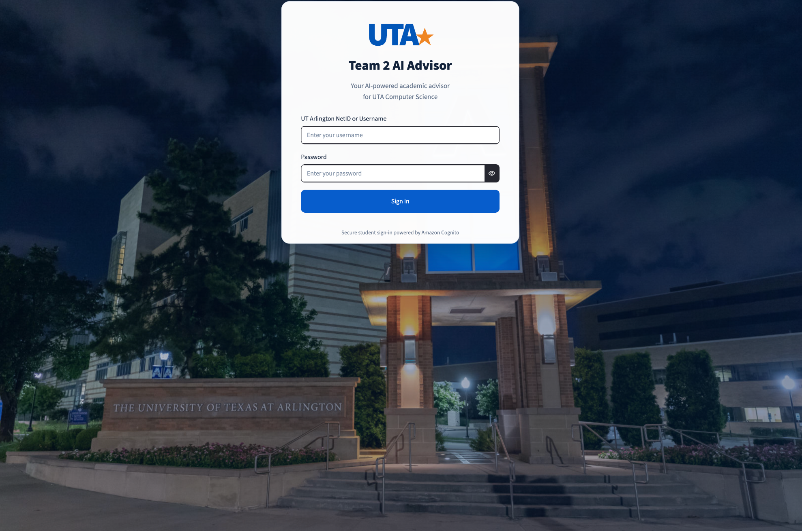
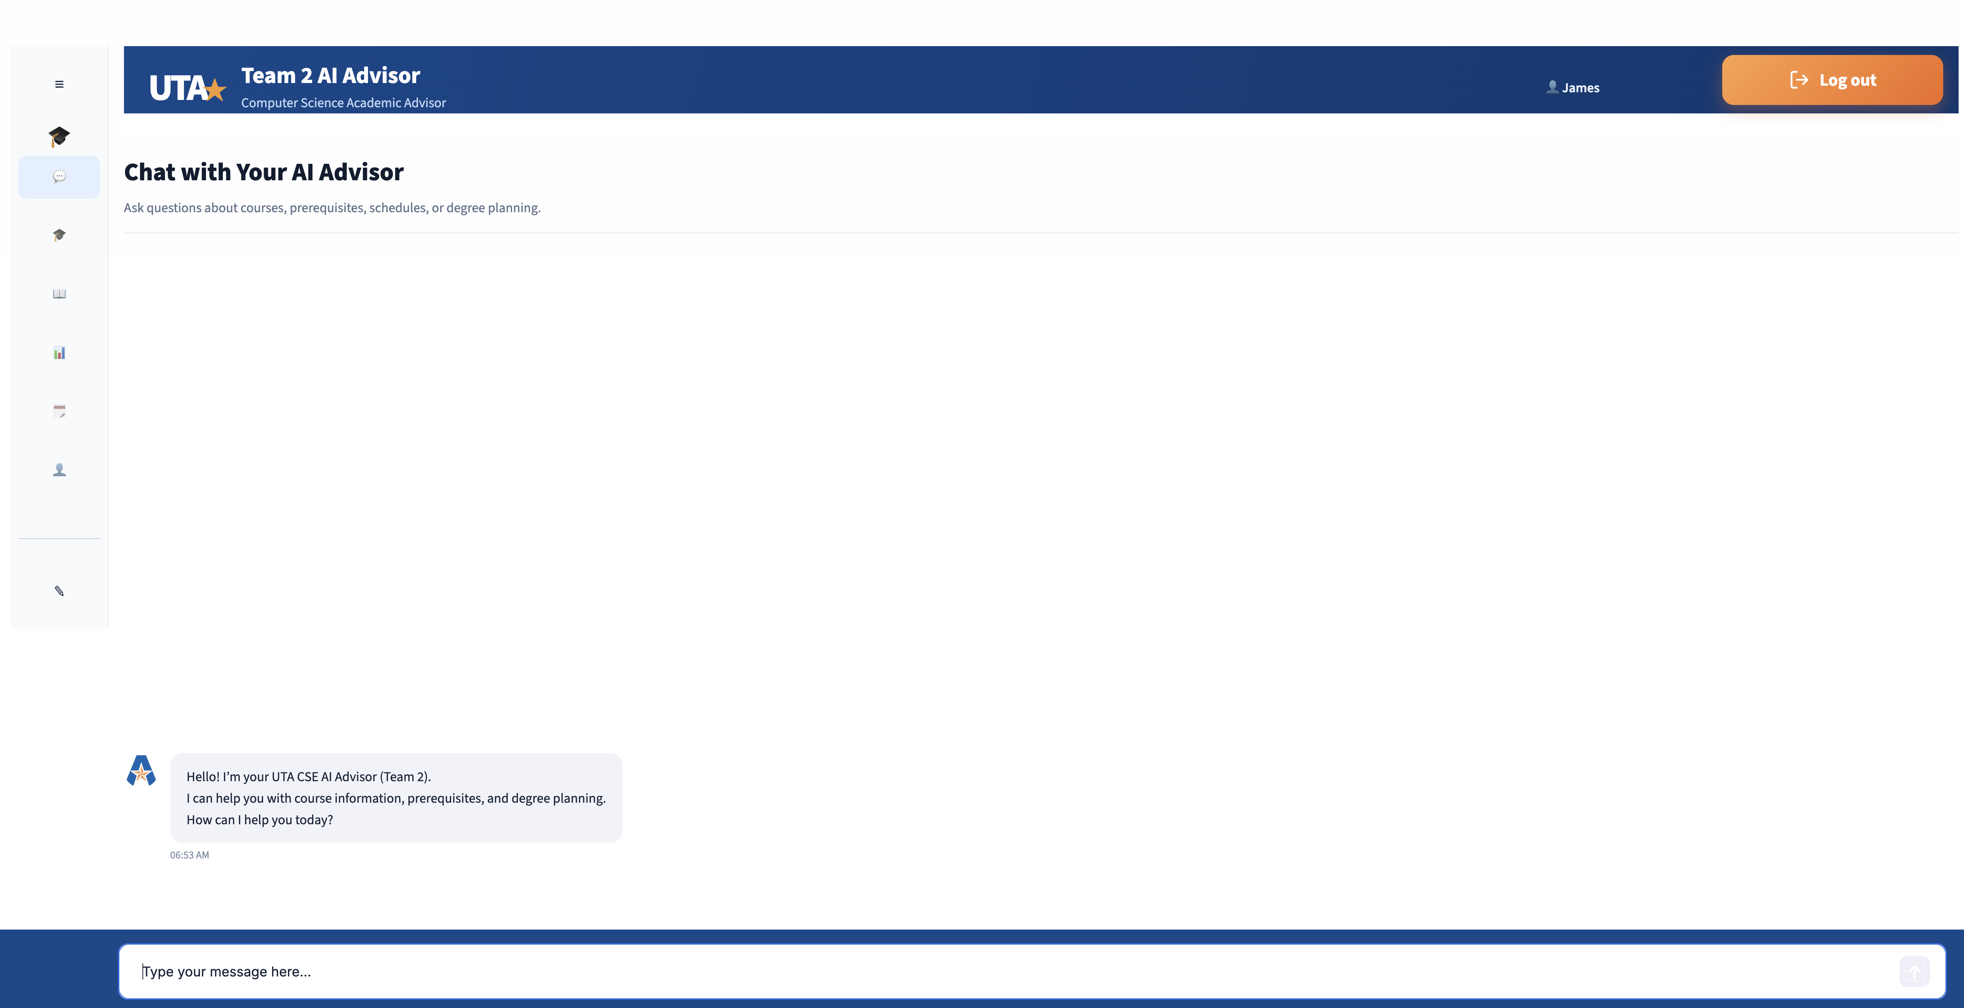
UTA • TEAM 2 AI ADVISOR
Application Screenshots
SECURE SIGN-IN
STUDENT CHAT EXPERIENCE
Cognito-backed student login screen
Course, prerequisite and degree-planning requests
CSE 4392 / 5320 • TEAM ASSIGNMENT 2

Slide 23
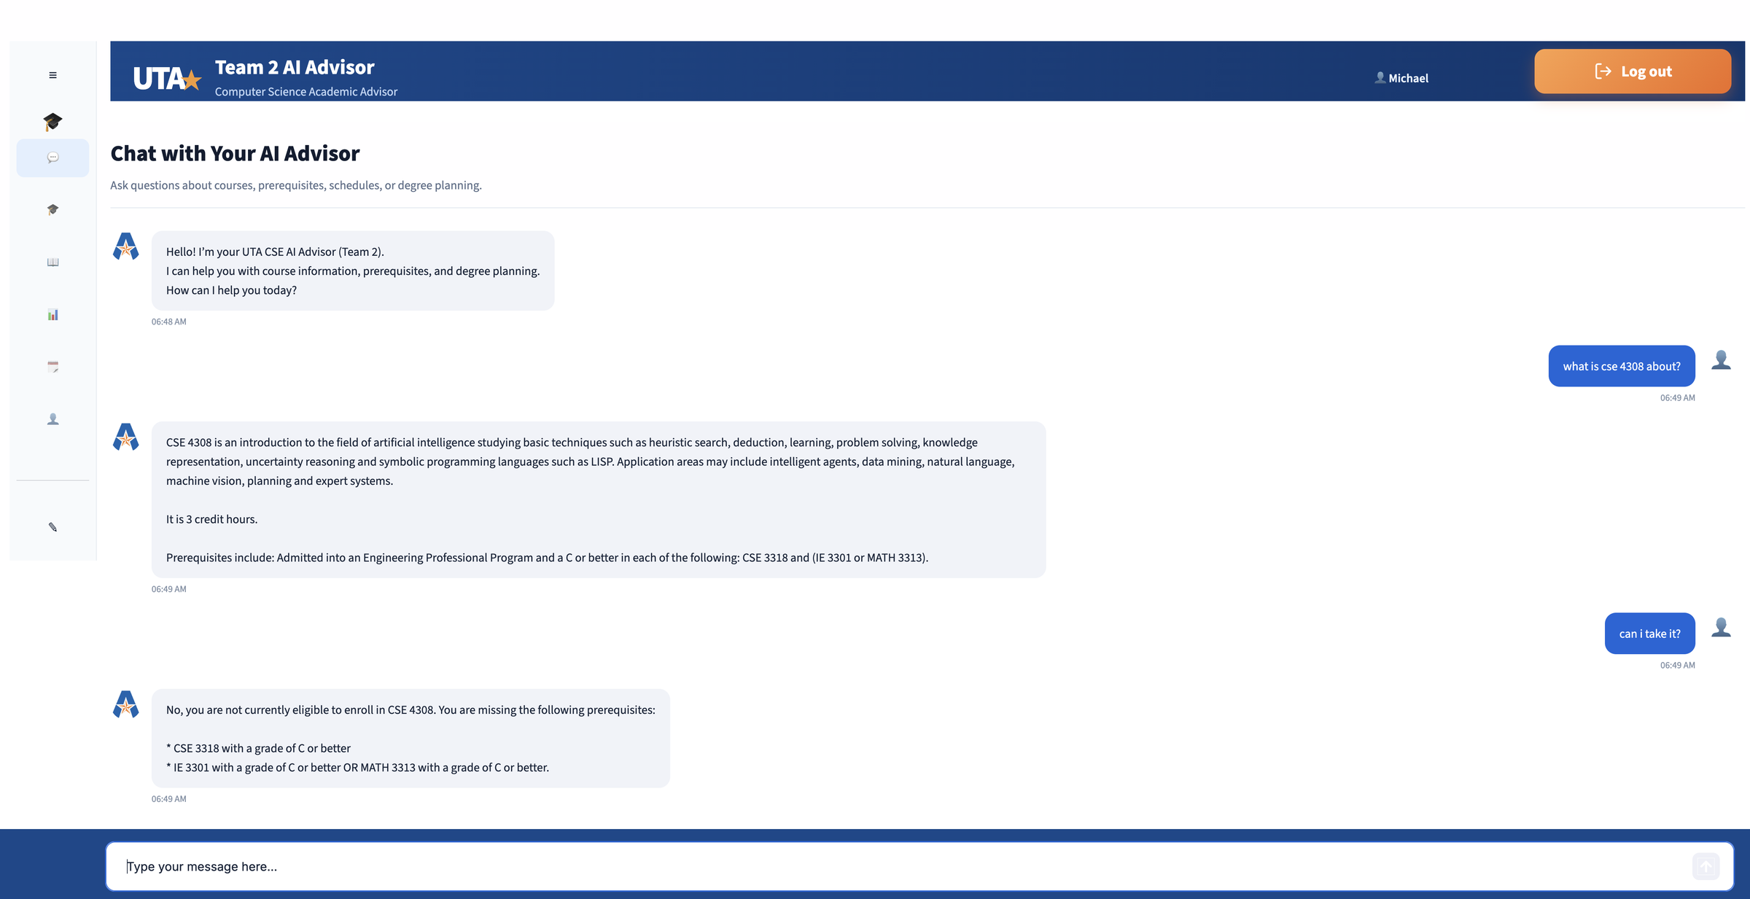
UTA • TEAM 2 AI ADVISOR
Demo: Course Question and Follow-Up Eligibility
INPUT 1
“what is cse 4308 about?”
OUTPUT 1
Course description, 3 credit hours and catalog prerequisites, retrieved with RAG.
INPUT 2
“can i take it?” (no course named)
OUTPUT 2
“it” resolved to CSE 4308 from history. Python checked the transcript: not eligible, missing CSE 3318 and IE 3301 or MATH 3313 (C or better).
Logged in as Michael Smith (michael1234): BS-CS sophomore test profile, 17 credits completed
Shows requirements 3, 4(a) and 6
CSE 4392 / 5320 • TEAM ASSIGNMENT 2

Slide 24
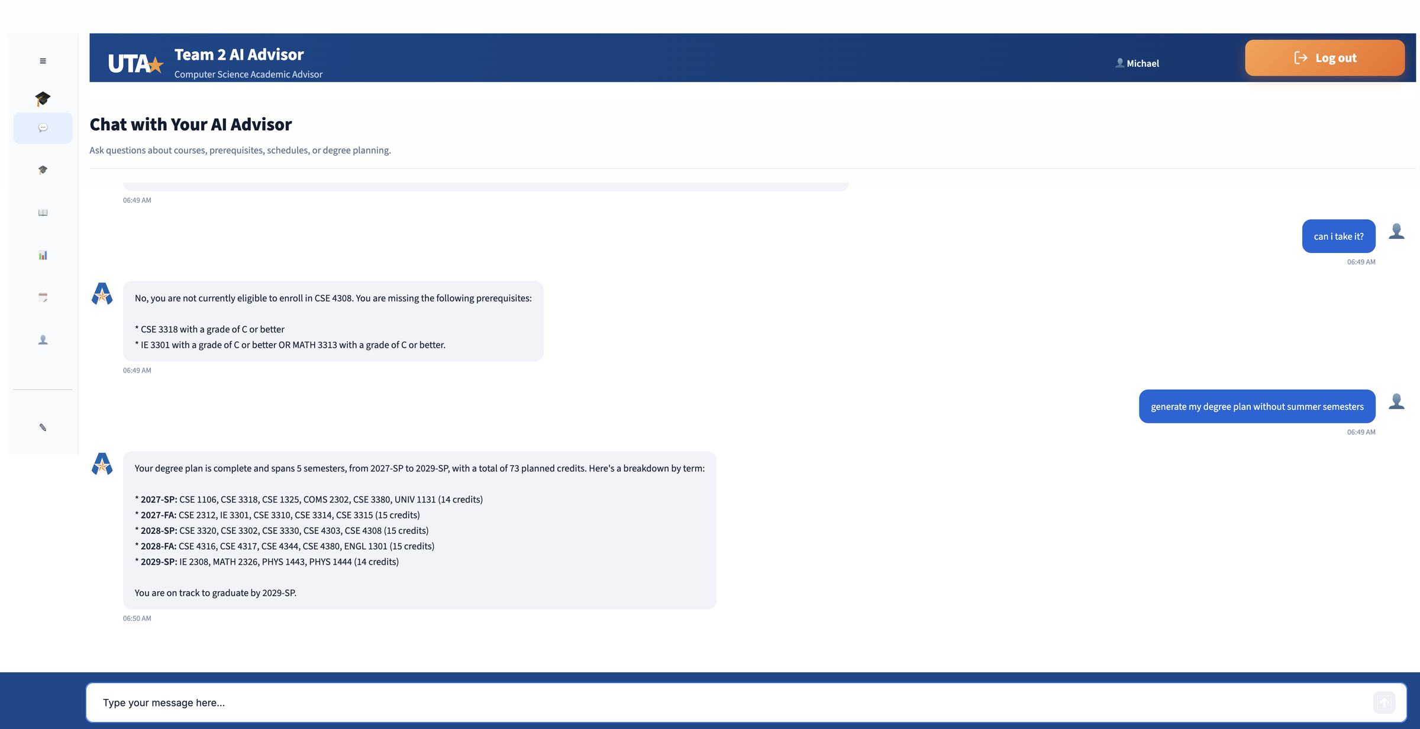
UTA • TEAM 2 AI ADVISOR
Demo: Degree Plan Generation
INPUT
“generate my degree plan without summer semesters”
OUTPUT
A complete plan: 5 semesters, 2027-SP to 2029-SP, 73 credits.
WHAT IT SHOWS
Fall and spring terms only, as the student asked. At most 15 credits per term. Prerequisites come first (CSE 3318 before CSE 4308). Built from Michael’s transcript.
Logged in as Michael Smith (michael1234): BS-CS sophomore test profile, 17 credits completed
Shows requirements 2 and 4(a)
CSE 4392 / 5320 • TEAM ASSIGNMENT 2

Slide 25
UTA • TEAM 2 AI ADVISOR
TEAM 2 AI ADVISOR
LIVE DEMO
CSE 4392 / 5320 • TEAM ASSIGNMENT 2

Slide 26
UTA • TEAM 2 AI ADVISOR
Lessons Learned
What we learned
Challenges & improvements
• LLMs interpret student questions; Python enforces academic rules.
• Prerequisite text must be translated into accurate, validated rules.
• DynamoDB provides catalog-year-specific courses, programs and transcripts.
• Concurrent prerequisites and section conflicts require careful checks.
• RAG retrieves supporting catalog text instead of relying on model memory.
• Missing or unvalidated catalog data can prevent complete degree plans.
• Modular AWS services simplify testing, deployment and troubleshooting.
• Diverse student scenarios reveal edge cases before real-world use.
CSE 4392 / 5320 • TEAM ASSIGNMENT 2

Slide 27
UTA • TEAM 2 AI ADVISOR
Conclusions and Future Work
An integrated AI advising prototype
Natural-language interaction + retrieval + academic rules + cloud deployment
Achievements
Next steps
• Working student login and chat interface
• RAG-based course information
• Prerequisite checks and degree-plan generation
• Expand validated catalog and technical electives
• Improve schedule optimization and plan visualization
• Add deeper testing and academic-policy coverage
THANK YOU • QUESTIONS?
CSE 4392 / 5320 • TEAM ASSIGNMENT 2

