Slide 1
Software Design Patterns
- The Agile Unified Methodology

Slide 2
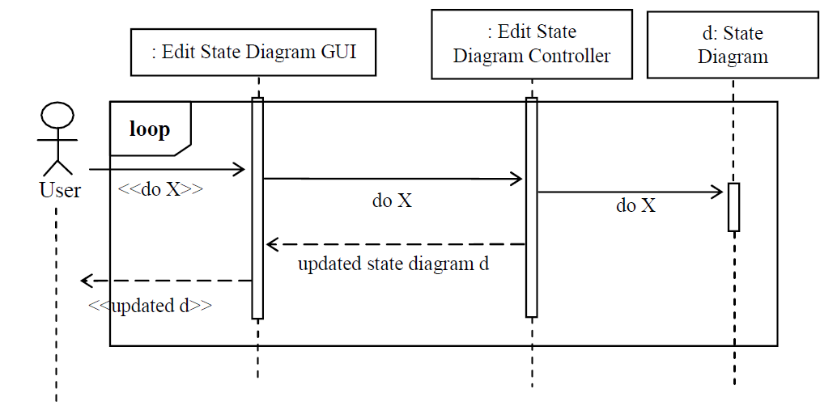

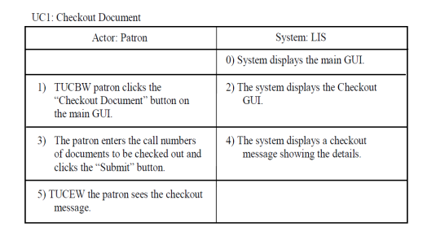
Actor-System Interaction & Object Interaction
Actor-system interaction
Object interaction
Foreground processing of a use case.
Background processing of a use case by objects.
Acquiring actor input and actor action.
High-level algorithms to process actor requests.
Displaying system responses.
Producing system responses.
Copyright © The McGraw-Hill Companies, Inc.

Slide 3
Object Interaction Modeling
OIM specifies how objects interact with each other to carry out the background processing of a business process.
Object interaction modeling is aided by the specification of scenarios and scenario tables.
A scenario is an informal, step-by-step description of object interaction.
A scenario table organizes the interaction into a five column table - it facilitates translation to a sequence diagram.
Copyright © The McGraw-Hill Companies, Inc.

Slide 4
Steps for Object Interaction Modeling
For each expanded use case do the following:
  Step 1. Identify and mark nontrivial steps in the right column of the expanded use case.
  A nontrivial step is one that requires background processing.
  It goes beyond the presentation layer (i.e., the Graphical User Interface or GUI).
  Step 2. For each nontrivial step, produce a scenario to describe:
  How objects interact to process the actor request.
  Begin with the step on the left column of the nontrivial step.
  Step 3. Convert the scenario into a scenario table, if desired.
  Step 4. Convert the scenarios or scenario table into a sequence diagram.
Copyright © The McGraw-Hill Companies, Inc.

Slide 5
How to Identify a Nontrivial Step?
If the step does not require background processing, then it is a trivial step.
If the system response simply displays a menu, or input dialog, then it is a trivial step.
If the step displays the same system response for all actors, then it is a trivial step.
If the system response is different for different actors, then it is a nontrivial step.
Copyright © The McGraw-Hill Companies, Inc.

Slide 6
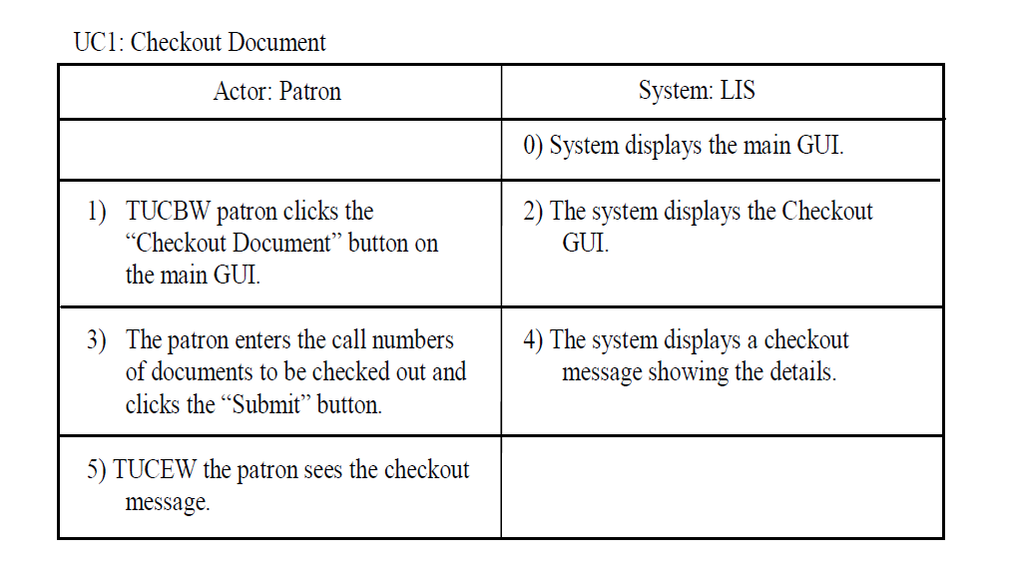
Example
*
nontrivial
step
Copyright © The McGraw-Hill Companies, Inc.

Slide 7
Scenarios
Each sentence of the scenario is a declarative sentence consisting of (third person, simple present tense)
  a subject,
  an action of the subject,
  an object that is acted upon, and
  possibly/optionally other objects/data required by the action.
The sentences are arranged in a scenario table to
  facilitate scenario description and
  facilitate translation into a sequence diagram
Copyright © The McGraw-Hill Companies, Inc.

Slide 8
Class Exercise
Write a scenario for the nontrivial step of the Checkout Document expanded use case.
Begin with 3)
End with 4)
Copyright © The McGraw-Hill Companies, Inc.

Slide 9
How to Write a Scenario
3) Patron enters the call numbers of documents to be
checked out and clicks the Submit button (on GUI).
4.1) ?
4.2) ?
…
4.x) The system displays a checkout message showing
the document details.
First, list the tasks needed to produce the output from the input.
Second, arrange the tasks in a chronological order.
Next, determine who initiates and who performs each task.
Finally, convert each task into a scenario sentence.
Copyright © The McGraw-Hill Companies, Inc.

Slide 10
Checkout Document Scenario Description
3) The patron enters the call numbers of documents to be checked out and clicks the Submit button.
4.1) Checkout GUI checks out the documents with the checkout controller using the document call numbers.
4.2) The checkout controller gets the documents from the database manager (DBMgr) using the document call numbers.
4.3) DBMgr returns the documents to the checkout controller.
4.4) The checkout controller returns checkout confirmation msg to Checkout GUI.
4.5) Checkout GUI displays msg to patron.
Copyright © The McGraw-Hill Companies, Inc.

Slide 11
Convert to Scenario Table
Using Microsoft Word, insert a tab between each of the following:
  the line number and the subject
  the subject and the subject action
  the subject action and the optional data or object required by the subject action
  the optional data or object and the object acted upon.
Select all of the scenario texts.
Click Insert→Table→Convert Texts to Table, and select separate text at tabs, then click OK.
Make minor changes to the scenario table if needed.
Copyright © The McGraw-Hill Companies, Inc.

Slide 12
Convert to Scenario Table
3) | The patron | enters | the call numbers of documents to be checked out | and clicks the Submit button.
4.1) | Checkout GUI | checks out the documents with the | checkout controller | using the document call numbers.
4.2) | The checkout controller gets | the documents from | the database manager (DBMgr) | using the document call numbers.
4.3) | DBMgr | returns | the documents to | the checkout controller.
4.4) | The checkout controller | returns | checkout confirmation msg | Checkout GUI.
4.5) | Checkout GUI | displays | msg to | patron.
Copyright © The McGraw-Hill Companies, Inc.

Slide 13
Final Scenario Table
3) | The patron | enters | call numbers | Checkout GUI
4.1) | Checkout GUI | checks out documents | call numbers | checkout controller
4.2) | Checkout controller | gets documents | call numbers | database manager (DBMgr)
4.3) | DBMgr | returns documents |  | checkout controller
4.4) | Checkout controller | returns | checkout msg | Checkout GUI
4.5) | Checkout GUI | displays | msg | patron
Copyright © The McGraw-Hill Companies, Inc.

Slide 14
Scenario Description
3) The patron enters the call numbers of documents to be checked out and clicks the Submit button.
4.1) Checkout GUI checks out the documents with the checkout controller using the document call numbers.
4.2) Checkout controller creates a blank msg.
4.3) For each document call number,
4.3.1) The checkout controller gets the document from the database manager (DBMgr) using the document call number.
4.3.2) DBMgr returns the document d to the checkout controller.
4.3.3) If the document exists (i.e., d!=null)
4.3.3.1) the checkout controller checks if the document is available (for check out).
4.3.3.2) If the document is available for check out,
4.3.3.2.1) the checkout controller creates a Loan object using patron p and document d,
4.3.3.2.2) the checkout controller sets document d to not available,
4.3.3.2.3) the checkout controller saves the Loan object with DBMgr,
4.3.3.2.4) the checkout controller saves document d with the DBMgr,
4.3.3.4.5) the checkout controller writes “checkout successful” to msg.
4.3.3.3) else,
4.3.3.3.1) the checkout controller writes “document not available” to msg.
4.3.4) else
4.3.4.1) the checkout controller writes “document not found” to msg.
4.4) The checkout controller returns msg to Checkout GUI.
4.5) Checkout GUI displays msg to patron.
Could be simplified, e.g.,
reducing the number of steps.
Copyright © The McGraw-Hill Companies, Inc.

Slide 15
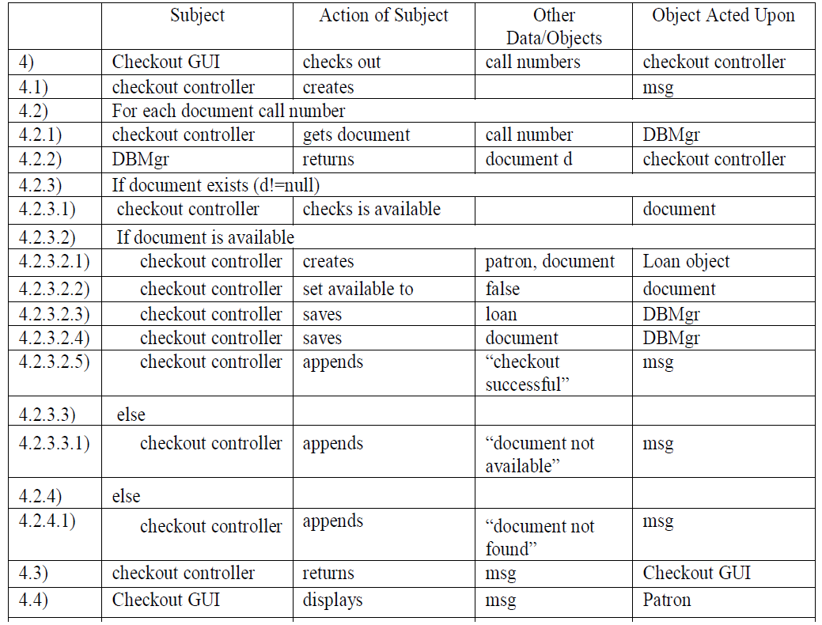
(Message)
Could be simplified, e.g.,
reducing the number of steps.
Copyright © The McGraw-Hill Companies, Inc.

Slide 16
Guidelines for Scenario Construction
Specify the normal scenario first (i.e., assume everything will go as expected).
If needed, augment the normal scenario with alternative flows.
Keep it simple and stupid --- leave details to coding.
Leave exception handling to coding.
It is sometimes desirable to construct a prototype to validate design idea.
Copyright © The McGraw-Hill Companies, Inc.

Slide 17
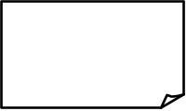
From Scenario Table to Sequence Diagram
:object acted upon
for each line of the scenario table:
Case 1: subject is an Actor.
action + other
objects/data
object
acted upon
Actor
Copy this template sequence diagram.
Example:
:Checkout GUI
Then paste and edit, that is, substitute the generic texts with app-specific terms.
<<enter call numbers>>
Patron
Copyright © The McGraw-Hill Companies, Inc.

Slide 18
From Scenario Table to Sequence Diagram
object:
Case 2: subject is an object and object acted upon is an actor.
<<message>>
actor
:Checkout GUI
<<display msg>>
Patron
Copyright © The McGraw-Hill Companies, Inc.

Slide 19

From Scenario Table to Sequence Diagram
: Subject
:object acted upon
Case 3: both subject and object acted upon are objects.
action + other
objects/data
action
performing
:Checkout GUI
:Checkout Controller
action
performing
Checkout Documents call numbers
Copyright © The McGraw-Hill Companies, Inc.

Slide 20
From Scenario Table to Sequence Diagram
Case 4: both subject and object acted upon are the same (a special case of case 3).
object1:
action + data / objects
return value if any
Other Data/ Objects
Object Acted Upon
Subject
Subject Action
shipment
compute base rate
shipment
shipment:
compute base rate
Copyright © The McGraw-Hill Companies, Inc.

Slide 21
3) | The patron | enters | call numbers | Checkout GUI
4.1) | Checkout GUI | checks out documents | call numbers | checkout controller
4.2) | Checkout controller | gets documents | call numbers | database manager (DBMgr)
4.3) | DBMgr | returns documents |  | checkout controller
4.4) | Checkout controller | returns | checkout msg | Checkout GUI
4.5) | Checkout GUI | displays | msg | patron
: Checkout GUI
:Checkout Controller
3)
:DBMgr
4.1)
4.2)
<<enter call numbers>>
checkout doc call numbers
Patron
get doc call numbers
4.5)
4.4)
checkout msg
documents
<< msg >>
4.3)
Copyright © The McGraw-Hill Companies, Inc.

Slide 22
Difference of Analysis and Design
Analysis
application problem-oriented
models application domain
describes what the world is
project-oriented decisions
should allow design alternatives
Design
software solution-oriented
models the software system
prescribes a software solution
system-oriented decisions
usually reduces implementation choices
Copyright © The McGraw-Hill Companies, Inc.

Slide 23
Modeling a Manual Library System
Patron presents id card to librarian.
:Librarian
These are analysis sequence diagrams that model an existing system.
<<id card>>
Patron
Librarian pulls out patron’s folder using id number.
:Librain
:PatronFolders
<<uid, pass-word>>
get folder using patron id
patron folder
Patron
Copyright © The McGraw-Hill Companies, Inc.

Slide 24

Analysis/Informal Sequence Diagram
info exchange b/t actor and object
:LoginGui
an object of LoginGui class
<<uid, password>>
the object is processing the request.
Patron
Patron submits uid and password
to LoginGui.
:LoginGui
:LoginController
<<uid, pass-word>>
verify uid and password
LoginGui calls LoginController to
verify the login. The controller returns a msg indicating result of verification. LoginGui shows msg to Patron.
<<msg>>
<<msg>>
Patron
Copyright © The McGraw-Hill Companies, Inc.

Slide 25

From Informal SD to Design SD
:LoginGui
:LoginController
<<uid, pass-word>>
LoginGui calls LoginController to
verify the login. The controller returns a msg indicating result of verification. LoginGui shows msg to Patron.
verify uid and password
<<msg>>
<<msg>>
Patron
:LoginGui
:LoginController
<<uid, pass-word>>
msg := verify (uid:String, password: Password) : String
Patron
<<msg>>
return value
function call
parameter & type
return type
Copyright © The McGraw-Hill Companies, Inc.

Slide 26
Sequence Diagram: Flow of Control
:LoginGui
:LoginController
1
2
<<uid, pass-word>>
msg := verify (uid:String, password: Password) : String
<<msg>>
Patron
3
(1) Patron submits uid and password to LoginGui object.
(2) LoginGui object calls the verify function of a LoginController object. The called function returns msg of type String.
(3) The LoginGui object shows msg to patron.
Copyright © The McGraw-Hill Companies, Inc.

Slide 27

Analysis Sequence Diagram: Manual Library
real world object within the library system
collection
:Librarian
:Patron Folder
book:Book
f:Patron Folder
id card, book
get patron folder w/id
patron
patron folder f
[patron folder not found] error msg, id card
outside
library
system
[patron folder found] get book card
book card
[patron folder found] insert book card into patron folder
[patron folder found] id card, book
[patron folder found] return patron folder
This an analysis sequence diagram models the current, manual operation, little design decision is made.
Copyright © The McGraw-Hill Companies, Inc.

Slide 28
Design Sequence Diagram: Computerized Library
:CheckoutGUI
:DBMgr
l:Loan
d:Document
<<uid,call# list>>
u:=getUser
(uid):User
Patron
Loop
(UML 2.0)
<<msg>>
[u!=null] process(callNumList)
Loop
(for each cn in callNumList)
d:=get
Document(cn):
Document
[d!=null]a:=isAvailable():boolean
[a]create(u,d)
[a]saveLoan(l)
conditional
call (UML 1.0)
[a]setAvailable(false)
[a]save-
Document(d)
Copyright © The McGraw-Hill Companies, Inc.

Slide 29
Deriving Design Class Diagram
Design class diagram (DCD) is a structural diagram.
It shows the classes, their attributes and operations, and relationships between the classes. It may also show the design patterns used.
It is used as a basis for implementation, testing, and maintenance.
It should contain only classes appear in the design sequence diagrams, and a few classes from the domain model.
Copyright © The McGraw-Hill Companies, Inc.

Slide 30
Deriving Design Class Diagram
It is derived mainly from the design sequence diagrams, and a few classes from the domain model (DMCD) :
  The design sequence diagrams derive the classes, methods, attributes, and dependence relationships.
  The domain model provides inheritance and aggregation relationships and relevant classes and attributes.
DCD may contain design classes like controller, command, GUI classes. Domain model only contains application classes.
DCD must be carefully specified. DM is more liberal.
Copyright © The McGraw-Hill Companies, Inc.

Slide 31
Steps for Deriving DCD
Deriving classes.
Deriving methods of classes.
Deriving attributes of classes.
Deriving relationships between classes.
Copyright © The McGraw-Hill Companies, Inc.

Slide 32
Step 1. Deriving Classes
Identify all classes used in all of the design sequence diagrams and put them down in the DCD:
  classes of objects that send or receive messages
  classes of objects that are passed as parameters or return types/values
Copyright © The McGraw-Hill Companies, Inc.

Slide 33
Identify Classes Used in Sequence Diagrams
classes used.
<<singleton>>
:Checkout
GUI
:Checkout
Controller
:DBMgr
l:Loan
d:Document
<<uid,
cnList>>
msg:=check-
out(uid, cnList)
u:=get
User(uid):User
[u!=null]
process(cnList)
Identify objects that send or receive messages, passed as parameters or return type.
Loop
(for each cn in cnList)
d:=get
Document(cn):
Document
a:=isAvailable():boolean
[a]create(u,d)
[a]save(l)
[a]setAvailable(false)
[a]save(d)
<<msg>>
Copyright © The McGraw-Hill Companies, Inc.

Slide 34
Classes Identified
CheckoutGUI
User
CheckoutController
DBMgr
Loan
Document
Copyright © The McGraw-Hill Companies, Inc.

Slide 35
Step 2. Deriving Methods of Classes
Identify methods belonging to each class and fill them in the DCD:
  Methods are identified by looking for messages that label an incoming edge of each object.
  The sequence diagram may provide information about the parameters, their types, and return types.
Copyright © The McGraw-Hill Companies, Inc.

Slide 36
Identify Methods
:Checkout
GUI
:Checkout
Controller
:DBMgr
l:Loan
d:Document
<<uid,
cnList>>
msg:=check-
out(uid, cnList)
u:=get
User(uid):User
[u!=null]
process(cnList)
Loop
(for each cn in cnList)
methods of CheckoutController
d:=get
Document(cn)
a:=isAvailable():boolean
[a]create(u,d)
[a]save(l:Loan)
[a]setAvailable(false)
[a]save(d:Document)
methods of Document
<<msg>>
Copyright © The McGraw-Hill Companies, Inc.

Slide 37
Fill In Identified Methods
CheckoutGUI
User
CheckoutController
Loan
checkout(uid,cnList): String
process(cn:String[])
create(u:User, d:Document)
DBMgr
Document
getUser(uid):User
getDocument(callNo):Document
saveLoan(loan)
saveDocument(book)
isAvailable(): boolean
setAvailable(a:boolean)
Copyright © The McGraw-Hill Companies, Inc.

Slide 38
Step 3. Deriving Attributes for Classes
Identify attributes from design sequence diagrams and domain model and fill in the DCD:
  Attributes are not objects and have only scalar types.
  Attributes may be used to get objects.
  Attributes may be identified from getX() and setX(...) methods, which are also called accessor methods.
  Needed attributes may also be found in the domain model.
Copyright © The McGraw-Hill Companies, Inc.

Slide 39
Identify Attributes
:Checkout
GUI
:Checkout
Controller
:DBMgr
l:Loan
d:Document
<<uid,
cnList>>
msg:=check-
out(uid, cnList)
attribute of User
u:=get
User(uid):User
[u!=null]
process(cnList)
Loop
(for each cn in cnList)
d:=get
Document(cn)
attributes of Document
a:=isAvailable()
[a]create(u,d)
[a]save(l)
[a]setAvailable(false)
[a]save(d)
<<msg>>
attribute value
Copyright © The McGraw-Hill Companies, Inc.

Slide 40
Fill In Attributes
CheckoutGUI
User
display(msg:String)
uid : String
CheckoutController
From domain model, needed to implement the create method
checkout(uid,cnList)
process(cn:String)
Loan
<<singleton>>
dueDate : Date
DBMgr
Document
callNum : String
isAvailable : boolean
getUser(uid)
getDocument(callNo)
saveLoan(loan)
saveDocument(book)
create(u:User, d:Document)
isAvailable() : boolean
setAvailable(a:boolean)
Copyright © The McGraw-Hill Companies, Inc.

Slide 41
Step 4. Deriving Relationships
Identify relationships from design sequence diagrams and domain model and fill in the DCD:
  An arrow from one object to another is a call and hence it indicates a dependence relationship.
  An object passed as a parameter or return value indicates an association or uses relationship.
  Two or more objects passed to a constructor may indicate an association and an association class.
  The domain model may contain useful relationships as well.
Copyright © The McGraw-Hill Companies, Inc.

Slide 42
Identify Relationships
:Checkout
GUI
:Checkout
Controller
:DBMgr
l:Loan
d:Document
<<uid,
cnList>>
msg:=check-
out(uid, cnList)
u:=get
User(uid):User
CheckoutController and DBMgr use User.
[u!=null]
process(cnList)
call relationship
Loop
(for each cn in cnList)
d:=get
Document(cn)
a:=isAvailable()
association w/ an association class.
[a]create(u,d)
[a]save(l)
[a]setAvailable(false)
[a]save(d)
<<msg>>
Copyright © The McGraw-Hill Companies, Inc.

Slide 43
Fill In Relationships
The dashed arrow lines denote uses or dependence relationships.
CheckoutGUI
Application of the creator pattern.
display(msg:String)
<<create>>
<<create>>
CheckoutController
checkout(uid,cnList)
process(cn:String)
User
uid : String
Loan
<<create>>
dueDate : Date
create(u:User, d:Document)
DBMgr
Document
callNum : String
available : boolean
getUser(uid)
getDocument(callNo)
saveLoan(loan)
saveDocument(book)
isAvailable() : boolean
setAvailable(a:boolean)
Copyright © The McGraw-Hill Companies, Inc.

Slide 44
From Sequence Diagram to Implementation
:Checkout
GUI
:DBMgr
l:Loan
d:Document
public class CheckoutGUI {
DBMgr dbm=new DBMgr ();
public void process(String[] cnList) {
for(int i=0; i<cnList.length; i++) {
Document d=dbm.getDocument(cnList[i]);
if (d.isAvailable()) {
Loan l=new Loan(u, d); dbm.saveLoan(l);
d.setAvailable(false); dbm.saveDocument(d);
}
}
<<uid,cnList>>
u:=
getUser(uid):
User
Patron
[u!=null]
process(cnList)
Loop
(for each cn in cnList)
d:=get
Document(cn):
Document
a:=isAvailable():boolean
[a]create(u,d)
[a]saveLoan(l)
[a]setAvailable(false)
[a]save-
Document(d)
<<msg>>
Copyright © The McGraw-Hill Companies, Inc.

