Slide 1
Learning Transformers

Slide 2
Word Embedding
Transformers explained - https://www.youtube.com/watch?v=ZhAz268Hdpw
Words are represented in numbers (vector) - input features
Google’s Word2Vec has 300 dimensions
ChatGPT use a 1200 dimensions
Transformer Explainer: LLM Transformer Model Visually Explained
Youtube videos by 3blue1brown

Slide 3
What is a Transformer?
https://poloclub.github.io/transformer-explainer/
Transformer Architecture
Every text-generative Transformer consists of these three key components:
Embedding: Text input is divided into smaller units called tokens, which can be words or subwords. These tokens are converted into numerical vectors called embeddings, which capture the semantic meaning of words.
Transformer Block is the fundamental building block of the model that processes and transforms the input data. Each block includes:
Attention Mechanism, the core component of the Transformer block. It allows tokens to communicate with other tokens, capturing contextual information and relationships between words.
MLP (Multilayer Perceptron) Layer, a feed-forward network that operates on each token independently. While the goal of the attention layer is to route information between tokens, the goal of the MLP is to refine each token's representation.
Output Probabilities: The final linear and softmax layers transform the processed embeddings into probabilities, enabling the model to make predictions about the next token in a sequence.

Slide 4
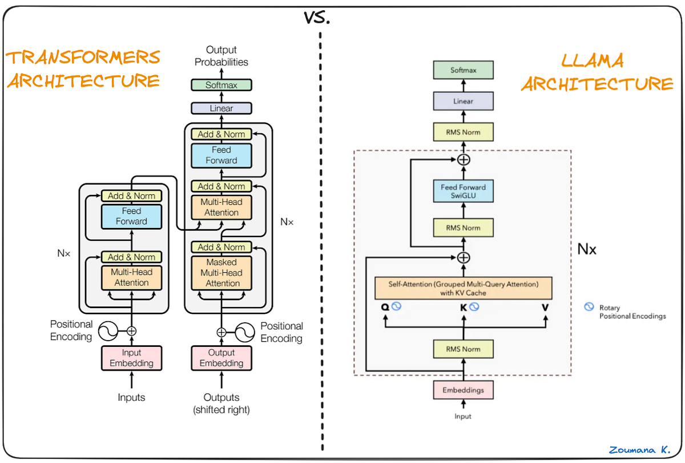

Slide 5
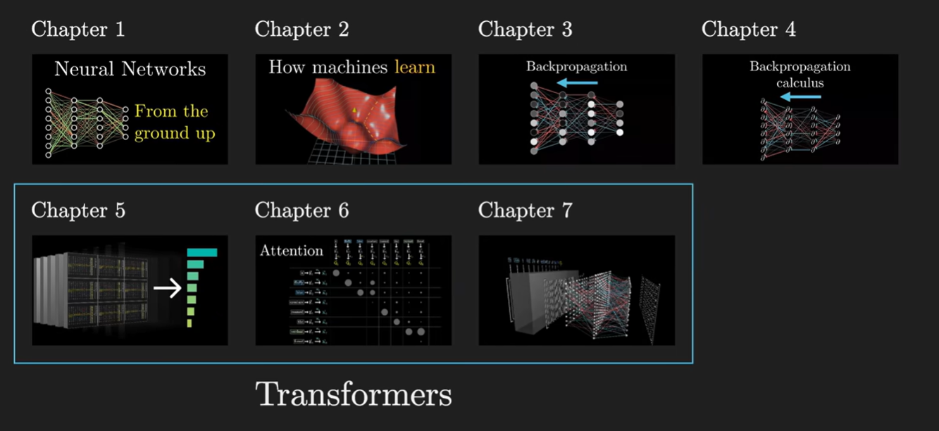
From 3Blue1Brown

Slide 6
Neural Network
What is a Neural Network? https://www.youtube.com/watch?v=aircAruvnKk

