Slide 1
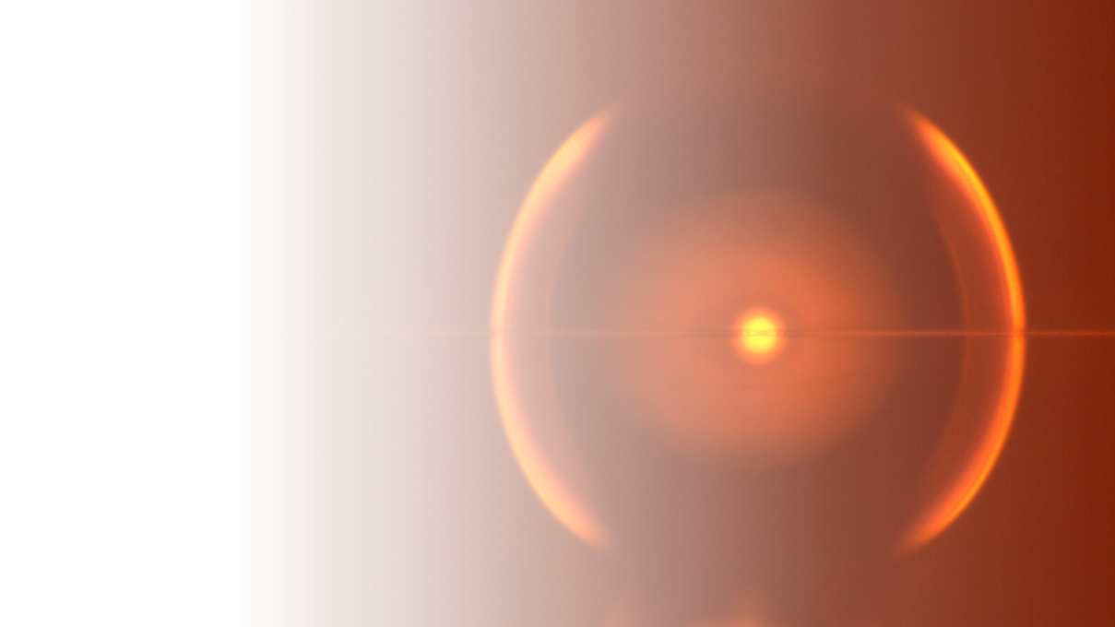
Tailoring GVD in microspheres with alumina coating
PhD Candidate: Marvyn Inga
Advisor: Gustavo Wiederhecker
University of Campinas - Brazil

Slide 2
Outline
Introduction
Notes:
Introduction
Optical Microcavities

Slide 3
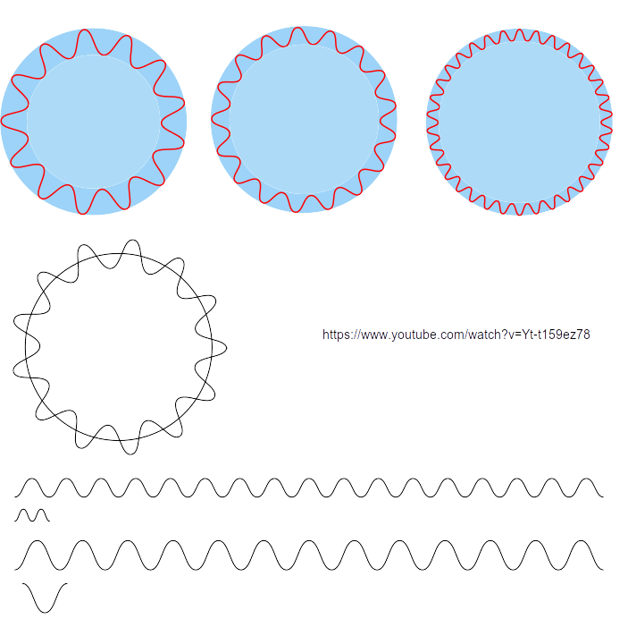

Slide 4
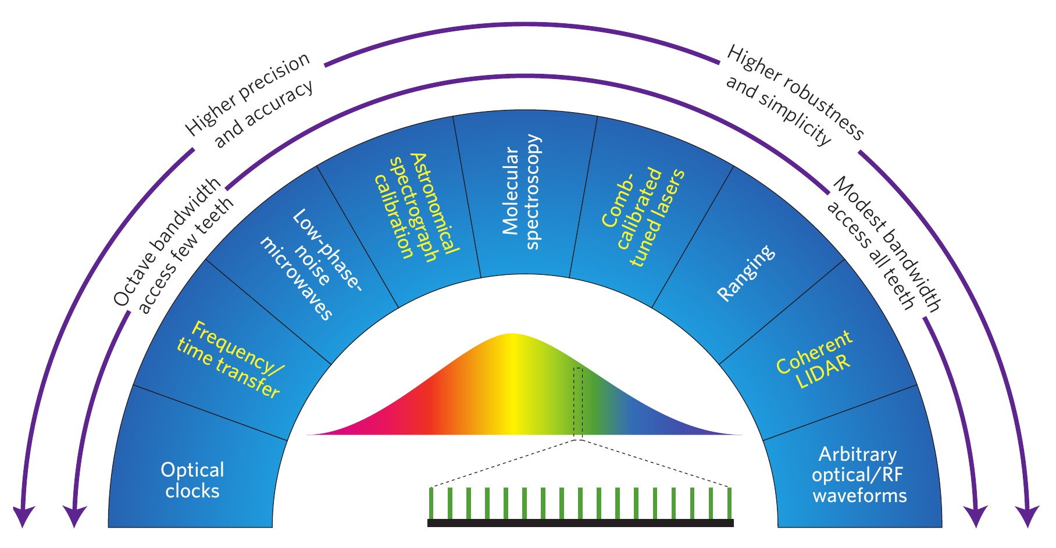
Optical Frequency Combs Applications

Slide 5
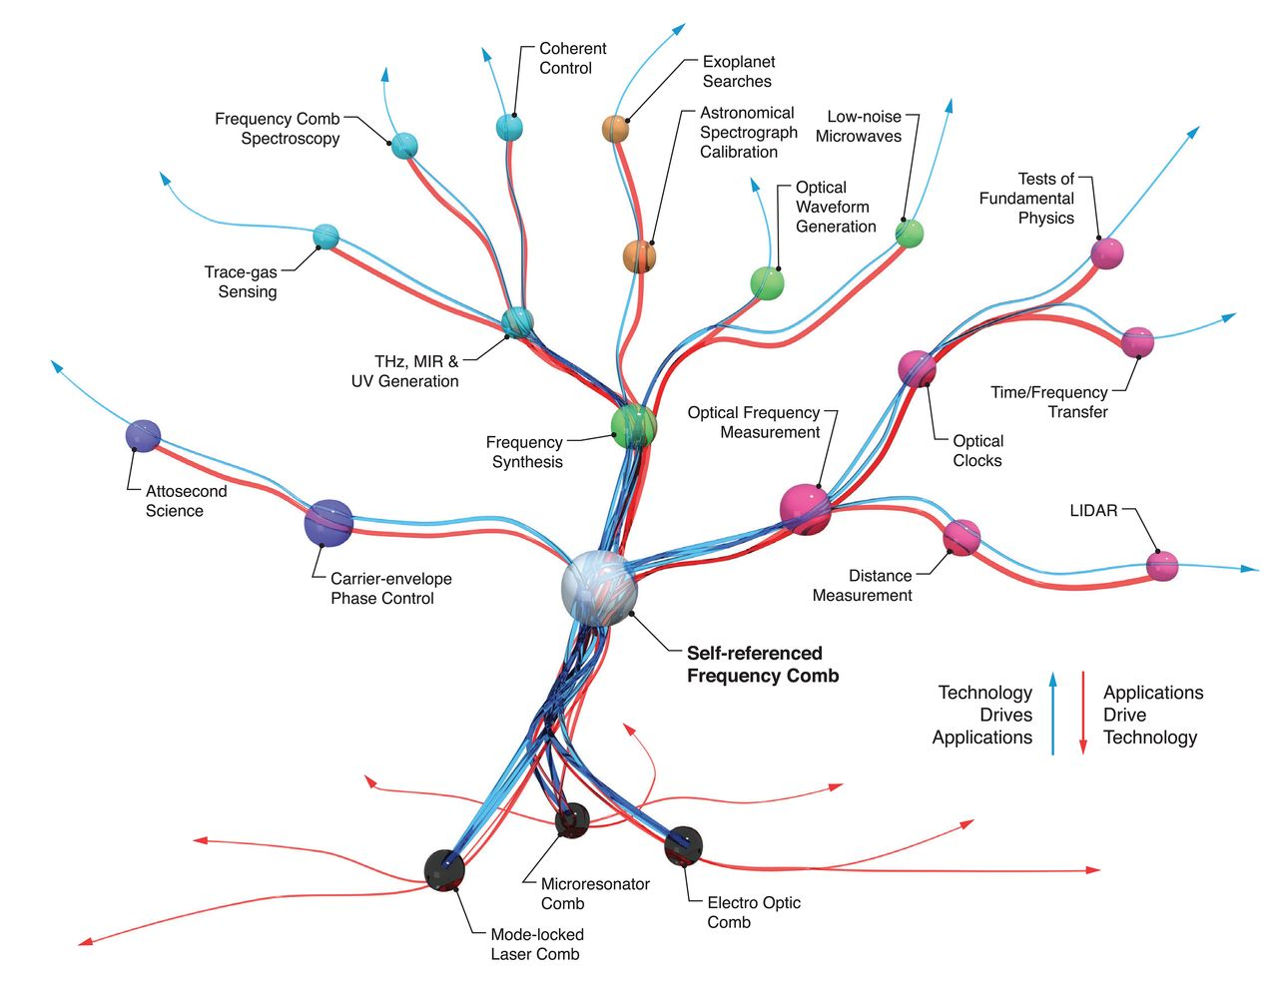
Optical Frequency Combs Applications

