Slide 1
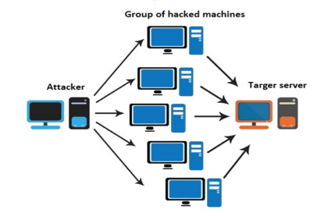
Problem:
In a Distributed Denial of Service (DDoS) attack, a network of compromised devices is used to overwhelm a target with a flood of requests, making it unable to serve legitimate requests
Goal:
Detecting DDoS attacks using Machine Learning Models

Slide 2
Next are the basic steps of our proposed solution.

Slide 3
Collecting data: from a reliable source, our data is “CIC-DDoS2019 Dataset” the dataset offers an extended set of distributed denial of service attacks, most of which employ some form of amplification through reflection.

Slide 4
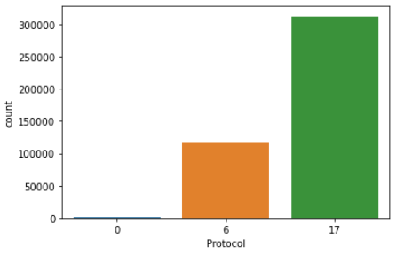
Preparing the Data:
Cleaning the data to remove unwanted data, missing values, rows, and columns, duplicate values
Making sure that data is evenly distributed and balanced, if not we have to balance it, here we used oversampling for balancing
Unbalanced !

Slide 5
Preparing the Data:
Finally Split the cleaned data into two sets a training set and a testing set. The training set is the set your model learns from. A testing set is used to check the accuracy of your model after training

Slide 6

Choosing a Model: linear model from sklearn
Training the Model: it is the most important step where we pass the prepared data to your machine learning model to find patterns and make predictions
Making Predictions: In the end, you can use your model on unseen data to make predictions accurately.

