Slide 1
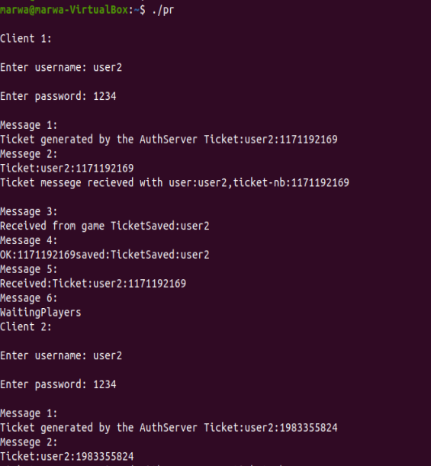
3 clients are created
Username & password was entered from the keyboard

Slide 2
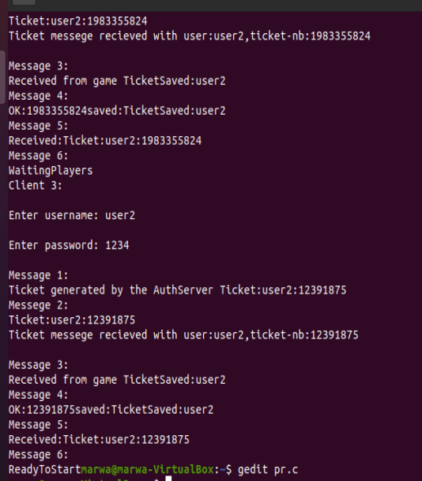
Message 1 : The client sends Auth:user:password to server
Then the server generates ticket as printed
Message 2 :message received from Auth Server, then game server generates the ticket

Slide 3
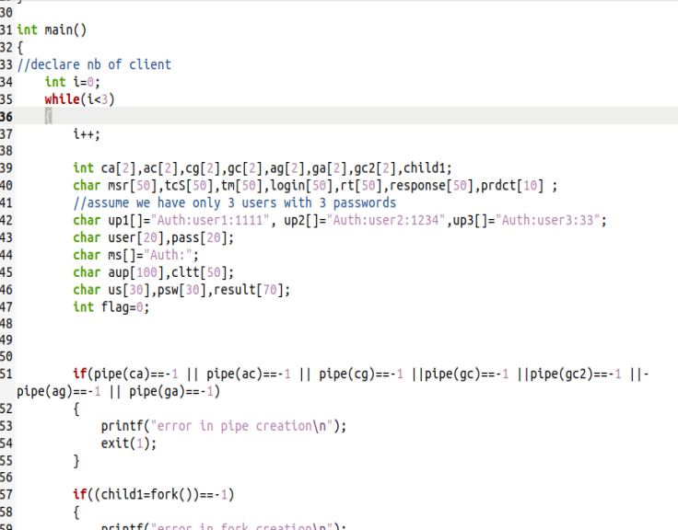
While at the beginning to create 3 clients
6 pipes created

Slide 4
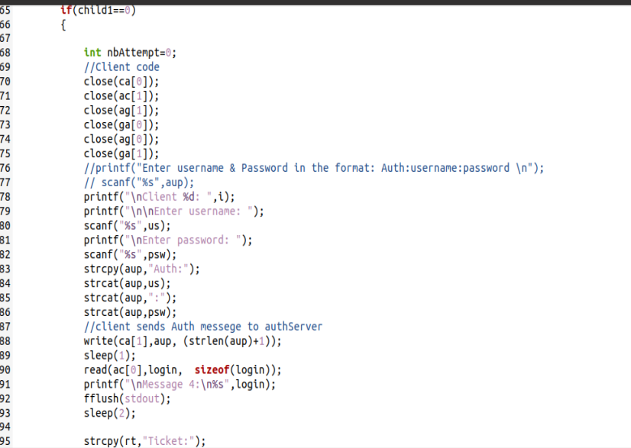
Unneeded pipes are closed for each process
Functions and methods used to generate messages in a specific format
To give priority for printing on screen

Slide 5
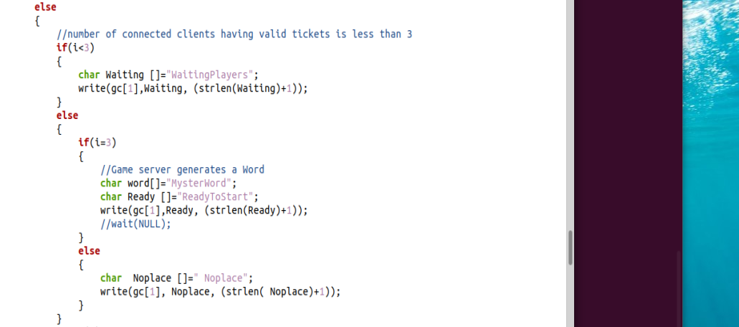
Server send to client a response according to number of connected clients
If less than 3 then waiting
If 3 then ready
Else no place

Slide 6
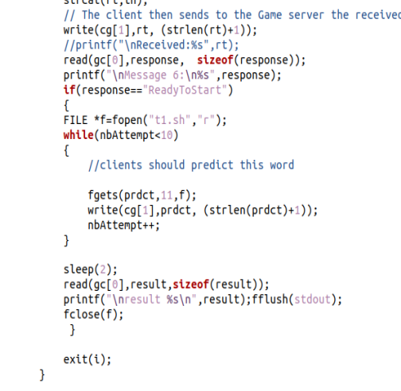
If the response was Ready to start,
Client reads string of 10 char from a file and sends them to game

Slide 7
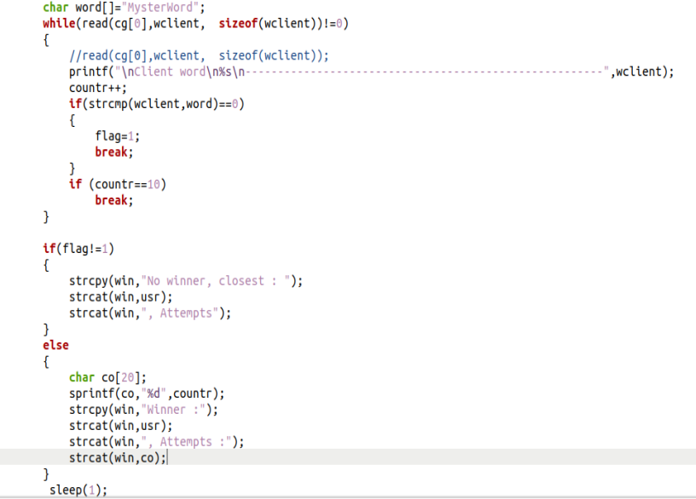
Meanwhile, the game receives the words and compares each word with the generated word. Once there is a match it stops reading and generate win message containing user name and number of attempts
If there is no match loss message is generated in char [] win , that is in both cases send to the clients

Slide 8
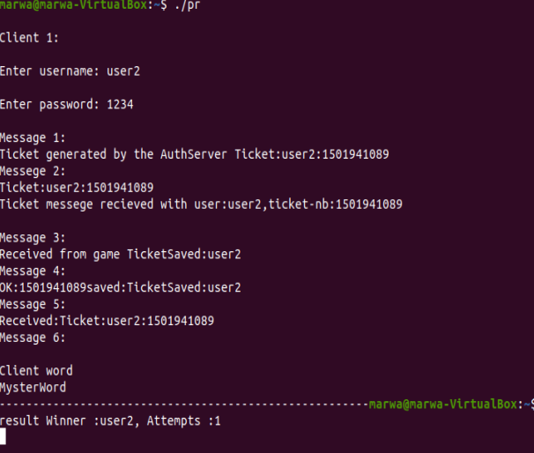
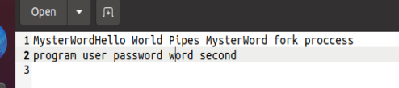
The word sent by the client from the file
Equal to MysterWord after first attempt
The server replies with the success message

Slide 9
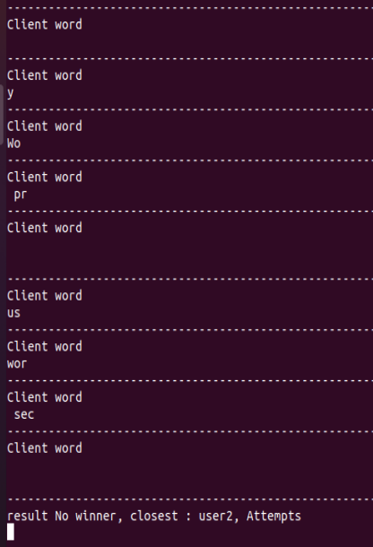
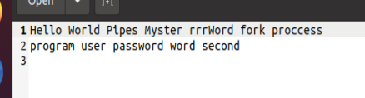
After 10 attempts word is not found
Server sends fail message with the username

