Slide 1
French-English Translation Application
Leveraging Machine Learning for Real-Time Translation

Slide 2
Project Objective
Develop an interactive app for French-English translation using the T5 model.
User-friendly interface for a smooth experience.

Slide 3
Target Audience
Language learners
Travelers
Educators and students
Researchers needing accurate translations

Slide 4
Problem Statement
Language barriers impact international communication and education.
Manual translation is time-consuming and inefficient.

Slide 5
Current Solutions & Limitations
Google Translate, DeepL, Microsoft Translator
Often lack context-awareness and customization.
Require internet and data sharing, limited offline use.

Slide 6
Our Solution
Model Used: T5 (Text-to-Text Transfer Transformer)
Benefits: Context-aware, customizable, and scalable.
Supports integration into apps with better accuracy.

Slide 7
Why We Chose T5-Small for Translation
🔍 What is T5-Small?
T5 stands for “Text-To-Text Transfer Transformer”
Developed by Google Research
T5-small is a lightweight version of the full T5 model (60M parameters vs. 220M+)
Unified framework: every NLP task (e.g., translation, summarization, classification) is framed as text-to-text

Slide 8
Why We Used T5-Small
Suited for low-resource machines (faster training/inference, lower RAM usage)
Achieves good translation quality on modest hardware
Supports multilingual training and general-purpose NLP via task prefixing (e.g., "translate English to French")

Slide 9
Model Parameter Comparison
Parameter | Purpose | Used In | Type / Range
input_ids | Encoded token IDs for French input | Training & Inference | Tensor[int]
labels | Encoded token IDs for English target (used to compute loss) | Training only | Tensor[int]
max_length | Maximum tokens to generate in output | model.generate | Integer (e.g. 128)
num_beams | Number of beams for beam search decoding | model.generate | Integer (e.g. 4)
early_stopping | Stops generation when all beams reach EOS token | model.generate | Boolean (True/False)
outputs.loss | Loss computed from model prediction and labels | Training only | Float
outputs.logits | Raw prediction scores (before softmax) | Training & Evaluation | Tensor[float]

Slide 10
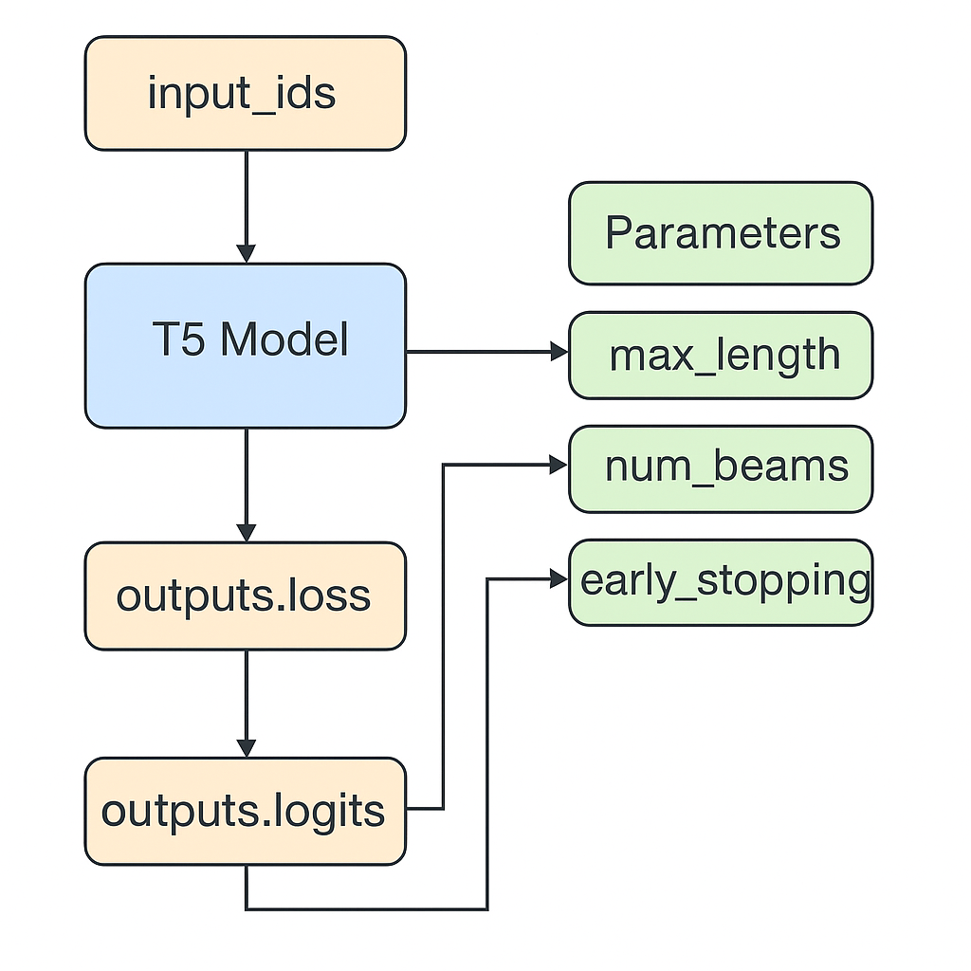
Model Parameter Interaction Flow

Slide 11
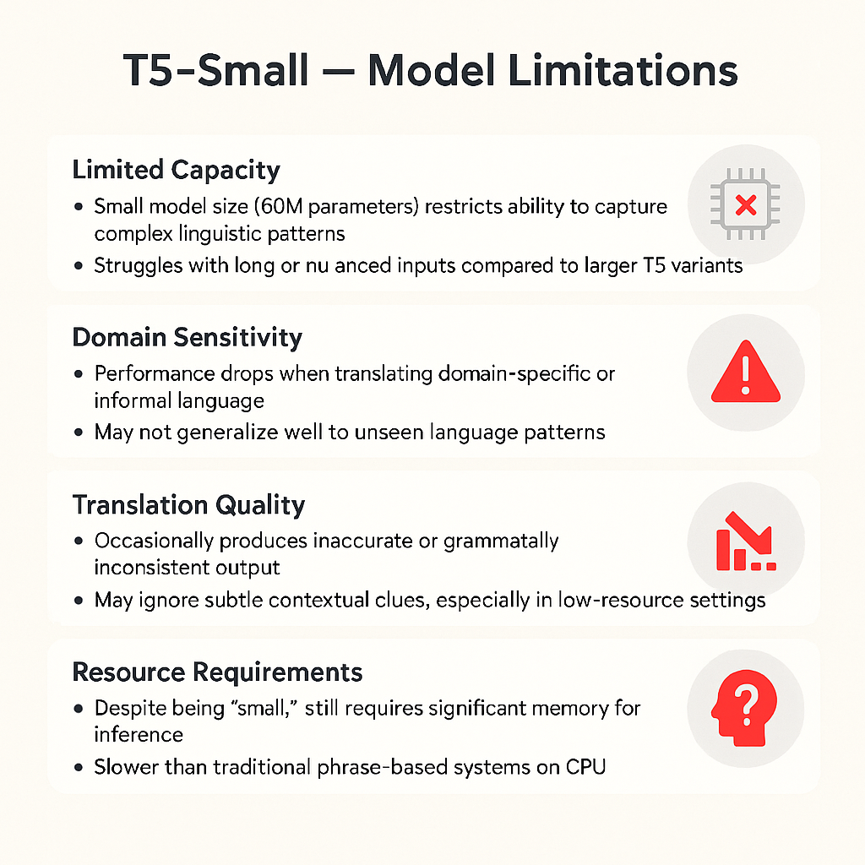

Slide 12
CCAligned Multilingual Dataset (ahelk/ccaligned_multilingual)
🔹 Overview • A large-scale parallel dataset from Common Crawl • Covers 137+ languages aligned with English • 392M+ document pairs across 8,000+ language pairs • Public domain – freely available via Hugging Face
🔹 Key Features • Sentence-level and document-level alignments • High multilingual coverage, including low-resource languages • Useful for training and evaluating translation & cross-lingual models
🔹 How It Was Built • Language detection on Common Crawl documents • URLs with matching patterns used for alignment • Enables non-English pairings via pivot through English
🔹 Considerations • May contain noisy or misaligned samples • Bias toward web content domains • Requires filtering for high-quality tasks

Slide 13
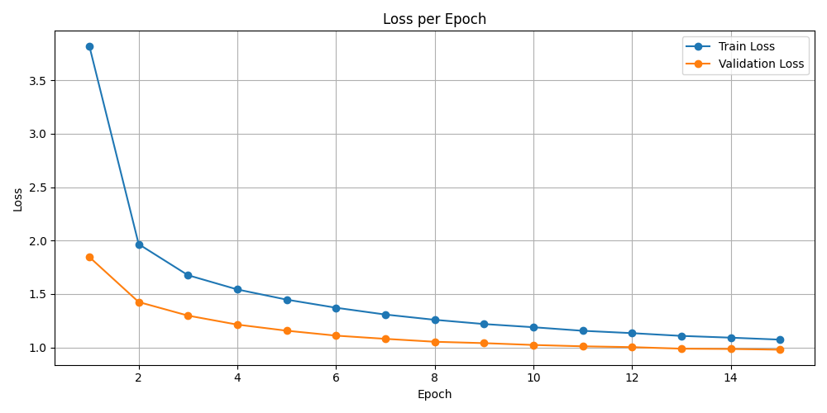
Training Performance: Loss per Epoch

Slide 14
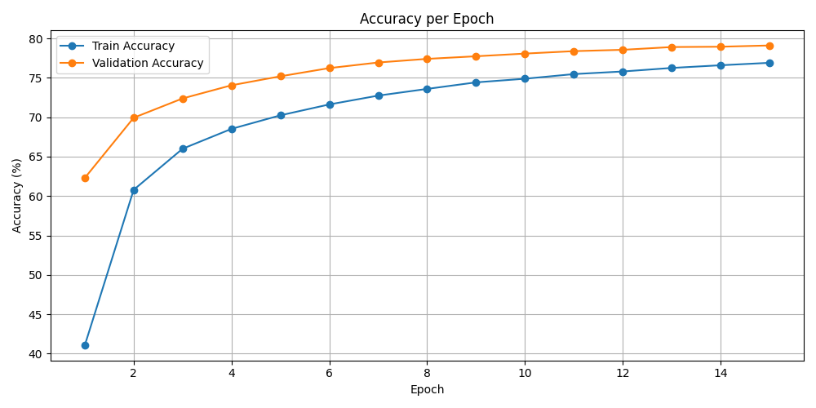
Training Performance: Accuracy per Epoch

Slide 15
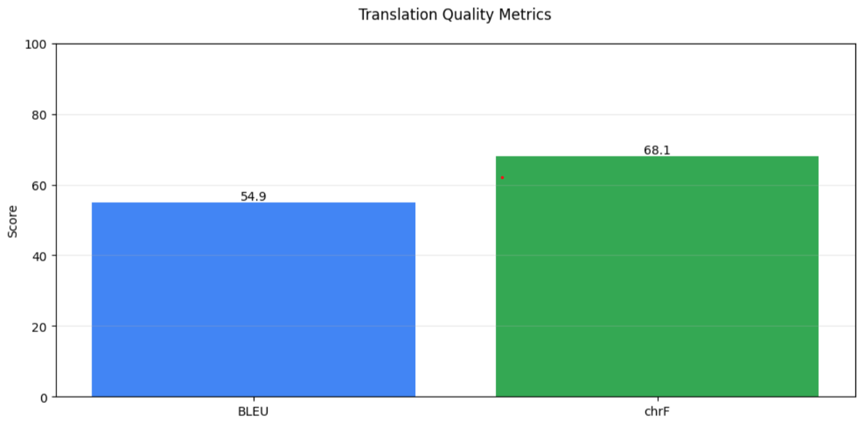
Translation Quality Metrics

Slide 16
Future Improvements
Add voice input/output capabilities.
Support more languages and offline usage.
Personalized translation based on user preferences.

Slide 17
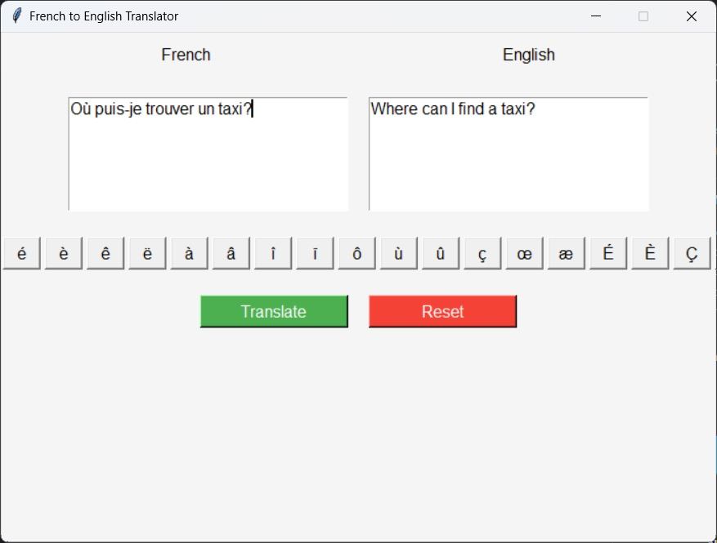
Demo

Slide 18
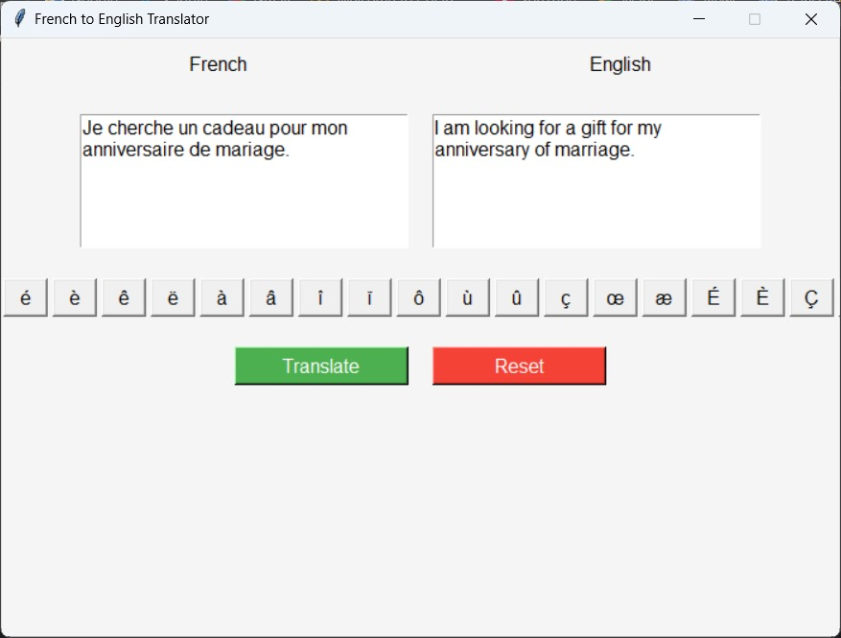
Demo

Slide 19
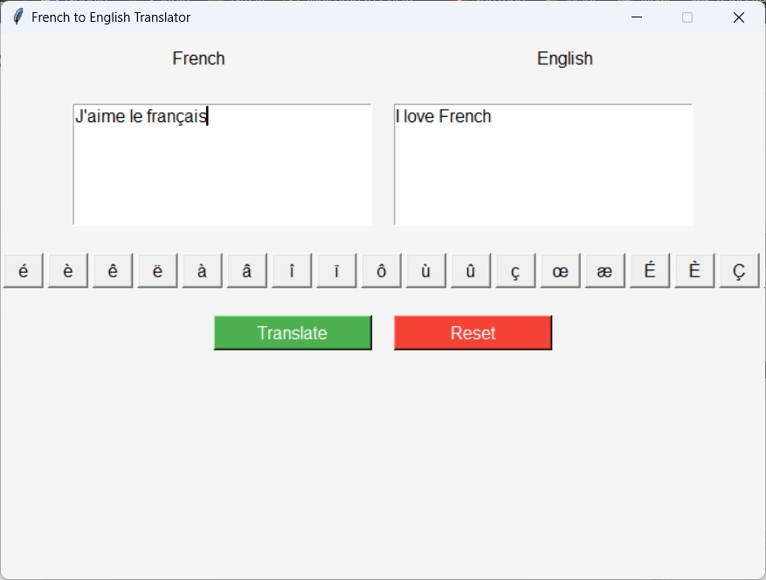
Demo

Slide 20
Conclusion
Bridges communication gaps using T5 model.
Effective tool for learners, travelers, and professionals.
Highlights the power of AI in language translation.

