Slide 1
RNA Seq-Differential Expression (Bladder Cancer)

Slide 2


Bladder Cancer
Member Of Team
1-Dina Fakhry Ali
2-Nehal Hessin Brham
3-Marwa Ashraf Mohammed

Slide 3
1.
Transition headline
Let’s start with the first set of slides

Slide 4
Introduction
The goal of differential expression analysis is to identify genes whose expression level differs under different conditions using statistical analysis to discover quantitative changes in the expression levels.
DESeq2 is a R/Bioconductor package for differential gene expression analysis on count based expression datasets using the negative binomial distribution.

Slide 5
Why sequence RNA?
1-1-- Functional studies
– Genome may be constant but an experimental condition has a pronounced effect on gene expression (differential expression)
• e.g. Drug treated vs. untreated cell line
• e.g. Wild type versus knock out mice
2- Predicting transcript sequence from genome sequence is difficult
3- Some molecular features can only be observed at the RNA level
– Alternative isoforms, fusion transcripts, RNA editing
4- Understand allele specific expression

Slide 6
Problem
Dataset didn’t follow the normal distribution which make an error in the data distribution

Slide 7
Solution
Use DeSeq2 package which
make the result more accurate

Slide 8
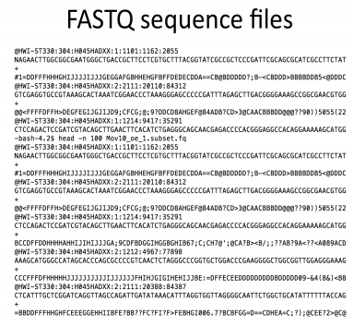
Problem In The Sequence
Low confidence bases, Ns.
Sequence specific bias, GC bias
Adaptors
Sequence contamination

Slide 9
RNA-seq differential expression workflow
Statistical analysis to identify the differentially expressed genes (DESeq2, limma, edgeR)
RNA-seq short reads
Reads mapping to the genome
(STAR, GSNAP, TopHat)
Quality control (FastQC)
Counting reads associated with genes (HTSeq, featurecounts)

Slide 10
Sources of variability
Phenotypic variability
Measurement error
Nature biological variations

Slide 11

Normalization.

Slide 12
NORMALIZATION
The number of mapped reads for each gene is relative to the expression of RNA ('interesting') in addition to several other factors ('uninteresting'). Normalization is the method of scaling raw count values to take the "uninteresting" variables into account. Through this way the levels of expression between the samples are more comparable

Slide 13
Method Of Normalization
RPKM/FPKM (reads/fragments per kilobase of exon per million reads/fragments mapped)
CPM (counts per million)
TPM (transcripts per kilobase million)
DESeq2’s median of ratios
EdgeR’s trimmed mean of M values (TMM)

Slide 14
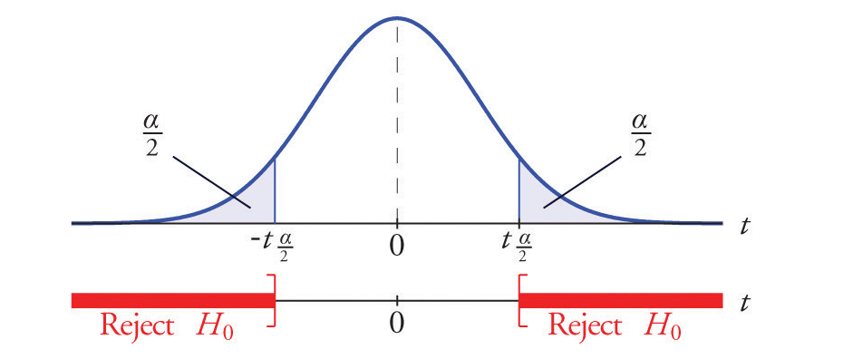
Statistical hypothesis testing
You need to make some assumptions to analyze this data, this assumption is called a hypothesis.
E.g. is there any different between the cases (e.g. control/disease)?
So if there is no difference, we call this the null hypothesis H0:
H0: d = 0
If there is a difference, we call this the alternative hypothesis H1:
H1: d ≠ 0

Slide 15
Types of hypothesis testing
Parametric test
If your data, follow the normal distribution
Examples: T test ANOVA test
Nonparametric test
If your data doesn’t follow the normal distribution
Examples: Wilcoxon test Kruskal-Wallis Test
The output of both tests is a statistic value and a p value which is correspond to the statistic value, A p-value less than 0.05 is statistically significant. It indicates strong evidence against the null hypothesis, as there is less than a 5% probability the null is correct or the error probability in the alternative hypothesis is less than 5%.

Slide 16
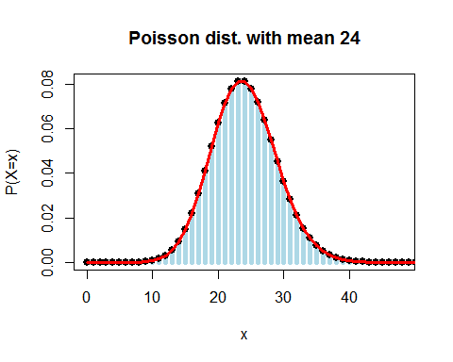
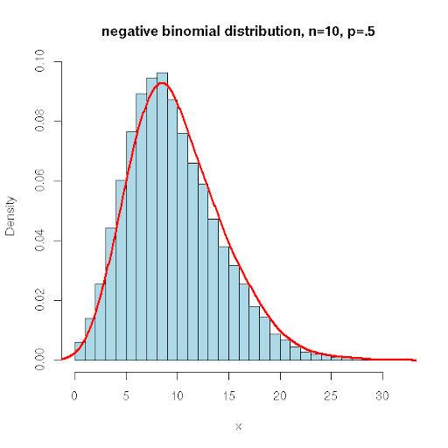
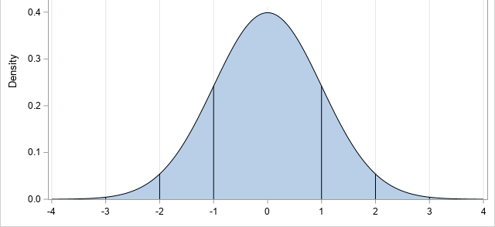
Probability Distributions
Poisson Distribution
Normal Distribution
Negative Binomial Distribution

Slide 17
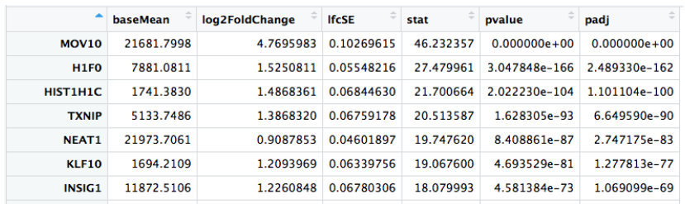
DESeq2 tutorial
The Output
1- Counts normalization
2- dispersion estimation
3- Shrink gene-wise dispersion estimates
DESeq2 pipeline
4- fit the negative binomial model
5- Fold change calculation and Wald test for significance testing
DESeq2 pipeline

Slide 18
Application Of RNA Seq-Diff-Expression
Application
It has Widespread uses in various fields:
1- Disease classification based on transcriptome profiling
2- understanding the mechanisms of diseases and drug resistance
3-Identifying therapeutic target genes
4-understanding the stem cells differentiation abilities
……..and others

Slide 19
Help in Analysis Data
https://david.ncifcrf.gov/tools.jsp

Slide 20
Practical Part
last
first
second

Slide 21
Thanks!
Any questions?

