Slide 1
Filesystem Project for Embedded Systems
.
Topic :
Marwa Awil
Student number: M00755729
.

Slide 2
Introduction
Project Overview
The filesystem project aims to develop a foundational component for a lightweight operating system tailored specifically for embedded systems. Sponsored by Embedded Solutions Inc., this initiative focuses on optimizing data management efficiency and performance within resource-constrained environments.
Goal: Develop a lightweight filesystem for an embedded operating system.
Significance: Critical for managing limited resources and optimizing performance in embedded systems.
Key Objectives: Modular architecture, compatibility with diverse hardware, rigorous testing.

Slide 3
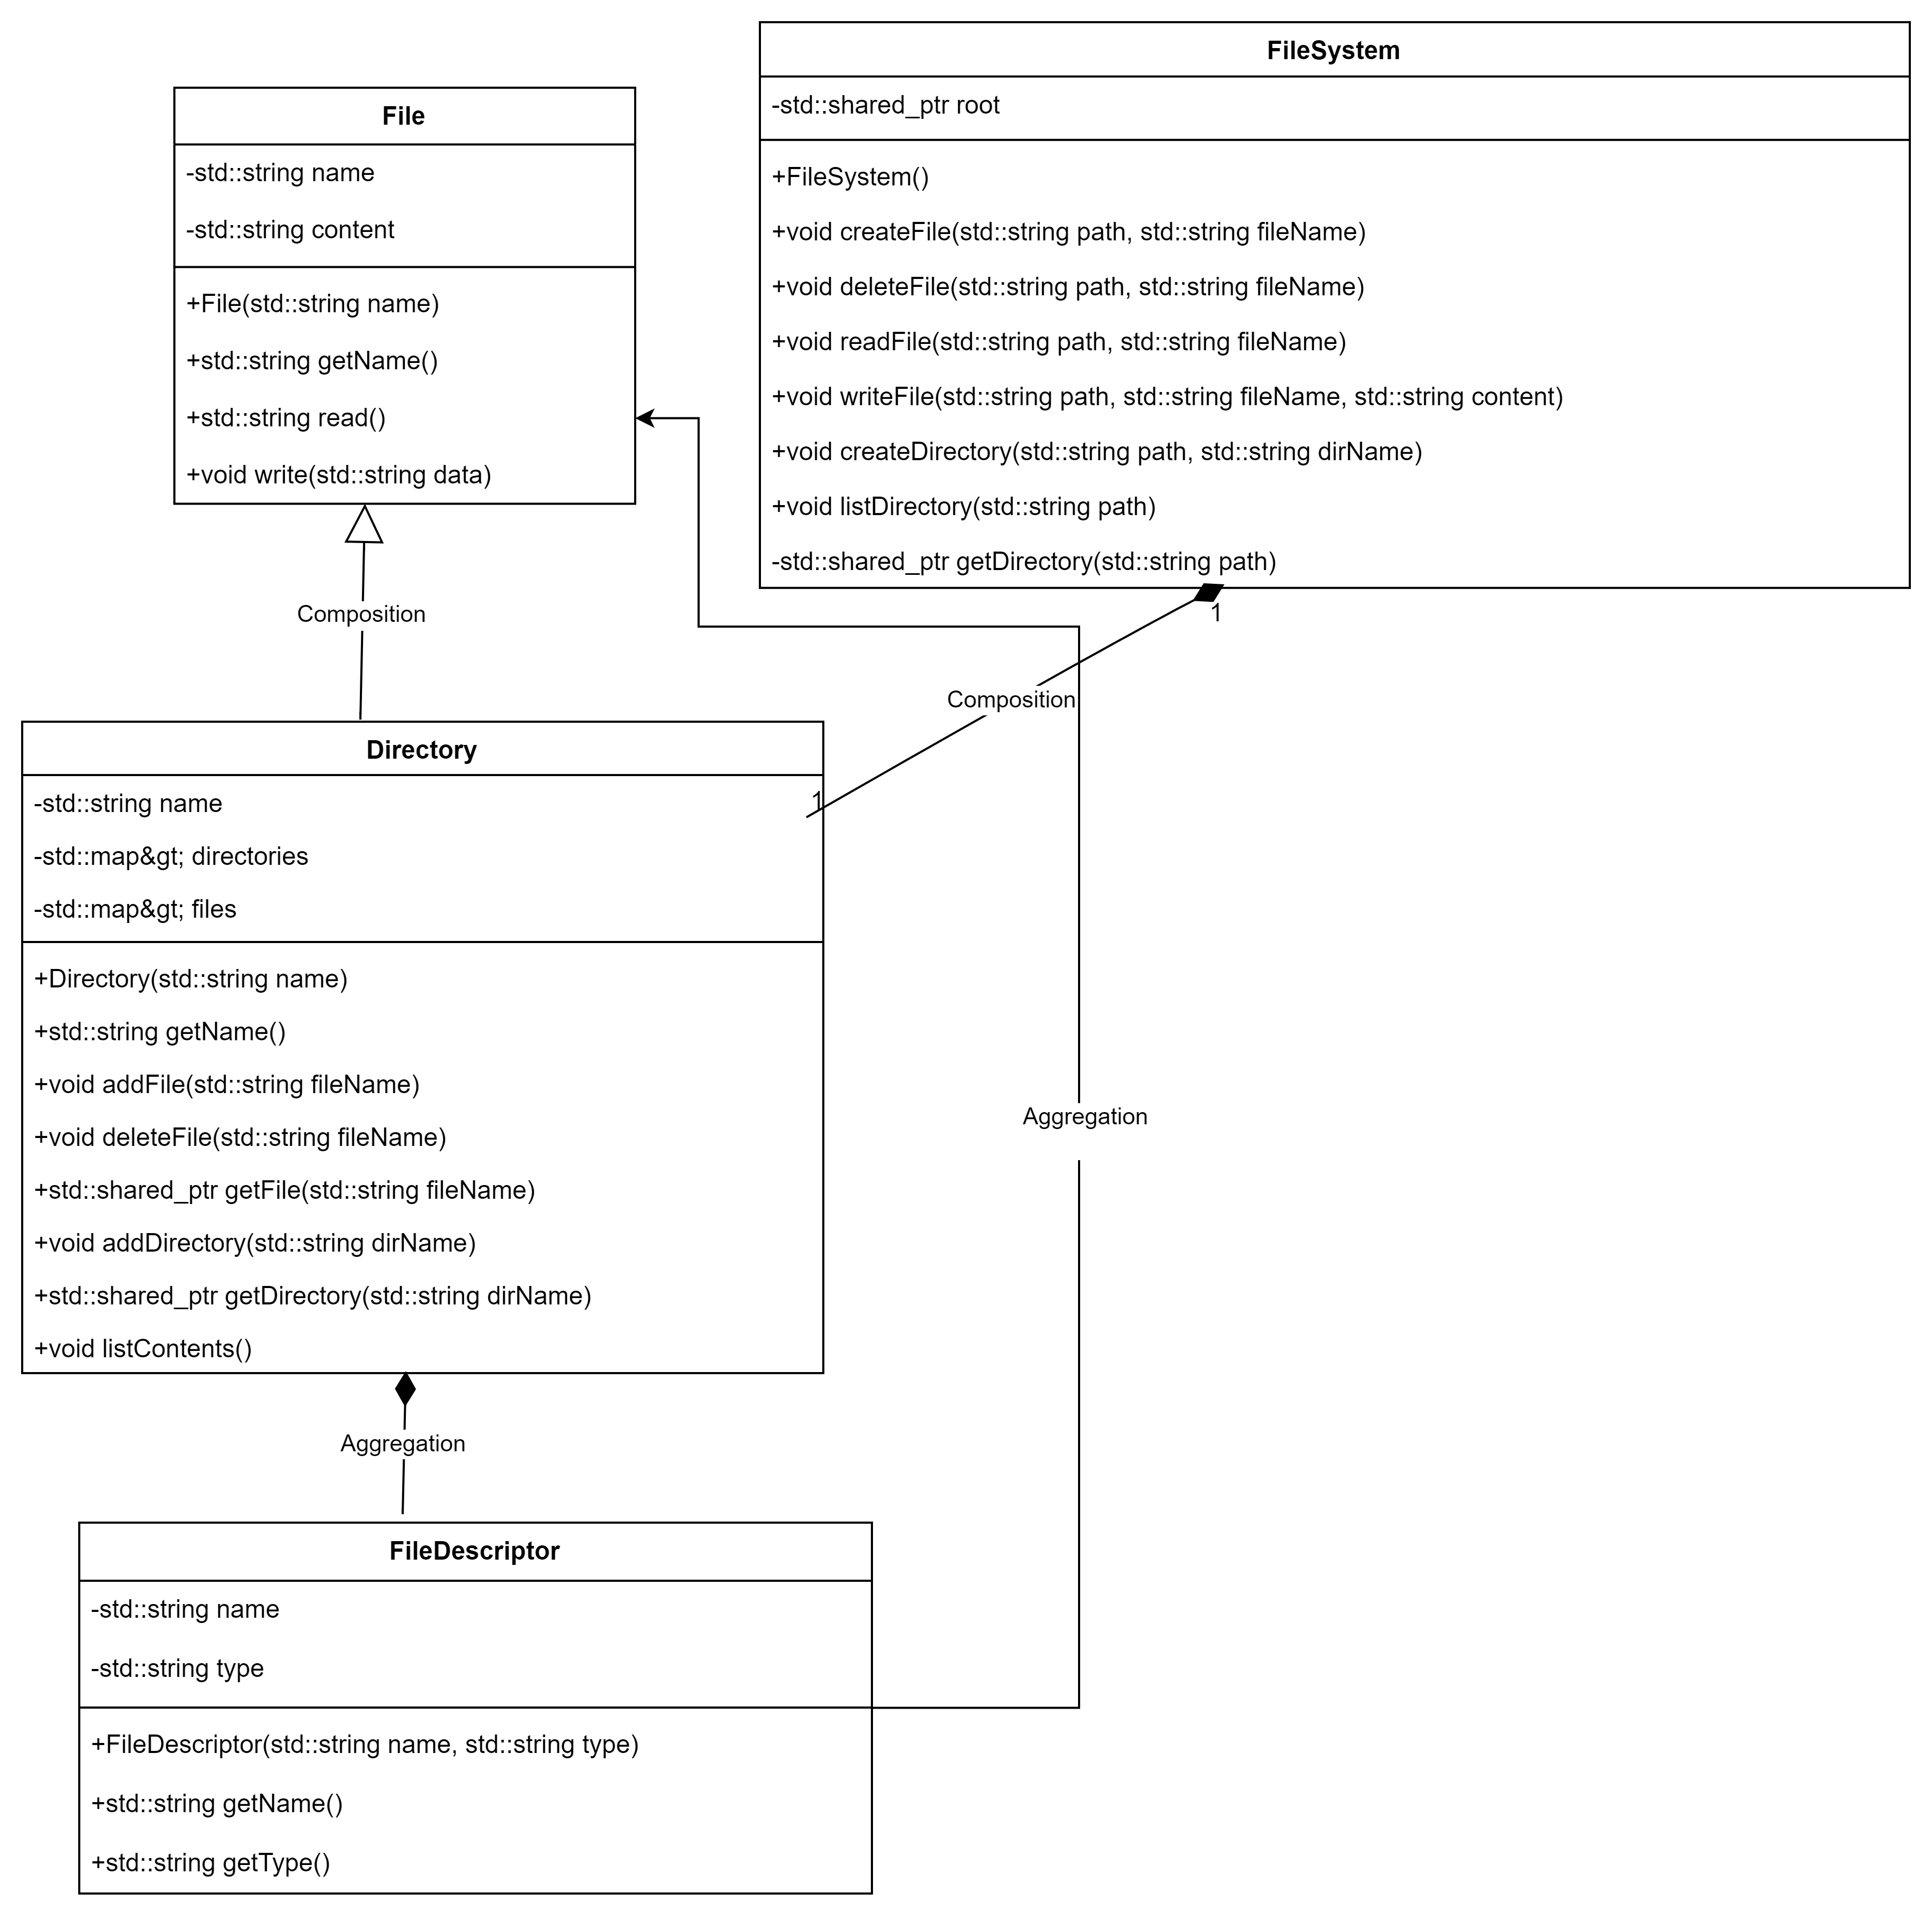
Design Phase
UML Class Diagram
The UML class diagram provided represents
the structure and relationships within
a simple filesystem.
Description: Shows the structure and relationships within the filesystem.
Key Components: File, Directory, FileSystem, FileDescriptor

Slide 4
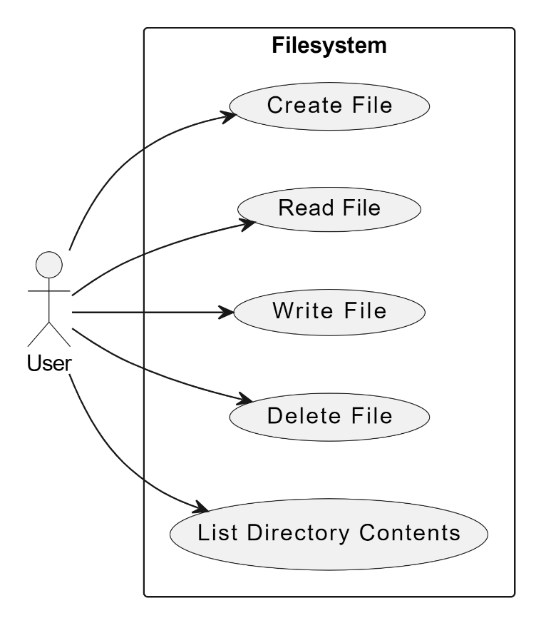
Use Case Diagram
The Use Case Diagram provided represents the structure
and relationships within a simple filesystem.
Description: Illustrates user interactions with the filesystem.
Key Components: Create File, Read File, Write File, Delete File, List Directory Contents
Creating Files: Users can create new files within directories.
Reading Files: Accessing and reading file contents.
Writing to Files: Updating or adding content to existing files.
Deleting Files: Removing files from the filesystem.

Slide 5
Key Features
File operations: Create, read, write, delete files.
Directory management: Create, list, manage nested directories.
Error handling: Gracefully manage invalid operations.
Performance optimization: Minimize overhead and maximize efficiency.

Slide 6
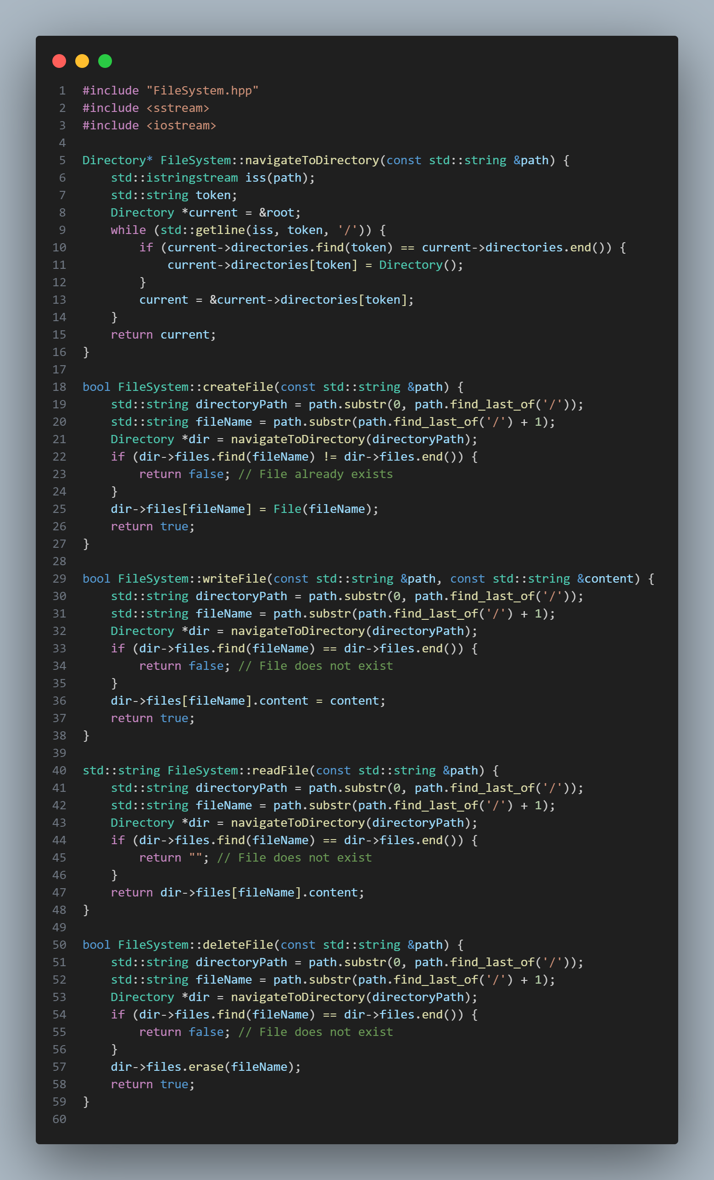
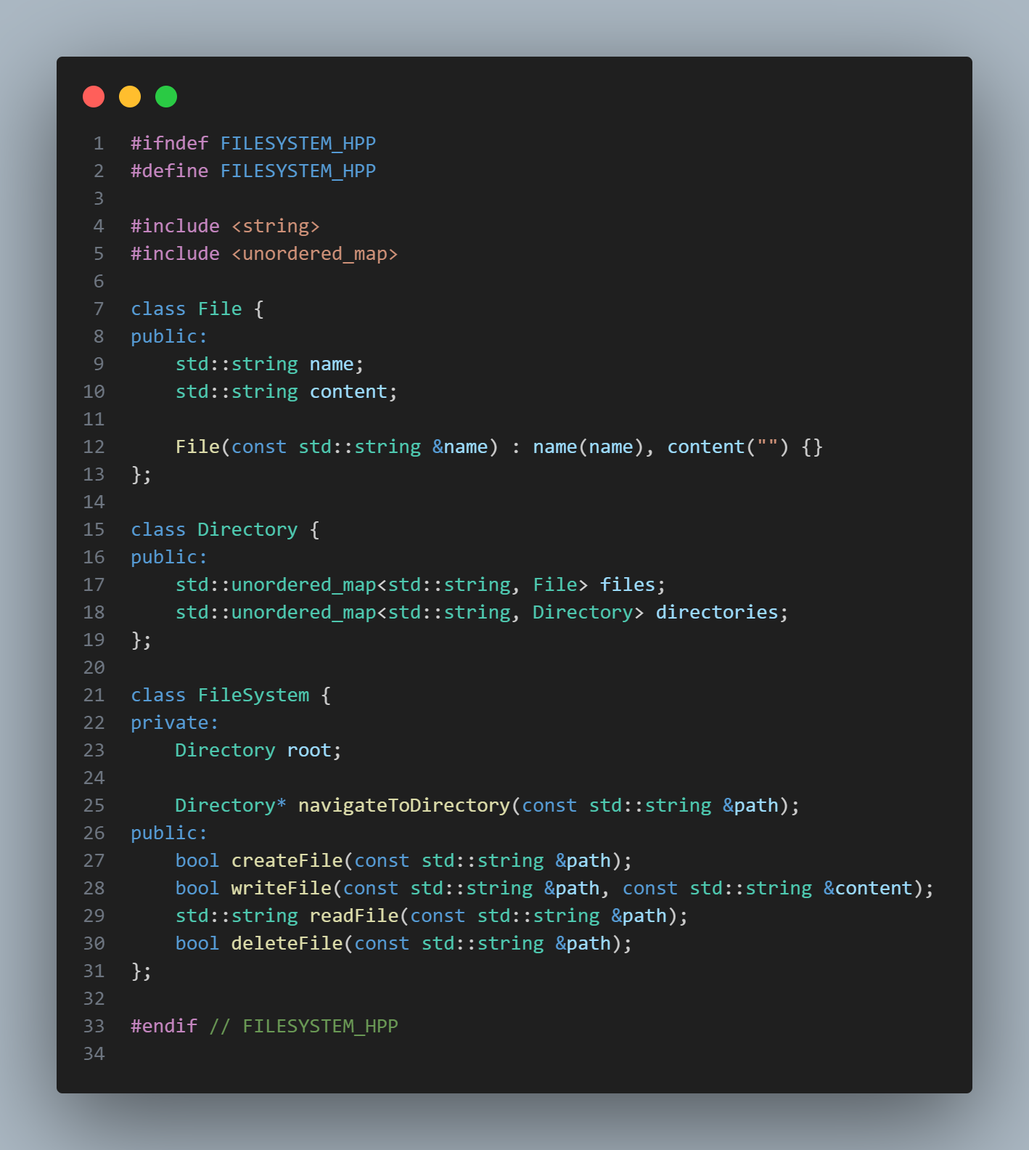
Implementation Phase
Filesystem.hpp
Filesystem.cpp

Slide 7
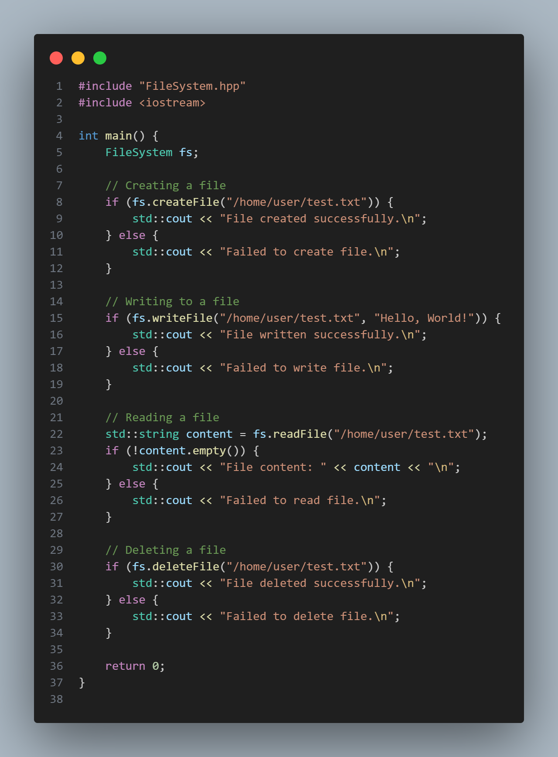
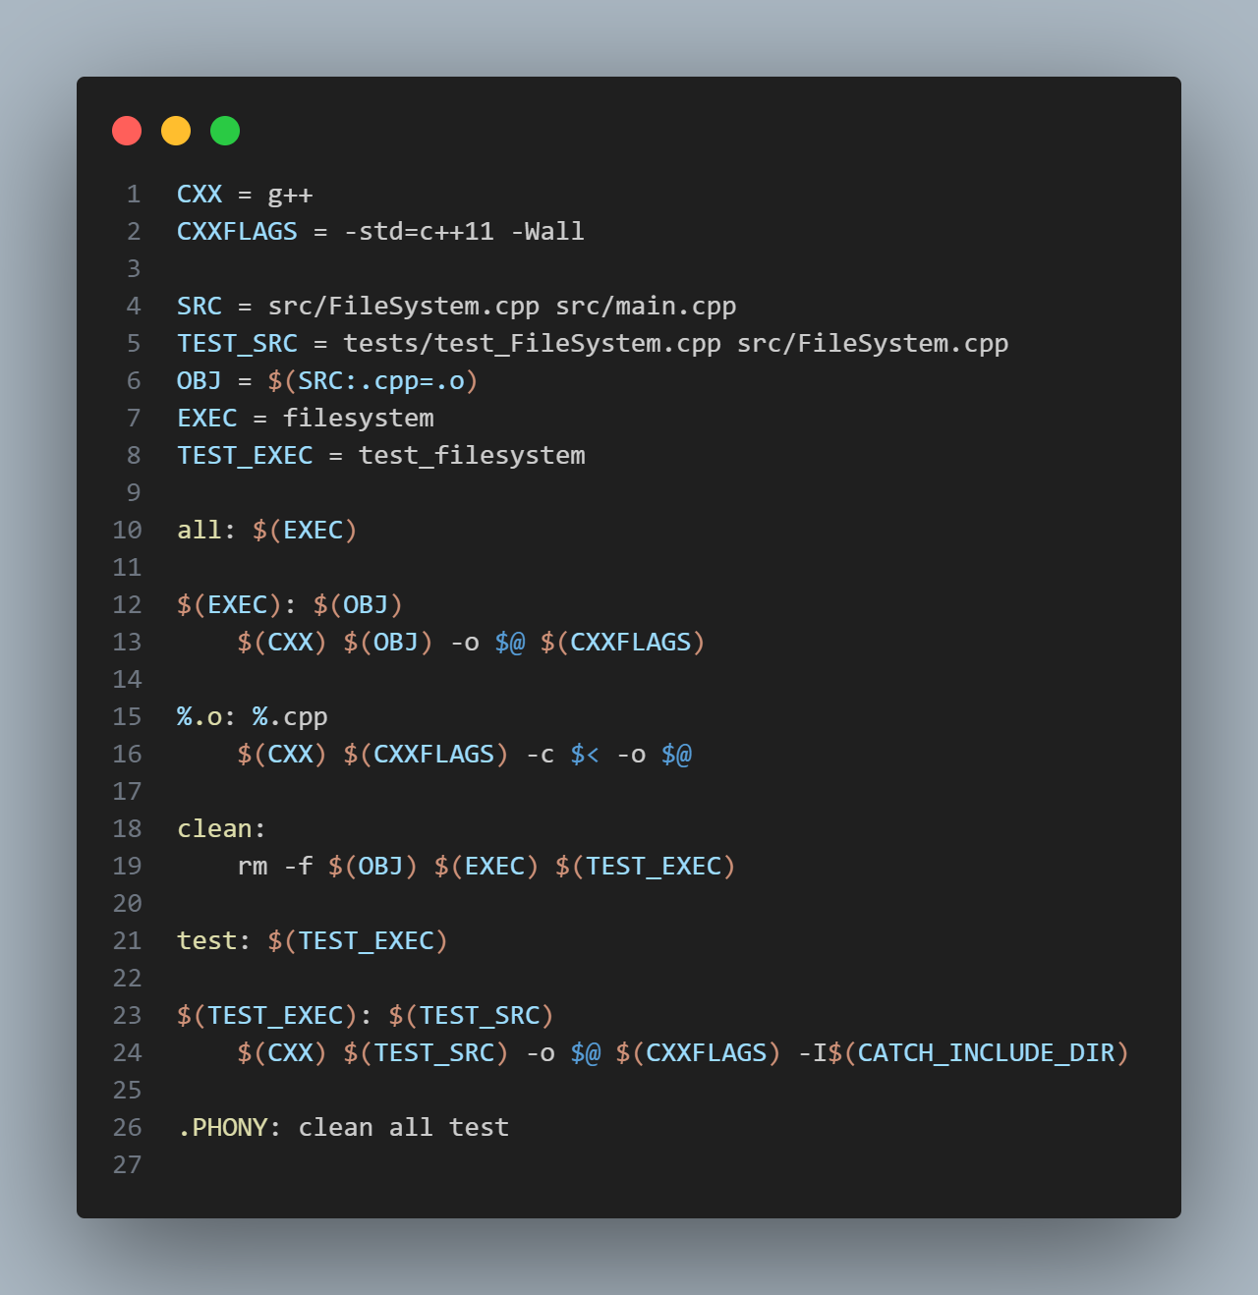
main.cpp
Make File

Slide 8
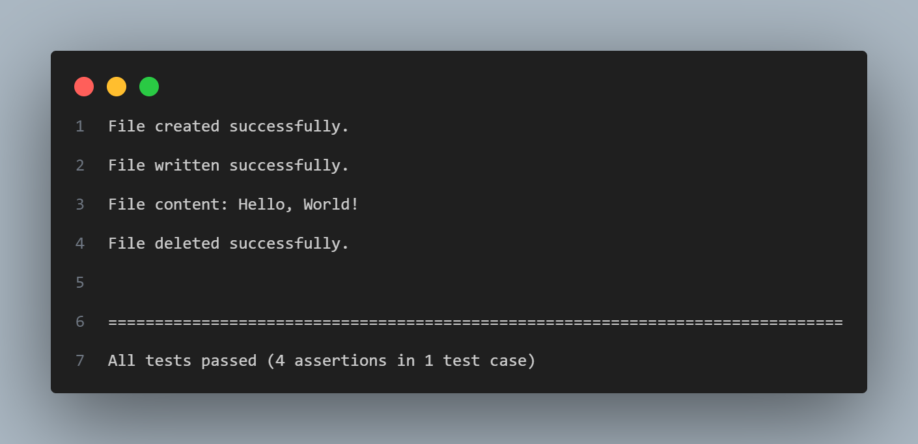
Output :

Slide 9
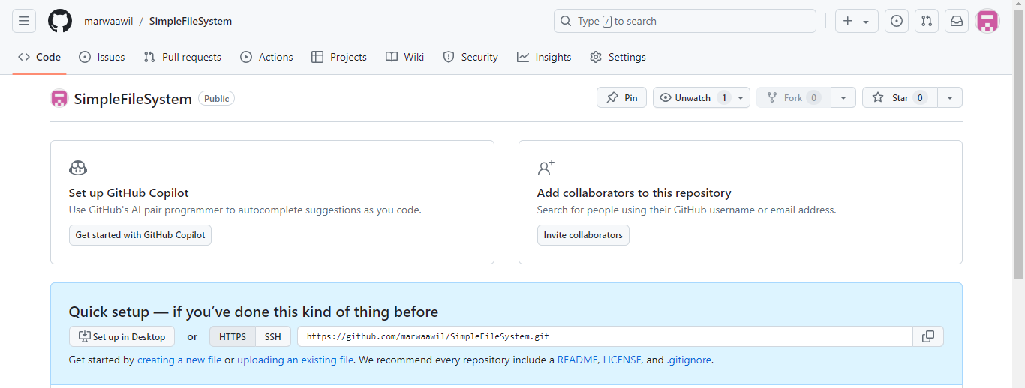
Version Control

Slide 10
Testing Approach
Description: Catch2 for comprehensive unit testing.
Testing Types:
Unit Testing: Validate individual components (File, Directory, FileSystem) for correctness.
Integration Testing: Ensure seamless interaction between filesystem components.
Edge Case Testing: Handle unusual scenarios (e.g., large files, nested directories) to verify robustness.

Slide 11
Testing cases
Description: Comprehensive coverage confirming functionality and robustness.
Evidence
File Operations: Successful creation, reading, writing, and deletion.
Directory Operations: Accurate directory creation and listing.
Error Handling: Appropriate responses to invalid operations.
Edge Case Testing: Handles unexpected inputs gracefully.

Slide 12
Challenges Faced
Optimizing performance for large files: Implemented efficient algorithms and data structures to handle large files.
Enhancing error handling mechanisms: Developed robust error-handling strategies to improve system reliability.
Managing complex directory structures: Applied modular design to simplify directory management and improve scalability.

Slide 13
Conclusion
The filesystem project successfully implemented essential file and directory management functionalities for embedded systems, demonstrating robust performance and reliability. Future improvements will focus on optimizing for larger files, enhancing error handling, and refining modular design for scalability.
Future Approach
Prioritize performance optimizations.
Develop robust error handling mechanisms.
Emphasize modular design for scalability.

Slide 14
Questions & Answers

Slide 15
Thank You

