Slide 1
Programmable CMOS ring oscillator
Submitted by: Submitted to: Dr. reda abdelbaseet
Asmaa el sayed UID:V23010585 Dr. Samar
Marwa Moaz UID:V23009897 Eng. Habeeba
Norhan Sabry UID:V23010794
Tasneem Ahmed UID:V23010213

Slide 2
Agenda
Introduction
Design metrics
Schemtaic of 11 stage ring oscillator
Schematic of inverter
Frequency of 10MHz simulation
10MHZ results
Frequency of 5MHz simulation
5MHz results
Frequency of 1MHz simulation
1MHz results
Comparison between circuit analysis and simulation results
Output sinusoidal

Slide 3
Introduction
Ring oscillators require odd number of stages
Minimum number of stages is three
Increasing the number of stages decreases the frequency
Controlling vdc and sizing of transistor controls the operating frequency

Slide 4
Design metrics
65nm technology
11 stages ring oscillator for a minimum frequency of 1Mhz
Ratio of wp/wn~2
Using switches to change the number of inverting stages to chane the frequenct to 5 and 10MHZ
Vdc=800mv

Slide 5
Ring oscillator 11 stages schematic

Slide 6
Inverter schematic

Slide 7
Frequency of 10 MHZ simulation
Close the switch on five stages
Perform transient analysis
Perform parametric analysis to get wp/wn ratio to equate rise and fall times
Calculate the average power=vdc*I
Use cap=5.2pF after each stage
Calculate the delay using the input of the fifth stage and the output from the feedback loop.

Slide 8
Results
F=10.29M
Tf=Tr=13ns
P=413.209uW
Td=9.4511ns

Slide 9
Frequency of 5 MHZ simulation
Close the switch on seven stages
Perform transient analysis
Perform parametric analysis to get wp/wn ratio to equate rise and fall times
Calculate the average power=vdc*I
Use cap=5.2pF in the first 5 stages and the next two 14pF
Calculate the delay using the input of the seventh stage and the output from the feedback loop.

Slide 10
Results
F=5.02153M
Tf=Tr=35ns
P=343.109uW
Td=24.949ns

Slide 11
Frequency of 1 MHZ simulation
Close the switch on eleven stages
Perform transient analysis
Perform parametric analysis to get wp/wn ratio to equate rise and fall times
Calculate the average power=vdc*I
Use cap=5.2pF for the first five stages, the following two 14pF and the final four 49pF
Calculate the delay using the input of the eleventh stage and the output from the feedback loop.

Slide 12
Results
F=1.1142M
Tf=Tr=122ns
P=178.762uW
Td=88.8347ns

Slide 13
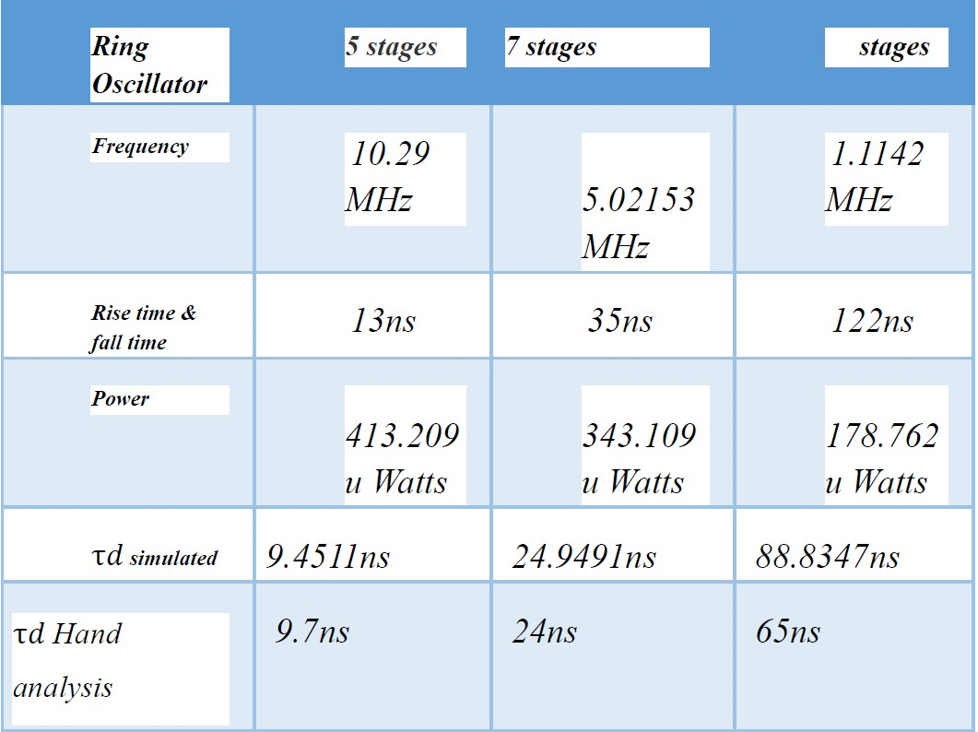
Comparison between circuit analysis and simulation results
F=1/(2*N*td)

Slide 14
Output sinusoidal
From 5 stages . 1st two cap=2pF, 3rd =3pF,
And final 2 =10pF

